Slide 1
Fundamentals of Nursing
Kozier & Erb's
Concepts, Process, and Practice
TENTH EDITION
CHAPTER 47
Nutrition

Slide 2
Introduction
Nutrition
All interactions between organism and food it consumes
Nutrients
Organic and inorganic substances required for body function
Nutritive value
Nutrient content of a specified amount of food

Slide 3
Essential Nutrients
Macronutrients
Water
Carbohydrates
Protein
Fats
Minerals and vitamins required in hundreds of grams

Slide 4
Essential Nutrients
Micronutrients
Vitamins
Minerals
Required in milligrams or micrograms

Slide 5
Carbohydrates
Carbon (C), hydrogen (H), oxygen (O)
Sugars
Monosaccharides
Glucose: Most abundant
Fructose
Galactose
Disaccharides
Starches
Polysaccharides
Fiber

Slide 6
Carbohydrates
Carbohydrate digestion
Major enzymes ptyalin (salivary amylase), pancreatic amylase, and disaccharidases
End products are monosaccharides.
Normally absorbed by the small intestine

Slide 7
Carbohydrates
Carbohydrate metabolism
The body breaks carbohydrates into glucose.
Maintains blood levels
Provides a ready source of energy
Storage and conversion
Used, or stored as glycogen or fat

Slide 8
Protein
Proteins (amino acids)
Protein digestion
Digestion begins in mouth with enzyme pepsin.
Most protein digested in the small intestine

Slide 9
Protein
Protein digestion
Pancreas secretes the proteolytic enzymes trypsin, chymotrypsin, and carboxypeptidase.
Glands in intestinal wall secrete aminopeptidase and dipeptidase, which break protein into amino acids.

Slide 10
Protein
Storage
Amino acids absorbed by active transport through small intestines
Plasma protein
Body tissue (metabolic pool)

Slide 11
Lipids
Fatty acids
Saturated
Unsaturated
Monounsaturated
Polyunsaturated

Slide 12
Lipids
Lipids: Fats and oils
Lipid digestion
Digestion begins in stomach, but mainly digested in small intestines.
Digestion primarily by bile, pancreatic lipase, and enteric lipase
End products of lipid digestion are glycerol, fatty acids, and cholesterol.
Reassembled inside intestinal cells into triglycerides and cholesterol es_{co}t_{n}e_{tin}r_{u}s_{ed on next slide}

Slide 13
Lipids
Lipid digestion
Small intestine and liver convert these into soluble compounds called lipoproteins (lipid + protein).
Lipid metabolism
Conversion of fat into usable energy occurs through enzyme lipase that breaks down triglycerides in adipose cells, releasing glycerol and fatty acids into the blood.

Slide 14
Micronutrients
Vitamin
Organic compounds that cannot be manufactured by body
Water-soluble
C, B complex
Needed daily
Fat-soluble
A, D, E, and K
Can be stored
Minerals
continued on next slide

Slide 15
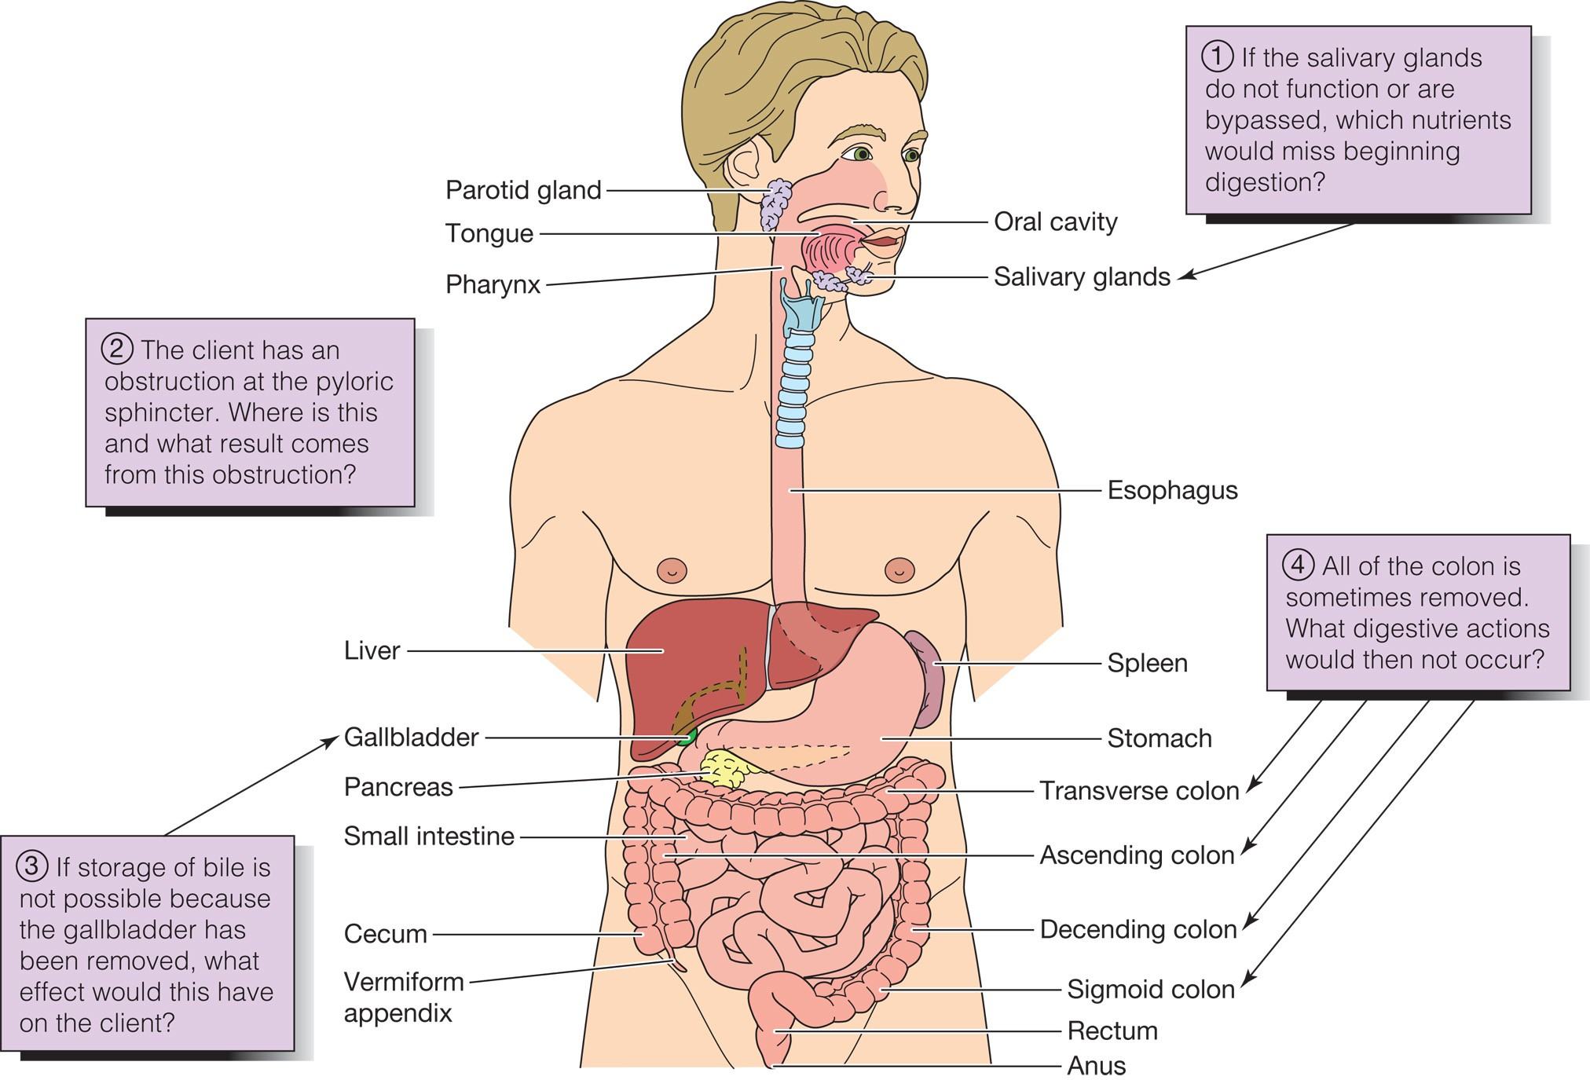
Anatomy & Physiology Review Digestive System

Slide 16
Body Weight and Body Mass Standards
Ideal Body Weight (IBW)
Optimal weight recommended for optimal health
Male: 106 pounds + 6 X number of inches over 5 feet tall
Female: 100 pounds + 5 X number of inches over 5 feet tall

Slide 17
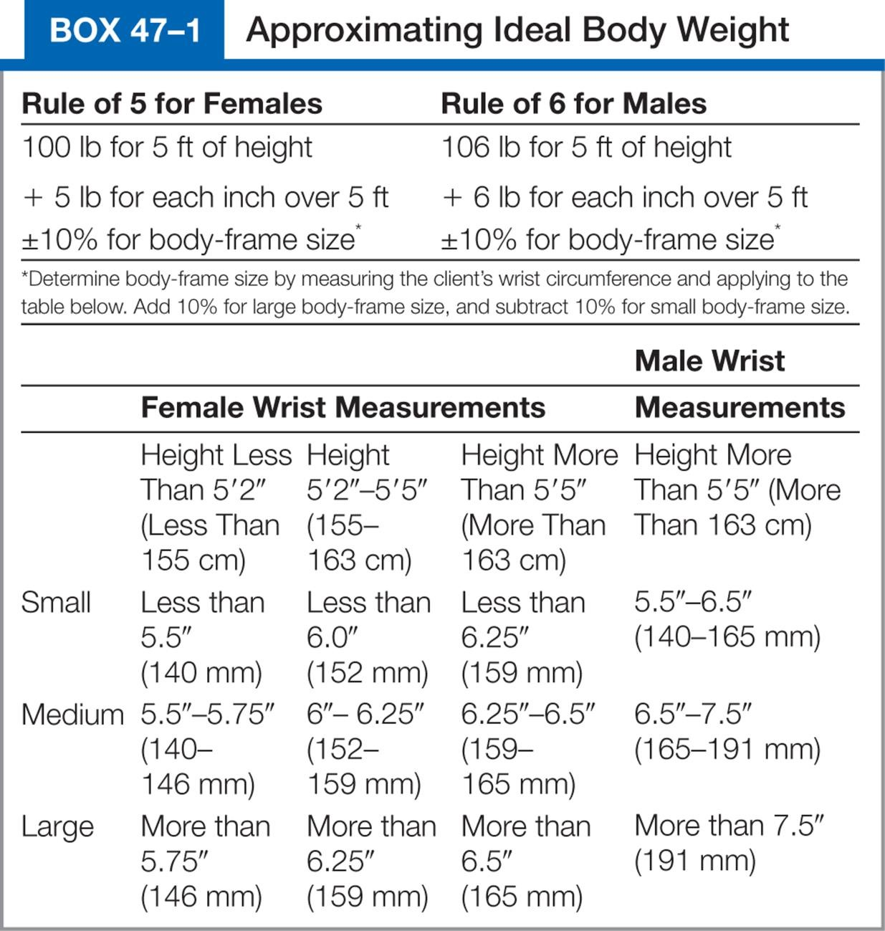
Box 47–1 Approximating Ideal Body Weight

Slide 19
Body Weight and Body Mass Standards
Measuring BMI
Take the weight in kilograms and divide by the height in meters squared.
Body Mass Index (BMI)
Considered more reliable indicator by health professionals
BMI = Weight (kg)/Height (meters2)

Slide 20
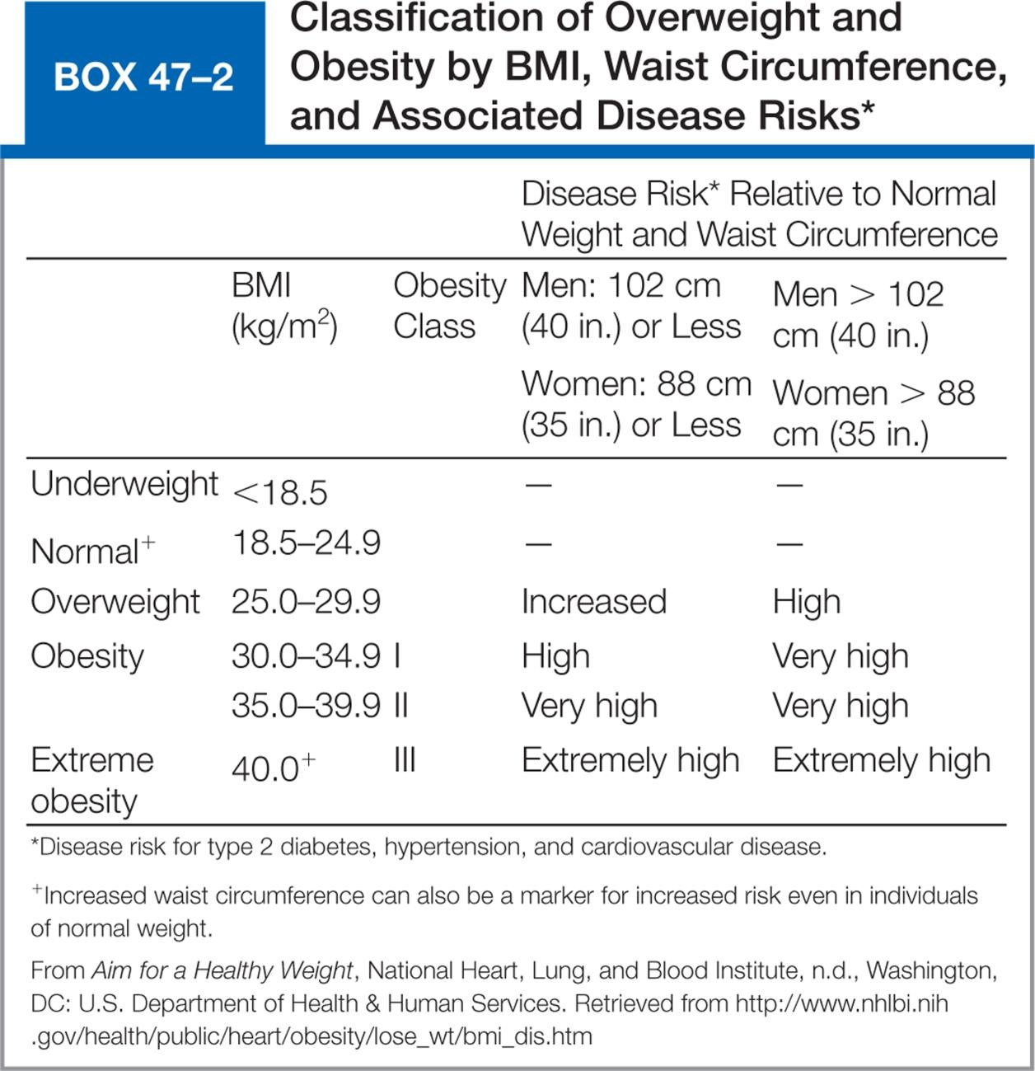
Box 47–2 Classification of Overweight and Obesity by BMI, Waist Circumference, and Associated Disease Risks*

Slide 21
Factors Affecting Nutrition
Development
Periods of rapid growth require an increase in nutrients
Sex
Ethnicity and culture
Traditional foods
Do not use "good food, bad food" approach

Slide 22
Factors Affecting Nutrition
Beliefs about food
Fads
Personal preferences
May be related to familiarity
Textures
Religious practices

Slide 23
Factors Affecting Nutrition
Lifestyle
Convenience items versus preparation
Muscular activity
Economics
Availability of meat, fresh vegetables
Medications and therapy
Include information in history interview
Radiotherapy

Slide 24
Factors Affecting Nutrition
Health
Medications
Therapy
Dysphagia: difficult swallowing
Alcohol consumption
Advertising
Psychological factors

Slide 25
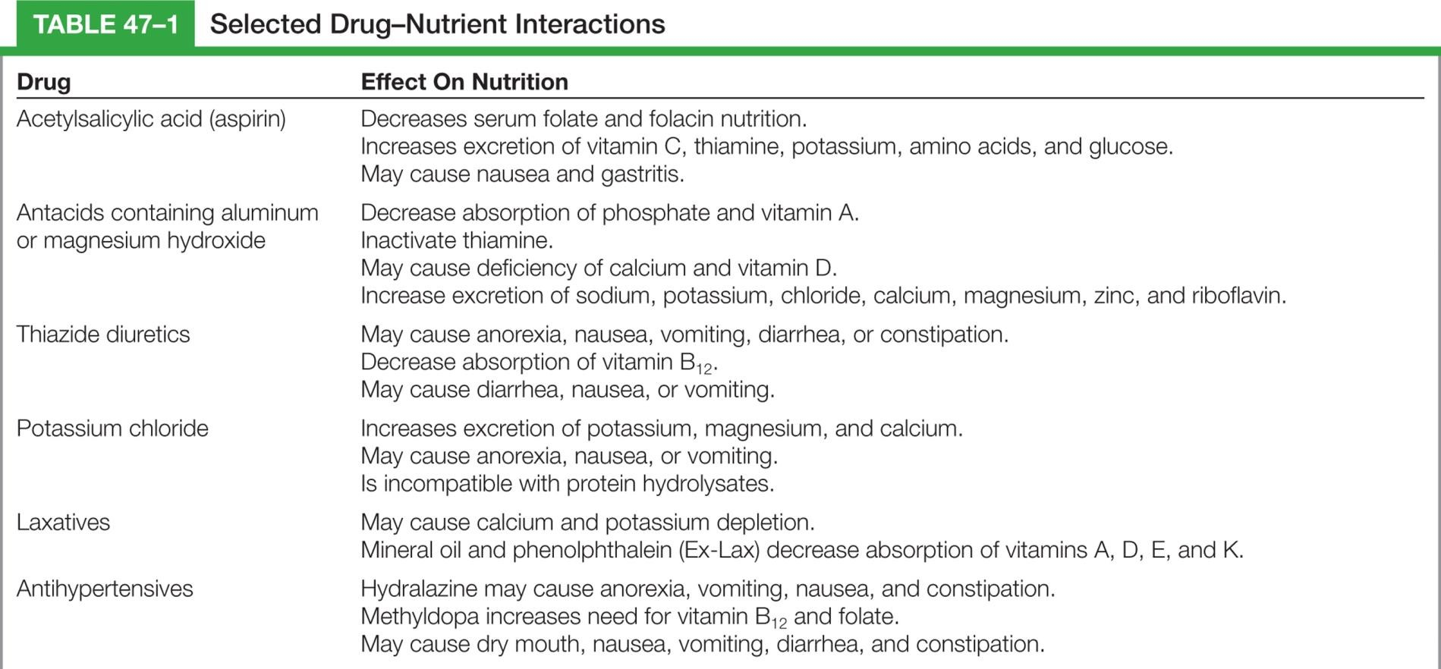
Table 47–1 Selected Drug-Nutrient Interactions
continued on next slide

Slide 26
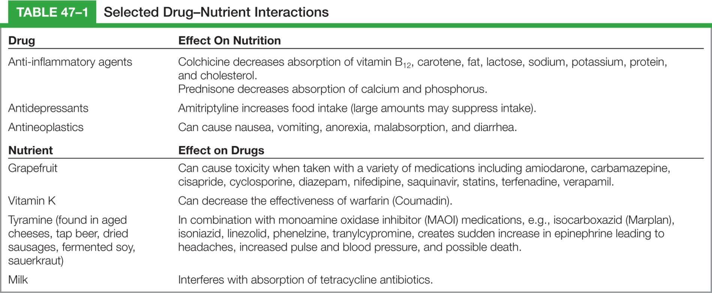
Table 47–1 (continued) Selected Drug-Nutrient Interactions

Slide 27
Nutritional Variations Throughout the Life Cycle
Neonate to 1 year
Demand feeding
Child fed when hungry
Regurgitation
Does not usually result in deficiency
Iron deficiency anemia
Anemia
Bottle mouth syndrome

Slide 28
Nutritional Variations Throughout the Life Cycle
Toddlers
Eat most foods
Adjust to 3 meals/day
Feed selves
Deciduous teeth allow range of foods
Preschooler
Adult foods
May require snacks

Slide 29
Nutritional Variations Throughout the Life Cycle
School-age child
Balanced diet of about 2400 Kcal
Protein-rich food for breakfast to sustain school work
Teach child about healthful eating
Poor eating habits lead to obesity

Slide 30
Nutritional Variations Throughout the Life Cycle
Adolescent
Increased need for nutrients and calories, calcium
Teach healthy lifelong eating habits
Risk for eating disorders
Anorexia nervosa
Bulimia

Slide 31
Nutritional Variations Throughout the Life Cycle
Young adult
Continue to eat a healthy diet with special attention to protein, calcium, and limiting cholesterol and caloric intake
Two or three liters of fluid should be included in the daily diet

Slide 32
Nutritional Variations Throughout the Life Cycle
Middle-aged adult
Postmenopausal women need to ingest sufficient calcium and vitamin D to reduce osteoporosis.
Antioxidants such as vitamin A, C, and E may be helpful in reducing the risk of heart disease in women.

Slide 33
Nutritional Variations Throughout the Life Cycle
Older adults
What is needed in their nutritional intake?
How many calories? Why is it different than other adults?
What can be done to avoid constipation?
continued on next slide

Slide 34
Nutritional Variations Throughout the Life Cycle
Older adults
What are the physical changes that occur with aging that may effect nutritional intake?
What are the psychosocial factors associated with aging that may affect nutritional intake?

Slide 35
Altered Nutrition
Malnutrition
Lack of necessary or appropriate food substances
Overnutrition
Overweight
Obese
Undernutrition

Slide 36
Altered Nutrition
Protein-calorie malnutrition (PCM)
Depressed visceral proteins
Visible muscle and fat wasting
Protein stores
Somatic
Skeletal muscle mass
Visceral
Plasma, hemoglobin, hormones, antibodies

Slide 37
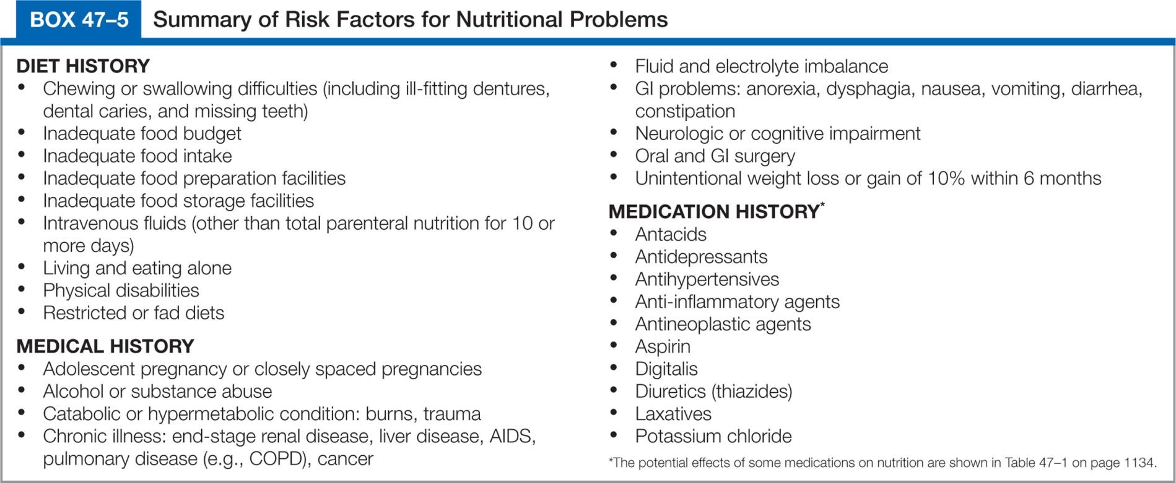
Box 47–5 Summary of Risk Factors for Nutritional Problems

Slide 38
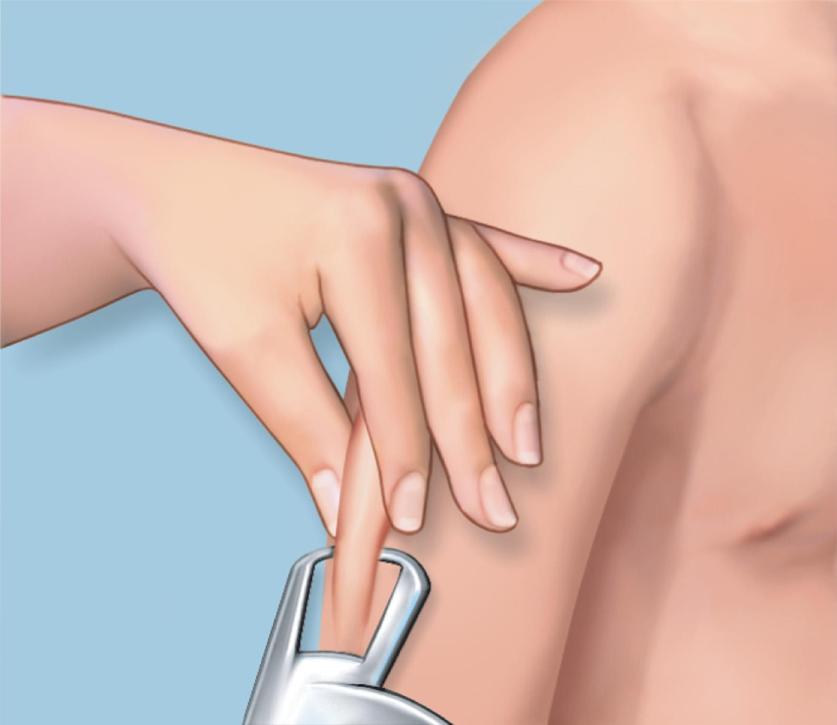
Figure 47–5 Measuring the triceps skinfold.

Slide 39
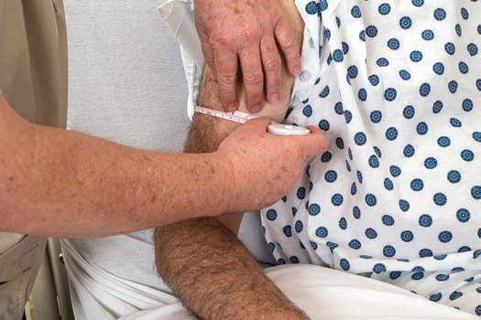
Figure 47–6 • Measuring the mid-arm circumference.

Slide 40
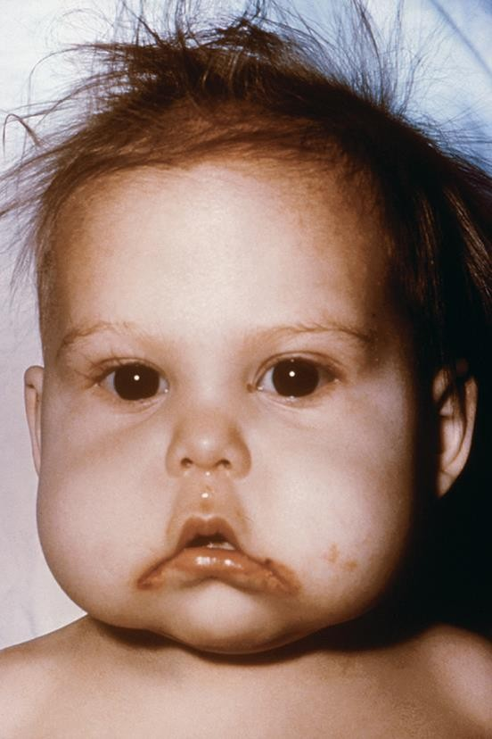
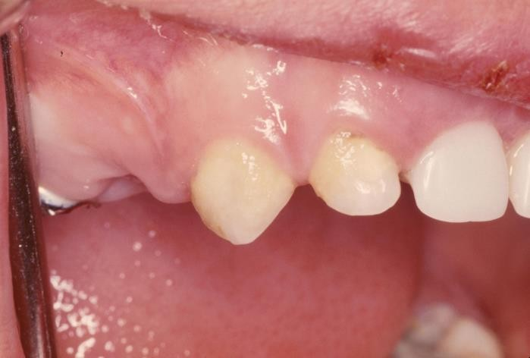
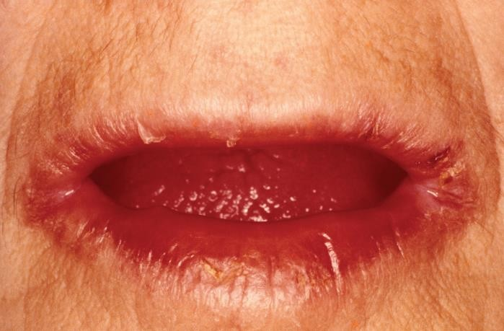
Figure 47–7 Examples of nutritional deficiencies: A, dull, sparse hair and inflammation of the corners of the mouth from protein deficiency; B, rickets from vitamin D or calcium deficiency; C, pallagra, caused by a chronic lack of niacin (vitamin B).
A from Centers for Disease Control and Prevention; B from Custom Medical Stock Photo; C from Biophoto Associates/Science Source.
B
A
C

Slide 41
Assessing
Clinical data (physical examination)
Focus on skin, hair, nails, eyes, and mucosa
Calculating percentage of weight loss
Compare height, current body weight, and usual body weight
IBW based on healthy people

Slide 42
Box 47–7 Calculating and Interpreting the Percent of Deviation from Usual Body Weight and the Percent of Weight Loss

Slide 43
Assessing
Dietary data
Eating patterns, habits
Food preferences
Frequency, type, and quantity of food consumed
Social, economic, ethnic, religious factors
Living and eating companions, etc.
continued on next slide

Slide 44
Diagnosing
Imbalanced Nutrition: More Than Body Requirements
Imbalanced Nutrition: Less Than Body Requirements
Readiness for Enhanced Nutrition
Risk for Imbalanced Nutrition: More Than Body Requirements

Slide 45
Diagnosing
Diagnostic label used as etiology
Activity Intolerance
Constipation
Low Self-Esteem
Risk for Infection

Slide 46
Planning
Maintain or restore optimal nutritional status
Promote healthy nutritional practices
Prevent complications associated with malnutrition
Decrease weight or regain specified weight

Slide 47
Planning
Planning for home care
Provide aid with eating, purchasing food, and preparing meals
Instruct about nutrition therapy
Assess client and family's abilities for self-care, financial resources, and need for referrals

Slide 48
Implementing
Hospitalized client
Provided in collaboration with the primary care provider and the dietitian
Reinforce information presented by dietitian
Create an atmosphere that encourages eating
Provide and assist with eating as needed
continued on next slide

Slide 49
Implementing
Hospitalized client
Monitor the client's appetite and food intake
Administer enteral and parenteral feedings
Consult with primary care provider and dietitian about nutritional problems

Slide 50
Implementing
Assisting with special diets
Clear liquid diet
Fluid and carbohydrates
No adequate protein, fat, vitamins, minerals, calories
Full liquid diet
Liquids or foods that turn liquid at body temperature
Clients with GI disturbances
continued on next slide
Copyright © 2016, 2012, 2008 Pearson Education, Inc. All Rights Reserved

Slide 51
Implementing
Assisting with special diets
Soft diet
Low residue (low-fiber)
What's the difference between this and pureed?
Diet as tolerated
Advance the diet if the patient is responding as expected
continued on next slide
Copyright © 2016, 2012, 2008 Pearson Education, Inc. All Rights Reserved

Slide 52
Implementing
Stimulating the appetite
Decrease in food intake often accompanied by decrease in fluid intake.
Short-term decrease not a problem, but over time it leads to nutritional problems.
Determine reason for lack of appetite, then deal with problem

Slide 53
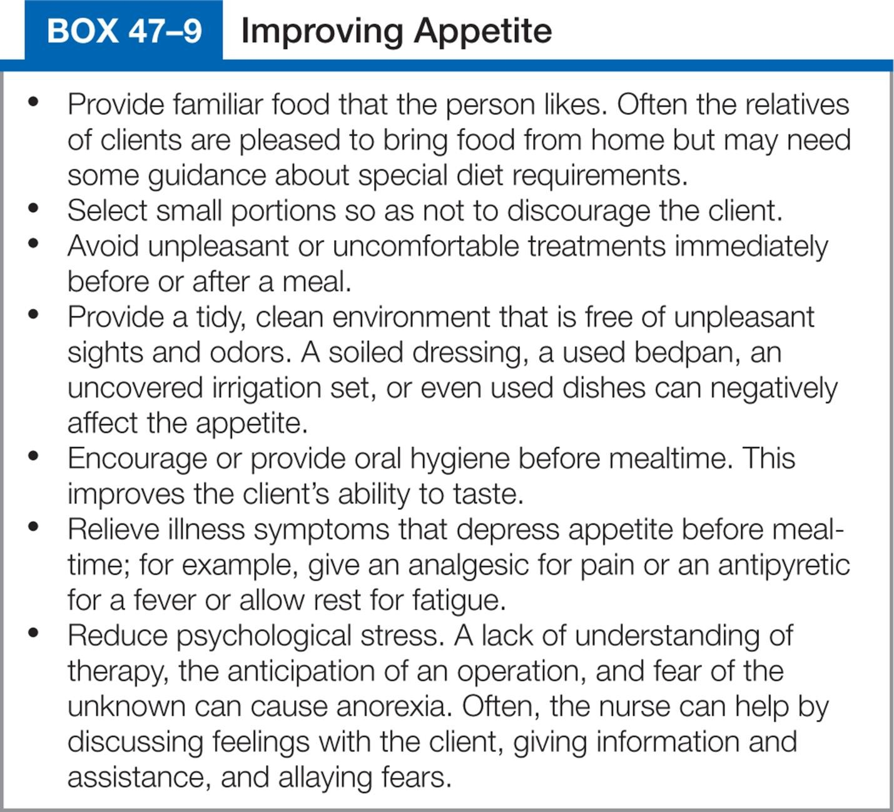
Box 47–9 Improving Appetite

Slide 54
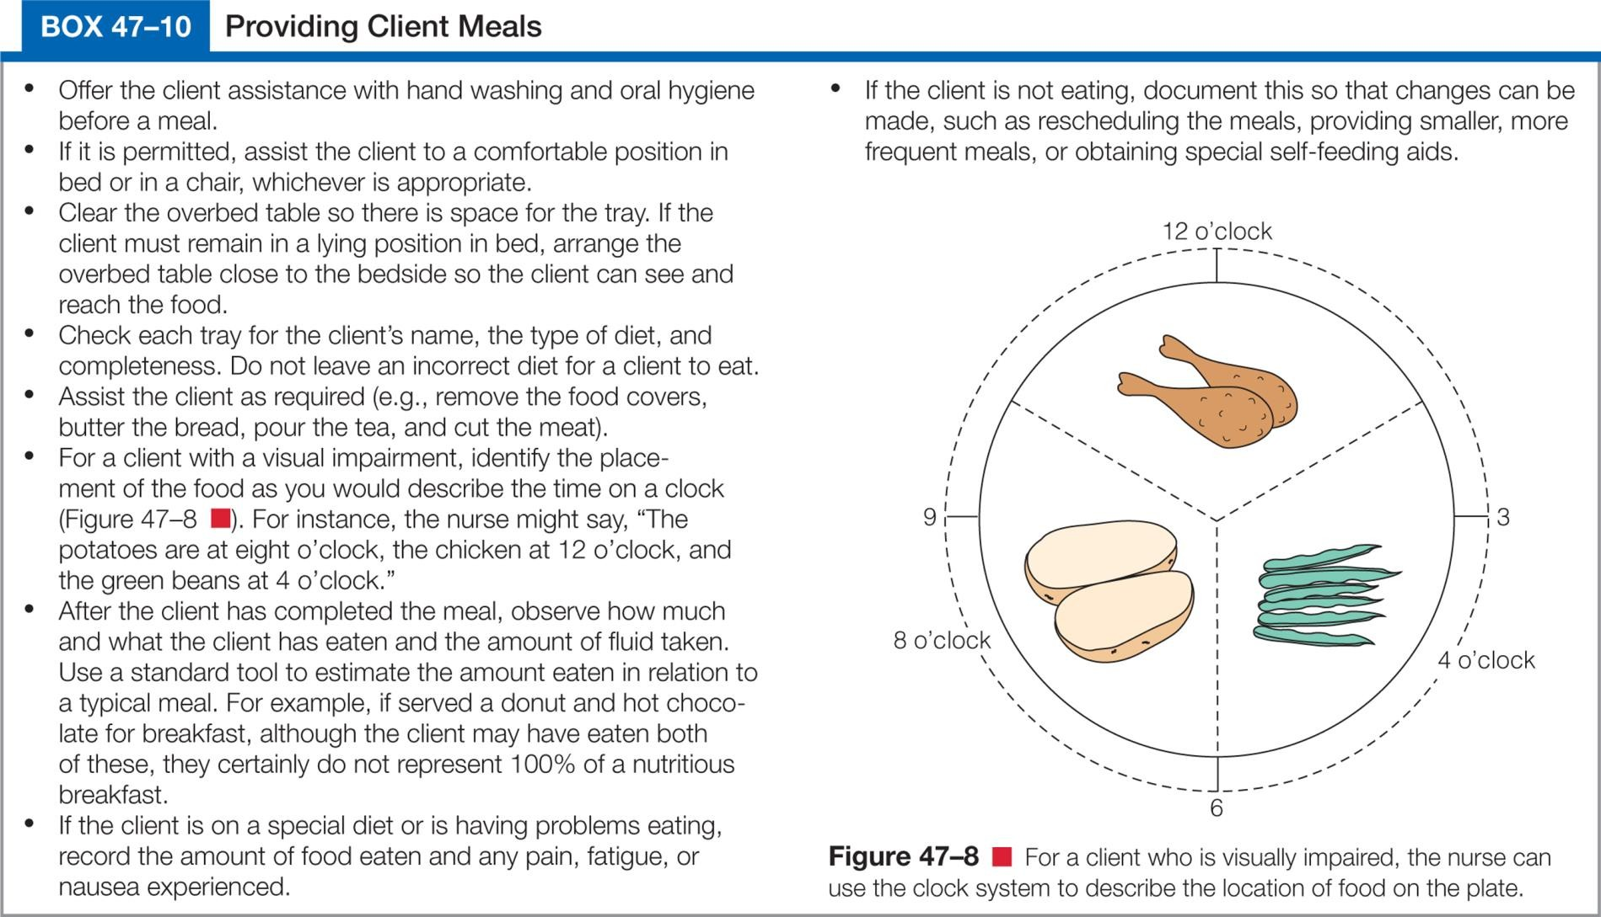
Box 47-10 Providing Client Meals

Slide 55
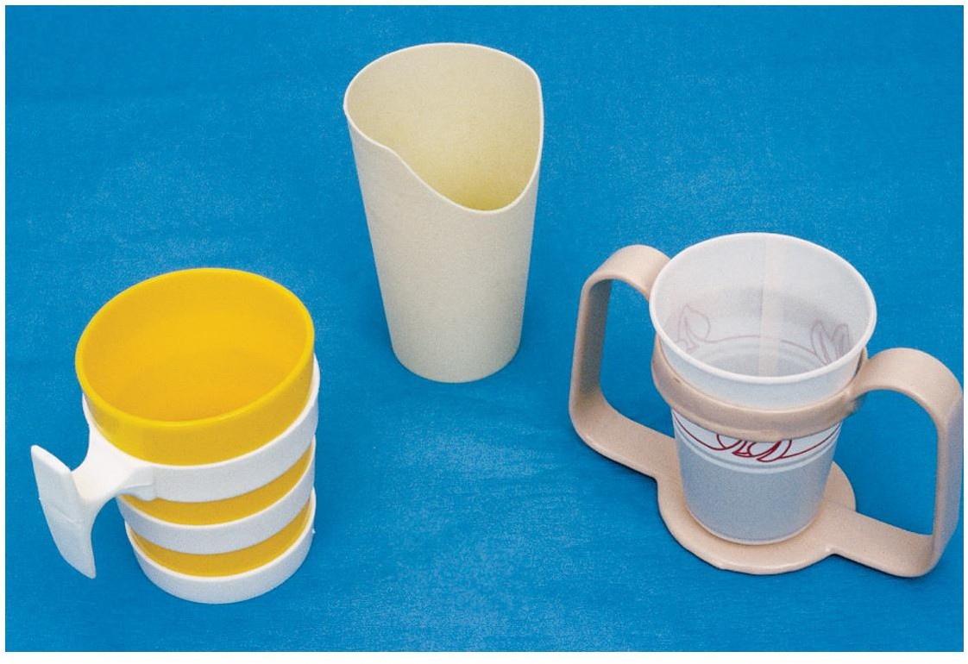
Figure 47–9 Left to right: glass holder, cup with hole for nose, two-handled cup holder.

Slide 56
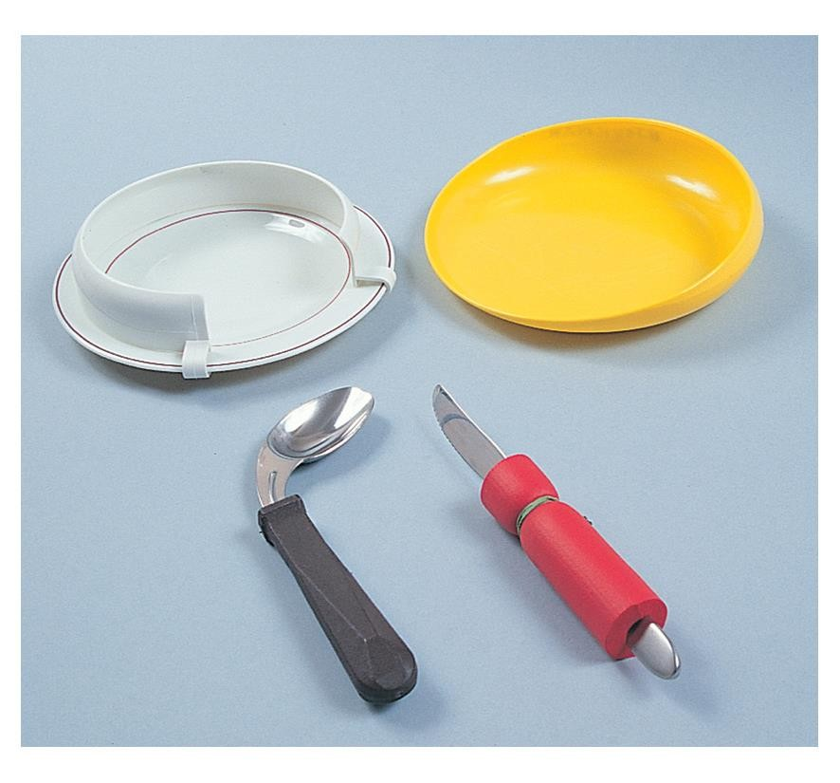
Figure 47–10 Dinner plate with guard attached and lipped plate facilitate scooping; wide-handled spoon and
knife facilitate grip.
.

Slide 57
Implementing
Enteral nutrition
Enteral
Through the GI system
Enteral access devices
Nasogastric tube
Nasoenteric (nasointestinal) tube
Gastrostomy and jejunostomy devices
continued on next slide

Slide 58
Implementing
Enteral nutrition
Enteral access devices
Percutaneous endoscopic gastrostomy (PEG)
Percutaneous endoscopic jejunostomy (PEJ)

Slide 59
Skill 47–1 Inserting a Nasogastric tube
continued on next slide
Copyright © 2016, 2012, 2008 Pearson Education, Inc. All Rights Reserved

Slide 60
Skill 47–1 (continued) Inserting a Nasogastric tube
continued on next slide
Copyright © 2016, 2012, 2008 Pearson Education, Inc. All Rights Reserved

Slide 61
Skill 47–1 (continued) Inserting a Nasogastric tube
continued on next slide
Copyright © 2016, 2012, 2008 Pearson Education, Inc. All Rights Reserved

Slide 62
Skill 47–1 (continued) Inserting a Nasogastric tube
continued on next slide
Copyright © 2016, 2012, 2008 Pearson Education, Inc. All Rights Reserved

Slide 63
Skill 47–1 (continued) Inserting a Nasogastric tube
continued on next slide
Copyright © 2016, 2012, 2008 Pearson Education, Inc. All Rights Reserved

Slide 64
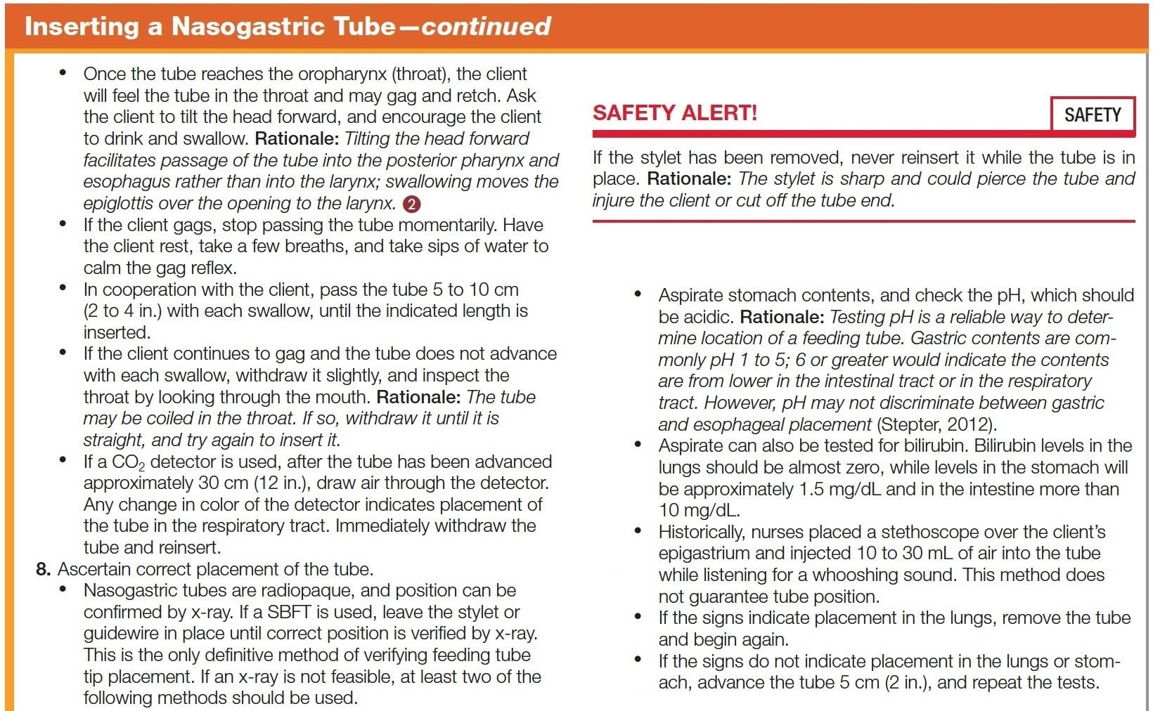
Skill 47–1 (continued) Inserting a Nasogastric tube
continued on next slide
Copyright © 2016, 2012, 2008 Pearson Education, Inc. All Rights Reserved

Slide 65
Skill 47–1 (continued) Inserting a Nasogastric tube
continued on next slide
Copyright © 2016, 2012, 2008 Pearson Education, Inc. All Rights Reserved

Slide 66
Skill 47–1 (continued) Inserting a Nasogastric tube
continued on next slide
Copyright © 2016, 2012, 2008 Pearson Education, Inc. All Rights Reserved

Slide 67
Skill 47–1 (continued) Inserting a Nasogastric tube

Slide 68
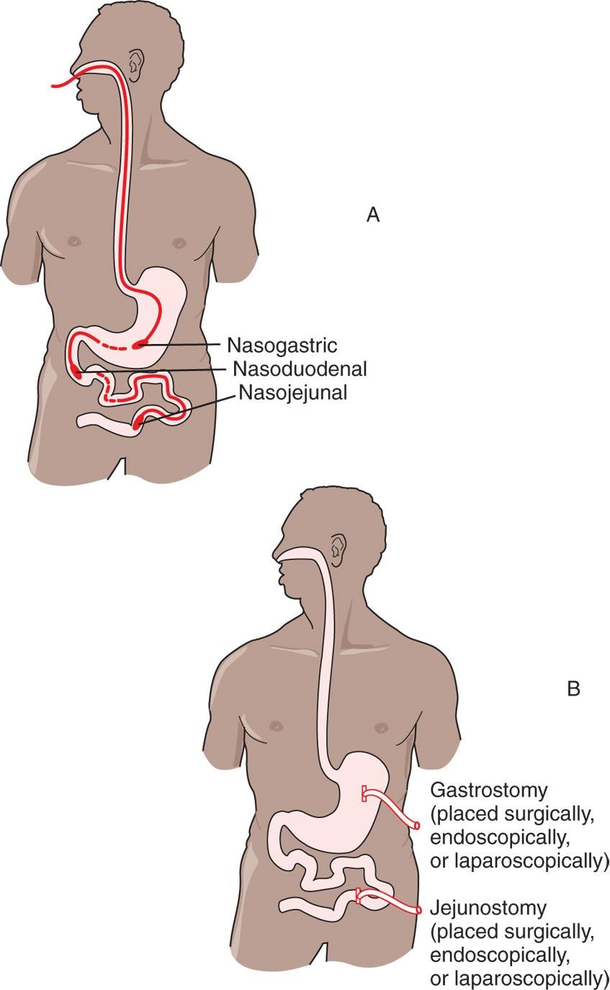
Figure 47–13 Placements for enteral access: A, for nasoenteric/nasointestinal tubes; B, for gastrostomy and
jejunostomy tubes.

Slide 69
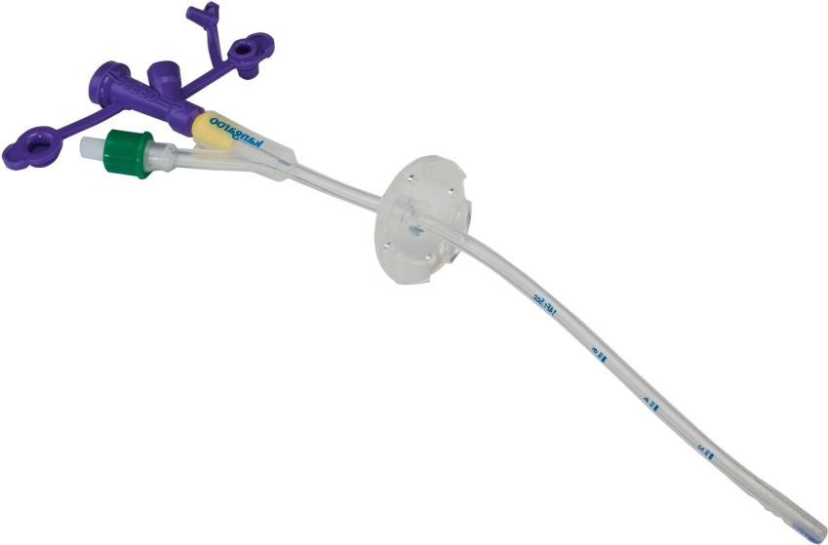
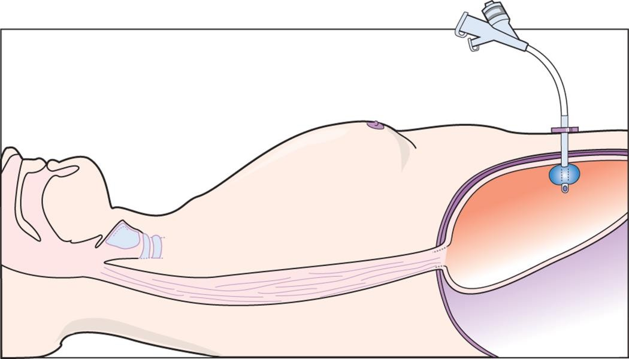
Figure 47–14 Percutaneous endoscopic gastrostomy (PEG) tube.
A, Courtesy Covidien.
A
B

Slide 70
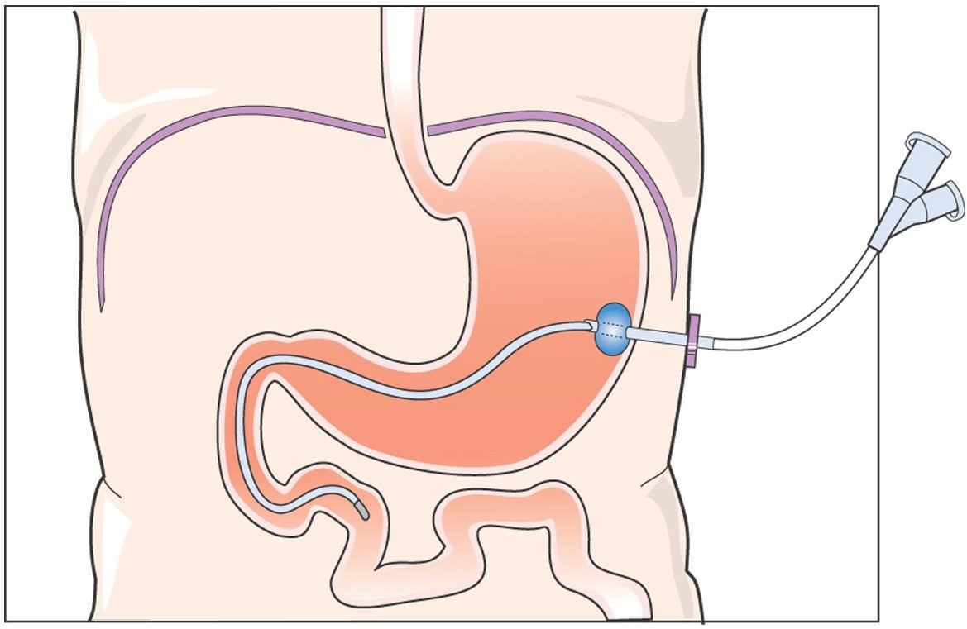
Figure 47–15 Percutaneous endoscopic jejunostomy (PEJ) tube.

Slide 71
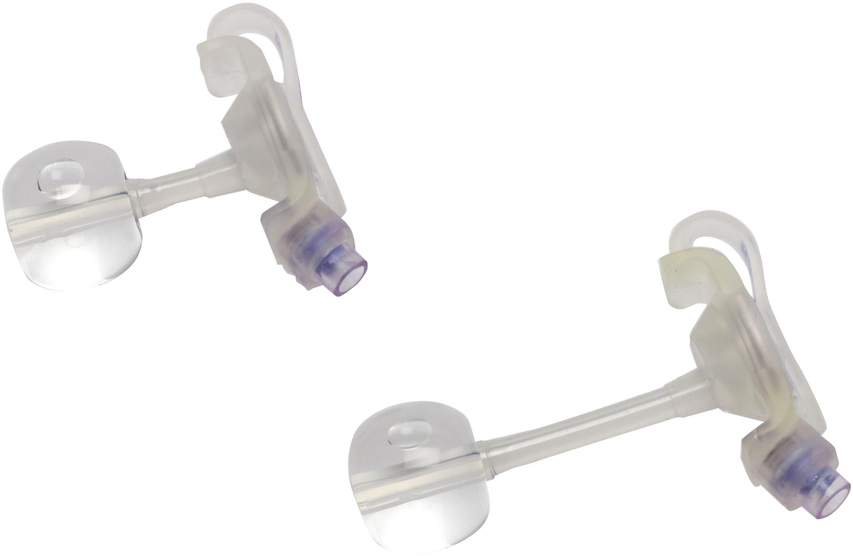
Figure 47–16 Low-profile gastrostomy feeding tube.
Courtesy Covidien.

Slide 72
Implementing
Enteral nutrition
Testing feeding tube placement
Initially, tube placement confirmed by radiography and tube marked with indelible ink at exit point from nose
Length of visible tubing documented
continued on next slide
Copyright © 2016, 2012, 2008 Pearson Education, Inc. All Rights Reserved

Slide 73
Implementing
Enteral nutrition
Testing feeding tube placement
Verify placement before feedings, at intervals
Aspirate GI secretions
Measure pH of aspirated fluid
Auscultate epigastrium while injecting 5– 20 mL of air
Confirm length of tube insertion with insertion mark
continued on next slide
Copyright © 2016, 2012, 2008 Pearson Education, Inc. All Rights Reserved

Slide 74
Implementing
Enteral nutrition
Enteral feedings
Administer
Intermittent
300–500 mL per feeding over 30 minute period
Usually administered room temp
continued on next slide
Copyright © 2016, 2012, 2008 Pearson Education, Inc. All Rights Reserved

Slide 75
Implementing
Enteral nutrition
Enteral feedings
Administer
Continuous
Administered over 24 h with infusion pump
Usually administered cold
Refeeding syndrome
Periods of malnutrition, starvation
Open system or closed system

Slide 76
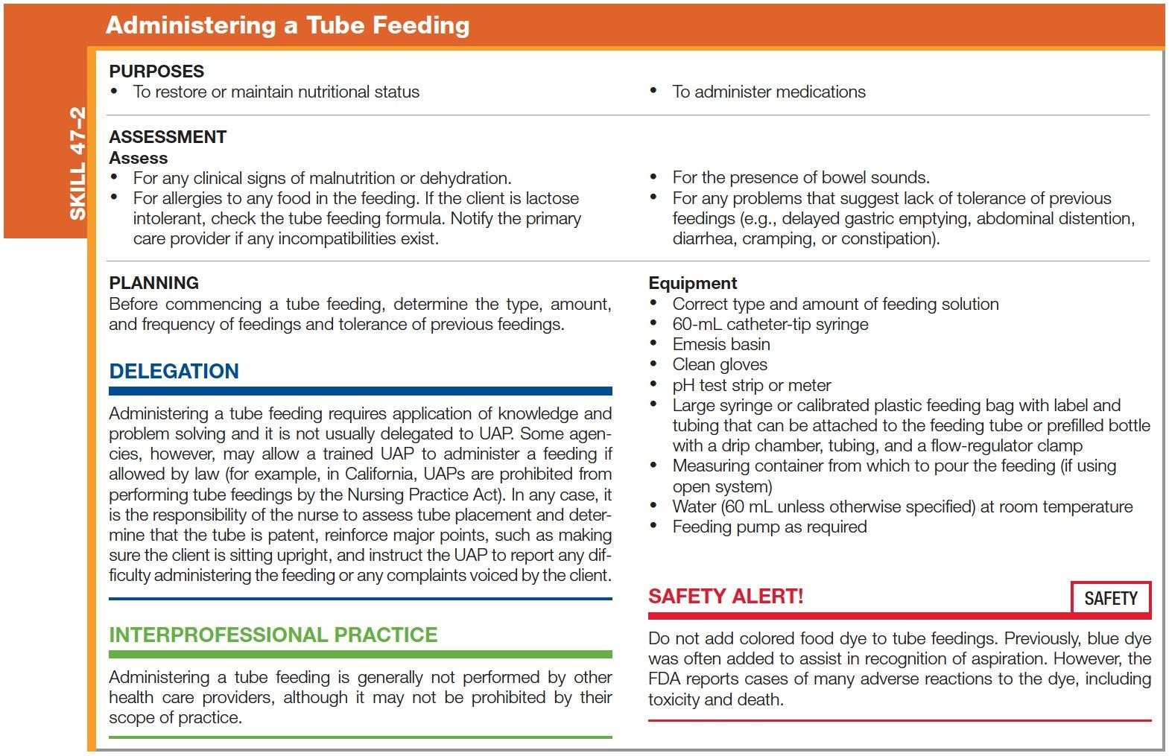
Skill 47–2 Administering a Tube Feeding
continued on next slide
Copyright © 2016, 2012, 2008 Pearson Education, Inc. All Rights Reserved

Slide 77
Skill 47–2 (continued) Administering a Tube Feeding
continued on next slide
Copyright © 2016, 2012, 2008 Pearson Education, Inc. All Rights Reserved

Slide 78
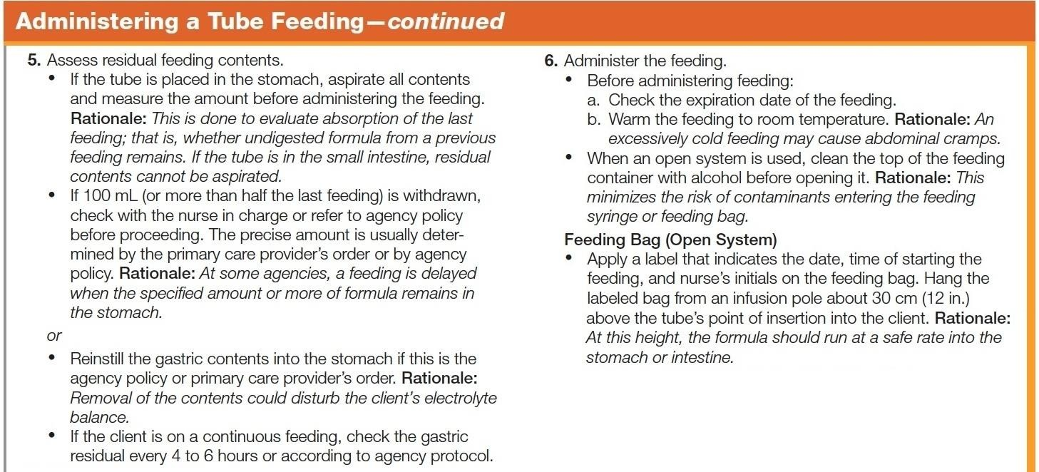
Skill 47–2 (continued) Administering a Tube Feeding
continued on next slide
Copyright © 2016, 2012, 2008 Pearson Education, Inc. All Rights Reserved

Slide 79
Skill 47–2 (continued) Administering a Tube Feeding
continued on next slide
Copyright © 2016, 2012, 2008 Pearson Education, Inc. All Rights Reserved

Slide 80
Skill 47–2 (continued) Administering a Tube Feeding
continued on next slide
Copyright © 2016, 2012, 2008 Pearson Education, Inc. All Rights Reserved

Slide 81
Skill 47–2 (continued) Administering a Tube Feeding

Slide 82
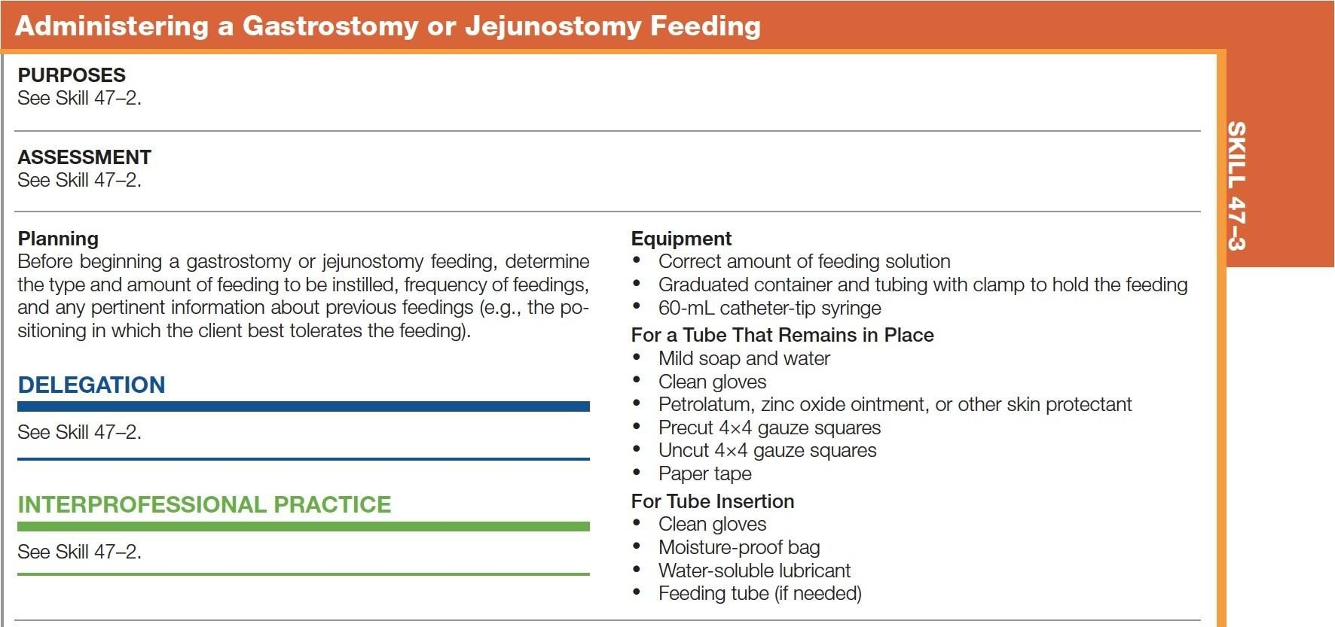
Skill 47–3 Administering a Gastrostomy or Jejunostomy Feeding
continued on next slide
Copyright © 2016, 2012, 2008 Pearson Education, Inc. All Rights Reserved

Slide 83
Skill 47–3 (continued) Administering a Gastrostomy or Jejunostomy Feeding
continued on next slide
Copyright © 2016, 2012, 2008 Pearson Education, Inc. All Rights Reserved

Slide 84
Skill 47–3 (continued) Administering a Gastrostomy or Jejunostomy Feeding

Slide 85
Implementing
Enteral nutrition
Managing clogged feeding tubes
Clogged tubes must be removed and reinserted; prevention is key.
Flush with at least 30 mL water before, between, and after each medication is instilled
Do not add meds to formula or to each other, as precipitates may form
continued on next slide

Slide 86
Implementing
Enteral nutrition
Managing clogged feeding tubes
First, reposition client to release kink in tubing
If still blocked, flush and aspirate with water repeatedly

Slide 87
Implementing
Parenteral nutrition
Total parenteral nutrition (TPN) or IV hyperalimentation
Hypertonic; injected only into high-flow central veins
Used in clients with severe malnutrition, severe burns, bowel disease disorders, acute renal failure, hepatic failure, metastatic cancer, and major surgeries (NPO 5 days)
continued on next slide
Copyright © 2016, 2012, 2008 Pearson Education, Inc. All Rights Reserved

Slide 88
Implementing
Parenteral nutrition
Total parenteral nutrition (TPN) or IV hyperalimentation
Carries risk of infection and fluid/electrolyte imbalances
Requires surgical aseptic technique, frequent lab monitoring for TPN modification
continued on next slide
Copyright © 2016, 2012, 2008 Pearson Education, Inc. All Rights Reserved

Slide 89
Implementing
Parenteral nutrition
Total parenteral nutrition (TPN) or IV hyperalimentation
Infusions started gradually to prevent hyperglycemia
Glucose levels monitored
Discontinued gradually to prevent hyperinsulinemia and hypoglycemia
continued on next slide
Copyright © 2016, 2012, 2008 Pearson Education, Inc. All Rights Reserved

Slide 90
Implementing
Parenteral nutrition
Peripheral parenteral nutrition (PPN)
Less concentrated solution, can provide lipids but associated with phlebitis
Used more to prevent than to correct nutritional imbalance
Enteral or parenteral can be provided in home.

Slide 91
Evaluating
The goals established in the planning phase are evaluated according to specific desired outcomes.

Slide 92
Evaluating
If the outcomes are not achieved, the nurse should explore the reasons.
Cause of problem identified? Outcomes realistic?
Family included and supportive?
Client's preferences considered?
Do symptoms cause loss of appetite?
Anything interfering with digestion or absorption?

