Slide 1

Communicable disease epidemiology

Slide 3
Communicable diseases
A communicable or infectious disease is an illness caused by transmission of a specific infectious agent or its toxic products from an infected person or animal to a susceptible host, either directly or indirectly.

Slide 4
Success stories in epidemiology
Snow’s work on cholera
Erradication of smallpox.

Slide 5
Nearly eradicated

Slide 6
New infectious diseases
Lassa fever-viral disease transmitted from rodents.
AIDS
SARS
Avian flu.
Swine flu
Covid-19

Slide 7
Epidemic and endemic diseases
An epidemic is the occurence in a community or region of a number of cases of a disease that is unusually large or unexpected for the given place and time.

Slide 8
Epidemics
Epidemics are either point-source or contagious( propogated ) in origin.
In a point source epidemic, susceptible individuals are exposed more or less simultaneously to one source of infection.
In contagious epidemic the disease is passed from person to person and the initial rise in number of cases is slower.

Slide 9
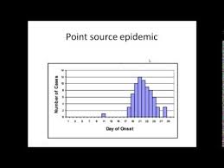
Point source epidemic

Slide 10
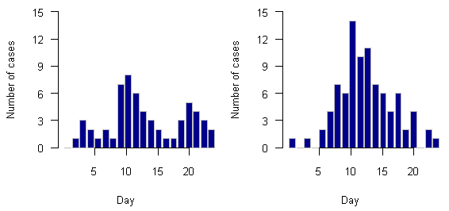
Propogated outbreak

Slide 11
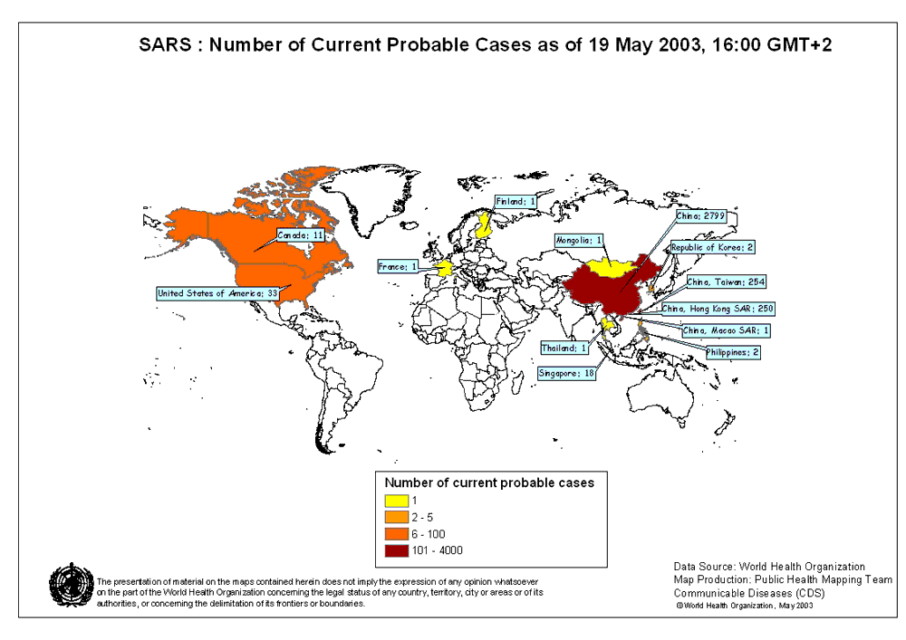
Outbreaks
good world map

Slide 12
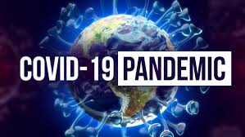

Slide 13
Endemic disease
A disease that is usually present in a given geographical area or population group at relatively high prevalence and incidence rates, in comparison with other areas or populations.

Slide 14
Chain of infection
Communicable diseases occur as a result of the interaction of the agent, the transmission process and the host.
The control of such diseases may involve changing one or more of these components, all of which are influenced by the environment.

Slide 15
HOST
The
Analytical Epidemiological Triad
AGENT
ENVIRONMENT

Slide 16
AGENTS
Nutrients
Poisons
Allergens
Radiation
Physical trauma
Microbes
Psychological experiences

Slide 17
Chain of infection
The infectious agent.
pathogenicity: the ability of the agent to produce disease.
pathogenicity= number of persons developing clinical illness / the number exposed to infection.

Slide 18
Chain of infection
Infectious agent.
Virulence: a measure of the severity of disease.
Infectivity: the ability of the agent to invade and produce infection in the host.
Infective dose: the amount required to cause infection in susceptible subjects.

Slide 19
Chain of infection
Infectious agent
Reservoir: the natural habitat of an infectious agent. It may include humans, animals and environmental sources.

Slide 20
Chain of infection
The ease with which a disease spreads – how infectious it is – is measured using the ‘reproduction number’, R₀, which is the average number of people who are expected to catch the disease from a single infected person. For COVID-19, R₀ is currently estimated to be around 2-3. Flu, in comparison, has a R₀ of 1.3, while measles has a R₀ as high as 18.

Slide 21
Chain of infection
Transmission
the second link in the chain of infection.
It is the spread of an infectious agent through the environment or to another person.
Transmission can be direct or indirect.

Slide 22
Chain of infection
Transmission
Indirect transmission may be vehicle –borne, vector borne, or airborne.
Vehicle –borne- contaminated materials- such as food, clothes, cooking utensils.
Vector borne- the agent is carried by an insect or animal.
The distinction between types of transmission is important when methods for control of communicable diseases are being selected.

Slide 23
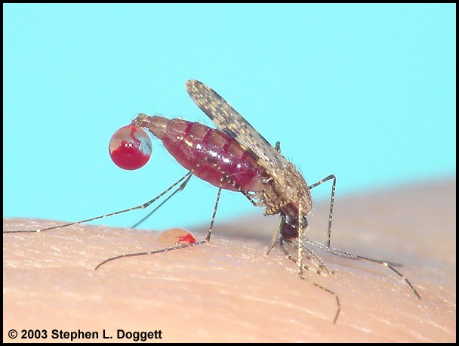
MALARIA
Vector: Anopheles mosquito.
430 known species of Anopheles, only 30-50 transmit malaria.
Factors, like temperature and humidity,accelerate the parasite growth in the mosquito.

Slide 24
Chain of infection
Host
is the third link in the chain of infection.
Is the person or animal that provides a suitable place for an infectious agent to grow and multiply under natural conditions.

Slide 25
HOST FACTORS
Age
Genetic endowment
Immunologic state
Personal behavior

Slide 26
Chain of infection
Environment
plays a critical role in the development of communicable diseases . General sanitation,temperature, air pollution, water quality, are among the factors that influence all stages in the chain of infection.

Slide 27
ENVIRONMENT
Crowding
Atmosphere
Modes of communication – phenomena in the environment that bring host and agent together, such as vector, vehicle, reservoir

Slide 28
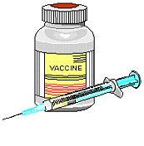


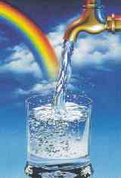
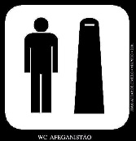

CONTROL METHODS
VACCINATION
ENVIRONMENTAL CONTROL
Personal Hygiene
Protection of food
Water Supplies
Sanitation
Vector control

Slide 29
Vaccine-preventable diseases
• Diphtheria
Haemophilus influenzae type b
Hepatitis A
Measles
Mumps
Pneumococcal disease
Rotavirus (severe diarrhea)
Tetanus (lockjaw)
Varicella (chickenpox)
Japanese encephalitis
Cholera
Typhoid
Hepatitis B
Meningococcus
Pertussis (whooping cough)
Polio
Rubella (German measles)
Varicella (chickenpox)
Tuberculosis
Yellow fever

Slide 30
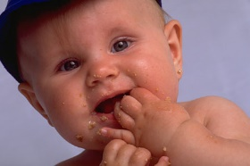
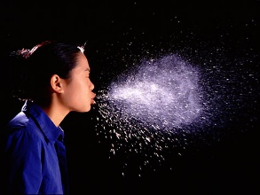
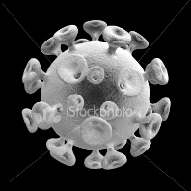
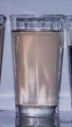

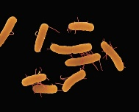

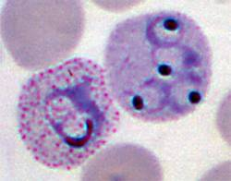
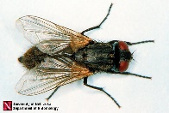
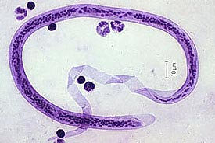
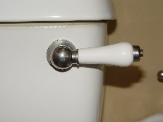
CONTROL STRATEGY
Host
Host
Air;
Food; Water;
Person-person;
Insect;
Fomites
Vector
viral
bacterial
protozoal
helminths
Agent

Slide 31
CONTROL STRATEGY
Identify the cause (diagnosis)
Notification
Treatment of cases
Interrupt transmission
Prevent recurrence
Analysis and reporting
Surveillance

Slide 32
Identify the cause
Confirm Diagnosis - a) clinical b) laboratory
Extent of infected cases – endemic or an outbreak?
Is this the first case or have there been others over
an extended period of time?
Where did the infected person come from - local or imported?
Epidemiology - common events (e.g. all went to a wedding)
Are there exceptions? (e.g. no cases in center of village)
Population at risk - (e.g. only forest worker)
Changes in the environment (e.g. climate change)
Route of transmission

Slide 33
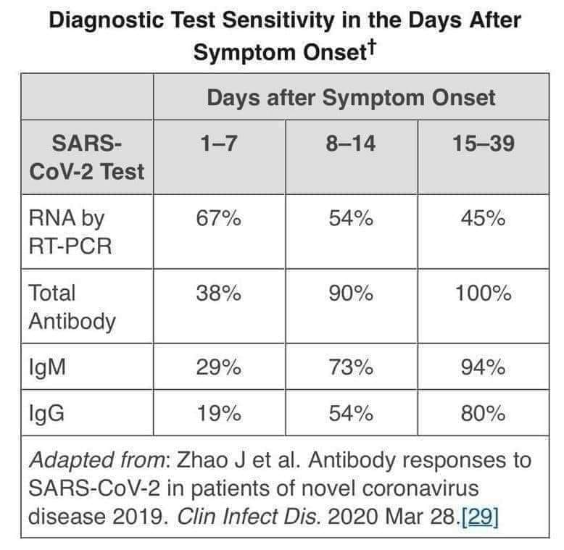

Slide 34
Distal determinants of morbidity and mortality
Socio-economic factors: personal and household wealth, community development, womens’ education & employment
Institutional factors: health systems, health regulations/laws, technological development, environmental interventions
Cultural factors: traditional beliefs about illness & health, religious values, role & status of women, etc.
Broader context: political economy, transportation and communication systems, etc.

Slide 35
What are the Challenges ?
Aging/Population Growth

Slide 36

What are the Challenges ?
Globalisation

Slide 37
Challenges
we don’t yet know whether the coronavirus will track our seasons, like the flu, or be fairly constant all year round. If the coronavirus does prefer colder weather, like flu, then the epidemic could gain a second wind during the Northern Hemisphere winter months.

Slide 38
Challenges
We don’t know how much this coronavirus will mutate over time. The viruses that cause flu are constantly mutating, which is why people need annual vaccinations to protect against whichever are the most prevalent strains that year.
The coronavirus is probably mutating at a slower rate, but if it keeps circulating, then we’ll see changes. The question is what those changes will do: they could make the virus better at evading our immune systems, for instance, or more easily transmitted.

Slide 39
Challenges
We don’t know how long those who are infected are subsequently immune for. Some other viruses in the coronavirus family, such as those that cause the common cold, only provide immunity for around three months or so.
“There’s evidence for short-term immunity [after contracting COVID-19],“but we just don’t have the data yet to know whether it provides long-term immunity.It is estimated that we need to be immune to the coronavirus for at least a year, possibly two, in order for the population to build up herd immunity. If this isn’t the case, he says, our best hope for herd immunity might be a vaccine, although this is still believed to be at least a year away

Slide 40
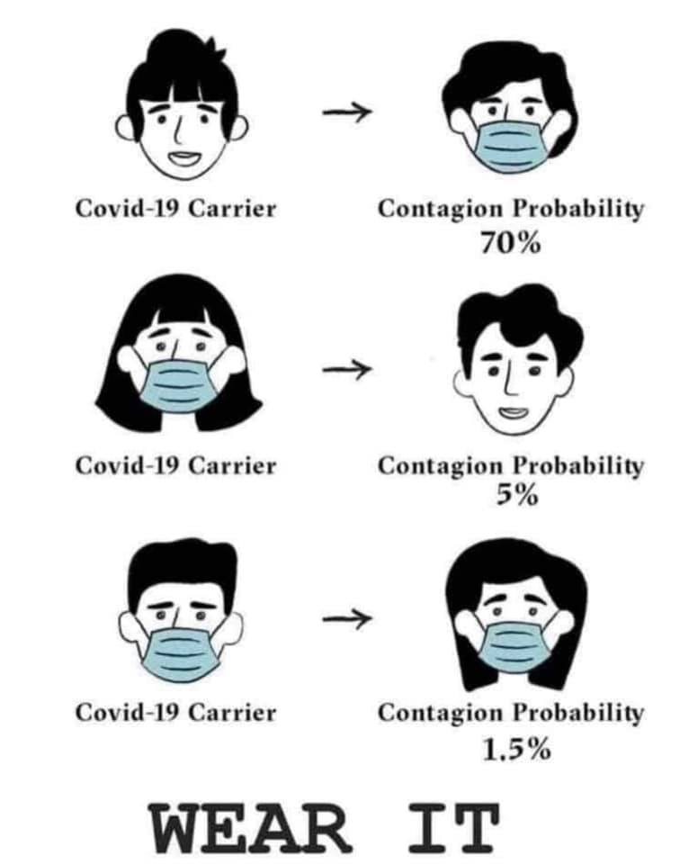

Slide 41
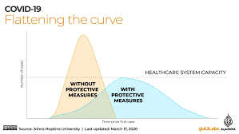

Slide 42
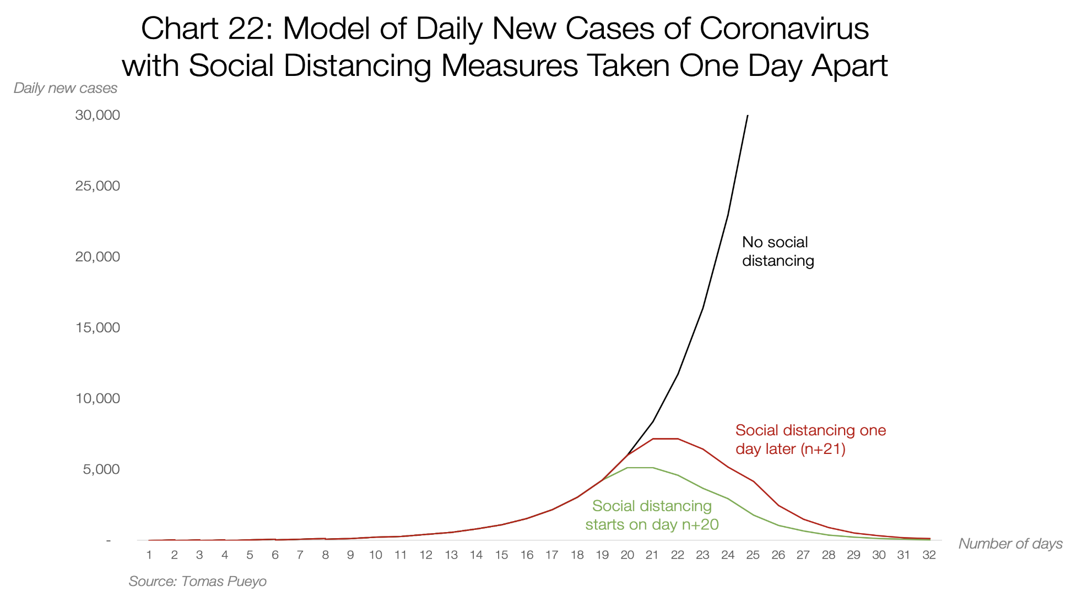

Slide 43
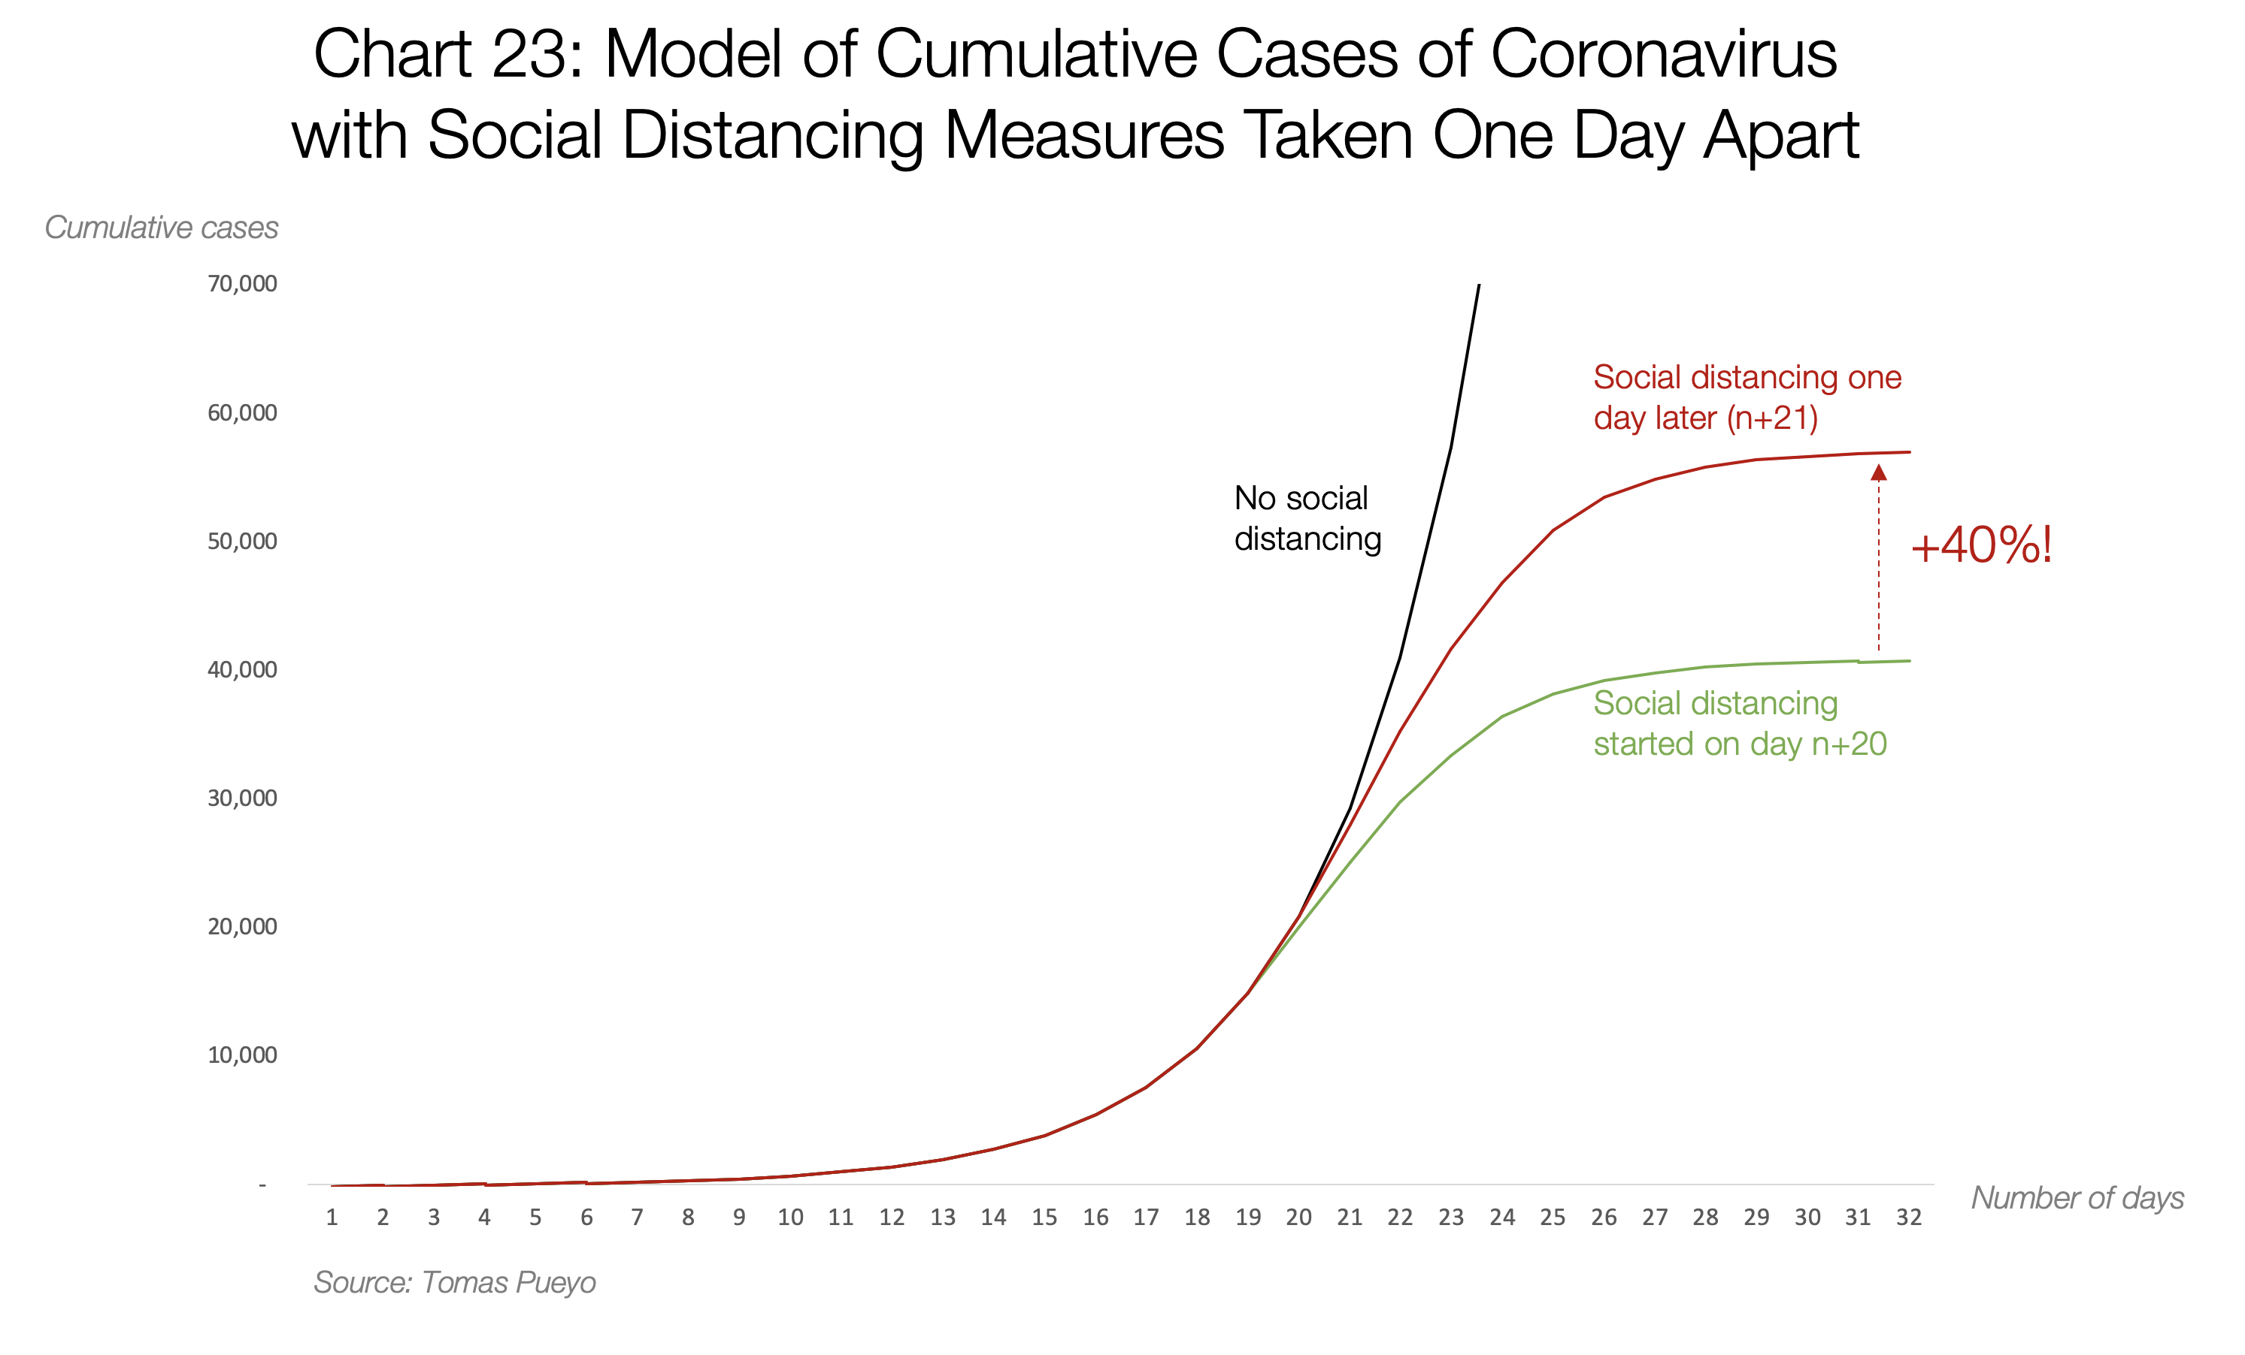

Slide 44
Herd Immunity
Herd immunity is what happens when enough people are immune to a disease (in this case, COVID-19) for the chains of transmission to be broken. As more people become immune, infected people are less able to pass on the disease, and the spread of the disease slows down. This provides an indirect form of protection for those who are not immune.
Usually, individuals become immune through vaccination. But there isn’t yet a vaccine for coronavirus, so herd immunity could only currently be achieved if enough people contract the disease and recover, developing an immunity to it in the process

Slide 45
