Slide 1
Basic Principles in Pharmacology

Slide 2
Pharmacology
Pharmacology: is the study of drugs, their uses and how they affect organisms
Pharmacokinetics: describes what the body does to a drug.
Pharmacodynamics: describes what the drug does to the body.
Notes:
Why should nurses learn pharmacology?
Preadministration assesment
Dosage and administration
Promotig therapeutic effects
Minimizing side effects ex hypoglycemia

Slide 3
A drug: any chemical that can affect living processes.

Slide 4
Properties of an ideal drug
Effective
Safe
Selective

Slide 5
Additional properties of an ideal drug
Reversible action
Predictability
Ease of administration
Freedom from drug interaction
Low cost
Chemical stability
Notes:
Maximum benefit minimum harm،

Slide 6
Most Drugs Have Three Names
Chemical
Complicated, describes the chemical and physical properties of the drug
Generic
Describes the active ingredient
Trade
Assigned by the company marketing the drug
Example:
The chemical name for diazepam: 7-chloro-1, 3-dihydro-1-methyl-5- phenyl-2H-1, 4-benzodiazepin-2-one
Trade name: Valium

Slide 7
Most Drugs Have Three Names
Example
Chemical name: P-Isobutylhydratropic Acid
Generic name: Ibuprofen
Trade names: Trufen, Advil, Motrin…

Slide 8
Routes of Drug Administration
Enteral
Oral
Sublingual
Parenteral
Intravenous (IV)
Intramuscular (IM)
Subcutaneous (SC)
Other routes
Inhalation
Intrathecal/Intraventricular
Topical
Transdermal
Rectal
Harvey, R. A. et al. Lippincott's Illustrated Reviews

Slide 9
Routes of Administration
Determined by
Properties of the drug
Water or lipid solubility
Ionization
Therapeutic objective
Rapid onset
Prolonged effect
Local effect

Slide 10
Enteral Route
Oral administration:
Advantages
Easily self-administered
Low risk of systemic infections (compared to parenteral)
Easier to manage toxicity
Disadvantages
Inactivation of drugs due to first pass effect or stomach acidity
Enteric coated to protect the stomach (e.g. Aspirin)
to protect the drug from stomach acidity
Extended release to control how fast the drug is released from the pill to the body

Slide 11
Enteral route
Sublingual: Drug diffuses into the capillary network to the systemic circulation
Advantages
Rapid absorption
Convenience
Low incidence of infection
Bypass GI
Bypass first pass effect

Slide 12
Parenteral route
Direct administration of the drug across body barriers into the systemic circulation
Used for: 1. Drugs with poor GI absorption (e.g. Heparin)
2. Drugs unstable in GI (e.g. Insulin)
3. Unconscious patients
4. Rapid onset of action
5. High bioavailability
Advantage: no first pass metabolism
Disadvantages: Risk of infection
Can be irreversible
Notes:
Which dose is higher IV or oral?

Slide 13
Parenteral Routes
Intravenous (IV)
Bolus: Immediate delivery of full amount
Infusion: Delivery over a longer time
Intramuscular
Aqueous solution (Rapid absorption)
Depot preparation in nonaqueous
vehicle (Sustained dose)
Subcutaneous
Less risk of hemolysis
May provide sustained slow effect

Slide 14
Additional Routes
Inhalation
Oral or nasal
Rapid delivery across the large surface area of mucous membranes
Intrathecal/intraventricular
Direct injection into the cerebrospinal fluid
Rapid delivery
To avoid the blood brain barrier
Topical: application
Skin, for local effect.
Transdermal:
Sustained delivery of drugs (e.g. nicotine patches)
Rectal
Avoids first pass metabolism
Rapid delivery
Used when oral administration is not possible (antiemetics)

Slide 15
Pharmacology
Pharmacology: is the study of drugs, their uses and how they affect organisms
Pharmacokinetics: describes what the body does to a drug.
Pharmacodynamics: describes what the drug does to the body.

Slide 16
Pharmacokinetics

Slide 17
Pharmacokinetics
ADME
Absorption
Distribution
Metabolism
Elimination
Harvey, R. A. et al. Lippincott's Illustrated Reviews

Slide 18
ADME
Absorption: The drug absorption from the site of administration which permits the entry of the therapeutic agent into the plasma
Distribution: Reversible process, the drug leaves the bloodstream and distributes into the interstitial and intracellular fluids
Metabolism: Biotransformation of the drug into metabolites by the liver or other tissues
Elimination: The drug and its metabolites are eliminated into urine, bile or feces

Slide 19
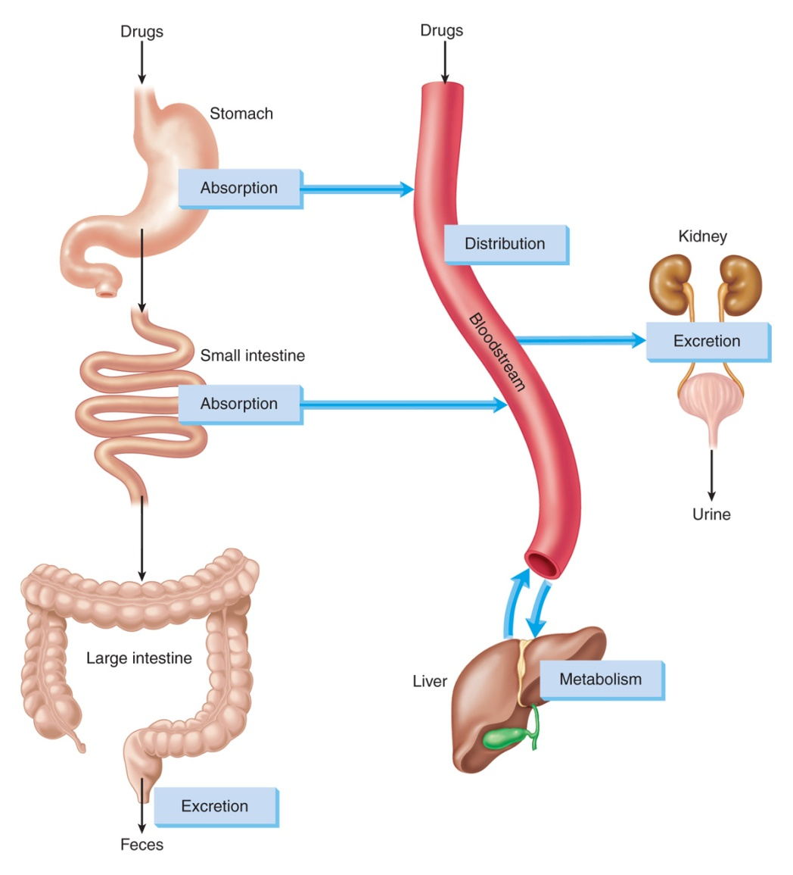
ADME
Adams et al. Pharmacology for Nurses: A Pathophysiologic Approach

Slide 20
Factors Affecting Drug Absorption
Route of administration
Drug formulation
Drug dosage
Digestive motility
Digestive tract enzymes
Blood flow at administration site
Degree of ionization of drug
pH of surrounding environment
Drug-drug interactions
Food-drug interactions
Dietary supplement/herbal product–drug interactions
Notes:
20

Slide 21
Bioavailability: The fraction of administered drug that reaches the systemic circulation.
Example 100 mg of a drug were administered orally, 70 mg of the drug were absorbed unchanged.
The bioavailability of this drug is 0.7 or 70%
For IV drug the bioavailability is presumed to be 100%

Slide 22
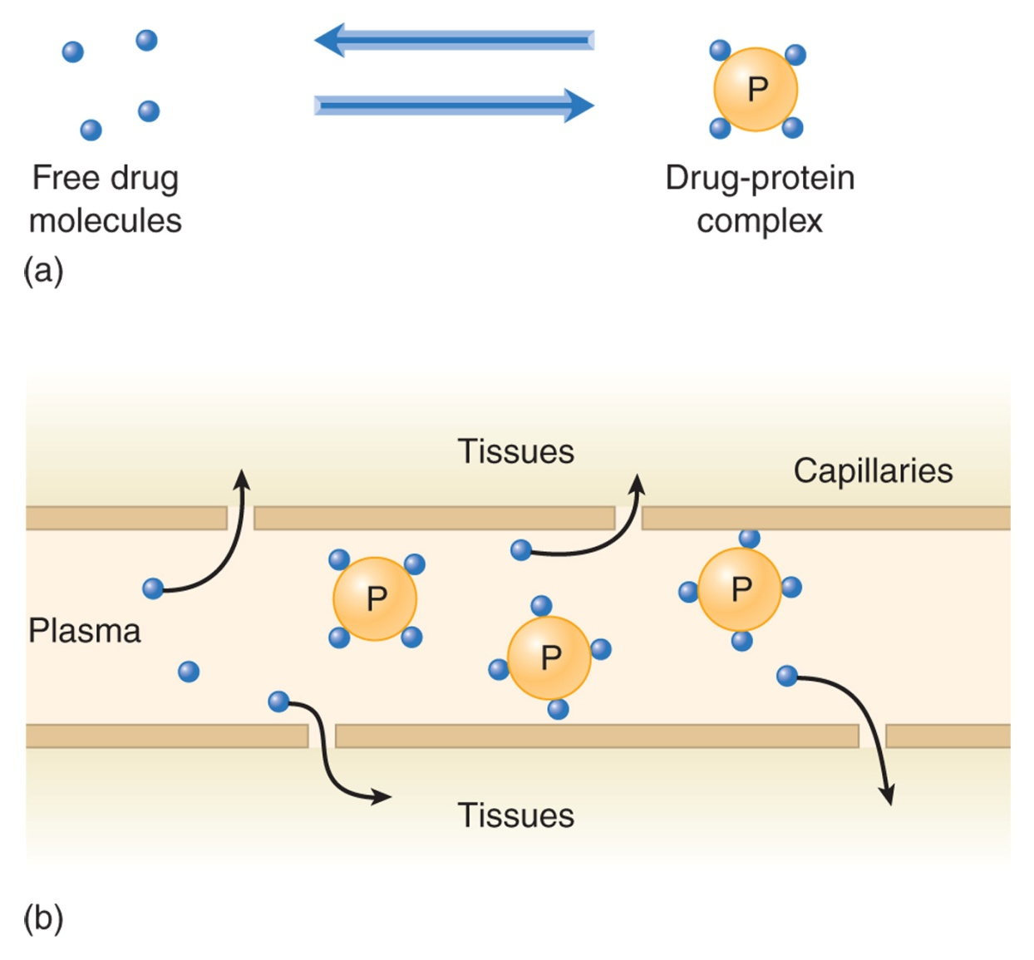
Drug Distribution
Adams et al. Pharmacology for Nurses: A Pathophysiologic Approach

Slide 23
Metabolism (Biotransformation)
Changes drug so it can be excreted
Involves biochemical reactions
Liver—primary site
Notes:
23

Slide 24
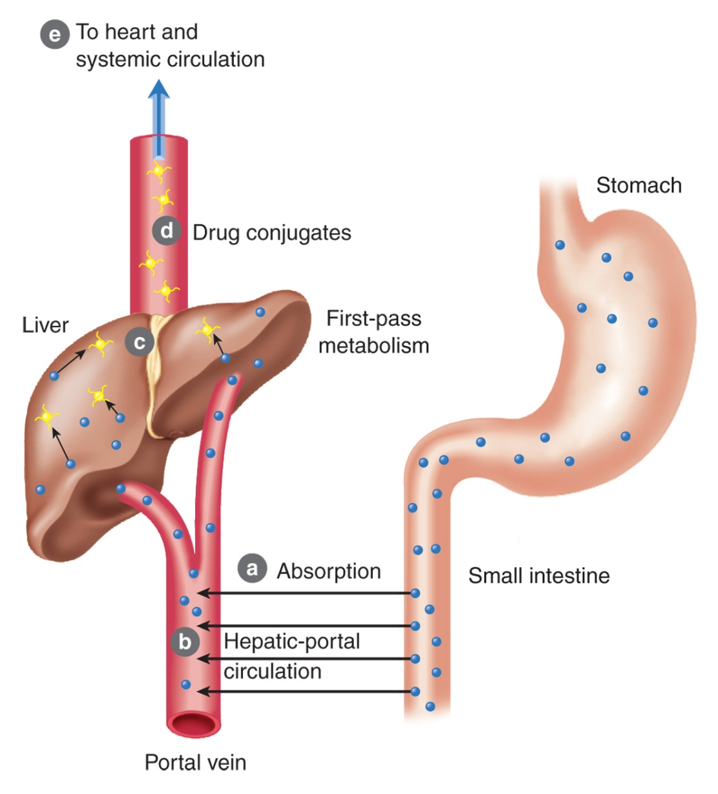
First-Pass Effect (oral drugs)
Drug absorbed
Drug enters hepatic circulation, goes to liver
Drug is metabolized to inactive form
Drug conjugates and leaves liver
Drug is distributed to general circulation
Adams et al. Pharmacology for Nurses: A Pathophysiologic Approach
Notes:
24

Slide 26
Excretion
Primary Site of Excretion of Drugs Is Kidneys
Ionized and water-soluble drugs are filtered
Secretion mechanism is less active in infants and older adults
Notes:
26

Slide 27
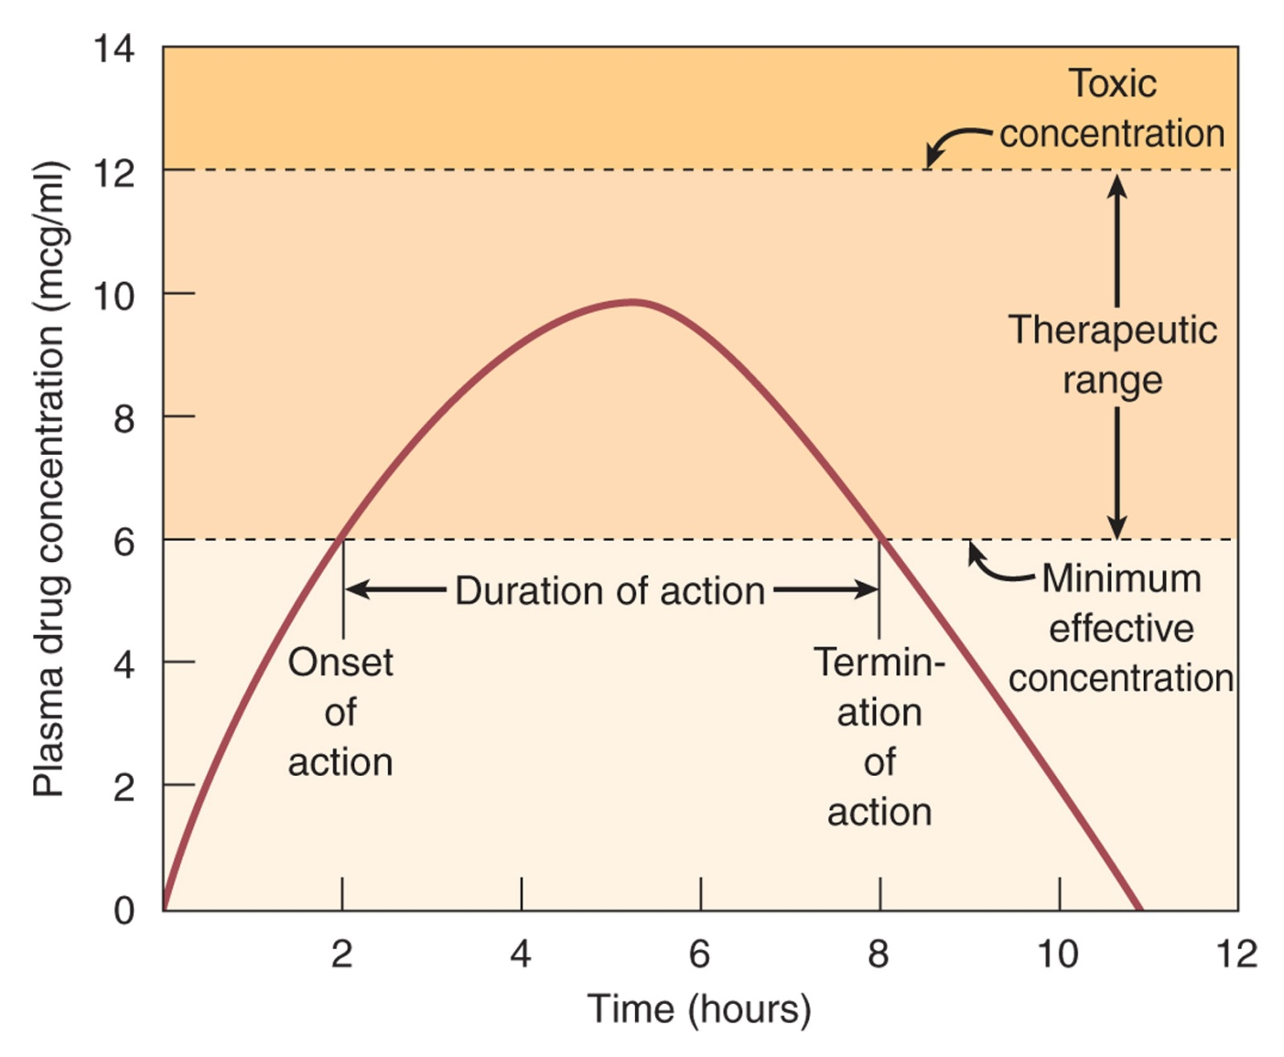
Adams et al. Pharmacology for Nurses: A Pathophysiologic Approach

Slide 28
Plasma Half-Life (t_{1/2}) of Drugs
Length of time needed to decrease drug plasma concentration by one half
The greater the half-life, the longer it takes to excrete
Determines frequency and dosages
Notes:
28

Slide 29
Pharmacodynamics

Slide 30
Pharmacodynamics
Pharmacodynamics: The action of a drug on the body and the influence of drug concentration on the magnitude of response
Most drugs cause their effects by interacting with Receptors (drug target)
Receptors are present on the cell surface or within the cell

Slide 32
Signal transduction
The process by which the drug receptor complex initiates alterations in biochemical or molecular activity of a cell
Harvey, R. A. et al. Lippincott's Illustrated Reviews

Slide 33
Agonist: An agent that binds to a receptor and causes a biological response
Antagonist: An agent (drug) that decreases or opposes the actions of another drug or endogenous ligand
An antagonists binds to a receptor and blocks its physiologic response
(e.g. Antihistamine, used for allergy)

Slide 34
Agonist: An agent that binds to a receptor and cause a biological response
Agonist: mimics the action of the original endogenous ligand on the receptor
(e.g. Norepinephrine on β-1 receptor of the heart)

Slide 35
The magnitude of the drug effect depends on:
The concentration of the drug at the receptor site which depends on:
The dose of the drug administered
The rate of the drug’s ADME

Slide 36
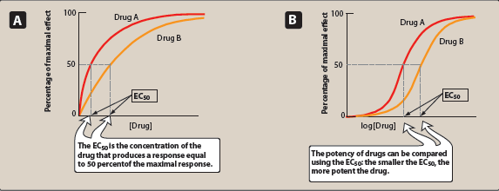
Dose Response curves
Potency: A measure of the amount of a drug needed to produce an effect of a given magnitude
Harvey, R. A. et al. Lippincott's Illustrated Reviews

Slide 37
Efficacy: The ability of a drug to produce a response when it interacts with a receptor
EC50: The drug concentration that shows 50% of maximal response
Harvey, R. A. et al. Lippincott's Illustrated Reviews

Slide 38
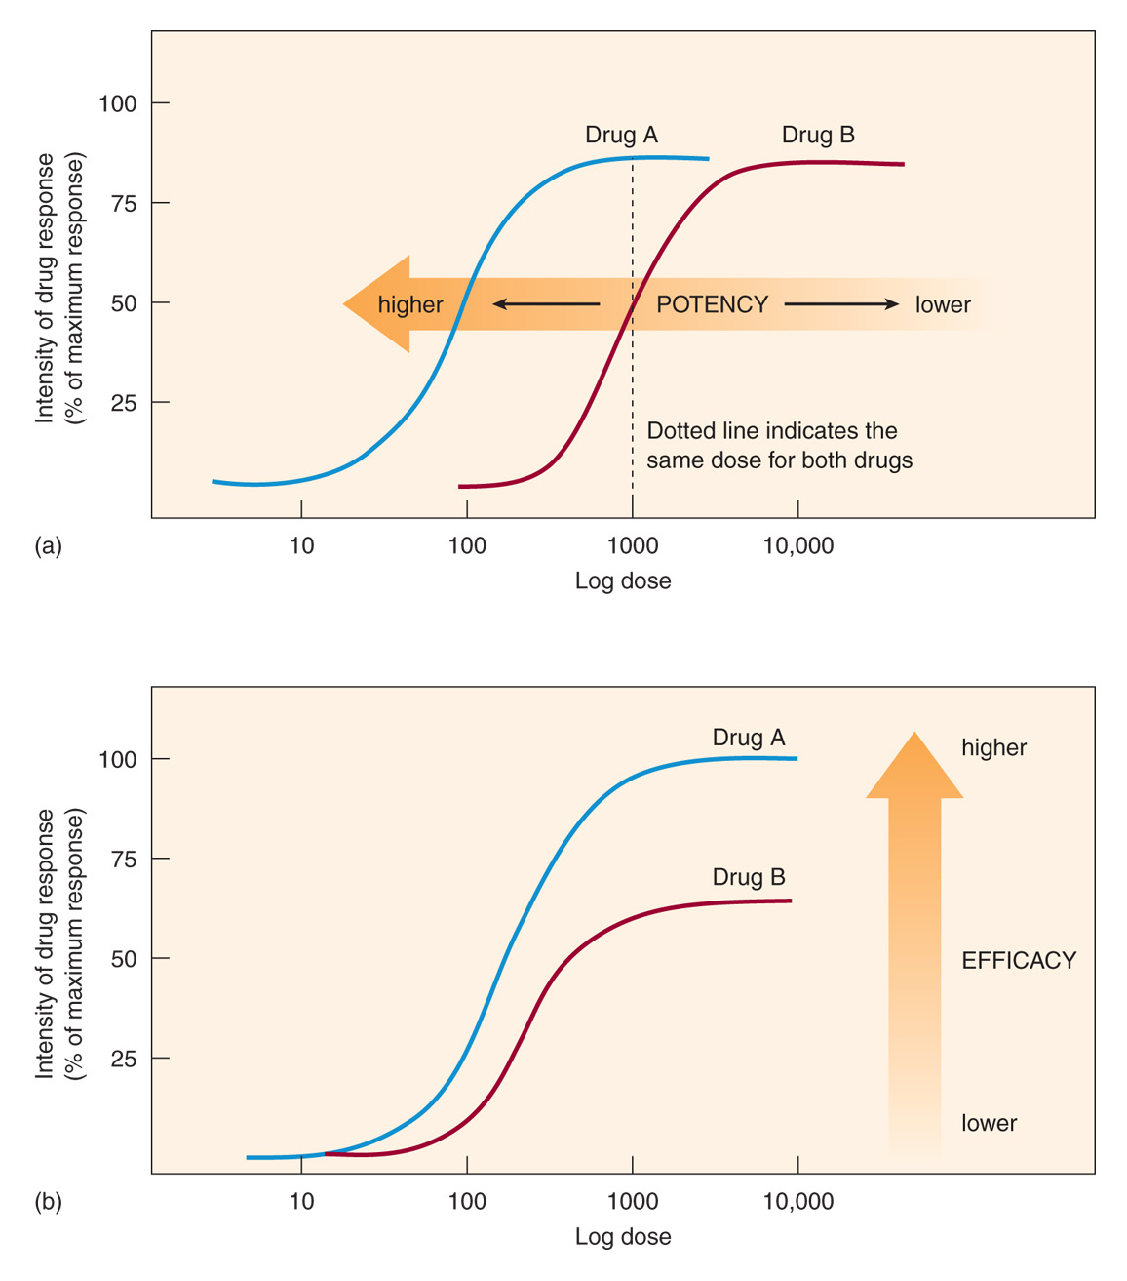
Adams et al. Pharmacology for Nurses: A Pathophysiologic Approach

Slide 39
Therapeutic index of a drug: the ratio of the dose that produces toxicity to the dose that produces a clinically desired or effective response in 50% of the population
Therapeutic index=
TD50: the drug dose the produces a toxic effect in 50% of the population
ED50: the drug dose the produces a therapeutic effect in 50% of the population
TD50
ED50

Slide 40
Therapeutic index is a measure of drug safety
A narrow therapeutic index drug
(e.g. warfarin, digoxin)
A large therapeutic index drug
more safe to use
(e.g. penicillin)
Harvey, R. A. et al. Lippincott's Illustrated Reviews

