Slide 1
School-Age Group

Slide 2
School age
The period from 6 years to the starting of adolescence phase (12 years)

Slide 3
Growth and Development of a
School-Age Child
Rate of growth slows relative to infancy & early childhood, cognitive growth and development continue to proceed at rapid rates.
Influenced by the attitudes of their friends.
•An adult vision level is achieved.
•Posture becomes more erect. lordosis and knock-knee appearance disappear.

Slide 4
Physical Growth
Lymphoid tissue reach of greater amount in
school than adult
lymphatic tissue continues to grow up until
about age 9.
Frontal sinuses develop at about 6 years, so sinus headache becomes a possibility (before that, headache in children is rarely caused by a sinus infection).

Slide 5
Height & Weight
Height and Weight: (age *5(2)+80(8)
Rate is roughly 6 cm in height and 2 kg per year
At 6 year around 117cm& 22kg in weight
At 12 year 150 cm & 44 kg in weight
Girls’ growth rate is faster than boys’ until roughly 12 year—possibly linked with puberty
Boys are taller and heavier while girls retain more fatty tissue

Slide 6
School-Age Children
Vital signs approach those in adulthood.
Pulse, 70 to 90
beats/min
Respiration rate, 18 to 20 breaths/min
Systolic blood pressure, 80 to 110 mm Hg
■ Temp: 98.6° F (37° C)
Source: © Trout55/ShutterStock, Inc.

Slide 7
Physical Development in Middle
Childhood
Age heart rate respiratory rate
Fetus | 140 | 40---50
Neonate | 120---140 | 40---50
Infancy | 110---130 | 30---40
Toddler | 100---120 | 25---30
Preschool | 80---100 | 20---25
School | 70---90 | 18---20

Slide 8
Motor Development
Gross Motor Development
Gross motor skills- muscle coordination improves so children can better learn to ride bikes, skate, skip rope, and swim
During middle childhood, running, jumping, hopping, and ball skills become more refined.
Steady improvements also occur in reaction time—11-year-olds can respond almost twice as quickly to a stimulus as 5-yedar olds.
8

Slide 9
Motor Development
Fine Motor Development
Fine motor skills- Myelin in the brain increases significantly from 6-8 years old so skills such as using a keyboard are easier to master
Gains are especially evident in writing and drawing.
6 years, easily tie their shoelaces. They can cut and paste well and draw a person with good detail.
7 years this has been called the “e raser year” because children are never quite content with what they have done.
9 years, their writing begins to look mature and less awkward.
9

Slide 10
Nutrition
Children need to eat more than preschoolers
Children need to eat breakfast before school
Most school children are not physically fit. Many children engage in sedentary leisure activities (e.g., TV, computer games). Parents need to be involved in the treatment of juvenile obesity
Tooth development: Beginning at 5 or 6 years, loss of primary teeth occurs at a rate of 4 teeth per year.
24 new teeth develop during this time span. Second and third molars (wisdom teeth) develop during adolescence
Fluoride in toothpaste and drinking water helps prevent tooth decay
10

Slide 11
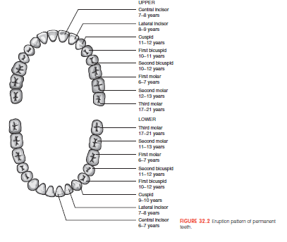
Eruption pattern of permanent teeth

Slide 12
Social Development
Family
Being accepted becomes very important
Friends
Friends become more important
The influence of family is not as strong as it used to
be
have same-sex friends
Share secrets with friends, Learned to share, learning to give a present without receiving one in return or doing a favor without expecting a reward is also a part of this process,
❑ School
11
Learn new things on his own

Slide 13
The Self
Self Regulation:
Increased capacity for self-regulation in middle and late childhood
Development of Self Understanding
Defining one’s ―self‖ shifts to using internal characteristics or personality traits.
Social comparison increases
Understanding Others
Children show an increase in perspective
taking
Children become increasingly skeptical of others’ claims

Slide 14
Peers
Positive relationships with peers are especially important in middle and late childhood
Three common values among 6 to 12 year-olds are:
❐ Protect friends
❐ Don’t tell adults what is happening
❐ Don’t be too different from your
peers

Slide 15
Emotional & Social Development
Children have to learn to cope with their feelings and the feelings of others through play. There are four
different types of play that young children engage in.
EXPLORING: An object or situation- finding out what happens if you touch or drop something.
PRACTISING: LEARNING TO COORDINATE MUSCLES AND ACTIONS
PRETENDING: use their imagination
SOCIAL LEARNING: play roles they have seen, such as teacher and students, doctors and patients.
14

Slide 16
Play
•To be a police officer, a 7-year-old needs a badge and gun,
whereas before a pointed finger sufficed .
Most girls and boys of this age also enjoy helping in the kitchen with jobs such as making cookies and salads
•8 -year -olds like table games but hate to lose.
•9-year -olds play hard. They wake in the morning, squeeze in some activity before school, and plan something the moment they arrive home again.
Many 10-year-olds spend most of their time playing television remote control games. Boys and girls play separately at age 10: children typically ready to play competitive board games
Eleven- and 12-year-old children enjoy dancing to popular
music and playing table games

Slide 17
Emotional Problems in Children
Externalizing behaviors – undesirable emotion, behavior, or a combination that affects other people (aggression, lack of control)
Internalizing behaviors – undesirable emotion, behavior, or a combination that primarily affects oneself (depression, Anxiety disorders, suicidal tendencies, & social withdrawal).

Slide 18
Emotional Problems in Children
Aggression:
Boys are more physically aggressive than girls
Girls show as much verbal aggression as boys
Emotion:
Girls admit to feeling sadness, shame, and guilt; boys tend to deny that they experience these emotions

Slide 19
Bullying
A form of aggressive behavior. Use of force to affect
others
Child bullies often tend to:
Have low grades in school
Use alcohol and/or tobacco
Outcomes of bullying:
More likely to experience depression, socially withdrawn, aggressive and attempt suicide
Be lonely and have difficulty making friends
More health problems (headaches, dizziness, sleep problems, anxiety)
Most children find ways to halt ongoing victimization by: ignoring; retaliating; defusing, &
Avoiding

Slide 20
School Aged Cognitive Development
latency period : School age is a process of resolving oedipal situation.
Less egocentric direct his energy to others
The conflict over
Industry/Accomplishment vs Inferiority
Industrious children build a sense of competence
and self-confidence.
Non-industrious children begin to develop inferiority complexes.
Sensitive of other’s opinions of him/her
Better self-control and frustration tolerance
Coping with stressful events
19

Slide 21
Cognitive Development
Concrete operational
―Black or white‖, ―right or wrong‖
Principle of CONSERVATION: Volume remains the same whether in a large container or small container ( 9 years).
At 6 year :obey command as open door ,know right arm
At 7 year read clock : do not understand property rights yet.
At 8 year Know month ,days ,number count from 1- 20
At 10-12 year write short letter to friends, use
telephone read story, books
20

Slide 22
Cognitive Development
Reading skills
Name numbers & letters easly
Read fluently & pronounce words correctly
❑ Thinking skills
Think logically, make sense of what is happening around him, orient time and place ,season, month
Ability to understand ideas & remember things improve
Place objects in order, or sort & group them, understand
past ,present future, Principles of addition & subtraction
Flow more complex directions & rules
❑ Thoughts & ideas
Develop fears of the unknown (may be afraid of ghosts, monsters, or dark places, understand bad events & may fear robbers, having injuries & death. Worry about how
does in school.
21

Slide 23
Moral Development
Lawrence Kohlberg’s Theory:
Before age 9, most children use level 1 (Preconventional reasoning: Act to avoid punishment and get what they want)
Children at mid school age follow a “fairness” level of moral reasoning : “It isn’t fair for some people to have more things than others.”
Laws are absolute principles
Punishment is given for breaking rule
Indignation with ―unfairness‖

Slide 24
Problems during School-age years
Emotional problems: Anxiety problems caused by school phobia (fear), or trouble keeping up in school.
Drug Abuse : airplane glue, cooking spray
Lack of sleep: Lack of sleep decreases child’s energy. This may lead to learning, and behavior problems.
Phobia from school manifested by vomiting abdominal pain, regression : insist the child attend school, as the more missed, the harder the adjustment.
Behaviours problems: Lying, Cheating,
&stealing (7year).

Slide 25
Problems during School-age
years:
Learning Disabilities: difficulties in the use of listening, speaking, reading, writing, reasoning, or mathematical abilities (decreased ability to think, learn, & remember).
Attention-Deficit Hyperactivity Disorder (ADHD) - a learning disability marked by a combination of overactivity inattention, impulsiveness, a low tolerance for frustration, and a great deal of inappropriate activity. More common in boys than girls
Often treated with stimulant drugs, instructions on regulating behavior, and parent training

Slide 26
Problems during School-age years
Poor nutrition or not enough physical activity: prefer fast food or junk food, or lack physical activity. This can result to being underweight, overweight. These conditions lead to medical problems, such as diabetes, hypertension (high blood pressure), and hyperlipidemia (high blood cholesterol).
Social problems: Poor behavior may cause problems with social skills. This is often seen in children with certain medical conditions, such as attention deficit hyperactive disorder (ADHD). Being rejected by other children may also lead to
emotional problems.

Slide 27
Problems during School-age
years
Injuries are the leading cause of death during
middle and late childhood
❐ Motor vehicle accidents are most common
cause of severe injury: Look both ways before crossing the street.
Fires, burns, drowning, and gun-related deaths follow in frequency
Cancer is the leading cause of death in children 5–
14 years old
❐ Most common child cancer is leukemia
Many elementary-school children already possess
risk factors for cardiovascular disease

Slide 28
How can help child during school-
age years
Encourage child to exercise for at least one hour everyday. Computer and video games should only be used for 1 to 2 hours a day or less.
Encourage child to try different creative activities. All activities should be fit to your child's age.
Assurance for School-aged children that they are loved and safe is important.
Get involved in child’s activities. Spend
time with him, Get to know his friends.

Slide 29
Preparing the School-Aged Child
for Hospitalization
Make sure your child eats a variety of healthy foods each day. Limit the amount of foods high in fat and sugar. Make sure your child eats breakfast to give him energy for the rest of the day. Have him sit with the family at mealtime even if he does not like to eat.
Make sure your child gets enough sleep (about 10 to 11 hours) every night. Schedule his sleep with the same bed time and wake time each day.
Time out may be used as a way to discipline your child. Do not criticize or show disapproval when he has done something wrong. Explain what you would like him to do instead, and tell him why.

Slide 30
Nursing Interventions to Reduce Fear
Approach with a smile and introduce self
Allow child to:
Keep parent or guardian close
Keep favorite toy or blanket
Provide a tour
Allow child to touch and see equipment
Assign the same nurse when possible
Can participate in care and treatment
Understand written and verbal instructions

Slide 31
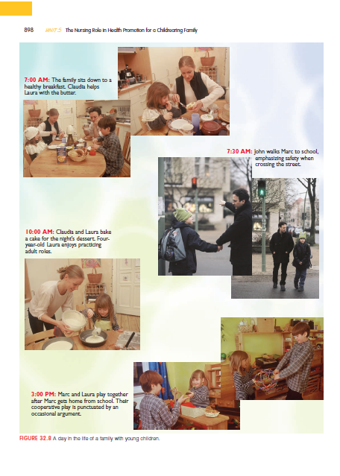
School aged children daily life

Slide 32
Red flags: school age
School failure
Lack of friends
Social isolation
Aggressive behavior: fights, fire
setting, animal abuse
30

