Slide 1
1

Slide 2
Infant
or
the
infancy
period:
•
Is the period that start from
28 days
life.
of
life through the first year
Hallmarks of infancy are:
of
-
-
-
-
Physical growth
Motor development
Vocal development
Cognitive and Emotional/social
development
2

Slide 3
Infant
Physical
Growth
–
Growth best marker of nutritional status
• Evaluated using growth charts
Weight gain
–
• Double birth weight by 6 months
• Triple birth weight by 12 months
Length gain
–
• Increase length by 50% by 12 months
Head circumference
–
–
Body Mass Index
3

Slide 4
Physical
Growth
Weight
•
Most infants double their birth weight at 6
months and triple it by 1year.
•
All children shall fall between
5th
to
95th
percentile according to growth chart.
•
The average 1-year -old boy weighs 10 kg; the
average girl weighs 9.5 kg.
4

Slide 5
Length
•
Increases in length during the first year by 50%.
•
Infant growth is most apparent in the trunk during
the early months. During the second half of the first
year , it becomes more apparent as lengthening of
legs.
Length increases 2.5 cm each month in the first 6
the
•
months of life.
•
And increases 1.5 cm each month in the second 6
months of lif e (shall know birth ’s length)
•
Using growth chart (must fall between 5th to 95th
Percentile).
5

Slide 7
Head Circumference
•
Head circumference increases rapidly during the
infant period, reflecting rapid brain growth. By
the end of the first year , the brain has already
reached two thirds of its adult size.
Children head circumference increases 2 cm each
•
month in the first 6 months of life.
•
And increase 0.5 cm each months in the second
6
month of the first year (shall know head
circumference at birth).
•
Some infants' heads appear asymmetric until
the second half of the first year. This may
occur from always being placed in one sleeping
position. Suggest to parents that they place the
infant on the back to sleep and prone when playing
7

Slide 8
Body
Systems
•
In the cardiovascular system, heart rate slows to 100
to 120 bpm by the end of the first year .
•
A slightly elevated blood pressure to 100/60 mm Hg.
•
The respiratory rate of an infant slows to 20 to 30
breaths/min by the end of the first year.
•
The ability to adjust to cold is mature by age 6
months. By this age, an infant can shiver in response to
cold (which increases muscle activity and provides
warmth) and has developed additional adipose tissue to
serve as insulation. The amount of brown fat, which
protected the newborn from cold, decreases during
the first year .
8

Slide 9
Teeth
–
The first baby tooth usually erupts at age 6
months, followed by a new one monthly, lower
erupts first (6-10 mo) then the upper (8-12mo)
–
Some newborns may be born with teeth (called
natal teeth) or have teeth erupt in the first 4
weeks of life (called neonatal teeth) .
– Most infants have little difficulty with teething,
but some appear very distressed.
– Generally, the gums are sore and tender before a
new tooth breaks the surface. As soon as the tooth
is through, the tenderness passes.
–Acetaminophen, 10 to 15 mg/kg every 4 hours, up to
four times a day, may be used for teething
discomfort.Teething rings that can be placed in the
refrigerator provide soothing coolness against the
9
tender gums.

Slide 10
Nutrition
during
infancy
•
Without proper nutrition, infants cannot reach their
physical potential and also may suffer cognitive and social consequences.
• Malnutrition & It’s Effects
Malnutrition, the condition of having an improper
•
amount
results.
and
balance
of
nutrients produces several
-
-
-
slower growth
susceptibility to disease lower IQ scores
10

Slide 11
Vitamins and Minerals for
Infants
•
Vitamin D
– concern if no sunlight; dark skin;
mom
is
deficient
– at risk
Vitamin
– single
Vitamin
infants---supplement
K
dose at birth
B-12
•
•
– breastfed by a vegan mom may need supplement
Iron
– breastfed OK for 6 months; formula-include iron
Fluoride
•
•
– supplement at 6 month if no fluoride in w¹¹ater
11

Slide 12
•
Readiness for Solid Foods
•
Increased digestive enzymes
– so solid foods can be digested with
Loss of extrusion reflex
ease
•
– infant’s tongue pushes the spoon and food back out
– need to be able to transfer food from
to the back
Able to sit without support Purposefully bring hand to mouth Age of about 4-6 months
front
of
mouth
•
•
•
12

Slide 13
Feeding schedule
4-6 months: Baby rice cereal
• iron-fortified; hypoallergenic
• mix with breast milk or formula without added sugar
Add one food at a time
•
salt or
•
• see how tolerates foods and watch for allergic reactions
Strained vegetables, fruits, meats
•
•
•
6-7 months: infant spoon and cup with
8 months: pick up small pieces of food
is able to sit up
9-12 months: soft foods; table foods
NO cow’s milk, egg whites, ?wheat?
spout
when
lid
infant
•
13
•

Slide 14
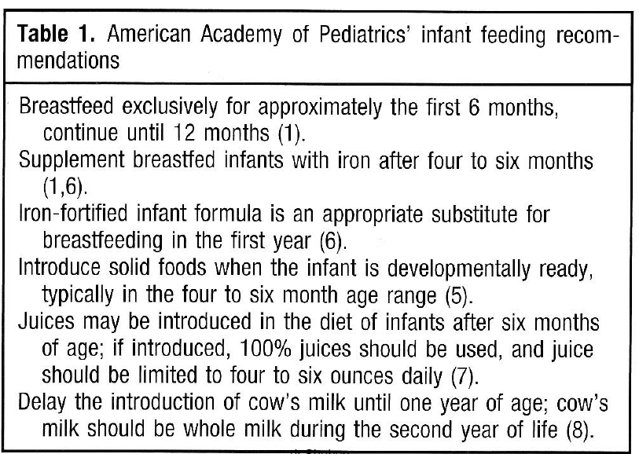

Slide 15
Infants: Foods to Avoid
•
Avoid Honey and Corn Syrup
– contain spores of Clostridium botulinum, in infants can cause botulism, a deadly food borne illness
Avoid high risk choking foods
– hotdogs, nuts, raw carrots, raisins, apple chunks, popcorn, gum, grapes, plain peanut butter,
Don’t leave baby alone during feeding
•
₁₅ •

Slide 16
Infancy
•
Feeding
problems
16
during infancy
–
–
Colic
Baby bottle
Syndrome
Diarrhea
Failure to thrive
–
–
16

Slide 17
Colic
•
Colic is paroxysmal abdominal pain that. The cause of
colic is unclear. It may occur in susceptible infants
from overfeeding or from swallowing too much air
while feeding ( common on Formula-fed babies) with normal bowel sound .
Loose Stools
•
Stools of breast- fed infants are generally softer
than those of formula-fed infants. If a mother takes
a laxative while breast- feeding, an infant 's stools
may be very loose.
An infant who is formula- fed can have loose stools if
the formula is not diluted properly. Occasionally,
loose stools may begin with the introduction of solid
food, such as fruit .
•
•17

Slide 18
Baby-Bottle Syndrome
•
Putting an infant to bed with a bottle can result in
aspiration or decay of teeth. Decay occurs because
while an infant sleeps, liquid from the propped bottle
continuously soaks the upper front teeth and lower
back teeth ( the lower front teeth are protected by
the tongue).
is most serious when the bottle is filled with sugar
water, formula, milk, or fruit juice. The carbohydrate
in these solutions ferments to organic acids that
demineralize the tooth enamel until it decays.
To prevent this problem, advise parents never to put
their baby to bed with a bottle.
If parents insist a bottle is necessary to allow a baby
to fall asleep, encourage them to fill it with water and
use a nipple with a smaller hole to prevent the baby
from receiving a large amount of fluid.
•
•
•
18

Slide 19
Baby-Bottle Syndrome

Slide 20
Body
Mass
Index
Formula used to assess nutritional status of
child
➢ Be sure weight in kg & height in meters
➢ Duplicate height in meters
➢ Divide weight by height in meters squared
➢ Children should normally fall between
-95th percentile
10th
➢ <
19
95th
over nutrition, >
10th
under nutrition

Slide 21
Motor Development
During the first year babies learn to control their
•
muscles
muscles,
and
movements.
The
control
of
large
such as in the
arms and legs (sitting,
walking) is called GROSS MOTOR SKILLS.
•
The control of
smaller muscles and movements,
such as
those
FINE
in the fingers (grasping
an
object)
is
called
MOTOR
SKILLS.
20
20

Slide 22
Gross
Motor
Development
•
3 months: Holds head steadily when
held up; Lifts head and chest when lying on stomach
6 months: easily lifts head, chest and
•
upper
abdomen and
can bear
weight
on
arms
21
Head Control
Age 6 months
Newborn

Slide 23
Sitting
up
•
2months old:
needs assistance
6 months old: can sit alone in the tripod position
8 months old: can sit without support and engage in play
Age
2
months
•
•
Age 8 months
22

Slide 24
Nine to 12-
months
Ambulation
•
•
9 month old: crawl
1 year: stand independently from a crawl position
13 month old: walk
and toddle quickly
15 month old: can run
13 month old
•
•
23

Slide 25
Fine
Motor
-
Infant
•
Newborn has very little control.
Objects will be involuntarily grasped and dropped without notice.
6 month old: palmar grasp – uses entire hand to pick up an object
9 month old: pincer grasp – can grasp small objects using thumb and forefinger
•
6-month-old
•
•
1 year old: transfer
hand to hand
objects from
12-month-old
24

Slide 26
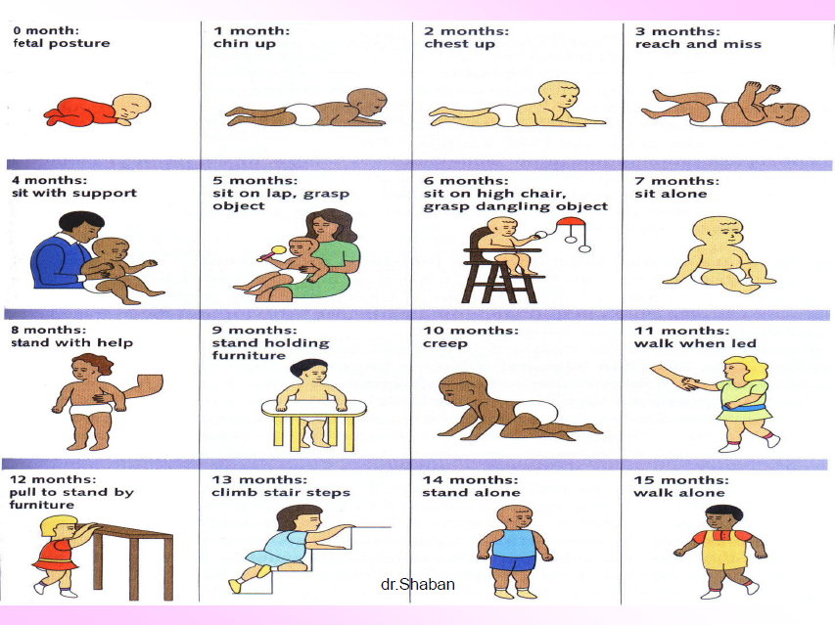
o
month:
1 month:
chin up
2 months:
chest up
3 months:
reach and miss
fetal posture
4 months:
sit with support
5 months:
sit on lap. object
6 months:
sit on high chair,
7 months:
sit alone
grasp
grasp dangling
object
8 months:
standwith help
9 months:
stand holding furniture
10 months:
creep
11 months:
walk when led
12 months:
pull to stand by furniture
13 months:
climb stair steps
14 months:
stand alone
15 months:
walk alone
25
dr.Shaban
25
25

Slide 27
INTELLECTUAL DEVELOPMENT
The most important intellectual development a child makes is the ability to use and understand language.
•
Babies understand simple words such as ‘bye-bye’ at
6 - 9 months.
– Infant’s ability to recognize native language
– 10-12 months: May say a few words (Babbling: Make
the sounds of all languages; Holophrases: One
is used to mean a whole sentence
On average, a child
word
•
–
–
Understands about 50 words at age 13 months
Speaks first word at 10–15 months of age
26

Slide 28
Cognitive
Development
•
Cognition begins with alertness, awareness,
recognition, and interest in visual, auditory, and
tactile (touch) stimuli.
As motor development
improves, the infant begins to explore and
manipulate objects.
Infants develop object
permanence toward the end of the first year.
children make the A-Not-B error, the tendency to reach to where objects have been found before, rather than to where they were last hidden.
27

Slide 29
PERCEPTUAL DEVELOPMENT
•
Hearing
–
–
Sound supports visual and tactile exploration.
Ability to identify location of sound improves over the first 6 months.
–
By 6 months, babies "screen out" sounds
used in their language.
By 6 to 12 months, infants focus on larger speech units critical for meaning.
not
–
28

Slide 30
Vision
By 2 months, infants focus on objects and
discriminate colours well.
By 11 months, visual acuity reaches a near-adult level.
Depth Perception
•
•
•
–
Crawling infants distinguish deep and shallow
surfaces and avoid dangerous-looking drop- offs. “Babies avoided reaching over risky gaps in the sitting posture but fell into risky gaps while attempting to reach in the crawling posture…
29

Slide 31
Emotional/Social Development
The most important social task is the development of attachment
to the primary caretaker, most often the child's mother.
The development of basic trust, a derivative of the positive
•
•
attachment between
during the first year. development.
2-3 mos.
the infant and the primary caretaker, occurs
This is a cornerstone of emotional
Social smile, respond to facial
expression;
3-4 mos.
6-8 mos.
Makes
different crying sounds for different reasons
Laugh at active stimuli
Anger, fear, attachment; Stranger anxiety;
Can tell
8-12 mos.
the difference between family members
Social referencing: Reading others’
emotional cues to determine how to respond to a situation
30

Slide 32
SOLITARY PLAY
•
Normally
occurs during
infancy,
infants will
play
by
themselves.
7-8 months: Tries to imitate sounds
11-12 months: Spends time looking
Infants are ready for a variety of
objects to handle, these objects
should be small enough an infant
can lift them with one hand, enjoy
a teething ring to chew on at
this time ; interested in brightly
colored balls or toys; enjoy
putting things in and taking
things out of containers.
made by adults
in
mirrors
•
31
31

Slide 33
32
Temperament
Types
Flexible Fearful Feisty
Regular rhythms Adapts slowly Active
Positive mood Withdraws Intense
Adaptability Distractible
Low intensity Sensitive
Low sensitivity Irregular
Moody

Slide 34
33
Temperament
Types
Flexible,
Fearful,
and
Feisty

Slide 35
Teaching, Infant Safety
•
Teaching, infant safety, is defined as instruction on
safety during the first year of life .Some important
activities involved when implementing this
intervention include instructing the parent
in the following at:
0 to 3 months
/caregiver
•
•
•
Using car seat
Putting infant to sleep on back
Checking temperature of formula and bath
water
4 to 6 months
•
•
•
Never leaving infant unattended in tub
Using a safe highchair
Removing small objects from infant 's reach
34

Slide 36
Teaching, Infant Safety
•
•
•
•
•
7 to 9 months
Providing barriers to potentially dangerous areas
Supervising infant's activity at all times
10 to 12 months
Providing protection from glass furniture, sharp
edges
Storing all cleaning supplies out of infant's reach
•
•
•
Preventing infant's access to balconies, and
Selecting toys according to manufacturer's
recommendations
stairs
age
35

Slide 37
Red
Flags
in
infant
development
Unable to sit alone by age 9 months
Unable to transfer objects from hand
hand by age 1 year
•
•
to
•
Abnormal pincer grip or grasp by age
15 months
•
•
Unable to
Failure to
2 years.
walk alone by 18 months
speak recognizable words by
36

