Slide 1
Correlation and linear regression

Slide 2
Correlation
Studies the relationship between two continuous variables.
It answers the question: Is there a linear association between the variables?

Slide 3
Packed cell volume (PCV) and Hb
18.00
16.00
Hb
14.00
12.00
10.00
25.00
30.00
35.00
40.00
45.00
50.00
55.00
PCV

Slide 4
Packed cell volume (PCV) and Hb
r (correlation coefficient) = 0.67
18.00
r indicates how linear is the
relationship
16.00
Hb
14.00
r indicates the strength of the
relationship.
12.00
10.00
r is a dimensionless quantity ranging from (-1 to +1)
25.00
30.00
35.00
40.00
45.00
50.00
55.00
PCV
r is not scale dependent

Slide 5
Packed cell volume (PCV) and Hb
The square of the correlation coefficient gives the proportion of the variation of one variable ”explained” by the other.
Thus (0.67)² =0.45 or 45% of the variability of hb can be explained by PCV or vice versa.
18.00
16.00
Hb
14.00
12.00
10.00
25.00
30.00
35.00
40.00
45.00
50.00
55.00
PCV

Slide 6
When not to use the correlation coefficient?
If the relatioship is non-linear.
In situations where one of the variables is determined in advance.
Used with caution in the presence of outliers.
Used with caution when the variables are measured over more than one distinct group.

Slide 7
Pearson Correlation coefficient
r = Σ(x-x)(y-y)
√{Σ(x-x)²Σ(y-y)²}

Slide 8
Tests of significance
We want to test whether the observed correlation could have arisen by chance.
H₀ : r = 0.
H_{A} : r ≠ 0.
To test whether this is significantly different from zero...
t = r / SE(r) SE(r) = √{(1-r²)/(n-2)}

Slide 9
Tests of significance-example
r = 0.67
t = 2.83
df = 20-2= 18
P= 0.01
df= n-2
There is a correlation of 0.67. The probability of such a
correlation arising by chance when there is in fact
no relation is only 1%. Thus we reject the null hypothesis
and accept that Hb and PCV are associated.

Slide 10
Other types of correlation coefficients
Spearman correlation used for ranked data.
Point biserial correlation coefficient: to describe correlation between quantitative data ( annual income) and qualitative data with only two categories ( male & female)
Cramer ’s phi coefficient: to describe the relationship between two qualitative variables such as ethnic background and attitude towards legal abortions.

Slide 11
Regression

Slide 12
Regression

Slide 13
Regression what for?
Have 2 continuous variables and want to study the relationship between them.
Want to study the effect of one variable on the other!
In correlation between x and y we are not interested in
whether y predicts x or vice versa.
In regression we assume that a change in x will lead directly
to a change in y.
X = independent variable y = dependent variable

Slide 14
Hemoglobin and age
18.00
HB (g/dl)
16.00
14.00
12.00
10.00
20
30
40
50
60
70
Age (years)

Slide 15
Hemoglobin and age
18.00
HB (g/dl)
16.00
14.00
12.00
10.00
20
30
40
50
60
70
Age (years)

Slide 16
Regression from sample to population
18.00
y = α + βx
16.00
HB (g/dl)
α is the intercept
14.00
12.00
β is the regression coefficient
10.00
20
30
40
50
60
70
Age (years)
β is the slope of the line . When x increases by 1 unit y changes by β units.

Slide 17
Least square method
The best line is caculated by using the least square method.
18.00
HB (g/dl)
16.00
14.00
Y = mean of y
12.00
E=y-y’: y’ is the point on the line.
10.00
20
30
40
50
60
70
Age (years)

Slide 18
Least square method
y-y = (y-y’) + (y’-y)
Σ (y-y)² = Σ(y-y’)² + Σ (y’-y)²
TSS = ESS + RSS
Regression sum of squares
Total sum of squares
Error sum of sqaures

Slide 19
Least square method
TSS = ESS + RSS
TSS = ESS +RSS
1 = ESS + R²
This is always greater
than zero
TSS
TSS
TSS
Not more than 1!
The closer this to 1 the greater the points are explained by the regression line!
TSS

Slide 20
Least square method
0 ≤ R ² ≤ 1
R² is called the coefficient of determination.
When we have simple linear regression then:
R²: is the square of the correlation coefficient

Slide 21
Least square method
TSS = ESS + RSS
TSS is an expression of the total variation of the y’s.
ESS is an expression of the total variation of y’s which can’t be explained by the regression line.
RSS is an expression of that part of the total variation of the y’s which can be explained by the regression line

Slide 22
Regression coefficient
β = Σ (x-x)(y-y)
Σ(x-x)²

Slide 23
Tests of significance
We are interested in estimating α and β ..... from a and b.
Y = a + bx
y = α + βx
H₀ : β = 0
H_{A} : β ≠ 0

Slide 24
Tests of significance
To test the hypothesis that there is no association between hemogloin and age
t-statistic = b/SE(b) df= n-2
b= 0.134, SE(b)= 0.017, df= 18. t = 7.84. , P < 0.001
We expect hb to increase by 0.134 g/dl for every year of age

Slide 25
Confidence intervals
A 95% confidence interval for β is given by
b –t_{(0.05)} x SE(b) to b+t _{(0.05)} x SE(b)
0.134 – 2.101 x 0.017 to 0.134 + 2.101 x 0.017
95% CI = (0.10 to 1.17 )

Slide 26
Multiple regression
y = α + β₁x₁ + β₂x₂ + ... + β_{k}x_{k}

Slide 27
Multiple regression
y = α + β₁x₁ + β₂x₂ + ... + β_{k}x_{k}

Slide 28
What is multiple regression used for? Example
To look for relationships between continuous variables, allowing for a third variable (adjusting for confounders)
Is the relationship between hb and PCV only apparent because they both increase with age?
Hb = 5.59 + 0.205 (PVC)

Slide 29
What is multiple regression used for? Example
Is the relationship between hb and PCV only apparent because they both increase with age?
Hb= α + β₁ (age) + β₂ (PVC)
Hb= 5.24 + 0.110 (age) + 0.097 (PVC)

Slide 30
Conclusions
Correlation and regression are used to study the associations between continuous variables.
Correlation is used for studying the strength and linear associations between 2 variables.
Regression is used to study variables where one variable is believed to be a direct cause of the other.
Multiple regression is a very good tool for studying the relationship between factors and adjusting for confounders.

Slide 31
Logistic Regression

Slide 32
Measures of disease frequency

Slide 33
Measures of disease frequency
Risk = incidence proportion = cumulative incidence

Slide 34
Measures of disease frequency
Risk- the probability of a person developing a certain disease or condition.
Number of subjects developing disease during a time period
Risk=
Number of subjects followed for the time period
Measuring an event- onset of disease, death from a given disease, or any event that marks a health outcome!
Have to specify a period of time- otherwise risk values are meaningless!!!

Slide 35
Measures of disease frequency Risk
e.g- oral contraceptive use and bacteriuria
Total population 2390 women
482 were OC users in 1973 of which 27 developed bacteruria in 1976
Risk of bacteruria among OC users=27/482=5.6% during this 3 –year period.

Slide 36
Measures of association

Slide 37
Measures of association
The central objective of epidemiology is to study the cause of disease----
exposure disease
What do you compare???
Risk in exposed with the risk of nonexposed----- in a single summary parameter!!!
Relative Risk RR

Slide 38
Relative risk
Relative Risk = risk in exposed/ risk in unexposed
R_{e}
RR
=
R_{o}
How much more likely one group is to develop a disease than another!!!

Slide 39
Relative risk 2x2 table
Disease
Yes
No
a
b
Yes
exposure
c
d
No
Risk in exposed / risk in non exposed = a / (a+b)
c / (c+d)

Slide 40
Relative risk-example
bacteruria
Yes
No
Yes
27
455
OC use
77
1831
No
104
2286
RR= 27/482 / 77/1908 = 1.4 40% increase in risk!!!
RR= 1 no risk
RR > 1 increased risk
RR < 1 decreased risk

Slide 41
Case-control study-OR
Exposure Disease Investigator

?
?
In a case-control study, participants are selected on the basis of disease status- not possible to calculate risk of disease- but RR can be estimated by calculating the ratio of the odds of exposure among cases to that among controls.
Odds of exposure among cases
OR =
OR~RR
Odds of exposure among controls

Slide 42
2 x 2 table OR
Disease
Yes
No
a
b
Yes
exposure
c
d
No
OR= a/c
= ad/cb
b/d

Slide 43
OR- Example
Myocardial infarction
Yes
No
23
304
Yes
OC users
133
2816
No
156
3120
OR= a/c
= ad/cb =23x2816/ 133x 304 = 1.6
b/d

Slide 44
Measures of association
Relative effects- strength of association
RR- relative risk – R_{e}/R_{o} –measures the strength of association between exposure and disease
In case- control studies- OR~RR = odds of exposure among cases/ odds of exposure among controls

Slide 45
Logistic Regression
In linear regression the dependent or outcome variable must be continuous. In clinical research, the outcome variable in a relationship will often be Binary.

Slide 46
Logistic Regression
1.00
A
A
A
A
A
A
A
A
A
A
A
A
A
A
A
A
A
A
A
A
A
A
A
A
A
A
A
A
A
A
A
A
A
A
A
A
A
A
A
A
A
A
A
A
A
A
A
A
A
A
A
A
A
A
A
A
A
A
A
A
A
A
A
A
A
A
A
A
A
A
A
A
A
A
A
A
A
A
A
A
A
A
A
A
A
A
A
A
A
A
A
A
A
A
A
A
A
A
A
A
A
A
A
A
A
A
A
A
A
0.75
Smoking status
0.50
0.25
0.00
A
A
A
A
A
A
A
A
A
A
A
A
A
A
A
A
A
A
A
A
A
A
A
A
A
A
A
A
A
A
A
A
A
A
A
A
A
A
A
A
A
A
A
A
A
A
A
A
A
A
A
A
A
A
A
A
A
A
A
A
A
A
A
A
A
A
A
A
A
A
A
A
A
A
A
A
A
A
A
A
A
A
A
A
A
A
A
A
A
A
A
A
A
A
A
A
A
A
A
A
A
A
A
A
A
A
A
A
A
A
A
A
A
A
A
A
A
A
A
A
A
A
A
A
A
A
A
A
A
A
A
A
A
A
A
A
A
A
A
A
A
A
A
A
A
A
A
A
A
A
A
A
A
A
A
A
A
A
A
A
A
A
A
A
A
A
A
A
A
A
A
A
A
A
A
A
A
A
A
A
A
A
A
A
A
A
A
A
A
A
A
A
A
A
A
A
A
A
A
A
A
A
A
A
A
A
A
A
A
A
A
A
A
A
A
A
A
A
A
A
18.00
20.00
22.00
24.00
age

Slide 47
Logistic Regression
In linear regression………………
y = α + β₁x₁ + β₂x₂ + ... + β_{k}x_{k}
In logistic regression……………………
P (Y = 1) = (e ^{β0 +β1x}) / (1+e^{β0 + β1x})
Probability that Y=1 for a given value of X

Slide 48
Logistic Regression
The value of P(Y=1) is restricted by the maths of the logistic model to lie between zero and one, which is what we want, since it is a probability.
P (Y = 1) = (e ^{β0 +β1x}) / (1+e^{β0 + β1x})
e is the exponential operator, equal to 2.7183
There is no restriction on the type of independent variable- can be nominal, ordinal or continous

Slide 49
Example
Study about breast cancer and OCP(oral contraceptive pill).
Outcome variable: Y =1 (malignant)
Y =0 (benign)
Independent variable- ever used a OCP?
YES= 1, NO= 0
P (Y = 1) = (e ^{β0 +β1x OCP}) / (1+e^{β0 + β1xOCP})

Slide 50
Example ...ctd...
In linear regression we use the least squares method to estimate the regression parameters β0 and β1.
In logistic regression we use the maximum likelihood estimation. Essentially this means choosing the population which is most likely to have generated the sample results observed.

Slide 51
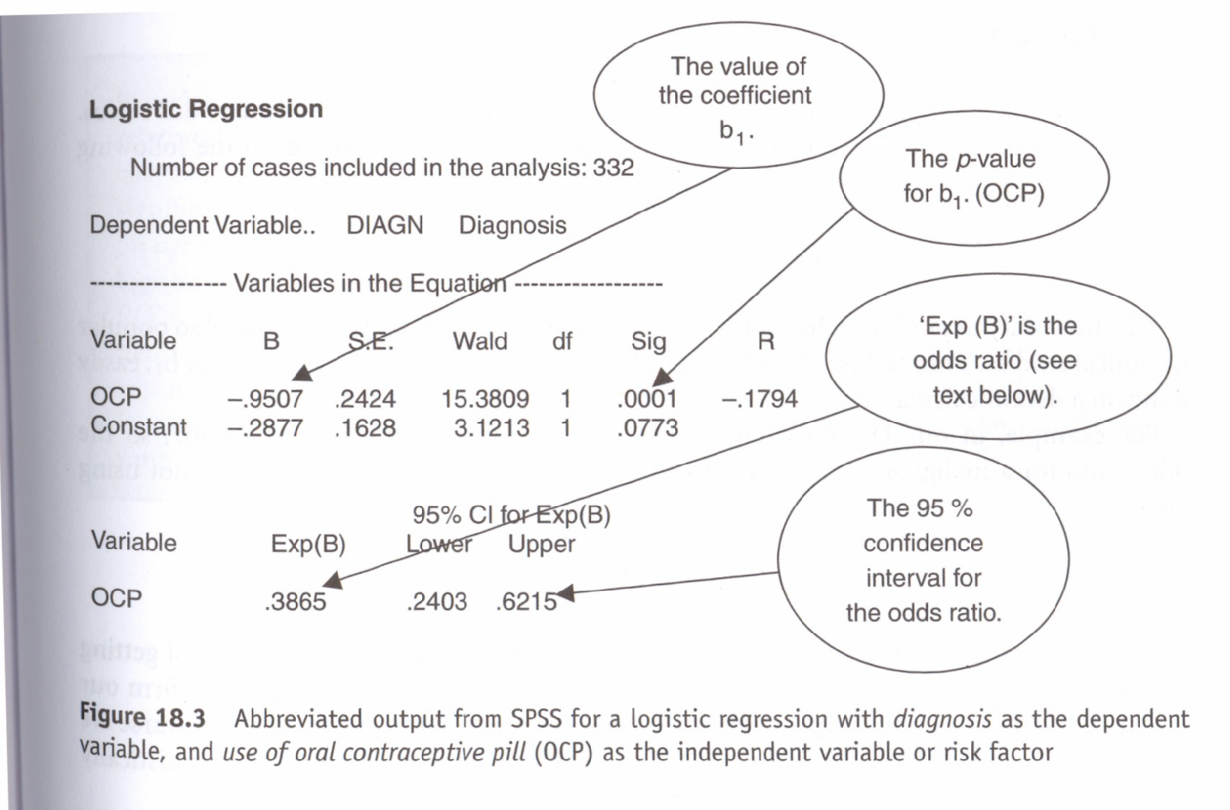
SPSS OUTPUT

Slide 52
Example..ctd
From the spss output... b0= -0.2877 and b1= -0.9507.
If we substitute these values in the equation....
if OCP= 0( NO OCP USE). P(Y=1)=0.4286
if OCP= 1( HAS USED OCP).P(Y=1)=0.2247
CONCLUSION... OCP PROTECTS AGAINTS MALIGNANCY!!!!

Slide 53
ODDS RATIO
Logistic regression model readily produces odds ratios.
Odds ratio = e ^{b0+b1}/ e^{b0}= e^{b1}
For our example, b₀= -0.2877, b1= -0.9507, so the odds ratio for a malignant disgnosis for woman using OCP compared to women not using OCP is 0.386.

Slide 54
Statistical inference in the logistic regression model
OR= 1 means there is no relationship between the two factors. If OR is less than 1 or higher than 1 then there is a relationship.....
Is this relationship statistically significant??? P- Value and 95% CI!
In the example 95% CI= (0.24-0.62).. Does not include 1 so it is statistically significant.
Be careful this is just a crude OR.

Slide 55
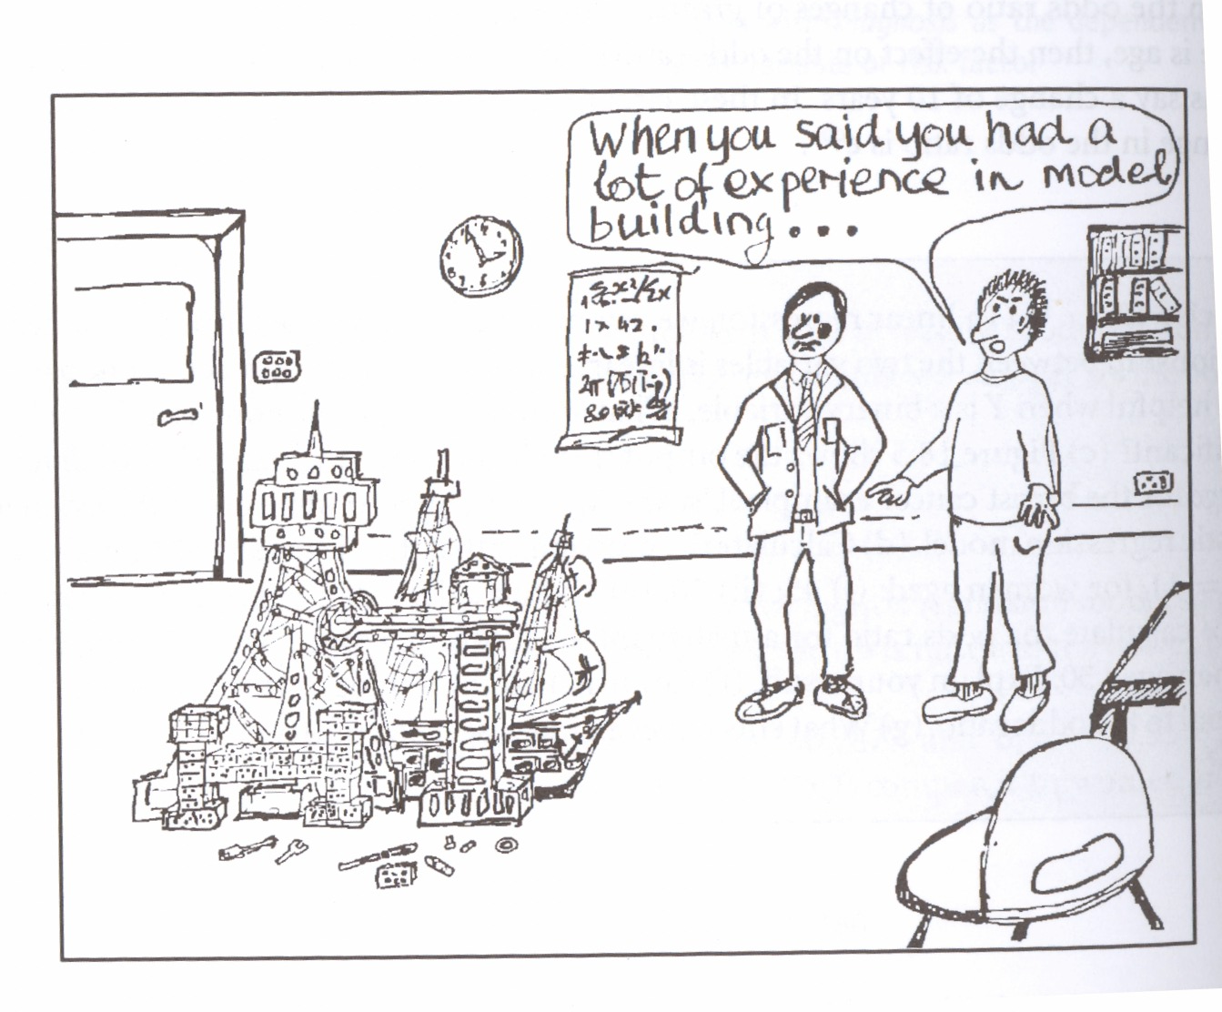
The multiple logistic regression model

Slide 56
The multiple logistic regression model
P (Y = 1) = (e ^{β0 +β1x OCP + β2xage + β3xBMI}) / (1+e^{β0 + β1xOCP+β2xage +β3xBMI})

Slide 57
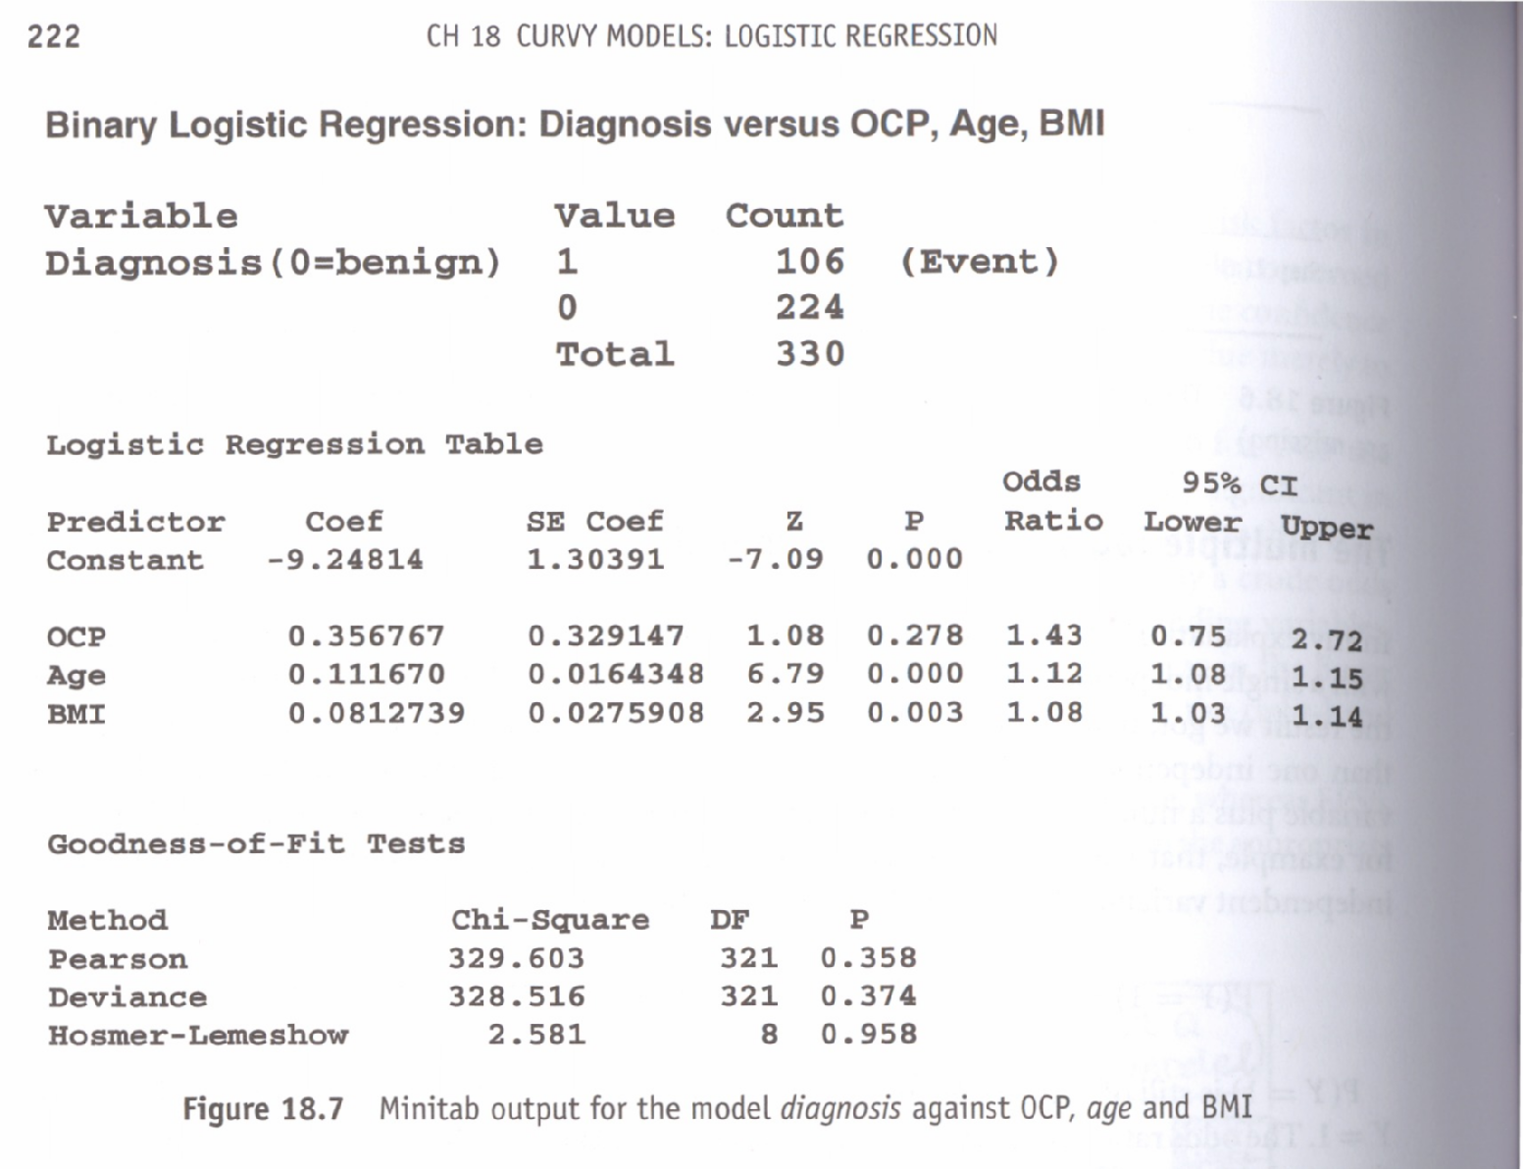
The multiple logistic regression model

