Slide 1
Cardiac Dysrhythmias Sinus Rhythms

Slide 2
Principles of Electrophysiology
Electrocardiography can show only electrical activity of the heart.
You may have electrical activity with no mechanical performance (e.g. Pulseless Electrical Activity)
Dysrhythmia Interpretation should be inline with physical assessment.

Slide 3
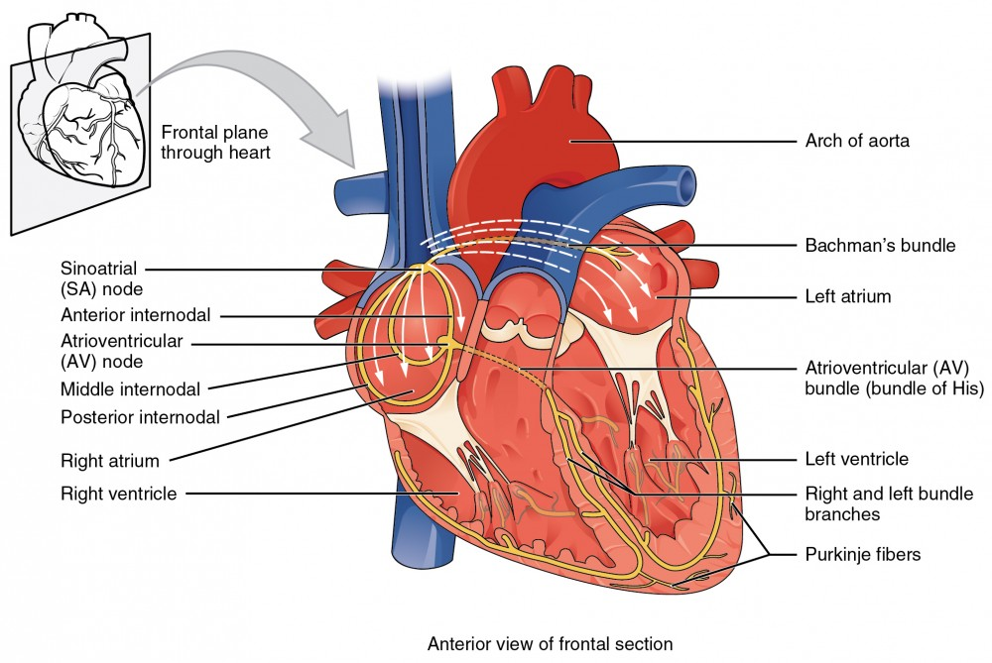
The cardiac conduction system
SA Node (60-100)
AV Node (40-60)
Purkinje Fibers (20-40)

Slide 4
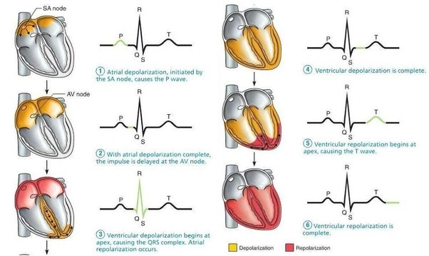
Flow of electrical impulse

Slide 5
Einthoven’s Triangle
A “lead” is a representation of the difference in voltage between 2 points.
Bipolar limb leads (frontal plane):
Lead I: RA (-) to LA (+) (Right Left, or lateral)
Lead II: RA (-) to LL (+) (Superior Inferior)
Lead III: LA (-) to LL (+) (Superior Inferior)
Augmented unipolar limb leads (frontal plane):
Lead aVR: RA (+) to [LA & LL] (-) (Rightward)
Lead aVL: LA (+) to [RA & LL] (-) (Leftward)
Lead aVF: LL (+) to [RA & LA] (-) (Inferior)

Slide 6
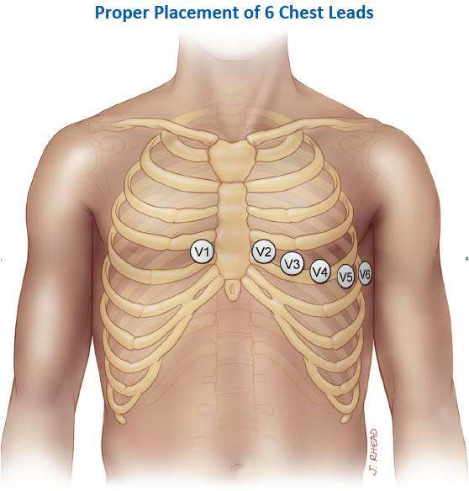
Precordial Leads
V1: right 4th intercostal space
V2: left 4th intercostal space
V3: halfway between V2 and V4
V4: left 5th intercostal space, midclavicular line
V5: horizontal to V4, anterior axillary line
V6: horizontal to V5, mid-axillary line
Unipolar (+) chest leads (horizontal plane):
Leads V1, V2, V3: (Posterior Anterior)
Leads V4, V5, V6:(Right Left, or lateral)

Slide 8
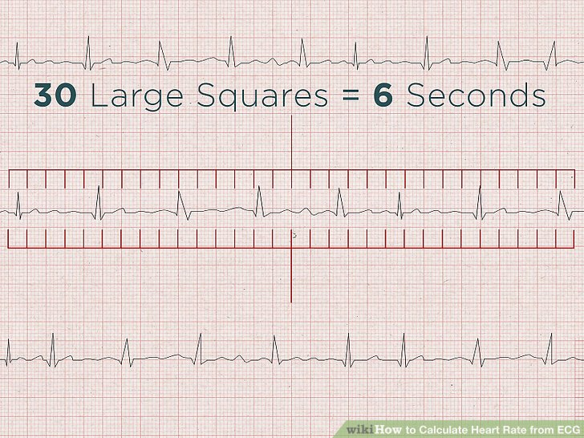
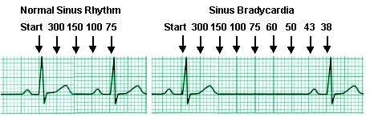
Rhythm Analysis Procedure
1) Determine Heart Rate (Atrial and Ventricular)
Calculate the QRS’s and X 10
Each large square is 0.2 sec. So, each time dived 60 by the number of squares

Slide 9
Rhythm Analysis Procedure
2) Determine Regularity (Pattern of Irregularity)
Unifocal PVC’s

Slide 10
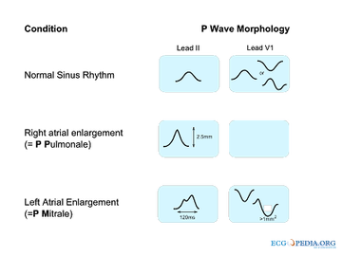
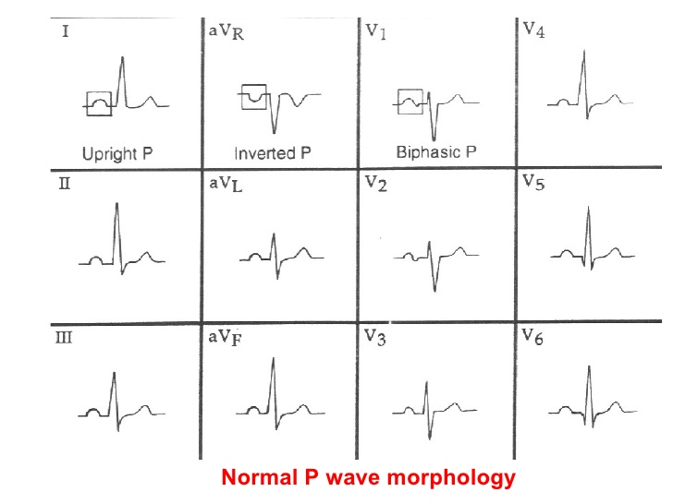
Rhythm Analysis Procedure
3) Identify Morphology of P waves and A:V Ratio

Slide 11
Rhythm Analysis Procedure
4) Determine PR Interval
The PR interval should be between 120 and 200 milliseconds or 0.12 and 0.20 seconds.

Slide 12
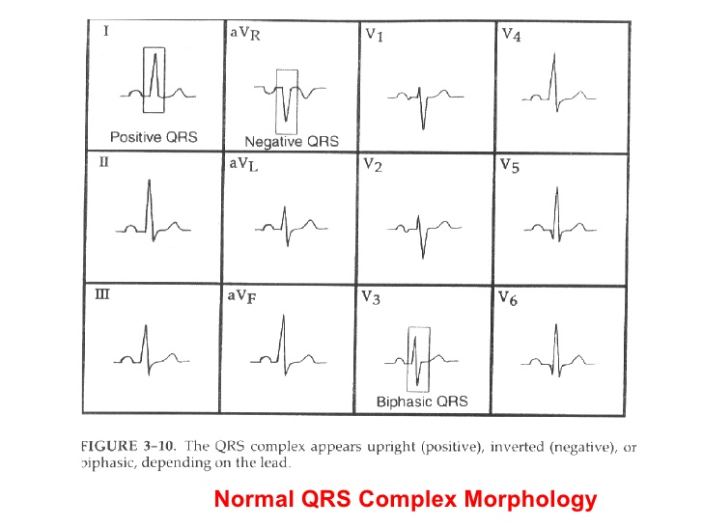
Rhythm Analysis Procedure
5) Determine QRS Morphology and Duration (Normally less than 120 ms and consistent)

Slide 13
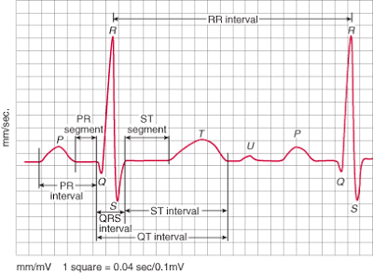
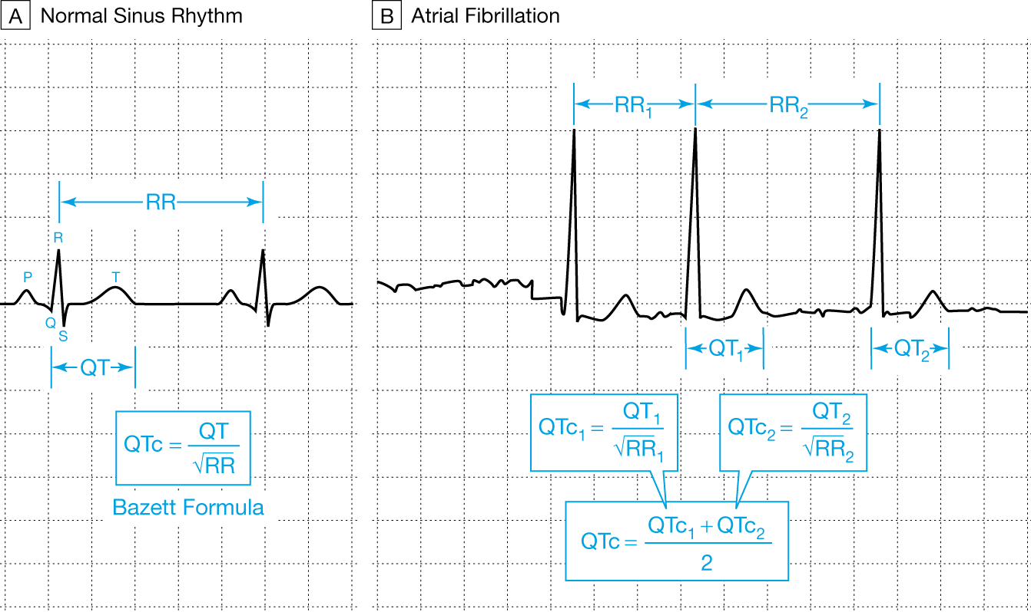
Rhythm Analysis Procedure
6) Determine the QT Interval (Normally less than ½ the preceding R-R interval)

Slide 14
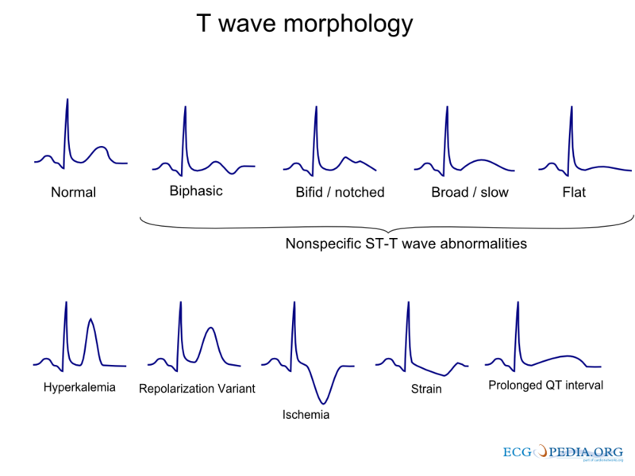

Slide 15
Sinus Rhythm
Rate: 60 to 100 bpm
Regularity: Regular
Early/Late Beats: None
P Wave Morphology and AV Ratio: Uniform Upright P waves. Ratio 1:1
PR Interval: Between: 120-200ms (0.12-0.20seconds)
QRS Duration and Morphology: Less than 120ms (0.12seconds). Identical Morphology
QT Interval: Less than ½ the preceding R-R Interval

Slide 16
Sinus Bradycardia
Rate: Below 60 bpm
Regularity: Regular
Early/Late Beats: None
P Wave Morphology and AV Ratio: Uniform Upright P waves.
A-V Ratio 1:1PR Interval: 120-200ms (0.12-0.20seconds)
QRS Duration and Morphology: Less than 120ms (0.12seconds). Identical Morphology
QT Interval: Less than ½ the preceding R-R Interval

Slide 17
Sinus Bradycardia
Causes:
Drug induced (β-adrenergic blockers, Calcium Channel Blockers and digitalis preparations.
Increased Vagal tone from vomiting, straining, or carotid sinus massage.
Sinus Brady may be a normal variant, especially in athletes.
Hypothyroidism, hyperkalemia.
Special Concerns:
Sudden onset Sinus Bradycardia can severely decrease cardiac output and lead to dizziness, lightheadedness, syncope etc.
It is also a common early rhythm in acute inferior myocardial infarction.
It can also be the presenting rhythm with increased intracranial pressure.
Notes:
Medications that lower the sino-atrial node rate have what is called negative chronotropic properties. These include beta blockers, calcium channel blockers, digoxin etc., all which can lead to sinus bradycardia. Any stimulation of the parasympathetic nervous system will result in sinus bradycardia. The so-called vaso-vagal response can be triggered by straining, vomiting, or by stimulation of baroreceptors in the carotid sinuses. Hypothyroidism and hyperkalemia are also common causes. Further, sinus bradycardia can be a normal variant in athletes.
Remember that half of the formula for the determination for cardiac output is the heart rate. A patient’s response to sinus bradycardia can vary from an asymptomatic to a syncopal response. Thus, the hemodynamic response to a patient in sinus bradycardia must be assessed.

Slide 18
Treatment of Bradycardias
Only symptomatic Bradycardia is Treated!
Atropine 0.5 – 1.0 mg q3-5min (total of 0.03-0.04 mg/kg)
Transcutaneous Pacing
Dopamine Infusion (Not Push) 2-10µg/kg/min
Epinephrine Infusion (Not Push) 1-4µg/min
Notes:
Bradycardias are only treated when the patient is symptomatic. A patient is symptomatic if there are signs and symptoms of decreased organ tissue perfusion, a decrease in level of consciousness, light-headedness, syncope, dizziness, hypotension, chest discomfort, congestive heart failure, decreased urine output, shortness of breath, weakness or fatigue.
If there is concern regarding long-term bradycardia, then a permanent pacemaker is strongly considered.
Most symptomatic bradycardias of any origin are treated using the above algorithm.
In this module, you are charged with remembering two possible specific causes and two treatments for each rhythm.
Initial treatment for symptomatic bradycardia is the administration of atropine. The medication atropine will block excessive parasympathetic stimulation of the heart and result in an increased heart rate. If atropine is ineffective, transcutaneous pacing is initiated. This procedure is painful, and patients often require analgesics and sedatives during transcutaneous pacing. Lastly, the medications epinephrine or dopamine can be administered as continuous infusions, NOT AS PUSH MEDICATIONS. Pushing epinephrine on a patient with a pulse can have lethal consequences.

Slide 19
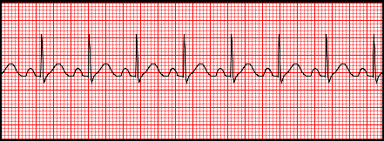
Sinus Tachycardia
Rate: 100bpm to 160bpm
Regularity: Regular
Early/Late Beats: None
P Wave Morphology and AV Ratio: Uniform Upright P waves. A-V Ratio 1:1
PR Interval: 120-200ms (0.12-0.20seconds)
QRS Duration and Morphology: Less than 120ms (0.12seconds).
Identical Morphology
QT Interval: Less than ½ the preceding R-R Interval

Slide 20
Sinus Tachycardia
Causes:
Exertion, Exercise, Fever, Pain, Anxiety.
Stimulants (caffeine, nicotine, cocaine).
Medications that decrease parasympathetic tone (atropine).
Medications that increase sympathetic tone.
Hypoxia, Hypo/Hypervolemia, CHF, Hyperthyroidism, Pulmonary Embolism
Special concerns:
An increased heart-rate improves cardiac output (to a certain point), but also increases workload of the heart.
With increased heart rate above 120 bpm, the EDV decreases.

Slide 21
Sinus Tachycardia
Treatment:
Treat the underlying cause
Patients with compromised heart function or CAD may not tolerate sinus tachycardia!!
medications with negative chronotropic properties are β-adrenergic blockers and Calcium Channel Blockers.

Slide 22
Sinus dysrhythmia
Rate: Varies, Between 60-100bpm termed Sinus dysrhythmia, below 60bpm termed S. Bradydysrhythmia, above 100bpm termed S. Tachydysrhythmia
Regularity: Irregular, may be Irregularly or Regularly Irregular
Early/Late Beats: Beats occur at variable intervals.
P Wave Morphology and AV Ratio: Uniform Upright P waves. A-V Ratio 1:1PR Interval: 120-200ms (0.12-0.20seconds)
QRS Duration and Morphology: Less than 120ms (0.12seconds). Identical Morphology
QT Interval: Less than ½ the preceding R-R Interval

Slide 23
Sinus Arrest
Sinus Arrest occurs when there is a sudden absence of electrical activity initiated by the SA node.
Causes include increased Vagal tone, Sinus Node calcification or Ischemia, Myocarditis, Hypoxia.
Drug induced: medications with negative chronotropic properties (digitalis, β-blockers, Ca++ Channel Blockers).

