Slide 1
Chemotherapy Part II

Slide 2
Measuring tumor response
Complete Response- one month absence
Partial Response- 50% decrease tumor mass (one month)
Stable Disease- less than 50% decrease or less than 25% increase
Progression- 25% increase or new growth
Notes:
7
Once a patient has received treatment, a repeat work-up is done to measure tumor response. The response is labeled as above.
Why is this important to know…………
Knowing the course of chemotherapy treatment based on disease response and normal chemotherapy courses, allows you to have information which enables you to prioritize patient educations.
Let’s look at some examples of how you would apply this information

Slide 3
Administration Schedule
Bolus therapy:
  Used to rapidly administer Parenteral therapy
  Mostly administered in outpatient setting
Infusion therapy:
  Parenteral therapy lasting 30min-24hrs
  Given as inpatient or outpatient setting.

Slide 4
Dose Category
Standard dose
  Most patients
High dose
  Dose is potentially sufficient to eradicate tumor & cause severe side effects that warrant supportive therapy
Dose intensification
  Higher than standard dose at shorter than usual intervals
Notes:
Dose intensification:
1. Divided fractional dose over 2 or more days to enhance cell kill
2. Long term infusion in which dose is administered as a continuous infusion for from 1 to several days to minimize side effects

Slide 5
Drug Resistance
Phenomenon by which cancer cell becomes resistant to chemotherapy
Intrinsic/permanent resistance:
  Cells are resistant to agent prior to exposure to agent
Acquired resistance:
  Malignant cells become resistant to the agent after exposure to it
  May be single or multi-drug resistant

Slide 6
Dose Determination
Mg/kg of body weight
Body Surface Area (BSA) mg/m²
  Use calculation, BSA calculator
  Modifications:
    Obese patient
    Ascites/edema
    Pre-existing hepatic dysfunction, renal impairment, poor performance status, toxicity from prior chemo
Notes:
Mg/kg used most often in infants <1 yr, <10kg
BSA – use in adults & kids > 1yr >10kg
Ideal body weight, pre-ascites weight, dose reduction
Carboplatin – Calvert formula – AUC based on glomerular filtration rate

Slide 7
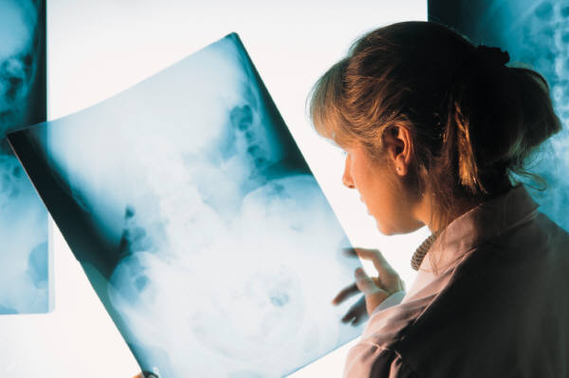
Response
Tumor Response:
  Complete (CR)
  Partial (PR)
  Stable (SD)
  Progressive (PD)
  Relapse
Patient Response:
  Performance status
  Subjective patient response
Notes:
Complete – absence of all S&S of cancer for 1 month using objective criteria (bidimensional tumor measurements)
Partial – at least 50% decrease of measureable tumor mass for 1 month without development of a new tumor
Stable – decrease tumor mass of <50% or <25% increase growth
Progressive – growth of 25% or more or development of new tumors
Relapse – after CR, new tumor appears or original tumor reappears. Or, from PR – a new tumor appears or the original tumor increases in size
Performance status:
Karnofsky – evaluates adults in %
Eastern Coop Onc Group (ECOG) – 1-5 scale
Zubrod scale – 0-5 scale
Lansky Play-Performance Scale – kids <10yrs
Subjective pt response: eval based on pt’s perception of how he/she feels regardless of objective parameters

Slide 8
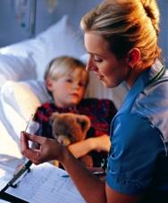
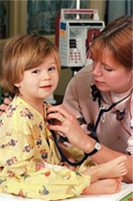
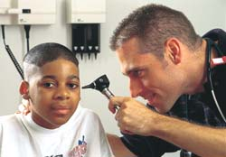
Assessments

Slide 9
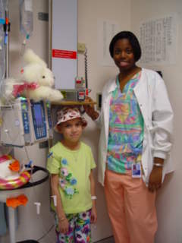
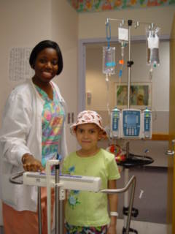
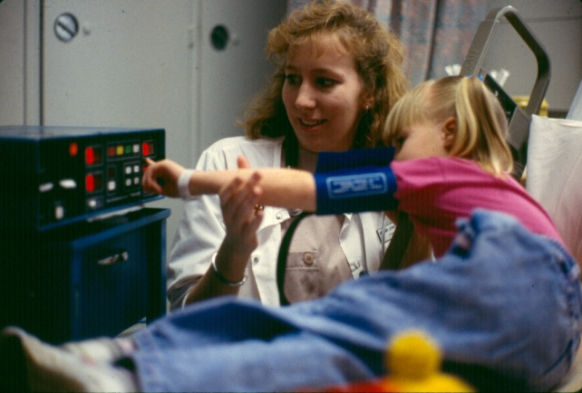
Pre-Administration

Slide 10
Pre-Treatment Assessment
Medical history
  Allergies
  Performance scales
  Eastern Cooperative Oncology Group ECOG Performance Status
Score
0
1
2
3
4
Clinical Status
Asymptomatic
Symptomatic, fully ambulatory
Symptomatic, in bed <50% of the day
Symptomatic, in bed >50% of the day but not bedridden
Bedridden

Slide 11
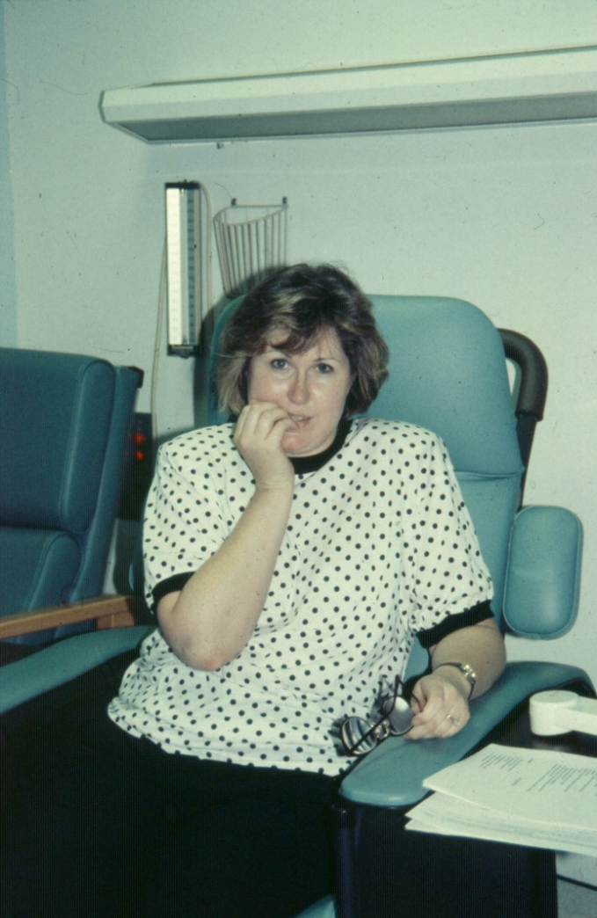
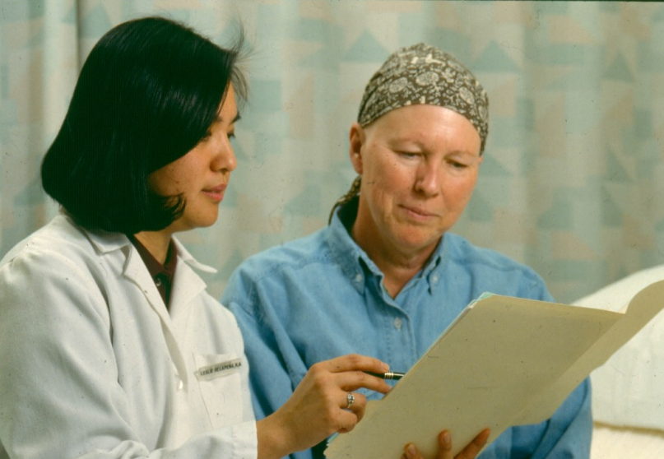
Pre-Treatment Assessment
Previous experience
Psychosocial status
Teaching requirements
Symptom management

Slide 12

Pre-Treatment Assessment
Rights in Drug Administration
Right medication.
Right dose.
Right time.
Right route.
Right patient.
Right education.
Right documentation.
Right to refuse.
Right assessment.
Right evaluation.

Slide 13
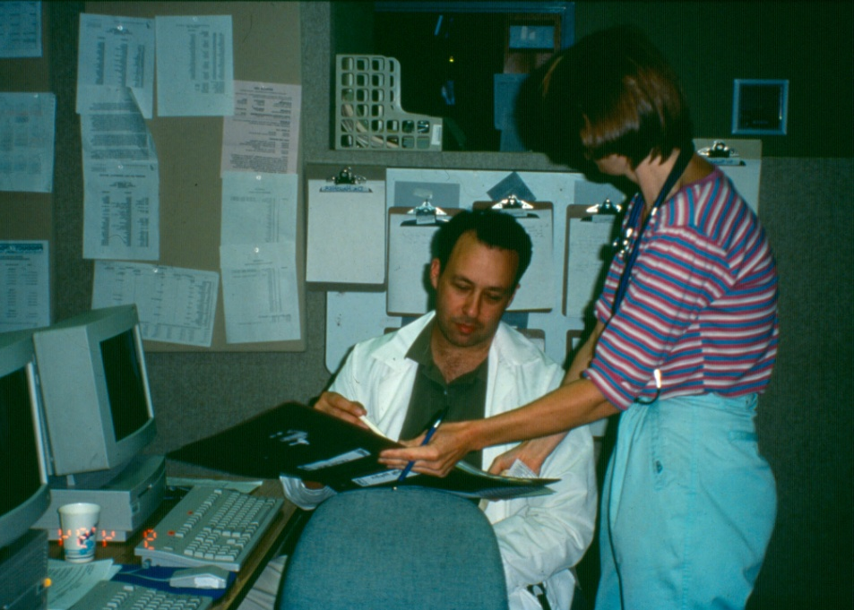
Prescriber Orders
Pre-medications
Adjuvant medications
Cytotoxic and/or
biologic agents
Hydration
Antiemetics

Slide 14
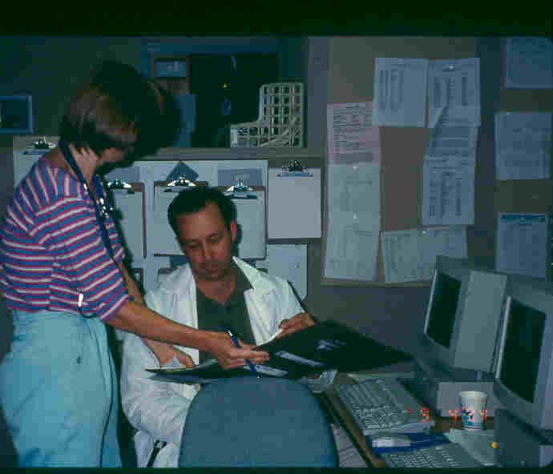
Question Physician Orders When Appropriate

Slide 15
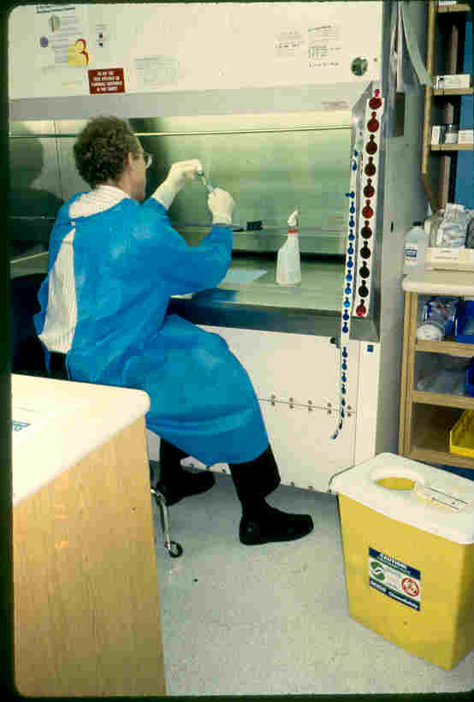
Drug Preparation - Pharmacy

Slide 16
Clinical Area Preparation
Cytotoxic/Biologic Agent
IV equipment
Appropriate fluids/antiemetics
Safety gown
Absorbent plastic backed pad
Hazardous waste container
Emergency equipment/medications

Slide 17
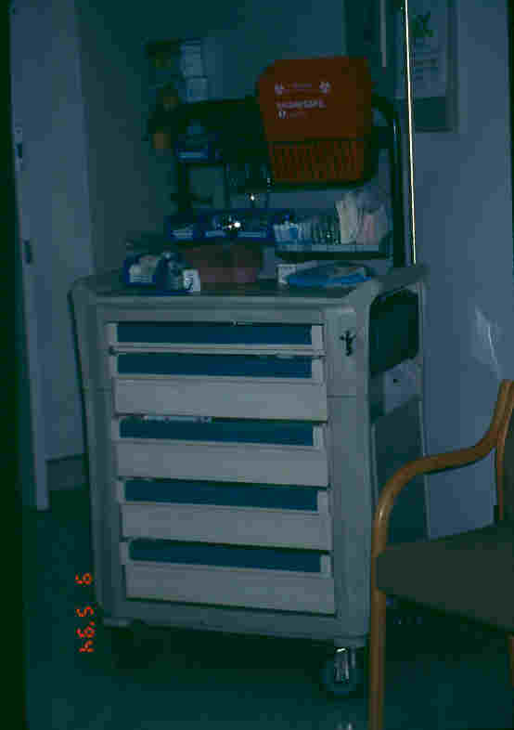
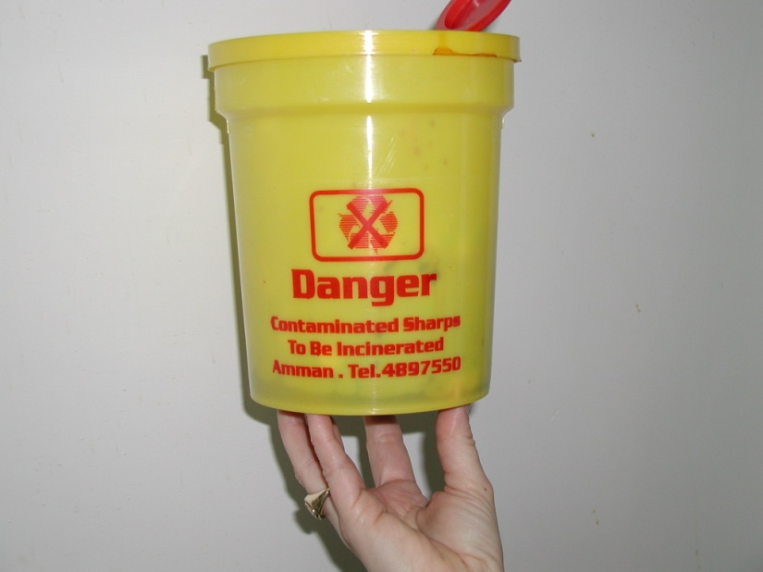
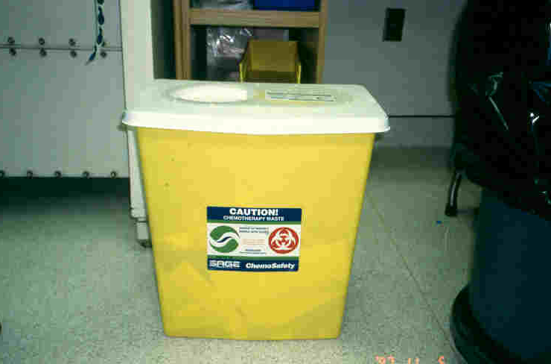
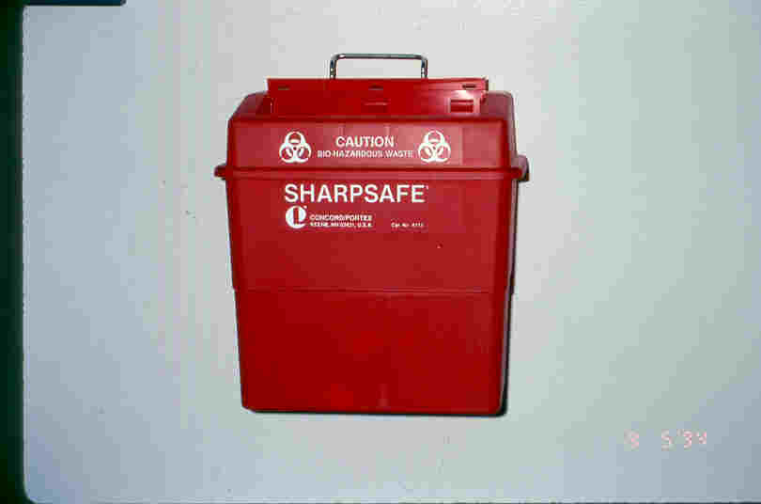
Room Preparation: Equipment

Slide 18

What is a Body Surface Area?
The calculation made using a patient’s height & weight to ensure appropriate chemotherapy dosage.
BSA = √ht (cm) x wt (kg)/ 3600

Slide 19
Two Nurse Check
With change of caregiver
With change of cytotoxic agent bag
With a change in pump settings

Slide 20
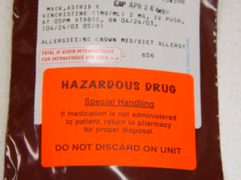
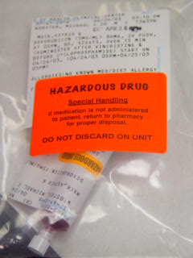
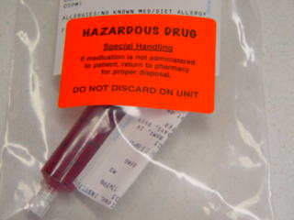
Medication Labeling

Slide 21
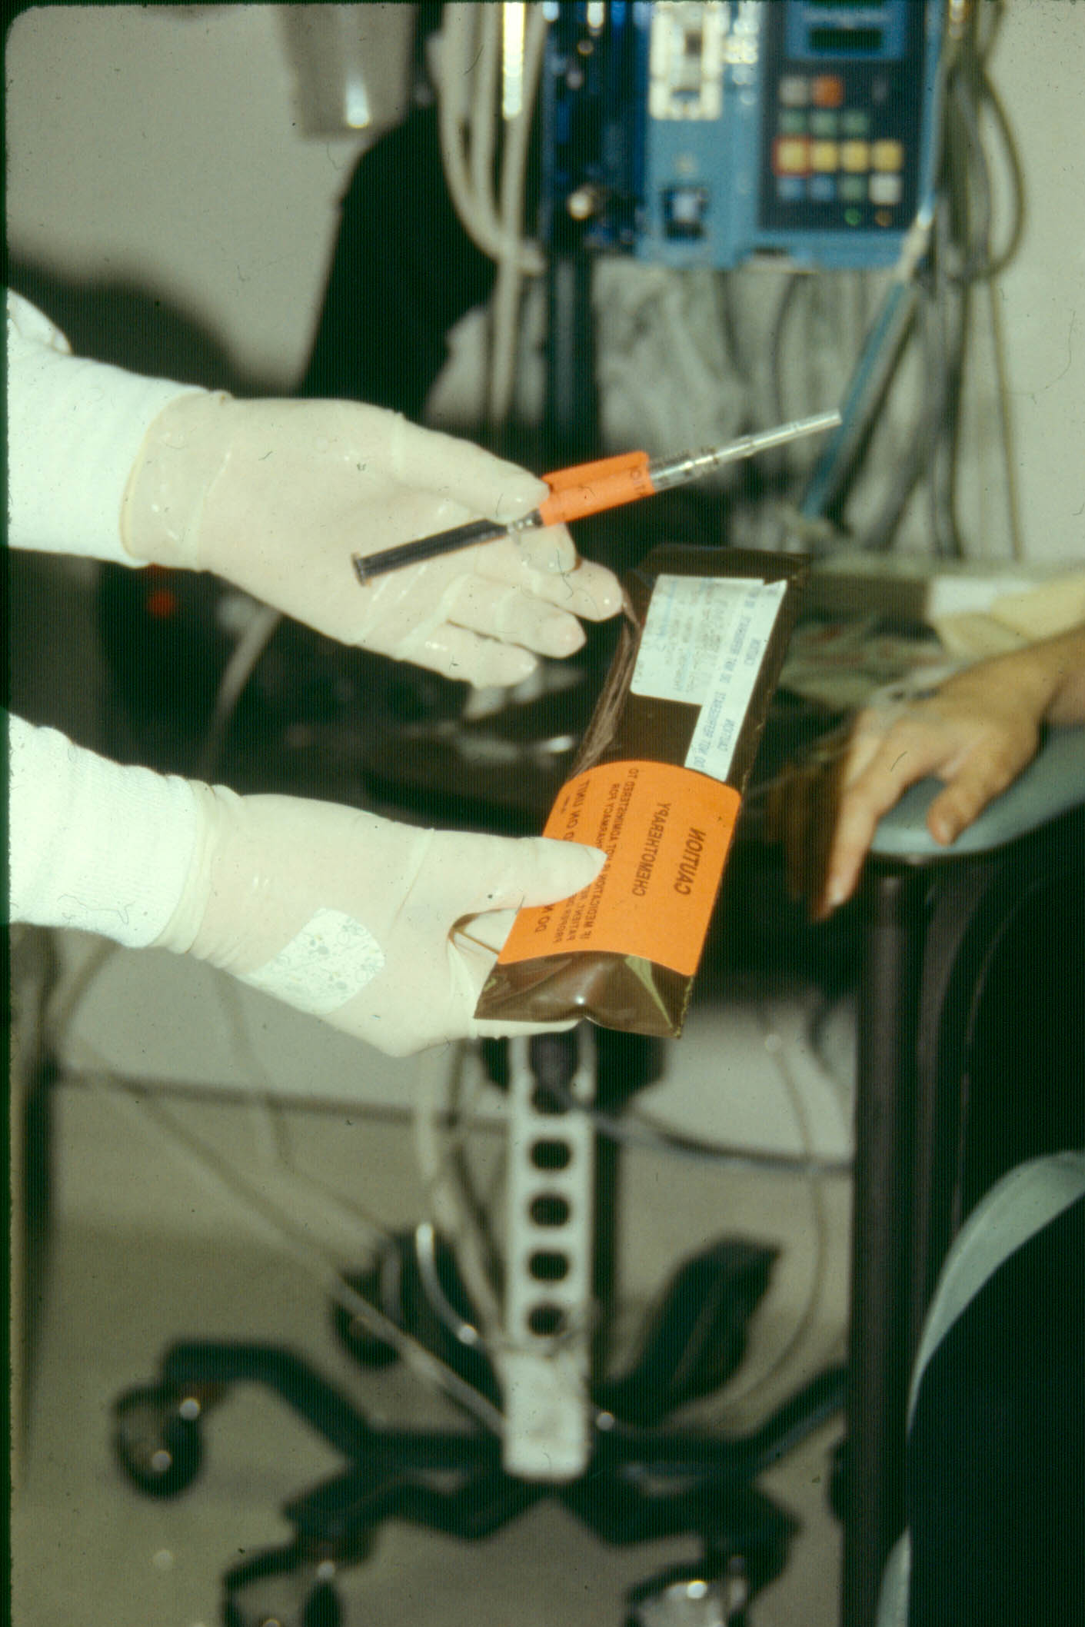
Syringe Labeling

Slide 22
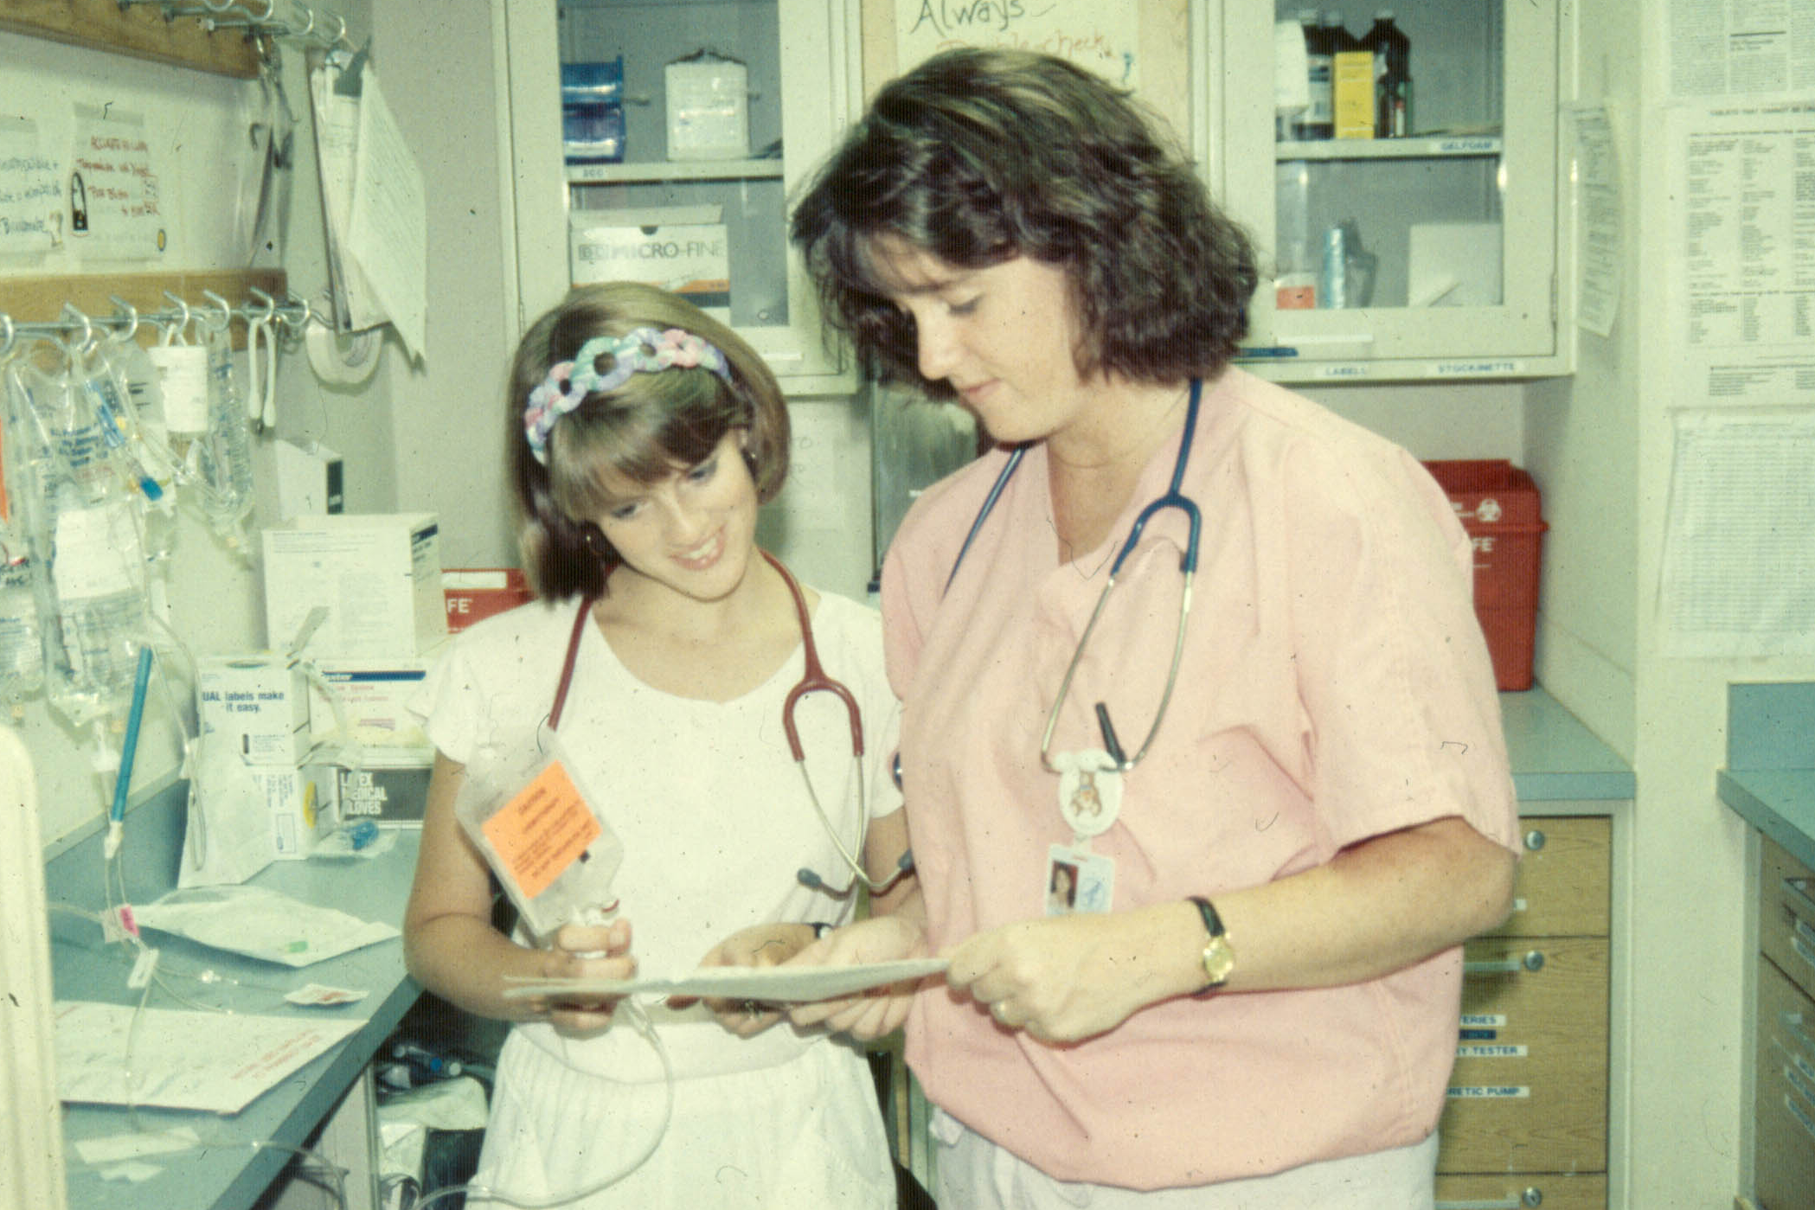
Double Checking Medications
Patient name
Medical record #
Agent
Dosage
Route
Volume
Time of administration
Expiration date

Slide 23
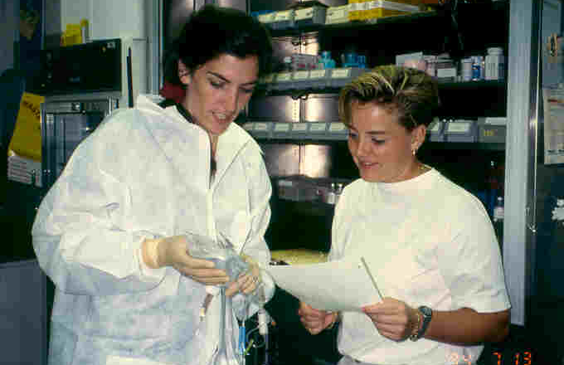
Check Calculations with 2nd Nurse

Slide 24
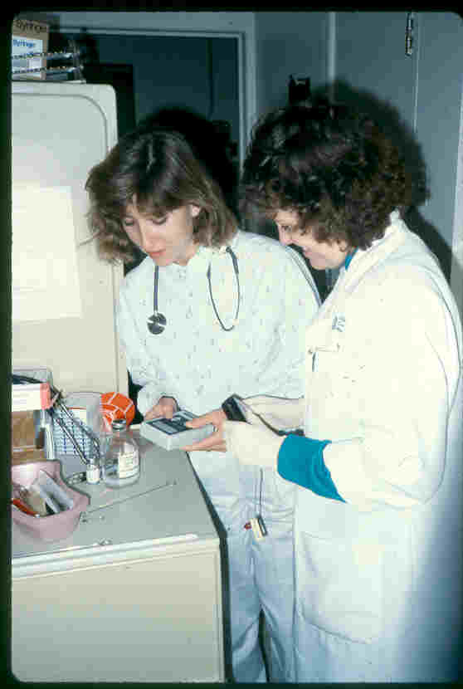
Check Pumps with 2nd Nurse

Slide 25
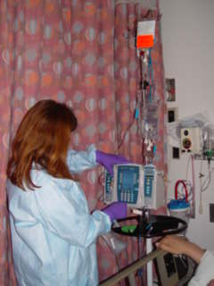
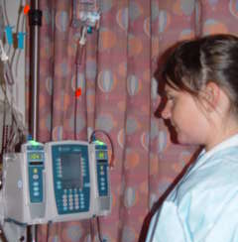
Infusion Pump Double Check

Slide 26
The Antiemetic Dilemma
Before Chemotherapy
After Chemotherapy
Notes:
See Handout

Slide 27
Veins - What’s Best For My Patient?
Site Selection
Factors Influencing Patency & Fragility
Needle Choices

Slide 28
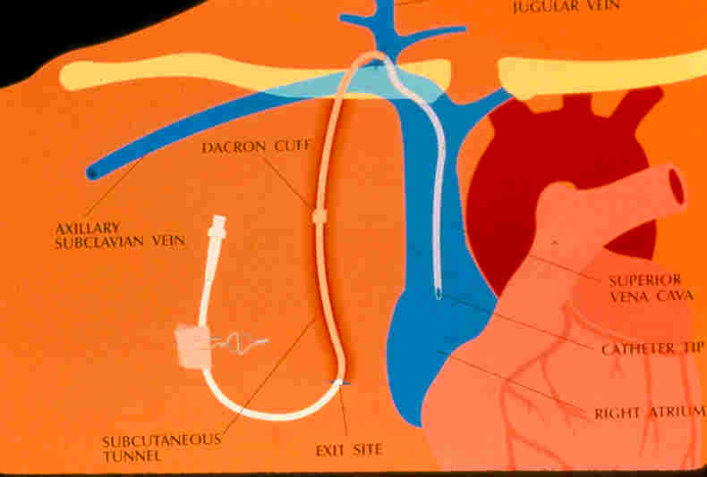
VAD Anatomy

Slide 29
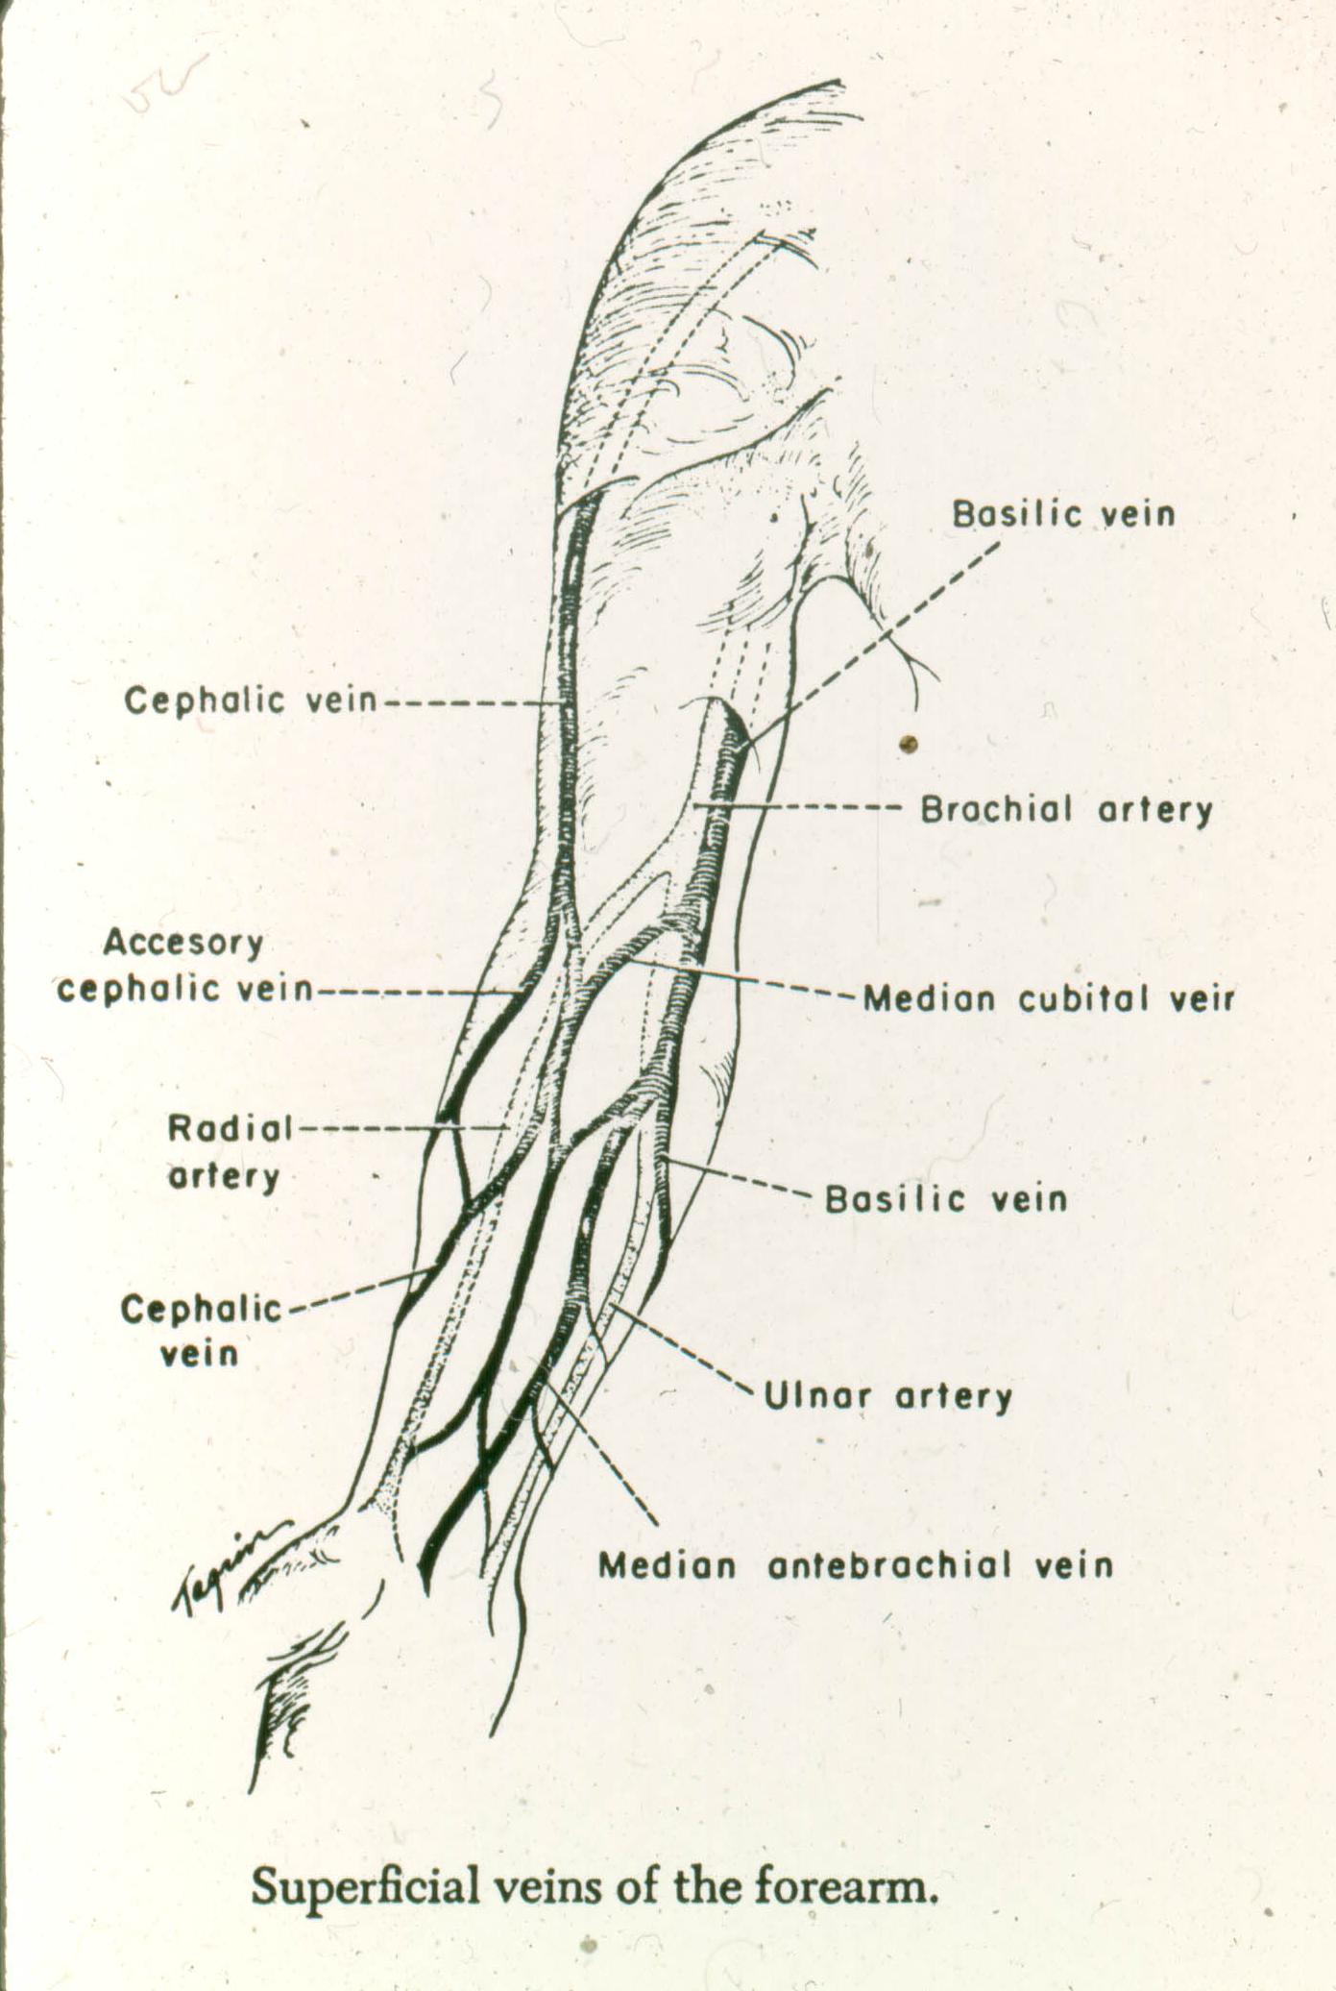
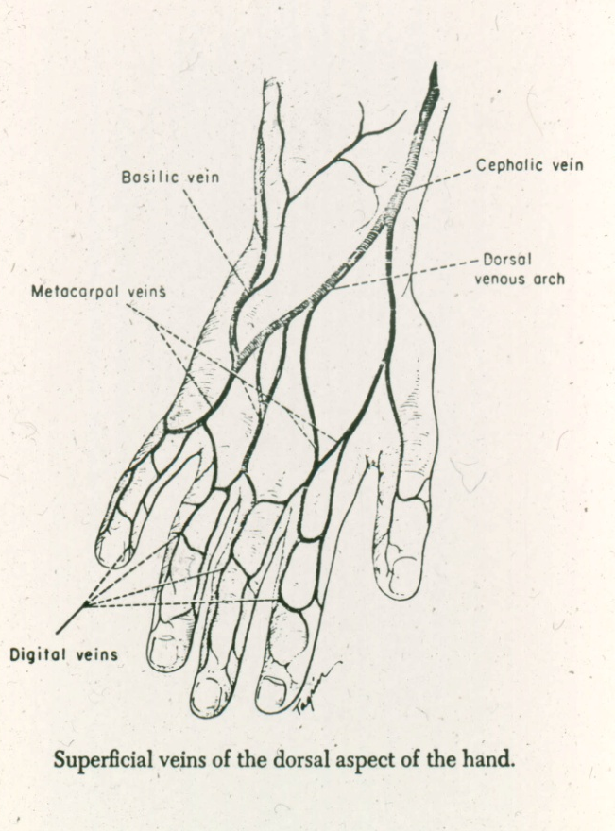
Vascular Access: Peripheral
Begin distally and
proceed proximally
Areas to avoid
  Hematoma
  Phlebitis
  Sites distal to previous
  venipuncture
  Dorsal aspect of wrist
  Antecubital fossa

Slide 30
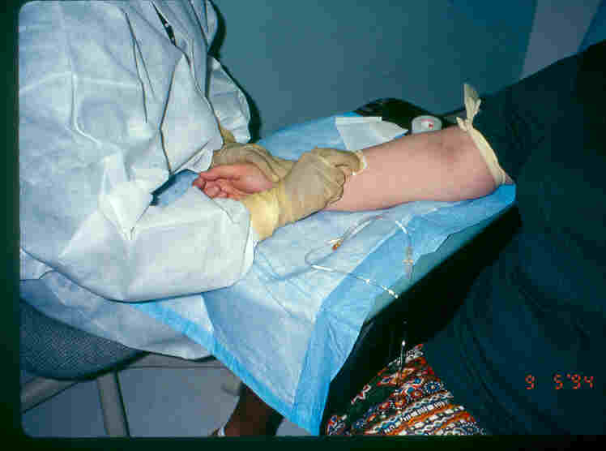
IV Insertion

Slide 31
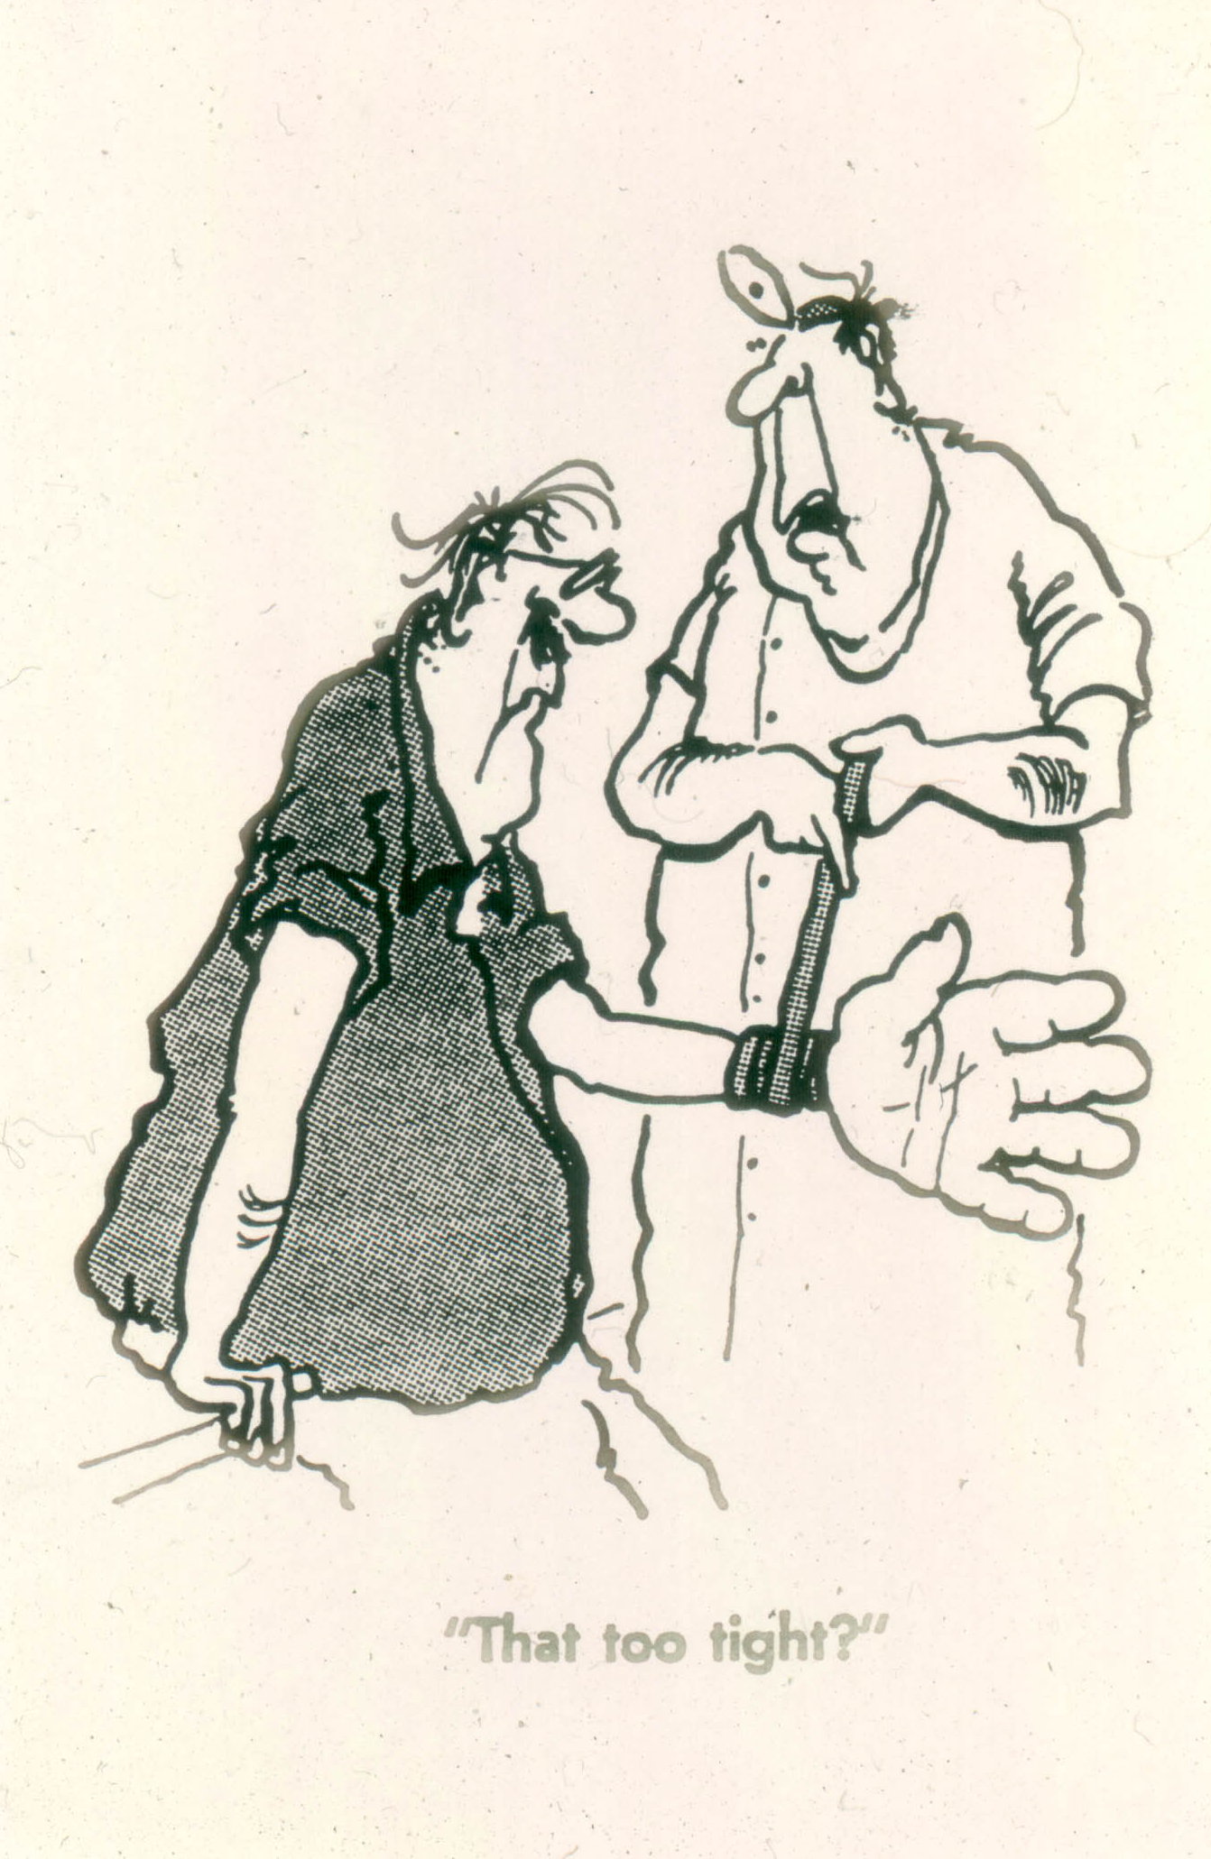
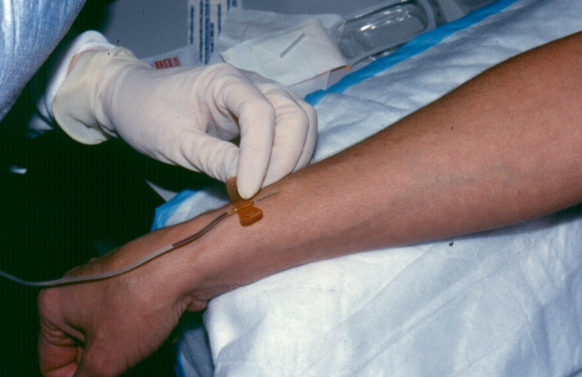
Vascular Access: Peripheral

Slide 32
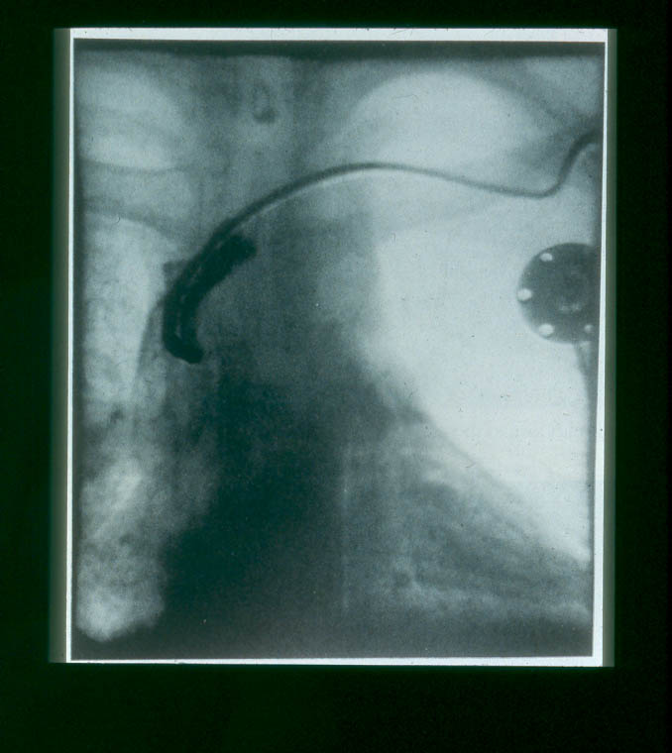
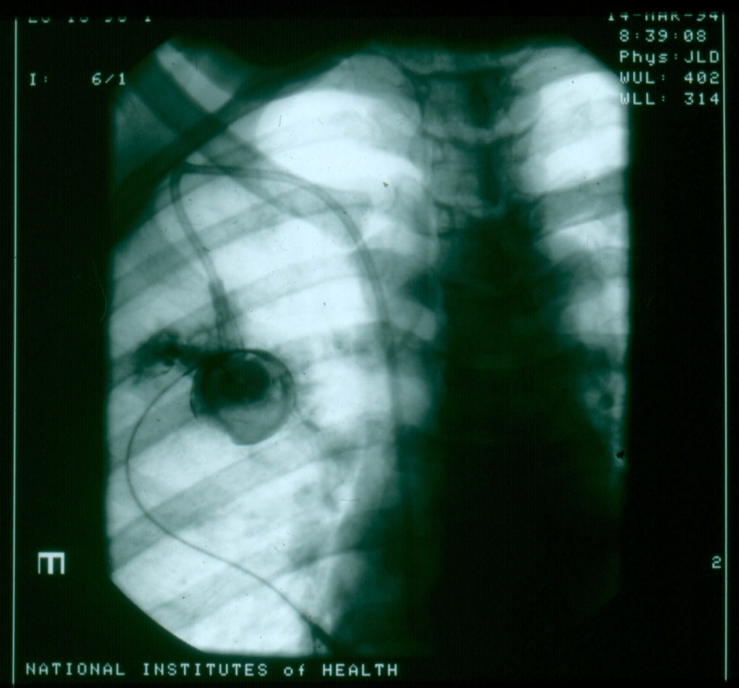
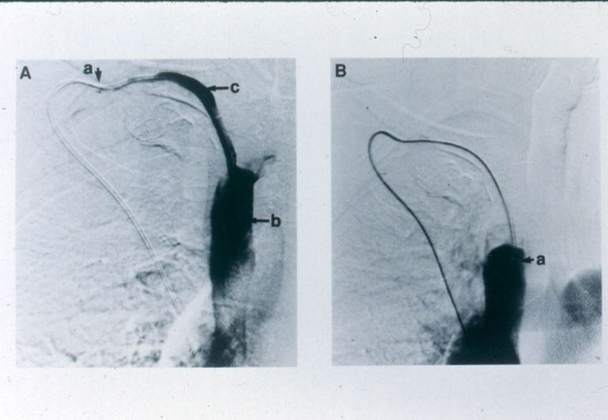
Vascular Access: Central

Slide 33
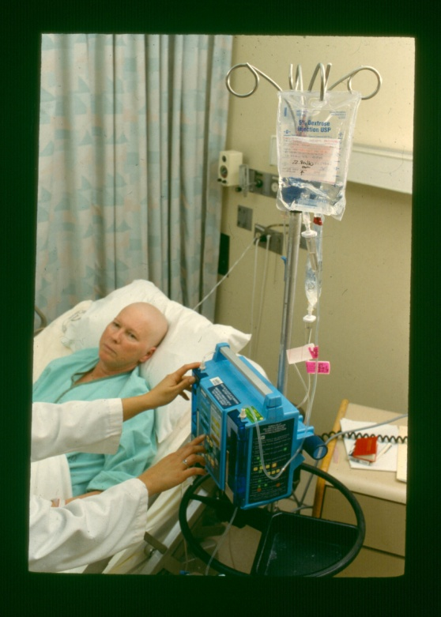
Routes of Administration: Continuous
General
  Infusion device required
  Site assessment: observe hourly
  Check blood return prior to initiation, with tubing change and at end of infusion

Slide 34
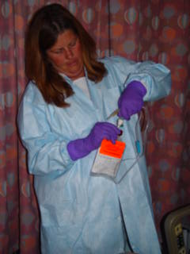
Administration

Slide 35
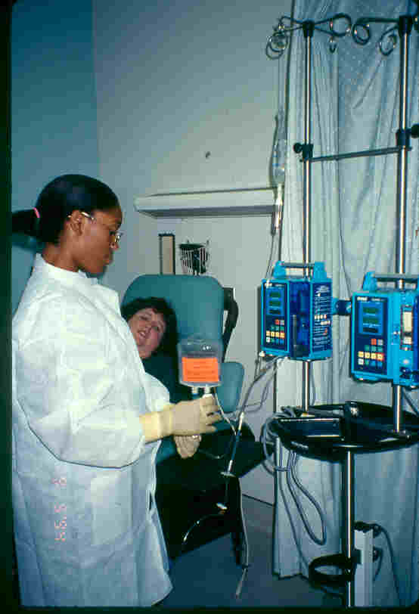
Back-Flow Technique

Slide 36
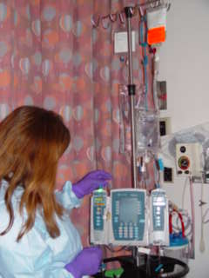
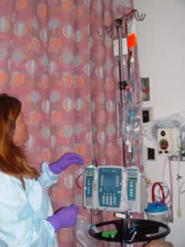
Administration

Slide 37
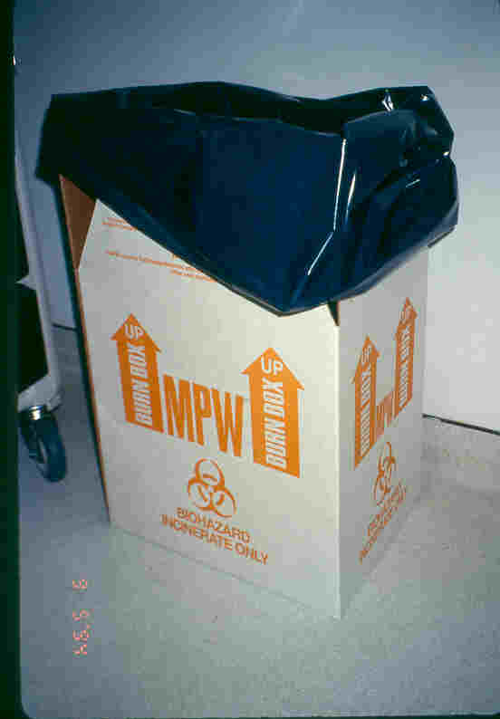
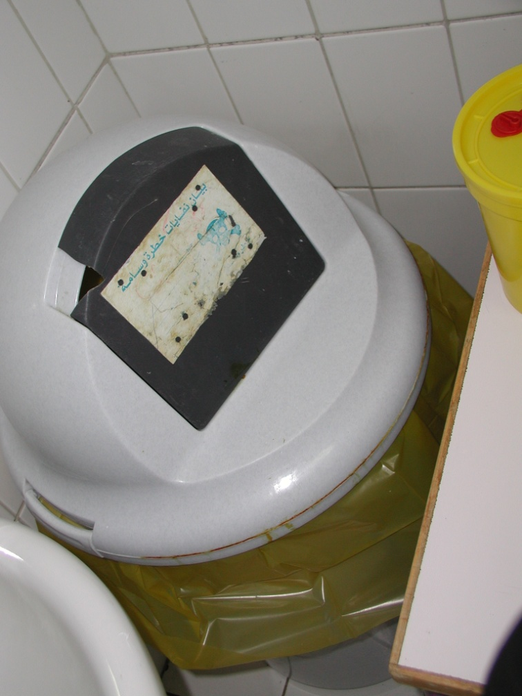
Waste

Slide 38
Characteristics of Chemotherapy
Carcinogenic
Mutagenic
Teratogenic: cause development malformations.
Fetotoxic: ability of a substance to cause harm to the developing fetus.
Notes:
5
Chemotherapy effects particularly new growing immature cells
Therefore embro’s or developing babies are at a higher risk if exposed to these chemicals
In relation the newer growing cells in our bodies are the ones effected by chemo and therefore that is where we see the common side effects
E.g hair cells , mucosal lining, G.I.T, Diarrhoea, vomiting result as these cells grow quickly and are relatively immature compared to bone and muscle cells which are mature and are rarely effected

Slide 39
Chemotherapy Routes of Exposure
Inhalation: aerosolization of drug (droplet)
Absorption: through skin, or mucous membrane
Ingestion: contact with contaminated food, hand to mouth
Notes:
Talk to each component

Slide 40
Chemo-Protective Equipments
Cap
Eye shields
Mask
Chemotherapy gloves
Gown
Shoe covers
Notes:
9
Review equipment

Slide 41
Safe-Handling Chemotherapy
Preparation
Administration
Discharging of Waste and Body Fluids
Extravasation
Spills
Notes:
10
This slide explains when they would where chemotherapy equipmet

Slide 42
Examples
You are administering IV chemotherapy. What protective equipment do you wear?
You are cleaning a chemotherapy spill in the bed. What do you wear?
You are removing chemotherapy from the pharmacy bag. What do you wear?
Notes:
11
Quiz them about what they would wear. Stess to use common sense and think about the routes of exposure

Slide 43
What is the exposure risk to me?
Light-headedness / dizziness
Nausea & vomiting
Headaches/hair loss
Mucous membrane reactions
General malaise
Local tissue necrosis
Cellulitis
Fetal damage/death
Notes:
6
If you experience some of these signs and symptoms then consider if you have been exposed or in contact with chemo recently

Slide 44
What Can I Do?
Use Common Sense
And
Protect Yourself!
Notes:
13

Slide 45
Acute exposure to chemotherapy
Notes:
14
So you do all the precauions and you are still exposed.
What do you do? Move to the next slide

Slide 46
Handling Acute Exposure
Despite all of your efforts to protect yourself, chemotherapy splashes on your face. What do you do?
Notes:
19
Asme as exposure to blood body fluid
Flush eyes, hands, skin etc with runningwater for 10 mins

Slide 47
Handling Acute Exposure
Flush affected area with copious amounts of water
Notify head nurse or charge nurse
Go to the emergency room for evaluation
Complete incident report

Slide 48
Chemotherapy Spills
Notes:
16

Slide 49
Chemotherapy Spills
Secure the area and alert other staff
Obtain chemotherapy spill kit
Put on protective coverings
Observe amount of chemotherapy spilled
Absorb spill with absorbent towels
Dispose of towels in doubled bags
Cover area with blue plastic pad
Dispose of protective clothing
Notify housekeeping of spill
Notes:
20
After a brief discription, go through the process of putting on all the spill gear and demonstrate a chemo spill clean up
If thereis a spill you will need two nurses to do the clean up procedure
Instructions are on the back of the spill kit
Spill kits should be available on every unit that gives chemo (even if rarely)
The Red chemo bin found in the N.E.R building store room has a complete spill kit for demostration, a copy of the chemo policy IPP
Please carefully replace all items when finished for the next presentation
PLEASE STESS ESTIMATION OF SPIL

Slide 50
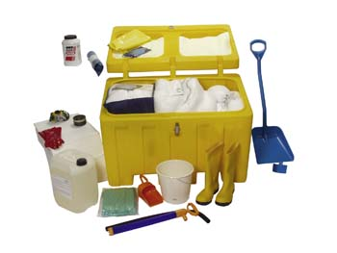
Spill Kit

Slide 51
How Do I Protect Patients & Families
EDUCATION
Notes:
15
Patients and family members need to follow the same precaustions as you and me.
Changing baby’s diaper= gloves
Double flusing toilet once discharged from clinic after chemotherapy……etc….patients need to know precautions too to protect family members.

Slide 52
Patient Education Scenario
Patient Y has completed her first of four cycles of adriamycin and cytoxan for breast cancer. She is schedualed to go home. What are the priority educational needs.
Notes:
18
S/S to repport to MD (fever, bleeding, etc)
Protect from infection= Infection high risk of mortality n cancer patients
Follow-up visit and labwork
prn MEDICAITON
Any specifics related to chemotherapy drugs
MOST IMPORTANT is reporting a fever and other signs and symptoms.
This is new to the patient.
Generally you have a small window of time to educate a patient so prioritization is sometimes necessary and essential

Slide 53
Patient Education Example
Patient X has just completed all courses of chemotherapy and is being discharged from the hospital. The family says to you, “I am so glad that this is over. We can now put this behind us.”
What do you do? What do you think that patient’s family might be thinking?
Notes:
Patient is probably thinking that he /she does not need to return for follow-up. It is important that the patient understands the follow- instructions.
Know the treatment plan will enable you to communicate the appropriate discharge and follow up information.

Slide 54
Conclusion
Safe-Handling precautions are in our best interest and are there to protect us.
Patient education is essential to protect the patient/family from chemotherapy.
Know your relevant policies and procedures.
Know who your resources are and use them.

