Slide 1
Pathophysiology of Cancer

Slide 2
Introduction
Cancer is not a single disease, but a group of heterogeneous diseases that share common biologic properties (e.g., clonal cell growth and invasive ability).

Slide 3
Proliferative growth patterns
Cell proliferation is the process by which cells divide and reproduce. In normal tissue, cell proliferation is regulated so that the number of cells actively dividing is equal to the number of cells dying.
Abnormal cell differentiation and growth results in an abnormal mass of tissue, called a neoplasm.

Slide 4
Proliferative growth patterns
Neoplasia means new growth and refers to an abnormal mass of tissue characterized by autonomous, excessive, and uncoordianted growth.
Although they are not synonymous, the terms neoplasm and tumor are often used interchangeably. Neoplasms are classified as benign or malignant. Cancer is the most common term for all malignant tumors.

Slide 5
Benign growth patterns
Hypertrophy: is an increase in cell size resulting in an increase in organ size.
Hyperplasia: is a reversible increase in the number of cells in an organ or a tissue in response to a specific growth stimulus (e.g., prostate hyperplasia).

Slide 6
Proliferative growth patterns
Metaplasia: is the conversion of one cell type to another cell type not usually found in the involved tissue.
Metaplasia can be induced by inflammation, vitamin deficiencies, chronic irritation, or various chemical agents.
An example of metaplasia is substitution of columnar epithelial cells of the respiratory tract by squamous epithelial cells in response to inhaled irritants such as cigarette smoke.
The process is reversible if the stimulus is removed, or metaplasia may progress to dysplasia if the stimulus persists.

Slide 7
Proliferative growth patterns
Dysplasia: is an abnormal changes in the size, shape, or organization of cells.
The common stimulus creating a dysplasia is usually an external one such as radiation, inflammation, toxic chemicals, or chronic irritation.
Dysplasia often precedes a tissues becoming cancerous, and some forms of dysplasia are known as precancerous lesions.

Slide 8
Tumor terminology
Benign tumors are designated by attaching the suffix –oma (e.g., fibroma for benign tumor of fibrous tissue and adenoma for benign tumor of glandular tissue). Exceptions to this rule are; hepatomas, lymphomas and melanomas.
Epithelial – carcinoma.
Connective tissue – sarcoma.

Slide 9
Characteristics of cancer cells

Slide 10
Altered cell differentiation
In normal cell growth, cells become more specialized and acquire specific structural and functional characteristics as they mature, a process called differentiation.
During a transformation from a normal cell to a malignant cell, altered differentiation can result from changes in the appearance and metabolism of the cell, the presence of tumor specific antigens, and the loss of normal function.

Slide 11
Appearance changes
Cancer cells vary in size and shape, a feature called pleomorphism. Some are large and some are extremely small. The nuclei may be large or multiple.
There may be an abnormal number of chromosomes called aneuploidy, or abnormal arrangement of chromosomes.

Slide 12
Appearance changes
Cancer cells vary in their ability to retain the morphologic and functional traits of the original tissue.
Cells that are more mature in appearance and closely resemble the normal cell are well differentiated.
Cells that grow rapidly and do not have the original tissues morphologic characteristics and specialized cell functions are termed undifferentiated.

Slide 13
Appearance changes
Anaplastic or undifferentiated cells appear cytologically disorganized and have no resemblance to the tissue of origin.
The more undifferentiated a malignant cell, the more aggressive it is believed to be.

Slide 14
Altered metabolism
Cell membrane changes may result in the production of surface enzymes that aid invasion and metastasis.
In addition, a loss of glycoprotiens that normally assist in cellular adhesion and organization results in a loss of cell-to-cell adhesion and increases cell mobility.

Slide 15
Altered metabolism
Higher rates of anerobic glycolysis in the cancer cell also make the cell less dependent on oxygen.
Production of abnormal growth factor receptors may independently signal the cell to grow and may increase sensitivity to normal growth factors.

Slide 16
Altered metabolism
Cancer cells may inappropriately secrete hormone-like substances in an organ or tissue that does not normally produce or release those hormones (paraneoplastic syndrome).
For example, in small cell carcinoma of the lung, ADH is produced, resulting in hyponatremia.

Slide 17
Tumor-specific antigen
Some tumors produce an excess of specific antigens or produce new tumor-associated antigens making the cancer cell as non-self.
For example: PSA (prostate specific antigen): is a protein produced by prostate gland cells. An elevation of PSA may indicate prostate cancer.
Tumor-specific antigen may be used for diagnosis or to assess the effectiveness of treatment.

Slide 18
Altered cellular function
The need for cell renewal or replacement is the usual stimulus for cell proliferation. Cell production stops when the stimulus is gone, producing a balance between cell production and cell loss.
The rate of normal cellular proliferation differs in each tissue. In some tissues, such as bone marrow, hair follicles the rate of cellular proliferation is rapid. In other tissues, such as myocardium, neurons, and cartilage, cellular proliferation does not occur.

Slide 19
Altered cellular function
Cancer cells also demonstrate a loss of contact inhibition. Normal cells cease movement when they come in contact with another cell and symmetrically arrange themselves around each other. Cancer cells invade others without respect to these constraints.
When normal cells are surrounded by other cells, they simply stop dividing. Cancer cells lack or exhibit decreased contact inhibition of growth, continuing to divide.

Slide 20
Altered cellular function
Cancer cells are less genetically stable than normal cells because of the development of an abnormal chromosome arrangements.
Chromosomal instability results in new, increasingly malignant mutants as cancer cells proliferate. These mutant cells can create a surviving subpopulation of advanced neoplasms with unique biologic and cytogenetic characteristics that are highly resistant to therapy.

Slide 21
Altered cellular function
Cancer cells also possess to metastasize, the hallmark of malignant neoplasm.
Metastasis: the spread of cancer cells from a primary site to distant secondary sites, is aided by the production of enzymes on the surface of the cancer cell.

Slide 22
Tumor growth
The rate of tissue growth in normal and cancerous tissue depends on three factors.
1- the duration of the cell cycle.
2- the number of cells that are actively dividing.
3- cell loss.

Slide 23
Cell cycle
Is a coordinated sequence of events resulting in duplication of DNA and division into two daughter cells.

Slide 24
G1
Last from hours to days or longer, RNA and protein synthesis occurs in preparation for DNA replication.

Slide 25
S phase or synthesis
Last approximately from 10 to 20 hours, DNA replication occurs in preparation for division.

Slide 26
G2
Lasts from 2 to 10 hours, DNA synthesis ceases while RNA and protein synthesis continues.
In addition, precursors of the mitotic spindle apparatus are produced.

Slide 27
M phase (mitosis)
Last from 30 to 60 minutes, cell division occurs. This phase is further subdivided into four stages: prophase, metaphase, anaphase and telophase.
After mitosis the daughter cells enter the G1 phase and begin the cycle reproductive cycle again or direct themselves into a resting phase called G0.

Slide 28
G0 (resting phase)
In this stage, cells perform all functions other than those related to proliferation.

Slide 29
Cell-cycle time
Is the amount of time required for a cell to move from one mitosis to another mitosis.
A common misconception is that the rate of cancer cell proliferation is faster than that of a normal cell. Usually cancer cell proliferate at the same rate as the normal cells of the tissue of origin. The difference is that the proliferation of cancer cells is continuous.
The length of G0 phase is the major factor in determining the cell-cycle time.

Slide 30
Doubling time
A cell divides to produce two daughter cells, each of them divides producing four cells, eight cells and so on.
Thus, cell numbers increase in powers of two, called exponential growth. The growth rate of tumor is expressed in doubling time.
Doubling time: is the length of time it takes for a tumor to double its volume.

Slide 31
Doubling time
The average doubling time for most primary solid tumors is approximately 2 months. Rapidly growing tumors as testicular cancer may double every month. Whereas, slowing growing tumors as prostate cancer may double every year.
Factors that affect doubling time are cell-cycle time, growth fraction, cell loss by cell death, differentiation or metastasis.

Slide 32
Growth Fraction
Because not all tumor cells divide simultaneously, growth fraction is an important concept in the determination of doubling time.
Growth fraction is the ratio of the total number of cells to the number of dividing cells

Slide 33
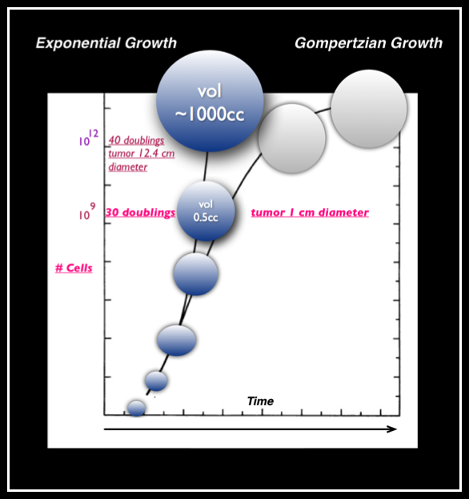
Gompertzian Growth Curve

Slide 34
Pathogenesis of cancer
Self-sufficiency in growth signals.
Insensitivity to growth-inhibitory signals.
Evasion of apoptosis.
Defects in DNA repair.
Limitless replication potential.
Sustained angiogenesis.
Ability to invade and metastasize.

Slide 35
Carcinogenesis
Is the process by which normal cells transformed into cancer cells.

Slide 36
Carcinogenic Factors
Heredity.
Hormonal factors.
Environmental agents:
chemicals.
Radiation.
Oncogenic viruses:
Human papollomavirus (HPV): cervical or anal carcinoma.
Epstein-Barr virus (EBV): lymphoma, nasopharyngeal carcinoma.
Hepatitis B virus (HBV): hepatocellular carcinoma.
Hepatitis C virus (HCV): hepatocellular carcinoma.
Human herpesvirus-8 (HHV-8): Kaposi sarcoma.
Human immunodeficiency virus (HIV): is an important cofactor in many human cancers because of its immunosuppressive effects.
Bacteria and parasites: helicobacter pylori.

Slide 37
Routes of tumor spread
The most common route for metastases is via:
The lymphatic system.
Circulation.
Adjacent invasion.

Slide 38
Metastasis
Growth and progression of the primary tumor.
Angiogenesis.
Local invasion.
Detachment and embolization.
Arrest in distant organ capillary beds.
Extravasation.
Proliferation.

Slide 39
Any Question?

