Slide 1
Testicular Cancer
Adnan Abu Arqoub 1182551 Jehan Diaa Bargouthi 1182887

Slide 2
Introduction
Testicular cancer is that type of cancer that starts in the male reproductive glands known as testis or testicles
This type of cancer is one of the most rare cancers and it’s count for only 1% of all cancer types
Testicular cancer mostly affect males aged between 15-35 years
It’s very treatable if early diagnosed and the risk of death from this cancer is very small

Slide 3
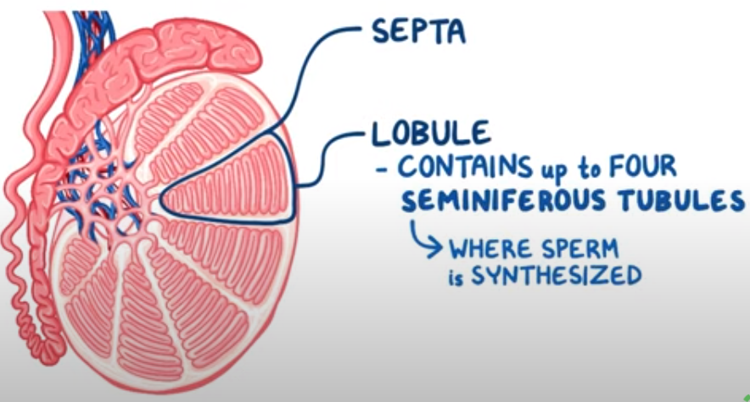
Testis are a pair of the male reproductive glands
Each testicle is covered by TUNICA ALBUGINEA
They have 2 main functions: first is producing male hormones ( testosterone) and the second is making sperms in the seminiferous tubule

Slide 4
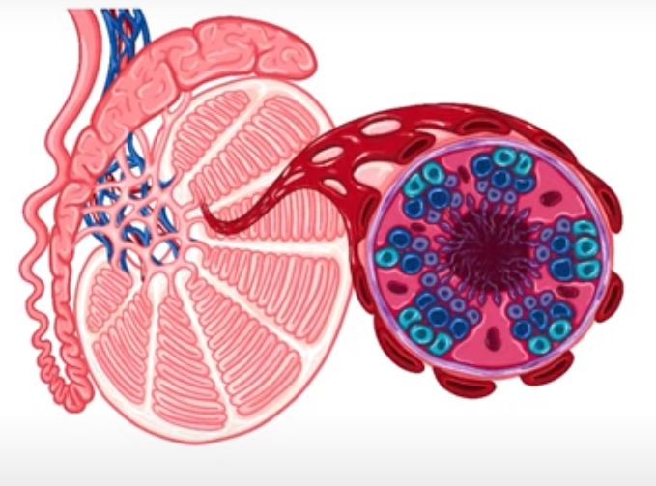
The seminiferous tubule has
Thick wall of epithelial cells that surrounds a fluid filled lumen
has two types of cells
Germ cells
Sertoli cells
Outside the tubule
Connective tissues with capillaries and LEYDIG CELLS

Slide 5
Pathophysiology
During fetal development the body is derived from three GERM layers
Ectoderm
Mesoderm
Endoderm
those layers are made of GERM cells (most differentiate and some don’t)
When the germ cells in the testis start to divide uncontrollably :
Benign / malignant tumours can be fromed

Slide 6
Types of testicular cancer
Testicular cancer has two types depending on the cells where it started
Germ Cell tumours (Most common 95% of cases)
this type of testicular cancer is divided into 2 subtypes
seminomas tumours
non-seminomas tumours which include : •yolk sack tumours
•Teratomas
•Choriocarcinoma
• Embryonal carcinoma
2. NON Germ cell tumours (5% of cases*)

Slide 7
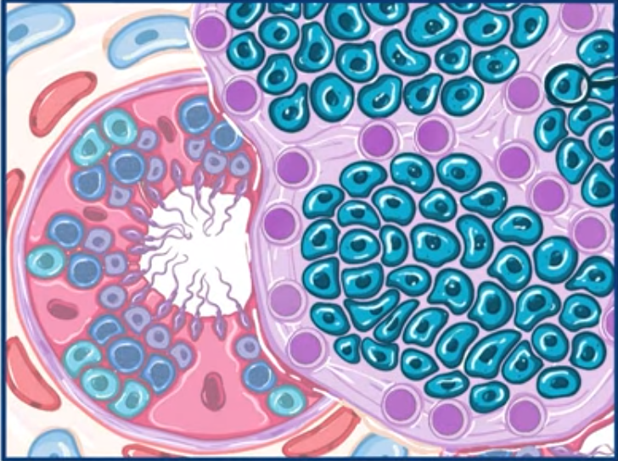
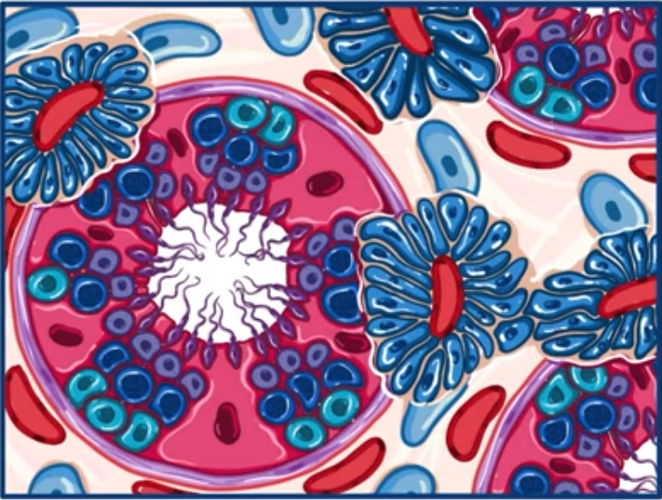
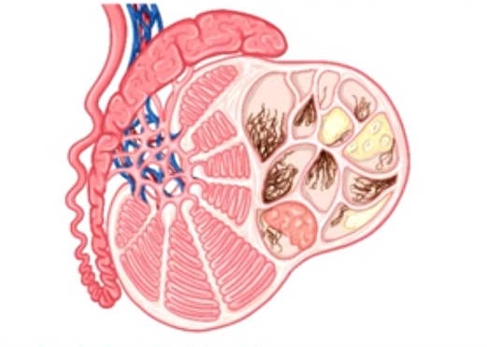
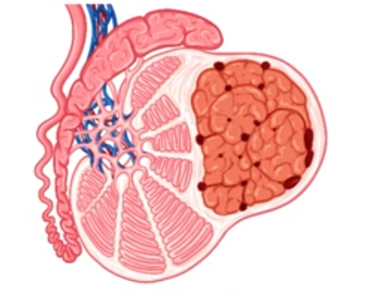
SEMINOMAS TUMOURS
YOLK SAC TUMOURS
MATURE CYSTIC TERATOMA
IMMATURE TERATOMA

Slide 8
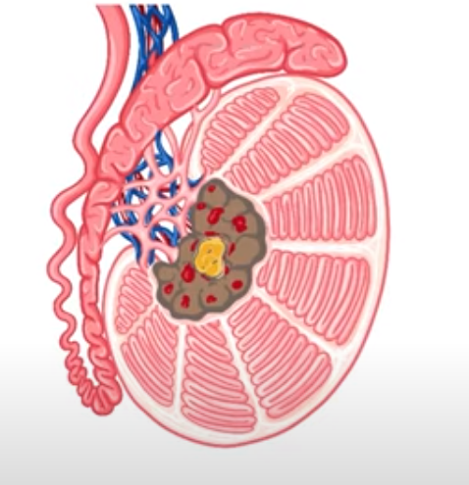
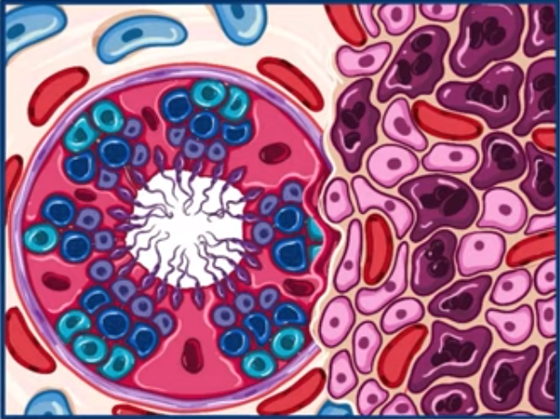
CHORIOCARCINOMA
EMBRYONAL CARCINOMA

Slide 9
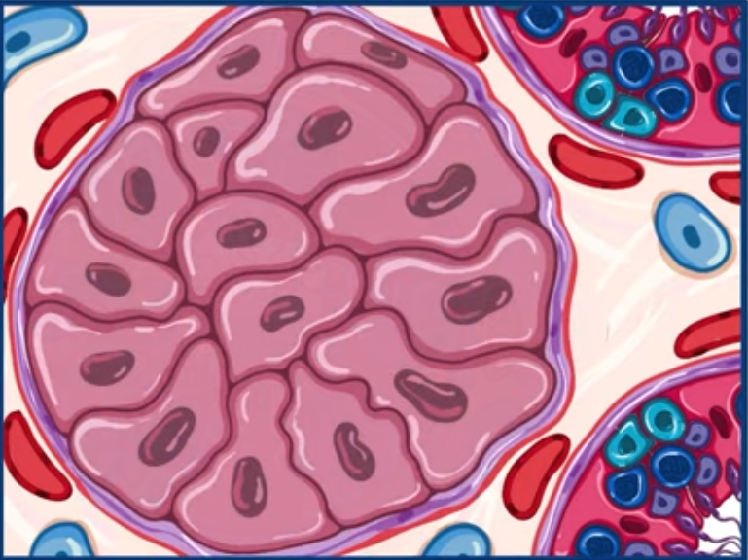
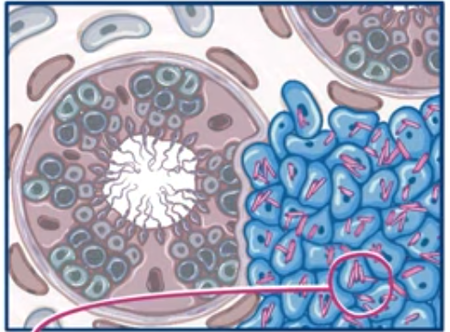
Non Germ Cell tumours
Sertoli Cell tumours
Leydig Cell tumours

Slide 10
Signs & Symptoms
Tumours present as Small painless lumps
Swollen testicles
Firm to Touch
Sharp or dull pain in the testicles and lower abdomen and back pain
Gynecomastia (enlargement of the breast)
Testicle atrophy
Loss of libido
Erectile dysfunction

Slide 11
Risk Factors
Cryptorchidism
Klinefelter syndrome
In utero exposure (diethylstilbestrol)
Genetics
Family history
Infertility

Slide 12
Diagnosing and Prevention
Physical exam
Ultrasound
CT & MRI
Blood tests (PLAP , AFP, hCG, LDH)
DO NOT PREFORM A BIOPSY (WHY?)
It can’t be prevented but it can be detected early to prevent further complication by doing Regular testicle self examination

Slide 13
Self Examination

Slide 14
Stages Of testicular cancer
Stage 0 : not really cancer but a warning that cancer could grow (has some risk factors)
Stage 1 : cancer found only in the testicle ( not spreading)
Stage 2 : cancer has spread to one or more lymph nodes in the abdomen
Stage 3 : cancer could be found further than the testicles and abdomen ( e.g spread to lungs) high tumour marker levels

Slide 15
Medical Management
Surveillance : for stage 0 and stage 1
if the cancer shows signs of growth, hormonal changes then :
Surgery (inguinal orchiectomy) , testis-sparing surgery
Chemotherapy
Radiation therapy (only for seminoma cancer and metastasis )

Slide 16
Nursing management
Assessment of physical and psychological status
Monitor the patient for any side effects after the surgery , chemo , radiation
Patients may have difficulty coping after surgery due to the effect on the body image, and sexuality

Slide 17
Resources
Heath line
PubMD
MedScape
Myoclinic
Nurseslab

