Slide 1
Caring for the Child and Family with a Hematologic Disorder
1289 - 1317

Slide 2
Disorder of RBC : Anemias
Anemia is reduction in the number of RBCs, the quantity of hemoglobin, & the volume of packed red cells to below-normal levels.
It has several types:
Normochromic ,Normocytic anemia: decreased in production of RBC due to decrease stimulation. RBC is normal in color & size but low in number→ anemia.
Acute blood loss anemia: anemia that result from acute blood loss.
Anemia of acute infection: infection leads to increase destruction of RBC→ anemia occur.

Slide 3
Anemia of renal diseases: problems in kidneys leads to decreased erythropoietin secretion, thus, decreasing RBCs production→ anemia (normaocytic)
Anemia of neoplastic disorders: invasion of bone marrow leads to decrease production of RBCs, thus, normaocytic anemia.
Aplastic anemia: (congenital or acquired), depression of hematopoietic activity in bone marrow will affect the RBC production with WBCs
& platelets affected → anemia occur.
Hypoplastic anemia: same as previous condition,
but the effect is on RBC production only.

Slide 4
Aplastic Anemia
Type of anemia characterized by severe bone marrow damage that leads to pancytopenia, leukopenia & thrombocytopenia
Hypoplastic anemia; profound depression of erythrocytes with normal/ slightly decreased WBC & platelets

Slide 5
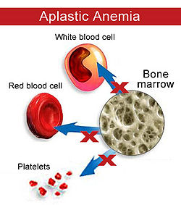

Slide 6
Etiology
Aplastic anemia can be primary ( congenital) or secondary (acquired) . The best known congenital disorder is Fanconi syndrome is a rare hereditary characterized by:-
- pancytopenia
- hypoplasia of the bone marrow
- patchy brown discoloration of the skin due to deposition of melanin and associated with multiple congenital anomalies of the musculoskeletal and genitourinary systems.

Slide 9
Factors contribute to development of acquired anemia
Infection with human parvovirus, hepatitis or overwhelming infection
irradiation
Drugs e.g. chemotherapy agents, antibiotics
Industrial & household chemicals e.g. benzene, dyes
Idiopathic

Slide 10
Diagnostic Evaluation
Clinical manifestation which include anemia, leukopenia, ↓platelet count
definitive diagnosis from bone marrow aspiration « red bone marrow → yellow, fatty bone marrow »

Slide 11
Therapeutic Management
Objectives of treatment based on:
Recognition that the underlying diseases process is failure of the bone marrow to carry out its hematopoietic functions.
Therefore restoring function to the marrow in 2 approaches
Immunosuppressive therapy
Replacement of the bone marrow through transplantation
*Bone marrow transplantation (hemopoietic stem cell
Transplantation) is the treatment of choice for severe aplastic anemia.

Slide 12
Antilymphocyte globulin (ALG) or antithymocyte globulin (ATG) is the principal drug treatment for aplastic anemia:-
to suppress T-lymphocyte–dependent autoimmune responses
Cyclosporine may use for children not respond to ATG
Colony – stimulating factors, may be used to enhance bone marrow production.
RBC + PLT transfusion

Slide 13
Nursing Considerations
Nursing Diagnosis: Risk for infection related to dramatic decrease in number of WBCs
Nursing Diagnosis: Risk for injury related to ineffective
blood clotting mechanisms secondary to inadequate
platelet formation
During ATG, attention directed to the IV infusion to prevent extravasations so central vein should be used
- Immediate reactions to ATG; fever, skin rash, delayed reactions with in 7-14 days; it can be prevented with corticosteroids.

Slide 14
2. Meticulous care of venous access catheter to prevent infection
3. Emergency preparation should be planned e.g. epinephrine & O2 readily available
4. Chemotherapeutic agents, reactions include: nausea, vomiting, alopecia, extensive mucosal ulcerations, ecchymosis of oral mucosa from thrombocytopenia.
5. Assess respiratory status to detect hypoxemia caused by low Hb
Assess vital signs for signs of hemorrhage infection & activity intolerance

Slide 15
7. Assess cardiovascular status to detect arrhythmias or myocardial ischemia
8. Monitor & record I&O & urine SG to determine fluid balance
9. Monitor laboratory values to determine effectiveness of therapy
10. Assess stool urine & emesis for occult blood loss caused by decreased platelets level
Monitor for infection, bleeding & bruising caused by decrease levels of WBC & platelets
Encourage fluids & administer IV fluid to replace fluids lost by fever & bleeding
Administer oxygen to improve tissue oxygen because low Hb level reduce the blood's oxygen-carrying capacity

Slide 16
14. Administer transfusion therapy as prescribed to replace low level of blood components
15. Maintain the patient's diet to promote RBC production & fight infection
16. Avoid giving IM injections to reduce the risk of hemorrhage
17. Avoid taking rectal temperature to reduce the risk of hemorrhage
18. Avoid contact sports
19. Avoid excessive exercise

Slide 17
Hypochromic(pale), microcystic anemia
Iron deficiency anemia
As the body require iron to produce hemoglobin, insufficient quantities of iron limit hemoglobin production. And affecting RBC production resulting in anemia.
RBCs are both small in size (hypocytic) and pale (hypochromic) due to the stunted hemoglobin
Mainly related to poor nutrition intake.
May be due to GI mal-absorption , or Bleeding
Adolescent ( female menstruating),as well as the infants of 6 months of age.

Slide 18
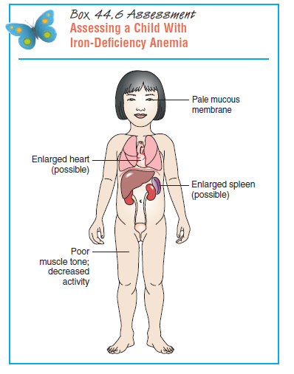
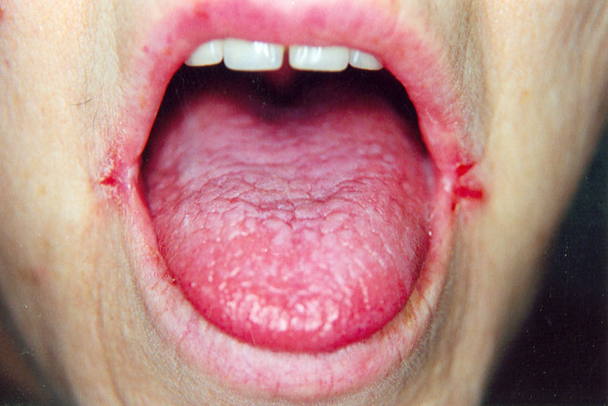
Clinical manifestations
Pale
Poor muscle development
Prone to infection
Glossitis, angular stomatitis
Impaired cognitive skills

Slide 19
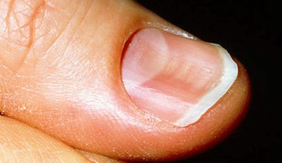
In severe of chronic IDA, children display the following symptoms:
Cracks in corners of the mouth
Dysphasia
Neuralgic pain
Numbness & tingling in the extremities
Smooth tongue
Spoon-shaped brittle nails
Vasomotor disturbances

Slide 20
Diagnostic Evaluation
- RBC =microcytic and hypochromic and
possibly poikilocytic (irregular in shape)
HCT = ↓ < 33%, ↓MCV = <70 um3
- Iron studies
Serum iron concentration “SIC” = measure the amount of circulating iron, “70ug/dl” in infant, higher in children
Total iron-binding capacity “TIBC”, measure the amount of transferrin or iron- binding globulin > 350 ug/dl
-** iron incorporated into Mono-Amine Oxydaze MAO , enzyme for CNS maturation
20

Slide 21
Diagnostic Measures IDA
Decrease level of :
- Hgb 11g/100ml
- Hct 33 %
- MCV
- MCH
- iron level
- Ferreten : stored iron
** iron incorporated into Mono-Amine Oxydaze MAO , enzyme for CNS maturation

Slide 22
Managements
Correction of the iron by oral supplements.
Consumption of food rich in iron (meats, fish, dried fruit, vegetables, whole cereal).
Consumption of food rich in vitamin C, to enhance iron absorption. Such as(orange, strawberries, potatoes).
When adequate dosage is reached, stool turn to a tarry green or black color
Ferrous sulfate to correct the deficiency.
Blood transfusion if Hb is less than 4 mg/dl.

Slide 23
Therapeutic Management
Prevention is achieved through
Optimum nutrition & appropriate iron supplementation by using breast feeding for the first 12 months or commercial formula, begin iron supplementations 1mg/kg/day
Dietary counseling, iron-fortified formula, ingested iron is absorbed from duodenum by acid environment, parenteral iron administration is painful, expensive

Slide 24
Nursing considerations
Objectives: prevention of nutritional anemia through parent education
Education about dietary iron supplementation during infancy stored that overweight isn’t a good health
Observe signs of anemia
Check blood values
Instructing parent regarding proper administration of oral iron supplementation
When adequate dosage is reached, stool turn to a tarry green or black color
Store iron for 1 month supply in safely place
Counseling families
Meal planning based on budget, cultural pattern & food preference

Slide 25
Factors affect the absorption of iron supplements
Stomach acidity
It administered into two divided doses between meals
Give with citrus fruit or juice
Interventions
Carefully assess the child's drug history, certain drugs such as pancreatic enzymes & vitamin E, may interfere with iron metabolism & absorption such as steroid & aspirin
Provide passive stimulation, allow frequent rest, give small, frequent feedings & elevate the head of the bed to decrease oxygen demands
Provide foods high in iron to replenish iron stores

Slide 26
Ensure that parents are providing their infant with iron fortified formula & cereals
Administer iron with citrus juice before meals
Give liquid iron through a straw to prevent staining the skin & teeth
Don't give iron with milk products because they may interfere with iron absorption
Ensure that parents are keeping the iron safely stored out of the child's reach at home
Brush teeth after administration of iron
Advise parents to expect black tarry stools

Slide 27
Macrocytic / megaloblastic Anemia
Macrocytic = large in size
Megaloblastic = nucleated immature RBC
Folic acid deficiency anemia: low level of folic acid will lead to arrest in of maturity process of RBC leading to abnormally large RBCs, → anemia.
Prenicious Anemia : low level of vit. B12 will lead to arrest of RBC maturation
gastric mucosa fails to secrete sufficient amount of internsic factors

Slide 28
Hemolytic Anemia
Increase RBC destruction caused by :-
Abnormal RBC structure
Extracellular destruction forces
Congenital spherocytosis: RBC small and defective due to abnormal protein cell membrane , increase permeability to sodium , lead to cell swelling , rupture & destroy-----to jaundice
G-6 P D : enzyme maintenance of RBC deficiency
Sickle cell anemia

Slide 29
G6PD, Favism
Glucose-6-phosphate dehydrogenase deficiency is
an X-linked recessive, hereditary disease.
Glucose-6-phosphate dehydrogenase is a metabolic enzyme involved in the metabolism of the red blood cells. Also it protects RBC from stress of oxidizing substances.
Individuals with the disease may exhibit non immune hemolytic anemia in response to a number of causes, most commonly infection or exposure to certain medications or chemicals or consumption of broad beans that leads to hemolytic reaction

Slide 30
Causes & Manifestations:
Under normal circumstances, patients with G6PD does not have problems
Any condition that leads to increase oxidative stress on RBC will leads to hemolysis of the RBC such as:
Illness (especially severe infections)
Certain drugs such as thiazolesulfone ,Sulfonamides analgesics (aspirin)
Certain foods, most notably broad beans
Certain chemicals such as henna.
Symptomatic patients are almost exclusively male, due to the X-linked pattern of inheritance

Slide 31
Pathophysiology
As the hemolysis of the RBCs occur, increase destruction will lead to over accumulation of indirect billirubin that liver enzymes can not metabolize leading to jaundice.
Anemia occur related to over destruction of RBCs.
Patient looks pale irritable, tiered.
40

Slide 32
Diagnostic test
Complete blood count
Liver enzymes (to exclude other causes of jaundice)
Glucose-6-phosphate dehydrogenase
(Coombs' test) - this should be negative, as hemolysis in G6PD is not immune-mediated

Slide 33
Treatment
The most important measure is prevention - avoidance of the drugs and foods that cause hemolysis
In the acute phase of hemolysis; blood transfusions might be necessary
Some patients benefit from removal of the spleen (splenectomy).

Slide 34
Sickle Cell Anemia
Presence of abnormally shaped (elongated) RBCs.
Autosomal recessive inherited disorder
on the beta chain of hemoglobin.
the amino acid valine takes the place of the normally appearing glutamic acid
where red blood cells form “sickle” shapes instead of round ones.
20

Slide 35
Defective hemoglobin caused by mutation at one amino acid: Valine replaces glutamic acid
Forming long hemoglobin fibers – cause sickle shape inside RBC
Elongated cells block the capillaries, leads to microscopic obstruction and ischemia occur.
Causing swelling, inflammation, pain, and cell death .

Slide 37
Sickeling may be triggered by any factor that increases the body’s need for oxygen or alert the transport of it, such as:
Fever, emotional & physical stress.
Increasing blood velocity (low intake), dehydration
Hypoxia :submitted to low oxygen tension (less than 60% to 70%)
Cold.
Blood Low pH (Acidosis)
Trauma.
Infections.

Slide 38
Clinical manifestation
Manifestations are classified according to
the crisis that could occur
vaso-occlusive crisis.
spleenic sequestration.
aplastic crisis.
acute chest syndrome.

Slide 39
Clinical manifestations are related to the shorten life span of the blood cells (hemolytic anemia) and tissue destruction resulting from vaso-occlusion crisis.
Brain: CVA, headache, convulsion
Eyes: retinopathy, retinal detachment.
Bones: osteoporosis, osteomylitis
aseptic necrosis of the head of the femur or humerus
Heart: cardiomegally, exercise intolerance.
Lungs: infection, cough, fever, tachypnea.
Liver: hepatomegaly, cirrhosis.
Spleen: spleenomegally.
Kidneys: enuresis, hematurea, renal failure.
Skin: decreased peripheral circulation.

Slide 40
The most common reason for hospitalization is due to acute painful episodes.
Pain results from avascular necrosis of bone marrow, it experienced in back, abdomen, chest & joints.
Generalized pain lasts for several days or weeks.
The pain can be acute (sudden), chronic (long lasting), or a mixture of the two.

Slide 41
spleenic sequestration:
Profound anemia, hypovolemia, shock. Because blood pool in the spleen.
Aplastic crisis:
Anemia, pallor, fatigue. Because of decreased production of RBC & increase destruction of it.
Acute chest syndrome:
Fever, cough, chest & back pain, dyspnea, hypoxemia.

Slide 42
Diagnostic tests
Difficult to Dx. Before 6 months of life …. Why ?????
Hemoglobin electrophoresis : HgSS.
History & physical examination:
Some infants have swelling of the hands and feet (a hand–foot syndrome)
Serum analysis that reveales anemia
• Hb (6-10 g/dl).
Increased RBCs levels.
30

Slide 43
Clinical therapy
The child in sickle-cell crisis has three primary needs:
pain relief and adequate hydration and oxygenation to prevent further sickling and halt the crisis
Control the pain:
By parenteral analgesia, such as morphine.
Increase hydration.
Oxygenation.
Treat infections:
By antibiotic such as penicillin ( prophylactic )
Monitor infections by cultures : (Pneumococcal meningitis and salmonella-induced osteomyelitis )
Give immunization as scheduled : pneumococcal vaccine

Slide 44
Transfusion of RBCs:
(usually packed RBCs) to maintain the hemoglobin above 12 g/dL (termed hypertransfusion).
To improve tissue oxygenation and temporary suspension of production of RBCs containing HbS.
Monitor for iron overload (hemosidrosis) with frequent transfusion.
Give deferoxamine with vitamin C to enhance
excretion of iron.
Other therapy:
Hydroxyurea (antineoplastic agent ), decreases the production of abnormal blood cells and leads to lesser pain, increase hemoglobin F/ fetal hgb.
Hematopiotic stem cell transplantation.

Slide 45
Nursing intervention
Monitor child during blood transfusion.
Monitor iron overload.
Promote hydration.
Pain management: Give analgesia as order.
Emotional support.
Infection control
educational support.
Ensure adequate nutrition

Slide 46
Thalassemias
The word thalasemia come from Greek word
thalassic mean “sea”
Heredities blood disorders characterized by deficiencies in the rate production of specific glopin Beta chains in hemoglobin .
It is mostly common in the area around Mediterranean Sea.
They affect one of the two pairs of polypeptide chains (alpha & beta) in the hemoglobin chain.

Slide 47
Beta-Thalassemia
The most common type, normally there are one gene in each chromosome that mean a total of two genes. It occurs in forms:-
Beta thalassemia minor or thalassemia trait
( Heterozygous): -
One gene is deleted. Asymptomatic silent carrier.
produce both defective beta hemoglobin and normal
hemoglobin .
RBC : normal, Hgb decreased 2 to 3 g/100 mL below NL
The blood cells are moderately hypochromic and microcytic
because of the poor hemoglobin formation (pallor)
should not receive a routine iron supplement

Slide 48
Thalassemia major (Cooley’s anemia).
Sever anemia " both beta chain are deleted, and it’s the most sever type of beta thalassemia.
As a compensatory mechanism, the body produce fetal hemoglobin which is fragile and easily destroyed shortening their life span.
As hemolysis increases, hemosiderin (iron- containing pigment) is deposited in the skin, causing a bronze appearance.

Slide 49
Pathophysiology
Chronic anemia(damage of RBC) leads to hyperplasia of bone marrow cavity & thinning of the bone marrow cortex(immature RBC).
As a result; pathologic fractures and skeletal deformities may occur.
Spleenomegally occur as the spleen become
hyperactive from pooling the cells.
long term complications related to hemochromatosis ,”hemosideriosis”? (excessive absorption & accumulation of iron in the body), including gallbladder disease, liver enlargement, jaundice, growth retardation & heart failure.

Slide 50
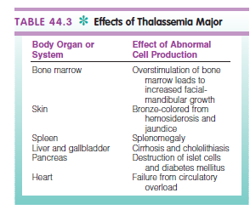
Thalassemia Major

Slide 51
Mode of transmission :-
Its autosomal – recessive disorder, both parent should be carriers to produce a child with beta thalassemia major.
In addition, if one of the parent is carrier; their child may be have (minor, trait or intermediate).

Slide 52
Clinical manifestations
The onset of s/s in major thalassemia insidious and not recognized until late infancy or toddlerhood ?!!
The clinical affect of thalassemia major
are attributed to :-
Defective syntheses of hemoglobin A
Structurally impaired RBC
Shortened life span of erythrocyte .

Slide 53
Clinical manifestations
Paleness.
Failure to thrive.
Hepatomegaly.
Hypoxia ,Anemia , Headache
Iron overload
Spleenomegally.
Irritability, bone pain, activity intolerance.
Anorexia restlessness.
Retarded growth: specially sexual maturation, secondary sexual characteristic absent .
Enlarged head and maxilla, protrusion of upper
central teeth.

Slide 54
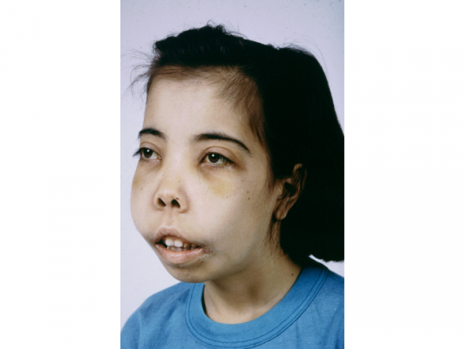
Bone changes ( older children if untreated)
Enlarged head
Prominent frontal and parietal bosses
Flat or depressed bridge of the nose
Enlarged maxilla
Protrusion of the lip
Oriental appearance of eyes

Slide 55
Diagnostic evaluation:-
RBCs account and shape (decrease in mature RBCs)
Hypochromic And microcytic
Hb and hematocrit decreased : less 5gr/100 ml
Serum Iron level : high
Hb – electrophoresis (analyze the quantity and specific hemoglobin variant found in blood). It revealed decreased production of the globin chains in hemoglobin & elevated F hemoglobin
Most children are diagnosed by the sixth month of
their life.

Slide 57
Treatment
The treatment is supportive.
Blood transfusion every 2-4 weeks (Hypertransfusion therapy ) is the conventional therapy. Since iron overload is the main side effect of this therapy.
Children need to receive an iron-chelating drug such as Desforal (deferoxamine) (I.V, S\C 30 -40 mg/kg/day, On a pump over 8 – 12 hours for 5 – 7 days a week) or (give I.V Q 4 hours at time of blood transfusion.
Food rich of iron should be avoided.
Splenectomy ??
Bone marrow transplantation

Slide 58
Prognosis:-
Child who receives blood transfusion may survive well into adulthood. The most common cause of death is heart disease.
Nursing consideration:-
– Blood transfusion
– Monitor complication of blood transfusion 3- Support family
4 – Genetic counseling

Slide 59
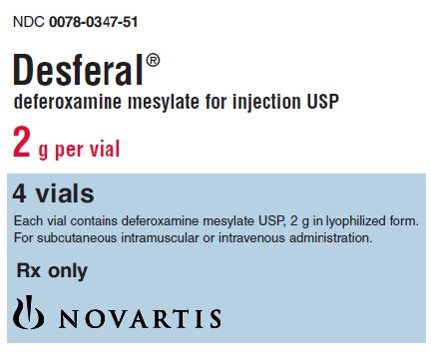
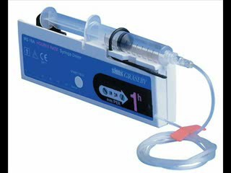
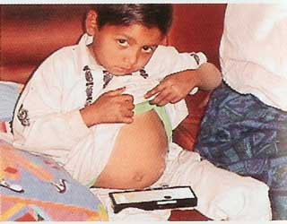

Slide 60
Disorder of WBC Leukemia
Is a cancer of the blood or bone marrow and is characterized by an abnormal proliferation (production by multiplication) of blood cells, usually white blood cells (leukocytes).
10

Slide 61
Classifications
Leukemia is divided according to the affected cells or into acute and chronic.
Acute leukemia
Is characterized by the rapid increase of immature blood cells. This crowding makes the bone marrow unable to produce healthy blood cells.
Immediate treatment is required in acute leukemias due to the rapid progression and accumulation of the malignant cells, which then spill over into the bloodstream and spread to other organs of the body.

Slide 62
Chronic leukemia
Is distinguished by the excessive build up of relatively mature, but still abnormal, blood cells.
Typically taking months or years to progress, the cells are produced at a much higher rate than normal cells, resulting in many abnormal white blood cells in the blood.
Chronic leukemia are monitored for some time before treatment to ensure maximum effectiveness of therapy

Slide 63
In lymphoblastic :lymphocytic leukemias, the cancerous change took place in a type of marrow cell that normally goes on to form lymphocytes.
In myeloid :myelogenous leukemias, the cancerous change took place in a type of marrow cell that normally goes on to form red cells, some types of white cells, and platelets.

Slide 64
Cell type | Acute | Chronic
Lymphocytic leukemia | Acute lymphocytic leukemia | Chronic lymphocytic leukemia
Myelogenous leukemia | Acute myelogenous leukemia | Chronic myelogenous leukemia

Slide 65
Clinical manifestation
Minor infection as common cold that has failed to
completely disappear.
Fever failed to disappear although use of
antibiotic
Pale, restlessness.
Irritable, anorexia
Weight loss
– Bone + joint pain
– Sudden bleeding from teeth, mouth, nose.

Slide 66
Clinical manifestation
8- Bruising without cause 9 – Recurrent infection 10 – Abdominal pain
– Decrease apatite
– Lymphoidadenopathy
– Dyspnea
– Anemia, fatigue, bleeding, decrease platelets 15 – Hepato – spleenomegally.

Slide 67
There is no single known cause for all of the different types of leukemia.
Researchers have strong suspicions about four possible causes:
natural or artificial radiation
certain kinds of chemicals
some viruses
genetic predispositions

Slide 68
Diagnostic evaluation
History & physical examination
WBC differentiation
Bone marrow aspiration (biopsy)
CBC, U\S
lymph node biopsy.
Lumber puncture

Slide 69
Nursing role during chemotherapy
Teaching and support for family about side effect of medication and complication
Prepare family and child before start
treatment.

Slide 70
Disorder of blood coagulation
Hemophilia
ITP
Henouch-schonlein syndrome
DIC

Slide 71
Hemophilia
A group of inherited deficiency disorders of specific coagulation proteins.
That results from low or absence of some clotting factors.
Types of the disease occur according to the deficient factors.
20

Slide 72
Hemophilia A is a deficiency of clotting factor VIII that represent 80% of cases.
Hemophilia B is a deficiency of clotting factor IX
that represents 15 % of cases.
Hemophilia C, is a deficiency of clotting factor X ; the less sever form of hemophilia.
Von willebrand's disease, is a deficiency of clotting factor VIII, and poor platelet aggregation.
21

Slide 73
Hemo A
Hemo B
Hemo C
Miss. kamlah ahmed 22

Slide 74
Hemophilia A & B is X- linked recessive trait, which means that the defect of the genes are carried on the X chromosome.
So the males are always affected & female are affected or carrier of the disease.
The degree of bleeding is related to the amount of clotting factors.

Slide 76
Clinical manifestation
Clinical severity | Factors activity | Bleeding tendency
sever | 1% | Spontaneous bleeding without trauma
Moderate | 1%-5% | Bleeding with trauma
mild | 5%-50% | Bleeding with sever trauma and surgery.

Slide 77
Hemarthrosis (bleeding in joint cavity, knee, elbow, ankles)
Stiffness, tingling, in affected joint
(before bleeding)
Decrease ability to move joint
Pain, redness, swelling.
Spontaneous hematuria
Epistaxis
Intracranial hemorrhage(cause of death
GI bleeding (anemia) 9-hematomas in the
spinal cord causes (paralysis)
)

Slide 78
Diagnostic evaluation
- History & physical examination.
- prolonged PTT : best reveals low factor VIII , clotting time prolonged
3- CBC (normal platelets) , normal PT .
4- Factors VIII, IX. (low levels) 5- DNA testing
Test | Normal value
Bleeding time | 2-9 minutes
Ptt | 42 – 54 seconds
Pt | 11 -15 seconds

Slide 79
Treatment
The goal of the treatment is to replace the missing
factor, thus prevent bleeding.
Replacement the missing factors VIII concentration by giving intravenous desmopressin acetate DDAVP (vasopressin analog) To stimulate the release of factor VIII thus, increase factor VIII by two to fourth fold.
Cryoprecipitate is a frozen blood product prepared from plasma used to replace factors VIII, XIII & fibrinogen.
Clotting factors to replace factors VIII, IX.
Blood transfusion of plasma, PRBC, Whole blood.

Slide 80
Nursing Role:-
Support family.
Teaching and explanation
give children soft toys to prevent injuries.
Safe sport like swimming.
Special dental care
Immunization not to give IM, S\C
monitor for signs of bleeding.
Counseling
Limit joint involvement & pain(ice packs,
Immobilization)
Avoid taking temperature rectally, or give suppository medication, use paper tape for dressing, avoid venopunctures,

Slide 81
Therapeutic Management
1. Passive ROM should never be part of an exercise regimen after acute episode, since the joint capsule could easily be stretched & bleeding could recur
2. Avoid NSAID such as ibuprofen & aspirin because it inhibit platelet function
3. Active ROM exercise is best who could control over pain tolerance
4. Promotion of vasoconstriction during bleeding episodes by applying ice, pressure & hemostatic agents
5. Aspirin shouldn’t used, use acetaminophen “Tylenol” instead of aspirin

Slide 82
Recognize & control bleeding
The earlier a bleeding episode is recognized, the more effectively treated
Factors replacement therapy should be instituted according to medical protocol
Supportive measures such as,
RICE =
Rest
Ice
Compression
Elevation
82

Slide 83
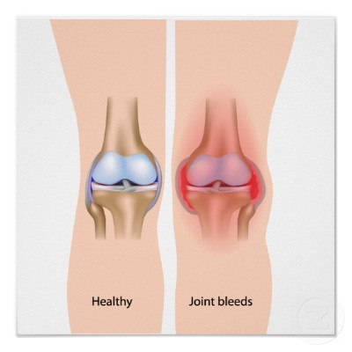
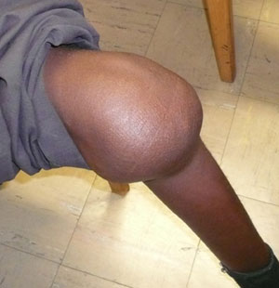
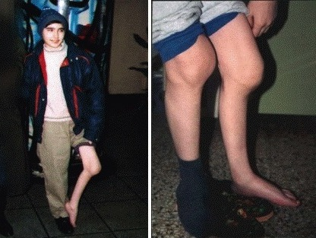

Slide 84
Idiopathic Thrombocytopenic Purpura
Also known as autoimmune thrombocytopenic purpura (ITP), is a disorder characterized by increase destruction of platelets.
Even production of platelets in bone marrow generally is normal (megakarycytes).
As the rate of platelets decreases; blood clotting slows, bleeding often in mucosa.
It can be acute and improve within 1-3 months or
chronic if the condition lasts for a longer period.
30

Slide 85
Etiology & Pathophysiology
The cause is unknown exactly (but its autoimmune
response to disease related antigens).
On other word it occurs after a viral infection
such as vercella ,measles, rubella, mumps, and chickenpox, or after infection with parvovirus B19..
An antibody that acts against platelets binds to platelet surface, react with membrane glycoprotein; and cause platelets destruction in the liver & spleen.

Slide 86
Clinical Manifestation
Symptoms includes
multiple ecchymoses
& petechiae.
Bleeding from mucus membrane, mouth or nose.
A child typically been
well.

Slide 87
PETECHIAE, PURPURA, AND ECCHYMOSES
Three terms that refer to bleeding that occurs in the skin are petechiae, purpura, and ecchymoses.
Generally, the term "petechiae" refers to smaller lesions. "Purpura" and "ecchymoses" are terms that refer to larger lesions.
In certain situations purpura may be palpable. In all situations, petechiae, ecchymoses, and purpura do not blanch when pressed.

Slide 88
a. This 7-year-old boy has petechiae from thrombocytopenia secondary to chemotherapy.
b. The palpable purpura on the foot of this nearly 3- year-old boy are associated with the disease Henoch- Schönlein Purpura: increase vessels permeability ---= hypersensitivity reaction to specific allergen

Slide 89
Diagnostic test
The diagnosis is made by taking history of the patient, physical examination & libratory findings.
Platelets count is less than20,000/mm3,
normal hemoglobin & WBC counts.
Coombs’test (direct or indirect) can be performed to detect the presence of antibodies.

Slide 90
Treatment
In minor cases no treatment is required, children improve without therapy within 6 months.
In some cases children may need corticosteroid (oral prednisone )therapy to reduce immune response.
Intravenous immunoglobulin can be administered as anti-D immunoglobulin that improve platelets count within 24-48 hours.

Slide 91
Nursing interventions
Emotional, educational support to family.
Teaching about the disease, complication. 3- Prevent bleeding (safe environment
e.g. avoid aggressive sports such as running.
4- Restricted sport to swimming for example. 5- Avoid medication as aspirin and ibuprofen.

Slide 92
DIC
Disseminated intravascular coagulation, is a life threatening pathological process in which clotting factors are abnormally activated.
Resulting in wide spread of clot formation in the
small vessels throughout the body.
It is complication of other serious disease such as infections, sepsis, hypoxia, shock, trauma, burn, liver disease, cancer.

Slide 93
Coagulation
Stage one
Intrinsic Factors
Extrinsic Factors
From plasma
From tissue
Release factors VIII, IX, XII |  |  |  |  | Release factors VII, X, III
+ platelets aggregation
V.C
B.F

Slide 94
Presence Complete thromboplastine time (III) and converted to…
Stage two
Prothrombin (II) that converted to thrombin with help of Ca++ & K +
Stage three
Thrombin converted to fibrinogen
that will converted into fibrin
Stage four
Formation of the plug

Slide 95
Pathophysiology
Widespread formation of tiny blood clots within microcirculation of all body organs.
The fibrinolytic pathway is activated, promoting the dissolution of the clots that have been formed.
The amounts of thrombin that inters the circulation greatly exceed that of clotting inhibitors to regulate it.
The deposit of thrombin, decrease blood flow to
organs leading to ischemia, infarction & necrosis

Slide 96
Pathophysiology
The excessive amount of thrombin also activate platelets aggregation; causing thrombocytopenia.
Plasma begin to break down fibrin before a stable clot is formed.
5. Clotting factors are depleted, the ability to form clot is lost, and hemorrhage occurs.

Slide 97
Manifestations
All symptoms of diffuse bleeding:
Hematurea.
Petechiae or purpura.
Oozing at injection site.
Circulatory collapse, shock, oligurea.
Major vessels thrombosis.
Cyanosis, pallor, cool extremities.
Weakness, malaise.

Slide 98
Treatment
Clinical therapy is supportive.
Identification of the underlying
cause.
Replacement of the depleted coagulation factors.
Anticoagulation therapy (heparin).

Slide 99
Nursing managements
Assessing bleeding, prevent injuries.
Observe petechiae, ecchymoses & oozing every 1 – 2 hours.
Assess extremities for capillary refill, warmth & pulse.
Assess stool for presence of blood.
Maintain skin integrity, gentile positioning.

