Slide 1
Abuse & Violence

Slide 2
Introduction
Statistics show that most abuse is perpetrated by someone the victim knows.
Victims of abuse are found across the life span, and they can be spouses or partners, children, or elderly parents.

Slide 3
Clinical Picture of Abuse and Violence
Victims of abuse or violence certainly can have physical injuries needing medical attention, but they also experience psychological injuries with a broad range of responses.
Some clients are agitated and visibly upset; others are withdrawn and aloof, appearing numb or oblivious to their surroundings.
Often, domestic violence remains undisclosed for months or even years because victims fear their abusers. Victims frequently suppress their anger and resentment and do not tell anyone. This is particularly true in cases of childhood sexual abuse.

Slide 4
Clinical Picture of Abuse and Violence
Survivors of abuse often suffer in silence and continue to feel guilt and shame. Children particularly come to believe that somehow they are at fault and did something to deserve or provoke the abuse. They are more likely to miss school, are less likely to attend college, and continue to have problems through adolescence into adulthood.
As adults, they usually feel guilt or shame for not trying to stop the abuse. Survivors feel degraded, humiliated, and dehumanized. Their self-esteem is extremely low, and they view themselves as unlovable. They believe they are unacceptable to others, contaminated, or ruined.
Depression, suicidal behavior, and marital and sexual difficulties are common.

Slide 5
Clinical Picture of Abuse and Violence
Victims and survivors of abuse may have problems relating to others. They find trusting others to be difficult.
In relationships, their emotional reactions are likely to be erratic, intense, and perceived as unpredictable. Intimate relationships may trigger extreme emotional responses such as panic, anxiety, fear, and terror.
Even when survivors of abuse desire closeness with another person, they may perceive actual closeness as intrusive and threatening.

Slide 6
Clinical Picture of Abuse and Violence
Nurses should be particularly sensitive to the abused client’s need to feel safe, secure, and in control of his or her body. They should take care to maintain the client’s personal space, assess the client’s anxiety level, and ask permission before touching him or her for any reason.
Because the nurse may not always be aware of a history of abuse when initially working with a client, he or she should apply these cautions to all clients in the mental health setting.

Slide 7
Characteristics of Violent Families
Family violence encompasses spouse battering; neglect and physical, emotional, or sexual abuse of children; elder abuse; and marital rape.
In many cases, family members tolerate abusive and violent behavior from relatives they would never accept from strangers.
In violent families, the home, which is normally a safe haven of love and protection, may be the most dangerous place for victims.

Slide 8
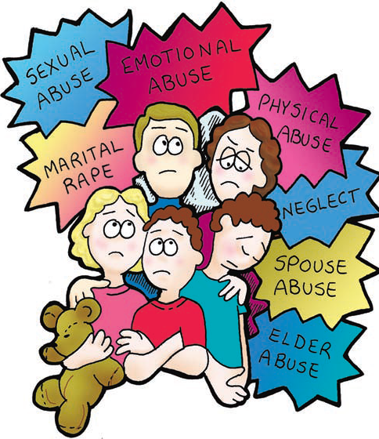
Family Violence

Slide 9
Characteristics of Violent Families
Social isolation.
Abuse of power and control.
Alcohol and other drug abuse.
Intergenerational transmission process.

Slide 10
Cultural Considerations
Although domestic violence affects families of all ethnicities, races, ages, national origins, sexual orientations, religions, and socioeconomic backgrounds, a specific population is particularly at risk: immigrant women.
Battered immigrant women face legal, social, and economic problems different from U.S. citizens who are battered and from people of other cultural, racial, and ethnic origins who are not battered.

Slide 11
Intimate Partner Violence
Intimate partner violence is the mistreatment or misuse of one person by another in the context of an emotionally intimate relationship.
The relationship may be spousal, between partners, boyfriend, girlfriend, or an estranged relationship. The abuse can be emotional or psychological, physical, sexual, or a combination (which is common).
Psychological abuse (emotional abuse) includes name-calling, belittling, screaming, yelling, destroying property, and making threats as well as subtler forms, such as refusing to speak to or ignoring the victim.
Physical abuse ranges from shoving and pushing to severe battering and choking and may involve broken limbs and ribs, internal bleeding, brain damage, and even homicide.
Sexual abuse includes assaults during sexual relations such as biting nipples, pulling hair, slapping and hitting, and rape.

Slide 12
Clinical Picture
An abusive husband often believes his wife belongs to him (like property) and becomes increasingly violent and abusive if she shows any sign of independence, such as getting a job or threatening to leave. Typically, the abuser has strong feelings of inadequacy and low self-esteem as well as poor problem-solving and social skills.
He is emotionally immature, needy, irrationally jealous, and possessive. He may even be jealous of his wife’s attention to their own children or may beat both his children and his wife.
By bullying and physically punishing the family, the abuser often experiences a sense of power and control. Therefore, the violent behavior often is rewarding and boosts his self-esteem.

Slide 13
Cycle of Abuse and Violence
The cycle of violence or abuse is another reason often cited for why women have difficulty leaving abusive relationships. A typical pattern exists: Usually, the initial episode of battering or violence is followed by a period of the abuser expressing regret, apologizing, and promising it will never happen again. He professes his love for his wife and may even engage in romantic behavior (e.g., buying gifts and flowers). It is called honeymoon period.
The woman naturally wants to believe her husband and hopes the violence was an isolated incident. After this honeymoon period, the tension-building phase begins; there may be arguments, stony silence, or complaints from the husband. The tension ends in another violent episode after which the abuser once again feels regret and remorse and promises to change.

Slide 14
Assessment
Because most abused women do not seek direct help for the problem, nurses must help identify abused women in various settings.
Nurses may encounter abused women in emergency rooms, clinics, or pediatricians’ offices.
Some victims may be seeking treatment for other medical conditions not directly related to the abuse or for pregnancy.

Slide 15
SAFE Questions?
Stress/Safety: What stress do you experience in your relationships? Do you feel safe in your relationships? Should I be concerned for your safety?
Afraid/Abused: Have there been situations in your relationships where you have felt afraid? Has your partner ever threatened or abused you or your children? Have you ever been physically hurt or threatened by your partner? Are you in a relationship like that now? Has your partner ever forced you to engage in sexual intercourse that you did not want?
Friends/Family: Are your friends aware that you have been hurt? Do your parents or siblings know about this abuse? Do you think you could tell them, and would they be able to give you support?
Emergency plan: Do you have a safe place to go and the resources you (and your children) need in an emergency? If you are in danger now, would you like help in locating a shelter? Would you like to talk to a social worker/a counselor/me to develop an emergency plan?

Slide 16
Treatment and Intervention
Studies have shown that arresting the batterer may reduce short-term violence but may increase long-term violence.

Slide 17
Treatment and Intervention
Battered women’s shelters can provide temporary housing and food for abused women and their children when they decide to leave the abusive relationship.
In many cities, however, shelters are crowded; some have waiting lists, and the relief they provide is temporary.
The woman leaving an abusive relationship may have no financial support and limited job skills or experience. Often she has dependent children. These barriers are difficult to overcome, and public or private assistance is limited.

Slide 18
Treatment and Intervention
In addition to the many physical injuries that abused women may experience, there are emotional and psychological consequences.
Individual psychotherapy or counseling, group therapy, or support and self-help groups can help abused women deal with their trauma and begin to build new, healthier relationships.
Battering also may result in PTSD.

Slide 19
Child Abuse
Child abuse or maltreatment generally is defined as the intentional injury of a child.
It can include physical abuse or injuries, neglect or failure to prevent harm, failure to provide adequate physical or emotional care or supervision, abandonment, sexual assault, and overt torture or maiming.

Slide 20
Child Abuse
Fathers, stepfathers, uncles, older siblings, and live-in partners of the child’s mother often perpetrate abuse on girls.
About 75% of reported cases involve father–daughter incest; mother–son incest is much less frequent.
Estimates are that 15 million women in the United States were sexually abused as children, and one third of all sexually abused victims were molested when they were younger than 9 years of age.

Slide 21
Types of Child Abuse
Physical abuse of children often results from unreasonably severe corporal punishment or unjustifiable punishment such as hitting an infant for crying.
Intentional, deliberate assaults on children include burning, biting, cutting, twisting limbs, or scalding with hot water.
The victim often has evidence of old injuries (e.g., scars, untreated fractures, or multiple bruises of various ages) that the history given by parents or caregivers does not explain adequately.

Slide 22
Sexual Abuse
Sexual abuse involves sexual acts performed by an adult on a child younger than 18 years. Examples include incest, rape, and sodomy performed directly by the person or with an object, oral–genital contact, and acts of molestation such as rubbing, fondling, or exposing the adult’s genitals.
Sexual abuse may consist of a single incident or multiple episodes over a protracted period. A second type of sexual abuse involves exploitation, such as making, promoting, or selling pornography involving minors, and coercion of minors to participate in obscene acts.

Slide 23
Neglect
Neglect is malicious or ignorant withholding of physical, emotional, or educational necessities for the child’s well-being.
Child abuse by neglect is the most prevalent type of maltreatment and includes refusal to seek health care or delay doing so; abandonment; inadequate supervision; reckless disregard for the child’s safety; punitive, or abusive emotional treatment; spousal abuse in the child’s presence; giving the child permission to be truant; or failing to enroll the child in school.

Slide 24
Psychological Abuse
Psychological abuse (emotional abuse) includes verbal assaults, such as blaming, screaming, name-calling, and using sarcasm; constant family discord characterized by fighting, yelling, and chaos; and emotional deprivation or withholding of affection, nurturing, and normal experiences that engender acceptance, love, security, and self-worth.
Emotional abuse often accompanies other types of abuse (e.g., physical or sexual abuse). Exposure to parental alcoholism, drug use, or prostitution—and the neglect that results—also fall within this category.

Slide 25
Clinical Picture
Parents who abuse their children often have minimal parenting knowledge and skills. They may not understand or know what their children need, or they may be angry or frustrated because they are emotionally or financially unequipped to meet those needs.
Although lack of education and poverty contribute to child abuse and neglect, many incidences of abuse and violence occur in families who seem to have everything—the parents are well educated with successful careers, and the family is financially stable.

Slide 26
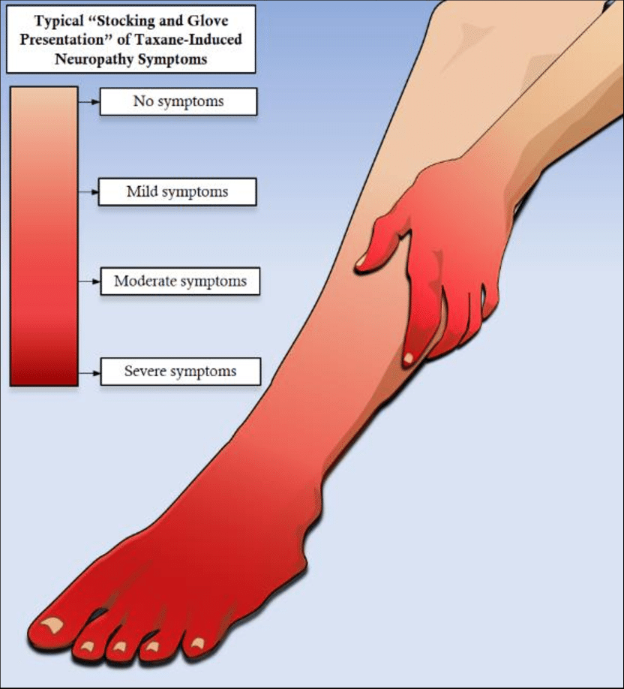
Assessment
As with all types of family violence, detection and accurate identification are the first steps. Burns or scalds may have an identifiable shape, such as cigarette marks, or may have a “stocking and glove” distribution, indicating scalding.
The parent of an infant with a severe skull fracture may report that he or she “rolled off the couch,” even though the child is too young to do so or the injury is much too severe for a fall of 20 inches. Bruises may have familiar, recognizable shapes such as belt buckles or teeth marks.

Slide 27
Assessment
Children who have been sexually abused may have urinary tract infections; bruised, red, or swollen genitalia; tears of the rectum or vagina; and bruising.
The emotional response of these children varies widely. Often, these children talk or behave in ways that indicate more advanced knowledge of sexual issues than would be expected for their ages. The key is to recognize when the child’s behavior is outside what is normally expected for his or her age and developmental stage.

Slide 28
Assessment
The nurse does not have to decide with certainty that abuse has occurred. Nurses are responsible for reporting suspected child abuse with accurate and thorough documentation of assessment data.
The nurse alone or in consultation with other health team members (e.g., physicians or social workers) may report suspected abuse to appropriate local governmental authorities.

Slide 29
Warning Signs of Abused/ Neglected Children
Serious injuries such as fractures, burns, or lacerations with no reported history of trauma.
Delay in seeking treatment for a significant injury.
Child or parent giving a history inconsistent with severity of injury, such as a baby with contrecoup injuries to the brain (shaken baby syndrome) that the parents claim happened when the infant rolled off the sofa.
Inconsistencies or changes in the child’s history during the evaluation by either the child or the adult.
Unusual injuries for the child’s age and level of development, such as a fractured femur in a 2-month-old or a dislocated shoulder in a 2-year-old.
High incidence of urinary tract infections; bruised, red, or swollen genitalia; tears or bruising of rectum or vagina.
Evidence of old injuries not reported, such as scars, fractures not treated, and multiple bruises that parent/caregiver cannot explain adequately.

Slide 30
Treatment and Intervention
The first part of treatment for child abuse or neglect is to ensure the child’s safety and well-being. This may involve removing the child from the home, which also can be traumatic. Given the high risk for psychological problems, a thorough psychiatric evaluation also is indicated.
A relationship of trust between the therapist and the child is crucial to help the child deal with the trauma of abuse.

Slide 31
Treatment and Intervention
Long-term treatment for the child usually involves professionals from several disciplines, such as psychiatry, social work, and psychology.
The very young child may communicate best through play therapy, where he or she draws or acts out situations with puppets or dolls rather than talks about what has happened or his or her feelings.
Social service agencies are involved in determining whether returning the child to the parental home is possible based on whether parents can show benefit from treatment.
Family therapy may be indicated if reuniting the family is feasible. Parents may require psychiatric or substance abuse treatment. If the child is unlikely to return home, short-term or long-term foster care services may be indicated.

Slide 32
Elder Abuse
Elder abuse is the maltreatment of older adults by family members or caregivers. It may include physical and sexual abuse, psychological abuse, neglect, self-neglect, financial exploitation, and denial of adequate medical treatment.
Estimates are that people over age 65 are injured, exploited, abused, or neglected by their caregivers and that only 1 in 14 elder maltreatment cases are reported. Nearly 60% of the perpetrators are spouses, 20% are adult children, and 20% are others such as siblings, and grandchildren.

Slide 33
Elder Abuse
Most victims of elder abuse are 75 years or older; 60% to 65% are women.
Abuse is more likely when the elder has multiple chronic mental and physical health problems and when he or she is dependent on others for food, medical care, and various activities of daily living.

Slide 34
Elder Abuse
Elders are often reluctant to report abuse, even when they can, because the abuse usually involves family members whom the elder wishes to protect.
Victims also often fear losing their support and being moved to an institution.

Slide 35
Clinical Picture
The victim may have bruises or fractures; may lack needed eyeglasses or hearing aids; may be denied food, fluids, or medications; or may be restrained in a bed or chair.
The abuser may use the victim’s financial resources for his or her own pleasure while the elder cannot afford food or medications.
Abusers may withhold medical care from an elder with acute or chronic illness.
Self-neglect involves the elder’s failure to provide for himself or herself.

Slide 36
Assessment
Careful assessment of elderly persons and their caregiving relationships is essential in detecting elder abuse.
Often, determining whether the elder’s condition results from deterioration associated with a chronic illness or from abuse is difficult.

Slide 37
Possible Indicators of Elder Abuse
PHYSICAL ABUSE INDICATORS:
Frequent, unexplained injuries accompanied by a habit of seeking medical assistance from various locations.
Reluctance to seek medical treatment for injuries or denial of their existence.
Disorientation indicating misuse of medications.
Fear in the presence of family member or caregiver.

Slide 38
Possible Indicators of Elder Abuse
PSYCHOSOCIAL ABUSE INDICATORS:
Change in elder’s general mood or usual behavior.
Isolated from previous friends or family.
Sudden lack of contact from other people outside the elder’s home.
Helplessness.
Hesitance to talk openly.
Anger or agitation.
Withdrawal or depression.

Slide 39
Possible Indicators of Elder Abuse
MATERIAL ABUSE INDICATORS:
Unpaid bills.
Standard of living below elder’s means.
Sudden sale or disposal of elder’s property/possessions.
Unusual or inappropriate activity in bank accounts.
Signatures on checks that differ from the elder’s.
Recent changes in will or power of attorney when elder is not capable of making those decisions.
Lack of television, clothes, or personal items that are easily affordable.
Unusual concern by the caregiver over the expense of the elder’s treatment when it is not the caregiver’s money being spent.

Slide 40
Possible Indicators of Elder Abuse
NEGLECT INDICATORS:
Poor personal hygiene.
Lack of needed medications or therapies.
Dirt, fecal or urine smell, or other health hazards in the elder’s living environment.
Rashes, sores, or lice on the elder.
Elder has an untreated medical condition or is malnourished or dehydrated not related to a known illness.
Inadequate material items, such as clothing, blankets, furniture, and television.

Slide 41
Possible Indicators of Elder Abuse
INDICATORS OF SELF-NEGLECT:
Inability to manage personal finances, or giving away money while not paying bills.
Inability to manage activities of daily living, such as personal care, shopping, or housework.
Refusing needed medical attention, isolation, and substance use.
Failure to keep needed medical appointments.
Confusion, memory loss, and unresponsiveness.
Lack of toilet facilities, or living quarters infested with animals or vermin.

Slide 42
Possible Indicators of Elder Abuse
WARNING INDICATORS FROM CAREGIVER:
Elder is not given opportunity to speak for self, to have visitors, or to see anyone without the presence of the caregiver.
Attitudes of indifference or anger toward the elder.
Blaming the elder for his or her illness or limitations.
Defensiveness.
Conflicting accounts of elder’s abilities, problems, and so forth.
Previous history of abuse or problems with alcohol or drugs.

Slide 43
Treatment and Intervention
Elder abuse may develop gradually as the burden of care exceeds the caregiver’s physical or emotional resources.
Relieving the caregiver’s stress and providing additional resources may help to correct the abusive situation and leave the caregiving relationship intact.
In other cases, the neglect or abuse is intentional and designed to provide personal gain to the caregiver, such as access to the victim’s financial resources. In these situations, removal of the elder or caregiver is necessary.

Slide 44
Rape and Sexual Assault
Rape is a crime of violence and humiliation of the victim expressed through sexual means.
Rape is the perpetration of an act of sexual intercourse with a female against her will and without her consent, whether her will is overcome by force, fear of force, drugs, or intoxicants.
It is also considered rape if the woman is incapable of exercising rational judgment because of mental deficiency or when she is younger than the age of consent.
The crime of rape requires only slight penetration of the outer vulva; full erection and ejaculation are not necessary.

Slide 45
Rape and Sexual Assault
Rape can occur between strangers, acquaintances, married persons, and persons of the same sex.
Almost two thirds of rapes are committed by someone known to the victim.
A phenomenon called date rape (acquaintance rape) may occur on a first date, on a ride home from a party, or when the two people have known each other for some time. It is more prevalent near college and university campuses.
The rate of serious injuries associated with dating violence increases with increased consumption of alcohol by either the victim or the perpetrator.

Slide 46
Assessment
To preserve possible evidence, the physical examination should occur before the woman has showered, brushed her teeth, douched, changed her clothes, or had anything to drink.
This may not be possible, because the woman may have done some of these things before seeking care. If there is no report of oral sex, then rinsing the mouth or drinking fluids can be permitted immediately.

Slide 47
Assessment
To assess the woman’s physical status, the nurse asks the victim to describe what happened.
If the woman cannot do so, the nurse may ask needed questions gently and with care.
Rape kits and rape protocols are available in most emergency room settings and provide the equipment and instructions needed to collect physical evidence.
The physician is primarily responsible for this step of the examination.

Slide 48
Warning Signs of Relationship Violence
Emotionally abuses you.
Tells you with whom you may be friends or how you should dress, or tries to control other elements of your life.
Talks negatively about women in general.
Gets jealous for no reason.
Drinks heavily, uses drugs, or tries to get you drunk.
Acts in an intimidating way by invading your personal space such as standing too close or touching you when you don’t want him to.
Cannot handle sexual or emotional frustration without becoming angry.
Does not view you as an equal: sees himself as smarter or socially superior.
Guards his masculinity by acting tough.

Slide 49
Treatment and Intervention
Victims of rape fare best when they receive immediate support and can express fear and rage to family members, nurses, physicians, and law enforcement officials who believe them.
Education about rape and the needs of victims.

Slide 50
Treatment and Intervention
Therapy usually is supportive in approach and focuses on restoring the victim’s sense of control; relieving feelings of helplessness, dependency, and obsession with the assault that frequently follow rape; regaining trust; improving daily functioning; finding adequate social support; and dealing with feelings of guilt, shame, and anger.
Group therapy with other women who have been raped is a particularly effective treatment. Some women attend both individual and group therapies.
It often takes 1 year or more for survivors of rape to regain previous levels of functioning.

Slide 51
Psychiatric Disorders Related to Abuse and Violence

Slide 52
Posttraumatic Stress Disorder (PTSD)
Posttraumatic stress disorder is a disturbing pattern of behavior demonstrated by someone who has experienced a traumatic event such as a natural disaster, a combat, or an assault.
The person with PTSD was exposed to an event that posed a threat of death or serious injury and responded with intense fear, helplessness, or terror.
Three clusters of symptoms are present: reliving the event, avoiding reminders of the event, and being on guard, or experiencing hyperarousal.
The person persistently reexperiences the trauma through memories, dreams, flashbacks, or reactions to external cues about the event and therefore avoids stimuli associated with the trauma.
The victim feels a numbing of general responsiveness and shows persistent signs of increased arousal such as insomnia, hyperarousal, irritability, or angry outbursts. He or she reports losing a sense of connection and control over his or her life.
In PTSD, the symptoms occur 3 months or more after the trauma, which distinguishes PTSD from acute stress disorder. This diagnosis is appropriate when symptoms appear within the first month after the trauma and do not persist longer than 4 weeks.

Slide 53
PTSD
PTSD can occur at any age, including during childhood. Estimates are that up to 60% of people at risk, such as combat veterans and victims of violence and natural disasters, develop PTSD.
Complete recovery occurs within 3 months for about 50% of people.
The severity and duration of the trauma and the proximity of the person to the event are the most important factors affecting the likelihood of developing PTSD.
One fourth of all victims of physical assault develop PTSD. Victims of rape have one of the highest rates of PTSD—approximately 70 percent.

Slide 54
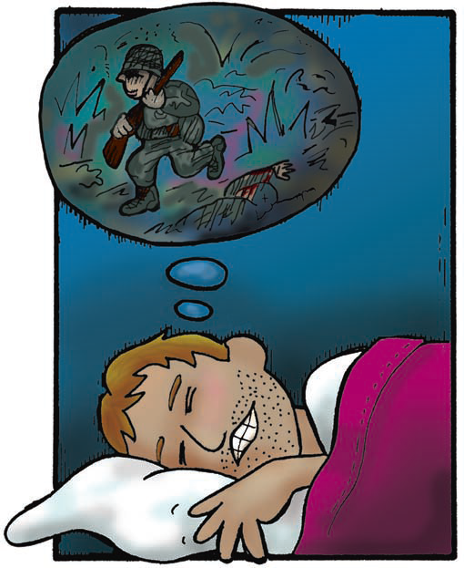
PTSD

Slide 55
Dissociative Disorders
Dissociation is a subconscious defense mechanism that helps a person protect his or her emotional self from recognizing the full effects of some horrific or traumatic event by allowing the mind to forget or remove itself from the painful situation or memory.
Dissociation can occur both during and after the event. As with any other protective coping mechanism, dissociating becomes easier with repeated use.

Slide 56
Dissociative Disorders
Dissociative disorders have the essential feature of a disruption in the usually integrated functions of consciousness, memory, identity, or environmental perception.
This often interferes with the person’s relationships, ability to function in daily life, and ability to cope with the realities of the abusive or traumatic event. This disturbance varies greatly in intensity in different people, and the onset may be sudden or gradual, transient or chronic.
Dissociative symptoms are seen in clients with PTSD.

Slide 57
Dissociative Disorders
The DSM-IV-TR describes different types of dissociative disorders:
Dissociative amnesia: The client cannot remember important personal information (usually of a traumatic or stressful nature).
Dissociative fugue: The client has episodes of suddenly leaving the home or place of work without any explanation, traveling to another city, and being unable to remember his or her past or identity. He or she may assume a new identity.
Dissociative identity disorder (formerly multiple personality disorder): The client displays two or more distinct identities or personality states that recurrently take control of his or her behavior. This is accompanied by the inability to recall important personal information.
Depersonalization disorder: The client has a persistent or recurrent feeling of being detached from his or her mental processes or body. This is accompanied by intact reality testing; that is, the client is not psychotic or out of touch with reality.

Slide 58
Dissociative Disorders
Dissociative disorders, relatively rare in the general population, are much more prevalent among those with histories of childhood physical and sexual abuse.
Some believe the recent increase in the diagnosis of dissociative disorders in the United States is the result of more awareness of this disorder by mental health professionals.

Slide 59
Dissociative Disorders
The media has focused much attention on the theory of repressed memories in victims of abuse. Many professionals believe that memories of childhood abuse can be buried deeply in the subconscious mind or repressed because they are too painful for the victims to acknowledge and that victims can be helped to recover or remember such painful memories.
If a person comes to a mental health professional experiencing serious problems in relationships, symptoms of PTSD, or flashbacks involving abuse, the mental health professional may help the person remember or recover those memories of abuse.
Some mental health professionals believe there is danger of inducing false memories of childhood sexual abuse through imagination in psychotherapy. This so called false memory syndrome has created problems in families when clients made groundless accusations of abuse.

Slide 60
Major Symptoms of Dissociative Identity Disorder
Presence of two or more distinct identities or personality states.
At least two identities recurrently taking control of the person’s behavior.
Inability to recall important personal information: more extensive than ordinary forgetfulness.
Symptoms not related to any substance use or medical condition.

Slide 61
Treatment and Interventions
Survivors of trauma and abuse who have PTSD or dissociative disorders often are involved in group or individual therapy in the community to address the long-term effects of their experiences.
Cognitive–behavioral therapy is effective in dealing with the thoughts and subsequent feelings and behavior of trauma and abuse survivors.
Therapy for clients who dissociate focuses on reassociation, or putting the consciousness back together.
Both paroxetine (Paxil) and sertraline (Zoloft) have been used to treat PTSD successfully.
Clients with dissociative disorders may be treated symptomatically, that is, with medications for anxiety or depression or both if these symptoms are predominant.

Slide 62
Treatment and Interventions
Clients with PTSD and dissociative disorders are found in all areas of health care, from clinics to primary care offices.
The nurse is most likely to encounter these clients in acute care settings when there are concerns for their safety or the safety of others or when acute symptoms have become intense and require stabilization.
Treatment in acute care is usually short term, with the client returning to community-based treatment as quickly as possible.

Slide 63
Nursing Interventions
Promote Client’s Safety:
Discuss self-harm thoughts.
Help client develop plan for going to safe place when having destructive thoughts or impulses.

Slide 64
Nursing Interventions
Help Client Cope with Stress and Emotions:
Use grounding techniques to help client who is dissociating or experiencing flashbacks.
Validate client’s feelings of fear, but try to increase contact with reality.
During dissociative experience or flashback, help client change body position but do not grab or force client to stand up or move.
Use supportive touch if client responds well to it.
Teach deep breathing and relaxation techniques.
Use distraction techniques such as participating in physical exercise, listening to music, talking with others, or engaging in a hobby or other enjoyable activity.
Help to make a list of activities and keep materials on hand to engage client when client’s feelings are intense.

Slide 65
Nursing Interventions
Help Promote Client’s Self-Esteem:
Refer to client as “survivor” rather than “victim.”
Establish social support system in community.
Make a list of people and activities in the community for client to contact when he or she needs help.

