Slide 1
Grief & Loss

Slide 2
Introduction
Experiences of loss are normal and essential in human life.
Loss allows a person to change, develop, and fulfill innate human potential.
It may be planned, expected, or sudden. Although it can be difficult, loss sometimes is beneficial. Other times, it is devastating and debilitating.

Slide 3
Introduction
Grief refers to the subjective emotions and affect that are a normal response to the experience of loss.
Grieving, also known as bereavement, refers to the process by which a person experiences the grief. It involves not only the content (what a person thinks, says, and feels) but also the process (how a person thinks, says, and feels).
All people grieve when they experience life’s changes and losses. Often, grieving is one of the most difficult and challenging processes of human existence; rarely is it comfortable or pleasant.
Anticipatory grieving is when people facing an imminent loss begin to grapple with the very real possibility of the loss or death in the near future.
Mourning is the outward expression of grief. Rituals of mourning include having a wake, sitting Shiva, holding religious ceremonies, and arranging funerals.

Slide 4
Types of Losses
The Maslow’s hierarchy begins with physiologic needs (food, air, water, sleep), safety needs (a safe place to live and work), and security and belonging needs (satisfying relationships). The next set of needs includes self-esteem needs, which lead to feelings of adequacy and confidence. The last and final need is self-actualization, the ability to realize one’s full innate potential.

Slide 5
Physiologic Loss
Physiologic loss: Examples include amputation of a limb, a mastectomy or hysterectomy, or loss of mobility.

Slide 6
Safety Loss
Safety loss: Loss of a safe environment is evident in domestic violence, child abuse, or public violence.

Slide 7
Loss of Security and a Sense of Belonging
Loss of security and a sense of belonging: The loss of a loved one affects the need to love and the feeling of being loved.
Loss accompanies changes in relationships, such as birth, marriage, divorce, illness, and death; as the meaning of a relationship changes, a person may lose roles within a family or group.

Slide 8
Loss of Self-esteem
Loss of self-esteem: Any change in how a person is valued at work or in relationships or by him or her self can threaten self-esteem.
Death of a loved one, a broken relationship, loss of a job, and retirement are examples of change that represent loss and can result in a threat to self-esteem.

Slide 9
Loss related to Self-actualization
Loss related to self-actualization: An external or internal crisis that blocks or inhibits strivings toward fulfillment may threaten personal goals and individual potential.
A person who wanted to go to college, write books, and teach at a university reaches a point in life when it becomes evident that those plans will never materialize. Or a person loses hope that they will find a mate and have children. These are losses that the person will grieve.

Slide 10
The Grieving Process
Nurses interact with clients responding to myriad losses along the continuum of health and illness.
Regardless of the type of loss, nurses must have a basic understanding of what is involved to meet the challenge that grief brings to clients. By understanding the phenomena that clients experience as they deal with the discomfort of loss, nurses may promote the expression and release of emotional as well as physical pain during grieving.
Supporting this process means ministering to psychological and physical needs.

Slide 11
The Grieving Process
The therapeutic relationship and therapeutic communication skills such as active listening are paramount when assisting grieving clients.
Recognizing the verbal and nonverbal communication content of the various stages of grieving can help nurses to select interventions that meet the client’s psychological and physical needs.

Slide 12
Tasks of Grieving
Grieving tasks, or mourning, that the bereaved person faces involve active rather passive participation.
It is sometimes called “grief work” because it is difficult and requires tremendous effort and energy to accomplish.

Slide 13
Tasks of Grieving
Rando (1984) describes tasks inherent to grieving that she calls the “six R’s”:
Recognize: Experiencing the loss, and understanding that it is real, it has happened.
React: Emotional response to loss, feeling the feelings.
Recollect and re-experience: Memories are reviewed and relived.
Relinquish: Accepting that the world has changed (as a result of the loss), and there is no turning back.
Readjust: Beginning to return to daily life; loss feels less acute and overwhelming.
Reinvest: Accepting changes that have occurred; reentering the world, forming new relationships and commitments.

Slide 14
Dimensions of Grieving
People have many and varied responses to loss. They express their bereavement in their thoughts, words, feelings, and actions as well as through their physiologic responses.
Therefore, nurses must use a holistic model of grieving that encompasses cognitive, emotional, spiritual, behavioral, and physiologic dimensions.

Slide 15
Disenfranchised Grief
Disenfranchised grief is grief over a loss that is not or cannot be acknowledged openly, mourned publicly, or supported socially.
Circumstances that can result in disenfranchised grief include:
A relationship that has no legitimacy.
The loss itself is not recognized.
The griever is not recognized.
The loss involves social stigma.

Slide 16
Disenfranchised Grief
In each situation, there is an attachment followed by a loss that leads to grief.
The grief process is more complex because the usual supports that facilitate grieving and healing are absent.

Slide 17
Complicated Grieving
Some believe complicated grieving to be a response outside the norm, occurring when a person is void of emotion, grieves for prolonged periods, or has expressions of grief that seem disproportionate to the event.
People may suppress emotional responses to the loss or become obsessively preoccupied with the deceased person or lost object. Others actually may suffer from clinical depression when they cannot make progress in the grief process.

Slide 18
Complicated Grieving
Previously existing psychiatric disorders also may complicate the grief process, so nurses must be particularly alert to clients with psychiatric disorders who also are grieving.
Grief can precipitate major depression in a person with a history of the disorder. These clients also can experience grief and a sense of loss when they encounter changes in treatment settings, routine, environment, or even staff.

Slide 19
Complicated Grieving
Although nurses must recognize that complications may arise in the grief process, the process remains unique and dynamic for each person.

Slide 20
Characteristics of Susceptibility
For some, the effects of grief are particularly devastating because their personalities, emotional states, or situations make them susceptible to complications during the process. People who are vulnerable to complicated grieving include those with the following characteristics:
Low self-esteem.
Low trust in others.
A previous psychiatric disorder.
Previous suicide threats or attempts.
Absent or unhelpful family members.

Slide 21
Characteristics of Susceptibility
A person’s perception is another factor contributing to vulnerability: Perception, or how a person thinks or feels about a situation, is not always reality.
After the death of a loved one, a person may believe that he or she really cannot continue and is at a great disadvantage. He or she may become increasingly sad and depressed, not eat or sleep, and perhaps entertain suicidal thoughts.

Slide 22
Risk Factors Leading to Vulnerability
Death of a spouse or child.
Death of a parent (particularly in early childhood or adolescence).
Sudden, unexpected, and untimely death.
Multiple deaths.
Death by suicide or murder.
Based on the experiences previously identified, those most intimately affected by the terrorist attacks on September 11, 2001 could be considered at increased risk for complicated grieving.

Slide 23
Complicated Grieving as a Unique and Varied Experience
The person with complicated grieving also can experience physiologic and emotional reactions.
Physical reactions can include an impaired immune system, increased adrenocortical activity, increased levels of serum prolactin and growth hormone, psychosomatic disorders, and increased mortality from heart disease.
Characteristic emotional responses include depression, anxiety or panic disorders, delayed or inhibited grief, and chronic grief.

Slide 24
Complicated Grieving as a Unique and Varied Experience
Because the grieving process is unique to each person, the nurse must assess the degree of impairment within the context of the client’s life and experiences—for example, by examining current coping responses compared with previous experiences and assessing whether or not the client is engaging in maladaptive behaviors such as drug and alcohol abuse as a means to deal with the painful experience.

Slide 25
Application of the Nursing Process
The state of disequilibrium that a crisis produces causes great consternation, compelling the person to return to homeostasis, a state of equilibrium or balance.
Factors that influence the grieving person’s return to homeostasis are adequate perception of the situation, adequate situational support, and adequate coping.
These factors help the person to regain balance and return to previous functioning or even to use the crisis as an opportunity to grow.

Slide 26
Application of the Nursing Process
For the nurse to support and facilitate the grief process for clients, he or she must observe and listen for cognitive, emotional, spiritual, behavioral, and physiologic cues.
Although the nurse must be familiar with the phases, tasks, and dimensions of human response to loss, he or she must realize that each client’s experience is unique.
Skillful communication is key to performing assessment and providing interventions.

Slide 27
Application of the Nursing Process
Attentive presence is being with the client and focusing intently on communicating with and understanding him or her.
The nurse can maintain attentive presence by using open body language such as standing or sitting with arms down, facing the client, and maintaining moderate eye contact, especially as the client speaks.
Creating a psychologically safe environment includes ensuring the client of confidentiality, refraining from judging or giving specific advice, and allowing the client to share thoughts and feelings freely.

Slide 28
Assessment
Effective assessment involves observing all dimensions of human response: what the person is thinking (cognitive), how the person is feeling (emotional), what the person’s values and beliefs are (spiritual), how the person is acting (behavioral), and what is happening in the person’s body (physiologic).
Effective communication skills during assessment can lead the client toward understanding his or her experience. Thus, assessment facilitates the client’s grief process. While observing for client responses in the dimensions of grieving, the nurse explores three critical components in assessment:
Adequate perception regarding the loss.
Adequate support while grieving for the loss.
Adequate coping behaviors during the process.

Slide 29
Perception of the Loss
Assessment begins with exploration of the client’s perception of the loss. What does the loss mean to the client? For the woman who has spontaneously lost her first unborn child and the woman who has elected to abort a pregnancy, this question could have similar or different answers. Other questions that assess perception and encourage the client’s movement through the grief process include the following:
What does the client think and feel about the loss?
How is the loss going to affect the client’s life?
What information does the nurse need to clarify or share with the client?

Slide 30
Perception of the Loss
Assessing the client’s “need to know” in plain and simple language invites the client to verbalize perceptions that may need clarification. This is especially true for the person who is anticipating a loss, such as one facing a life-ending illness or the loss of a body part.
The nurse uses open-ended questions and helps to clarify any misperceptions.

Slide 31
Perception of the Loss
Consider the following. The doctor has just informed Ms. Morrison that the lump on her breast is cancerous and that she can be scheduled for a mastectomy in 2 days.
The nurse visits the client after rounds and finds her quietly watching television.

Slide 32
Perception of the Loss
Exploring what the person believes about the grieving process is another important assessment. Does the client have preconceived ideas about when or how grieving should happen? The nurse can help the client realize that grieving is very personal and unique: each person grieves in his or her own way.
Later in the shift, the nurse finds Ms. Morrison hitting her pillow and crying. She has eaten little food and has refused visitors.

Slide 33
Support
Purposeful assessment of support systems provides the grieving client with an awareness of those who can meet his or her emotional and spiritual needs for security and love.
The nurse can help the client to identify his or her support systems and reach out and accept what they can offer.

Slide 34
Coping Behaviors
The client’s behavior is likely to give the nurse the easiest and most concrete information about coping skills.
The nurse must be careful to observe the client’s behavior throughout the grief process and never assume that a client is at a particular phase.
The nurse must use effective communication skills to assess how the client’s behavior reflects coping as well as emotions and thoughts.
The following day, the nurse has heard in report that Ms. Morrison had a restless night. She enters Ms. Morrison’s room and sees her crying with a full tray of food untouched.

Slide 35
Coping Behaviors
The nurse also must consider several other questions when assessing the client’s coping. How has the person dealt with loss previously? How is the person currently impaired? How does the current experience compare with previous experiences? What does the client perceive as a problem? Is it related to unrealistic ideas about what he or she should feel or do?.
The critical factors of perception, support, and coping are interrelated as well and provide a framework for assessing and assisting the client.

Slide 36
Data Analysis and Planning
The nurse must base nursing diagnoses for the person experiencing loss on subjective and objective assessment data.

Slide 37
Interventions
Exploring the Perception of Loss.
Obtaining Support.
Promoting Coping Behaviors.

Slide 38
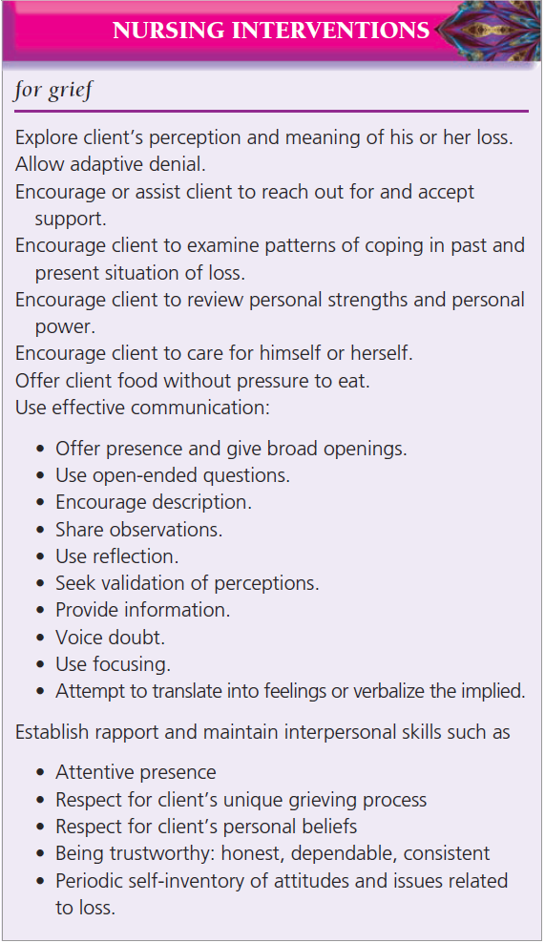

Slide 39
Evaluation
Evaluation of progress depends on the goals established for the client. A review of the tasks and phases of grieving can be useful in making a statement about the client’s status at any given moment.
The nurse may say the client is still experiencing denial. Or that the client is showing signs of reorganization, recovery or healing.

