Slide 1
Schizophrenia

Slide 2
Introduction
Schizophrenia causes distorted and bizarre thoughts, perceptions, emotions, movements, and behavior.
It cannot be defined as a single illness; rather, schizophrenia is thought of as a syndrome or as disease process with many different varieties and symptoms, much like the varieties of cancer.

Slide 3
Introduction
Schizophrenia usually is diagnosed in late adolescence or early adulthood. Rarely does it manifest in childhood. The peak incidence of onset is 15 to 25 years of age for men and 25 to 35 years of age for women.
The prevalence of schizophrenia is estimated at about 1% of the total population.

Slide 4
Introduction
The symptoms of schizophrenia are divided into two major categories: positive or hard symptoms/signs, which include delusions, hallucinations, and grossly disorganized thinking, speech, and behavior; and negative or soft symptoms/signs, which include flat affect, lack of volition, and social withdrawal or discomfort.
Medication can control the positive symptoms, but frequently the negative symptoms persist after positive symptoms have abated. The persistence of these negative symptoms over time presents a major barrier to recovery and improved functioning in the client’s daily life.

Slide 5
Types of Schizophrenia
Schizophrenia, paranoid type: characterized by persecutory (feeling victimized or spied on) or grandiose delusions, hallucinations, and, occasionally, excessive religiosity (delusional religious focus) or hostile and aggressive behavior.

Slide 6
Types of Schizophrenia
Schizophrenia, disorganized type: characterized by grossly inappropriate or flat affect, incoherence, loose associations, and extremely disorganized behavior.

Slide 7
Types of Schizophrenia
Schizophrenia, catatonic type: characterized by marked psychomotor disturbance, either motionless or excessive motor activity.
Motor immobility may be manifested by catalepsy (waxy flexibility) or stupor.
Excessive motor activity is apparently purposeless and is not influenced by external stimuli. Other features include extreme negativism, mutism, peculiarities of voluntary movement, echolalia, and echopraxia.

Slide 8
Types of Schizophrenia
Schizophrenia, undifferentiated type: characterized by mixed schizophrenic symptoms (of other types) along with disturbances of thought, affect, and behavior.

Slide 9
Types of Schizophrenia
Schizoaffective disorder is diagnosed when the client has the psychotic symptoms of schizophrenia and meets the criteria for a major affective or mood disorder.

Slide 10
Clinical Course
Although the symptoms of schizophrenia are always severe, the long-term course does not always involve progressive deterioration. The clinical course varies among clients.

Slide 11
Onset
Onset may be abrupt or insidious, but most clients slowly and gradually develop signs and symptoms such as social withdrawal, unusual behavior, loss of interest in school or work, and neglected hygiene.
The diagnosis of schizophrenia usually is made when the person begins to display more actively positive symptoms of delusions, hallucinations, and disordered thinking (psychosis).

Slide 12
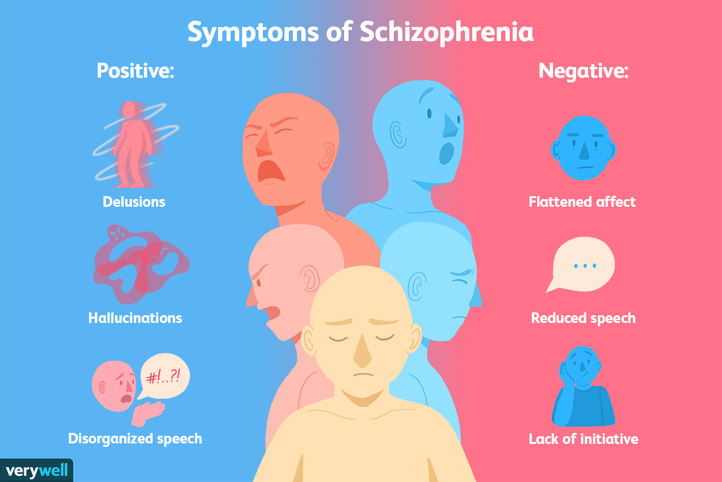

Slide 13
Treatment
Psychopharmacology: Antipsychotic medications are prescribed primarily for their efficacy in decreasing psychotic symptoms.
They do not cure schizophrenia; rather, they are used to manage the symptoms of the disease.

Slide 14
Treatment
The conventional antipsychotics target the positive signs of schizophrenia, such as delusions, hallucinations, disturbed thinking, and other psychotic symptoms, but have no observable effect on the negative signs.
The atypical antipsychotics not only diminish positive symptoms but also, for many clients, lessen the negative signs of lack of volition and motivation, social withdrawal, and anhedonia.

Slide 15
Maintenance Therapy
Two antipsychotics are available in injection forms for maintenance therapy: fluphenazine (Prolixin) and haloperidol (Haldol).
The effects of the medications last 2 to 4 weeks, eliminating the need for daily oral antipsychotic medication. The duration of action is 7 to 28 days for fluphenazine and 4 weeks for haloperidol.

Slide 16
Side Effects
Serious neurologic side effects include extrapyramidal side effects (EPS) (acute dystonic reactions, akathisia, and parkinsonism), tardive dyskinesia, and seizures.
Nonneurologic side effects include weight gain, sedation, photosensitivity, and anticholinergic symptoms such as dry mouth, blurred vision, constipation, urinary retention, and orthostatic hypotension.

Slide 17
Psychosocial Treatment
Individual and group therapies, family therapy, family education, and social skills training can be instituted for clients in both inpatient and community settings.

Slide 18
Treatment
Individual and group therapy sessions are often supportive in nature, giving the client an opportunity for social contact and meaningful relationships with other people.
Groups that focus on topics of concern such as medication management, use of community supports, and family concerns also have been beneficial to clients with schizophrenia.

Slide 19
Treatment
A new therapy, cognitive enhancement therapy (CET), combines computer-based cognitive training with group sessions that allow clients to practice and develop social skills. This approach is designed to remediate or improve the clients’ social and neurocognitive deficits, such as attention, memory, and information processing.
The experiential exercises help the client to take the perspective of another person, rather than focus entirely on self.
Positive results of CET include increased mental stamina, active rather than passive information processing, and spontaneous and appropriate negotiation of unrehearsed social challenges.

Slide 20
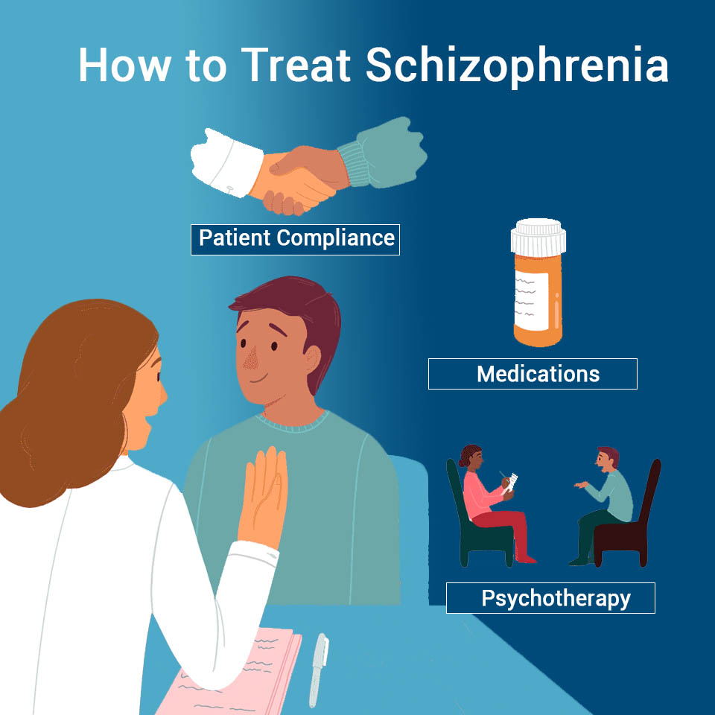

Slide 21
Application Of The Nursing Process

Slide 22
Assessment
Schizophrenia affects thought processes and content, perception, emotion, behavior, and social functioning; however, it affects each individual differently.
The degree of impairment in both the acute or psychotic phase and the chronic or long-term phase varies greatly; thus, so do the needs of and the nursing interventions for each affected client.

Slide 23
History
The nurse first elicits information about the client’s previous history with schizophrenia to establish baseline data.
The nurse asks questions about how the client functioned before the crisis developed, such as “How do you usually spend your time?” and “Can you describe what you do each day?”

Slide 24
History
The nurse assesses the age at onset of schizophrenia, knowing that poorer outcomes are associated with an earlier age at onset.
Learning the client’s previous history of hospital admissions and response to hospitalization also is important.

Slide 25
History
The nurse also assesses the client for previous suicide attempts. Ten percent of all people with schizophrenia eventually commit suicide. The nurse might ask, “Have you ever attempted suicide?” or “Have you ever heard voices telling you to hurt yourself?”
Likewise, it is important to elicit information about any history of violence or aggression because a history of aggressive behavior is a strong predictor of future aggression. The nurse might ask, “What do you do when you are angry, frustrated, upset, or scared?”

Slide 26
History
The nurse assesses whether the client has been using current support systems by asking the client or significant others the following questions:
Has the client kept in contact with family or friends?
Has the client been to scheduled groups or therapy appointments?
Finally, the nurse assesses the client’s perception of his or her current situation—that is, what the client believes to be significant present events or stressors. The nurse can gather such information by asking, “What do you see as the primary problem now?” or “What do you need help managing now?”

Slide 27
General Appearance, Motor Behavior, and Speech
Appearance may vary widely among different clients with schizophrenia. Some appear normal in terms of being dressed appropriately, sitting in a chair conversing with the nurse and exhibiting no strange or unusual postures or gestures.
Others exhibit odd or bizarre behavior. They may appear disheveled and unkempt with no obvious concern for their hygiene, or they may wear strange or inappropriate clothing (for instance, a heavy wool coat and stocking cap in hot weather).

Slide 28
General Appearance, Motor Behavior, and Speech
Overall motor behavior also may appear odd. The client may be restless and unable to sit still, exhibit agitation and pacing, or appear unmoving (catatonia).
He or she also may demonstrate seemingly purposeless gestures (stereotypic behavior) and odd facial expressions such as grimacing. The client may imitate the movements and gestures of someone whom he or she is observing (echopraxia).

Slide 29
General Appearance, Motor Behavior, and Speech
Conversely, the client may exhibit psychomotor retardation (a general slowing of all movements).
Sometimes the client may be almost immobile, curled into a ball (fetal position). Clients with the catatonic type of schizophrenia can exhibit waxy flexibility: they maintain any position in which they are placed, even if the position is awkward or uncomfortable.

Slide 30
General Appearance, Motor Behavior, and Speech
The client may exhibit an unusual speech pattern.
Two typical patterns are word salad (jumbled words and phrases that are disconnected or incoherent and make no sense to the listener) and echolalia (repetition or imitation of what someone else says).
Speech may be slowed or accelerated in rate and volume: the client may speak in whispers or hushed tones or may talk loudly or yell. Latency of response refers to hesitation before the client responds to questions. This latency or hesitation may last 30 or 45 seconds and usually indicates the client’s difficulty with cognition or thought processes.

Slide 31
Mood and Affect
Clients with schizophrenia report and demonstrate wide variances in mood and affect. They often are described as having flat affect (no facial expression) or blunted affect (few observable facial expressions).
The typical facial expression often is described as mask-like. The affect also may be described as silly, characterized by giddy laughter for no apparent reason.
The client may exhibit an inappropriate expression or emotions incongruent with the context of the situation. This incongruence ranges from mild or subtle to grossly inappropriate.

Slide 32
Mood and Affect
The client may report feeling depressed and having no pleasure or joy in life (anhedonia). Conversely, he or she may report feeling all-knowing, all-powerful, and not at all concerned with the circumstance or situation.
It is more common for the client to report exaggerated feelings of well-being during episodes of psychotic or delusional thinking and a lack of energy or pleasurable feelings during the chronic, or long-term, phase of the illness.

Slide 33
Thought Process and Content
Schizophrenia often is referred to as a thought disorder because that is the primary feature of the disease: thought processes become disordered, and the continuity of thoughts and information processing is disrupted.
The nurse can assess thought process by inferring from what the client says. He or she can assess thought content by evaluating what the client actually says.
For example, clients may suddenly stop talking in the middle of a sentence and remain silent for several seconds to 1 minute (thought blocking). They also may state that they believe others can hear their thoughts (thought broadcasting), that others are taking their thoughts (thought withdrawal), or that others are placing thoughts in their mind against their will (thought insertion).

Slide 34
Delusions
A common characteristic of schizophrenic delusions is the direct, immediate, and total certainty with which the client holds these beliefs. Because the client believes the delusion, he or she therefore acts accordingly.
For example, the client with delusions of persecution is probably suspicious, mistrustful, and guarded about disclosing personal information; he or she may examine the room periodically or speak in hushed, secretive tones.

Slide 35
Delusions
Initially, the nurse assesses the content and depth of the delusion to know what behaviors to expect and to try to establish reality for the client.
When eliciting information about the client’s delusional beliefs, the nurse must be careful not to support or challenge them.
The nurse might ask the client to explain what he or she believes by saying “Please explain that to me” or “Tell me what you’re thinking about that.”

Slide 36
Sensorium and Intellectual Processes
Hallucinations can involve the five senses and bodily sensations. They can be threatening and frightening for the client; less frequently, clients report hallucinations as pleasant.
Initially, the client perceives hallucinations as real, but later in the illness, he or she may recognize them as hallucinations.

Slide 37
Sensorium and Intellectual Processes
The following are the various types of hallucinations:
Auditory hallucinations, the most common type, involve hearing sounds, most often voices, talking to or about the client. There may be one or multiple voices; a familiar or unfamiliar person’s voice may be speaking.
Command hallucinations are voices demanding that the client take action, often to harm self or others, and are considered dangerous.

Slide 38
Sensorium and Intellectual Processes
Visual hallucinations involve seeing images that do not exist at all, such as lights or a dead person, or distortions such as seeing a frightening monster instead of the nurse.
They are the second most common type of hallucination.

Slide 39
Sensorium and Intellectual Processes
Olfactory hallucinations involve smells or odors. They may be a specific scent such as urine or feces or a more general scent such as a rotten odor.
In addition to clients with schizophrenia, this type of hallucination often occurs with dementia, seizures, or cerebrovascular accidents.

Slide 40
Sensorium and Intellectual Processes
Tactile hallucinations refer to sensations such as electricity running through the body or bugs crawling on the skin.
Tactile hallucinations are found most often in clients undergoing alcohol withdrawal; they rarely occur in clients with schizophrenia.

Slide 41
Sensorium and Intellectual Processes
Gustatory hallucinations involve a taste lingering in the mouth or the sense that food tastes like something else.
The taste may be metallic or bitter or may be represented as a specific taste.

Slide 42
Sensorium and Intellectual Processes
Cenesthetic hallucinations involve the client’s report that he or she feels bodily functions that are usually undetectable.
Examples would be the sensation of urine forming or impulses being transmitted through the brain.

Slide 43
Sensorium and Intellectual Processes
Kinesthetic hallucinations occur when the client is motionless but reports the sensation of bodily movement.
Occasionally, the bodily movement is something unusual, such as floating above the ground.

Slide 44
Sensorium and Intellectual Processes
During episodes of psychosis, clients are commonly disoriented to time and sometimes place.
The most extreme form of disorientation is depersonalization, in which the client feels detached from her or his behavior.
Although the client can state her or his name correctly, she or he feels as if her or his body belongs to someone else or that her or his spirit is detached from the body.

Slide 45
Sensorium and Intellectual Processes
Assessing the intellectual processes of a client with schizophrenia is difficult if he or she is experiencing psychosis.
The client usually demonstrates poor intellectual functioning as a result of disordered thoughts.
The nurse is more likely to obtain accurate assessments of the client’s intellectual abilities when the client’s thought processes are clearer.

Slide 46
Sensorium and Intellectual Processes
Clients often have difficulty with abstract thinking and may respond in a very literal way to other people and the environment. For example, when asked to interpret the proverb, “A stitch in time saves nine,” the client may explain it by saying, “I need to sew up my clothes.”
The client may not understand what is being said and can easily misinterpret instructions. This can pose serious problems during medication administration. For example, the nurse may tell the client, “It is always important to take all your medications.” The client may misinterpret the nurse’s statement and take the entire supply of medication at one time.

Slide 47
Judgment and Insight
Judgment is frequently impaired in the client with schizophrenia. Because judgment is based on the ability to interpret the environment correctly, it follows that the client with disordered thought processes and environmental misinterpretations will have great difficulty with judgment.
At times, lack of judgment is so severe that clients cannot meet their needs for safety and protection and place themselves in harm’s way. This difficulty may range from failing to wear warm clothing in cold weather to failing to seek medical care even when desperately ill. The client also may fail to recognize needs for sleep or food.

Slide 48
Judgment and Insight
Insight also can be severely impaired, especially early in the illness, when the client, family, and friends do not understand what is happening.
Over time, some clients can learn about the illness, anticipate problems, and seek appropriate assistance as needed. However, chronic difficulties result in clients who fail to understand schizophrenia as a long-term health problem requiring consistent management.

Slide 49
Roles and Relationships
Social isolation is prevalent in clients with schizophrenia, partly as a result of positive signs such as delusions, hallucinations, and loss of ego boundaries.
Relating to others is difficult when one’s self-concept is not clear. Clients also have problems with trust and intimacy, which interfere with the ability to establish satisfactory relationships.
Low self-esteem, one of the negative signs of schizophrenia, further complicates the client’s ability to interact with others and the environment.

Slide 50
Physiologic and Self-Care Considerations
Clients with schizophrenia may have significant self-care deficits. Inattention to hygiene and grooming needs is common, especially during psychotic episodes.
The client can become so preoccupied with delusions or hallucinations that he or she fails to perform even basic activities of daily living.

Slide 51
Physiologic and Self-Care Considerations
Clients also may fail to recognize sensations such as hunger or thirst, and food or fluid intake may be inadequate. This can result in malnourishment and constipation. Constipation is also a common side effect of antipsychotic medications, compounding the problem.
Paranoia or excessive fears that food and fluids have been poisoned are common and may interfere with eating. If the client is agitated and pacing, he or she may be unable to sit down long enough to eat.

Slide 52
Physiologic and Self-Care Considerations
Occasionally, clients develop polydipsia, which leads to water intoxication. Serum sodium levels can become dangerously low, leading to seizures.
Polydipsia usually is seen in clients who have had severe and persistent mental illness for many years as well as long-term therapy with antipsychotic medications.

Slide 53
Physiologic and Self-Care Considerations
To assist the client with community living, the nurse assesses daily living skills and functional abilities.
Such skills—having a bank account and paying bills, buying food and preparing meals, and using public transportation—are often difficult tasks for the client with schizophrenia.
He or she might never have learned such skills or may be unable to accomplish them consistently.

Slide 54
Data Analysis
The nurse must analyze assessment data for clients with schizophrenia to determine priorities and establish an effective plan of care.
Not all clients have the same problems and needs, nor is it likely that any individual client has all the problems that can accompany schizophrenia.
Levels of family and community support and available services also vary, all of which influence the client’s care and outcomes.

Slide 55
Data Analysis
The analysis of assessment data generally falls into two main categories: data associated with the positive signs of the disease and data associated with the negative signs.
The North American Nursing Diagnosis Association’s nursing diagnoses commonly established based on the assessment of psychotic symptoms or positive signs are as follows:
Risk for Other-Directed Violence.
Risk for Suicide.
Disturbed Thought Processes.
Disturbed Sensory Perception.
Disturbed Personal Identity.
Impaired Verbal Communication.

Slide 56
Data Analysis
The North American Nursing Diagnosis Association’s nursing diagnoses based on the assessment of negative signs and functional abilities include the following:
Self-Care Deficits.
Social Isolation.
Deficient Diversional Activity.
Ineffective Health Maintenance.
Ineffective Therapeutic Regimen Management.

Slide 57
Outcome Identification
It is likely that the client with an acute psychotic episode of schizophrenia will receive treatment in an intensive setting such as an inpatient hospital unit.
During this phase, the focus of care is stabilizing the client’s thought processes and reality orientation as well as ensuring safety. This is also the time to evaluate resources, make referrals, and begin planning for the client’s rehabilitation and return to the community.

Slide 58
Outcome Identification
Examples of outcomes appropriate to the acute, psychotic phase of treatment are as follows:
The client will not injure self or others.
The client will establish contact with reality.
The client will interact with others in the environment.
The client will express thoughts and feelings in a safe and socially acceptable manner.
The client will participate in prescribed therapeutic interventions.

Slide 59
Outcome Identification
Once the crisis or the acute, psychotic symptoms have been stabilized, the focus is on developing the client’s ability to live as independently and successfully as possible in the community.
This usually requires continued follow-up care and participation of the client’s family in community support services.
Prevention and early recognition and treatment of relapse symptoms are important parts of successful rehabilitation.
Dealing with the negative signs of schizophrenia, which medication generally does not affect, is a major challenge for the client and caregivers.

Slide 60
Outcome Identification
Examples of treatment outcomes for continued care after the stabilization of acute symptoms are as follows:
The client will participate in the prescribed regimen (including medications and follow-up appointments).
The client will maintain adequate routines for sleeping and food and fluid intake.
The client will demonstrate independence in self-care activities.
The client will communicate effectively with others in the community to meet his or her needs.
The client will seek or accept assistance to meet his or her needs when indicated.

Slide 61
Outcome Identification
The nurse must appreciate the severity of schizophrenia and the profound and sometimes devastating effects it has on the lives of clients and their families. It is equally important to avoid treating the client as a “hopeless case,” someone who no longer is capable of having a meaningful and satisfying life.
It is not helpful to expect either too much or too little from the client. Careful ongoing assessment is necessary so that appropriate treatment and interventions address the client’s needs and difficulties while helping the client to reach his or her optimal level of functioning.

Slide 62
Intervention
Promoting safety of client and others and right to privacy and dignity.
Establishing therapeutic relationship by establishing trust.
Using therapeutic communication (clarifying feelings and statements when speech and thoughts are disorganized or confused).
Interventions for delusions: Do not openly confront the delusion or argue with the client. Establish and maintain reality for the client. Use distracting techniques. Teach the client positive self-talk, positive thinking, and to ignore delusional beliefs.
Interventions for hallucinations: Help present and maintain reality by frequent contact and communication with client. Elicit description of hallucination to protect client and others. The nurse’s understanding of the hallucination helps him or her know how to calm or reassure the client. Engage client in reality-based activities such as card playing, occupational therapy, or listening to music.

Slide 63
Intervention
Coping with socially inappropriate behaviors: Redirect client away from problem situations. Deal with inappropriate behaviors in a nonjudgmental and matter-of-fact manner; give factual statements.
Reassure others that the client’s inappropriate behaviors or comments are not his or her fault (without violating client confidentiality).
Try to reintegrate the client into the treatment milieu as soon as possible. Do not make the client feel punished for inappropriate behaviors. Teach social skills through education, role modeling, and practice.
Client and family teaching.
Establishing community support systems and care.

Slide 64
Client / Family Education
How to manage illness and symptoms.
Recognizing early signs of relapse.
Developing a plan to address relapse signs.
Importance of maintaining prescribed medication regimen and regular follow-up.
Avoiding alcohol and other drugs.
Self-care and proper nutrition.
Teaching social skills through education, role modeling, and practice.
Seeking assistance to avoid or manage stressful situations.
Counseling and educating family/significant others about the biologic causes and clinical course of schizophrenia and the need for ongoing support.
Importance of maintaining contact with community and participating in supportive organizations and care.

Slide 65
Early Signs of Relapse
Impaired cause-and-effect reasoning.
Impaired information processing.
Poor nutrition.
Lack of sleep.
Lack of exercise.
Fatigue.
Poor social skills, social isolation, loneliness.
Interpersonal difficulties.
Lack of control, irritability.
Mood swings.
Ineffective medication management.
Looks and acts different.
Hopeless feelings.
Loss of motivation.
Neglecting appearance.
Forgetfulness.

Slide 66
Any Question?

