Slide 1
Psychosocial Theories

Slide 2
Psychoanalytic Theories
Sigmund Freud: The Father of Psychoanalysis:
Psychoanalytic theory supports the notion that all human behavior is caused and can be explained (deterministic theory).
Freud believed that repressed (driven from conscious awareness) sexual impulses and desires motivate much human behavior.
Freud concluded that many of their problems resulted from childhood trauma or failure to complete tasks of psychosexual development.

Slide 3
Personality Components: Id, Ego, and Superego.
The id is the part of one’s nature that reflects basic or innate desires such as pleasure-seeking behavior, aggression, and sexual impulses. The id seeks instant gratification, causes impulsive unthinking behavior, and has no regard for rules or social convention.
The superego is the part of a person’s nature that reflects moral and ethical concepts, values, and parental and social expectations; therefore, it is in direct opposition to the id.
The third component, the ego, is the balancing or mediating force between the id and the superego. The ego represents mature and adaptive behavior that allows a person to function successfully in the world. Freud believed that anxiety resulted from the ego’s attempts to balance the impulsive instincts of the id with the stringent rules of the superego.

Slide 4
Freud’s Components of Personality

Slide 5
Behavior Motivated by Subconscious Thoughts and Feelings.
Freud believed that the human personality functions at three levels of awareness: conscious, preconscious, and unconscious.
Conscious refers to the perceptions, thoughts, and emotions that exist in the person’s awareness, such as being aware of happy feelings or thinking about a loved one.
Preconscious thoughts and emotions are not currently in the person’s awareness, but he or she can recall them with some effort—for example, an adult remembering what he or she did, thought, or felt as a child.
The unconscious is the realm of thoughts and feelings that motivate a person even though he or she is totally unaware of them. This realm includes most defense mechanisms and some instinctual drives or motivations. According to Freud’s theories, the person represses into the unconscious the memory of traumatic events that are too painful to remember.

Slide 6
Behavior Motivated by Subconscious Thoughts and Feelings.
Freud believed that much of what we do and say is motivated by our subconscious thoughts or feelings (those in the preconscious or unconscious level of awareness).
A Freudian slip is a term we commonly use to describe slips of the tongue—for example, saying “You look portly today” to an overweight friend instead of “You look pretty today.” Freud believed these slips are not accidents or coincidences but rather are indications of subconscious feelings or thoughts that accidentally emerge in casual day-to-day conversation.

Slide 7
Freud’s Dream Analysis.
Freud believed that a person’s dreams reflect his or her subconscious and have significant meaning, although sometimes the meaning is hidden or symbolic.
Dream analysis, a primary technique used in psychoanalysis, involves discussing a client’s dreams to discover their true meaning and significance. For example, a client might report having recurrent frightening dreams about snakes chasing her. Freud’s interpretation might be that the woman fears intimacy with men; he would view the snake as a phallic symbol, representing the penis.
Another method used to gain access to subconscious thoughts and feelings is free association, in which the therapist tries to uncover the client’s true thoughts and feelings by saying a word and asking the client to respond quickly with the first thing that comes to mind.

Slide 8
Five Stages of Psychosexual Development.
Freud based his theory of childhood development on the belief that sexual energy, termed libido, was the driving force of human behavior. He proposed that children progress through five stages of psychosexual development: oral (birth to 18 months), anal (18 to 36 months), phallic/oedipal (3 to 5 years), latency (5 to 11 or 13 years), and genital (11 to 13 years).
Psychopathology results when a person has difficulty making the transition from one stage to the next or when a person remains stalled at a particular stage or regresses to an earlier stage.
Freud’s open discussion of sexual impulses, particularly in children, was considered shocking for his time.

Slide 9
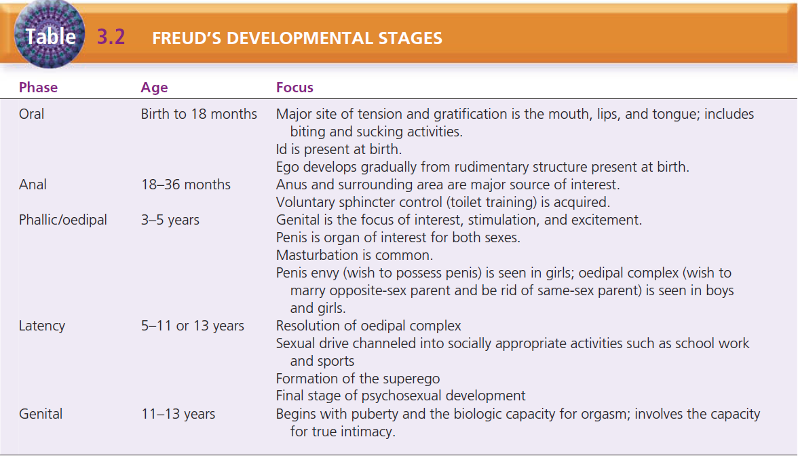

Slide 10
Ego Defense Mechanisms.
Freud believed the self, or ego, uses ego defense mechanisms, which are methods of attempting to protect the self and cope with basic drives or emotionally painful thoughts, feelings, or events.

Slide 11
Ego Defense Mechanisms
Defense Mechanism | Description
Compensation | Overachievement in one area to offset real or perceived deficiencies in another area. • Napoleon complex: diminutive man becoming emperor. • Nurse with low self-esteem working double shifts so her supervisor will like her.
Conversion | Expression of an emotional conflict through the development of a physical symptom, usually sensorimotor in nature. •Anxiety caused by repressed feelings can manifest itself into a cough or even an illness.
Denial | Failure to acknowledge an unbearable condition; failure to admit the reality of a situation or how one enables the problem to continue. • Diabetic person eating chocolate candy. • Spending money freely when broke.

Slide 12
Ego Defense Mechanisms
Defense Mechanism | Description
Displacement | Ventilation of intense feelings toward persons less threatening than the one who aroused those feelings. • Person who is mad at the boss yells at his or her spouse. • Child who is harassed by a bully at school mistreats a younger sibling.
Dissociation | Dealing with emotional conflict by a temporary alteration in consciousness or identity. • Amnesia that prevents recall of yesterday’s auto accident. • Adult remembers nothing of childhood sexual abuse.
Undoing | Exhibiting acceptable behavior to make up for or negate unacceptable behavior. • Person who cheats on a spouse brings the spouse a bouquet of roses. • Man who is ruthless in business donates large amounts of money to charity.

Slide 13
Ego Defense Mechanisms
Defense Mechanism | Description
Identification | Modeling actions and opinions of influential others while searching for identity, or aspiring to reach a personal, social, or occupational goal. • Nursing student becoming a critical care nurse because this is the specialty of an instructor she admires.
Intellectualization | Separation of the emotions of a painful event or situation from the facts involved; acknowledging the facts but not the emotions. • Person shows no emotional expression when discussing serious car accident.
Introjection | Accepting another person’s attitudes, beliefs, and values as one’s own. • Person who dislikes guns becomes an avid hunter, just like a best friend.

Slide 14
Ego Defense Mechanisms
Defense Mechanism | Description
Projection | Unconscious blaming of unacceptable inclinations or thoughts on an external object. •You might hate someone, but your superego tells you that such hatred is unacceptable. You can 'solve' the problem by believing that they hate you.
Rationalization | Excusing own behavior to avoid guilt, responsibility, conflict, anxiety, or loss of self-respect. • Student blames failure on teacher being mean. • Man says he beats his wife because she doesn’t listen to him.
Reaction formation | Acting the opposite of what one thinks or feels. • Woman who never wanted to have children becomes a supermom.

Slide 15
Ego Defense Mechanisms
Defense Mechanism | Description
Regression | Moving back to a previous developmental stage to feel safe or have needs met. • Five-year-old asks for a bottle when new baby brother is being fed. • Man pouts like a 4-year-old if he is not the center of his girlfriend’s attention.
Repression | Excluding emotionally painful or anxiety-provoking thoughts and feelings from conscious awareness. • Woman has no memory of the mugging she suffered yesterday. • Woman has no memory before age 7, when she was removed from abusive parents.
Resistance | Overt or covert antagonism toward remembering or processing anxiety-producing information. • Nurse is too busy with tasks to spend time talking to a dying patient. • Person attends court-ordered treatment for alcoholism but refuses to participate.

Slide 16
Ego Defense Mechanisms
Defense Mechanism | Description
Sublimation | Substituting a socially acceptable activity for an impulse that is unacceptable. • Person who has quit smoking sucks on hard candy when the urge to smoke arises. • Person goes for a 15-minute walk when tempted to eat junk food.
Substitution | Replacing the desired gratification with one that is more readily available. • Woman who would like to have her own children opens a day care center.
Suppression | Conscious exclusion of unacceptable thoughts and feelings from conscious awareness. • Student decides not to think about a parent’s illness to study for a test. • Woman tells a friend she cannot think about her son’s death right now.

Slide 17
Developmental Theories
Erik Erikson and Psychosocial Stages of Development:
In each stage, the person must complete a life task that is essential to his or her well-being and mental health.
These tasks allow the person to achieve life’s virtues: hope, purpose, fidelity, love, caring, and wisdom.

Slide 18
Developmental Theories
In Erikson’s view, psychosocial growth occurs in sequential phases, and each stage is dependent on completion of the previous stage and life task. For example, in the infant stage (birth to 18 months), trust versus mistrust, the infant must learn to develop basic trust (the positive outcome) such as that he or she will be fed and taken care of.
The formation of trust is essential: mistrust, the negative outcome of this stage, will impair the person’s development throughout his or her life.

Slide 19
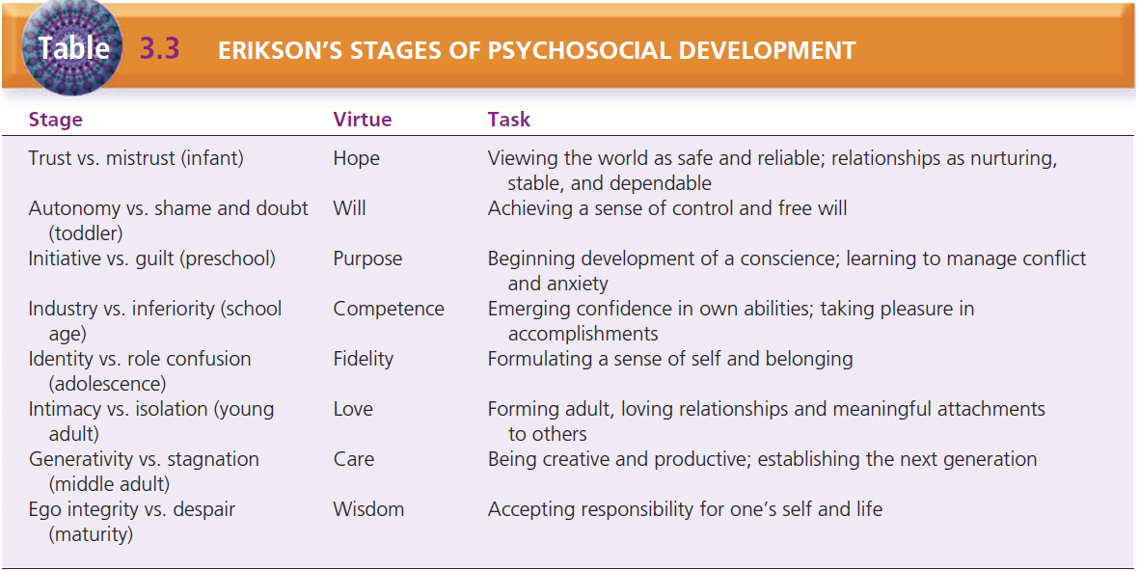

Slide 20
Jean Piaget and Cognitive Stages of
Development
Jean Piaget explored how intelligence and cognitive functioning develop in children.
He believed that human intelligence progresses through a series of stages based on age, with the child at each successive stage demonstrating a higher level of functioning than at previous stages.

Slide 21
Jean Piaget and Cognitive Stages of
Development
Piaget’s four stages of cognitive development are as follows:
Sensorimotor—birth to 2 years: The child develops a sense of self as separate from the environment and the concept of object permanence; that is, tangible objects do not cease to exist just because they are out of sight. He or she begins to form mental images.
Preoperational—2 to 6 years: The child develops the ability to express self with language, understands the meaning of symbolic gestures, and begins to classify objects.
Concrete operations—6 to 12 years: The child begins to apply logic to thinking, and is increasingly social and able to apply rules; however, thinking is still concrete.
Formal operations—12 to 15 years and beyond: The child learns to think and reason in abstract terms, further develops logical thinking and reasoning, and achieves cognitive maturity.

Slide 22
Jean Piaget and Cognitive Stages of
Development
Piaget’s theory suggests that individuals reach cognitive maturity by middle to late adolescence.
Some critics of Piaget believe that cognitive development is less rigid and more individualized than his theory suggests. Piaget’s theory is useful when working with children.

Slide 23
Interpersonal Theories
Harry Stack Sullivan: Interpersonal Relationships and Milieu Therapy.
Harry Stack Sullivan (1892–1949) was an American psychiatrist who extended the theory of personality development to include the significance of interpersonal relationships.
Sullivan believed that one’s personality involves more than individual characteristics, particularly how one interacts with others. He thought that inadequate or nonsatisfying relationships produce anxiety, which he saw as the basis for all emotional problems.

Slide 24
Interpersonal Theories
Therapeutic Community or Milieu. Sullivan envisioned the goal of treatment as the establishment of satisfying interpersonal relationships.
The therapist provides a corrective interpersonal relationship for the client. Sullivan coined the term participant observer for the therapist’s role, meaning that the therapist both participates in and observes the progress of the relationship.

Slide 25
Interpersonal Theories
In the concept of therapeutic community or milieu, the interaction among clients is seen as beneficial, and treatment emphasizes the role of this client-to-client interaction. Until this time, it was believed that the interaction between the client and the psychiatrist was the one essential component to the client’s treatment.
Sullivan and later Jones observed that interactions among clients in a safe, therapeutic setting provided great benefits to clients.
The concept of milieu therapy involved clients’ interactions with one another, including practicing interpersonal relationship skills, giving one another feedback about behavior, and working cooperatively as a group to solve day-to-day problems.

Slide 26
Hildegard Peplau: Therapeutic
Nurse–Patient Relationship
Hildegard Peplau was a nursing theorist and clinician who built on Sullivan’s interpersonal theories and also saw the role of the nurse as a participant observer.
Peplau developed the concept of the therapeutic nurse– patient relationship, which includes four phases: orientation, identification, exploitation, and resolution.

Slide 27
Hildegard Peplau: Therapeutic
Nurse–Patient Relationship
During these phases, the client accomplishes certain tasks and makes relationship changes that help the healing process.

Slide 28
Hildegard Peplau: Therapeutic
Nurse–Patient Relationship
The orientation phase is directed by the nurse and involves engaging the client in treatment, providing explanations and information, and answering questions.
The identification phase begins when the client works interdependently with the nurse, expresses feelings, and begins to feel stronger.
In the exploitation phase, the client makes full use of the services offered.
In the resolution phase, the client no longer needs professional services and gives up dependent behavior. The relationship ends.

Slide 29
Roles of the Nurse in the Therapeutic Relationship.
Peplau also wrote about the roles of the nurse in the therapeutic relationship and how these roles help meet the client’s needs. The primary roles she identified are as follows:

Slide 30
Roles of the Nurse in the Therapeutic Relationship.
Stranger––offering the client the same acceptance and courtesy that the nurse would to any stranger;
Resource person––providing specific answers to questions within a larger context;
Teacher––helping the client to learn formally or informally;
Leader––offering direction to the client or group;
Surrogate––serving as a substitute for another such as a parent or sibling;
Counselor––promoting experiences leading to health for the client such as expression of feelings.

Slide 31
Anxiety
Peplau defined anxiety as the initial response to a psychic threat. She described four levels of anxiety: mild, moderate, severe, and panic.

Slide 32
Anxiety
Mild anxiety is a positive state of heightened awareness and sharpened senses, allowing the person to learn new behaviors and solve problems. The person can take in all available stimuli (perceptual field).
Moderate anxiety involves a decreased perceptual field (focus on immediate task only); the person can learn new behavior or solve problems only with assistance. Another person can redirect the person to the task.
Severe anxiety involves feelings of dread or terror. The person cannot be redirected to a task; he or she focuses only on scattered details and has physiological symptoms of tachycardia, diaphoresis, and chest pain. A person with severe anxiety may go to an emergency department, believing he or she is having a heart attack.
Panic anxiety can involve loss of rational thought, delusions, hallucinations, and complete physical immobility and muteness. The person may run aimlessly, often exposing himself or herself to injury.

Slide 33
Crisis Intervention
A crisis is a turning point in an individual’s life that produces an overwhelming emotional response.
Individuals experience a crisis when they confront some life circumstance or stressor that they cannot effectively manage through use of their customary coping skills.
Caplan (1964) identified the stages of crisis:
The person is exposed to a stressor, experiences anxiety, and tries to cope in a customary fashion;
Anxiety increases when customary coping skills are ineffective;
The person makes all possible efforts to deal with the stressor, including attempts at new methods of coping; and
When coping attempts fail, the person experiences disequilibrium and significant distress.

Slide 34
Crisis Intervention
Crises occur in response to a variety of life situations and events and fall into three categories:
Maturational crises, sometimes called developmental crises, are predictable events in the normal course of life, such as leaving home for the first time, getting married, having a baby, and beginning a career.
Situational crises are unanticipated or sudden events that threaten the individual’s integrity, such as the death of a loved one, loss of a job, and physical or emotional illness in the individual or family member.
Adventitious crises, sometimes called social crises, include natural disasters like floods, earthquakes, or hurricanes; war; terrorist attacks; and violent crimes such as rape or murder.

Slide 35
Crisis Intervention
Note that not all events that result in crisis are “negative” in nature. Events like marriage, retirement, and childbirth are often desirable for the individual but may still present overwhelming challenges.
Aguilera (1998) identified three factors that influence whether or not an individual experiences a crisis: the individual’s perception of the event, the availability of emotional supports, and the availability of adequate coping mechanisms.
When the person in crisis seeks assistance, these three factors represent a guide for effective intervention. The person can be assisted to view the event or issue from a different perspective. Assisting the person to use existing supports or helping the individual find new sources of support can decrease the feelings of being alone or overwhelmed. Finally, assisting the person to learn new methods of coping will help to resolve the current crisis and give him or her new coping skills to use in the future.

Slide 36
Crisis Intervention
Crisis is described as self-limiting; that is, the crisis does not last indefinitely but usually exists for 4 to 6 weeks. At the end of that time, the crisis is resolved in one of three ways.
In the first two, the person either returns to his or her pre-crisis level of functioning or begins to function at a higher level; both are positive outcomes for the individual. The third resolution is that the person’s functioning stabilizes at a level lower than pre-crisis functioning, which is a negative outcome for the individual.

Slide 37
Crisis Intervention
Crisis intervention includes a variety of techniques based on the assessment of the individual:
Directive interventions are designed to assess the person’s health status and promote problem-solving, such as offering the person new information, knowledge, or meaning; raising the person’s self-awareness by providing feedback about behavior; and directing the person’s behavior by offering suggestions or courses of action.
Supportive interventions aim at dealing with the person’s needs for empathetic understanding, such as encouraging the person to identify and discuss feelings, serving as a sounding board for the person, and affirming the person’s self-worth.
Techniques and strategies that include a balance of these different types of intervention are the most effective.

Slide 38
Treatment Modalities

Slide 39
Benefits of Community Mental
Health Treatment
Inpatient treatment is often the last, rather than the first, mode of treatment for mental illness. Current treatment reflects the belief that it is more beneficial and certainly more cost-effective for clients to remain in the community and receive outpatient treatment whenever possible.
The client can often continue to work and can stay connected to family, friends, and other support systems while participating in therapy.
Outpatient therapy also takes into account that a person’s personality or behavior patterns, such as coping skills, styles of communication, and level of self-esteem, gradually develop over the course of a lifetime and cannot be changed in a relatively short inpatient course of treatment.
Hospital admission is indicated when the person is severely depressed and suicidal, severely psychotic, experiencing alcohol or drug withdrawal, or exhibiting behaviors that require close supervision in a safe, supportive environment.

Slide 40
Individual Psychotherapy
Individual psychotherapy is a method of bringing about change in a person by exploring his or her feelings, attitudes, thinking, and behavior.
It involves a one-to-one relationship between the therapist and the client. People generally seek this kind of therapy based on their desire to understand themselves and their behavior, to make personal changes, to improve interpersonal relationships, or to get relief from emotional pain or unhappiness.

Slide 41
Individual Psychotherapy
A therapist’s theoretical beliefs strongly influence his or her style of therapy. For example, a therapist grounded in interpersonal theory emphasizes relationships, whereas an existential therapist focuses on the client’s self-responsibility.

Slide 42
Groups
A group is a number of persons who gather in a face-to face setting to accomplish tasks that require cooperation, collaboration, or working together.
Group content refers to what is said in the context of the group, including educational material, feelings and emotions, or discussions of the project to be completed.
Group process refers to the behavior of the group and its individual members, including seating arrangements, tone of voice, who speaks to whom, who is quiet, and so forth.
Content and process occur continuously throughout the life of the group.

Slide 43
Stages of Group Development
A group may be established to serve a particular purpose in a specified period such as a work group to complete an assigned project or a therapy group that meets with the same members to explore ways to deal with depression.
In the pregroup stages, members are selected, the purpose or work of the group is identified, and group structure is addressed.
Group structure includes where and how often the group will meet, identification of a group leader, and the rules of the group—for example, whether individuals can join the group after it begins, how to handle absences, and expectations for group members.

Slide 44
Stages of Group Development
The working stage of group development begins as members begin to focus their attention on the purpose or task the group is trying to accomplish.
This may happen relatively quickly in a work group with a specific assigned project but may take two or three sessions in a therapy group because members must develop some level of trust before sharing personal feelings or difficult situations.
Group cohesiveness is the degree to which members work together cooperatively to accomplish the purpose.
Cohesiveness is a desirable group characteristic and is associated with positive group outcomes. It is evidenced when members value one another’s contributions to the group; members think of themselves as “we” and share responsibility for the work of the group. When a group is cohesive, members feel free to express all opinions, positive and negative, with little fear of rejection or retribution.
If a group is “overly cohesive,” in that uniformity and agreement become the group’s implicit goals, there may be a negative effect on the group outcome.

Slide 45
Group Leadership
Groups often have an identified or formal leader— someone designated to lead the group. In therapy groups and education groups, a formal leader is usually identified based on his or her education, qualifications, and experience.
Support groups and self-help groups usually do not have identified formal leaders; all members are seen as equals.

Slide 46
Group Leadership
Effective group leaders focus on group process as well as on group content.
Tasks of the group leader include giving feedback and suggestions; encouraging participation from all members (eliciting responses from quiet members and placing limits on members who may monopolize the group’s time); clarifying thoughts, feelings, and ideas; summarizing progress and accomplishments; and facilitating progress through the stages of group development.

Slide 47
Group Therapy
The therapeutic results of group therapy include the following:
Gaining new information, or learning.
Gaining inspiration or hope.
Interacting with others.
Feeling acceptance and belonging.
Becoming aware that one is not alone and that others share the same problems.
Gaining insight into one’s problems and behaviors and how they affect others.
Giving of oneself for the benefit of others (altruism).

Slide 48
Group Therapy
Therapy groups vary with different purposes, degrees of formality, and structures and include:
Psychotherapy groups.
Family therapy.
Family education.
Education groups.
Support groups.
Self-help groups.

Slide 49
Psychotherapy Groups
The goal of a psychotherapy group is for members to learn about their behavior and to make positive changes in their behavior by interacting and communicating with others as a member of a group.
Groups may be organized around a specific medical diagnosis, such as depression, or a particular issue, such as improving interpersonal skills or managing anxiety.
Group techniques and processes are used to help group members learn about their behavior. Members also learn they have responsibilities to others.

Slide 50
Psychotherapy Groups
There are two types of groups: open groups and closed groups.
Open groups are ongoing and run indefinitely, allowing members to join or leave the group as they need to.
Closed groups are structured to keep the same members in the group for a specified number of sessions.

Slide 51
Family Therapy
Family therapy is a form of group therapy in which the client and his or her family members participate. The goals include understanding how family dynamics contribute to the client’s psychopathology, mobilizing the family’s inherent strengths and functional resources, restructuring maladaptive family behavioral styles, and strengthening family problem-solving behaviors.
Family therapy can be used both to assess and to treat various psychiatric disorders.

Slide 52
Family Education
The specific features of this educational program include emphasis on emotional understanding and healing in the personal realm and on power and action in the social realm.

Slide 53
Education Groups
The goal of an education group is to provide information to members on a specific issue—for instance, stress management, medication management, or assertiveness training.
The group leader has expertise in the subject area and may be a nurse, therapist, or other health professional.

Slide 54
Support Groups
Support groups are organized to help members who share a common problem to cope with it.
The group leader explores members’ thoughts and feelings and creates an atmosphere of acceptance so that members feel comfortable expressing themselves.
Rules for support groups differ from those in psychotherapy in that members are allowed—in fact, encouraged—to contact one another and socialize outside the sessions.
Confidentiality may be a rule for some groups; the members decide this. Support groups tend to be open groups in which members can join or leave as their needs dictate.

Slide 55
Support Groups
Common support groups include those for cancer or stroke victims, persons with AIDS, and family members of someone who has committed suicide.
One national support group, Mothers Against Drunk Driving (MADD), is for family members of someone killed in a car accident caused by a drunk driver.

Slide 56
Self-Help Groups
In a self-help group, members share a common experience, but the group is not a formal or structured therapy group.
Although professionals organize some self-help groups, many are run by members and do not have a formally identified leader.
Some are locally organized and announce their meetings in local newspapers. Others are nationally organized, such as Alcoholics Anonymous, Parents Without Partners, Gamblers Anonymous.

Slide 57
Complementary and Alternative Therapies
Complementary medicine includes therapies used with conventional medicine practices (the medical model). Alternative medicine includes therapies used in place of conventional treatment.
Integrative medicine combines conventional medical therapy and CAM therapies that have scientific evidence supporting their safety and effectiveness.

Slide 58
Complementary and Alternative Therapies
Clients may be reluctant to tell the psychiatrist or primary care provider about the use of CAM.
Therefore, it is important that the nurse ask clients specifically about use of herbs, vitamins, or other health practices in a nonjudgmental way.

Slide 59
Psychiatric Rehabilitation
Psychiatric rehabilitation involves providing services to people with severe and persistent mental illness to help them to live in the community.
These programs are often called community support services or community support programs. Psychiatric rehabilitation focuses on the client’s strengths, not just on his or her illness.
The client actively participates in program planning. The programs are designed to help the client manage the illness and symptoms, gain access to needed services, and live successfully in the community.

Slide 60
Psychiatric Rehabilitation
These programs assist clients with activities of daily living such as transportation, shopping, food preparation, money management, and hygiene.
Social support and interpersonal relationships are recognized as a primary need for successful community living.
Psychiatric rehabilitation programs provide opportunities for socialization, such as places where clients can go to be with others in a safe, supportive environment.
Vocational referral, training, job coaching, and support are available for clients who want to seek and maintain employment.

Slide 61
Psychiatric Rehabilitation
There is often a disparity between what health-care professionals view as the client’s needs and what the client perceives as valuable.
Offering services that meet each client’s most important goals can significantly improve his or her quality of life and promote recovery and well-being.

Slide 62
The Nurse & Psychosocial
Interventions
Psychosocial interventions are nursing activities that enhance the client’s social and psychological functioning and improve social skills, interpersonal relationships, and communication.
Nurses often use psychosocial interventions to help meet clients’ needs and achieve outcomes in all practice settings, not just mental health.

Slide 63
The Nurse & Psychosocial
Interventions
For example, a client with diabetes tells the nurse,
“I promise to have just one bite of cake. Please! It’s my grandson’s birthday cake.” (manipulative behavior)

Slide 64
The Nurse & Psychosocial
Interventions
The nurse might use behavioral limit-setting by saying,
“I can’t give you permission to eat the cake. Your blood glucose level will go up if you do, and your insulin can’t be adjusted properly.”

Slide 65
The Nurse & Psychosocial
Interventions
When a client first attempts to change a colostomy bag but needs some assistance, the nurse might say,
“You gave it a good effort. You were able to complete the task with a little assistance.” (giving positive feedback)

Slide 66
Summary
Points to consider regarding psychosocial theories and treatment:
No one theory explains all human behavior. No one approach will work with all clients.
Becoming familiar with the variety of psychosocial approaches for working with clients will increase the nurse’s effectiveness in promoting the client’s health and well-being.
The client’s feelings and perceptions about his or her situation are the most influential factors in determining his or her response to therapeutic interventions, rather than what the nurse believes the client should do.

