Slide 1
Legal and Ethical Issues

Slide 2
Legal Considerations

Slide 3
Rights of Clients and Related Issues
Clients receiving mental health care retain all civil rights afforded to all people except the right to leave the hospital in the case of involuntary commitment.
They have the right to refuse treatment, to send and to receive sealed mail, and to have or refuse visitors.
Any restrictions (e.g., mail, visitors, and clothing) must be made for a verifiable, documented reason. These decisions can be made by a court or a designated decision-making person or persons, for example, primary nurse or treatment team, depending on local laws or regulations.

Slide 4
Rights of Clients and Related Issues
Examples include the following:
A suicidal client may not be permitted to keep a belt, shoelaces, or scissors because he or she may use these items for self-harm.
A client who becomes aggressive after having a particular visitor may have that person restricted from visiting for a period of time.
A client making threatening phone calls to others outside the hospital may be permitted only supervised phone calls until his or her condition improves.

Slide 6
Involuntary Hospitalization
Most clients are admitted to inpatient settings on a voluntary basis, which means they are willing to seek treatment and agree to be hospitalized. Some clients, however, do not wish to be hospitalized and treated. Health-care professionals respect these wishes unless clients are a danger to themselves or others.
Civil commitment or involuntary hospitalization curtails the client’s right to freedom (the ability to leave the hospital when he or she wishes). All other client rights, however, remain intact.

Slide 7
Involuntary Hospitalization
A person can be detained in a psychiatric facility for 48 to 72 hours on an emergency basis until a hearing can be conducted to determine whether or not he or she should be committed to a facility for treatment for a specified period.

Slide 8
Release from the Hospital
Clients admitted to the hospital voluntarily have the right to leave, provided they do not represent a danger to themselves or others. They can sign a written request for discharge and can be released from the hospital against medical advice.
If a voluntary client who is dangerous to himself or herself or to others signs a request for discharge, the psychiatrist may file for a civil commitment to detain the client against his or her will until a hearing can take place to decide the matter.

Slide 9
Release from the Hospital
While in the hospital, the committed client may take medications and improve fairly rapidly, making him or her eligible for discharge when he or she no longer represents a danger.
Some clients stop taking their medications after discharge and once again become threatening, aggressive, or dangerous. Mental health clinicians increasingly have been held legally liable for the criminal actions of such clients; this situation contributes to the debate about extended civil commitment for dangerous clients.

Slide 10
Mandatory Outpatient Treatment
Legally mandatory outpatient treatment (MOT) is the requirement that clients continue to participate in treatment on an involuntary basis after their release from the hospital into the community.
This may involve taking prescribed medication, keeping appointments with healthcare providers for follow-up, and attending specific treatment programs or groups.
Benefits of MOT include shorter inpatient hospital stays, although these individuals may be hospitalized more frequently; and protection of clients from criminal victimization by others.

Slide 11
Mandatory Outpatient Treatment
MOT is sometimes also called conditional release or outpatient commitment. Court-ordered outpatient treatment is most common among persons with severe and persistent metal illness who have had frequent and multiple contacts with mental health, social welfare, and criminal justice agencies.
This supports the notion that clients are given several opportunities to voluntarily comply with outpatient treatment recommendations and that court-ordered treatment is considered when those attempts have been repeatedly unsuccessful.
The court’s concern is that clients with psychiatric disorders have civil rights and should not be unreasonably required to participate in any activities against their will.

Slide 12
Conservatorship
The appointment of a conservator or legal guardian is a separate process from civil commitment. People who are gravely disabled; are found to be incompetent; cannot provide food, clothing, and shelter for themselves even when resources exist; and cannot act in their own best interests may require appointment of a conservator.
In these cases, the court appoints a person to act as a legal guardian who assumes many responsibilities for the person, such as giving informed consent, writing checks, and entering contracts.
The client with a guardian loses the right to enter into legal contracts or agreements that require a signature (e.g., marriage or mortgage). This affects many daily activities that are usually taken for granted. Because conservators or guardians speak for clients, the nurse must obtain consent or permission from the conservator.
Some states distinguish between conservator of the person (synonymous with legal guardian) and conservator of financial affairs only––also known as power of attorney for financial matters.

Slide 13
Least Restrictive Environment
Clients have the right to treatment in the least restrictive environment appropriate to meet their needs.
It means that a client does not have to be hospitalized if he or she can be treated in an outpatient setting or in a group home.
It also means that the client must be free of restraint or seclusion unless it is necessary.

Slide 14
Least Restrictive Environment
Restraint is the direct application of physical force to a person, without his or her permission, to restrict his or her freedom of movement.
The physical force may be human or mechanical or both.
Human restraint occurs when staff members physically control the client and move him or her to a seclusion room.
Mechanical restraints are devices, usually ankle and wrist restraints, fastened to the bed frame to curtail the client’s physical aggression, such as hitting, kicking, and hair pulling.

Slide 15
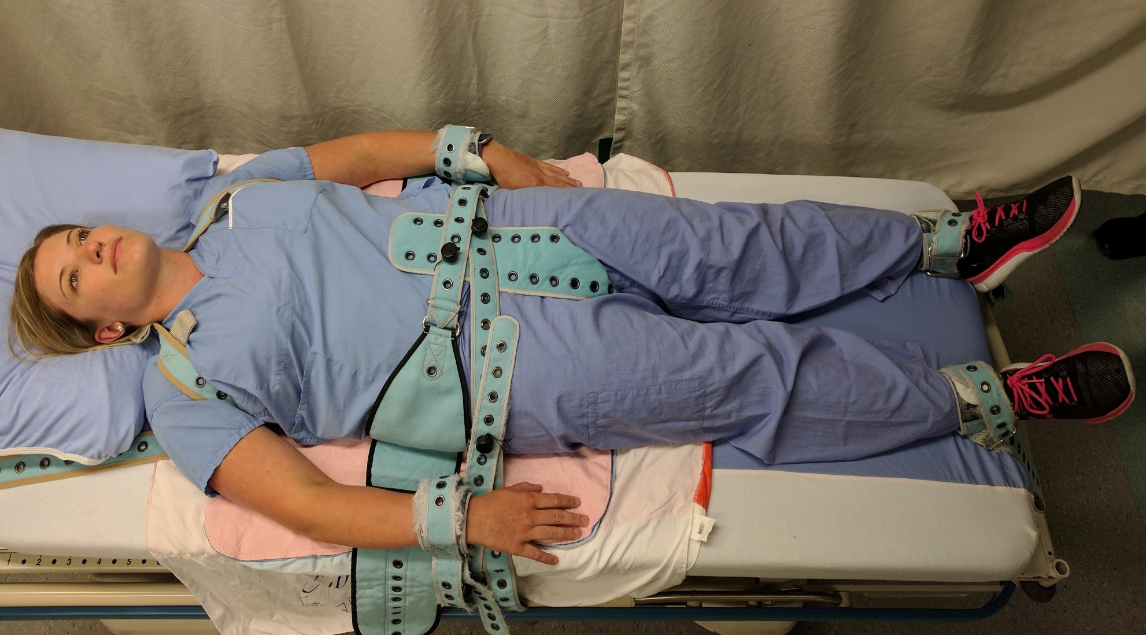
Restraint

Slide 16
Least Restrictive Environment
Seclusion is the involuntary confinement of a person in a specially constructed, locked room equipped with a security window or camera for direct visual monitoring.
For safety, the room often has a bed bolted to the floor and a mattress. Any sharp or potentially dangerous objects, such as pens, glasses, belts, and matches, are removed from the client as a safety precaution.
Seclusion decreases stimulation, protects others from the client, prevents property destruction, and provides privacy for the client.
The goal is to give the client the opportunity to regain physical and emotional self-control.

Slide 17
Seclusion Room

Slide 18
Least Restrictive Environment
Short-term use of restraint or seclusion is permitted only when the client is imminently aggressive and dangerous to himself or herself or to others, and all other means of calming the client have been unsuccessful.
For adult clients, use of restraint and seclusion requires a face-to-face evaluation by a licensed independent practitioner within 1 hour of restraint or seclusion and every 8 hours thereafter, a physician’s order every 4 hours, documented assessment by the nurse every 1 to 2 hours, and close supervision of the client.
For children, the physician’s order must be renewed every 2 hours, with a face-to-face evaluation every 4 hours. The nurse assesses the client for any injury and provides treatment as needed. Staff must monitor a client in restraints continuously on a 1:1 basis for the duration of the restraint period.

Slide 19
Least Restrictive Environment
A client in seclusion is monitored 1:1 for the first hour and then may be monitored by audio and video equipment.
The nurse monitors and documents the client’s skin condition, blood circulation in hands and feet (for the client in restraints), emotional well-being, and readiness to discontinue seclusion or restraint. He or she observes the client closely for side effects of medications, which may be given in large doses in emergencies.
The nurse or designated care provider also implements and documents offers of food, fluids, and opportunities to use the bathroom per facility policies and procedures.

Slide 20
Least Restrictive Environment
As soon as possible, staff members must inform the client of the behavioral criteria that will be used to determine whether to decrease or to end the use of restraint or seclusion. Criteria may include the client’s ability to verbalize feelings and concerns rationally, to make no verbal threats, to have decreased muscle tension, and to demonstrate self control.
If a client remains in restraints for 1 to 2 hours, two staff members can free one limb at a time for movement and exercise. Frequent contact by the nurse promotes ongoing assessment of the client’s well-being and self-control.
It also provides an opportunity for the nurse to reassure the client that restraint is a restorative, not a punitive, procedure. Following release from seclusion or restraint, a debriefing session is required within 24 hours.

Slide 21
Least Restrictive Environment
The nurse also should offer support to the client’s family, who may be angry or embarrassed when the client is restrained or secluded. A careful and thorough explanation about the client’s behavior and subsequent use of restraint or seclusion is important.
If the client is an adult, however, such discussion requires a signed release of information. In the case of minor children, signed consent is not required to inform parents or guardians about the use of restraint or seclusion.
Providing the family with information may help prevent legal or ethical difficulties. It also keeps the family involved in the client’s treatment.

Slide 22
Clinical Vignette: Seclusion
The goal of seclusion is to give the client the opportunity to regain self-control, both emotionally and physically. Most clients who have been secluded, however, have very different feelings and thoughts about seclusion. Clients report feeling angry, agitated, bored, frustrated, helpless, and afraid while in seclusion. They perceive seclusion as a punishment and receive the message that they were “bad.”
Many clients are not clear about the reasons for seclusion or the criteria for exiting seclusion, and they believe that seclusion lasted too long. In general, clients think that other interventions such as interaction with staff, a place to calm down or scream when needed, or the presence of a family member could reduce or eliminate the need for seclusion.

Slide 23
Confidentiality
The protection and privacy of personal health information is regulated by the federal government through the Health Insurance Portability and Accountability Act (HIPAA) of 1996.
The law guarantees the privacy and protection of health information and outlines penalties for violations.

Slide 24
Confidentiality
Both civil (fines) and criminal (prison sentences) penalties exist for violation of patient privacy.
Protected health information is any individually identifiable health information in oral, written, or electronic form.
Mental health and substance abuse records have additional special protection under the privacy rules.

Slide 25
Duty to Warn Third Parties
One exception to the client’s right to confidentiality is the duty to warn.
As a result of this decision, mental health clinicians have a duty to warn identifiable third parties of threats made by clients, even if these threats were discussed during therapy sessions.

Slide 26
Duty to Warn Third Parties
The clinician must base his or her decision to warn others on the following:
Is the client dangerous to others?
Is the danger the result of serious mental illness?
Is the danger serious?
Are the means to carry out the threat available?
Is the danger targeted at identifiable victims?
Is the victim accessible?

Slide 27
Insanity Defense
One legal issue that sparks controversy is the insanity defense, with insanity having a legal meaning but no medical definition.
The argument that a person accused of a crime is not guilty because that person cannot control his or her actions or cannot understand the wrongfulness of the act is known as the M’Naghten Rule.
In actuality, this defense is used in only 0.9% (9 in 1,000) of all criminal cases and is successful in less than 20% of those cases.

Slide 28
Nursing Liability
Nurses are responsible for providing safe, competent, legal, and ethical care to clients and families.
Nurses are expected to meet standards of care, meaning the care they provide to clients meets set expectations and is what any nurse in a similar situation would do.

Slide 29
Torts
A tort is a wrongful act that results in injury, loss, or damage. Torts may be either unintentional or intentional.
Unintentional Torts: Negligence and Malpractice.
Negligence is an unintentional tort that involves causing harm by failing to do what a reasonable and prudent person would do in similar circumstances.
Malpractice is a type of negligence that refers specifically to professionals such as nurses and physicians. Clients or families can file malpractice lawsuits in any case of injury, loss, or death.

Slide 30
Torts
For a malpractice suit to be successful, that is, for the nurse, physician, or hospital or agency to be liable, the client or family needs to prove the following four elements:
Duty: A legally recognized relationship (i.e., physician to client, nurse to client) existed. The nurse had a duty to the client, meaning that the nurse was acting in the capacity of a nurse.
Breach of duty: The nurse (or physician) failed to conform to standards of care, thereby breaching or failing the existing duty. The nurse did not act as a reasonable, prudent nurse would have acted in similar circumstances.
Injury or damage: The client suffered some type of loss, damage, or injury.
Causation: The breach of duty was the direct cause of the loss, damage, or injury. In other words, the loss, damage, or injury would not have occurred if the nurse had acted in a reasonable, prudent manner.

Slide 31
Torts
Not all injury or harm to a client can be prevented, nor do all client injuries result from malpractice.
In the mental health setting, lawsuits most often are related to suicide and suicide attempts. Other areas of concern include clients harming others (staff, family, or other clients), sexual assault, and medication errors.

Slide 32
Torts
Intentional Torts. Psychiatric nurses also may be liable for intentional torts or voluntary acts that result in harm to the client.
Examples include assault, battery, and false imprisonment.

Slide 33
Torts
Assault involves any action that causes a person to fear being touched in a way that is offensive, insulting, or physically injurious without consent or authority. Examples include making threats to restrain the client to give him or her an injection for failure to cooperate.
Battery involves harmful or unwarranted contact with a client; actual harm or injury may or may not have occurred. Examples include touching a client without consent or unnecessarily restraining a client.
False imprisonment is defined as the unjustifiable detention of a client such as the inappropriate use of restraint or seclusion.

Slide 34
Torts
Proving liability for an intentional tort involves three elements:
The act was willful and voluntary on the part of the defendant (nurse).
The nurse intended to bring about consequences or injury to the person (client).
The act was a substantial factor in causing injury or consequences.

Slide 35
Prevention of Liability
Nurses can minimize the risk for lawsuits through safe, competent nursing care and descriptive, accurate documentation.

Slide 36
Steps to Avoid Liability
Practice within the scope of state laws and nurse practice act.
Collaborate with colleagues to determine the best course of action.
Use established practice standards to guide decisions and actions.
Always put the client’s rights and welfare first.
Develop effective interpersonal relationships with clients and families.
Accurately and thoroughly document all assessment data, treatments, interventions, and evaluations of the client’s response to care.

Slide 37
Ethical Issues

Slide 38
Ethical Issues
Ethics is a branch of philosophy that deals with values of human conduct related to the rightness or wrongness of actions and to the goodness and badness of the motives and ends of such actions.
Ethical theories are sets of principles used to decide what is morally right or wrong.

Slide 39
Ethical Issues
Utilitarianism is a theory that bases decisions on “the greatest good for the greatest number.”
Decisions based on utilitarianism consider which action would produce the greatest benefit for the most people.
Deontology is a theory that says decisions should be based on whether or not an action is morally right with no regard for the result or consequences.
Principles used as guides for decision-making in deontology include autonomy, beneficence, nonmaleficence, justice, veracity, and fidelity.

Slide 40
Ethical Principles
Autonomy refers to the person’s right to self-determination and independence.
Beneficence refers to one’s duty to benefit or to promote good for others.
Nonmaleficence is the requirement to do no harm to others either intentionally or unintentionally.
Justice refers to fairness; that is, treating all people fairly and equally without regard for social or economic status, race, sex, marital status, religion, ethnicity, or cultural beliefs.
Veracity is the duty to be honest or truthful.
Fidelity refers to the obligation to honor commitments and contracts.

Slide 41
Ethical Dilemmas in Mental Health
An ethical dilemma is a situation in which ethical principles conflict or when there is no one clear course of action in a given situation.
For example, the client who refuses medication or treatment is allowed to do so based on the principle of autonomy. If the client presents an imminent threat of danger to self or others, however, the principle of nonmaleficence (do no harm) is at risk. To protect the client or others from harm, the client may be involuntarily committed to a hospital, even though some may argue that this action violates his or her right to autonomy. In this example, the utilitarian theory of doing the greatest good for the greatest number (involuntary commitment) overrides the individual client’s autonomy (right to refuse treatment).
Ethical dilemmas are often complicated and charged with emotion, making it difficult to arrive at fair or “right” decisions.

