Slide 1
Time Management
Prepared By:
Hiba Zeidan (1181087)
Wajeeha Hussein (1181707)
Fatema Jebara (1182097)
Samera Wasaya (1182292)
Siham Shwiki (1182316)
Reem Abu Zaid (1182454)
Prepared For: Miss Maram Jaghama

Slide 2
Learning Objectives
01
02
03
04
05
06
Analyze how time is managed both personally and at the unit level of the organization.
Describe the importance of allowing adequate time for planning and priority setting.
Identify common internal and external time wasters and its interventions that help reduce it.
Complete a time inventory to increase self-awareness regarding personal priority setting and
time management.
Describe how planning fallacies influence the perception of the time needed to complete a task.
Complete tasks according to the priority level they have been assigned whenever possible.

Slide 3
Time management can be defined as making optimal use of any available time.
Homisak (2012) notes that many people with poor time management skills spend inordinate amounts of time burning the candle at both ends, blaming others for their time inefficiencies, and getting others to work harder.

Slide 4
THREE BASIC STEPS TO TIME MANAGEMENT
The first step requires time be set aside for planning and establishing priorities.
The second step entails completing the highest priority task whenever possible and finishing one task before beginning another.
The third and final step, the person must reprioritize what tasks will be accomplished based on new information received.

Slide 5
Keys to Optimizing Time Management
Prioritizing Duties
Managing and Controlling Crises
Reducing Stress
Balancing work and Managing Time

Slide 6
Taking Time To Plan and Establishing Priorities
Planning fallacies is a phenomenon in which predictions about how much time will be needed to complete a future task display an optimism bias and underestimate the time needed.
Planning occurs first in the management process which leads to a great ability in organizing.
Two common mistakes in planning:
Underestimating the importance of a daily plan.
Not allowing adequate time for planning.

Slide 7
SMART Approach
Pugsley (2009) stated that many students fail to establish a plan to complete learning activities due to the unclear image of what the final product must look like.
He suggested the SMART approach which leads to effective planning for a manager, leader or staff nurse.

Slide 8
The Time Efficient Work Environment
Disorganization is a consequence to poor planning and working in an environment that is not conductive to time management
Suggestions that assist the staff nurse in planning work activities:
Gather all the supplies and equipment that will be needed before starting an activity.
Group activities that are in the same location.
Use time estimates.
Document your nursing interventions as soon as possible after an activity is completed.
Strive to always end the workday on time.

Slide 9
Unit Manager
In regards to the staff nurse, the unit manager also needs daily planning actions to identify and utilize time as a resource most efficiently.
These actions include:
Identifying key priorities that must be accomplished during that day.
Determining the level of achievement that must be expected for each prioritized task.
Assessing the staff assigned to work with you.
Reviewing the short and long term plans of the unit regularly.
Planning ahead for meetings.
Allowing time at the end of the day to assess the progress in the establishement of the desired goals.

Slide 10
7. Taking regular scheduled breaks throughout the day.
8. Using a planner to organize your day to make it feel less chaotic.

Slide 11
Priority Setting and Procrastination
Priority setting is perhaps the most critical skill in good time management, because all actions we take have some type of relative importance.
One simple means of prioritizing what needs to be accomplished is to divide all requests into
three categories:
Don’t do
Do later
Do now

Slide 12
The “don’t do”
Problems that will take care of themselves or are better accomplished by someone else.
The individual either throws them away or passes them on to the appropriate person
The “do later”
Problems that do not have immediate deadlines; so
we can procrastinate "to postpone" them (تأجيل أو مماطلة)
Procrastination must be used appropriately and
selectively.
Before setting “do later” items aside, the leader or
manager should establish a plan that includes a definite
time in the near future to address these requests.

Slide 13
The “do now”
Are the unit’s day-to-day operational needs.
May also represent items that had been put off earlier.
Making lists:
Are planning tools in prioritizing all the “do now” items.
Should not be longer than what can be realistically accomplished in 1 day, allow adequate time for each task.
May not include the routine tasks because they may distract attention from other priority tasks.
Individuals who use lists to help them organize their day must be careful not to confuse importance and urgency.

Slide 14
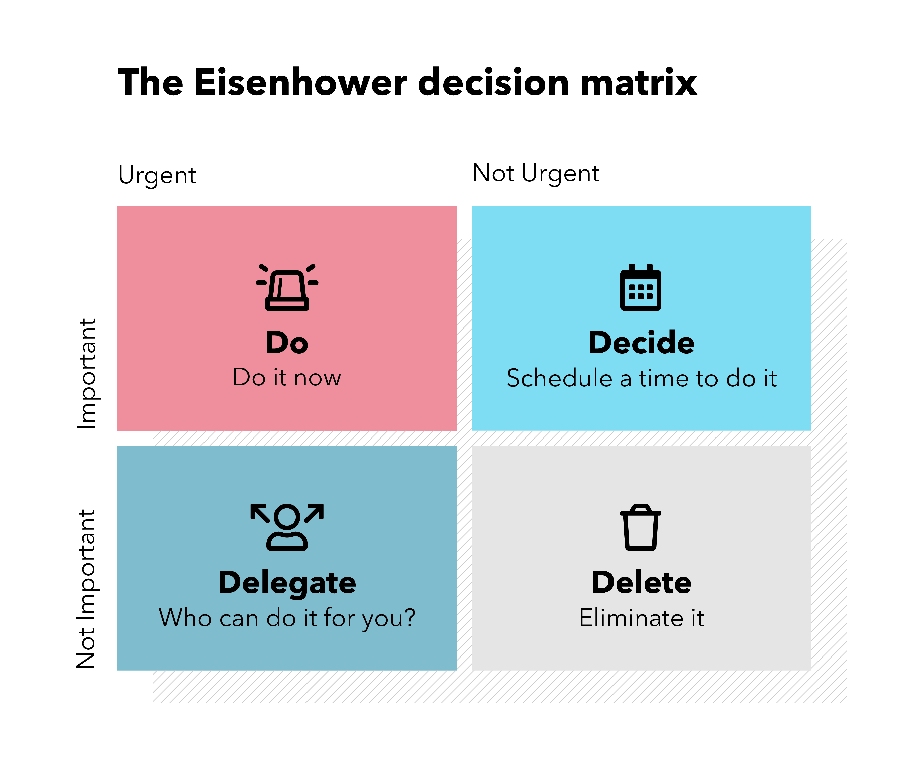
Not all-important things are urgent, and not all urgent things are important.

Slide 15
Reprioritizing
Often, one’s priorities or list will change during a day, week, or longer because new information is received.
Other priorities set earlier may no longer be accurate when reprioritizing neglected after new information is received.
Prioritizing is also important after an occasional crisis occurs "No amount of planning can prevent an occasional crisis".
What is the most critical skill in good time management? A) Allow adequate time for planning B) Recognizing the need for daily planning C) Priority setting D) Handling situations as they arise

Slide 16
Dealing with Interruptions
Interruptions: they are acts that temporarily stop an activity or a situation peformed at a specific time.
All managers experience interruptions, however lower-level managers mostly experience them due to:
No quiet workspace.
Clerical help to filter interruptions
These interruptions lead to situational stress and lowered job satisfaction.
Managers need to develop leadership skills and strengthen their willpower and focus to overcome these interruptions.

Slide 17
Time Wasters
There are 4 time wasters and they are:
Technology
Internet, gaming, e-mail, and social media sites.
Socializing
Subordinates are discouraged from taking time from a manager with idle chatter in several ways:
- Do not make yourself overly accessible.
- Interrupt.
- Avoid promoting socialization.
- Be brief.
- Schedule long-winded pests.
Paper Overload
Paper clutter, including organizational memos, staffing requests, quality assurance reports, incident reports, and patient evaluations.
Poor Filing System
Increased use of computerization and e-mails

Slide 18
Personal Time Management
Personal time management refers in part to self-knowledge.
Managing time is difficult if a person is unsure of his or her priorities for time management, including personal short-term, intermediate, and long-term goals.
Self-awareness is a leadership skill
Effective time management is an essential part of finding balance between work life and personal life, however those who lack self-awareness, it is difficult to achieve that balance.

Slide 19
Maybe you need another one...
01
Everyone should be aware of how he or she values the time of others.
02
A lack of punctuality suggests that you do not value other people’s time.
03
Find your productivity sweet spot

Slide 21
Time Inventory
A time inventory allows you to compare what you planned to do, as outlined by your appointments and “to do” entries, with what you did.
Mattison notes that one of the biggest mistakes students make when attempting to get organized is the fact that they try and squeeze all responsibilities into their week without taking into consideration that there is only 24 hours in a day. “Going without sleep, relationship time, food or exercise is not a good option”.
When using a time inventory, Mattison suggests plotting in sleep first and then the time that is immovable, including classes and clinicals. After that, whatever else is important to them, such as family time or church. Next, study time and planned break times should be included in the time inventory.

Slide 22
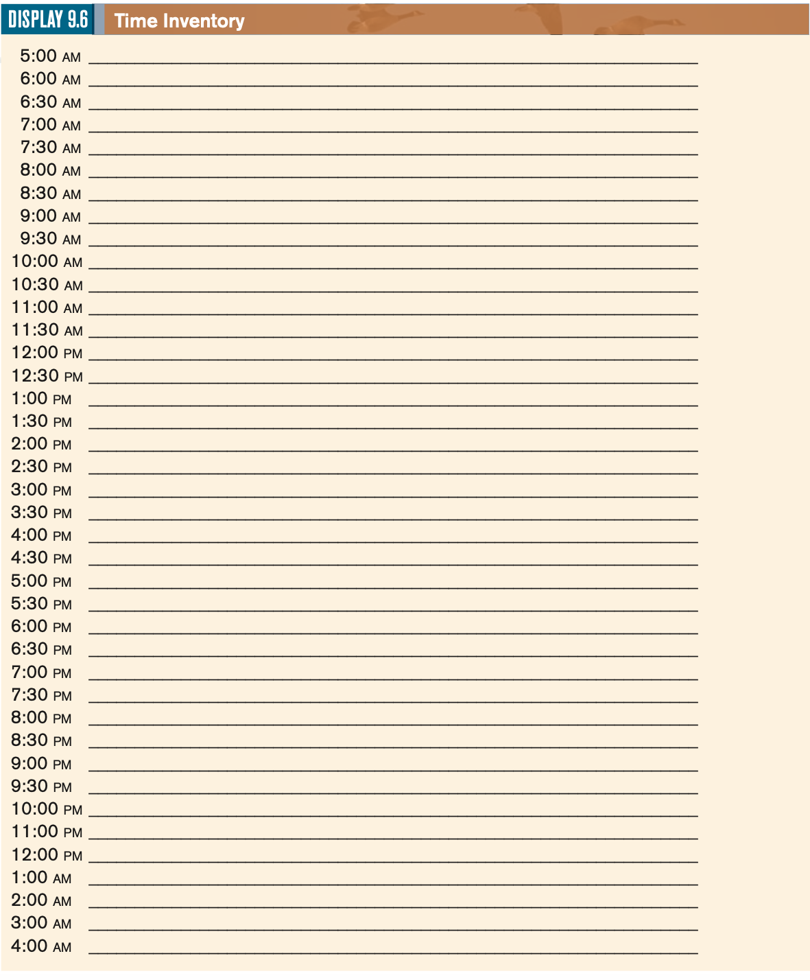
It may be necessary to maintain the time inventory for several days or even several weeks to be able to objectively identify patterns of behavior.
Remember there is no way to borrow or steal more hours in the day. If time is habitually used ineffectively, managing time will be very stressful.

Slide 23
Integrating Leadership Roles And Management Functions In Time Management
Managing time appropriately reduces stress and increases productivity.
Time is a finite and valuable resource, learning to use it wisely is essential for effective management.
The current status of health care, the nursing shortage, and decreasing reimbursements have resulted in many health-care organizations trying to do more with less.
The effective use of time management tools, therefore, becomes even more important to enable leader-managers to meet personal and professional goals.

Slide 24
The leadership skills needed to manage time resources draw heavily on interpersonal communication skills.
The leader is a resource and role model to subordinates in how to manage time.
Leadership skill of self-awareness is also necessary in time management.
Leaders must understand their own value system, which influences how they use time and how they expect subordinates to use time.
The leader-manager must initiate an analysis of time management on the unit level, involve team members and gain their cooperation in maximizing time use, and guide work to its conclusion and successful implementation.

Slide 25
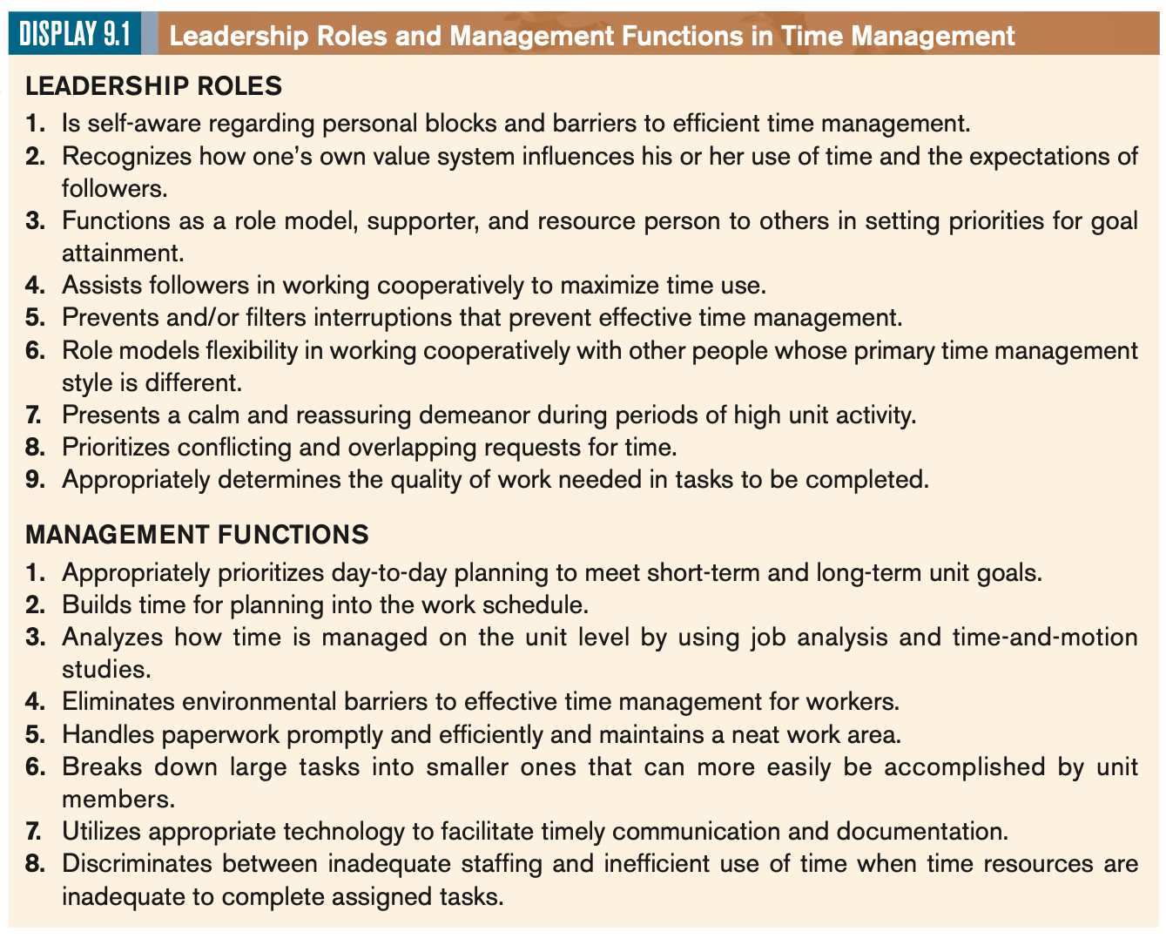

Slide 26
References
Marquis, B.L., & Huston, C.J. (2012). Leadership roles and management functions in nursing
(7thEd.). Philadelphia: Lippincott
Thank you for your cooperation and time!!

