Slide 1
Time Management
Chapter 9 – p.191

Slide 2
Definition
Time Management can be defined as making optimal use of time.
Because time is a valuable resource, learning to use it wisely requires both leadership skills and management functions.
There is a close relationship between stress and time management.
Good time management skills allow an individual to spend time on things that matter.

Slide 3
Poor time management
Getting less done than expected
The inability to meet a deadline set by your manager
Spending too much time on one part of the job and then having insufficient time to do the rest of the job.

Slide 4
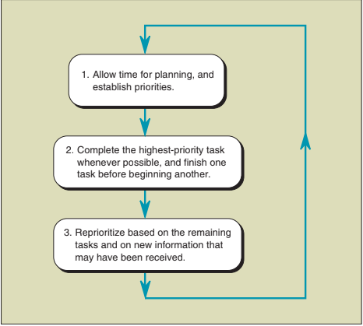
Three Basic Steps to Time Management

Slide 5
Three Basic Steps to Time Management
Planning
“Fail to plan - plan to fail”
Two common mistakes in planning are underestimating the importance of a daily plan and not allowing adequate time for planning.
The planning fallacy is a phenomenon in which predictions about how much time will be needed to complete a future task display an optimism bias and underestimate the time needed.

Slide 6
Three Basic Steps to Time Management
2. Prioritizing
3. Reexamining and reprioritizing

Slide 7
The SMART approach to studying
Set specific, clear goals to be accomplished
Record your progress as measurable progress maintains your interest.
Identify the steps needed to accomplish your agreed goals
Be realistic about your time constraints and set goals that can be accomplished within these constraints.
Set a time frame and plan for this.

Slide 8
Time Efficient work Environment
Staff nurses could be disorganized while caring for patients :
Poor planning
Bad Work environment
Using industrial engineering principles, Nurses would be able to plan work activities

Slide 9
Industrial Engineering Principles
Gather all supplies needed for an activity
Group activities that are in the same location
Time estimates
Document ASAP after interventions
End work days on time

Slide 10
Like the Nursing staff, Managers Also should plan and coordinate their duties
Example (Releasing time to care : The productive ward (RTC)
Here are some of planning actions that could help the manager utilize time efficiently:
Everyday Identify Key Priorities (and how to do them), & In what order.
Determine the level of achievement expected for each task.
Assess the assigned staff working with you.
Review Short & Long - term plans
Plan ahead for meetings
Assess the progress throughout the day
Take scheduled breaks
Electronic calendars

Slide 13
Priority Setting and Procrastination
Prioritizing is the key to good time management
All requests are divided into three categories;
“Don't Do”
“Do later”
“Do Now”

Slide 14
“Dont Do” Request
Utilized for a number of different reasons
Problems will take care of themselves
Problems have become outdated
Tasks can be better accomplished by someone else

Slide 15
“Do Later” Requests
Problems that do not have immediate deadline
Can be “procrastinated”
Large projects must be broken down into smaller projects by leader
Plan should be constructed

Slide 16
Procrastination
Can be appropriate in some cases
Usually a barrier to effective time management
Must be used appropriately and selectively

Slide 17
“Do Now” Requests
Reflect day-to-day operational needs
Examples?
These requests may reflect tasks that had been put off earlier

Slide 18
Prioritizing the “Do Now” Requests
Written lists can be helpful
Can bee monthly, weekly, or daily lists that help to coordinate operations
Need to allow adequate time for each task. Unexpected events must also be taken into consideration
“Not all important things are urgent, and not all urgent things are important.”

Slide 19
Reprioritizing
Considered the last step in time management
Priorities can change
Occasional crisis may occur
“No amount of planning can prevent occasional crisis”
If crisis occurs-new plan must be made

Slide 20
Dealing with Interruptions
“Lower-level managers experience more interruptions than higher-level managers.”
They do not have a quiet workplace
No addition help to filter interruptions
Skills are required to prevent interruptions, as they can threaten effective time management.
What leadership skills can be used to deal with interruptions?
Leaders are role-models – staff will mirror their leaders and managers

Slide 21
Time Wasters
Time wasters can be different from one individual to another
Four main time wasters:
Technology
Socializing
External time wasters including: paperwork overload, a poor filing system
Interruptions
“Once staff recognize that the manager is serious about keeping protected time and not accepting all types of interruptions, then it will become standard practice” (Ashurst, 2013, p. 51).

Slide 22
Key Points to Discourage Time Wasting Socializing
Do not make yourself overly accessible
Interrupt
Avoid promoting socialization
Be Brief
Schedule long-winded pests

Slide 23
Personal time management
Personal time management refers in part to self-knowledge & self awareness.
Managing time is difficult if a person is unsure of his or her priorities for time management, including:
Personal short-term, intermediate, and long-term goals.
Concrete plan with timelines is needed.

Slide 24
Bran’s 12 Habits to Master Time Management #1
1. Strive to be authentic. (Genuine)
2. Favor trusting relationships.
3. Maintain lifestyle that gives you maximum energy.
4. Organize day by your biorhythms.
5. Set very few priorities and stick to them.
6. Turn down things inconsistent with your priorities.
7. Set aside time for focused effort.

Slide 25
Bran’s 12 Habits to Master Time Management #2
8. Always look for ways of doing thing better and faster.
9. Build solid processes.
10.Spot trouble ahead and solve problems immediately.
11.Break goals into small units of work and think only about
one unit at a time.
12.Finish what is important and stop doing what is no
longer worthwhile.

Slide 26
Further instructions
Focus on what is important to accomplish in one’s life.
Be self-aware regarding general tendency.
Everyone avoids certain types of work or has methods of wasting time.
Svehaug’s (2013) productivity sweet spot:
Each person works better at certain times of the day or for certain lengths of.

Slide 27
Con’t
Each individual should be aware of how he or she values the time of others.
Being punctual goes beyond common courtesy.
Tardiness reflects some disregard for the value of other people’s time.
A lack of punctuality suggests that you do not value other people’s time.

Slide 28
Time inventory
Helps the individual determine:
How much time he or she spends on a particular task.
What time of day he or she is most productive.
It is important to maintain the time inventory for several days or even weeks and to repeat it annually to see if long-term changes have been made

Slide 29
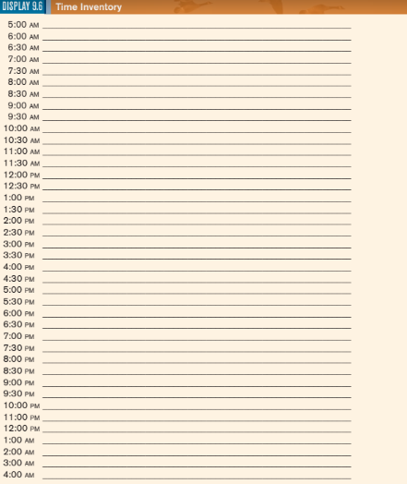
Time Inventory

Slide 30
INTEGRATING LEADERSHIP ROLES AND MANAGEMENT FUNCTIONS IN TIME MANAGEMENT
*There is a close relationship between time management and stress .(managing time reduces stress and increases productivity).
*Leadership skills needed to manage time resources draw heavily on interpersonal communication skills .
*Leader is a resource and role model to subordinates in how to manage time.

Slide 31
A manager must be able to prioritize activities to meet short and long term needs and in order to achieve this the must do the following things:
The leader manager must initiate an analysis of time management on the unit level.
Involve team members and gain their cooperation in maximizing time use.
They must guide work to its conclusion and successful implementation.

