Slide 1
Cancer
Treatment Modalities

Slide 2
Radiotherapy
Approximately 60% of all people with cancer will be treated with radiation therapy

Slide 3
Biologic effects of Radiation
Radiation therapy uses high-energy ionizing radiation to kill all cancer cells.
It is considered a local therapy because cancer cells are destroyed only in the anatomic area being treated.
The radiation causes the breakage of one or both strands of the DNA molecule inside the cells, thereby preventing their ability to grow and divide.

Slide 4
Biologic effects of Radiation
The dose of radiation administered is determined by a number of factors, including:
  The radio sensitivity of the tumor.
  The normal tissue tolerance.
  The volume of tissue to be irradiated.

Slide 5
Gray
One Gray (GY)= 100 rads
Treatment are usually given on a daily basis, 5 days per week for an average of 25 to 30 treatment.

Slide 6
Uses of radiation therapy for the treatment of cancer
Primary therapy (e.g., carcinomas of the cervix).
Combined modality therapy (e.g., Local recurrence following surgery for breast cancer).
Palliative therapy

Slide 7

Administration of Radiation Therapy
External Beam Radiation (teletherapy).
Intraoperative Therapy.
Internal Radiation (brachytherapy).

Slide 8
Nursing Care / Skin
Assess skin within treatment area erythema, pain, and dry or moist desquamation (peeling of skin).
Marking on skin for treatment purposes must removed unless otherwise instructed.
Within the treatment area, avoid use of soaps, deodorants, powder, perfumes, and cosmetics.
Avoid wearing tight-fitting clothing over treatment area.
Wear cotton clothing close to the skin.

Slide 9
Fatigue
Assess level of fatigue.
Determine activities that increase fatigue.
Identify activities that reserve energy, plan rest periods throughout the day.
Assist patient and family in obtaining resources for transportation, routine works, and meal preparation.
Assure optimal nutritional status.

Slide 10
Anorexia
Assess nutritional status, food intake, weight.
Suggest small, frequent meals, high protein and high calorie foods and snacks.
Utilize nutritional supplement.

Slide 11
Oral Stomatitis
Assess oral cavity at least daily.
Review mouth care: brush teeth after each meal, floss once a day (if tolerated).
Rinse mouth with warm saline every 2 hours or as needed.
When mouth is tender, select soft, nonirritating foods and fluids to consume.
Utilize topical anesthetics or analgesics as ordered before meals to improve comfort with eating.

Slide 12
Taste changes
Assess for taste changes.
Recommend experimenting with a variety of foods to find foods that provide some satisfying taste.
Perform mouth care before meals.

Slide 13
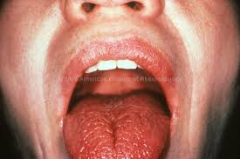
Xerostomia (Dry Mouth Syndrome)
Assess for xerostomia .
Inspect oral cavity for signs of infection.
Provide soft and moistened foods.
Provide fluids with meals and snacks.
Use saliva substitutes.

Slide 14
Pharyngitis and Esophagitis
Assess for sore throat, esophagus.
Provide soft, nonirritating foods.
Utilize topical anesthetics or analgesics prior to meals as ordered.

Slide 15
Cough
Assess for cough, fever, chills, or sweats.
Provide cough medications, antibiotics as ordered.
Encourage fluid intake as tolerated
Encourage warm saline gargles as needed.

Slide 16
Nausea and vomiting
Assess for nausea and vomiting.
Prophylactically use antiemetic for treatment that are emetogenic.
Utilize antiemetic as needed.
Monitor hydration state and encourage fluids.
Encourage small, frequent meals.
Encourage resting after meals.

Slide 17
Diarrhea
Assess for diarrhea.
Utilize low-reside diet when diarrhea occurs
Utilize antidiarrheal medication as needed
Monitor hydration state
Assess perianal tissues for inflammation

Slide 18
Cystitis
Assess for cystitis, dysuria, ferquency
Assess for bladder infection
Encourage fluid intake
Utilize medication as ordered

Slide 19
Surgery
Approximately 55% of all individuals with cancer are treated with surgical intervention.
Combining surgery with other therapies has significantly lengthened disease-free intervals.
Surgery can be used for prevention, diagnosis, definitive treatment, rehabilitation, or palliation.

Slide 20
Factors Influencing Treatment Decisions
Tumor cell kinetics.
Tumor location.
Physical status.
Quality of life.

Slide 21
Types of Therapies
The role of surgery in cancer can be divided into six categories:
Definitive surgery for primary cancer, local therapy, and integration with other adjuvant modalities.
Surgery for residual disease.
Surgery for metastatic disease with curative intent.
Surgery for oncologic emergencies.
Surgery for reconstruction and rehabilitation.
Surgery for palliation.

Slide 22
Definitive Surgery
Aims to remove the cancer with a margin of clear tissue around the cancer itself.
This surgery may also include assessment and/or removal of adjacent or regional structures to verify the stage of disease.

Slide 23
Surgery for Residual
It enhance the ability of other interventions to improve the outcome for a specific cancer. Such examples include ovarian cancer, where other cancer modalities, such as chemotherapy, may make an impact on remaining disease that is unresectable.
Unfortunately, some surgical procedures may be ineffective, or worsen outcomes and possibly should be avoided.

Slide 24
Surgery for Metastatic Disease
It may be curative in nature, based on the type of cancer, location and number of metastatic deposits, and other available treatment options.

Slide 25
Surgery for Oncology Emergencies
Oncologic emergencies may necessitate surgery related to impending destruction of vital organs, hemorrhage, perforation, obstruction, compression, or abscess formation.
In these instances, seldom does the surgical procedure have a direct impact on the primary or metastatic site of cancer, but instead is performed because of a complication of the cancer itself or related treatment modalities.
Surgical intervention may promote comfort, ease pain even if death is imminent.

Slide 26
Surgeries for Rehabilitation or Reconstruction
An additional identifiable surgical need is the assessment for, advocacy of, and insertion of devices to aid in the administration of therapies either regionally or systematically.

Slide 27
Indications for use
Procedures as FNA are being studied in cancer prevention and early detection clinical trials.
Identifying cancer in its earliest stages, not only improve the mortality rate, but potentially decreases the need for more invasive surgical procedures.

Slide 28
Nursing care considerations
Nurses play vital roles in the education, support and care of cancer patients and their families.
From prevention and early detection to diagnosis and staging, during preoperative, perioperative and postoperative care, and through rehabilitation and palliative care, nurse continually contribute valuable interventions and insight.

Slide 29
Nursing Care
Preoperative concerns:
Blood transfusion.
Anxiety/ pain control.
Nutrition.
Homeostasis.

Slide 30
Chemotherapy
In chemotherapy, antineoplastic agents are used in an attempt to destroy tumor cells by interfering with cellular functions and reproduction.
Chemotherapy is used primarily to treat systemic disease rather than lesions that are localized and amenable to surgery or radiation.

Slide 31
Chemotherapy
Chemotherapy may be combined with surgery or radiation therapy, or both, to reduce tumor size preoperatively, to destroy any remaining tumor cells postoperatively, or to treat some forms of leukemia.
The goals of chemotherapy (cure, control, palliation) must be realistic because they will define the medications to be used and the aggressiveness of the treatment plan.

Slide 32
Characteristics of Chemotherapy
Carcinogenic.
Mutagenic.
Teratogenic: cause development malformations.
Fetotoxic: ability of a substance to cause harm to the developing fetus.
Notes:
5

Slide 33
Measuring Tumor Response
Complete Response: one month absence.
Partial Response: 50% decrease tumor mass (one month).
Stable Disease: less than 50% decrease or less than 25% increase.
Progression: 25% increase or new growth.
Notes:
7

Slide 34
Administration Schedule
Bolus therapy:
  Used to rapidly administer Parenteral therapy
  Mostly administered in outpatient setting
Infusion therapy:
  Parenteral therapy lasting 30min-24hrs
  Given as inpatient or outpatient setting.

Slide 35
Dose Category
Standard dose
  Most patients
High dose
  Dose is potentially sufficient to eradicate tumor & cause severe side effects that warrant supportive therapy
Dose intensification
  Higher than standard dose at shorter than usual intervals
Notes:
Dose intensification:
1. Divided fractional dose over 2 or more days to enhance cell kill
2. Long term infusion in which dose is administered as a continuous infusion for from 1 to several days to minimize side effects

Slide 36
Drug Resistance
Phenomenon by which cancer cell becomes resistant to chemotherapy
Intrinsic/permanent resistance:
  Cells are resistant to agent prior to exposure to agent
Acquired resistance:
  Malignant cells become resistant to the agent after exposure to it
  May be single or multi-drug resistant

Slide 37
Dose Determination
Mg/kg of body weight
Body Surface Area (BSA) mg/m²
  Use calculation, BSA calculator
  Modifications:
    Obese patient
    Ascites/edema
    Pre-existing hepatic dysfunction, renal impairment, poor performance status, toxicity from prior chemo
Notes:
Mg/kg used most often in infants <1 yr, <10kg
BSA – use in adults & kids > 1yr >10kg
Ideal body weight, pre-ascites weight, dose reduction
Carboplatin – Calvert formula – AUC based on glomerular filtration rate

Slide 38
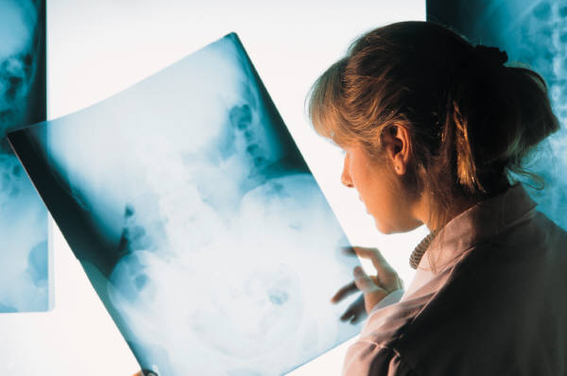
Response
Tumor Response:
  Complete (CR)
  Partial (PR)
  Stable (SD)
  Progressive (PD)
  Relapse
Patient Response:
  Performance status
  Subjective patient response
Notes:
Complete – absence of all S&S of cancer for 1 month using objective criteria (bidimensional tumor measurements)
Partial – at least 50% decrease of measureable tumor mass for 1 month without development of a new tumor
Stable – decrease tumor mass of <50% or <25% increase growth
Progressive – growth of 25% or more or development of new tumors
Relapse – after CR, new tumor appears or original tumor reappears. Or, from PR – a new tumor appears or the original tumor increases in size
Performance status:
Karnofsky – evaluates adults in %
Eastern Coop Onc Group (ECOG) – 1-5 scale
Zubrod scale – 0-5 scale
Lansky Play-Performance Scale – kids <10yrs
Subjective pt response: eval based on pt’s perception of how he/she feels regardless of objective parameters

Slide 39

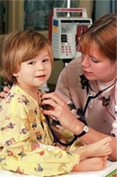
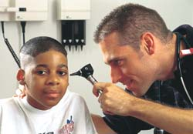
Assessments

Slide 40
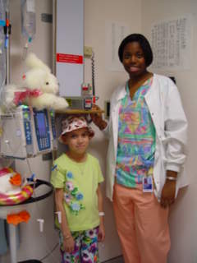
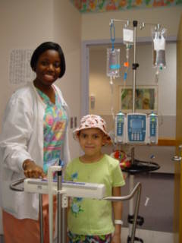
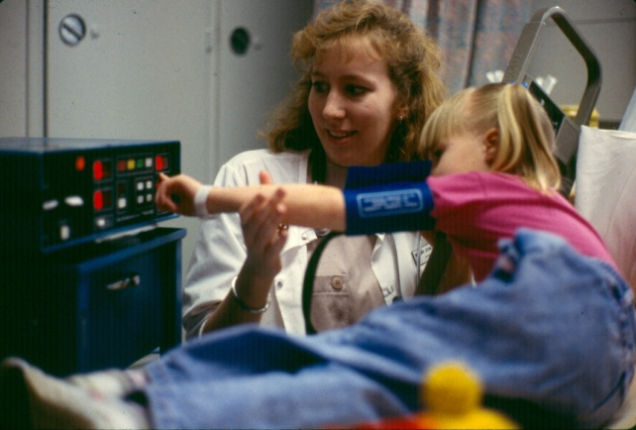
Pre-Administration

Slide 41
Pre-Treatment Assessment
Medical history
  Allergies
  Performance scales
  Eastern Cooperative Oncology Group ECOG Performance Status
Score
0
1
2
3
4
Clinical Status
Asymptomatic
Symptomatic, fully ambulatory
Symptomatic, in bed <50% of the day
Symptomatic, in bed >50% of the day but not bedridden
Bedridden

Slide 42
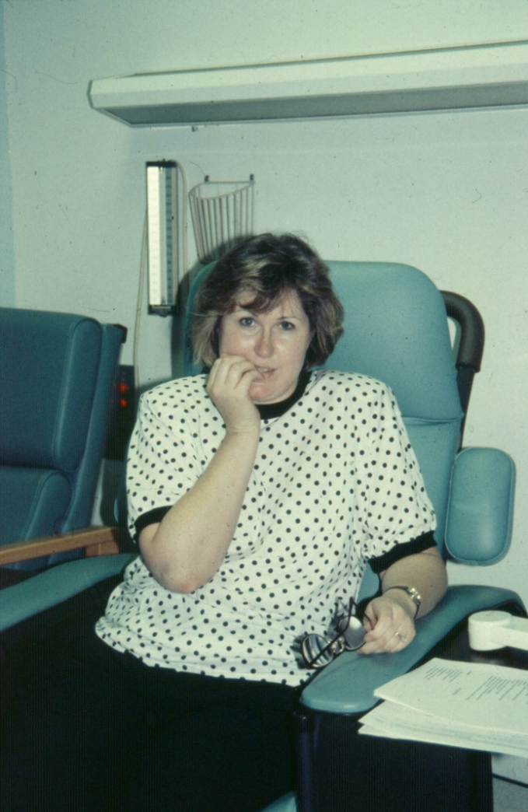

Pre-Treatment Assessment
Previous experience
Psychosocial status
Teaching requirements
Symptom management

Slide 43
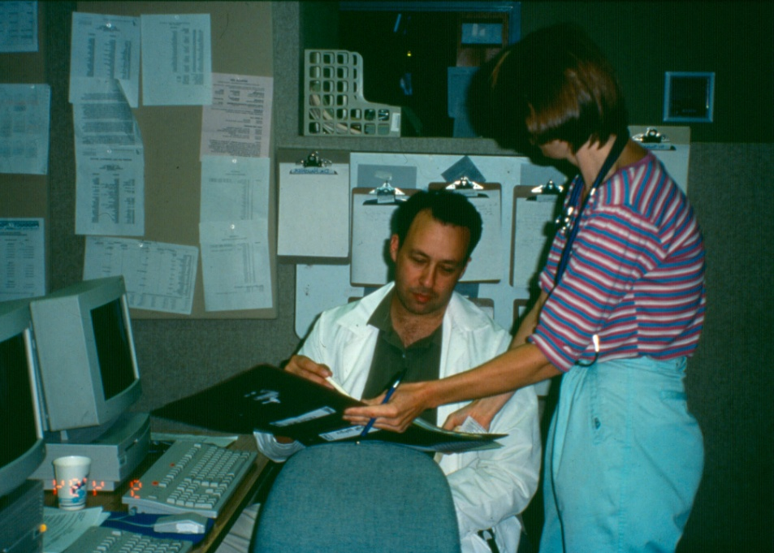
Prescriber Orders
Pre-medications
Adjuvant medications
Cytotoxic and/or
biologic agents
Hydration
Antiemetics

Slide 44
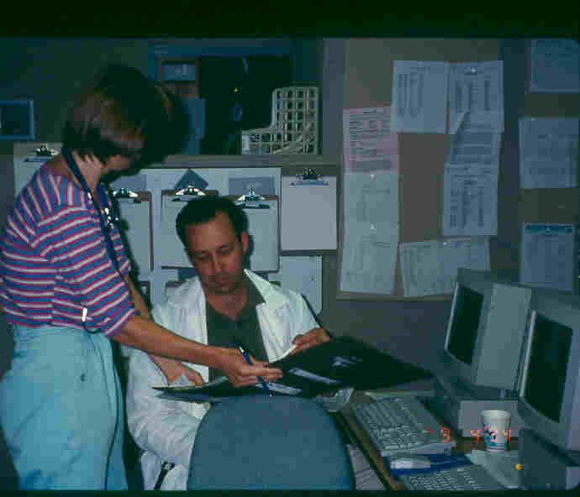
Question Physician Orders When Appropriate

Slide 45
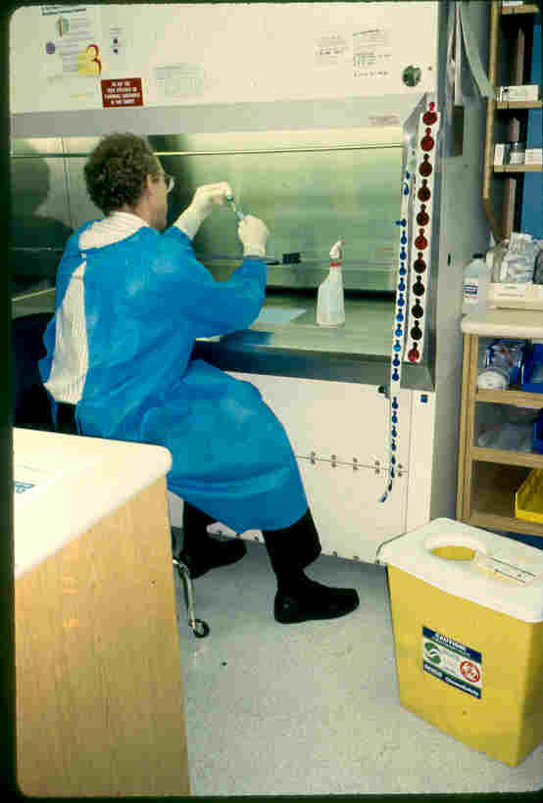
Drug Preparation - Pharmacy

Slide 46
Clinical Area Preparation
Cytotoxic/Biologic Agent
IV equipment
Appropriate fluids/antiemetics
Safety gown
Absorbent plastic backed pad
Hazardous waste container
Emergency equipment/medications

Slide 47
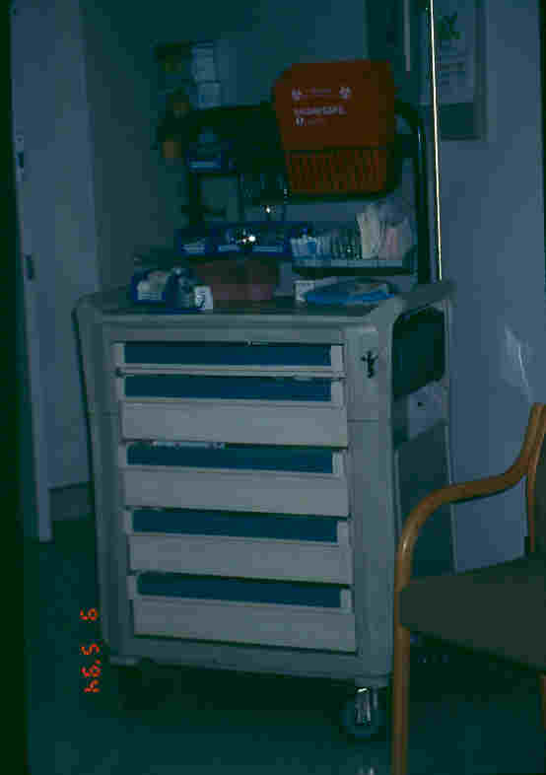
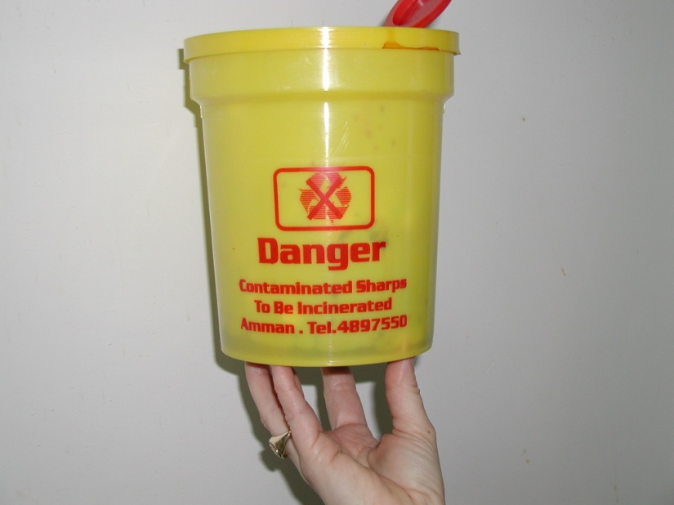
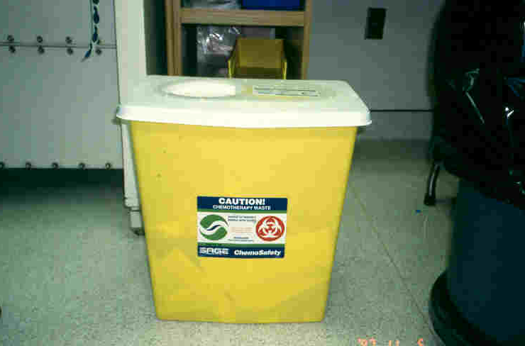
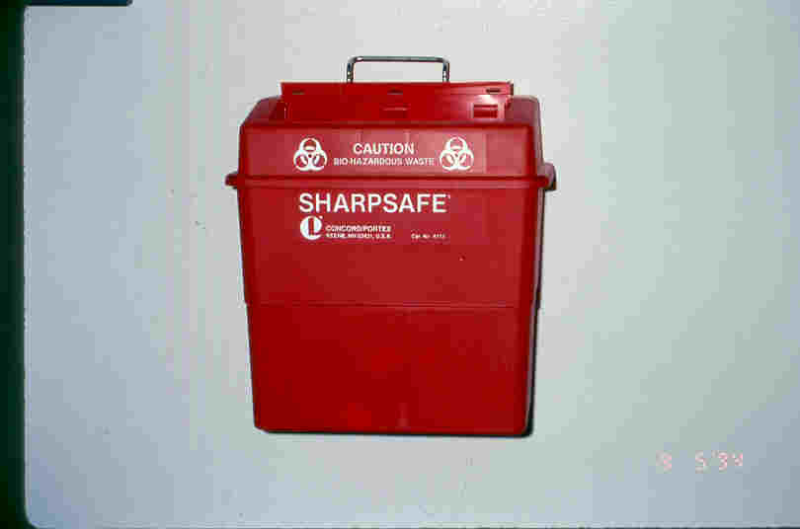
Room Preparation: Equipment

Slide 48

What is a Body Surface Area?
The calculation made using a patient’s height & weight to ensure appropriate chemotherapy dosage.
BSA = √ht (cm) x wt (kg)/ 3600

Slide 49
Two Nurse Check
With change of caregiver
With change of cytotoxic agent bag
With a change in pump settings

Slide 50
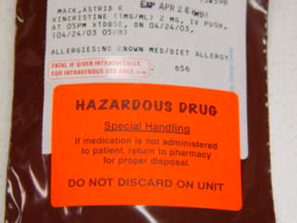
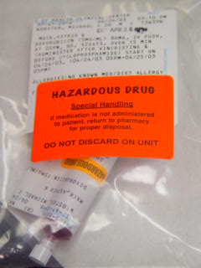
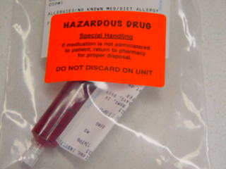
Medication Labeling

Slide 51
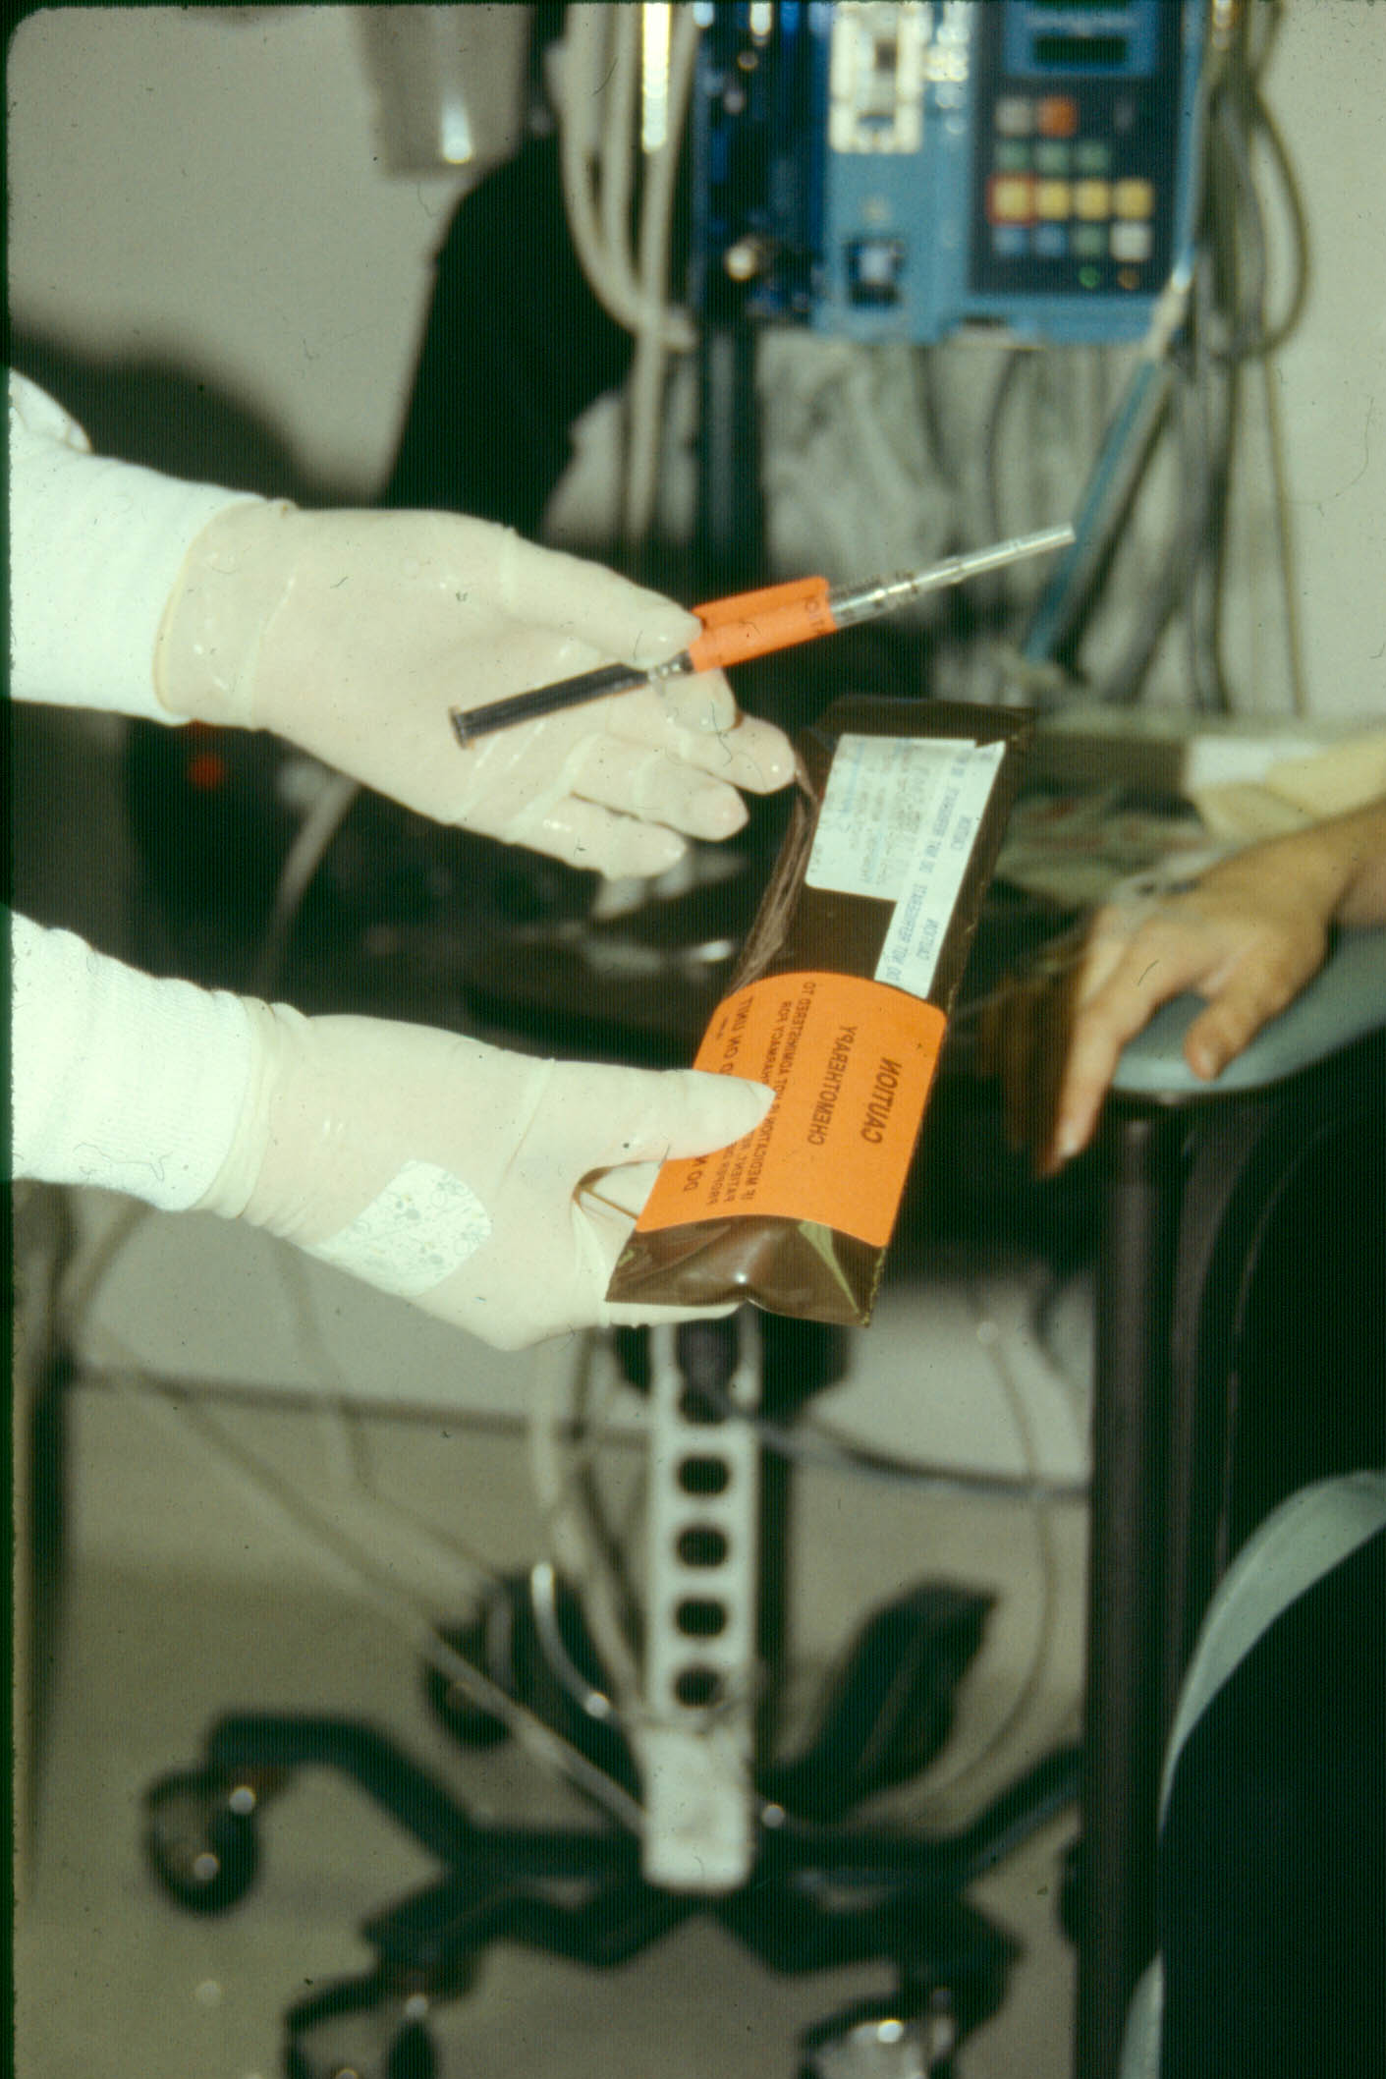
Syringe Labeling

Slide 52
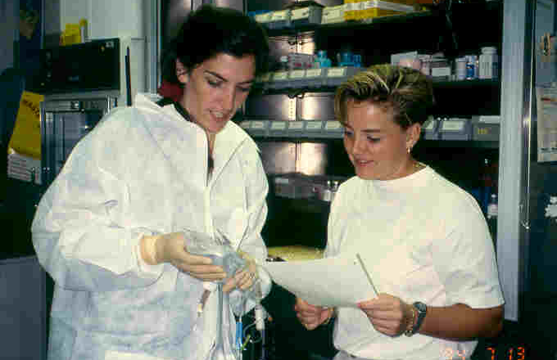
Check Calculations with 2nd Nurse

Slide 53
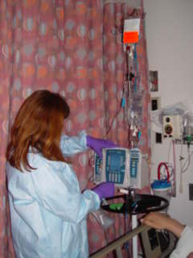
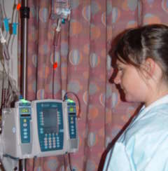
Infusion Pump Double Check

Slide 54
The Antiemetic Dilemma
Before Chemotherapy
After Chemotherapy
Notes:
See Handout

Slide 55
Administration of Chemotherapeutic Agents
Chemotherapeutic agents may be administered in the hospital, clinic, or home setting by topical, oral, intravenous, intramuscular, subcutaneous, intracavitary, and intrathecal routes.
The administration route usually depends on the type of agent, the required dose, and the type, location, and extent of tumor being treated.
Patient education is essential to maximize safety if chemotherapy is administered in the patient’s home.

Slide 56
Dosage
Dosage of antineoplastic agents is based primarily on the patient’s total body surface area, previous response to chemotherapy or radiation therapy, and major organ function.

Slide 57
Special Problems: Extravasation
Special care must be taken whenever intravenous vesicant agents are administered.
Vesicants are those agents that, if deposited into the subcutaneous tissue (extravasation), cause tissue necrosis and damage to underlying tendons, nerves, and blood vessels.
Although the complete mechanism of tissue destruction is unclear, it is known that the pH of many antineoplastic drugs is responsible for the severe inflammatory reaction as well as the ability of these drugs to bind to tissue DNA.

Slide 58
Special Problems: Extravasation
Sloughing and ulceration of the tissue may be so severe that skin grafting may be necessary.
The full extent of tissue damage may take several weeks to become apparent.
Medications classified as vesicants include dactinomycin, daunorubicin, doxorubicin (Adriamycin), nitrogen mustard, mitomycin, vinblastine, vincristine, and vindesine.

Slide 59
Special Problems: Extravasation
Only specially trained physicians and nurses should administer vesicants.
Careful selection of peripheral veins, skilled venipuncture, and careful administration of medications are essential.

Slide 60
Special Problems: Extravasation
Indications of extravasation during administration of vesicant agents include the following:
Absence of blood return from the intravenous catheter.
Resistance to flow of intravenous fluid.
Swelling, pain, or redness at the site.

Slide 61
Special Problems: Extravasation
If extravasation is suspected, the medication administration is stopped immediately, and ice is applied to the site.
The physician may aspirate any infiltrated medication from the tissues and inject a neutralizing solution into the area to reduce tissue damage.
Selection of the neutralizing solution depends on the extravasated agent. Examples of neutralizing solutions include sodium thiosulfate, hyaluronidase, and sodium bicarbonate.

Slide 62
Special Problems: Extravasation
Recommendations and guidelines for managing vesicant extravasation have been issued by individual medication manufacturers, pharmacies, and the Oncology Nursing Society, and they differ from one medication to the next.
When frequent, prolonged administration of antineoplastic vesicants is anticipated, right atrial Silastic catheters or venous access devices may be inserted to promote safety during medication administration and reduce problems with access to the circulatory system.

Slide 63
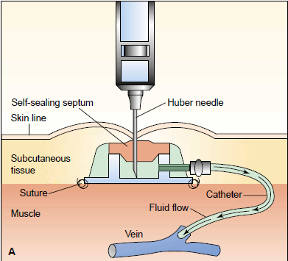
A schematic diagram of an implanted vascular access device used for administering medication, fluids, blood products, and nutrition. The self-sealing septum permits repeated puncture by Huber needles without damage or leakage.

Slide 64
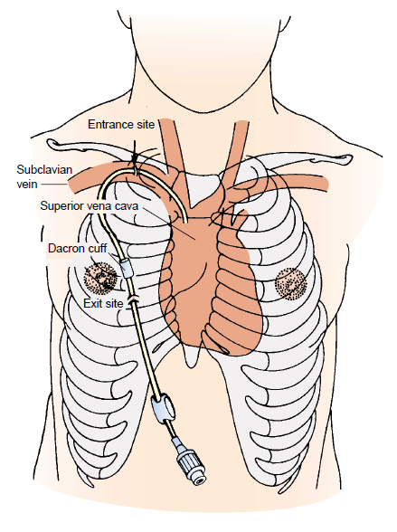
Right atrial catheter. The right atrial catheter is inserted into the subclavian vein and advanced until its tip lies in the superior vena cava just above the right atrium. The proximal end is then tunneled from the entry site through the subcutaneous tissue of the chest wall and brought out through an exit site on the chest. The Dacron cuff anchors the catheter in place and serves as a barrier to infection.

Slide 65
Toxicity
Toxicity associated with chemotherapy can be acute or chronic.
Cells with rapid growth rates (eg, epithelium, bone marrow, hair follicles, sperm) are very susceptible to damage, and various body systems may be affected as well.

Slide 66
Nursing Management in Chemotherapy
The nurse has an important role in assessing and managing many of the problems experienced by the patient undergoing chemotherapy.
Because of the systemic effects on normal as well as malignant cells, these problems are often widespread, affecting many body systems.

Slide 67
Assessing fluid and electrolyte status
Anorexia, nausea, vomiting, altered taste, and diarrhea put the patient at risk for nutritional and fluid and electrolyte disturbances.
Changes in the mucosa of the gastrointestinal tract may lead to irritation of the oral cavity and intestinal tract, further threatening the patient’s nutritional status. Therefore, it is important for the nurse to assess the patient’s nutritional and fluid and electrolyte status frequently and to use creative ways to encourage an adequate fluid and dietary intake.

Slide 68
Modifying risks for infection and bleeding
Suppression of the bone marrow and immune system is an expected consequence of chemotherapy and frequently serves as a guide in determining appropriate chemotherapy dosage. However, this effect also increases the risk for anemia, infection, and bleeding disorders.
Therefore, nursing assessment and care focus on identifying and modifying factors that further increase the patient’s risk.
Aseptic technique and gentle handling are indicated to prevent infection and trauma.

Slide 69
Modifying risks for infection and bleeding
Laboratory test results, particularly blood cell counts, are monitored closely.
Untoward changes in blood test results and signs of infection and bleeding must be reported promptly.
The patient and family members are instructed about measures to prevent these problems at home.

Slide 70
Administering chemotherapy
The local effects of the chemotherapeutic agent are also of concern. The patient is observed closely during its administration because of the risk and consequences of extravasation.
Local difficulties or problems with administration of chemotherapeutic agents are brought to the attention of the physician promptly so that corrective measures can be taken immediately to minimize local tissue damage.

Slide 71
Implementing safeguards
Nurses involved in handling chemotherapeutic agents may be exposed to low doses of the drugs by direct contact, inhalation, and ingestion.
Urinalyses of personnel repeatedly exposed to cytotoxic agents demonstrate mutagenic activity. Although not all mutagens are carcinogenic, they can produce permanent inheritable changes in the genetic material of cells.

Slide 72
Implementing safeguards
Although long-term studies of nurses handling chemotherapeutic agents have not been conducted, it is known that chemotherapeutic agents are associated with secondary formation of cancers and chromosome abnormalities.
Additionally, nausea, vomiting, dizziness, alopecia, and nasal mucosal ulcerations have been reported in health care personnel who have handled chemotherapeutic agents.

Slide 73
Implementing safeguards
Because of known and potential hazards associated with handling chemotherapeutic agents, the Occupational Safety and Health Administration, Oncology Nursing Society, hospitals, and other health care agencies have developed specific precautions for those involved in the preparation and administration of chemotherapy.

Slide 74
Safety in Administering Chemotherapy
Safety recommendations from the Occupational Safety and Health Administration (OSHA), Oncology Nursing Society (ONS), hospitals, and other health care agencies for the preparation and handling of antineoplastic agents follow:
Use a biologic safety cabinet for the preparation of all chemotherapy agents.
Wear surgical gloves when handling antineoplastic agents and the excretions of patients who received chemotherapy.
Wear disposable, long-sleeved gowns when preparing and administering chemotherapy agents.
Use Luer-Lok fittings on all intravenous tubing used to deliver chemotherapy.
Dispose of all equipment used in chemotherapy preparation and administration in appropriate, leak-proof, puncture-proof containers.
Dispose of all chemotherapy wastes as hazardous materials.
When followed, these precautions greatly minimize the risk of exposure to chemotherapy agents.

Slide 75
Safe-Handling Chemotherapy
Preparation.
Administration.
Discharging of Waste and Body Fluids.
Extravasation.
Spills.
Notes:
10

Slide 76
What is the exposure risk to me?
Light-headedness / dizziness
Nausea & vomiting
Headaches/hair loss
Mucous membrane reactions
General malaise
Local tissue necrosis
Cellulitis
Fetal damage/death
Notes:
6
If you experience some of these signs and symptoms then consider if you have been exposed or in contact with chemo recently

Slide 77
Handling Acute Exposure
Despite all of your efforts to protect yourself, chemotherapy splashes on your face. What do you do?
Notes:
19
Asme as exposure to blood body fluid
Flush eyes, hands, skin etc with runningwater for 10 mins

Slide 78
Handling Acute Exposure
Flush affected area with copious amounts of water
Notify head nurse or charge nurse
Go to the emergency room for evaluation
Complete incident report

Slide 79
Chemotherapy Spills
Notes:
16

Slide 80
Chemotherapy Spills
Secure the area and alert other staff
Obtain chemotherapy spill kit
Put on protective coverings
Observe amount of chemotherapy spilled
Absorb spill with absorbent towels
Dispose of towels in doubled bags
Cover area with blue plastic pad
Dispose of protective clothing
Notify housekeeping of spill
Notes:
20
After a brief discription, go through the process of putting on all the spill gear and demonstrate a chemo spill clean up
If thereis a spill you will need two nurses to do the clean up procedure
Instructions are on the back of the spill kit
Spill kits should be available on every unit that gives chemo (even if rarely)
The Red chemo bin found in the N.E.R building store room has a complete spill kit for demostration, a copy of the chemo policy IPP
Please carefully replace all items when finished for the next presentation
PLEASE STESS ESTIMATION OF SPIL

Slide 81
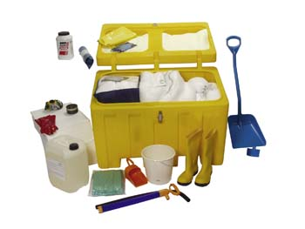
Spill Kit

