Slide 1

Chronic diseases (NURS438)
Presentation
Prostate Cancer
Students name:-
Omar Al-Abed 1201396
Yafa Abu Layya 1201212
Dana A Rimawi 1200519
Sabreen Maali 1200805
Instructor: Mutaz Dredei

Slide 2
Introduction and definition
What Is the Prostate?
The prostate is a part of the male reproductive system, which includes the penis, prostate, seminal vesicles, and testicles. The prostate is located just below the bladder and in front of the rectum. It is about the size of a walnut and surrounds the urethra (the tube that empties urine from the bladder). It produces fluid that makes up a part of semen.
As a man ages, the prostate tends to increase in size. This can cause the urethra to narrow and decrease urine flow. This is called benign prostatic hyperplasia, and it is not the same as prostate cancer. Men may also have other prostate changes that are not cancer.

Slide 3
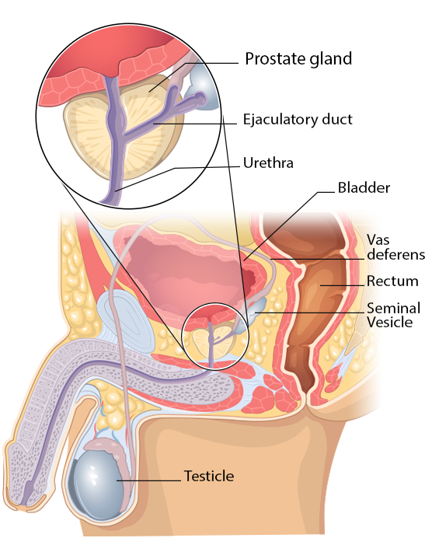

Slide 4
A cancer of the prostate gland, a part of the male reproductive system. Prostate is a small walnut-shaped gland in males that produces the seminal fluid that nourishes and transports sperm. This causes blood in urine, blood in semen, painful ejaculation and erectile dysfunction. Prostate cancer begins when cells in the prostate gland start to grow out of control.
Prostate cancer is the second most frequently diagnosed cancer in American men, following only skin cancer. It is estimated that one of every seven African-Americans and one in every eight Caucasians develops the disease. Although prostate cancer is most common in men over 65, it has been diagnosed in men as young as 40.

Slide 5
Epidemiology
Prostate cancer is the second most frequent cancer diagnosis made in men and the fifth leading cause of death worldwide. Prostate cancer may be asymptomatic at the early stage and often has an indolent course that may require only active surveillance. Based on GLOBOCAN 2018 estimates, 1,276,106 new cases of prostate cancer were reported worldwide in 2018, with higher prevalence in the developed countries. Differences in the incidence rates worldwide reflect differences in the use of diagnostic testing. Prostate cancer incidence and mortality rates are strongly related to the age with the highest incidence being seen in elderly men (> 65 years of age). African-American men have the highest incidence rates and more aggressive type of prostate cancer compared to White men.

Slide 6
Epidemiology Prostate cancer is diagnosed in very few people aged younger than 50 years (<0·1% of all patients). The mean age of patients with this disorder is 72–74 years, and about 85% of patients are diagnosed after age 65 years . At age 85 years the cumulative risk of prostate cancer ranges from 0·5% to 20% worldwide.

Slide 7
Etiology
Several factors are thought to contribute to its development:
Genetic predisposition: A genetic predisposition refers to a genetic variation which increases the likelihood of disease. These are passed on from parents to children, but not all children will necessarily receive the gene types which predispose to disease.
Diet: high in red meat.
Infections.
Hormonal imbalance.
Exposure to toxins.
Smoking.

Slide 8
Pathophysiology
Mutation and abnormal cell division
Enlargement encroaching on the urethra and bladder neck, leads to obstruction
Proliferation to surrounding tissues (rectum, seminal vesicles)
Metastastic spread to lymph nodes and bone (hip spine)

Slide 9
Screening and early detection
Screening is testing to find cancer in people before they have symptoms.
Prostate cancer can often be found early by testing for prostate-specific antigen (PSA) levels in a man’s blood.
PSA: has been thought of as a "screening" test for prostate cancer. Ideally, an optimal screening test detects a disease (in this case prostate cancer) when abnormal or elevated and rules out disease when the test is normal.
Another way to find prostate cancer is the digital rectal exam (DRE).
DRE: is a quick and safe screening technique in which a physician feels the prostate by inserting a gloved, lubricated finger into the rectum. This simple procedure allows your physician to determine whether the prostate is enlarged, has lumps, areas of hardness or other types of abnormal texture. The entire prostate cannot be felt during a DRE but a significant portion can be examined including the area where most prostate cancers are found. While this examination may produce momentary discomfort, it causes no significant pain.
If the results of either of these tests is abnormal, further testing (such as a prostate biopsy) is often done to see if a man has cancer.

Slide 10
Prevention
Some studies have found that men who are overweight or obese have a higher risk of developing prostate cancer.
Diet:
-Eat fewer calories or exercise more so that you maintain a healthy weight.
-Try to keep the amount of fat.
-Watch your calcium intake.
-Eat more fish because they have "good fat" particularly omega-3 fatty acids.
-Try to incorporate lycopene rich foods or foods like cooked tomatoes that are cooked in olive oil, and cruciferous vegetables (like broccoli and cauliflower) into many of your weekly meals.
-Avoid smoking, drink alcohol in moderation or none at all.
-Avoid over-supplementation with mega vitamins. Too many vitamins, especially folate, may "fuel the cancer".
-Relax and enjoy your life. Reducing stress in the workplace and home will improve your survivorship.

Slide 11
Clinical manifestations
Different people have different symptoms for prostate cancer. Some men do not have symptoms at all.
Most common:
Difficulty starting urination.
Weak or interrupted flow of urine.
Urinating often, especially at night.
Trouble emptying the bladder completely.
Pain or burning during urination.
Blood in the urine or semen.
Pain in the back, hips, or pelvis that doesn’t go away.
Painful ejaculation.

Slide 12
Assessment
Ask for a urine sample to check for infection. take a blood sample to test your level of prostate-specific antigen (PSA) – called PSA testing. examine your prostate by inserting a gloved finger into your bottom – called digital rectal examination.
The most accurate test for detecting prostate cancer is a prostate biopsy. This biopsy involves taking a tissue sample from the prostate and examining it under a microscope, which can help your doctor determine whether there is an uncontrolled growth of cells in the prostate gland.

Slide 13
Classification and staging
T1: The tumor can't be felt during a DRE or seen with an imaging test. It may be found by chance during a biopsy or during surgery for another health issue related to the prostate or bladder.
T2: The tumor can be felt by your doctor during a DRE and can be seen on an imaging test. Cancer is only in the prostate.
T3: The tumor has broken through the outside layer of the prostate gland.
T4: The tumor has grown outside the prostate and into nearby structures such as the bladder, rectum, pelvic muscles and pelvic wall.

Slide 14
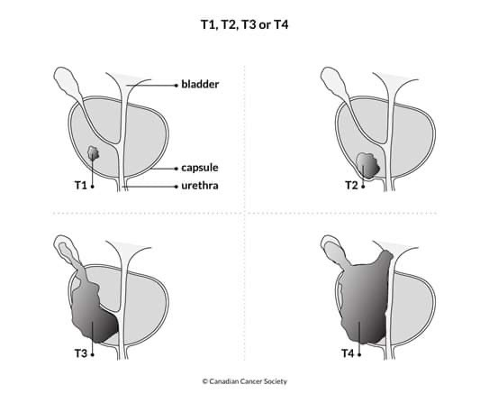

Slide 15
Therapeutic approaches
Cancer treatment options include:
Surgery: The goal is to remove the cancer or as much of the cancer as possible.
Chemotherapy: uses drugs to kill cancer cells.
Radiation therapy: uses high-powered energy beams, such as X-rays or protons, to kill cancer cells. Radiation treatment can come from a machine outside your body (external beam radiation), or it can be placed inside your body (brachytherapy).
Bone marrow transplant: Your bone marrow is the material inside your bones that makes blood cells from blood stem cells. It’s also knowns as a stem cell transplant, can use your own bone marrow stem cells or those from a donor. And it allows your doctor to use higher doses of chemotherapy to treat your cancer. It may also be used to replace diseased bone marrow.
Immunotherapy: also known as biological therapy, uses your body's immune system to fight cancer. Cancer can survive unchecked in your body because your immune system doesn't recognize it as an intruder. Immunotherapy can help your immune system "see" the cancer and attack it.

Slide 16
Hormone therapy: Some types of cancer are fueled by your body's hormones. Examples include breast cancer and prostate cancer. Removing those hormones from the body or blocking their effects may cause the cancer cells to stop growing.
Targeted drug therapy: focuses on specific abnormalities within cancer cells that allow them to survive.
Cryoablation: This treatment kills cancer cells with cold. During it, a thin, wand-like needle (cryoprobe) is inserted through your skin and directly into the cancerous tumor. A gas is pumped into the cryoprobe in order to freeze the tissue. Then the tissue is allowed to thaw. The freezing and thawing process is repeated several times during the same treatment session in order to kill the cancer cells.
Radiofrequency ablation: uses electrical energy to heat cancer cells, causing them to die. During it, a doctor guides a thin needle through the skin or through an incision and into the cancer tissue. High-frequency energy passes through the needle and causes the surrounding tissue to heat up, killing the nearby cells.
Clinical trials: are studies to investigate new ways of treating cancer. Thousands of cancer clinical trials are underway.

Slide 17
Nursing care
Nursing DX:
1- Acute Pain related to Disease process (compression/destruction of nerve tissue, infiltration Of nerves or their vascular supply, obstruction of a nerve pathway, inflammation) , Side effects of various cancer therapy agents , evidenced by , Reports of pain , Self-focusing/narrowed focus Alteration in muscle tone; facial mask of pain , Distraction/guarding behaviors , Autonomic responses, restlessness (acute pain).
Nursing Interventions:
Determine pain history (location of pain, frequency, duration, and intensity using numeric rating scale (0–10 scale), or verbal rating scale (“no pain” to “excruciating pain”) and relief measures used. Believe patient’s report. Rationale: Information provides baseline data to evaluate effectiveness of interventions. Pain of more than 6 mo duration constitutes chronic pain, which may affect therapeutic choices. Recurrent episodes of acute pain can occur within chronic pain, requiring increased level of intervention. Note: The pain experience is an individualized one composed of both physical and emotional responses.
Giving pain relievers when necessary with a prescription and under the supervision of a doctor, Rationale due to the sensitivity of the case we are dealing with.

Slide 18
2- Risk for Ineffective Sexuality Pattern related to Knowledge, skill deficit about alternative responses to health-related transitions, altered body function , structure, illness, and medical treatment , Overwhelming fatigue , Fear and anxiety , Lack of privacy . evidenced by deal with problems , Maintain sexual activity at a desired level as possible.
Nursing Interventions:
Advise patient of side effects of prescribed cancer treatment that are known to affect sexuality. Rationale: Anticipatory guidance can help patient and begin the process of adaptation to new state.
3- Risk for Infection related to Inadequate secondary defenses and immunosuppression, e.g., bone marrow suppression (dose-limiting side effect of both chemotherapy and radiation). Malnutrition, chronic disease process, Invasive procedures.
Nursing Interventions:
- Emphasize personal hygiene. Rationale Limits potential sources of infection and secondary overgrowth.
4-Fatigue
5- Fear/Anxiety
6- Risk for Fluid Volume Deficit

Slide 19
Symptom management and supportive therapy
supportive therapy :
Locally advanced prostate cancer may be treated with external-beam radiation therapy and concurrent hormonal therapy or with surgery alone.
Symptom management:
For the management and relief of signs and symptoms : In the event of infections, measures must be taken to prevent any possible infections by giving antibiotics when necessary Complications after receiving chemotherapy or radiation, such as vomiting and stinging, by giving anti-nausea drugs or some drinks that help relieve pain for the elderly
Providing palliative care and psychological support to the patient
Teaching the patient methods of prevention and everything related to treatment

Slide 20
Extra readings (case study)
A 68-year-old retired chef initially complained of frequency of micturition, urinary urgency, and hesitancy associated with a weak stream. Over the past several weeks, he has reported a few episodes of hematuria and incontinence. In addition to his urologic symptoms, the patient complained of low-grade, constant back pain and bouts of constipation. A digital rectal examination revealed the patient has an enlarged prostate gland with several palpably discreet nodules. His past medical history was unremarkable
Laboratory Studies:
The patient had a prostate-specific antigen (PSA) level of 95 ng/mL (range: 0.0–4.0 ng/mL), while a similar determination 6 years earlier showed a PSA of 1.5 ng/mL. His hemoglobin was 15 g/dL (range: 13.2–17.1 g/dL), hematocrit 43% (range: 38.5–50%), white blood cell 7,500/mm3, normal differential, platelets 250,000/mm3, blood urea nitrogen 15 mg/dL (normal range: 7–30 mg/dL), and creatinine level 1.0 mg/dL (range: 0.5–1.4 mg/dL). Alkaline phosphatase and liver function tests were all within normal range
Staging:
In the Tumor, Nodes, Metastases staging system, the tumor had extended bilaterally through the prostatic capsule (T3b), and metastasis was found in bone (M1b). The patient was staged as stage D2 with extensive local disease.

Slide 21
-Biopsy Results
Histologic evaluation of the biopsy specimens revealed adenocarcinoma in 7 of 12 multiple cores, representing 60% of the biopsied material
-Diagnosis
Based upon prostate biopsy evaluation and ultrasound images, radionuclide scintigraphy, and MRI studies, a diagnosis was made of advanced prostatic adenocarcinoma with metastases to the bone.
- Treatment Options
In view of the advanced stage of the disease and evidence of distant metastasis, the primary treatment modality for this patient was systemic therapy.
Importantly, the constellation of signs and symptoms of this patient’s disease underscored the critical need to select a systemic treatment that produced a rapid decline of serum testosterone and consequently allowed prompt control of the disease. He was, therefore, treated with abarelix, 12 a gonadotropin-releasing hormone (GnRH) antagonist.
- External Beam Radiation Therapy
- Treatment of Bone Metastases

Slide 22
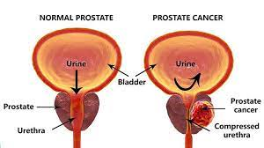
Conclusion
Prostate cancer is a type of cancer that affects the reproductive system in men that comes from many dangerous factors that they must protect themselves from and take precautions, the degree of treatment depends on age and the nature of the cancerous mass and its location, treatment is not inevitable and not impossible either, it has many side effects, especially After starting treatments such as chemotherapy. Cancer may be inherited, or it may be due to environmental reasons or genetic disorders.

Slide 23
Sources:
https://scholar.google.com/scholar?q=Etiology+of+Prostate+Cancer+-+an+overview+%7C+ScienceDirect+Topics&hl=ar&as_sdt=0&as_vis=1&oi=scholart
https://scholar.google.com/scholar?q=Introduction+to+Prostate+Cancer+%7C+SEER+Training&hl=ar&as_sdt=0&as_vis=1&oi=scholart
https://www.cancer.org/cancer/prostate-cancer/about/what-is-prostate-cancer.html
https://scholar.google.com/scholar?q=Prostate+cancer+epidemiology+-+The+Lancet&hl=ar&as_sdt=0&as_vis=1&oi=scholart
https://l.messenger.com/l.php?u=https%3A%2F%2Fwww.prostateconditions.org%2Fabout-prostate-conditions%2Fearly-detection-prevention&h=AT1wd3MH6mn7O2w8FX3Gj2371gCDJqeuZbGJ00S7njRqiSs6eW1Hj_SprD1bnxhvriXuidA1A2Yc1B-d8WVnwmxsFLFbiBRnEAp_BmvqQqROG0EHEwAOc6XL1HzR7McviMw01w
https://l.messenger.com/l.php?u=https%3A%2F%2Fwww.pcf.org%2Fpatient-resources%2Ffamily-cancer-risk%2Fprostate-cancer-prevention%2F&h=AT1wd3MH6mn7O2w8FX3Gj2371gCDJqeuZbGJ00S7njRqiSs6eW1Hj_SprD1bnxhvriXuidA1A2Yc1B-d8WVnwmxsFLFbiBRnEAp_BmvqQqROG0EHEwAOc6XL1HzR7McviMw01w
https://l.messenger.com/l.php?u=https%3A%2F%2Fwww.mayoclinic.org%2Fdiseases-conditions%2Fprostate-cancer%2Fsymptoms-causes%2Fsyc-20353087&h=AT1wd3MH6mn7O2w8FX3Gj2371gCDJqeuZbGJ00S7njRqiSs6eW1Hj_SprD1bnxhvriXuidA1A2Yc1B-d8WVnwmxsFLFbiBRnEAp_BmvqQqROG0EHEwAOc6XL1HzR7McviMw01w

Slide 24
https://l.messenger.com/l.php?u=https%3A%2F%2Fwww.cancer.org%2Fcontent%2Fdam%2FCRC%2FPDF%2FPublic%2F8795.00.pdf&h=AT1wd3MH6mn7O2w8FX3Gj2371gCDJqeuZbGJ00S7njRqiSs6eW1Hj_SprD1bnxhvriXuidA1A2Yc1B-d8WVnwmxsFLFbiBRnEAp_BmvqQqROG0EHEwAOc6XL1HzR7McviMw01w
https://nurseslabs.com/6-prostatectomy-nursing-care-plans/
https://www.ncbi.nlm.nih.gov/

