Slide 1

.
Faculty of Nursing , Pharmacy, & allied Health Sciences
Brain Cancer
Aya Manassrah
Mahmoud Fataftah
Adham Nawaja

Slide 2
Objectives expected to be explained:
Introduction and definition of the disease.
Epidemiology.
Etiology& prevention(risk factors that should be avoided).
Assessment & Diagnostic Findings.
Types of Brain tumors.
Pathophysiology & clinical manifestations.
Classification and staging.
Therapeutic approaches.
Nursing care(management).
Symptom management and supportive therapy.
Extra readings (e.g., articles, case studies…).
Conclusion.

Slide 3
Definition Of Brain Cancer
(what does it mean?)

Slide 4
Brain cancer is the result of cancerous cell growth in the brain. The cancer cells form tumors that can be slow-growing or fast-growing depending on the type of tumor.
Brain cancers include primary brain tumors, which start in the brain and almost never spread to other parts of the body, and secondary tumors (or metastases), which are caused by cancers that began in another part of the body.

Slide 5
Brain Cancer could be:
Benign brain tumors(non-cancerous): these are low grade (grade 1 or 2), which means they grow slowly and are less likely to return after treatment. Common types are meningiomas, neuromas, pituitary tumors and craniopharyngiomas.
Malignant brain tumors(cancerous): these are high grade (grade 3 or 4) and either start in the brain (primary tumours) or spread into the brain from elsewhere (secondary tumours); they're more likely to grow back after treatment. Common types include astrocytomas, oligodendrogliomas, glioblastomas and mixed gliomas.

Slide 6
Epidemiology
(Incidence & Mortality Rates)

Slide 7
Brain and other nervous system cancer is the 10th leading cause of death for men and women.The International Agency for Research on Cancer of the World Health Organization estimates that in 2020, brain and nervous system cancers occurred in 168,346 men and 139,756 women worldwide.
Worldwide age-standardized mortality for primary malignant brain tumors is ~2.8 for males and 2.0 for females per 100,000.

Slide 8
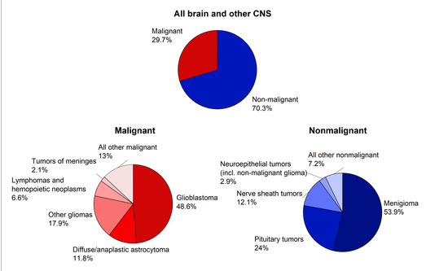
.
Figure 1 :Distribution of Brain and Other Central Nervous System (CNS) Tumors by Behavior and Major Histology Type, 2013 to 2017 of the united states.

Slide 9
Etiology & Risk Factors
(How can you prevent this disease?)

Slide 10
The Etiology of brain tumors is largely unknown. Several CNS tumors are associated with rare genetic conditions. Like: autosomal dominant disorder neurofibromatosis. Although a large number of studies have examined the relationship between environmental and occupational factors, only high-dose radiation is a proven risk factor & increases the incidence of brain tumors.

Slide 11
Risk factors:
family increased age.
history of brain cancer.
long-term smoking.
exposure to pesticides, herbicides, and fertilizer.
working with elements that can cause cancer, like lead, plastic, rubber, petroleum, and some textiles.

Slide 12
Cancers that commonly spread, or metastasize, to the brain include:
lung cancer.
breast cancer.
kidney cancer.
bladder cancer.
melanoma, which is a type of skin cancer.

Slide 13
Screening & early detection

Slide 14
At this time, there are no brain cancer screening methods that can be used to accurately detect a brain tumor before a person starts to experience symptoms. Oncologists can keep a watchful eye on an existing cancer if they believe it is likely to spread to the brain, but it is extremely difficult to screen for primary brain cancers, which tend to develop without producing any noticeable warning signs(Asymptomatic at the beginning).

Slide 15
Pathophysiology

Slide 16
Tumors of the brain produce neurologic manifestations. Small, critically located tumors may damage specific neural pathways traversing the brain. Tumors can invade, infiltrate, or supplant normal parenchymal tissue, disrupting normal function. Because the brain dwells in the limited volume of the cranial vault, growth of intracranial tumors with accompanying edema may cause increased intracranial pressure(ICP). Tumors adjacent to the third and fourth ventricles may impede the flow of cerebrospinal fluid, leading to obstructive hydrocephalus. In addition, tumors generate new blood vessels (ie, angiogenesis), disrupting the normal blood-brain barrier and promoting edema.

Slide 17
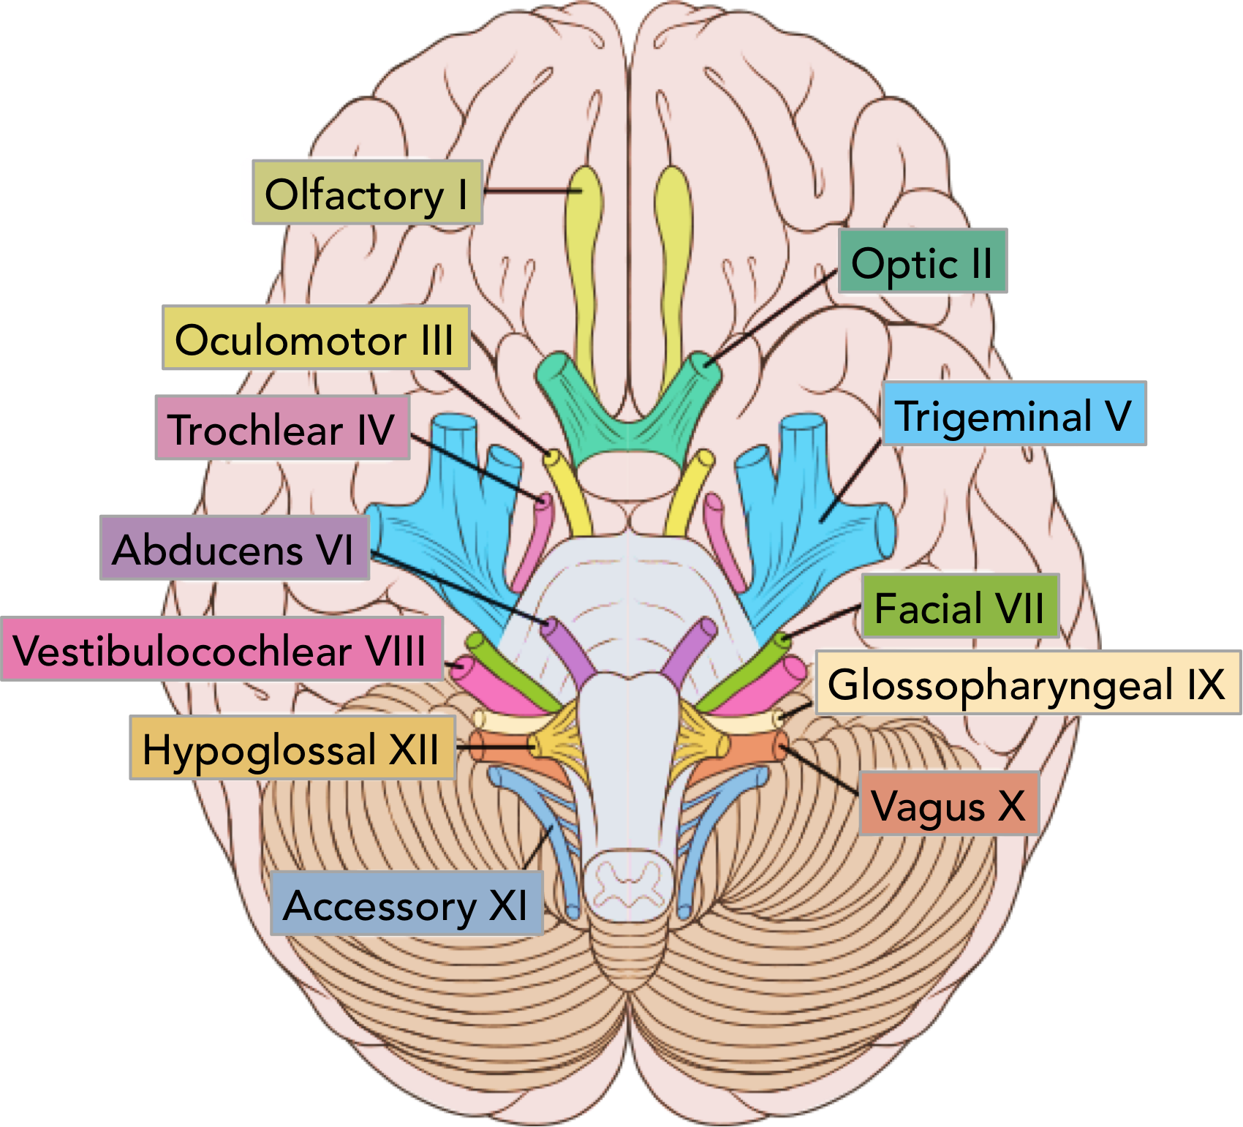

Slide 18
Clinical Manifestations
(Signs & Symptoms)

Slide 19
The signs & symptoms of brain cancer depend on the size and location of the brain tumor.
Headaches
Continues for at least a week.
Is worse in the morning.
Is worse when laying down.
Becomes worse after suddenly changing positions.
Nausea .
Vomiting.
a lack of coordination.
a lack of balance.
difficulty walking.
memory lapses.
difficulty thinking.
Language disturbances (aphasia)
Visual disturbances (papilledema)
abnormal eye movements.
muscle jerking & muscle twitching (cachexia)
unexplained passing out, or syncope.
Drowsiness.
numbness or tingling in the arms or legs.
Seizures.
hemiplegia

Slide 20
Assessment & Diagnostic findings

Slide 21
The history of the illness and the manner and time frame in which the symptoms evolved are key components in the diagnosis of brain tumors.
A neurologic examination: indicates the areas of the CNS that are involved (e.g. assessment of cranial nerves, and using of opthalmoscope to view the optic nerve, which may bulge if the pressure in the skull is raised, for example by a tumor).
Computed tomography (CT): enhanced by a contrast agent, can give specific information concerning the number, size, and density of the lesions and the extent of secondary cerebral edema. CT scans can provide information about the ventricular system.
A magnetic resonance imaging (MRI): is the most helpful diagnostic tool for detecting brain tumors, particularly smaller lesions, and tumors in the brain stem and pituitary regions, where bone is thick. In a few instances, the appearance of a brain tumor on an MRI scan is so characteristic that a biopsy is unnecessary, especially when the tumor is located in a part of the brain that is difficult to biopsy.

Slide 22
Positron emission tomography (PET): is used to supplement MRI scanning in centers where it is available. On PET scans, low-grade tumors are associated with hypometabolism and high-grade tumors show hypermetabolism. This information can be useful in making treatment decisions. (metabolic assessment)
A brain biopsy: which is a surgical procedure in which a small amount of the tumor is removed for diagnostic testing and to determine if your tumor is malignant.

Slide 23
A lumbar puncture: which is a procedure that collects a small sample of the fluid that surrounds your brain and spinal cord, to check for cancer cells.
Cerebral angiography: provides visualization of cerebral blood vessels and can localize most cerebral tumors.
An electroencephalogram (EEG): can detect an abnormal brain wave in regions occupied by tumor; it is used to evaluate temporal lobe seizures and to assist in ruling out other disorders.

Slide 24
Types Of Brain tumors

Slide 25
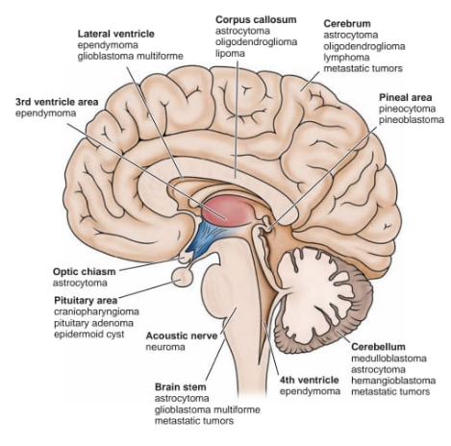

Slide 26
Gliomas
Glial tumors, the most common type of intracerebral brain neoplasm. Astrocytomas are the most common type of glioma and are graded from I to IV, indicating the degree of malignancy. The grade is based on cellular density, cell mitosis, and appearance. Usually, these tumors spread by infiltrating into the surrounding neural connective tissue and therefore cannot be totally removed without causing considerable damage to vital structures.

Slide 27
Meningiomas
Meningiomas, which represent 15% of all primary brain tumors, are common benign encapsulated tumors of arachnoid cells on the meninges.They are slow growing and occur most often in middle-aged
(40-60yrs) adults (more often in women). Manifestations depend on the area involved and are the result of compression rather than invasion of brain tissue.

Slide 28
Pituitary Adenomas
Pituitary tumors represent about 10% to 15% of all brain tumors and cause symptoms as a result of pressure on adjacent structures or hormonal changes such as hyperfunction or hypofunction of the pituitary.
Hormonal Effects of Pituitary Adenomas: pituitary tumors can produce one or more hormones normally produced by the anterior pituitary. There are prolactin-secreting pituitary adenomas (prolactinomas), growth hormone–secreting pituitary adenomas that produce acromegaly in adults, and adrenocorticotropic hormone (ACTH)–producing pituitary adenomas that result in Cushing’s disease. Adenomas that secrete thyroid-stimulating hormone or follicle-stimulating hormone and luteinizing hormone occur infrequently, whereas adenomas that produce both growth hormone and prolactin are relatively common. The female patient whose pituitary gland is secreting excessive quantities of prolactin presents with amenorrhea or galactorrhea (excessive or spontaneous flow of milk).

Slide 29
Pressure Effects of Pituitary Adenomas: Pressure from a pituitary adenoma may be exerted on the optic nerves, optic chiasm, or optic tracts or on the hypothalamus or the third ventricle.These pressure effects produce headache, visual dysfunction, hypothalamic disorders (disorders of sleep, appetite, temperature, and emotions), increased ICP.
Male patients with prolactinomas may present with impotence and hypogonadism. Acromegaly, caused by excess growth hormone, produces enlargement of the hands and feet. The clinical features of Cushing’s disease, a condition associated with prolonged overproduction of cortisol, occur with excessive production of ACTH. Manifestations include a form of obesity, osteoporosis, elevated blood glucose levels, and emotional disorders. Endocrine disorders resulting from these tumors.

Slide 30
Angiomas
Brain angiomas (masses composed largely of abnormal blood vessels) are found either in or on the surface of the brain. They occur in the cerebellum in 83% of cases. Some persist throughout life without causing symptoms; others cause symptoms of a brain tumor. The walls of the blood vessels in angiomas are thin, these patients are at risk for hemorrhagic stroke.

Slide 31
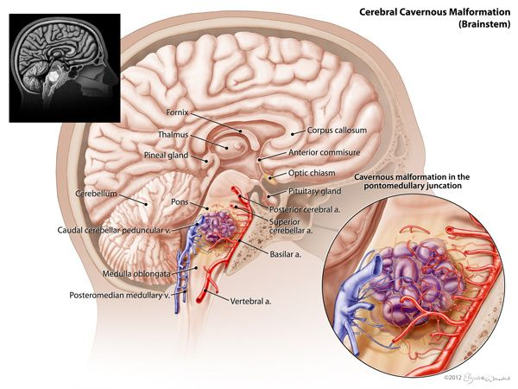

Slide 32
Classification & Staging

Slide 33
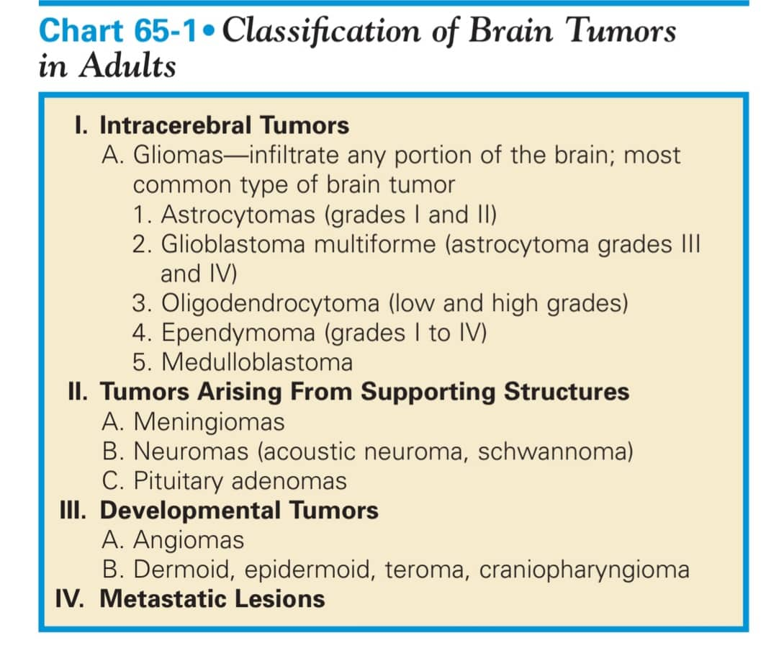

Slide 34
Based on the results of MRI, CT scans and other tests, the doctor will tell the Pt. the stage of the cancer. Staging describes the size of the cancer and if and how far it has spread beyond the brain.
Brain tumors are usually graded on a scale of 1 to 4, based on how quickly they are growing and their ability to invade nearby tissue: grades 1 and 2 are the slowest growing and are called low-grade tumors; grade 3 and 4 is the fastest growing.

Slide 35
Medical management & Therapeutic Approaches
(How is brain cancer treated?)

Slide 36
Surgery: Brain surgery is is the most common treatment for brain tumors. Depending on location of the tumor, it might be able to be removed fully, partially, or not all.
Chemotherapy: These drugs can destroy cancer cells in the brain and shrink the tumor. Pt. might recieve chemotherapy orally or intravenously.
Radiation therapy: This technique uses high-energy waves, like X-rays, to destroy tumor tissue and cancer cells that can’t be surgically removed.
Combination therapy: Receiving chemotherapy and radiation therapy at the same time.

Slide 37
Other medications: the doctor may prescribe medications to treat symptoms and side effects caused by the brain tumor and brain cancer treatments, like:
Corticosteroids: These drugs are used to lower swelling in the brain, which can lessen headache pain from the swelling without the need for prescription pain medications. These drugs may also help improve neurological symptoms by decreasing the pressure from the tumor and swelling in the healthy brain tissue.
Anti-seizure medications: These help control seizures.
osmotic diuretics (eg, mannitol ) to decrease the fluid content of the brain, which leads to a decrease in ICP.
Rehabilitation: Pt. might need to attend rehabilitation sessions if his cancer or treatment has affected Pt. ability to talk, walk, or perform other daily functions. Rehabilitation includes physical therapy, occupational therapy, and other therapies that can help the Pt. relearn activities.
Alternative therapies: There isn’t much scientific research that supports using alternative therapies to treat brain cancer. But some healthcare professionals do recommend steps like a blanced diet and vitamin and mineral supplementation to replace nutrients lost from the cancer treatment.

Slide 38
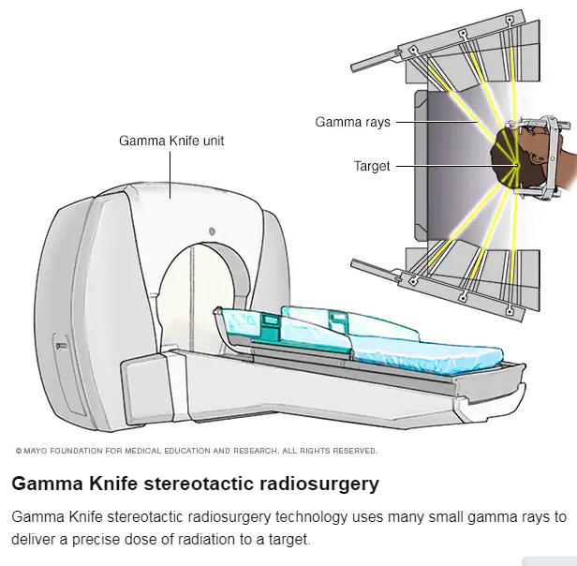

Slide 39
Nursing Care
(Nurse role!)

Slide 40
Nsg Dx. | Planning/ Goals | Interventions
Self-care deficit ( feeding, bathing & toileting) related to loss or impairment of motor & sensory function & decreased cognitive abilities. | Compensating for self-care deficit. | Encourage the Pt family to keep her as independent as possible for as long as possible. Increase assistance with self-care activities is required.
Imbalanced nutrition less than body requirements, due to treatment & tumor effects, decreased nutritional intake & malabsorption. | Improve nutrition. | Teaches the family how to position the patient foe comfort during meals. Meals time should be planned when the patient is rested and less distress from pain or other effect of treatment.
Anxiety related to fear of dying, un certainty,. | Relieve anxiety | Pt. needs the opportunity to physical
Impaired Skin Integrity related to general weakness. | achieve intact skin | body positioning, encourage balanced nutrition with adequate protein, do complete bathing daily.

Slide 41
A Case With Brain Tumor

Slide 42
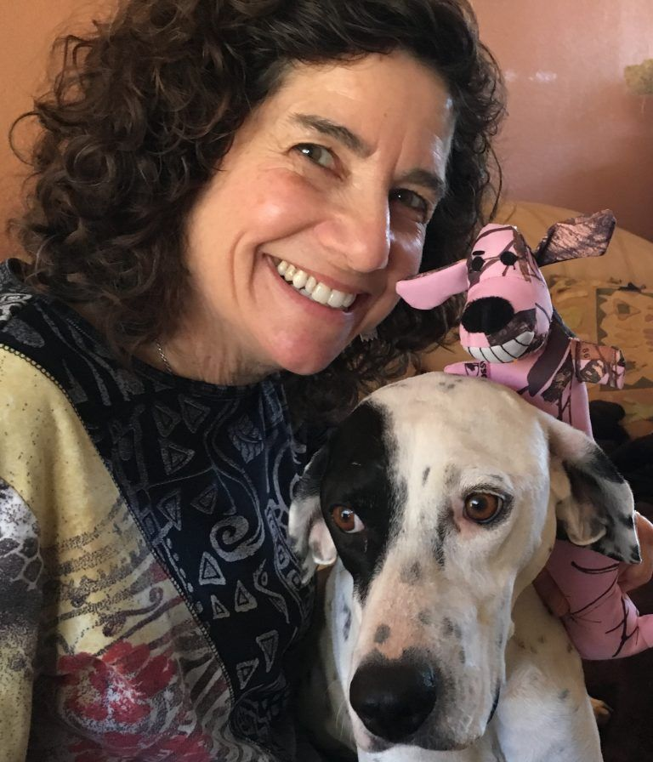
.
Case Study
At age 62, I was living a cabin-in-the-woods quiet life, filled with books, hikes, dog walks, a loving partner, good friends, and no reason to believe any of it would ever change. Until it did.
I lost control of my body and mind and received the crushing blow of a brain tumor diagnosis. Once my body was restored by a team of brilliant neurosurgeons and the miracle of modern medicine, it was up to me to figure out how to live peacefully on a watch-and-wait plan with my inoperable, but stable, brain tumor.
Forever changed by my diagnosis, I started to view life through the lens of the Japanese philosophy of wabi-sabi, embracing my perfectly imperfect brain. With time and a lot of practice, my watch-and-wait treatment protocol morphed into a new lifestyle where I found the unexpected gift of a calmer and more creative mind. I even wrote a book about it, Keep Calm, It’s Just a Brain Tumor.
Whether you are living with a chronic illness, fearful about disease progression or get anxious about an aging mind and body, cultivating a grateful wabi-sabi mindset can help you navigate life’s inevitable uncertainties, appreciate the beauty of imperfection and find more value in the ordinary moments of everyday.

Slide 43
“I think I’ve changed for the better. I’ll never say I’m grateful for having brain cancer, but it’s changed me and made my life significant in a way I never expected.”
— Dan Zappa, GBM survivor

Slide 44
References
https://www.ncbi.nlm.nih.gov/pmc/articles/PMC2861559/
https://www.cancer.org.au/cancer-information/types-of-cancer/brain-cancer/?fbclid=IwAR06_vg1nUdwqT5bJIshoVFnosuH6-LcOWUK-FmCwj5y-EDxmoCbaSP0ZBE
https://emedicine.medscape.com/article/779664-overview#a6
https://moffitt.org/cancers/brain-cancer/diagnosis/screening/#:~:text=Imaging%20tests%20%E2%80%93%20Magnetic%20resonance%20imaging,hard%2Dto%2Dreach%20areas
https://www.cancer.net/cancer-types/brain-tumor/types-treatment
https://www.abta.org/testimonials/just-an-sinus-infection/
https://www.abta.org/testimonials/keep-calm-its-just-a-brain-tumor/
Text Book Of Medical Surgical Nursing, Brunner & Suddarth’s 13th Edition.
Essentials Of Pathophysiology, Carol Mattson Porth 4th Edition.

