Slide 1
Integument
23
Adnan Abu Arqoub 1182551
Wajeeha HussEIN 1181707
Jehan Barghouthi 1182887
Dania Qassas 1182662
Lana alkhateeb 1182665

Slide 2
Learning OutComes
1. Delineate age-related changes that affect the skin, hair, nails, and glands.
2. Describe risk factors that can affect skin wellness for older adults.
3. Discuss the functional consequences of age-related changes and risk factors that affect the skin, hair, nails, and glands.
4. Assess skin in older adults, and recognize normal and pathologic skin changes.
5. Describe the assessment, prevention, and management of pressure ulcers.
6. Implement nursing interventions to address the following aspects of skincare: maintenance of healthy skin, prevention of xerosis, and referrals for the treatment of pathologic skin lesions.

Slide 3
Introduction
Skin is the most visible organ of the human body
Has several functions:
Thermoregulation
Excretion of metabolic wastes
Protection of underlying structures
Synthesis of vitamin D
Maintenance of fluid and electrolyte balance
Sensation of pain, touch, pressure, temperature, and vibratio
Skin also indicates about race, gender, work statue and age.

Slide 4
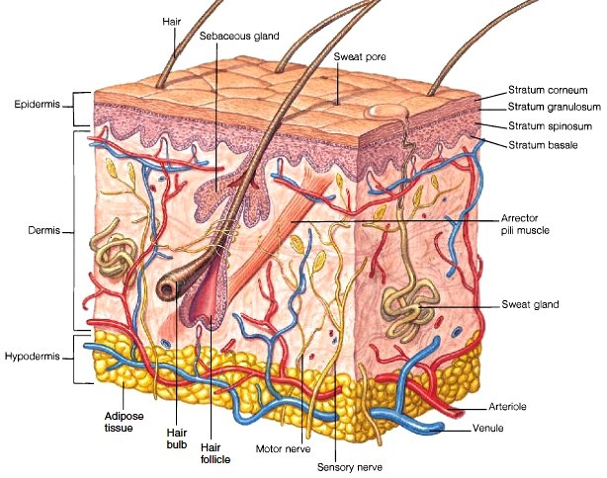
Age Related Changes That Affects The Skin
Skin is combined mainly of 3 layers
Epidermis
Dermis
Subcutaneous tissue
Also Hair ,Nails, Sweat glands
also are part of the integument system

Slide 5
Age Related Changes That Affects The Skin
Epidermis
impermeable outer layer
Protection
Always renewed (shed)
Melanocytes (cells that give color)
Papillae (what gives the skins its texture) also connects to the dermis through the dermis – epidermis junction

Slide 6
Age Related Changes That Affects The Skin
Dermis
Support
Nourishment
Sensory perception
Temperature regulation
Made of 80% collagen , 5% Elastin

Slide 7
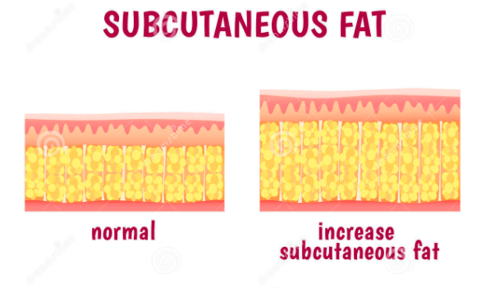
Age Related Changes That Affects The Skin
Subcutaneous tissue and Cutaneous nerves
Protects the underlying tissues from trauma
Storage
Insulation
Regulation of heat loss

Slide 8
Age Related Changes That Affects The Skin
Sweat Glands
Eccrine ( thermoregulation ) : which are important for thermoregulation, open directly onto the skin surface and are most abundant on the palms, soles, and forehead.
Apocrine ( Secretory glands ) : are larger than eccrine glands and open into hair follicles, primarily in the axillae and genital area.
Sebaceous Glands
are present in the dermal skin layer over every part of the body except the palms of the hands and the soles of the feet.
Secrets sebum (prevents water loss & prevents bacterial and fungal growth )

Slide 9
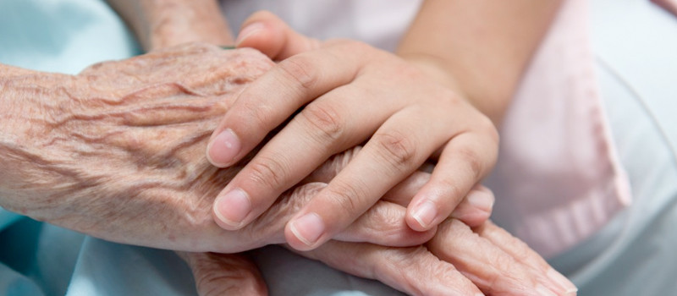
Age Related Changes That Affects The Skin
Nails
Nails growth depends on the age, climate, state of health, the circulation of blood and the activity of the fingers and toes , Nail growth begins to slow in early adulthood, with a gradual decrease of 30% to 50% over the individual’s lifespan. Other age-related changes affecting the nails include the development of longitudinal striations and a decrease in lunula size and nail plate thickness.

Slide 10
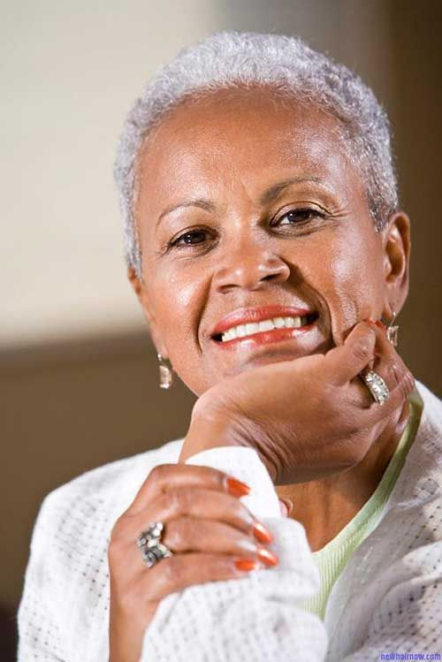
Age Related Changes That Affects The Skin
Hair
Hair distribution differs from part to part on the body , from males and females
Hair color and distribution change to some degree in all older adults, with the most noticeable changes being baldness and gray hair. By the age of 50 years, approximately 50% of people have graying hair and approximately 60% of white men have a noticeable degree of baldness.
Graying of the hair results from a decline in melanin production and the gradual replacement of pigmented hairs by nonpigmented ones.
Agerelated changes also affect hair distribution, with patches of coarse terminal hair developing over the upper lip and lower face in older women and in the ears, nares, and eyebrows of older men

Slide 11
Question
The Reason for Greying hair in older adult is :
A : Increase in the production of melanin
B : Decreased exposure to sun in old age
C : Decrease in the production of melanin

Slide 12
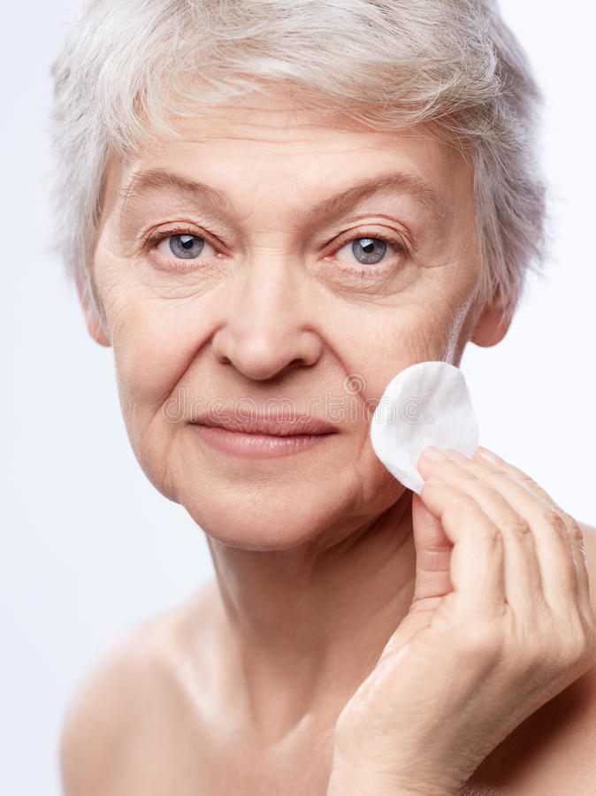
Risk Factors That Affects The Skin Wellness
Genetic influences
Life style and Environmental influences
Smoking, sun exposure, emotional stress, and substance or
alcohol abuse.
Photoaging: term used to describe skin changes that occur
because of exposure to ultraviolet radiation.
Medication Effects
Common adverse medication effects involving the skin include pruritus,
dermatoses, photosensitivity, alopecia and pigmentation changes.

Slide 13
Question
Which of the following medications causes dry mouth ?
A ) Erythromycin
B ) Ampicillin
C ) Atropine
D) Furosemide

Slide 14
Functional Consequences Affecting Skin Wellness
Susceptibility to Injury
Response to Ultraviolet Radiation
Comfort and Sensation
Cosmetic Effects

Slide 15
Question
One of the functional consequences of age-related changes to the skin is an increased susceptibility to injury. Which of the following factors contributes to this susceptibility?
A) Increased wound healing time
B) Changes in vitamin D synthesis
D) Changes in skin pigmentation

Slide 16
Question!
Which of the following functional consequences of skin changes will impact the nursing care of older adults?
A) Older adults have an increased incidence of moles requiring intervention.
B) There is a decreased incidence of skin cancer in older adults because of an increase in melanocytes.
C) In older adults, tactile sensitivity increases and there is an intense response to cutaneous stimulation.
D) Collagen changes interfere with tensile strength of older adults' skin, causing the skin to be less resilient

Slide 17
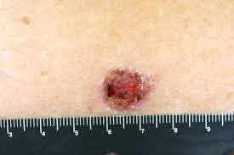
PATHOLOGIC CONDITIONS AFFECTING SKIN
Skin Cancer
Skin cancer, defined as an abnormal growth of skin cells, is the most common—as well as the most preventable—type of cancer .
Older adults are highly vulnerable to the two most common types of skin cancer, primarily because of the cumulative effects of sun exposure.
1 Basal cell carcinoma, which is the most common type, occurs most often on the head and neck
2 Squamous cell carcinoma, the second most common type, occurs most commonly on the head, neck, forearms, and dorsal hands .

Slide 18
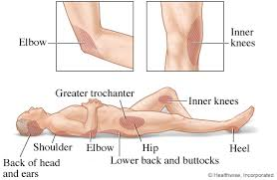
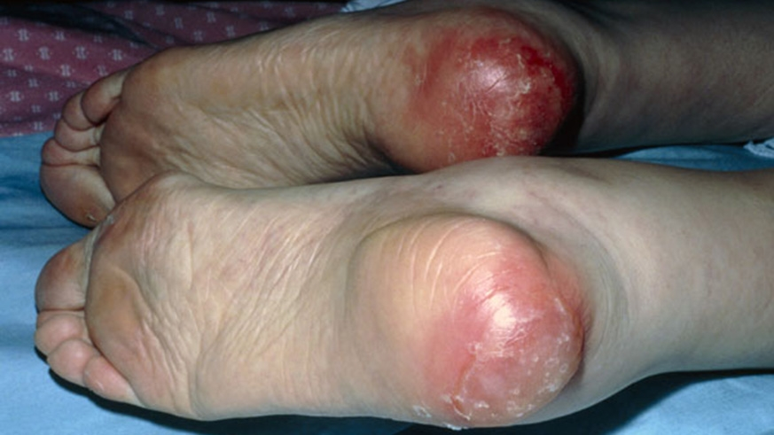
PATHOLOGIC CONDITIONS AFFECTING SKIN
Pressure Ulcer
Localized injury to the skin and/or underlying tissue, usually over a bony prominence, as
a result of pressure or pressure in combination with shear and/or friction.
Risk factors: immobility, surgery, older age, friable skin, urinary and fecal incontinence, and smoking.
Complications: sepsis, cellulitis, osteomyelitis, increased length of stay.

Slide 19
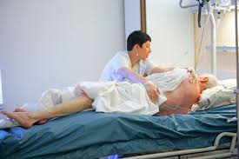
PATHOLOGIC CONDITIONS AFFECTING SKIN
interventions:
Pressure redistribution interventions.
Nutritional interventions.
Skincare.
Treatment measures.
Education of professionals, patients, caregivers.
Video :
https://www.youtube.com/watch?v=3Z7gU9G5UVg&ab_channel=LeafTV

Slide 20
PATHOLOGIC CONDITIONS AFFECTING SKIN
Stages of Pressure Ulcer Development:
Stage I: sores are not open wounds.
Stage II: the skin usually breaks open, wears away, or forms an ulcer, which is usually tender and painful.
Stage III: the sore gets worse and extends into the tissue beneath the skin, forming a small crater.
Stage IV: the pressure injury is very deep, reaching into muscle and bone and causing extensive damage.
deep tissue injury (DTI): there isn't an open wound but the tissues beneath the surface have been damaged.
Unstageable: that the stage is not clear.

Slide 21
Nursing Assessment of the skin
This includes the close observation of the skin on the entire body.
We focus on the characteristics of the skin such as the color, moisture, temperature, texture and turgor.
The skin gives a clue for physiologic or psychosocial functions and may indicate serious health problems.

Slide 22
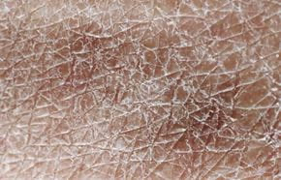
Identifying opportunities for health promotion
Identify the risk factors that may lead to any skin problem.
Older adults always have questions about their own skin changes.
Through this assessment, information is collected about the fluid and nutritional status.

Slide 23
Question!
To assess the skin turgor, the most appropriate technique for the nurse to use is which of these?
A. Palpation
B. Inspection
C. Percussion
D. Auscultation

Slide 24
Observing skin, hair and Nails
Environment around the patient is important. Adequate lighting, privacy, room temperature, personal space, safety are required.
The first method to be used is inspection, in which we look at the skin for any abnormality such as skin lesions.
There’s different types which include similar characteristics such as redness, inflammation and dark in color
Common skin lesions found in older adults are:
Actinic Keratosis, Melanomas, Cutaneous horns and Seborrheic dermatitis.

Slide 25
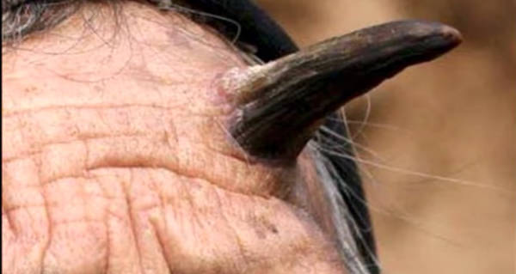
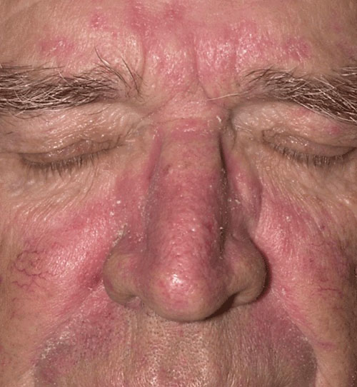

Slide 26
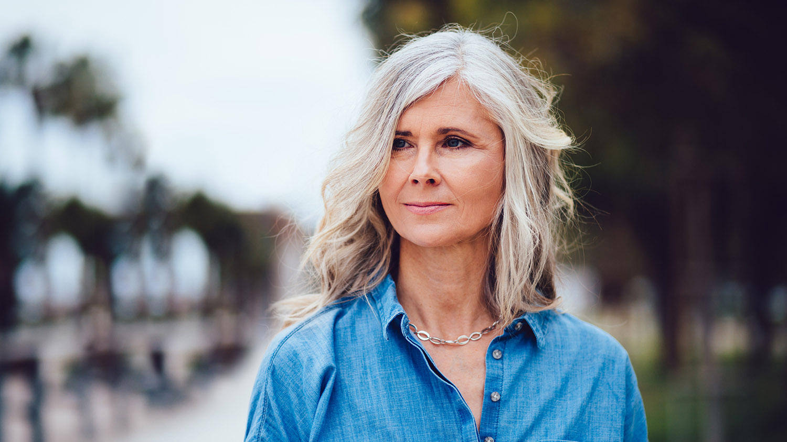
Hair assessment
We assess the distribution, texture of the hair and scalp.
It’s normal to find older adults with white grayish hair.
Lesions and infections may be present.
The hair represents the persons self esteem and whether they do personal grooming.

Slide 27
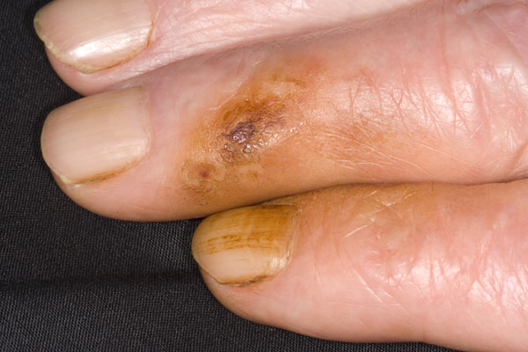
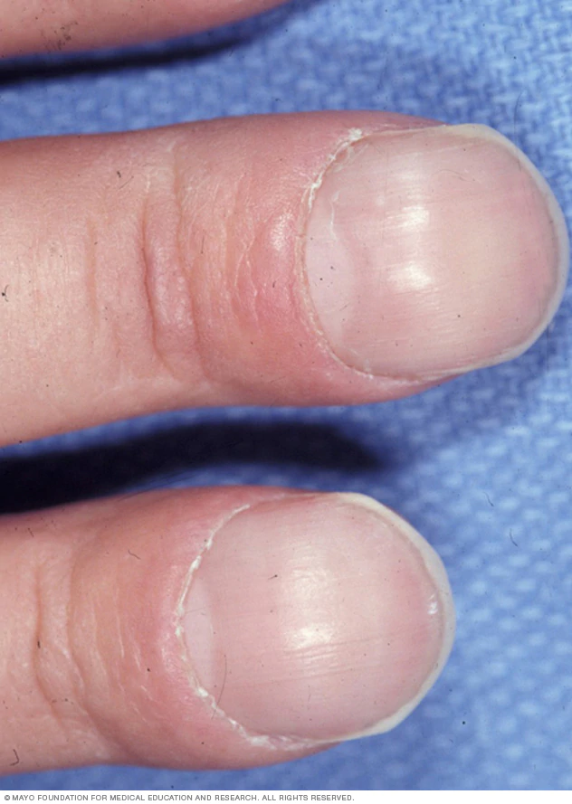
Nail Assessment
We must observe the nails color, cuticles, nail angle and its shape.
The capillary refill which monitors the blood circulation to tissues, must be checked.
Assessing the nails give an indication about physiologic functioning.

Slide 28
Nursing Diagnosis
Pressure Ulcers:
Impaired Skin Integrity r/t poor circulation a.m.b skin layers destruction and pus drainage.
Risk for Infection r/t open pressure ulcer or poor nutritional status.
Skin Cancer:
Ineffective Health Maintenance

Slide 29
Planning for wellness outcome
Focus on prevention.
Improve nutritional status.
Promote health education.

Slide 30
Nursing interventions
Teaching self-care practices.
Provide nutritional therapy.
Position the patient Q 2hrs.
Enhance their self esteem.

Slide 31
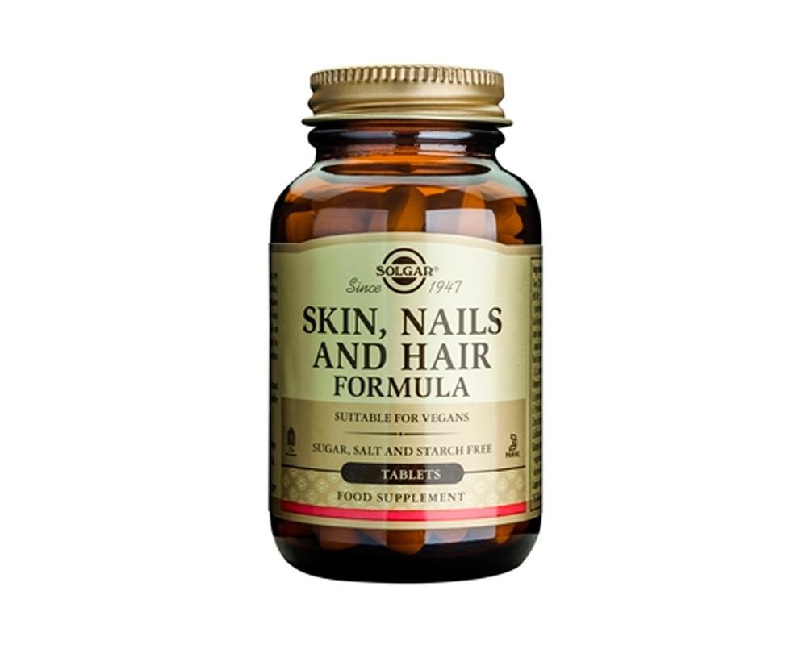
Promoting Healthy Skin
Preventing Skin Wrinkles
It’s important to maintain the optimal nutrition and hydration.
Educate the old age to limit sun exposure.
Avoid skincare products that contain alcohol.
Apply lotion 2 to 3 times daily.
Encourage fluid intake and eat carrots, apricots, salmon and nuts.
Use sunscreen with SPF 15 or more and wear long shirts.
Use topical products that contain alpha-hydroxy acids.
Eat foods such as papaya, spinach, broccoli and pomegranates.

Slide 32
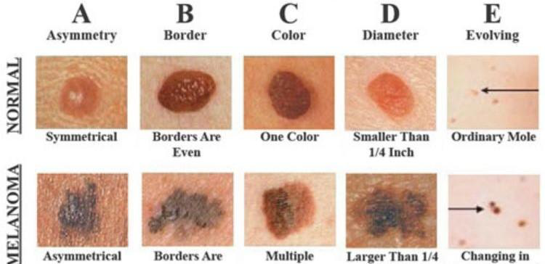
Detecting and Treating Harmful Skin Lesions
Detect skin lesions that look suspicious since they may be precancerous or cancerous.
Use ABCDE technique for melanomas.
Asymmetry
Border
Color
Diameter
Elevation and Enlargement
Pressure ulcers have to be observed and need to be managed.
Encourage the old age to come for monthly checkups for their skin.

Slide 33
Nursing evaluation
It’s important to evaluate if any skin changes (dryness, lesions, bruises) have disappeared.
Re-evaluation may be needed if there is no improvement after interventions prescribed.

