Slide 1
Hearing among geriatrics
Chapter 16

Slide 2
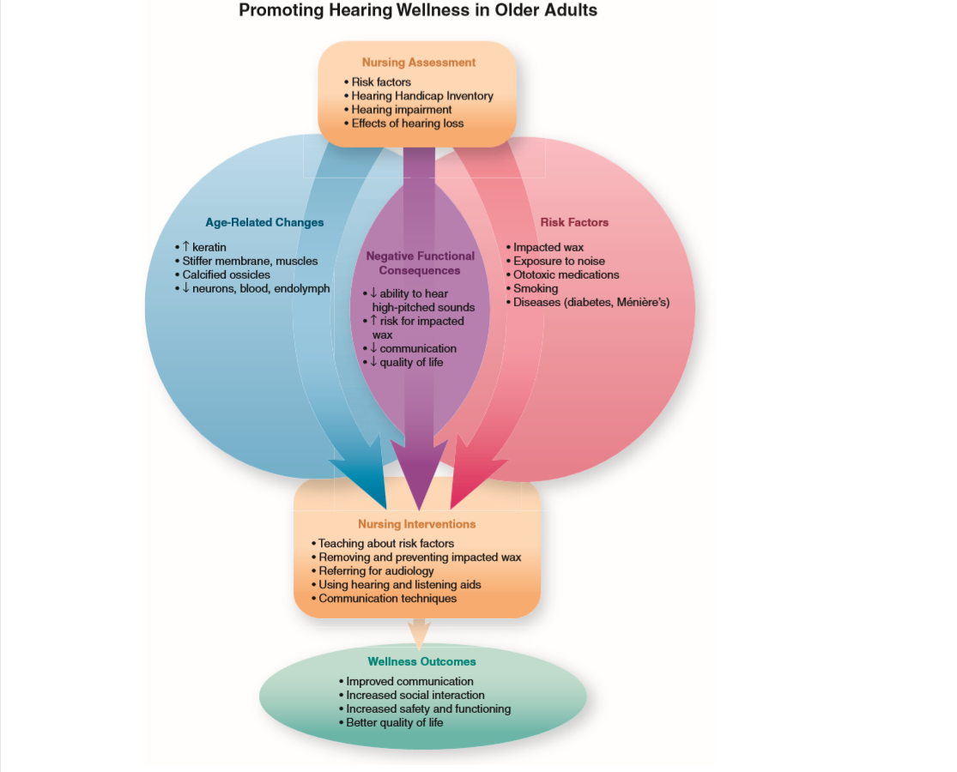

Slide 3
Age-Related Changes That Affect Hearing
(Figure 16-1, Table 16-1)
• External ear: thicker hair, thinner skin, increased keratin
• Middle ear: less resilient tympanic membrane, calcified ossicles, stiffer muscles and ligaments
• Inner ear and auditory nervous system: fewer neurons and hair cells, diminished blood supply, degeneration of spiral ganglion and central processing systems

Slide 4
Risk Factors That Affect Hearing Wellness
Lifestyle and environmental factors: smoking, background noise, exposure to noise or toxic chemicals
• Genetic predisposition to otosclerosis
• Impacted cerumen Ototoxic medications: aminoglycosides, aspirin, loop diuretics, quinine
Disease processes: diabetes, Paget disease, Ménière disease

Slide 5
Functional Consequences Affecting Hearing Wellness
• Presbycusis: diminished ability to hear high-pitched sounds, especially in the presence of background noise
Predisposition to impacted cerumen
• Psychosocial consequences: depression, social isolation, declines in cognitive function, diminished quality of life

Slide 6
Pathologic Condition Affecting Hearing
• Tinnitus: persistent sensation of noises that do not originate in the external environment

Slide 7
Nursing Assessment of Hearing
• Screening tool: The Hearing Handicap Inventory for the Elderly
• Past and present risk factors (e.g., use of ototoxic medications, noise exposure, family history of otosclerosis)
• Attitudes about hearing aids if impairment is present
• Impact of hearing impairment on communication and quality of life • Behavioral cues to impaired hearing
• Otoscopic examination for impacted cerumen • Tuning fork tests for hearing

