Slide 1
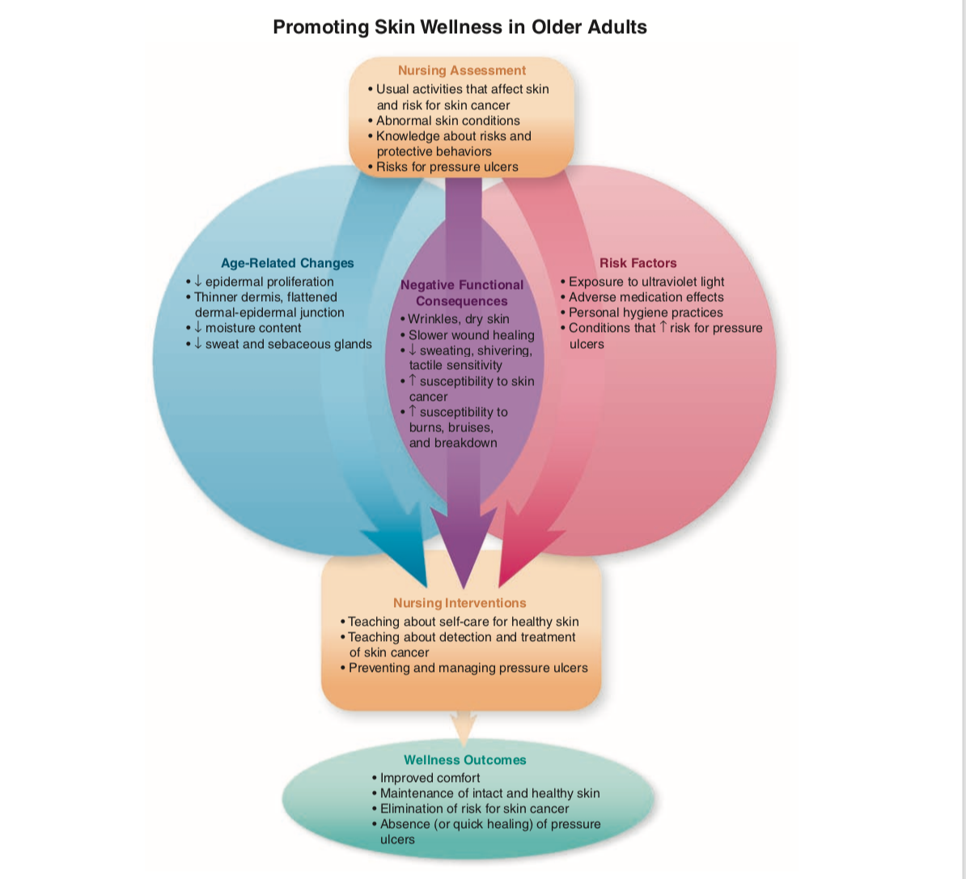

Slide 2
Age-Related Changes That Affect Skin Wellness
(Table 23-1)
• Decreased rate of epidermal proliferation
• Thinner dermis, flattened dermal–epidermal junction
• Diminished moisture content
• Decreased dermal blood supply
• Fewer sweat and sebaceous glands
• Decreased number of melanocytes and Langerhans cells
• Changes in patterns of hair distribution

Slide 3
Risks Factors That Affect Skin Wellness
Genetic factors (hair color and distribution, skin cancer)
Exposure to ultraviolet radiation (sunlight or tanning light)
Adverse medication effects
Personal hygiene practices
Factors that increase the risk for skin breakdown

Slide 4
Functional Consequences Affecting Skin Wellness
(Table 23-1)
Xerosis (dry skin), discomfort
Irregular pigmentation and other cosmetic changes
Increased susceptibility to injury, mechanical stress, and
effects of ultraviolet radiation
Delayed wound healing, increased susceptibility to
infection
Decreased tactile sensitivity, increased susceptibility to
burns
Diminished sweating and shivering, increased susceptibility to hypothermia and heat-related conditions
Increased risk for skin cancer
Increased risk for skin breakdown and pressure ulcers

Slide 5
Pathologic Conditions Affecting Skin Wellness
(Figure 23-1, Table 23-2)
• Skin cancer
• Pressure ulcers (Evidence-Based Practice box)

