Slide 1
Sleep and rest
Chapter 24

Slide 2
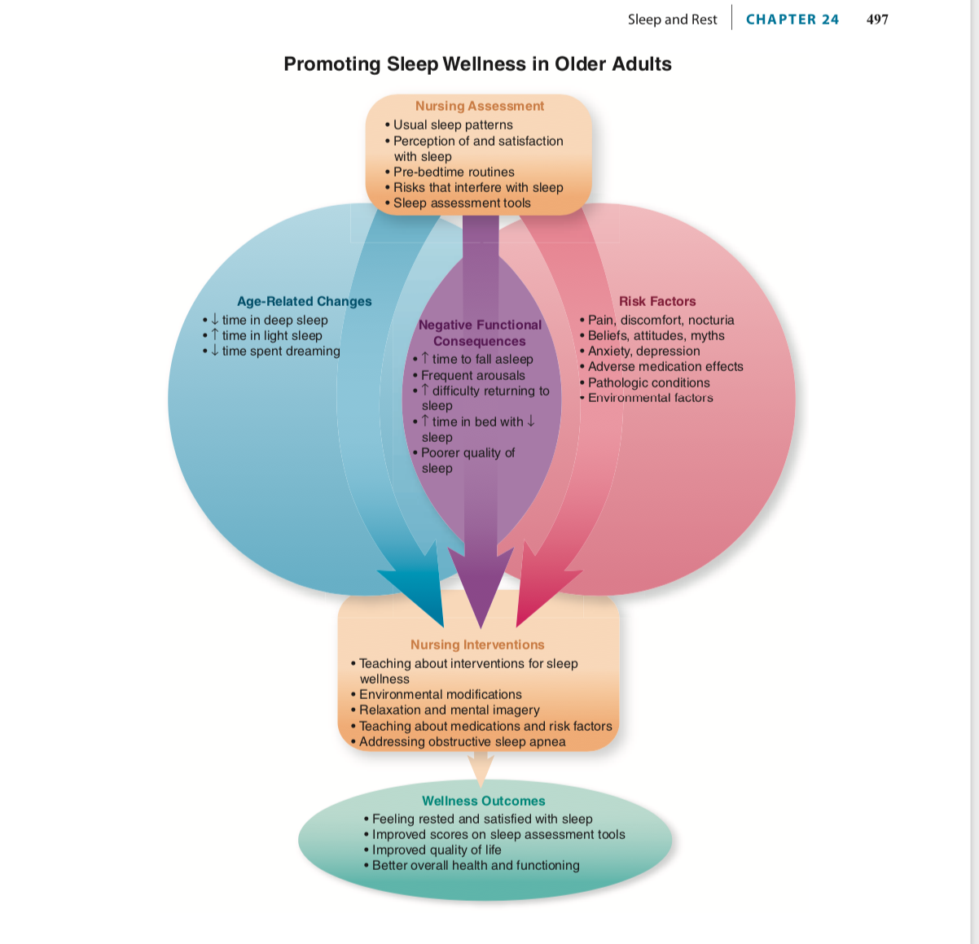

Slide 3
Age-Related Changes That Affect Sleep and Rest Patterns (Table 24-1)
• Time in bed and total sleep time
• Diminished sleep efficiency
• Alterations in sleep cycles and stages
• Shifts in circadian rhythm

Slide 4
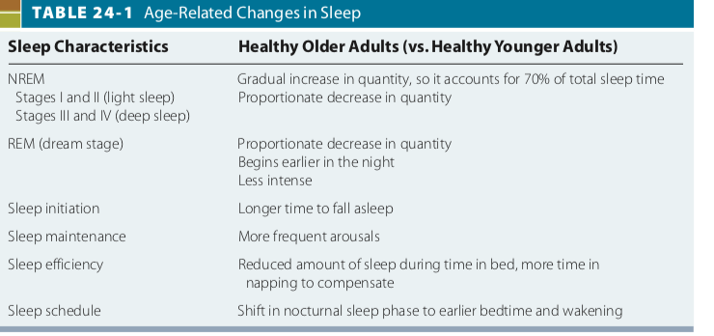

Slide 5
Risks Factors That Affect Sleep Wellness
(Tables 24-2 and 24-3)
Psychosocial factors: beliefs, attitudes, anxiety, depres- sion, boredom
Environmental factors: noise, light, lack of privacy
Physiologic factors: pain and discomfort, medication
effects, physiologic disorders

Slide 6
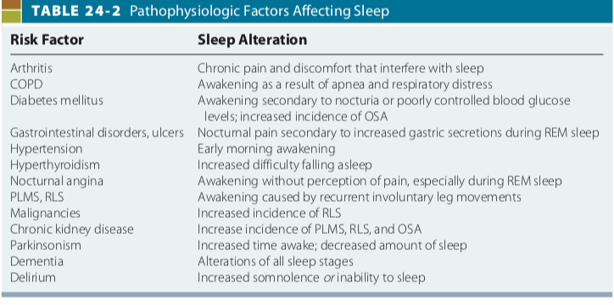

Slide 7
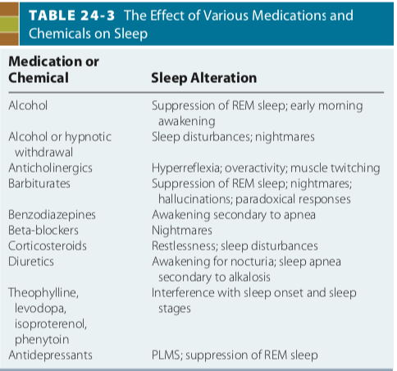

Slide 8
Functional Consequences Affecting Sleep Wellness
Longer time needed to fall asleep
Frequent arousals during the night
More time in bed to achieve same quantity of sleep
Diminished quality of sleep (less dreaming and deep
sleep)

Slide 9
Pathologic Condition Affecting Sleep Wellness
• Obstructive sleep apnea

Slide 10
Nursing Assessment of Sleep Patterns
(Box 24-1)
• Perception of quantity and quality of sleep
• Factors that affect sleep
• Usual sleep pattern and behaviors that affect it
• Actual sleep pattern (observed in institutional settings)
• Sleep assessment tool

Slide 11
