Slide 1
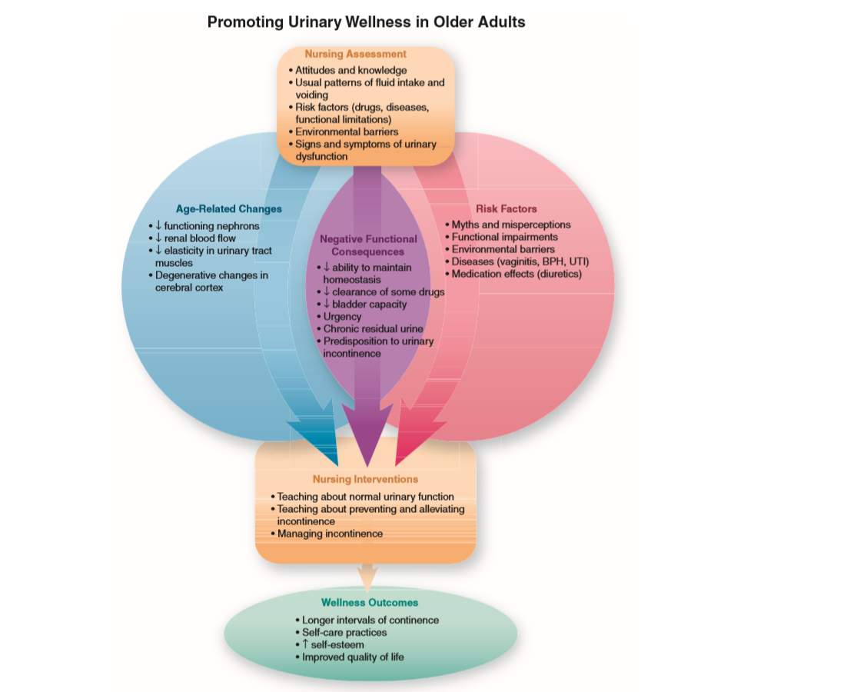

Slide 2
Age-Related Changes That Affect Urinary Wellness
• Kidney: degenerative changes, decreased blood flow, decreased number of functioning nephrons
• Urinary tract muscles: hypertrophy of bladder muscle, replacement of smooth muscle with connective tissue, relaxation of pelvic floor muscles • Voluntary control mechanisms: central nervous system, urinary tract, age-related changes of other systems (e.g., increased postural sway)

Slide 3
Risk Factors That Affect Urinary Wellness
• Misperceptions and attitudes (e.g., resignation, viewing urinary incontinence as “normal,” staff and caregiver attitudes that interfere with maintaining continence)
• Functional impairments that affect control over socially appropriate urinary elimination (e.g., dependency in ADLs)
• Pathologic changes of the genitourinary tract (e.g., pelvic floor dysfunction, benign prostatic hyperplasia)
• Other pathologic conditions (e.g., dementia, Parkinson’s, constipation)
• Medication effects (Table 19-1)
• Dietary and lifestyle factors (e.g., obesity, tobacco smoking, intake of caffeinated beverages)
• Environmental factors (Box 19-1)

Slide 4
Functional Consequences Affecting Urinary Wellness
• Effects on homeostasis: diminished ability to maintain electrolyte balance, changes in diurnal pattern of urine production
• Delayed excretion of water-soluble medications and increased risk of drug interactions and adverse effects
• Diminished bladder capacity; urinary urgency and frequency

Slide 5
Pathologic Condition Affecting Urinary Function
• Urinary incontinence: stress urinary incontinence, urge urinary incontinence, mixed urinary incontinence, overactive bladder
• Diminished quality of life due to urinary incontinence
• Practical and psychosocial effects of urinary incontinence on the older adult and caregivers

Slide 6
Nursing Assessment of Urinary Function
• Talking with older adults about urinary function (finding appropriate terminology)
• Identifying usual voiding patterns and influencing factors
• Identifying risk factors for urinary incontinence
• Identifying risk factors that influence renal function and homeostasis
• Identifying symptoms of impaired urinary elimination
• Being alert to misunderstandings about urinary elimination
• Psychosocial consequences of incontinence (e.g., anxiety, depression, social isolation)

