Slide 1
Introduction to antibiotics

Slide 2
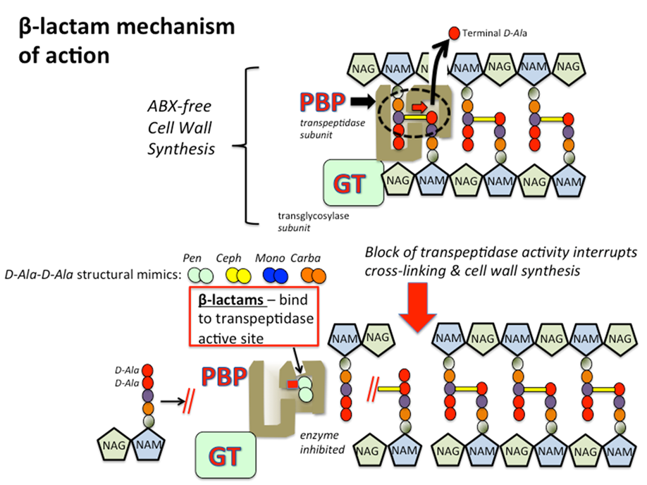
penicillins
Mechanism of action (MOA):
Cell wall inhibitors → interfere with the last step of
bacterial cell wall synthesis (transpeptidation or
cross-linkage) by binding with the penicillin-binding
proteins (PBPs) resulting in osmotically less stable
membrane → cell lysis occur either through
osmotic pressure or through the activation of
autolysins.
Penicillins are bactericidal and work in
time-dependent fashion.

Slide 3
Natural penicillins
Penicillin G / Benzylpenicillin (IM, IV)
- require renal dose adjustment (CrCl < 10 ml/min/1.73m2).
- hepatic dose adjustment when combined with renal impairment.
Penicillin V / Phenoxymethylpenicillin (PO)

Slide 4
Antibacterial spectrum:
Narrow spectrum agent; mostly aerobic gram positive cocci. Useful against:
1. ß- hemolytic streptococci (Group A, B, C)
2. Treponema pallidum (Syphillis) – Gram negative spirochete
3. N. menigitidis *note: resistance 1-3%
4. oral anaerobes
5. Enteroccocus (E. facaelis, NOT E. faecium)
NOT useful against:
1. most gram negative organisms
2. Beta-lactamase producing organisms (S. aureus - ~90%)

Slide 5
Penicillinase-resistant penicillins / antistaphylococcal penicillins
Nafcillin (IM, IV)
Oxacillin (IM, IV)
Cloxacillin (PO, IM, IV)
Dicloxacillin (PO)

Slide 6
Antibacterial spectrum:
Very narrow spectrum; gram positive aerobes
• drug of choice for MSSA
• maintains coverage for Streptococci (less so than penicillin/ amoxicillin)
• some oral anaerobic coverage (less so than penicillin/amoxicillin)
Not useful against: Enterococci, N. meningitis

Slide 7
Extended spectrum penicillins
Ampicillin (PO, IM, IV)
Amoxicillin (PO, IM, IV)
renal dose adjustment based on expert opinion.
Contraindicated in Infectious mononucleosis (in Canadian labelling not US).

Slide 8
Antibacterial spectrum:
narrow spectrum agent; mostly Gram positive aerobes, some Gram negative aerobes
covers everything that penicillin does (streptococcus, enterococcus, oral anaerobes)
Gram negative coverage (HiPEEL) - Non-beta-lactamase producing
- H. influenzae (~25% resistance)
- Proteus mirabilis
- E. coli (~30% resistance)
• Gram positive coverage
- better coverage of enterococcus (E.faecalis vs. penicillin)
- Listeria monocytogenes (HiPEEL)
• Useful against: ß- hemolytic streptococci (Group A, B, C).

Slide 9
Amoxicillin/ Clavulanate Ampicillin/ Sulbactam
Amoxicillin/ Clavulanate (PO, IV)
- renal dose adjustment (CrCl < 30ml/min/1.73m2)
- contraindicated in 1. patients with history of amoxicillin/ clavulanate associated hepatic dysfunction.
2. Augmentin XR → sever renal impairment (CrCl <30ml/min) and hemodialysis patients.
3. History of cholestatic jaundice.
Ampicillin/ Sulbactam (IM, IV)
- renal dose adjustment (CrCl < 30ml/min/1.73m2)
- contraindicated in patients with 1. history of Ampicillin/ Sulbactam associated hepatic dysfunction.
2. History of cholestatic jaundice.

Slide 10
Antibacterial spectrum:
broad-spectrum agent
• extends spectrum of amoxicillin to cover more gram negatives (E.coli, H. influenzae, Salmonella, Shigella) + gut anaerobes (B. fragilis)
Not useful against: Pseudomonas
“Like pip/tazo (minus Pseudomonal coverage)”

Slide 11
Antipseudomonal penicillins
Piperacillin (IM, IV)
- require renal dose adjustment (CrCl < 40ml/min)
- effective against many gram negative bacilli except Klebsiella.
Piperacillin / Tazobactam (IV)
- Renal dose adjustment (CrCl < 40 ml/min)
Ticarcillin / Clavulanate (IV)
- maintenance dose based on CrCl
- Hepatic dose adjustment when concomitant with renal dysfunction (CrCl <10 ml/min).

Slide 12
Antibacterial spectrum:
Most broad-spectrum penicillin
aerobic Gram positives (including MSSA, E. faecalis),
difficult aerobic Gram negatives (including Pseudomonas, Acinetobacter).
anaerobes (including B. fragilis)
• NOT useful against: MRSA, E. faecium, ESBL

Slide 13
Side effects
Hypersensitivity: contraindicated in patients with hypersensitivity to any penicillin.
Diarrhea.
Neurotoxicity: penicillins can provoke seizures if injected intrathecally or if very high blood levels are reached.
Hematologic toxicities: decreased coagulation may be observed with doses of piperacillin, ticarcillin, and nafcillin.

Slide 14
Pregnancy
Penicillins are pregnancy category B.
Penicillins are compatible for use during pregnancy and widely used in pregnant women.

Slide 15
Monobactams
Aztreonam (IM, IV)
- MOA → similar to penicillins
- Renal dose adjustment (CrCl < 30 ml/min)
- Contraindicated in patients with hypersensitivity to aztreonam.
- Pregnancy category B.
- Bactericidal.
- Concentration-dependent killing.
- Aztreonam oral inhalation used for cystic fibrosis.

Slide 16
Antibacterial spectrum:
Its antimicrobial activity directed primarily against gram-negative pathogens including Enterobacteriaceae and P. aeruginosa.
It lacks activity against gram positive organisms and anaerobes.
Aztreonam is resistant to the action of Beta-lactamases with the exception of the ESBLs.

Slide 17
Side effects
Neutropenia
Increased serum transaminases
Pain at the injection site
Phlebitis
Skin rash

Slide 18
Mechanisms of Resistance
Production of β-Lactamase emzymes (most common) for Gram negative bacteria
Changes in the active site of PBPs to lower affinity (Streptococcus pneumoniae).
Decreases expression of outer membrane proteins (OMPs).
Efflux pumps.

Slide 19
Chloramphenicol (PO, IV, ophthalmic, Otic)
Mechanism of action:
Binds reversibly to the bacterial 50S ribosomal subunit and inhibit protein synthesis at the peptidyl transferase reaction.
The drug is primarily bacteriostatic but depending in the dose and the organism, it may be bactericidal.
Time dependent killing.
Pregnancy category C.
Resistance is conferred by the presence of enzyme that inactivate chloramphenicol. Other mechanisms include decreased ability to penetrate the organism and ribosomal binding site alterations.

Slide 20
Antibacterial spectrum:
Its active against many types of microorganisms including chlamydia, rickettsiae, spirochetes, and anaerobes.
Side effects:
1. Anemias: cause haemolytic anemia in patients G6PD deficiency and aplastic anemia.
2. Gray baby syndrome.
Contraindications: Hypersensitivity to chloramphenicol, treatment of trivial of viral infections, and bacterial prophylaxis.

Slide 21
Cephalosporins

Slide 22
Mechanism of action :
Disrupt synthesis of the peptidoglycan layer of bacterial cell wall.
Cell wall synthesis inhibitor.
*There are 5 generations of cephalosporines.
*Antimicrobial properties:
1-Bactericidal
2-Time dependent killing.
*Broad spectrum Antibiotic.

Slide 23
Coverage:

Slide 24
Resistance:
Natural resistance occurs in organisms that lack a peptidoglycan cell wall or impermeable to the drug.
Acquired resistance by :
-beta-lactamases.
-Alterd PBPs
-Decreased permeability to the drug

Slide 25
Side effects :
1.Hypersensitivity
2.Diarrhea
3.Nephritis
4.Neurotoxicity
5.Hematologic toxicities
*Contraindications: Contraindicated in patients with a history of allergic reactions to penicillin, carbapenems or cephalosporins.

Slide 26
First Generation:
Cefazolin, Cephalexin and Cefadroxil. *Cover aerobic Gram positive bacteria like MSSA, beta hemolytic stretococcus and Some aerobic gram negative bacteria like Proteus, E.coli and Klebsilla .
Antibiotic | Dosage form | Renal adjustment | Hepatic adjustment | Pregnancy
Cefazolin | IV , IM | CrC l1-34ml/min →1/2 usual dose/12hours <10 ml/min → ½ usual dose/18 hours | ---- | Category B
cephalexin | PO | CrCl <30 ml/min | ---- | Category B
Cefadroxil | PO | CrCl <50 ml/min | ----- | Category B

Slide 27
Second Generation:
Cefuroxime, Cefaclor, Cefprozil, Cefoxitin.
Cover what 1st generation cover+ gram negative organism(H.influenza and moraxella ) + oral anaerobes.
Antibiotic | Dosage form | Renal Adj. | Hepatic Adj. | pregnancy
Cefuroxime | IV, IM, PO | CrCl< 30ml/min | ---- | B
Cefaclor | PO | CrCl< 10 ml/min | ---- | B
Cefprozil | PO | CrCl<30 ml/min | ----- | B
cefoxitin | IV , IM | GFR <50 ml/min/1.73 m2 | ------ | B

Slide 28
Third generation:
Ceftriaxone, Cefotaxime, Ceftazidime, Cefixime, Cefdinir, cefepime.
*ceftriaxone, cefotaxime :Broad-spectrum
Gram positive coverage: MSSA (reasonable coverage), Streptococcus (excellent coverage)
Gram negatives: N.menigitidis, N.gonnorhea
oral anaerobes
Dosage form : IV / IM
Pregnancy category B
Ceftriaxone : No renal or hepatic dosage adjustment.
Cefotaxime : No hepatic dosage adjustment.
Renal adjustment: If CrCl < 20 ml/min/1.73m2, Dose should be decreased 50%.

Slide 29
Ceftazidime:
Less broad-spectrum vs. ceftriaxone/cefotaxime
Gram positive coverage: poor ,Gram negatives: including Pseudomonas.
Dosage form : IV
Pregnancy category B
Renal dosage adjustment is necessary when CrCl <50 ml/minute.
Hepatic adjustment :No dosage adjustment.

Slide 30
Cefixime: Less broad-spectrum vs. ceftriaxone/cefotaxime
Gram positive coverage: poor.
Gram negatives: N. gonnorhea.
Dosage form: PO.
Pregnancy category B.
Hepatic adjustment : No dosage adjustment.
Renal adjustment: severe impairment(GFR<10 to 20 ml/min/1.73m2 , reduce dose by 50%.

Slide 31
Cefdinir: Less broad-spectrum vs. ceftriaxone/cefotaxime
Gram positive coverage: Good, >20% of Pneumococcus resistant.
Gram negatives: Moraxella, H.influenza.
Dosage form: PO.
Pregnancy Category B.
Hepatic Adjustment : No dosage adjustment.
Renal Adjustment : Dose adjustment is necessary when CrCl < 30ml/min.

Slide 32
4th Generation Cephalosporins :
Cefepime:
Broad spectrum ,Like ceftriaxone, BUT
Gram positives: better activity vs. MSSA
Gram negatives: Pseudomonas
Dosage form : IV ,IM .
Pregnancy Category B
Hepatic Adjustment : No dosage adjustment.
Renal Adjustment : Adjustment is necessary when CrCl < 60 ml/min .

Slide 33
Advanced generation: 5th Generation :
Ceftaroline :
Coverage : Broad spectrum.
*Active against MRSA and CAP .
Extended gram positive bacteria coverage.
Active against Streptococcus pneumoniae, Haemophilus influenzae, Moraxella.
Dosage form : IV.
Pregnancy category B .
Hepatic adjustment : No need .
Renal adjustment : If CrCl < 50 ml/min → Dosage Adjustment necessary.

Slide 34
VANcomycin
*MOA : Cell Wall Inhibitor .
*Antimicrobial properties: Bactericidal, Time-dependent killing.
* Narrow spectrum
ONLY Gram positives: • Aerobes: Staphylococci (MRSA, MSSA, CNST), Enterococci (E. faecalis & E. faecium) • Anaerobes: C. difficile, Propionibacterium spp.
Dosage form : Orally , IV .
Contraindication: hypersensitivity to vancomycin or any component of the formulation.
Side Effects:
1-Thrombophlebitis.
2-Nephrotoxicity.
3-Neutropenia and ototoxicity (Dose-related).
4-Red-man syndrome.

Slide 35
Red man syndrome:
Red man syndrome is associated with Rapid infusion rate → Vancomycin stimulate histamine release → Rash to the face and neck , weakness , angioedema and chest or back pain.
Management of Red man syndrome :
-IV infusion should be stopped immediately.
-Administer AntiHistamine like Diphenhydramine.
********
When To consider Nephrotoxicity :
preexisting renal impairment, concomitant nephrotoxic medications (ie, aminoglycosides, loop diuretics, amphotericin B, IV contrast dye, vasopressors, piperacillin/tazobactam, and flucloxacillin), advanced age, increased weight, dehydration, critically ill patients, patients with rapidly changing renal function, sustained high vancomycin serum trough concentrations above 15 to 20 mg/L or daily AUC >650 to 1,300 mg•hour/L, and prolonged exposure (eg, ≥4 days)

Slide 36
Hepatic and Renal adjustment :
Hepatic Impairment: No dosage adjustment provided.
Renal Impairment :
*Orally: No dosage adjustment is necessary.
*IV: Renally adjusted dose is based on GFR and weight(kg)
GFR < 50 ml/min/1.73 m^2

Slide 37
Mechanism of resistance:
Alteration of the peptidoglycan synthesis pathway , specifically the substitution of D-Alanine-D-Alanine (D-Ala-D-Ala), to either D-Alanine-D-Lactate (D-Ala-D-Lac) or D- Alanine-D-Serine, which reduce vancomycin binding.
Decreased permeability .

Slide 38
Pregnancy:
Oral Vancomycin: Category B.
IV Vancomycin : Category C.
***************
Trough levels:
Vancomycin levels in adult patients recommended patients: Maintain trough serum vancomycin concentrations of at least 10 mg/L for all infections to avoid the potential for resistance. Maintain trough serum vancomycin concentrations of 15-20mg/L for complicated infection.
Trough before 3rd , 4th or 5th dose.

Slide 39
Teicoplanin:
*MOA :cell wall inhibitor.
*Coverage: Gram positive aerobes like MRSA and Enterococcus, and anaerobes like C. difficile.
*Antimicrobial properties:
Bacteristatic
concentration-dependent Killing.
*Dosage Forms: IV / IM / PO
*Side Effects: Ototoxicity, fever, hypersensitivity, CNS effects ,hematologic effect, nephrotoxicity ,elevated LFTs.
*Contraindication: Hypersensitivity.
*Pregnancy : Avoid use during pregnancy unless clearly necessary.

Slide 40
Renal and hepatic adjustment:
If :
CrCl 40-60ml/min→ 50% of dose should be given.
CrCl < 40ml/min→ 33% of dose should be given.
No hepatic dosage adjustment is necessary.

Slide 41
antibiotic | Vancomycin | Teicloplanin
Loading dose | Loading dose is required to ensure vancomycin level(25-30mg/Kg) | Loading dose is recommended. 3 doses of 400 mg every 12 hours.
Maintenance dose | Based on patient’s creatinine clearance. | 400 mg once daily
Time/conc. Dependent | Time-dependent | Conc. Dependent
Nephrotoxic | More | less
Cross BBB | Cross | Do not cross
Major side effect | Thrombophlebitis, Nephrotoxicity, Neutropenia and ototoxicity (Dose-related) And Red-man syndrome. | Ototoxicity, fever, hypersensitivity, CNS effects ,hematologic effect, nephrotoxicity ,elevated LFTs
Dosage form | PO , IV | IV,IM , PO

Slide 42
Carbapenems
BacteriaCidal/ time dependent
Ertapenem
Imipenem/cilastin
Doripenem
Meropenem

Slide 43
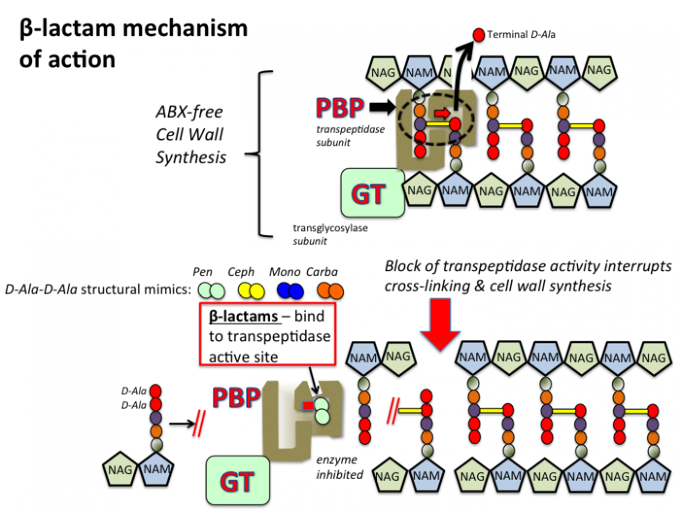
Mechanism of action:
Carbapenems inhibit cell wall synthesis
They bind to multiple penicillin binding proteins and
inhibit the final transpeptidation step in peptidoglycan synthesis.
while Cilastin prevents renal metabolism
of imipenem by competitive inhibition of
dehydropeptidase along the brush border of the renal tubules.

Slide 44
Antimicrobial Activity /Coverage
Excellent Activity against :
Most Aerobic gram positive
Most Aerobic gram negatives including ESBL
Anaerobic bacteria
Drug of choice for ESBL, and reserved for serious infections with resistant organisms.
Meropenim& doripenem best for gram (-)
Imipenem best for gram (+)
MEropenim is the best for CNS infections

Slide 45
Antimicrobial Activity /Coverage
Ertapenem (least broad spectrum) | Meropenem, Imipenem, Doripenem
Aerobic gram negatives including (ESBL) | Aerobic gram negatives including (ESBL)
Aerobic gram positives (MSSA, streptococcus) | Aerobic gram positives (MSSA, streptococcus)
Anaerobics | Anaerobics
 | Pseudomonas aeruginosa
 | enterococcus
 | acinetobacter
 | CNS infections

Slide 46
Differences between carbapenems”
 | Doripenem | Ertapenim | Meropenim | Imipenem
Dosage forms | IV | IV/IM | IV | IV/IM
Max doses | 1.5g/day | 1/day | 2g/day | 4g/day
Frequency of dosing | Every 8hr | Every 24 hr | Every6-8hr | Every 6-8 hr
Renal adjustment | CrCL<= 50ml/min | CrCL<=30 ml/min | Crcl<=50ml/min | CrCl<=90ml/min
BBB penetration | X | - | X | X
Pseudomonas coverage | X | - | X | X
Seizure risk | Low | <1% | low | Very high
Pregnancy category | B | Can be used | Not enough data | Crosses the placenta PK alters

Slide 47
Side Effects and cautions:
1-Anemia, thrombocytopenia and neutropenia.
2-Seizures and headache
3-GI side effects; Nausea vomiting and diarrhea.
Concerns related to side effects:
1-Hypersensitivity reactions: including anaphylaxis (when people are allergic to Beta Lactams)
2- use caution with CNS disorders (history of seizures)or renal impairment, and adjust doses to avoid drug accumulation which may increase seizure risk.
3- watch out if used with probenecid, it inhibits the excretion of carbapenems.

Slide 48
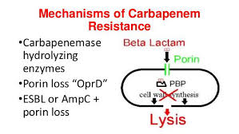
Resistance mechanism
Altered PBPs: modified PBP has a lower affinity for B- lactams
Decreased permeability to the drug
Active expulsion of carbapenems out of the periplasmic space through efflux pumps.
Loss of porins

Slide 49
Telavancin
Bacteriacidal/ conc dependent
Telavancin is a semisynthetic vancomycin derivative, lipoglycopeptide.

Slide 50
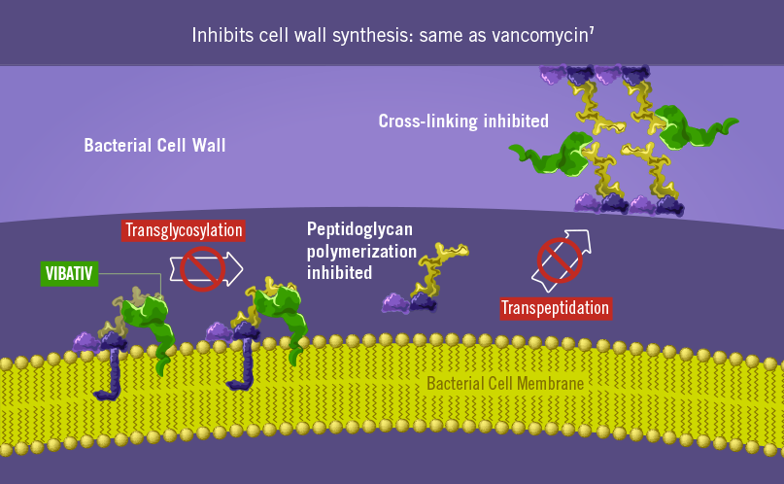
Mechanism of action:
It inhibits bacterial cell wall synthesis by novel combined actions:
first by blocking polymerization and cross-linking of peptidoglycan
by binding to D-Ala-D-Ala portion of cell wall.
Unlike vancomycin, additional mechanism involves disruption
of membrane potential and changes cell permeability due
to presence of lipophilic side chain moiety.
Dosage form: reconstituted solution for IV administration.

Slide 51
Antimicrobial activity / resistance mechanism:
Antimicrobial activity :
Similar to vancomycin; it works against major spectrum of gram (+) bacteria, including MRSA< penicillin resistant streptococci and ampicillin resistant enterococci. It also works against VRE.
Resistant mechanism:
The mechanism of resistant was observed in the Enterococci Bactria that have the vanA Operon. This operon enzymatically changes the bacterial peptidoglycan (drug target) which consequently alters the binding.
However, enterococci with vanB remain susceptible to Telavancin

Slide 52
Side effects & considerations:
CNS symptoms; dizziness, infustion site pain (infusion reaction)
Gi symptoms; metallic taste, nausea, vomiting, decreased appetite
Nephtotoxicity; it increases serum creatinine.
Interactions with medications that can cause QT prolongation such as haloperidol
Foamy urine
Considerations:
It needs renal dose adjustment when CrCl is <=50 ml/min, and no hepatic dose adjustment.
C/I In patients using IV unfractionated heparin
Pregnancy : teratogen , causes fatal harm.
Dose is adjusted based on renal function.

Slide 53
Polymixins( B & E )
Bacteriacidal/ conc dependent
Polymixin B: mixture of polymixin B1 and B2
Polymixin E : colistin
Dosage forms:
Polymixin B : parentral, ophthalmic, otic, and topical preparations.
Colistin which is only available as a prodrug “ colismethate sodium” can be given IV, or inhaled by a nebulizer.

Slide 54
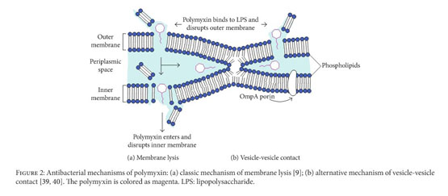
Mechanism of action:
Disruption of the bacterial outer membrane,
by binding to the surface phospholipids and
disrupts the structure of cell wall, resulting
in leakage of cell contents and cell death.

Slide 55
Antimicrobial activity $ resistance mechanism
Antimicrobial activity:
Narrow spectrum: aerobic Gram negatives
Reliable activity against: ESBLs, CREs, Pseudomonas, Acinetobacter
Useful for: highly resistant aerobic gram negative infections where there are no other options
Not useful for: Gram positives
Resistance mechanism:
Modifications of lipid A phosphates with positively charged groups or Complete loss of Lipopolysaccharides.
Alterations in the expression of outer membrane proteins, including efflux pumps and membrane stabilization proteins.

Slide 56
Side effects and precautions:
Side effects and precautions:
Neurotoxicity
nephrotoxicity ( decreased CrCL) dose dependent .
Use with caution with other antibiotics , because it may result in super-infections.
C/I in patients using muscle relaxants and other neurotoxic drugs ; it leads to respiratory depression.

Slide 57
Differences between polymixin B & E
 | Polymixin B | Polymixin E
Agents | Mix of B1 and B2 | Colistin
Coverage | Ecoli, H. influenza, P.auruginosa | Klebsiellaspp, acinetobacter
Renal adjustment | If total body clearance is not altered then no need to adjust | Needs renal dose adjustment Loading dose : stays the same Maintenance dose: based on CrCL
Pregnancy | safe during pregnancy and lactation (no studies recommend using it) | category C
Hepatic adjustment | No need | No need

Slide 58
Daptomycin, Quinupristin/dalfopristin, Nitrofurantoin, Aminoglycosides Nadine Amer

Slide 59
Daptomycin

Slide 60
Daptomycin
Cyclic lipopeptide antibiotic.
Bactericidal.
Concentration-dependent killing.
Mechanism of action: Binds to bacterial membranes and causes rapid depolarization of membrane potential; inhibiting intracellular synthesis of DNA,RNA and protein.
Administration: IV/intrathecal
Pregnancy category: B, only limited information is available from case reports about its successful use during the 2nd & 3rd trimesters.

Slide 61
Antibacterial spectrum
Narrow-spectrum (aerobic gram positives)
-Staphylococci (MSSA, MRSA,CNST)
-Streptococci (Penicillin-resistant)
-Enterococci (E.faecalis, E.faecium,VRE)
-Useful for resistant aerobic gram positives.
-Not useful for: any gram negative, any anaerobes, chest infection.
Note: Daptomycin should not be used for the treatment of pneumonia due to inactivation of antimicrobial activity by pulmonary surfactant.

Slide 62
Dose adjustment: Renal/hepatic
Renal impairment:
-CrCl≥30 ml/minute: No dosage adjustment necessary.
-CrCl<30 ml/minute: dose adjustment necessary
Hepatic impairment:
- Mild-Mod [Child-Pugh class A/B]: No dosage adjustment necessary. - Severe [ Child-Pugh Class c]: No dosage adjustments provided [has not been studied]

Slide 63
Side effects :
Cardiovascular: Chest pain, edema, hypertension ,hypotension.
CNS: Insomnia, headache, dizziness.
Dermatologic: Pruritus, diaphoresis, skin rash.
GI: Diarrhea, abdominal pain, vomiting
Genitourinary: urinary tract infection.
Hepatic: Abnormal hepatic function tests, increased serum alkaline phosphatase.
Infection: Gram negative organism infection, bacteremia, sepsis.
Neuromuscular & skeletal: Increased creatinine phosphokinase.
Respiratory: Pharyngolaryngeal pain, dyspnea.
C/Is: Hypersensitivity to daptomycin or any component of the formulation

Slide 64
Mechanism of resistance
Resistance to daptomycin is related to mutations in the membrane lipid composition.

Slide 65
Quinupristin/dalfopristin

Slide 66
Quinupristin/dalfopristin(streptogramins)
A mixture of two streptogramins in a ratio 30:70, respectively.
Bactericidal against staphylococci, bacteriostatic against VRE strains.
Time-dependant killing.
Long post antibiotic effect (PAE)
Mechanism of action: Quinupristin and dalfopristin synergistically inhibit bacterial protein synthesis by binding to different sites on the 50S bacterial ribosome.
Dalfopristin: Disrupts elongation by interfering with the addition of new amino acids to the peptide chain
Quinupristin: Prevents elongation similar to macrolides & causes release of incomplete peptide chain

Slide 67
Administration: IV/intrathecal(off-label)
Pregnancy category B. Adverse events have not been observed in animal reproduction studies.
Dosing: Renal/hepatic impairment: No dosage adjustment necessary
Antibacterial spectrum: -Primarily gram positive cocci including those resistant to other antibiotics ( E.faecium; VRE , MRSA, penicillin-resistant S.pneumonia). - Not active against E.faecalis - Unclear clinical efficacy against gram negative bacteria and some anaerobic bacteria.

Slide 68
Mechanisms of resistance:
-Enzymatic methylation of bacterial 23S ribosomal RNA site interferes with the binding of quinupristin. In some cases, it can switch the action from bactericidal to static
-Plasmid-associated acetyltransferase inactivates Dalfopristin.
-Active efflux pump

Slide 69
Side effects &contraindications:
Local: venous irritation (if given peripherally rather than centrally),local pain, local inflammation, localized edema, infusion site reaction.
Hyperbilirubinemia.
Arthralgia, myalgia.
Cautious: inhibitors of P450 CYP3A4 isoenzyme.
Contraindications: Hypersensitivity to streptogramins including (pristinamycin, virginiamycin) or any component of the formulation.

Slide 70
Nitrofurantoin

Slide 71
Nitrofurantoin
Bactericidal in urine at therapeutic doses.
Concentration-dependent killing
Mechanism of action: Nitrofurantoin is reduced by bacterial flavoproteins to reactive intermediates that inactivate or alter bacterial ribosomal proteins leading to:
Inhibition of protein synthesis.
Aerobic energy metabolism.
DNA, RNA, and cell wall synthesis
Resistance: Rare. The broad-based nature of nitrofurantoin mode of action explains the lack of acquired bacterial resistance to nitrofurantoin.
Administration: PO (Available as suspension &capsules)

Slide 72
Antibacterial spectrum:
Relatively broad-spectrum:
• aerobic gram negatives: E.coli, Klebsiella, ESBLs; (NOT: Proteus,
Serratia, Pseudomonas)
• aerobic Gram positives: Enterococci (-faecalis, -faecium, VRE)
• anerobes: none
• Niche drug: urinary tract (cystitis ONLY) – useful for ESBL
Cystitis. Caution: concentrates in urine – insufficient serum levels to
treat pyelonephritis (+/- bacteremia)

Slide 73
Dose adjustment: Renal/hepatic
-Hepatic impairment: No dosage adjustments provided. Contraindicated in patients with a previous history of cholestatic jaundice or hepatic dysfunction associated with nitrofurantoin.
-Renal impairment:
CrCl ≥60 ml/minute: No dosage adjustments necessary.
CrCl<60 ml/minute: Limited data suggests that nitrofurantoin is safe and effective for short-term treatment of uncomplicated acute cystitis in patients with an eGFR or CrCl 30 to 60 mL/minute. However, manufacturer’s labeling contraindicates its use when CrCl<60 ml/minute.
Avoid use in geriatric patients ≥ 65 years with a CrCl <30 mL/minute.

Slide 74
Pregnancy
-Pregnancy category B
-Nitrofurantoin crosses the placenta
-An increased risk of neonatal jaundice was observed following maternal nitrofurantoin use during the last 30 days of pregnancy.
-Nitrofurantoin may be used to treat infections during pregnancy; use during the first trimester should be limited to situations where no alternative therapies are available.
-Nitrofurantoin is contraindicated in pregnant patients at term (38 to 42 weeks' gestation), during labor and delivery, or when the onset of labor is about to happen.
-Alternative antibiotics should be used in pregnant patients with G-6-PD deficiency (

Slide 75
Side effects & contraindications:
Overall, nitrofurantoin is well tolerated. Common side effects include nausea, vomiting and diarrhea. Rare side effects include: pulmonary fibrosis,neuropathy and autoimmune hepatitis.
Contraindications:
-Anuria, oliguria, or significant renal impairment(CrCl <60 mL/minute or clinically significant elevated SCr).
-Hypersensitivity to drug or any component in the formulation.
-Previous history of cholestatic jaundice or hepatic dysfunction with prior nitrofurantoin use.
-Neonates younger than 1 month of age.
-pregnant patients at term (38 to 42 weeks gestation), during labor and delivery, or when the onset of labor is about to happen.

Slide 76
Aminoglycosides

Slide 77
Aminoglycosides:
Bactericidal.
Concentration-dependent killing.
Long PAE.
Mechanism of action: Inhibit protein synthesis. Bind to the 30S subunit and interfere with assembly of functional ribosomal apparatus and/or cause 30S subunit misreading of genetic code.
Pregnancy category D. Aminoglycosides may cause fetal harm if administered to a pregnant woman.

Slide 78
Table 1: Aminoglycosides class members and their route of administration.
Aminoglycoside member | Administration
Neomycin | PO,topical
Streptomycin | IV, IM
Amikacin | IV, IM,intrathecal, inhalation
Tobramycin | Ophthalmic, PO inhalation,IV,IM,intrathecal
Gentamicin | Topical, Ophthalmic,IV, IM, intrathecal

Slide 79
Antibacterial spectrum
Narrow spectrum; aerobic gram negatives only (including ESBLs)
• Can be used for synergy with a ß-lactam against Gram positives
(streptococci, enterococci)
• Differences between agents:
• Klebsiella, Serratia: G > T > A
• Pseudomonas: T > G >A
• Amikacin has lowest resistance; but 4X higher MICs
• Useful for: aerobic gram negatives, ESBLs, Pseudomonas
(Tobramycin)
• Not useful for: gram positives (except synergy with ß-lactams)

Slide 80
Mechanism of resistance:
Efflux pumps
decreased uptake of the drug
Plasmid associated synthesis of enzymes that inactivate aminoglycosides. - Each enzyme has its own aminoglycoside specificity, thus, cross-resistance cannot be presumed. (G>T>A)

Slide 81
Dose adjustment: Renal/hepatic
-Renal impairment: Level of GFR/CrCl where dosage adjustment is necessary:
Gentamicin:
Adults: Conventional dosing: GFR≤50 ml/minute Extended-interval dosing: CrCl<60 ml/minute Pediatrics: GFR ≤50 ml/minute/1.73 m2
Amikacin: Adults: GFR≤50 ml/minute Pediatrics:GFR≤50 ml/minute/1.73 m2.
Tobramycin: Adults: Conventional dosing: IV/IM, extended-interval dosing(IV)→ CrCl ≤ 60 mL/minute Pediatrics:GFR≤50 ml/minute/1.73 m2.

Slide 82
Streptomycin:
There are no dosage adjustments provided in the manufacturer’s labeling, however, it is recommended to adjust the dose when
CrCl ≤ 50 mL/min.
-Tuberculosis: CrCl<30 ml/minute: dosage adjustment necessary.
Neomycin:
No dose adjustments provided in the manufacturer’s labeling. However, dosage reduction or discontinuation of therapy should be considered if a patient develops renal insufficiency. The risk of nephron-and/ototoxicity is increased in patients with renal insufficiency.
- Hepatic impairment: No dosage adjustments provided in the manufacturer’s labeling. Not necessary as it doesn’t undergo hepatic metabolism)

Slide 83
Side effects & contraindications:
-Ototoxicity (vestibular and auditory).
-Nephrotoxicity.
-Neuromuscular paralysis.
-Allergic reactions (dermatitis in topically applied neomycin).
-Superinfections.
Contraindications: Hypersensitivity to any member of this class or any component of the formulation, myasthenia gravis. -Neomycin: Intestinal obstruction; patients with Inflammatory or ulcerative GI disease.

Slide 84
Dosing of aminoglycosides:
-Conventional dosing approach involves the administration of aminoglycoside in multiple daily doses.
-Extended-interval dosing (also referred to as once-daily dosing , single daily dosing, consolidated or high-dose aminoglycoside therapy) is an alternative approach to dosing these agents. It involves achieving higher peak concentrations.
The dosing strategies have comparable safety. The use of extended interval dosing has been shown to result in equal or less nephrotoxicity and/or ototoxicity when compared to conventional dosing. However, theoretically, extended-interval dosing is safer as the rate of uptake of aminoglycosides into the renal cortex and vestibular and cochlear tissues is saturable. Therefore, the efficiency of aminoglycoside uptake into these tissues may be reduced when higher doses are given less frequently.

Slide 85
The dosing strategies have comparable efficacy. However, extended-interval dosing offers more benefits as the rationale behind using it includes:
Post-antibiotic effect (PAE). Aminoglycosides exhibit significant bacterial growth inhibition even after drug concentrations fall to undetectable levels.
Concentration dependent killing. bactericidal activity of aminoglycosides requires a high peak/MIC ratio.
Adaptive post-exposure resistance: More frequent dosing may result in reduced bacterial uptake of aminoglycosides; thereby, increasing the MIC. Extended interval dosing may allow for the preservation of lower MICs.
Reduced emergence of resistant organisms: Achieving drug concentrations 8-10x the MIC may reduce the emergence of drug resistant organisms. -Other advantages of extended-interval dosing include:
-Ease of administration and reduced cost of serum concentration monitoring.
-Reduced preparation and administration times.
-Possibility of helping facilitate the transition from inpatient to outpatient care.

Slide 86
When to use extended-interval dosing?
The use of extended -interval dosing is controversial and may not be appropriate for all patients; use clinical judgment. Extended-interval dosing is preferred in:
-Moderate to Severe infections due to Gram negative aerobic bacteria.
-Immunocompetent, non-pregnant adults & children > 3 months with (UTI, intraabdominal infections, respiratory tract infections, Gynecologic infections (including pelvic inflammatory disease), Soft tissue Infections, bacteremia)
-Women with postpartum endometritis
-Febrile neutropenia patients with malignancy (adults & children)

Slide 87
When to use conventional dosing?
Settings in which conventional dosing may be more appropriate than extended-interval dosing include clinical states characterized by:
-Rapid clearance of aminoglycosides:
-Patients with extensive burns (>20% of body surface area)
-Patients with sepsis and well-preserved renal function
-Patients with cystic fibrosis (Note: Extended interval dosing may be appropriate in these patients; higher doses are required)
patients with variable pharmacokinetics since this renders extended-interval dosing less useful. -Neonates
-Patients with ascites
-Patients with anasarca

Slide 88
Miscellaneous:
Patients with enterococcal endocarditis
Pregnant patients
Pediatric patients
Patients with severe renal disease (Clcr <30 mL/min)
Neutropenic patients
Patients with Gram-positive infections where the aminoglycoside is being used for synergy
Patients with a history of allergy to aminoglycosides
Patients with a history or signs of hearing loss or vestibular dysfunction

Slide 89
Timing of serum samples:
Conventional dosing: Peak and trough concentration should be obtained. Draw peak 30 minutes after completion of 30-minute infusion or at 1 hour following initiation of infusion or IM injection; draw trough immediately before next dose is due. ( within 30 minutes prior to next dose in amikacin) -For tobramycin:Also obtain drug levels after the third dose unless renal dysfunction/toxicity expected.
Extended-interval dosing: Obtain a random level between 6 and 14 hours after the start of the infusion. Refer to institution-specific nomogram/policies to determine appropriate dosing interval. When therapy is continued for 5 days or more, monitor the aminoglycoside level once or twice weekly

Slide 90
fosfomycin

Slide 91
macrolides-Moa
Moa: bind to 50 s subunit of the bacterial ribosome thus inhibiting translocation step and also interfere with transpeptidation by inhibiting peptidyltransferase.
Peptidyltransferas: add the growing peptide chain to the next tRNA

Slide 92
Members of the group and coverage
Members of the group: Erythromycin, Clarithromycin, Azithromycin, Telithromycin.
Coverage:
Gram positive: streptococci(increasing resistance with S. pneumoniae ~20%)
Gram negative: H. influenzae, M. cattarhalis
Atypical

Slide 93
Bacteriostatic/Bactericidal, concentration/Time depending and side effects
Bacteriostatic, bactericidal at higher doses
Concentration depending killing
Side effects: GI disturbance (the most common), jaundice, ototoxicity.

Slide 94
Dosage form, hepatic and renal adjustment
Azithromycin (PO, IV, ophthalmic)
Renal and hepatic adjustment: not necessary
Erythromycin (ophthalmic, topical, IV, PO)
Renal and hepatic adjustment:
Adult: adjustment not necessary
Pediatric:
renal adjustment: GFR>10 ml/min/1.73m² adjustment not required
GFR<10 ml/min/1.73m² adjustment required
Hepatic adjustment: not necessary
Geriatric like adult

Slide 95
Dosage form, hepatic and renal adjustment
Clarithromycin (PO, IV)
Adult
Renal adjustment: CrCl ≥30ml/min (no adjustment) CrCl<30ml/min (decrease dose)
Hepatic adjustment: take hepatic failure in consideration just when there is concomitant renal impairment by doing appropriate dose reduction
Pediatric:
Renal adjustment:
GFR≥30ml/min/1.73m² (no dose adjustment)
GFR<30 (reduce the dose)
Hepatic adjustment no need with normal renal function
Geriatric like adults

Slide 96
Dosage form, hepatic and renal adjustment
Erythromycin and zinc acetate (topical) (no need for adjustment)
Roxithromycin(PO) reduce dose with sever hepatic impairment

Slide 97
pregnancy
Pregnancy:
Azithromycin : safe to use
Erythromycin: safe to use
clarithromycin: do not use unless there is no alternative
roxithromycin: safe to use
Erythromycin and zinc acetate: safe to use

Slide 98
Mechanism of resistance
Mechanism of resistance:
Inability of the organism to take the antibiotic
Efflux pump
Decreased 50S subunit affinity for the antibiotic
The presence of plasmid associated erythromycin esterases in gram negative

Slide 99
contraindications
contraindications:
azithromycin and erythromycin should be given cautiously to patients with hepatic dysfunction.
Caution with proarrhythmic patients or concomitant use with proarrhythmic agents since macrolide may prolong QTinterval

Slide 100
Linezolid

Slide 101
Moa
Moa: bind to 23S subunit of the 50S subunit inhibiting the formation of 70S complex
Coverage: narrow spectrum-gram positive only
Staphylococci (MSSA, MRSA, CNST)
Streptococci (penicillin-resistant)
Enterococci (E. faecalis, E. faecium, VRE)
Useful for aerobic resistance gram positive

Slide 102
Bacteriostatic/Bactericidal, concentration/Time depending and side effects
Bacteriostatic however it is bactericidal against streptococci
Time dependent activity
Side effects:
GI upset, nausea, diarrhea, Thrombocytopenia with longer than 10 days of use, peripheral neuropathies and optic neuritis (causing blindness) with longer than than 28 days of use, serotonin syndrome if given with large quantity of tyramine containing food, selective serotonin reuptake inhibitors, or monoamine oxidase inhibitors.

Slide 103
Dosage form, hepatic and renal adjustment , resistance, and pregnancy
Dosage form : PO,IV
Renal and hepatic adjustment is not necessary
resistance : reduce binding at the target site
pregnancy: limited use during pregnancy since it cause physiologic change (category c)

Slide 104
contraindications
hypersensitive patients, uncontrolled hypertension, pheochromocytoma, thyrotoxicosis, patient taking sympathomimetic, vasopressive, dopaminergic agents that increase the risk of serotonin syndrome, patients with carcinoid syndrome, patients taking SSRIs,TCAs,serotonin 5-HT₁ , triptanes, meperidine or buspirone.

Slide 105
rifampin

Slide 106
Moa and coverage
MOA: inhibit RNA transcription by binding to β subunit of mycobacterial DNA-dependent RNA polymerase.
Coverage:
Gram positive(staphylococci)
Gram negative (H. infeluenza, N. meningitidis)
Mycobacteria (M. tuberculosis, M. avium, M. leprae)

Slide 107
Bacteriostatic/Bactericidal, concentration/Time depending and side effects
Bactericidal
concentration dependent killing
Side effects: nausea, vomiting, rash

Slide 108
Dosage form, hepatic and renal adjustment , resistance, and pregnancy
Dosage form: PO, IV
Renal and hepatic adjustment: not necessary
Resistance: decreased affinity of the bacterial DNA-dependent RNA polymerase
Pregnancy category: cross placenta and is used for pregnancy (category c)

Slide 109
contraindications
Hypersensitivity to rifampin, or any component of the formulation, concurrent use of atazanavir, darunavir, fosamprenavir, praziquantel, ritonavir/saquinavir, saquinavir, or tipranavir, Jaundice associated with reduced bilirubin excretion, premature and newborn infants; breastfeeding women, hepatic function impairment Jaundice associated with reduced bilirubin excretion, premature and newborn infants, breastfeeding women, hepatic function impairment.

Slide 110
fosfomycin

Slide 111
Moa and coverage
Moa: It inhibits cell wall synthesis by inhibiting the enzyme UDP-N-acetylglucosamine enolpyruvyl transferase, which catalyzes the first step in peptidoglycan synthesis.
Coverage:
Used for cystitis only caused by E. coli, E. Faecalis.

Slide 112
Bacteriostatic/Bactericidal, concentration/Time depending and side effects
Bactericidal
concentration dependent killing
S.E: diarrhea, vaginitis, nausea, and headache.

Slide 113
Dosage form and renal hepatic adjustment
Dosage form: PO,IV
Adult:
Renal adjustment: just for IV
Crcl>40ml/min no dosage adjustment
Crcl<40 decrease the dose
Hepatic adjustment: no dose adjustment needed.

Slide 114
renal hepatic adjustment
Pediatric
Renal adjustment: children less than 12 y no adjustment
For children>12 :
Crcl>40 no dose adjustment
Crcl<40 decrease the dose
Hepatic adjustment: no dose adjustment needed.
Geriatric : refer to adult

Slide 115
Resistance, pregnancy and contraindications
Resistance: decreased affinity to the drug by the organism
Pregnancy: safe( category B)
Contraindication: hypersensitive patients to fosfomycin or other formulations

Slide 116
Tetracyclines:
Members:
Tetracycline
Demeclocycline
Doxycycline
Minocycline
Mechanism of action :
Tetracyclines enter susceptible organisms via passive diffusion and also by an energy-dependent transport protein mechanism unique to the bacterial inner cytoplasmic membrane. Tetracyclines concentrate intracellularly in susceptible organisms. The drugs bind reversibly to the 30S subunit of the bacterial ribosome. This action prevents binding of tRNA to the mRNA-ribosome complex, thereby inhibiting bacterial protein synthesis.

Slide 117
Time-dependent.
Antibacterial spectrum:
The tetracyclines are bacteriostatic antibiotics
broad-spectrum
Aerobic Gram positives: Streptococci, Staphylococci (including MRSA!), Listeria
Aerobic Gram negatives: easy to kill (E.coli, Klebsiella), N. menigtidis, Brucella spp.
Atypicals
Others: P. acnes, Vibrio, Treponema pallidum, H. pyelori, Plaspmodium spp. (malaria), Bartonella spp., Rickettsiae
Niches: MRSA, atypicals, Rickettsiae, Bartonella
If have a highly resistant organism, consider a Tetracycline!

Slide 118
Dosage forms:
Tetracycline Po ,topical
Demeclocycline :Po
Doxycycline: Po , IV , IP
Minocycline: IV ,Po ,topical
Side Effects:
1_Gastric discomfort.
2_Effects on calcified tissue.
3_Hepatotoxicity.
4_Phototoxicity.
5_Vestibulardysfunction.
6_Pseudotumor cerebri.
Contraimdications:
The tetracyclines should not be used in pregnant(category D) or breast-feeding women or in children less than 8 years of age or hypersensitivity .

Slide 119
DRUG | Renal adjustment | Hepatic adjustment
Tetracycline | CrCl <50 ml/min | NO
Demeclocycline | NO | NO
Doxycycline | NO | NO
Minocycline | CrCl<80 ml/min | NO
Mechanisms of Resistance:
1_Efflux pump
2_Enzymatic inactivation
3_Ribosome protection by proteins

Slide 120
Glycylcyclines(Tigecycline):
Tigecycline exhibits bactericidal action by reversibly binding to the 30S ribosomal subunit and inhibiting protein synthesis.
Time -dependent antibiotic.
IV only.
Renal adjustment: NO requirment
Hepatic adjustment : requires in sever cases of hepatic impairment (child -pugh class c)

Slide 121
Antibacterial spectrum:
VERY broad-spectrum:
• aerobic Gram positives: MSSA/MRSA, Streptococci, Enterococci (faecalis, faecium, VRE)
• aerobic Gram negatives: most gram negatives, ESBLS, CREs (NOT 3Ps: Pseudomonas, Providencia, Proteus & Morganella)
• anaerobes: (poor activity vs. B. fragilis)
• Useful for: most aerobic Gram positives & negatives, including resistants (MRSA, VRE, ESBLs)
• Not useful for: Pseudomonas, Proteus, Morganella, Providencia.

Slide 122
Mechanism of resistance: attributed to overexpression of efflux pump.
Side Effects:
1_Significant nausea and vomiting.
2_Acute pancreatitis.
3_Elevation in liver enzymes and serum creatinine.
other sides effects are similar to those of the tetracyclines.
Contraimdications:
The tetracyclines should not be used in pregnant or breast-feeding women or in children less than 8 years of age or hypersensitivity

Slide 123
Fluoroquinolones:
Members:
Nalidixic acid
Ciprofloxcacin
Norfloxacin
Ofloxacin
Levofloxacin
Moxifloxacin
Gemifloxacin

Slide 124
Bacteriocidal
Concentration-dependent antibiotic.
Mechanism of action:
Fluoroquinolones enter bacteria through porin channels and exhibit antimicrobial effects on DNA gyrase (bacterial topoisomerase II) and bacterial topoisomerase IV. Inhibition of DNA gyrase results in relax- ation of supercoiled DNA, promoting DNA strand breakage. Inhibition of topoisomerase IV impacts chromosomal stabilization during cell division, thus interfering with the separation of newly replicated DNA.

Slide 125
Dosage forms:
Nalidixic acid: Po.
Ciprofloxcacin: Po, IV, Otic, ophthalmic.
Norfloxacin: Po
Ofloxacin: Po, IV, Otic, ophthalmic.
Levofloxacin: Po, IV, ophthamic, oral inhalation
Moxifloxacin: ophthalmic, Po, IV
Gemifloxacin: Po

Slide 126
DRUGS | Renal adjustment | Hepatic adjustment
Nalidixic acid | CrCl≤20 ml/min | NO
Ciprofloxcacin | Requires adjustment according to CrCL | NO
Norfloxacin | CrCl ≤30 mL/minute/1.73 m2: 400 mg once daily | NO
Ofloxacin | CrCl <50 mL/minute | NO
levofloxacin | CrCl <50 mL/minute | NO
Moxifloxacin | NO | NO
Gemifloxacin | CrCl ≤40 mL/minute | NO
Mechanism of Resistance :
1_Decreased accumulation :a) Porin channels. b)Efflux pump.
2_Altered target.

Slide 127
Ciprofloxacin
Relatively narrow spectrum
• mostly aerobic gram negatives (including Pseudomonas)
• unreliable gram positive coverage
• No anaerobic coverage
• Useful for: aerobic gram negatives (Pseudomonas if susceptible)
• Not useful for: gram positive or anaerobic infections

Slide 128
levofloxacin, moxifloxacin
• Respiratory fluoroquinolones (cover S. pneumoniae)
Broad-spectrum
• aerobic gram positives (excellent S. pneumoniae coverage)
• aerobic gram negatives
• atypicals (Chlamydia, Mycoplasma, Legionella)
Differences between agents:
• Gram negatives: L > M
• Pseudomonas: levofloxocin (note increasing resistance ~30%), NOT moxifloxacin!
• gut anaerobes: moxifloxacin (note: increasing resistance ~30%) NOT levofloxacin
• Useful for: aerobic gram positives/Gram negatives, atypicals (classic indication: CAP)
• Not useful for: MRSA, enterococcus

Slide 129
Adverse effects of quinolons:
1.GI symptoms
2. Cartilage abnormalities
3.Quinolones cause cartilage abnormalities in juvenile animals, so they should be avoided when possible in children younger than 18 years of age and not used at all in pregnant women.
4. Tendonitis / tendon rupture.
5.QTc prolongation.
6. Clostridium difficile– associated diarrhea

Slide 130
Trimethoprim _ Sulfamethoxazole (TMP/SMX)
Mechanism of action:
Sulfamethoxazole does this by mimicking para- aminobenzoate (PABA) and thereby competitively inhibiting the enzyme dihydropteroate synthase that normally incorporates PABA into the synthesis path- way of THF .Trimethoprim, on the other hand, is a structural analog of dihydrofolate and therefore inhibits dihydrofolate reductase, which is required for conversion of dihydrofolate to THF

Slide 131
Bactericidal with Time-dependent activity
DOSAGE FORM: PO an IV.
Broad-spectrum
variable activity against MRSA/ MSSA) & Pneumococcus!
most aerobic gram negatives, ESBLS, NOT Pseudomonas
others: Pneumocystis, Burkholderia cepacia, Stenotrophomonas maltophilia, Nocardia (GPB)
Niches: MRSA (check C&S), ESBLs, Pneumocystis, Burkholderia cepacia, Stenotrophomonas maltophilia, Nocardia
If have a highly resistant organism, consider It!

Slide 132
Renal adjustment: when CrCl ≤30 mL/min.
Hepatic adjustment: NO requirment.
SIDE EFFECTS:
GI effects
Allergy to sulfa-drugs→ rash/fever (Stevens-Johnson syndrome)
In persons with (G-6-PD) deficiency(haemolytic anaemia).
Hyperkalemia when given with ACEI/ARBS or spironolactone Sudden death esp. elderly.
Megaloblastic anaemia with person of low diet intake ( uncommon).
Low risk of causing Clostridium difficile infection
leukopenia/ thrombocytopenia (B.M suppression) and Stevens–Johnson syndrome .

Slide 133
Contraindication:
Pregnancy (first trimester) :Sulfamethoxazole and trimethoprim cross the placenta.
An increased risk of congenital malformations (neural tube defects, cardiovascular malformations, urinary tract defects, oral clefts, club foot) following maternal use of sulfamethoxazole and trimethoprim during pregnancy has been observed in some studies. Folic acid supplementation may decrease this risk.
Breastfeeding.
Hypersensitivity.
Mechanism of Resistance:
1) an altered dihydropteroate synthetase.
2) decreased cellular per- meability to sulfa drugs.
3) enhanced production of the natural substrate, PABA

Slide 134
So the first grp penicillins, monobactams, chloramphenicol. Niveen Shamasneh
2nd grp cephalosporins, vancomycin, teicoplanin Fatima Abed
3rd grp carbapenems, televancin. polymixin E and B Lina Musallam
4th grp aminoglycosides, daptomycin,(quinupristin and dalfopristin), nitrofurantoin. Nadine Amer
5th grp macrolides, linezolid, rifampin, fosfomycin. Tariq Hamad
6th grp tetracyclines including tigecycline, fluroquinolones, TMP/SMX. Abdlrazzaq Shaloudi

