Slide 1
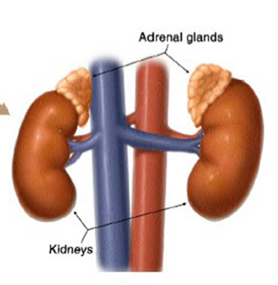
Adrenal disorders
Done by Majdoleen Almasalma
Instructor: Raed Madia
Internal medicine rotation
9th of Jan 2021

Slide 2
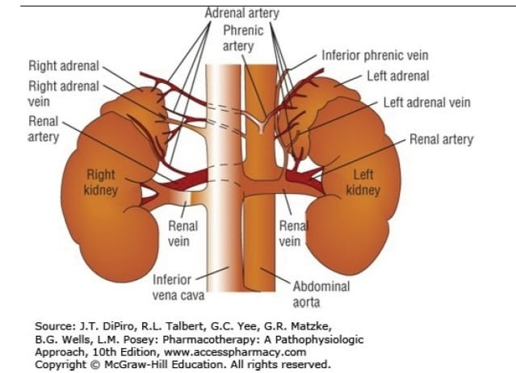
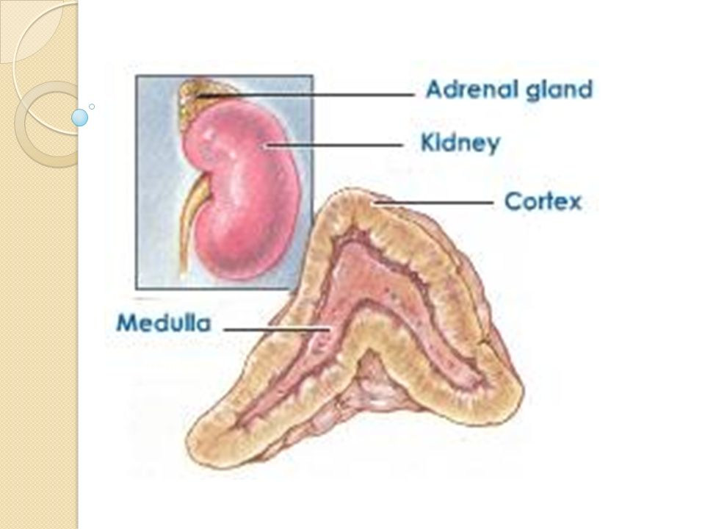
Adrenal Glands
The adrenal glands are located extra peritoneally to the upper poles of each kidney
The adrenal medulla occupies 10% of the total gland and is responsible for the secretion of catecholamines. The adrenal cortex accounts for the remaining 90% and is responsible for the secretion of three types of hormones from three separate zones.

Slide 3
Adrenal cortex zones
The zona glomerulosa (15%) ➔ mineralocorticoid production➔ aldosterone is the principal end-product.
The zona fasciculata (60%)➔ is high in cholesterol➔ responsible for basal and stimulated glucocorticoid production.
The zona reticularis (25%)➔ adrenal androgens production (testosterone and estradiol)

Slide 4
Adrenal cortex zones

Slide 5
Adrenal Hormones function
Mineralocorticoids ➔mainly Aldosterone (steroid hormone) maintains electrolyte and volume homeostasis by altering potassium and magnesium secretion and renal tubular sodium reabsorption.
Glucocorticoids, mainly cortisol, are responsible for the regulation of fat, carbohydrate, and protein metabolism.
Androgens influence the reproductive system in addition to modulating primary and secondary sex characteristics.

Slide 6
Regulation of hormone secretion
Glucocorticoid secretion is regulated by the pituitary hormone, adrenocorticotropic hormone (ACTH).
Under normal conditions, ACTH is released from the anterior pituitary in response to corticotropin-releasing hormone (CRH), which is secreted from hypothalamus.
Vasopressin and oxytocin have weak ACTH-releasing activity through binding to the inferior V3 receptor (in the Pituitary).
CRH, in combination with vasopressin and oxytocin, stimulates greater ACTH secretion than each hormone individually.

Slide 7
Negative feedback system involved in the regulation of cortisol secretion under normal conditions

Slide 8
Regulation of hormone secretion
Androgen regulation: When plasma androgen reaches sufficient concentrations, production is terminated via a negative feedback loop.
Other factors:
➔ Androgen release is increased during puberty and in women with hirsutism.
➔ Adrenal androgen release decreases with age and in fasting states, including anorexia nervosa.

Slide 9
Regulation of hormone secretion
Aldosterone secretion: The renin–angiotensin system regulates aldosterone secretion through both intrarenal and extrarenal mechanisms.
Renin production and subsequent aldosterone secretion is stimulated by blood pressure lowering (due to volume depletion), erect posture, salt depletion, β-adrenergic stimulation, and CNS excitation.
Renin production is inhibited by salt loading, angiotensin II, vasopressin, potassium, calcium, blood pressure increases, and a variety of drugs.
Following aldosterone secretion, increases in renal sodium and water retention as well as blood pressure occur, thereby turning off the stimulus for renin release.

Slide 10
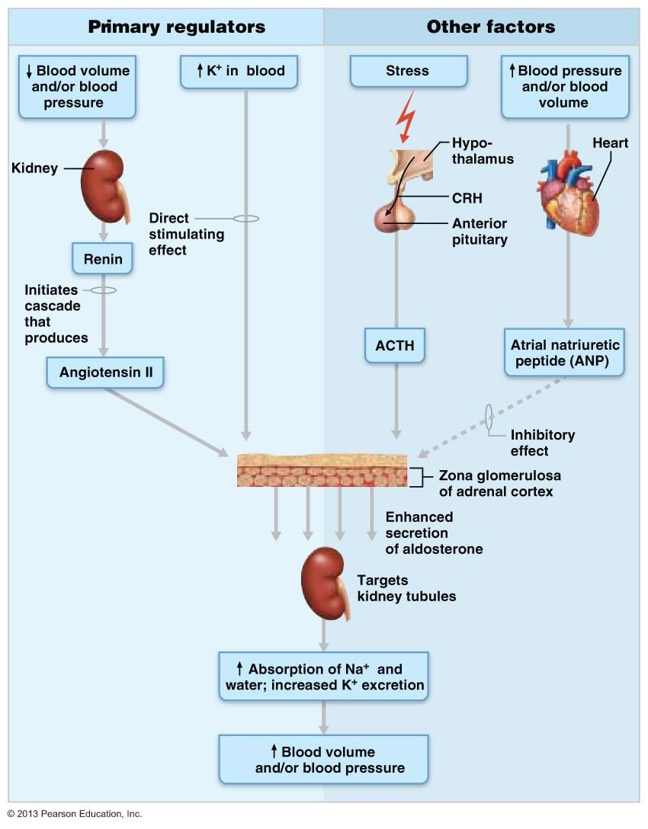
Aldosterone secretion

Slide 11
Hyperfunction of the adrenal gland
Cushing’s syndrome
Hyperaldosteronism

Slide 12
Cushing’s syndrome
Cushing syndrome is caused by supraphysiologic glucocorticoid levels originating from either exogenous administration or endogenous overproduction by the adrenal gland
Excess glucocorticoids are produced in response to overproduction of ACTH (ACTH-dependent) or by abnormal adrenocortical tissues regardless of ACTH stimulation (ACTH-independent) including adrenal adenomas and adrenal carcinomas.

Slide 13
Etiology of Cushing's syndrome
1- ACTH-dependent Cushing syndrome (80% of all Cushing syndrome cases) is usually caused by overproduction of ACTH by the pituitary gland, causing adrenal hyperplasia.
➔ 85% of these cases ➔ Pituitary adenomas ➔ Cushing disease.
➔ remaining 20% of ACTH-dependent cases ➔ Ectopic ACTH-secreting tumors and nonneoplastic corticotropin hypersecretion
** Ectopic ACTH syndrome refers to excessive ACTH production resulting from an endocrine or nonendocrine tumor, usually of the pancreas, thyroid, or lung (eg, small cell lung cancer).
2- ACTH-independent Cushing syndrome is usually caused by adrenal adenomas and carcinomas.

Slide 14
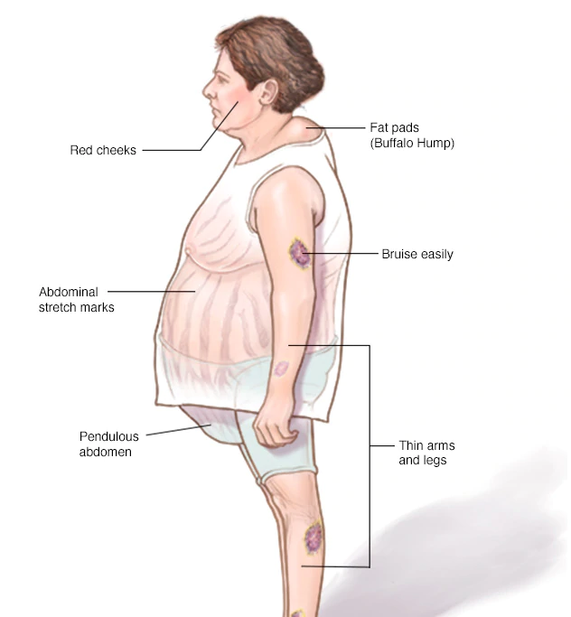
Signs and Symptoms of Cushing’s syndrome
The most common findings are central obesity and facial rounding
myopathies and muscular weakness
Peripheral obesity and fat accumulation
Visible skin changes like Hump
Hypertension.
Psychiatric changes .
Approximately 50% to 60% of patients will develop Cushing syndrome–induced osteoporosis. Of these, 40% will present with back pain and 20% will progress to compression fractures of the spine.
Gonadal dysfunction is common with amenorrhea seen in females.
Excess adrenal and ovary androgen secretion is responsible for females presenting with hirsutism.

Slide 15
Diagnosis of Cushing syndrome
Lab tests to establish the presence of hypercortisolism (using one or more of the following):
1- midnight plasma cortisol: a midnight serum cortisol greater than 7.5 μg/dL (>1.8 μg/dL if the patient is sleeping) is a highly sensitive assay for Cushing syndrome.
* In healthy individuals, cortisol release follows a circadian rhythm ➔ serum cortisol concentration peaks around 8:00 am ➔ declines by 60% to 80%, reaching a nadir between 3:00 and 4:00 am.
* This rhythm is lost in the patient with Cushing syndrome.
Limitations ➔ this test is rarely recommended because it requires that patients be admitted for more than 48 hours to avoid false-positive responses secondary to the stress of hospitalization
2- late-night salivary cortisol: it is highly correlated with free serum cortisol and independent of salivary flow rates, it reflects changes in serum cortisol within minutes. (levels greater than 550 ng/dl ➔ Cushing).

Slide 16
Diagnosis of Cushing syndrome
3- 24-hour urinary free cortisol (UFC) : measures only unbound cortisol, Normal reference values for UFC are 20 to 90 μg per 24-hour period. Values of twofold to threefold greater than the upper limit of normal urine cortisol suggest hyperfunction in adrenal glands.
Limitations➔ Starvation, hydration from water loading (≥5 L/day), alcoholism, and acute stress are all capable of elevating urine cortisol concentrations. Likewise, elevated UFC results can occur during therapy with topical steroids, carbamazepine, and fenofibrate depending on the type of UFC test. Conversely, renal impairment (creatinine clearance [CrCl] of <60 mL/min) can falsely lower UFC concentrations
4- low-dose dexamethasone suppression test (DST) using 1 mg dexamethasone for the
overnight test or 0.5 mg/6 h for the classic 2-day study)
➔ 1 mg of dexamethasone is administered at 11:00 pm. The following morning at 8:00 am fasting plasma cortisol is obtained for analysis. This supraphysiologic dose of dexamethasone suppresses ACTH stimulation and cortisol production in healthy individuals, but in cushing negative feedback is disrupted ➔ morning cortisol concentration above 5 μg/dL).

Slide 17
Treatment of Cushing's Syndrome
The treatment of choice for both ACTH-dependent and ACTH-independent Cushing syndrome is surgical resection of any offending tumors
secondary pharmacologic treatment ➔
- for patients who are not surgical candidates,
- for preoperative patients,
or as adjunctive therapy in postoperative patients awaiting response.
Or monotherapy is used as a palliative treatment when surgery is not indicated (rarely).

Slide 18
Pharmacologic treatment for Cushing Syndrome
Steroidogenesis inhibitors
Adrenolytic agents
Neuromodulators of ACTH release
Glucocorticoid-receptor blocking agents.

Slide 19
Steroidogenesis inhibitors
1- Metyrapone: MOA ➔ it inhibits 11 β-hydroxylase, thereby inhibiting cortisol synthesis. It has a quick onset of action.
Initial dose 0.5-1 g/day, divided every 4-6 hours, usual range ➔ 1-2 g/day, Divided every 4-6 hours
S/Es ➔ Hypertension, acne, and hirsutism. Nausea, vomiting, vertigo, headache, dizziness, abdominal discomfort, and allergic rash. ( caused by initial increase in plasma ACTH concentrations because of a sudden drop in cortisol which result in increase of androgenic and mineralocorticoid Hormones).
CYP3A4 inducer

Slide 20
Steroidogenesis inhibitors
2- Ketoconazole: MOA ➔ inhibits cytochrome P-450 enzymes, including 11 β-hydroxylase and 17 α-hydroxylase, It also has antiandrogenic activity, which may be beneficial in women but can cause gynecomastia and hypogonadism in men. The benefits of ketoconazole therapy are achieved only after several weeks of therapy.
Initial dose: 200mg once to twice daily, usual range ➔ 200-1,200 mg/day, Divided twice a day. Maximum: 1,600 mg/day. (CYP3A4 substrate and inhibitor).
S/Es ➔ reversible elevation of hepatic transaminases, GI discomfort, and dermatologic reactions.
C/I ➔ with hepatic disease.
Monitoring ➔ monitoring should include liver function tests at baseline followed by weekly monitoring of serum ALT throughout therapy.
Concomitant use with Metyrapone give synergistic reduction in cortisol levels; in addition to antagonism effect of the androgenic actions caused by Metyrapone.

Slide 21
Steroidogenesis inhibitors
Etomidate: is an imidazole derivative like ketoconazole that inhibits 11 β- hydroxylase, In addition to Inhibition of aldosterone synthase and antiproliferative effects on adrenal cortical cells.
It is only available in a parenteral formulation ➔ limited to patients with acute hypercortisolemia requiring emergency treatment or in preparation for surgery
Low doses of etomidate are often sufficient to suppress cortisol synthesis, The initial dose is 0.03 mg/kg by IV bolus followed by a continuous infusion of 0.1 to 0.3 mg/kg/h.
Monitoring is recommended to avoid excess sedation with this agent. Frequent monitoring of serum cortisol is also advised to prevent hypocortisolemia.

Slide 22
Adrenolytic agents
Mitotane:
MOA➔ is a cytotoxic drug that inhibits the 11-hydroxylation of 11-deoxycortisol and 11-desoxycorticosterone in the adrenal cortex, reducing synthesis of cortisol and corticosterone. Beneficial effects take weeks to months to exert.
Initial dose :0.5-1 g/day, increased by 0.5-1 g/day every 1-4 weeks,(maintenance ➔ 1-4 g/day).
S/Es ➔ May cause significant neurologic and GI side effects, and patients should be monitored carefully or hospitalized when initiating therapy.
➔ Nausea and diarrhea are common at doses greater than 2 g/day and can be avoided by gradually increasing the dose and/or administering it with food.
Lethargy, somnolence, and other CNS effects are also common.
Reversible hypercholesterolemia and prolonged bleeding times can occur.

Slide 23
Neuromodulators of ACTH release
Cyproheptadine ➔ a nonselective serotonin receptor antagonist and anticholinergic drug, can decrease ACTH secretion in some patients with Cushing disease.
S/Es ➔ sedation and weight gain significantly limit its use.
Pasireotide (Signifor Soln) is a somatostatin analogue that activates somatostatin receptors, thereby inhibiting ACTH secretion, leading to decreased cortisol secretion.
It is approved for treatment of adults with Cushing disease for whom pituitary surgery is not an option or has not been curative.
Initial dose: 0.6-0.9 mg twice daily, maintenance➔ 0.3-0.9 mg twice daily
Reduce dose in hepatic impairment

Slide 24
Glucocorticoid-receptor blocking agents
Mifepristone : is a potent progesterone- and glucocorticoid-receptor antagonist, it inhibits dexamethasone suppression and increases endogenous cortisol and ACTH levels in normal subjects.
It’s highly effective in reversing the manifestations of hypercortisolism (hyperglycemia, hypertension, and weight gain).
It is FDA approved for treatment of endogenous Cushing’s syndrome in patients who have type 2 diabetes or glucose intolerance and who are not eligible for, or have had poor response to, surgery.
S/E s ➔ include fatigue, nausea, headache, arthralgia, peripheral edema, endometrial thickening (with or without vaginal bleeding), and Hypokalemia.

Slide 25
Hyperaldosteronism
Excess Aldosterone secretion :
Primary hyperaldosteronism is usually caused by bilateral adrenal hyperplasia and aldosterone-producing adenoma (Conn’s syndrome).
Secondary hyperaldosteronism results from excessive stimulation of the zona glomerulosa by an extra-adrenal factor, usually the renin–angiotensin system.
Other factors include ➔ excessive potassium intake, oral contraceptives, pregnancy, and menses. Heart failure, cirrhosis, renal artery stenosis, and Bartter syndrome also can lead to elevated aldosterone concentrations.

Slide 26
CLINICAL PRESENTATION for Hyperaldosteronism
Symptoms ➔ muscle weakness, fatigue, paresthesias, headache, polydipsia, and nocturnal polyuria.
Signs ➔ hypertension and tetany/paralysis.
Laboratory findings ➔
1- suppressed renin activity
2- elevated plasma aldosterone
3- hypernatremia (>142 mEq/L), hypokalemia, hypomagnesemia, elevated serum bicarbonate (>31 mEq/L), and glucose intolerance
Lab test ➔ the plasma-aldosterone-concentration–to–plasma-reninactivity (PAC-to-PRA) ratio ➔ elevated ratio is highly suggestive of primary hyperaldosteronism

Slide 27
Pharmacologic therapy
Spironolactone (Aldactone) is a nonselective aldosterone receptor antagonist.
The initial dose is 25 mg once daily titrated upward at 4- to 8-week intervals. Most patients respond to doses between 25 and 400 mg/day given in single or divided doses.
S/es➔ GI discomfort, impotence, gynecomastia, menstrual irregularities, and hyperkalemia.
Eplerenone is a selective aldosterone receptor antagonist with high affinity for aldosterone receptors and low affinity for androgen and progesterone receptors. So , it’s associated with fewer sex-steroid–dependent effects than spironolactone.
Dosing starts at 50 mg daily, with titration at 4- to 8-week intervals to 50 mg twice a day; some patients may require total daily doses as high as 200 to 300 mg.

Slide 28
Pharmacologic therapy
Amiloride a potassium-sparing diuretic, is less effective than spironolactone, and patients often require additional therapy to adequately control blood pressure.
The initial dose is 5 mg twice daily, with a usual range of 20 mg/day given in two divided doses; doses up to 30 mg/day may be necessary.
Monitor for serum Cr, serum K, BP ( Amiloride, spironolactone, eplerenone)
Additional second-line options include calcium channel blockers, ACE inhibitors, and diuretics such as chlorthalidone, although all of these lack outcome data.

Slide 29
Hypofunction of the adrenal gland
Addison disease, or Primary adrenal insufficiency
Secondary adrenal insufficiency

Slide 30
Primary adrenal insufficiency.
Or Addison disease
Pathophysiology ➔ destruction of all regions of the adrenal cortex.
Associated with deficiencies of cortisol, aldosterone, and the androgens, while levels of CRH and ACTH increase in a compensatory manner.
Etiology ➔ Autoimmune dysfunction is responsible for 80% to 90% of cases in developed countries, whereas tuberculosis is the predominant cause in developing countries.
Or Medications that inhibit cortisol synthesis (eg, ketoconazole) or accelerate cortisol metabolism (eg, phenytoin, rifampin, and phenobarbital)

Slide 31
Secondary adrenal insufficiency.
Secondary adrenal insufficiency commonly results from exogenous corticosteroid use, leading to suppression of the hypothalamic-pituitary-adrenal axis and decreased ACTH release, resulting in impaired androgen and cortisol production.
Medications ➔ Mirtazapine and progestins (eg, medroxyprogesterone acetate and megestrol acetate)
➔ Secondary disease typically presents with normal mineralocorticoid concentrations ( normal aldosterone).

Slide 32
Signs and Symptoms
Symptoms ➔
Weakness, weight loss, GI symptoms, salt craving, headaches, memory impairment, depression, and postural dizziness.
Signs ➔
Increased skin pigmentation, postural hypotension, fever, decreased body hair, vitiligo, amenorrhea, and cold intolerance.
Laboratory Tests➔
The short cosyntropin stimulation test, Patients are given 250 μg of synthetic ACTH IV or intramuscularly, with serum cortisol measured at baseline and 30 to 60 minutes after the injection. ➔ cortisol concentration ≥18 μg/dL rules out adrenal insufficiency.
Other Diagnostic Tests ➔
Other tests include the insulin hypoglycemia test, the metyrapone test, and the CRH stimulation test.

Slide 33
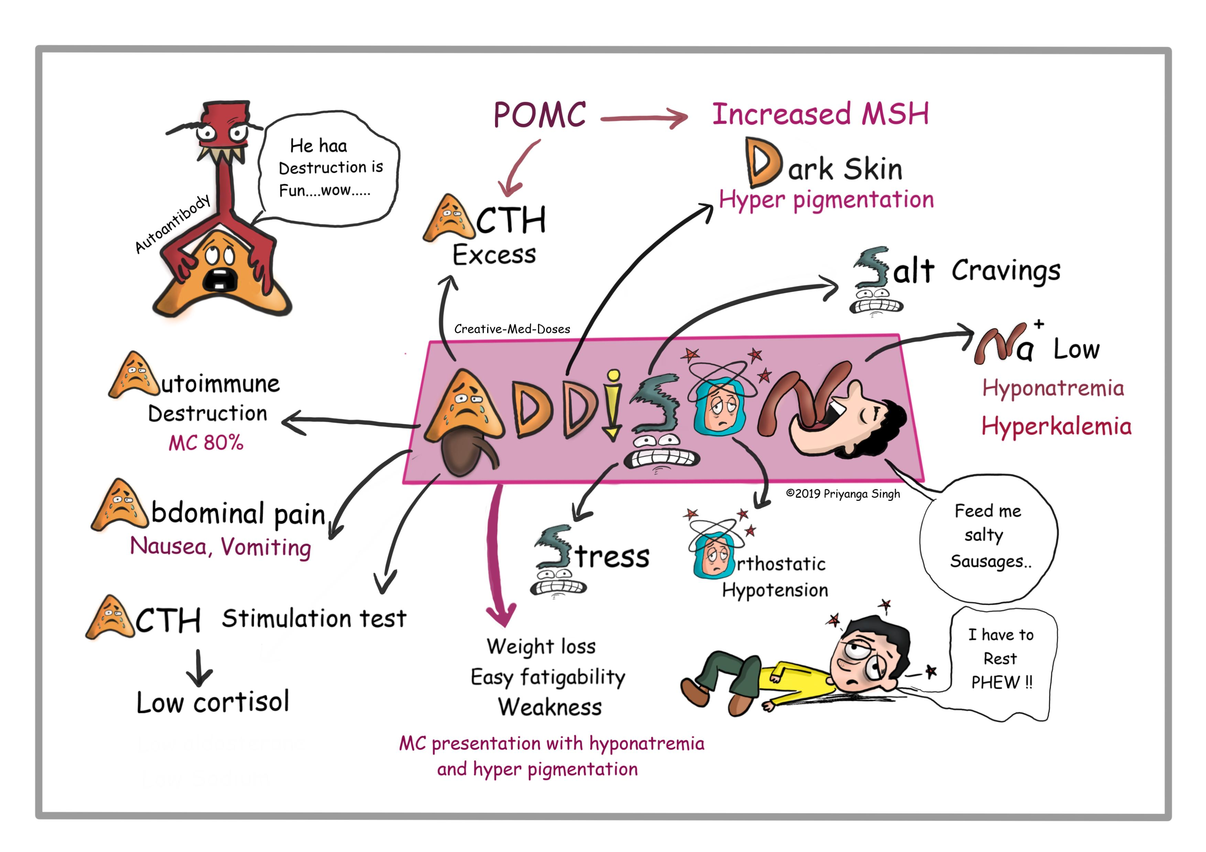

Slide 34
Pharmacologic Treatment
Corticosteroids
Hydrocortisone, cortisone, and prednisone are the glucocorticoids of choice,
Administration➔ twice daily at the lowest effective dose, recommended starting total daily doses are hydrocortisone 15 to 25 mg daily, which is approximately equivalent to cortisone acetate 25 to 37.5 mg, or prednisone 2.5 mg
Two thirds of the dose is given in the morning, and one third is given 6 to 8 hours later.
Monitoring of patient’s symptoms ➔ every 6 to 8 weeks to assess proper glucocorticoid replacement.

Slide 35
Pharmacologic Treatment
In primary adrenal insufficiency ➔
fludrocortisone acetate 0.05 to 0.2 mg orally once daily can be used to replace mineralocorticoid loss.
If parenteral therapy is needed, 2 to 5 mg of deoxycorticosterone trimethylacetate in oil can be administered intramuscularly every 3 to 4 weeks. The major reason for adding the mineralocorticoid is to minimize development of hyperkalemia.
Treatment of secondary adrenal insufficiency is identical to primary disease treatment, with the exception that mineralocorticoid replacement is usually not necessary.

Slide 36
Acute adrenal insufficiency
Adrenal crisis, or Addisonian crisis, is characterized by an acute adrenocortical insufficiency (endocrine emergency)
Causes ➔ Stressful situations, surgery, infection, and trauma especially in the patient with some underlying adrenal or pituitary insufficiency.
Most common cause ➔ is HPA-axis suppression brought on by abrupt withdrawal of chronic glucocorticoid use.

Slide 37
Acute adrenal insufficiency
Because most adrenal crises occur because of glucocorticoid dose reductions or lack of stress-related dose adjustments, patients receiving corticosteroid replacement therapy should add 5 to 10 mg hydrocortisone (or equivalent) to their normal daily regimen shortly before strenuous activities, such as exercise. During times of severe physical stress (eg, febrile illnesses and after accidents), patients should be instructed to double their daily dose until recovery.

Slide 38
Treatment of Acute adrenal insufficiency
1- Hydrocortisone (DOC➔ combined glucocorticoid and mineralocorticoid activity).
Administration ➔ given parenterally
The starting dose is 100 mg IV by rapid infusion, followed by a continuous infusion (usually 10 mg/h) or intermittent bolus of 100 to 200 mg every 24 hours. IV administration is continued for 24 to 48 hours. If the patient is stable at that time, oral hydrocortisone can be started at a dose of 50 mg every 6 to 8 hours, followed by tapering to the individual’s chronic replacement needs.
2- Fluid replacement
IV dextrose 5% in normal saline solution at a rate to support blood pressure.

Slide 39
PRINCIPLES OF GLUCOCORTICOID ADMINISTRATION
Adverse effects ➔ systemic steroids can lead to increased susceptibility to infection, osteoporosis, sodium retention with resultant edema, hypokalemia, hypomagnesemia, cataracts, peptic ulcer disease, seizures, and generalized suppression of the HPA axis.

Slide 40
PRINCIPLES OF GLUCOCORTICOID ADMINISTRATION
steroid administration at a high dose for long periods of time causes suppression of the HPA axis.
Symptoms of steroid withdrawal are similar to adrenocortical deficiency.
patients who have been on long-term steroid therapy will need to be gradually withdrawn toward physiologic doses over months.
the normal adult produces approximately 10 to 30 mg of cortisol per day with the peak concentration occurring around 8:00 am.
A normal morning serum cortisol (>20 μg/dL) or a normal ACTH test indicates that daily steroid maintenance therapy may be discontinued. A morning cortisol less than 3 μg/dL indicates axis suppression and the need for continued replacement therapy

Slide 41
PRINCIPLES OF GLUCOCORTICOID ADMINISTRATION
Alternate-day therapy (ADT) regimens are indicated to decrease the impact of prolonged steroid administration, But are not recommended in initial treatment management, but rather in the management of the stabilized patient who needs long-term therapy.
“On” & “Off” days
the “on” day dose gradually increased corresponding with a dose-reduction in the “off” day dose over a period of 14 days.
➔ After 2 weeks, no medication is taken on “off” days.
Note: Not all patients will have equivalent disease control on ADT, and it should be avoided in certain indications

Slide 42
Relative Potencies of glucocorticoids

Slide 43
Monitoring of Glucocorticoids treatment
Monitoring Glucose concentrations (serum and urine)
Electrolytes (serum and urine)
Ophthalmologic examinations
Stool tests for occult blood loss
Growth and development (children and adolescents)

Slide 44
Counseling
Counseling Take with food to minimize GI discomfort
Never discontinue medication on your own; check with your physician; gradual dose reduction is usually necessary
Carry or wear medical identification indicating that you are on long-term glucocorticoid therapy
Dosage increases can be necessary at times of increased stress (surgery or emergency treatments)
Be aware of potential side effects (ie, visual disturbances, thin skin ➔ bruising)
What to do if you miss a dose ??? If your dosing schedule is:
Every other day: Take as soon as possible if remembered that morning. If not remembered until later, skip that day. Take the next morning, and then skip the following day
Every day: Take as soon as possible but skip if almost time for the next dose. Never double doses

