Slide 1
Constipation
Ala’ badwan 1142403
Dr.raed madia

Slide 2
Constipation:
difficult or infrequent passage of stool, at times associated with straining or a feeling of incomplete defecation
most commonly fewer than three bowel movements per week
The condition is considered chronic if symptoms last for at least 3 months
Constipation is more common in women and the elderly

Slide 3
Pathophysiology
Constipation may be:
Primary(idiopathic): occurs without an identifiable underlying cause
- Normal transit
- Slow transit
- Pelvic floor dysfunction, or disordered defecation
Secondary: may be the result of constipating drugs, lifestyle factors, or medical disorders
Notes:
anticholinergic agents, chronic comorbidities, decreased fluid and/or fiber intake, Physiologic changes & diminished physical activity

Slide 4
Possible Causes of Constipation:
GI disorders
Metabolic and endocrine disorders
Cardiac disorders
Pregnancy
Neurogenic causes
Psychogenic causes
Lifestyle factors
Drug induced, that inhibit the neurologic or muscular function of the GI tract.
Notes:
dose dependent, with larger doses causing constipation more frequently

Slide 5
Drugs Causing Constipation
Analgesics
Opiates
Anticholinergics
Antihistamines
Antiparkinsonian agents
Phenothiazines
Tricyclic antidepressants
Antacids containing calcium carbonate or aluminum hydroxide
Diuretics (non–potassium-sparing)
Nonsteroidal antiinflammatory agents

Slide 6
Signs and symptoms
Infrequent bowel movements (<3 per week)
Stools that are hard, small, or dry
Difficulty or pain of defecation
Feeling of abdominal discomfort or bloating, incomplete evacuation

Slide 7
Alarm signs and symptoms
Hematochezia
Melena
Family history of colon cancer
Family history of inflammatory bowel disease
Anemia
Weight loss
Anorexia
Nausea and vomiting
Severe, persistent constipation that is refractory to treatment
New-onset or worsening constipation in elderly without evidence of primary cause

Slide 8
Physical examination
Perform rectal exam for presence of anatomical abnormalities (such as fistulas, fissures, hemorrhoids, rectal prolapse) or abnormalities of perianal descent.
Digital examination of rectum to check for fecal impaction, anal stricture, or rectal mass.

Slide 9
Laboratory and other diagnostic tests
In patients with alarm signs and symptoms or when structural disease is a possibility, select appropriate diagnostic studies:
  Protoscopy
  Sigmoidoscopy
  Colonoscopy
  Barium enema(X-ray exam that can detect changes or abnormalities in the large intestine)
Thyroid function tests, electrolytes, glucose, complete blood count

Slide 10
TREATMENT
Desired Outcome:
relieve symptoms
reestablish normal bowel habits
improve quality of life by minimizing adverse effects of treatment

Slide 11
Constipation Treatment Algorithm
Treat specific cause
No underlying diagnosis, then choose symptomatic therapy
  Dietary modification to increase fiber ± supplementation (bulk agents)
  Add Osmotic laxative (ie, PEG); trial 2-4 weeks if no relief
  If no relief add stimulant laxative (ie, bisacodyl)
  If no relief or no BM in 2 days, Lubiprostone or linaclotide trial
  Opioid-receptor antagonists if opioid-induced constipation

Slide 12
Nonpharmacologic Therapy
Dietary Modification: to increase the amount of fiber consumed.
Surgery: the presence of colonic malignancies or GI obstruction
Biofeedback: Patients with constipation due to pelvic floor dysfunction/disordered defecation
Electrical Stimulation: Sacral nerve stimulation

Slide 13
Pharmacologic Therapy
Bulk-Forming Agents:
psyllium hydrophilic colloids, methylcellulose, or polycarbophil
Tablets, powders, or granules
MOA: increase the water content of stool
Onset: 1-3 days
S.E: flatulence, abdominal bloating, and distention.
Consume sufficient fluid

Slide 14
Emollient Laxatives (stool softeners)
Docusate (sodium/calcium/potassium)
MOA: Surfactant agents & increase water and electrolyte secretion in the small and large bowel.
Onset: 1-3 days
Given orally, although docusate potassium has also been used rectally.
Prevention not treatment !
Notes:
in situations in which straining at stool should be avoided, such as after recovery from myocardial infarction (MI), with acute perianal disease, or after rectal surgery.
Not in preventing constipation if major causative factors (eg, heavy opiate use, uncorrected pathology, or inadequate dietary fiber)

Slide 15
Osmotic laxatives:
1. Hyperosmolar Agents (Lactulose and Sorbitol ): Onset: 1-3 days
Lactulose:
Nonabsorbable disaccharide
S.E: flatulence, nausea, and abdominal discomfort or bloating
as an alternative for acute constipation or in patients with an inadequate response to increased dietary fiber and bulking agents
Sorbitol:
Monosaccharide
Cost-effective alternative to lactulose.
It is as effective as lactulose but may cause less nausea and is much less expensive
S.E: flatulence, nausea, and abdominal discomfort or bloating

Slide 16
2. Polyethylene Glycol (PEG):
PEG MOA is osmotic laxative, not absorbed systemically or metabolized by colonic bacteria, so keeps water retention inside the lumen.
Daily use in low dose (17 g) may be safe and effective for up to 6 months
S.E: GI-related (nausea, vomiting, flatulence, and abdominal cramping)
PEG solutions with electrolytes are used as bowl cleansing regimens prior to GI-related procedures, and should not be used routinely for treatment of constipation.
Onset: 1-3 days

Slide 17
3. Glycerin:
MOA: osmotic laxative
is usually administered as a suppository and exerts its effect by osmotic action in the rectum
the onset of action is usually less than 30 minutes
S.E: rectal irritation.
Intermittent basis for constipation or fecal impaction, particularly in children

Slide 18
Saline cathartics:
Onset of action: 1-6 hours
Mg hydroxide, phosphate, sulfate high dose and citrate
Sodium phosphate
Should not be used on a routine basis (prior to diagnostic procedures )
SE: fluid and electrolyte depletion & magnesium or sodium accumulation in renal dysfunction or congestive heart failure.

Slide 19
Stimulant laxatives:
diphenylmethane (bisacodyl)
anthraquinone (senna )
Onset of action: 8-12 hours
MOA: stimulate the mucosal nerve plexus of the colon
S.E: abdominal cramping and electrolyte imbalances (particularly with chronic use).
not recommended as first-line treatment
Notes:
The long-term use of stimulant laxatives is controversial. Newer studies do not report damage to the enteric nervous system like earlier studies. Nerve damage may actually be the cause of the constipation rather than the result of using laxatives.

Slide 20
Intestinal Secretagogues
Lubiprostone:
MOA: is a chloride channel activator
Used for chronic idiopathic constipation in adult & constipation-predominant irritable bowel syndrome (IBS-C)
safe and effective for long-term treatment (up to 48 weeks).
Onset of action: 24 to 48 hours
S.E: nausea, headache, and diarrhea and may be dose dependent.

Slide 21
Linaclotide
MOA: increases intestinal fluid secretion and quickens intestinal motility.
Only the 145 mcg dose is approved for treatment of constipation due to the lack of improved efficacy with the higher dosing.
S.E: Diarrhea, flatulence and abdominal pain.
C/I under the age of 18

Slide 22
Opioid Receptor Antagonists
1- Alvimopan
MOA: oral GI-specific μ-opioid antagonist (not cross the blood–brain barrier)
Need hospitalization
Contraindicated in patients receiving therapeutic doses of opioids for more than 7 consecutive days prior to surgery
Dosing : 12 mg capsule administered 30 minutes to 5 hours before surgery and then 12 mg twice daily for up to 7 days or until discharge (maximum of 15 doses)
Notes:
approved for short-term use in hospitalized patients to accelerate recovery of bowel function after large or small bowel resection

Slide 23
2- Methylnaltrexone
MOA: μ-receptor antagonist (palliative care or when response to laxative therapy has been insufficient)
Not cross the blood–brain barrier
Dosing: weight-based dose SQ, usually every other day (no more than once daily)
Contraindicated in patients with known or suspected GI obstruction.

Slide 24
3- Naloxegol:
Oral pegylated naloxone molecule, antagonizes the μ-receptor
Dosing: 25 mg by mouth once daily, 1 hour before or 2 hours after a meal.
The dose should be reduced by half in patients with diminished renal function (CrCl <60 mL/min) or in those unable to tolerate 25 mg.
S.E: abdominal pain, diarrhea, and nausea.

Slide 25
Other Agents
Prucalopride:
MOA: (5-HT₄) receptor agonist
It demonstrates proenterokinetic effects (increased colonic motility and transit)
Probiotics

Slide 26
Prevention
Bulk-forming laxatives and docusates should be the first line of prevention.
1- For patients recovering from MI or rectal surgery, straining at defecation should be avoided.
2- In pregnant patients, constipation may result because of alterations in hormones or iron supplementation.

Slide 27
Diarrhea

Slide 28
Diarrhea
Diarrhea is an increased frequency and decreased consistency of fecal discharge as compared with an individual’s normal bowel pattern.
Is often a symptom of a systemic disease
Types of diarrhea:
Acute diarrhea: less than 14 days
Persistent (subacute)diarrhea: more than 14 days
chronic diarrhea: more than 30 days
Notes:
Diarrhea may be associated with a specific disease of the intestines or secondary to a disease outside the intestines

Slide 29
Etiology
Most cases of acute diarrhea are caused by infections (generally self-limited)
Mainly caused by:
Shigella, Salmonella, Campylobacter, Staphylococcus, and Escherichia coli
Norwalk and rotavirus groups

Slide 30
Other causes:
Malabsorption syndromes
lactose intolerance
administration of divalent ions (eg, magnesium-containing antacids)
consumption of poorly soluble carbohydrate .
Inflammatory diseases of the GI tract .
Altered intestinal motility

Slide 31
Pathophysiology
Disrupt water and electrolyte balance

Slide 32
Signs and symptoms
Abrupt onset of nausea, vomiting, abdominal pain, headache, fever, chills.
Frequent non bloody Bowel movements and diarrhea lasts 12-60 hours
In chronic diarrhea, a history of previous bouts, weight loss, anorexia, and chronic weakness are important findings

Slide 33
Laboratory tests
Stool analysis (microorganisms, blood, mucus, fat, osmolality, pH, electrolyte and mineral concentration, and cultures)
Stool test kits (GI viruses, particularly rotavirus)
Antibody serologic test (not practical and is nonspecific)
Total daily stool volume is also determined
Endoscopy and biopsy
Radiographic (neoplastic and inflammatory conditions)

Slide 34
Drugs Causing Diarrhea
Laxatives
Antacids containing magnesium
Antineoplastics
Antibiotics
Antihypertensives
Angiotensin-converting enzyme inhibitors
Cholinergics
Cardiac agents
Nonsteroidal antiinflammatory drugs
Misoprostol
Colchicine
Proton pump inhibitors
H₂-receptor blockers

Slide 35
Prevention of diarrhea
Isolation techniques and environmental hygiene practices
controlling the primary condition
Antibiotics and bismuth subsalicylate are advocated to prevent traveler’s diarrhea

Slide 36
Treatment

Slide 37
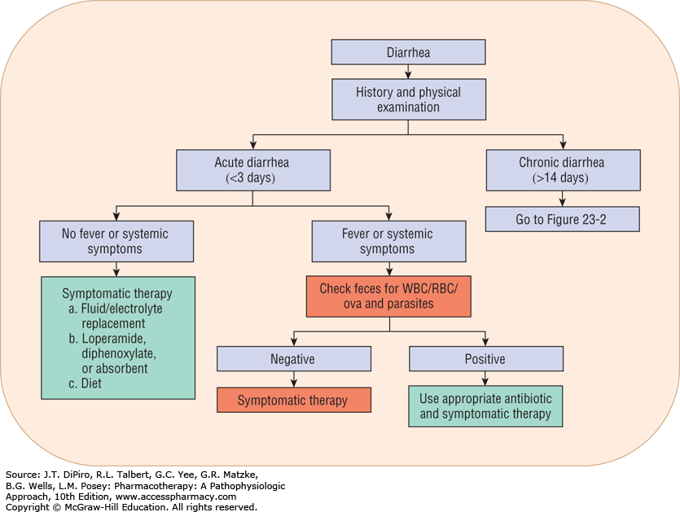

Slide 38
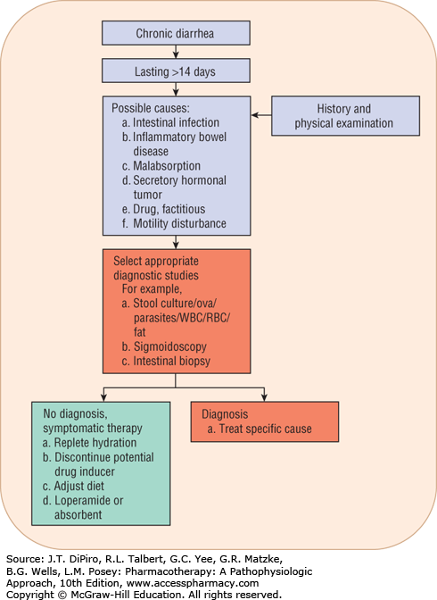
Notes:
Clinicians must clearly understand that diarrhea, like a cough, may be a body defense mechanism for ridding itself of harmful substances or pathogens. The correct therapeutic response is not necessarily to stop diarrhea at all costs.

Slide 39
Nonpharmacologic Management:
Dietary management:
Avoid solid foods and dairy products for 24 hours in patients with acute diarrhea
Rehydration: Correction & maintenance
Oral solutions are strongly recommended
Use IV fluids to correct fluid and electrolyte deficits in severe dehydration
Home oral rehydration therapy: 6 sugar spoons + 0.5 salt spoon in 1 liter of water
Notes:
A separate oral supplement of zinc 20 mg daily for 10 days in addition to ORS significantly reduces the severity and duration of acute diarrhea in developing countries

Slide 40
Pharmacologic Therapy
Antimotility agents
Adsorbents
Antisecretory compounds
Antibiotics
Enzymes
Intestinal microflora.

Slide 41
Opiates and Their Derivatives (Antimotilities)
MOA: delay the transit of intraluminal contents or increase gut capacity, prolonging contact and absorption.
addiction potential (a real concern with long-term use) and worsening of diarrhea in selected infectious diarrhea.
Notes:
Enkephalins, which are endogenous opioid substances, regulate fluid movement across the mucosa by stimulating absorptive processes.

Slide 42
1- Loperamide:
MOA: inhibits the calcium-binding protein calmodulin, controlling chloride secretion.
DF: 2 mg capsules or 1 mg/5 mL solution
Dosing: initially 4 mg orally, followed by 2 mg after each loose stool, up to 16 mg/day.
Acute, chronic diarrhea & traveler’s diarrhea.
Acts only peripherally.
S/E: dizziness and constipation.
If the diarrhea is concurrent with a high fever or bloody stool or/and lasting 48 hours beyond initiating loperamide the patient should be referred to a physician.

Slide 43
2- Diphenoxylate:
DF: 2.5 mg tablet and as a 2.5 mg/5 mL solution.
Dosing: 2.5 to 5 mg three or four times daily, not to exceed a 20 mg total daily
Atropine (0.025 mg) is included in the product to discourage abuse.
S.E: rarely toxic but some patients may complain of atropinism (blurred vision, dry mouth, and urinary hesitancy)
it should not be used in patients who are at risk of bacterial enteritis with E. coli, Shigella, or Salmonella

Slide 44
3- Difenoxin:
Combined with atropine and has the same uses, precautions, and side effects.
DF: 1 mg tablet
Dosing: 2 mg initially, followed by 1 mg after each loose stool, not to exceed 8 mg/day
4- Paregoric:
It is not widely prescribed today because of its abuse potential

Slide 45
Adsorbents
Polycarbophil:
MOA: nonspecific in their action; they adsorb nutrients, toxins, drugs, and digestive juices
Treat both diarrhea and constipation
DF: 500 mg chewable tablet.
Dosing: four times daily, up to 6 g/day in adults.

Slide 46
Antisecretory Agents
1- Bismuth subsalicylate:
MOA: antisecretory, antiinflammatory, and antibacterial effects
For indigestion, abdominal cramps, and diarrhea (traveler’s diarrhea)
Dosing: two tablets or 30 mL every 30 minutes to 1 hour up to eight doses per day
S.E:
darkening of the tongue and stools with repeat administration.
Salicylate can induce gout attacks in susceptible individuals.
Salicylate intx with anticoagulants or may produce salicylism (tinnitus, nausea, and vomiting).
Bismuth reduces tetracycline absorption
Notes:
Chewable tablets, Liquid,suspension(treatment

Slide 47
2- Octreotide:
MOA: analog of endogenous somatostatin; blocks the release of 5-HT administered by injection
Treatment of carcinoid tumors and other peptide-secreting tumors, dumping syndrome, and chemotherapy-induced diarrhea.
S.E: nausea, diarrhea, abdominal pain, steatorrhea (high dose) and cholelithiasis (prolong use)

Slide 48
Miscellaneous Products
Probiotics: replace colonic microflora.
Anticholinergic drugs: such as atropine block vagal tone and prolong gut transit time.
Lactase enzyme: in diarrhea secondary to lactose intolerance.
Notes:
Lactase is required for carbohydrate digestion. When a patient lacks this enzyme, eating dairy products causes an osmotic diarrhea.

Slide 49
Acute Diarrhea
Mild to moderate
Absence of moderate to severe dehydration, high fever, and blood or mucus in the stool
Self-limiting within 3 to 7 days.
Usually managed on an outpatient basis with oral rehydration, symptomatic treatment, and diet
Elderly persons with chronic illness as well as infants may require hospitalization for parenteral rehydration and close monitoring.

Slide 50
Severe diarrhea:
Toxic patients (fever, dehydration, hematochezia, or hypotension)
Require hospitalization (IV fluids and electrolyte administration, and empiric antibiotic therapy while awaiting culture and sensitivity results)

