Slide 1
DIABETES MELLITUS
Shorooq Abu Mushref
1140482

Slide 2
DIABETES
Chronic metabolic disorder associated with hyperglycemia.
Obesity , physical inactivity , smoking and aging are the most common causes for diabetes.
It can be type 1 or 2
Leads to ESRD , non traumatic limb amputation or blindness
Approx 2/3rd of patients die 2/2 CV events

Slide 3
Classifications
Type 1 DM
  Autoimmune
  Absolute Insulin Insufficiency
Type 2 DM
  Progressive Loss of β-cell insulin secretion
  Insulin Resistance
Gestational DM
  Second/Third trimester of pregnancy
  No hx of prior DM
Specific types of DM
  monogenic diabetes syndromes
  diseases of the exocrine pancreas
  drug or chemical-induced diabetes

Slide 4
Type 2 diabetes
Slow and progressive
Caused by diminished insulin secretion ,increase resistance and hormonal irregularities .
Pre diabetes state precede it.
Risk factors : obesity, hx of GD , first degree family history , HTN , HDL<35, Inactivity.
Notes:
IFG 100-125 MG/DL
OGTT 140-199MG/DL
A1C 5.7-6.4%

Slide 5
Clinical presentation
Onset age >30 yrs.
Often asymptomatic .
Cause hyperosmolar hyperglycmic state as acute complication.
Lethargy , polyurea , polydepsia , nocturia.
Cause micro and macrovascular complications.

Slide 6
Prediabetes state :
FPG 100-125mg/dl.
OGTT 140-199mg/dl.
A1C 5.7-6.4%.

Slide 7
Diagnosis
A1c>= 6.5% or FPG>126mg/dl or OGTT>=200mg/dl or random plasma glucose test >=200mg/dl

Slide 8
Prevention of type 2 diabetes
Lifestyle modification
Use of Metformin in pre diabetes patients
Chick blood pressure , eye , A1C , Scr

Slide 9
Treatment goals
Glycemic control :
A1c lower than 7%
A1c <6.5% in patients with long life expectancy no CVD risk or short duration of diabetes.
A1c <8% in elderly, patients with history of hypoglycemia, co morbidity , patients with micro or macro vascular complications.

Slide 10
Goals
Decrease micro and macrovascular complications .
Reduce mortality.
Improve quality of life.

Slide 11
Non pharmacological therapy
Diet control individualized.
Reduce energy intake while maintaining healthful pattern .
Monitor calorie intake.
Physical activity
Surgery

Slide 12
Immunization
Flu vaccine annually.
Pneumococcal vaccine .

Slide 13
Approach to treatment
Initiate naive patients on Metformin.
In non insulin regimen who don’t reach goal add another oral agent or GLP1 or insulin.
Re evaluate after 3 mo.
Initial dual therapy in pts with A1c >=9%.
In newly diagnosed pts with marked symptoms or A1c 10-12 % initiate basal and meal time insulin.

Slide 14
Treatment algorithm
A1c <6.5-7% (diet / consider low dose metformin )
A1c 7.1-9% (diet /initiate metformin)follow up after 3mo if still elevated add additional agent.
A1c 9-9.9% (diet /metformin / additional therapy start dual therapy if initial presentation)
A1c >10% (diet / basal and bolus insulin)
Notes:
BMI .35kg/m2
If pateint has A1c 1-1.5% above normal intiate on dual therapy

Slide 15
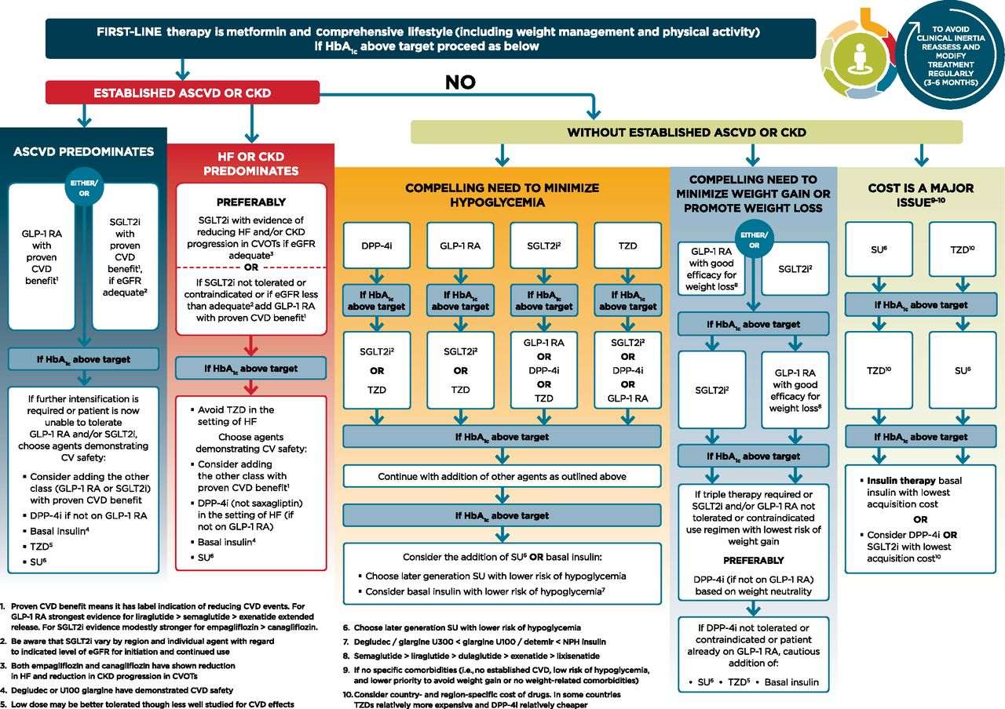

Slide 16
Bigunides
Metformin increase insulin sensitivity in liver and peripheral tissue .
Hypoglycemia is not risk.
Reduce A1c 1.5-2%
Reduce macrovascular complications
Reduce FPG in glucose toxicity
Reduce weight
c/I if CrCL lower than30 ml/min
Cause GI side effects and rarely lactic acidosis and vitamin B12 deficincy.
Notes:
Dose 500mg BID with meals may increase by 500 mg/d weekly until glycemic control or max dose 2500mg/d reached

Slide 17
Sulfonylurea
Glimperide, glipizid, glyburide, glipneclmid.
Enhance insulin secretion by binding to SUR on beta cells.
Metabolized and cleared by renal excretion (needs adjustment).
Reduce A1c by 1.5-2%.
Reduce microvascular complications.
Can cause hypoglycemia, weight gain as side effects
Notes:
Start at low dose for elderly and renal dysfunction patients
Titrate dose every 1-2 wks to the desired effect
All are equally effective at equipotent doses

Slide 18
Non sulfonylurea
Meglitinides (repaglinide/nateglinide)
Bind to receptors on beta cells adjacent to SUR
Increase insulin secretion during meals.
Reduce A1c by 1%
Cause hypoglycemia and weight gain
Notes:
Given 30 min prior to meals

Slide 19
Thiazolidinediones
Rosglitazone / pioglitazone
PPAR agonist in fat and vascular cells
Reduce A1c by 1.5%
Take 3-4mo to see effect
Cause edema and fluid retention , hepatotoxic , weight gain , fractures
Black box warning it can cause heart failure
Notes:
Titrate every 12 wks
May increase risk for bladder cancer

Slide 20
Alph glucosidase inhibtors
Acarbose and miglitol
Reduce postprandial BG by inhibiting intestinal break down of sucrose and complex carbs.
Reduce A1c by 0.3-1%
Cause GI problems ,flatulance, bloating , diarrhea .
Notes:
Dosing with meals

Slide 21
Bile acid sequestrants
Colesevelam
Bind to bile acid in intestinal lumen and prevent reabsorption.
Reduce A1c by 0.4% reduce LDL
Cause constipation
Inhibit absorption of ADEK vitamins

Slide 22
Dopamine agonist
Bromocriptine
Reduce A1c by 0.1-0.4%
Cause nausea ,HD, constipation.

Slide 23
DPP-4 inhibtors
Sitagliptin, saxagliptin, vildagliptin,alogliptin, linagliptin
Block breakdown of GLP-1
Reduce A1c by 0.7-1%
Cause hypoglycemia , pancreatitis , saxsgliptin and alogiptin cause HF , joint pain
Need renal adjustment except linagliptin
Notes:
Sitagliptin dose 100mg QD

Slide 24
SODIUM GLUCOSE CO TRANSPORTER TYPE 2 INHIBITOR
Canagliflozin,dapagliflozin, empagliflozin
Inhibit glucose reabsorption in renal tubules
Reduce FPG, systolic BP, weight.
A1c reduction by 0.5-1%
Low risk of hypoglycemia
Increase UTI and genital mycotic infections, hyperkalemia, increase LDL.

Slide 25
Insulin
Basal and bolus insulin
No max dose titrated to goal.
Given SQ
Absorption may be affected by some factors
May accumulate in renal failure patient
Can cause hypoglycemia
Notes:
Avoid use other oral drugs that cause hypoglycemia or use with caution

Slide 26
Bolus insulin
Short acting
Given before meals
Has short onset of action
Regular insulin (the only one can given IV)
Insulin lispro , aspart , glulisine(onset 15-30min)
Dosed with meals

Slide 27
Basal insulin
It can be intermediate acting or long acting
NPH is an intermediate acting insulin used to cover the time between meals and at night
Delayed onset of action(2-4hr)
Available alone or mixed with regular insulin
Also available with rapid acting insulin
Given BID
Notes:
Dose given 50:50

Slide 28
Basal insulin
Long acting insulin (glargine / detemir/degludac)
Give effect for 24 hr, onset of 3-5hr
Can be give at any time in the day

Slide 29
Inhaled insulin (Afrezza)
Similar to lispro insulin
C/I in lung disorders
Need spirometry test
Cause hypoglycemia and bronchospasm

Slide 30
Insulin dosing
Add basal insulin to the optimized oral regimen 0.1-0.2u/kg/d titrate to the desired effect
If mealtime BG high add meal time insulin
1:1 conversion between all insulin types except NPH BID dosing to glargine then reduce by 20%

Slide 31
Non insulin injectables
GLP -1 agonist (exenatide /liraglutide / albigultide/dulaglutide /lixisenatide )
Reduce A1c by 1-1.9%
Wight loss
Low risk of hypoglycemia
Not first line treatment and doesn’t replace insulin

Slide 32
Side effects
Increase heart rate
GI side effects
Cause slow motility which cause drug interaction
Pancreatitis
Black box warning thyroid

Slide 33
Non insulin injectabels
Amylinomimtic (pramlintide)
A1C reduction 0.4-0.5 %
Little effect on fasting BG
Suppress post prandial glucagon level
Increase staity ,slow gastric emptying may cause weight loss
SQ before meals TID
Cause nausea , vomiting , anorexia

Slide 34
Gestational diabetes
Diagnosis made if any of the following :
Fasting >=92mg/dl
1h>=180mg/dl
2h>=153mg/dl
OGTT recommended during 24-28 week gestation period.
First line treatment is diet control then insulin is the primary therapy
Metformin can be used as first or second line

Slide 35
Treatment of acute complications
Hypoglycemia (treat when patient symptomatic by oral 15-30g carb repeat every 15min if not sufficient consume full meal or
Use injectable glucagon IM/SQ

Slide 36
Acute complication of DM
Hyperosmolar hyperglycemia
Rehydration ,lytes, insulin infusion
Correct BG slowly to avoid cerebral edema

Slide 37
Long term complications
Retinopathy
Neuropathy
Foot ulcer
Microalbunimia and nephropathy

Slide 38
Hospitalize patients
Critical ill patients
Target BG 140-180
Start insulin when BG more than 180

Slide 39
Reference
Dipiro pharmacotherapy a pathophysiologic approch
Standards of Medical Care in Diabetes—2019 Abridged for Primary Care Providers
American Diabetes Association

Slide 40
Any questions

