Slide 1
Gastroesophageal Reflux Disease
Done by: Pinar Aweis

Slide 2
Table of Contents
01
02
03
About the disease
Pathophysiology
Risk factors
04
05
06
Clinical presentation
Diagnosis
Treatment

Slide 3
01
About the disease

Slide 4
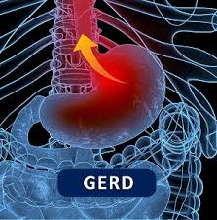
Definition
Gastroesophageal reflux disease (GERD) is a common medical disorder, which is defined as “symptoms or complications resulting from refluxed stomach contents into the esophagus or beyond, into the oral cavity (including the larynx) or lung.”
The key is that these troublesome symptoms adversely affect the well-being of the patient. Episodic heartburn that is not frequent enough or painful enough to be considered bothersome by the patient is not included in this definition of GERD.

Slide 5
Classification
Gastroesophageal reflux disease can be further classified as either:
Symptom-based
Tissue injury-based depending on how the patient presents.
Symptom-based GERD may exist with or without esophageal injury and most commonly presents as heartburn, regurgitation, or dysphagia.
Less commonly, odynophagia (painful swallowing) or hypersalivation may occur.
The absence of tissue injury or erosions is commonly termed nonerosive reflux disease (NERD).

Slide 6
Classification
Tissue injury-based GERD may exist with or without symptoms.
The spectrum of injury includes esophagitis (inflammation of the lining of the esophagus), Barrett’s esophagus (when tissue lining the esophagus is replaced by tissue similar to the lining of the intestine), strictures, and esophageal adenocarcinoma.
Esophagitis occurs when the esophagus is repeatedly exposed to refluxed gastric contents for prolonged periods of time. This can progress to erosion of the squamous epithelium of the esophagus (erosive esophagitis).

Slide 7
02
Pathophysiology

Slide 8
Pathophysiology
The key factor in the development of GERD is the abnormal reflux of gastric contents from the stomach into the esophagus, oral cavity, and/or the lung.
In some cases, gastroesophageal reflux is associated with defective lower esophageal sphincter (LES) pressure or function
Patients may have decreased gastroesophageal sphincter pressures related to:
Spontaneous transient LES relaxations
01
Transient increases in intra-abdominal pressure
02
An atonic LES
03

Slide 9
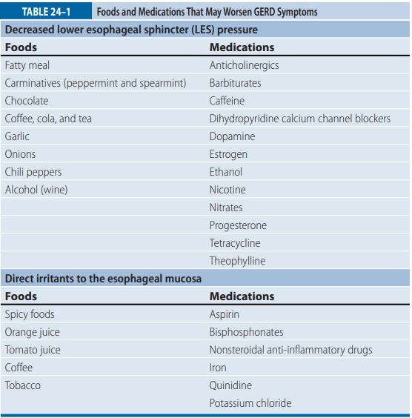

Slide 10
Pathophysiology
Problems with other normal mucosal defense mechanisms, such as:
Abnormal esophageal anatomy
Improper esophageal clearance of gastric fluids
Reduced mucosal resistance to acid
Delayed or ineffective gastric emptying
Inadequate production of epidermal growth factor
Reduced salivary buffering of acid may also contribute to the development of GERD.
Substances that may promote esophageal damage on reflux into the esophagus include gastric acid, pepsin, bile acids, and pancreatic enzymes.
Thus, the composition and volume of the refluxate, as well as duration of exposure, are important aggressive factors in determining the consequences of gastroesophageal reflux.

Slide 11
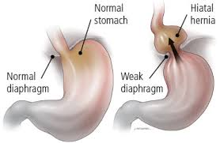
Pathophysiology
Abnormal anatomic features most commonly include hiatal hernia which occurs when a portion of the stomach protrudes through the diaphragm into the chest and causes a disruption in the normal anatomic barriers between the stomach and the esophagus.
Patients with hypotensive LES pressures and large hiatal hernias are more likely to experience gastroesophageal reflux following abrupt increases in intra-abdominal pressure compared with patients with a hypotensive LES and no hiatal hernia.

Slide 12
Pathophysiology
The presence of an “acid pocket” has gained attention as a potential explanation for postprandial reflux symptoms and may represent a target for treatment of reflux disease. While gastric acidity is buffered by food, pH monitoring has shown that this buffering effect may vary in different parts of the stomach and esophagus.
An “acid pocket” is thought to be an area of unbuffered acid in the proximal stomach that accumulates after a meal and may contribute to GERD symptoms postprandially.
GERD patients are predisposed to upward migration of acid from the acid pocket, which may also be positioned above the diaphragm in patients with hiatal hernia, increasing the risk for acid reflux.

Slide 13
03
Risk factors

Slide 14
Risk factors
01
02
03
04
05
Obesity
BMI ≥30
(due to increased intra-abdominal pressure & transient LES relaxations)
Smoking
Alcohol
Excessive
Caffeine
intake
Respiratory diseases

Slide 15
04
Clinical presentation

Slide 16
Clinical presentation
GERD symptoms are often grouped in 3 categories:
Typical or “classic” esophageal symptoms
Alarm or complicated symptoms (may be indicative of GERD complications)
Atypical or extraesophageal symptoms

Slide 17
Typical or “Classic” Symptoms
Pyrosis (heartburn): hallmark symptom described as a substernal feeling of warmth or burning rising up from the abdomen that may radiate to the neck
Regurgitation/Belching
Hyper-salivation
Chest pain (non cardiac in nature)

Slide 18
Alarm (Complicated) Symptoms Any of these symptoms warrant immediate referral for testing
Dysphagia
Unexplained weight loss
Odynophagia
Choking
Bleeding
Chest pain (if could be cardiac in nature)

Slide 19
Extraesophageal Symptoms (Atypical Symptoms) Symptoms that occur in organs other than the esophagus
Chronic cough
Recurrent sore throat
Asthma-like symptoms (about 50% of those with asthma have GERD)
Dental enamel erosion
Laryngitis/Hoarseness

Slide 20
05
Diagnosis

Slide 21
Diagnostic tests
Clinical history: is generally sufficient to make a clinical diagnosis in patients with typical symptoms
Endoscopy: Preferred for assessing for mucosal injury and complications.
Indications:
Persistent or progressive GERD symptoms despite appropriate therapy
Presence of dysphagia or odynophagia
Unexplained weight loss of more than 5%
Age >50
Alarm symptoms
NSAIDs/ ASA use
Family history of upper GI cancer
Presence of GI bleeding, strictures
Screening for Barrett's esophagus in high-risk patients
Prior to endoscopic or surgical antireflux procedures or after procedures in those with recurrent symptoms

Slide 22
Diagnostic tests
Ambulatory Reflux Monitoring With or Without Impedance: Assesses the acid exposure time (AET) and frequency of reflux episodes and helps determine if symptoms are acid-related.
Manometry/High-Resolution Esophageal Pressure Topography (HREPT): useful to identify motor disorders, evaluate peristaltic function in those who are candidates for antireflux surgery, and to assure proper placement of pH probes
Impedance Manometry: Evaluates bolus transit esophageal clearance/retention, LES and upper esophageal sphincter pressures and peristalsis.
Empiric Proton Pump Inhibitor as a Diagnostic Test for GERD: Less expensive and more convenient than ambulatory reflux monitoring but lacks standardized dosing regimen and duration of the diagnostic trial.
Barium Radiography: Not routinely used to diagnose GERD because it lacks sensitivity and specificity; cannot identify Barrett's esophagus. Can detect hiatal hernia.

Slide 23
06
Treatment

Slide 24
Desired Outcomes
The goals of treatment are to:
alleviate or eliminate the patient's symptoms
decrease the frequency or recurrence and duration of gastroesophageal reflux
promote healing of the injured mucosa
prevent complications.
Therapy is directed at augmenting defense mechanisms that prevent reflux and/or decrease the aggressive factors that worsen reflux or mucosal damage including:
decreasing the acidity of the refluxate (neutralize acid)
decreasing the gastric volume available to be refluxed
improving gastric emptying
increasing LES pressure
enhancing esophageal acid clearance
protecting the esophageal mucosa.

Slide 25
General Treatment Approach
GERD treatment is determined by disease severity and includes: (a) lifestyle changes and patient-directed therapy with antacids, nonprescription H2RAs and/or nonprescription PPIs, (b) pharmacologic treatment with prescription-strength acid suppression therapy, (c) surgery, and (d) endoscopic therapies
Initial therapy in patients who present with typical GERD symptoms (mild & intermittent) should include patient-directed (self-care) therapy (antacids, OTC H2- antagonist, or OTC PPIs) and lifestyle modifications
Those who do not respond to patient-directed therapy and lifestyle modifications after 2 weeks should seek medical attention and are usually started on empiric therapy consisting of an acid suppression agent such as a proton pump inhibitor (PPI)
Those who do not respond to empiric acid suppression therapy or have alarm symptoms should undergo testing such as an endoscopy.

Slide 26
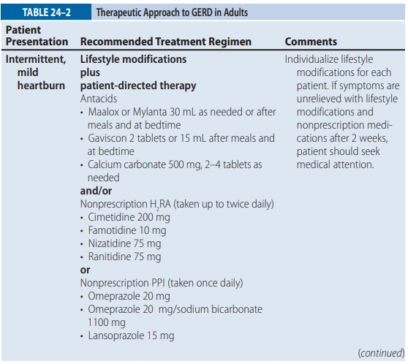

Slide 27
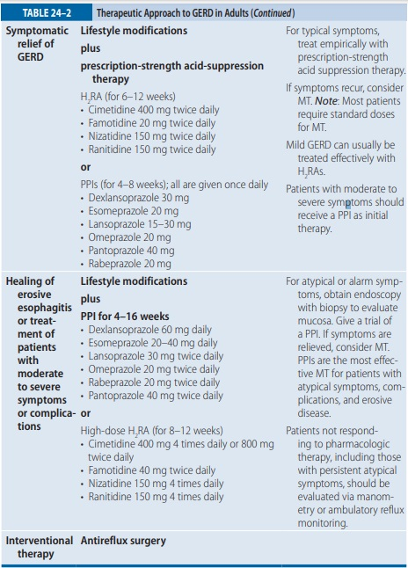

Slide 28
Non-pharmacological treatment Lifestyle modifications
Weight loss (if the patient is overweight or obese)
Elevation of the head of the bed 6 to 8 inches (15-20cm)
Eat smaller, more frequent meals (as opposed to larger meals less frequently
Include protein-rich meals in diet (increases LES pressure)
Avoid eating 3 hours prior to sleeping or lying down
Avoid foods and medications that may decrease LES pressure or increase transient LES relaxation (fatty meals, chocolate, alcohol, peppermint, spicy food, caffeine, barbiturates, anticholinergics, DHP CCBs ..etc)
Avoid alcohol
Tobacco cessation
Avoid tight-fitting clothes.
Always take drugs in the sitting upright or standing position and with plenty of liquid, especially for those that have a direct irritant effect on the esophageal mucosa (bisphosphonates, tetracyclines, quinidine, potassium chloride, iron salts, aspirin, NSAIDs)

Slide 29
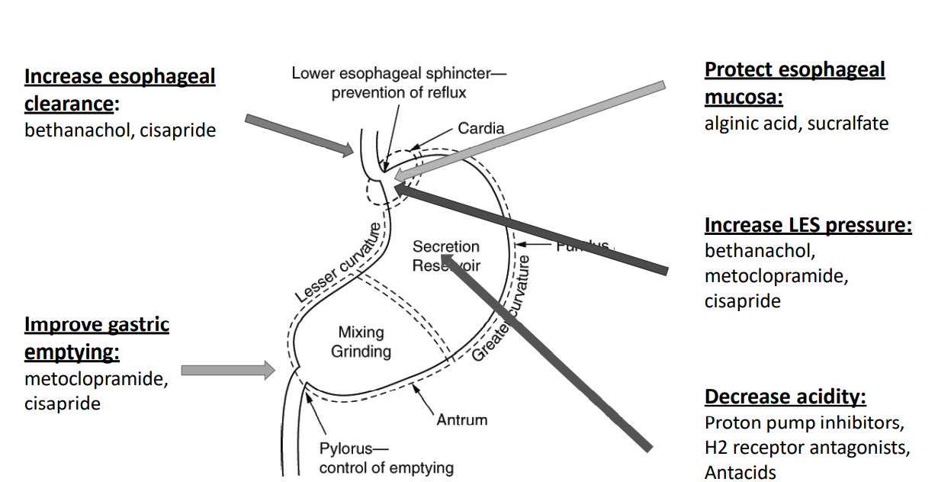
Pharmacological treatment

Slide 30
Antacids
Mechanism of action:
Neutralize hydrochloric acid in the stomach, which results in an increase in gastric pH
Antacids may offer immediate symptomatic relief (in < 5 mins) for mild GERD and help maintain the intragastric pH > 4, which decreases the activation of pepsinogen to pepsin, a proteolytic enzyme. The neutralization of gastric fluid may also lead to increased LES pressure.
Agents:
Magnesium hydroxide
Aluminum hydroxide
Calcium carbonate
Adverse effects:
Diarrhea (magnesium hydroxide)
Constipation (aluminum hydroxide and calcium carbonate)
Alterations in mineral metabolism
Acid-base disturbances

Slide 31
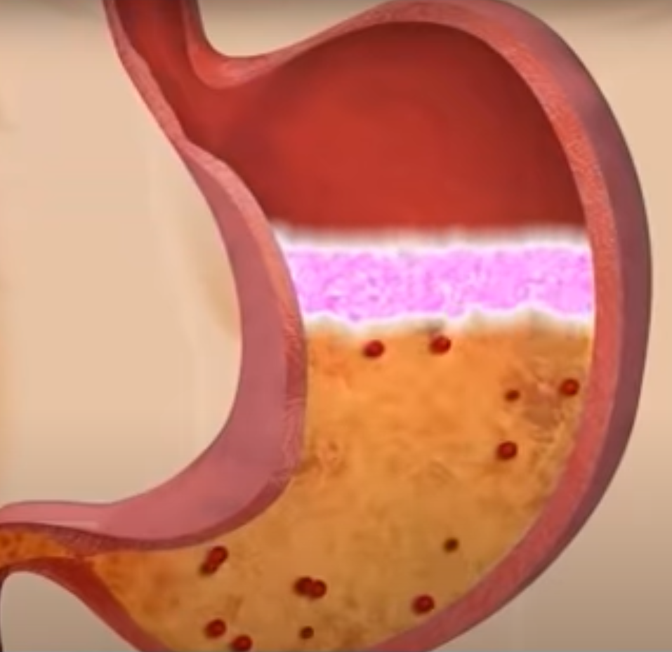
Antacids- Alginic Acid Combination
Mechanism of action:
The antacid neutralizes stomach acid and the alginic acid is a foaming agent that creates a viscous solution or “raft” that floats on top of the gastric contents. This viscous solution serves as a protective barrier for the esophagus against reflux of gastric contents and reduces the frequency of the reflux episodes.
The combination product may be superior to antacids alone in relieving the symptoms of GERD.
Agents:
Sodium bicarbonate, sodium alginate and calcium carbonate (Gaviscon)
Aluminum hydroxide, magnesium carbonate, alginic acid

Slide 32
Antacids
Antacids have clinically significant drug interactions with tetracycline, ferrous sulfate, isoniazid, digoxin, ketoconazoles sulfonylureas, and quinolone antibiotics.
Thus, patients should be counseled about separating antacids and other medications by at least 2 hours.
Patients should periodically monitor calcium and phosphate levels if on chronic antacid therapy and patients with kidney disease shouldn’t use aluminum or magnesium containing antacids.
In general, antacids have a short duration of action, which necessitates frequent administration throughout the day to provide continuous neutralization of acid. Taking antacids after meals can increase the duration of action from about 1 to 3 hours; however, nighttime acid suppression cannot be maintained with bedtime doses.

Slide 33
H2 -Receptor Antagonists
Mechanism of action:
Competitive inhibition of histamine at H2 receptors of gastric parietal cells which inhibits gastric acid secretion
Agents:
Cimetidine
Famotidine
Nizatidine
Ranitidine
Adverse effects:
Headache
Fatigue
Dizziness
Constipation/diarrhea
Response to the H2RAs is dependent on the: (a) severity of disease, (b) dosage regimen used, and (c) duration of therapy.

Slide 34
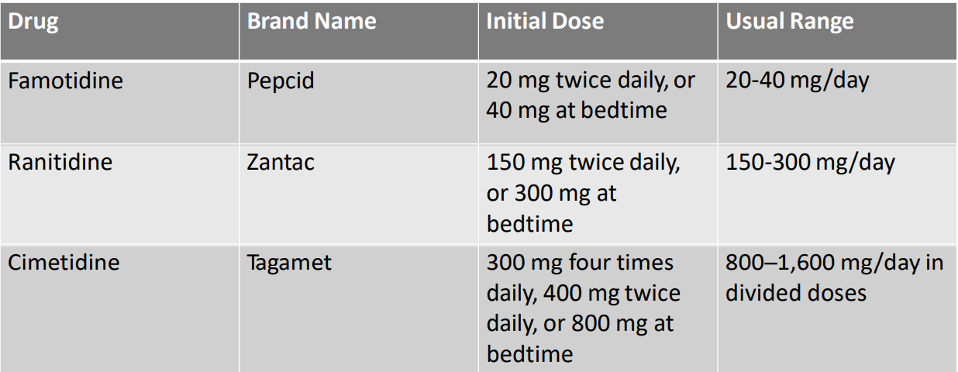

Slide 35
H2 -Receptor Antagonists
Because all of the H2RAs have similar efficacy, selection of the specific agent to use in the management of GERD should be based on factors such as differences in pharmacokinetics, safety profile, and cost.
Patients should be monitored for the presence of adverse effects, as well as potential drug interactions, especially when on cimetidine.
Cimetidine may inhibit the metabolism of theophylline, warfarin, phenytoin, nifedipine, and propranolol. An alternate H2RA should be selected if the patient is on any of these medications.
If patient is taking H2RAs once a day, it is preferable to take the dose at bedtime. Onset of relief is 30 to 45 minutes and duration of relief is 4 to 10 hours
Can be used PRN.

Slide 36
H2 -Receptor Antagonists
Low-dose nonprescription H₂RAs or standard doses given twice daily may be beneficial for symptomatic relief of mild GERD.
Patients not responding to standard doses may be hypersecretors of gastric acid and require higher doses. However, when standard doses of H₂RAs do not adequately relieve symptoms, it is more effective to switch to a PPI.
The efficacy of H₂RAs for GERD treatment is highly variable and frequently lower than desired. Prolonged courses are frequently required.

Slide 37
Proton pump inhibitors
Mechanism of action:
Block gastric acid secretion by inhibiting gastric H⁺/K⁺- ATPase in gastric parietal cells.
This produces a profound, long-lasting antisecretory effect capable of maintaining the gastric pH > 4, even during postprandial acid surges.
Agents:
Dexlansoprazole
Esomeprazole
Lansoprazole
Omeprazole
Omeprazole/sodium bicarbonate
Pantoprazole
Rabeprazole
IV options: pantoprazole, esomeprazole and lansoprazole
Capsules that can be opened/sprinkled: dexlansoprazole, lansoprazole, esomeprazole, omeprazole

Slide 38
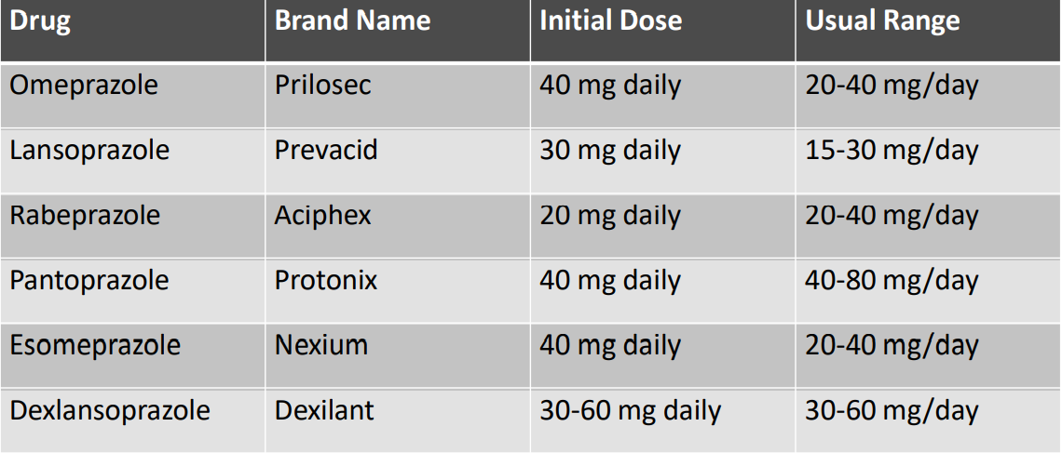

Slide 39
Proton pump inhibitors
Common adverse effects:
Headache
Diarrhea
Nausea
Abdominal pain
Serious adverse effects:
Increased risk of Clostridium difficile infections
Increase risk of community-acquired pneumonia
Long-term adverse effects (> 1 year):
Hypomagnesemia
Bone fractures
Vitamin B12 deficiency

Slide 40
Proton pump inhibitors
Patients should take oral PPIs 30- 60 mins before first meal in the morning or before their largest meal to maximize efficacy. If dosed twice daily, the second PPI dose should be taken approximately 10 to 12 hours after the morning dose and prior to a meal or snack.
All PPIs can decrease the absorption of medications such as ketoconazole, itraconazole, digoxin, atazanavir, iron, which require an acidic environment to be absorbed.
Concerns have been raised regarding the concomitant use of PPIs, particularly omeprazole with clopidogrel, since it is the strongest inhibitor of CYP2C19. The use of pantoprazole, rabeprazole or lansoprazole is recommended.
OTC PPIs include esomeprazole, omeprazole (alone or combined with sodium bicarbonate) and lansoprazole.

Slide 41
PPIs vs H2RA
PPI: 80-90% symptom relief and healing with daily dosing
H2RA: 50-75% improvement; ~50% healing
Symptomatic improvement as well as endoscopic healing rates are higher for the PPIs compared to the H2-receptor antagonists
PPIs are therefore preferred over H2-receptor antagonists in patients with erosive disease, moderate to severe symptoms, or with complications

Slide 42
Promotility Agents
Promotility agents may be useful as an adjunct to acid suppression therapy for patients with a known motility defect (eg, LES incompetence, decreased esophageal clearance, and delayed gastric emptying).
However, they are not generally recommended to be used for GERD treatment due to their limited effectiveness and undesirable adverse effect profiles
Agents:
Metoclopramide
Bethanechol
Cisapride

Slide 43
Promotility Agents
Cisapride is a prokinetic agent that is not used because it causes Torsade de Pointes.
Metoclopramide, a dopamine antagonist, increases LES pressure in a dose-related manner and accelerates gastric emptying. However, it has dose-related CNS side effects such as extrapyramidal effects and tardive dyskinesia thus it should be avoided in elderly and poor renal function.
Bethanechol, a promotility drug, has limited value in the treatment of GERD because of unwanted adverse effects, such as urinary retention, abdominal discomfort, nausea, and flushing. It is not routinely recommended for the treatment of GERD.

Slide 44
Mucosal Protectants
Sucralfate, a nonabsorbable aluminum salt of sucrose octasulfate, has limited value in the treatment of GERD.
It may not be useful in the routine treatment of acid reflux but may be useful in the management of radiation esophagitis and bile or nonacid reflux GERD.

Slide 45
Pharmacologic therapy
Patient directed therapy (self-care) is appropriate for intermittent, mild pyrosis and is managed using over-the counter products such as antacids, OTC H2 -receptor antagonists, and OTC proton pump inhibitors.
Exclusion Criteria for Self-Treatment:
Frequent heartburn
Worsening or alarm symptoms
Dyspepsia >2 weeks while on OTC H2RA or PPI
Nocturnal heartburn
Pregnant or nursing
Pediatrics

Slide 46
Maintenance therapy
Which patients should receive maintenance therapy?
Many patients with GERD relapse after medication is withdrawn, so maintenance treatment may be required. Consider long-term therapy to prevent complications and worsening of esophageal function in patients who have symptomatic relapse after discontinuation of therapy or dosage reduction, including patients with Barrett’s esophagus, strictures, or erosive esophagitis.
Most patients require standard doses to prevent relapses. PPIs are the drugs of choice for maintenance treatment of moderate to severe esophagitis or symptoms.
Usual once-daily doses are omeprazole 20 mg, lansoprazole 30 mg, rabeprazole 20 mg, or esomeprazole 20 mg. Low doses of a PPI or alternate-day regimens may be effective in some patients with milder symptoms. H₂RAs may be effective maintenance therapy in patients with mild disease.
“On-demand” maintenance therapy, by which patients take their PPI only when they have symptoms, may be effective for patients with endoscopy-negative GERD.

Slide 47
Special populations
Patients with Extraesophageal (Atypical) GERD
GERD can be considered as a potential co-factor in patients with asthma, chronic cough, or laryngitis
Careful evaluation of non-GERD causes should be undertaken in all of these patients
Patients with atypical symptoms may need higher doses of acid suppression therapy with longer treatment duration compared to those patients with typical symptoms
Elderly Patients:
Many elderly patients have decreased defense mechanisms such as decreased saliva production
PPI therapy may be warranted for those > 60 years of age with symptomatic GERD
They have superior efficacy and have once a day dosing
Long-term risk of bone fractures is a concern and elderly patients should be monitored appropriately
Elderly are at higher risk of being sensitive to possible CNS effects of H2 -receptor antagonists

Slide 48
Special populations
Patients with Refractory GERD
Refractory GERD should be considered in patients who have not responded to a standard course of twice a day PPI therapy over a 12-week period.
The majority of patients with refractory symptoms experience nocturnal acid breakthrough
Switching to a different PPI may be effective in some patients
Dexlansoprazole offers greater dosing flexibility since it does not need to be administered with food so may provide effective control of nocturnal symptoms.
Adding an H2 -receptor antagonist at bedtime for nocturnal symptoms is reasonable

Slide 49
Reference
Pharmacotherapy: A Pathophysiologic Approach, 11th edition, Joseph T. DiPiro, Gary C. Yee, L. Michael Posey, Stuart T. Haines, Thomas D. Nolin, Vicki Ellingrod

