Slide 1
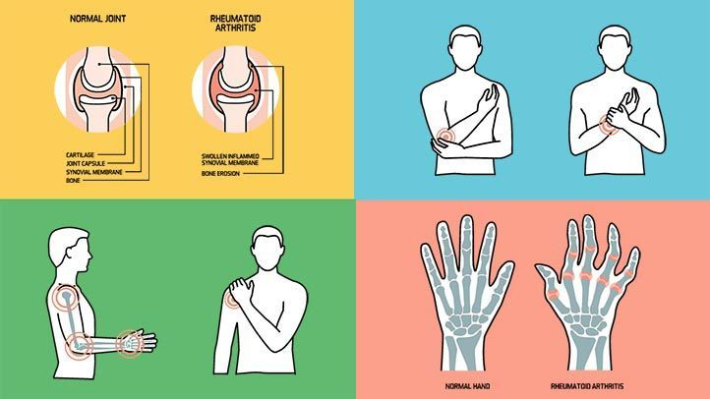
Rheumatoid Arthritis

Slide 2
Introduction
Rheumatoid arthritis (RA) is a common, chronic, progressive autoimmune condition that primarily affects the joint and synovium but can also have detrimental effects on organ systems throughout the body. It can have substantial and devastating effects on one’s ability to function and complete basic activities of daily living.

Slide 3
Epidemiology
Worldwide disease prevalence is approximately 1% (specifically in North American and Northern European countries), however, native American-Indian populations have the highest prevalence noted (approximately 5%-6%). The prevalence is lower in other regions.
Women are twice as likely to develop the disease compared with men.

Slide 4
Epidemiology
RA generally presents in the fifth decade of life with increasing prevalence up to the eighth decade of life. RA can affect children age 16 years or younger; in these patients, the condition is referred to as juvenile RA.
Cardiovascular (CV) disease is the leading cause of death in RA and presents the greatest concern. Patients with RA have a higher risk of major adverse CV events, and RA disease activity is a predictor of increased CV risk.
Other common comorbid autoimmune diseases include insulin-dependent diabetes mellitus and autoimmune thyroid disease.

Slide 5
Etiology
The specific cause of RA is unknown. The disease results from a mix of genetic susceptibility and nongenetic factors combined with a triggering event.
Genetic polymorphisms seem to play a large role. There is a thought that multiple genes are involved, specifically those of the human leukocyte antigen (HLA) system.
Genetics also seems to play a role based on familial studies. Patients with a first-degree relative with RA are at a higher risk of having RA themselves when nongenetic factors are standardized.

Slide 6
Etiology
Studies show some variability regarding the role of hormonal regulation and the likelihood of RA development, particularly with estrogen.
Pregnancy is often associated with disease remission in the last trimester, but flares commonly occur in the acute postpartum period.
Men with low testosterone levels are more likely to have RA, suggesting testosterone may provide a protective effect as well.

Slide 7
Etiology
Nongenetic or environmental factors possibly associated with RA include cigarette use (tied to increased disease activity, increased biomarkers, and poor prognoses), coffee consumption, and obesity.
An omega-3 rich diet seems to provide a favorable impact on disease development.
Occupational hazards, such as exposure to silica, may also play a role in susceptibility to disease.
Additional factors are thought to be needed to trigger the disease itself. An infectious process is hypothesized to be the primary trigger. The Epstein–Barr virus and retroviruses are most commonly associated with the disease.
Further studies are required to help uncover the exact etiology of RA.

Slide 8
Pathophysiology
Overstimulation of the innate immune system is thought to be one of the earliest histologic changes in RA.
T cells display an activated surface phenotype with high allele expression of the human major histocompatibility complex (HLA) and CD 27, increasing their affinity for lymphokines. Activated T cells stimulate B cells, causing production of autoantibodies which form large complexes that deposit throughout the body.
Antibodies to immunoglobulin G (IgG) have a strong correlation to the pathogenesis and poor prognosis of RA and are known as rheumatoid factor (RF).
B cells also produce proinflammatory cytokines, including tumor necrosis factor (TNF) and the interleukin (IL) system, which are responsible for inducing expression of adhesion molecules on the endothelium, further enhancing T-cell proliferation and differentiation, encouraging cell migration, and regulating matrix modeling.

Slide 9
Pathophysiology
Other mechanisms of pathogenesis include overexpression of tumor suppressor gene p53, which increases presence of anti-citrullinated protein antibodies (ACPA). ACPA positivity is associated with a poorer prognosis in patients with RA.
Migration of lymphocytes, macrophages, and mononuclear cells into the synovium and synovial cavity are some of the earliest histologic changes in RA. With the increased mass to the synovium comes hypertrophy and subsequently angiogenesis. As the vessels develop, cytokines also stimulate further migration of both innate and adaptive immune systems into the synovium, causing inflammation.
The inflamed, fibrotic synovium found in RA is known as a pannus, and it invades cartilage and bone around it, thereby promoting further destruction and dysregulation.

Slide 10
Pathophysiology
Cytokines in the cartilage drive the generation of reactive nitrogen and oxygen species while increasing chondrocyte catabolism, inhibiting chondrocyte anabolism, and increasing extracellular matrix destruction. Proinflammatory cytokines travel to the bone, and enhance the differentiation and activity of osteoclasts leading to bone matrix destruction.
Circulating immune complexes and T cells have been found in the extra-articular involvement of RA.

Slide 11
Clinical presentation
Joint Involvement
Hands, wrists, ankles, and feet most commonly affected, often bilaterally
Presence of warmth and swelling with or without pain
Prolonged morning stiffness, often for longer than 30 minutes in duration
Decreased functionality
Symptoms present for 6 weeks or more
Subluxations and deformities possible with advanced disease

Slide 12
Osteoarthritis, the most common form of arthritis, involves the wearing away of the cartilage that caps the bones in your joints.
With rheumatoid arthritis, the synovial membrane that protects and lubricates joints becomes inflamed, causing pain and swelling. Joint erosion may follow.

Slide 14
Patterns of joint involvement in rheumatoid arthritis.

Slide 16
Clinical presentation
Extra-articular Involvement
Generalized fatigue, weakness, and decreased mood are nonspecific implications of disease
Rheumatoid nodules can be found on extensor or pleural lining surfaces
Pulmonary complications such as Interstitial lung disease or pleural disease
Vasculitis
Ocular manifestations such as Keratoconjunctivitis sicca, scleritis, or Sjögren’s syndrome
Cardiac involvement such as Pericarditis, cardiac conduction abnormalities, or myocarditis
Hematologic involvement such as Felty syndrome or anemia
Lymphadenopathy may occur in patients with RA, and when present, it warrants a work-up for infection or malignancy.
Amyloidosis is a rare complication of longstanding RA and may lead to renal and gastrointestinal complications.
Osteoporosis in patients with RA is almost 2 times higher than in patients without RA.
Patients with high-titer RF or ACPA have a higher likelihood of extra-articular manifestations.

Slide 17
Clinical presentation
Laboratory Findings
The complete blood count can be altered by RA or its treatment
Rheumatoid factor is detected in 70% to 80% of patients with RA with higher titers, which reflects increased sensitivity and more progressive disease
Anti-cyclic citrullinated antibodies are more specific for disease, particularly early stage, and generally indicate more aggressive disease
Erythrocyte sedimentation rate and C-reactive proteins may indicate the presence of a nonspecific inflammatory process
Synovial fluid analysis through joint aspiration typically demonstrates a high white blood cell count in the absence of crystals or infection

Slide 18
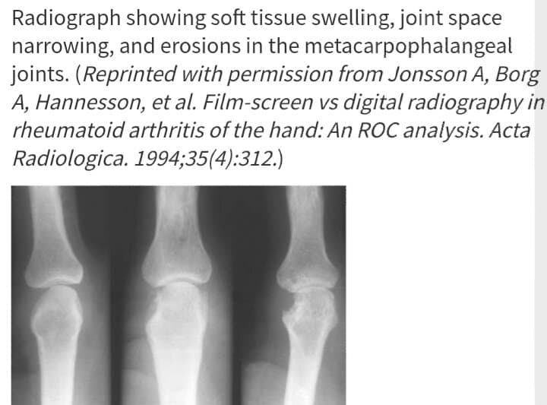
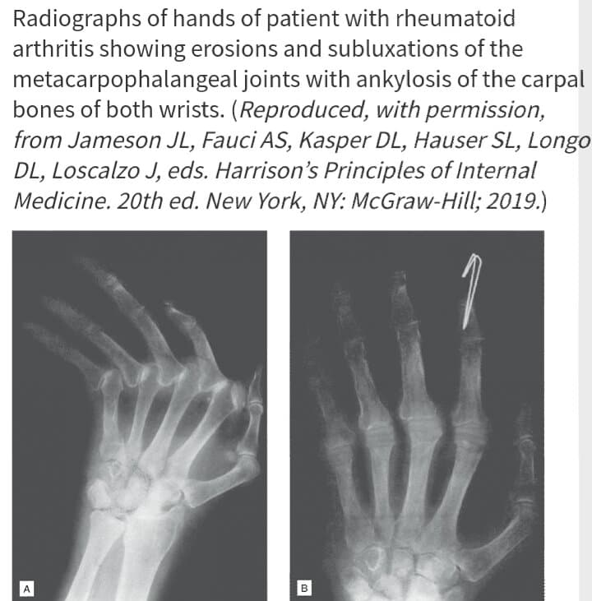
Clinical presentation
Radiography
In early stages of RA, it may show soft-tissue swelling and joint space narrowing
In late-stage disease, it may show joint subluxations, deviations, and secondary arthritis

Slide 19
Diagnostic criteria
Early identification of patients with RA may allow for earlier treatment geared toward preventing structural damage to joints.
A total score of 6 or more out of a possible total score of 10 is considered diagnostic for RA.
Not all patients with RA will score 6 or greater initially but may evolve to higher scores over time.

Slide 20
ACR/EULAR Rheumatoid Arthritis Classification Criteria

Slide 21
Treatment
Desired Outcomes
The ACR as well as the EULAR guidelines suggest a treat-to-target approach when treating patients with RA, suggesting that if remission cannot be achieved, low disease activity is an acceptable alternative target.
In general, RA treatment is directed toward reducing inflammation and symptoms, including joint pain and stiffness. Most of the therapies used to treat RA slow the disease progression and thus the progression of irreversible joint damage, which can help decrease disability and improve quality of life.

Slide 22
Treatment
General Approach To Treatment
Available pharmacologic therapies do not reverse joint damage that has already occurred. Therefore, early aggressive treatment of RA is imperative. Several studies have supported that early treatment of RA results in improved outcomes and have shown that patients with a shorter disease duration are more likely to respond to treatment.
Nonpharmacologic therapies also play a role in the management of RA and encourage patients to take an active role in managing their disease. Therefore, the approach to the treatment of RA should include both pharmacologic and nonpharmacologic methodologies.

Slide 23
Treatment
Nonpharmacologic treatment
Patient education should involve disease state education as well as medication education.
Physical therapy is beneficial for reducing pain and inflammation while preserving joint function.
Exercise and physical activity, including aerobic activity and muscle-strengthening exercises, have been demonstrated to improve RA-related disease outcomes.
Assistive devices and orthoses such as braces and supports are useful to improve pain and function.
Occupational therapy can be effective and provide several benefits such as exercises, appropriate footwear, and splinting.
Weight loss can help decrease the stress on joints.
Surgical options, including joint replacements, are reserved for patients with more severe disease where there may have significant cartilage loss.

Slide 24
Treatment
Pharmacologic Therapy
Currently available therapies used to treat RA and also slow the progression of the disease include:
Conventional DMARDs
Biologic DMARDs which fall into two categories: tissue necrosis factor (TNF) inhibitor biologics and non-TNF biologics
The small-molecule agent Tofacitinib
Many of the therapies used to treat RA are also indicated and used in the treatment of other conditions such as psoriatic arthritis and ankylosing spondylitis.

Slide 25
Treatment
The current guidelines for treatment of RA recommend initiation of conventional DMARDs irrespective of disease activity in treatment-naive patients once a diagnosis is established.
The preferred conventional DMARD is methotrexate unless a contraindication to its use exists.
In practice though choice of therapy may ultimately be dependent on level of disease activity, comorbid health conditions, patient preference, and often insurance coverage.

Slide 26
Treatment algorithm for rheumatoid arthritis based on the American College of Rheumatology guidelines

Slide 27
Treatment
In patients with early RA (duration of disease/symptoms of less than 6 months) and with low disease activity, treatment with DMARD monotherapy is recommended.
Double or triple DMARD therapy is recommended if disease activity is moderate or high.
A biologic agent can be used as monotherapy or with conventional DMARD(s) in patients with moderate or high disease activity.
Tofacitinib would be an alternate option if disease activity remains moderate or high with combination conventional DMARDs.

Slide 28
Treatment
If disease activity remains moderate or high despite DMARD or biologic agents, a low-dose glucocorticoid can be added for the shortest duration of time necessary. (Low-dose glucocorticoid is defined as prednisone 10 mg/day or less or an equivalent amount of another glucocorticoid.)
If patients achieve remission, DMARDs and biologic agents can be tapered; however, patients should remain on DMARD therapy at some level.

Slide 29
Treatment
In patients with established RA (duration of disease/symptoms for 6 months or more), treatment with DMARD monotherapy is recommended despite disease activity in DMARD-naive patients.
Combination conventional DMARDs or a biologic DMARD or tofacitinib can be used if disease activity remains moderate or high after an adequate trial with DMARD monotherapy.
In patients who are on TNF inhibitor monotherapy with moderate or high disease activity, one or two DMARDs can be added to the TNF inhibitor.

Slide 30
Treatment
A non-TNF biologic can be used in place of a TNF inhibitor if disease activity remains moderate or high on a TNF inhibitor. This is recommended over tofacitinib.
Therapy can be switched to another non-TNF biologic if a single non-TNF biologic is unable to adequately control disease activity.
If courses of two TNF inhibitors have not adequately controlled disease activity, a non-TNF biologic can be initiated.
Tofacitinib can be initiated if disease activity persists despite multiple TNF inhibitors in patients for whom non-TNF biologics are not an option.
Glucocorticoids can be added if disease flares occur or are inadequately controlled despite DMARD, TNF inhibitor, or non-TNF biologic therapy.

Slide 31
Treatment
DMARDs can take weeks to months to take effect in patients with RA.
NSAIDs and/or glucocorticoids, as well as other analgesics such as acetaminophen, can provide symptomatic relief and have a more rapid onset of action than DMARDs; they are often used as “bridge” therapy.
NSAIDs do not impact disease progression, and corticosteroids slow RA progression but have several side effects associated with their use, making both less desirable choices for long-term use.
Glucocorticoids can be administered orally or intramuscularly. Intra-articular injections can provide a local decrease in inflammation and pain relief. The intra-articular route is associated with fewer systemic adverse effects. Intra-articular injections should not be repeated more often than every 3 months because of the potential for accelerated loss of cartilage in the joint.
Typically, oral glucocorticoids, such as prednisone, are taken once daily. Intramuscular glucocorticoids such as triamcinolone acetonide and methylprednisolone acetate can be administered instead of oral steroids based on patient preference or in patients who may not adhere to daily oral therapy. This can also be used in place of an intra-articular injection when multiple joints are involved.
Glucocorticoids should be tapered.

Slide 32
Conventional Disease-Modifying Antirheumatic Drugs
Methotrexate:
It is the DMARD of choice for most patients unless its use is contraindicated. Methotrexate has a sustained clinical response over time and a glucocorticoid-sparing effect.
Methotrexate inhibits dihydrofolate reductase. Through this action, methotrexate inhibits DNA synthesis and repair and cellular replication.
Methotrexate is taken once weekly and is typically given in either tablet form or as a SC injection. It is also available as IM injection.
The bioavailability of oral methotrexate decreases at higher doses.
Methotrexate is about 50% protein bound and is excreted by the kidney.

Slide 33
Conventional Disease-Modifying Antirheumatic Drugs
Injectable methotrexate has a higher bioavailability compared with oral methotrexate and thus provides superior clinical efficacy. Injectable methotrexate is typically better tolerated and has less potential to cause gastrointestinal side effects as well.
The doses used for the treatment of RA typically range from 7.5 to 20 mg weekly. At doses higher than 15 mg weekly, oral methotrexate may not have significant added clinical benefit; changing to subcutaneous methotrexate may increase bioavailability and clinical benefit.
Clinical benefit can be seen 3 to 6 weeks after starting methotrexate therapy.

Slide 34
Conventional Disease-Modifying Antirheumatic Drugs
Methotrexate is teratogenic and is therefore contraindicated in pregnancy and breastfeeding.
Additional contraindications include alcoholism, alcoholic liver disease or other chronic liver disease, immunodeficiency, and preexisting hematologic disorders, such as leukopenia and thrombocytopenia.
Methotrexate excretion is reduced in renal impairment and may require dose reduction or discontinuation in some cases. Excretion is also reduced in ascites or pleural effusions.

Slide 35
Conventional Disease-Modifying Antirheumatic Drugs
Recommended laboratory monitoring prior to starting methotrexate includes CBC with differential, ALT, AST, and renal function. These should be monitored every 2 to 4 weeks for 3 months after initiation or following a dose increase, then every 8 to 12 weeks during 3 to 6 months of therapy, and every 12 weeks after 6 months of therapy.
A chest x-ray film can be considered before starting methotrexate in patients with underlying lung disease.
Hepatitis B, hepatitis C, and tuberculosis screenings should be obtained at baseline in high-risk patients.

Slide 36
Conventional Disease-Modifying Antirheumatic Drugs
Adverse effects of methotrexate include infection, pulmonary complications (eg, interstitial pneumonitis and COPD), gastrointestinal problems (eg, perforation and diarrhea), hematologic changes (eg, thrombocytopenia and leukopenia), and hepatic toxicities (eg, elevated liver enzymes and cirrhosis).
Because methotrexate is a structural analogue of folic acid, it can cause folic acid deficiency; methotrexate should be given with folic acid 1 to 5 mg daily to reduce the incidence of toxicities associated with methotrexate.

Slide 37
Conventional Disease-Modifying Antirheumatic Drugs
Leflunomide
It is an oral DMARD that inhibits pyrimidine synthesis, can be used as monotherapy or in combination with other DMARDs to treat RA. It has been shown to reduce signs and symptoms of RA, inhibit structural damage, and improve physical function.
It is significantly protein bound (>99.3%). The typical maintenance dose used to treat RA is 20 mg daily; the dose can be decreased to 10 mg daily if patients are unable to tolerate higher doses. A loading dose can be given of 100 mg for 3 days, but this may increase the risk for toxicities.
It has a half-life of about 2 weeks and may require washout with cholestyramine if rapid elimination is required due to toxicity or incidental pregnancy.
It is excreted by the kidneys as well as through direct biliary excretion.

Slide 38
Conventional Disease-Modifying Antirheumatic Drugs
Baseline monitoring of Leflunomide should include a tuberculosis screening, CBC with differential, ALT, AST, and renal function. These should be monitored frequently with the same monitioring frequency of methotrexate.
Adverse reactions associated with leflunomide include diarrhea, elevated liver enzymes, alopecia, elevated blood pressure, and rash.
If ALT is three times the upper limit of normal (ULN), leflunomide should be discontinued.
Leflunomide should not be used in pregnant or nursing mothers or in patients with severe hepatic impairment.

Slide 39
Conventional Disease-Modifying Antirheumatic Drugs
Sulfasalazine
It is a prodrug with two metabolites, 5-aminosalicylic acid (5-ASA) and sulfapyridine. The exact mechanism of action of sulfasalazine for the treatment of RA is unknown, but it has been shown to have immunomodulating and anti-inflammatory properties. Sulfasalazine can be used as monotherapy or in combination with other DMARDs to treat RA.
The typical starting dose of sulfasalazine is 500 mg daily or 1 g daily in two divided doses; this can be increased weekly to 2 g daily in two divided doses to minimize the risk of adverse events.
Clinical benefit can be seen in 4 weeks, but some individuals may need to be on sulfasalazine for 12 weeks before clinical benefit is achieved. If clinical benefit is not sufficient after 12 weeks of therapy, the dose can be further titrated to 3 g/day in evenly divided doses.
Sulfasalazine is primarily eliminated by the kidney and should be used with caution in renal impairment.
Sulfasalazine is contraindicated in sulfonamide or salicylate allergy.

Slide 40
Conventional Disease-Modifying Antirheumatic Drugs
Baseline monitoring of Sulfasalazine is the same as that of Methotrexate.
Glucose-6-phosphate dehydrogenase (G6PD) deficiency can cause hemolytic anemia; therefore, screening for this prior to initiation should be considered.
Sulfasalazine use is limited by its potential to cause gastrointestinal adverse effects, including diarrhea, nausea, vomiting, and anorexia. Less common adverse effects associated with sulfasalazine include rash, urticaria, blood cell abnormalities (including leukopenia, anemia, and thrombocytopenia), severe hypersensitivity reactions (including Stevens-Johnson syndrome), photosensitivity, elevated liver enzymes, and alopecia. Sulfasalazine can also cause urine and skin discoloration.
Sulfasalazine crosses the placenta and is present in breast milk but can be used in pregnant and nursing mothers with caution.

Slide 41
Conventional Disease-Modifying Antirheumatic Drugs
Hydroxychloroquine
It is typically used in combination with other DMARDs in patients with RA, but it can be used as monotherapy in mild cases. The mechanism of action in the treatment of RA is not fully understood, but a proposed mechanism for its anti-inflammatory properties is its interference with antigen processing in macrophages and other antigen-presenting cells.
Hydroxychloroquine’s oral absorption is incomplete and inconsistent. It is about 40% protein bound and excreted predominately in the urine.
The typical dose of hydroxychloroquine is 400 mg daily either as one dose or as two divided doses. Clinical benefit is delayed and may take several weeks.
The main advantage of hydroxychloroquine use is that it does not require frequent, routine laboratory monitoring because it is not generally associated with infection risk or hepatic, renal, or blood cell abnormalities.

Slide 42
Conventional Disease-Modifying Antirheumatic Drugs
The most common adverse effects with hydroxychloroquine are gastrointestinal side effects, including nausea, vomiting, and diarrhea; these can sometimes be mitigated by taking the medication with food or splitting the dose into two doses.
Irreversible retinal damage can occur with hydroxychloroquine use. For patients with risk factors for developing retinal damage, such as low body weight and renal and hepatic impairment, ophthalmologic exams should be conducted annually throughout the treatment with this drug. If patients do not have risk factors for developing retinal damage, an ophthalmologic examination should be completed within 5 years of starting hydroxychloroquine and then repeated annually.
Hydroxychloroquine can be continued during pregnancy as no studies have shown an increased risk of birth defects or ocular toxicities.
Hydroxychloroquine is excreted into the breast milk, and caution should be exercised in nursing mothers.

Slide 43
Biologic Disease-Modifying Antirheumatic Drugs
Biologics are genetically engineered protein molecules that have varying mechanisms by which they decrease inflammation.
They can be separated into two groups:
1- TNF inhibitor biologics includes adalimumab, etanercept, certolizumab, golimumab, and infliximab
2- Non-TNF biologics includes abatacept, tocilizumab, rituximab, anakinra, and sarilumab.
Biologic DMARDs are associated with an increased risk of infection due to their immunosuppressant effects.
A tuberculin skin test or interferon gamma release assay (IGRA) blood test should be obtained before starting a biologic to detect and treat latent or active tuberculosis.
Patients should also be screened for hepatitis B before starting biologic therapy because of the risk for reactivation.

Slide 44
Biologic Disease-Modifying Antirheumatic Drugs
Biologic agents can be used in combination with conventional DMARDs, but multiple biologics should not be used concomitantly due to additive immunosuppressive effects.
In general, if patients are switched from one biologic to another, the new agent should be initiated when the patient is due for a dose of the previous biologic to avoid potential adverse effects.
Patients should notify their providers if they are being treated for an infection or plan to undergo major surgery while on a biologic or before starting a biologic. A patient’s therapy may need to be held until appropriate postsurgical healing and/or resolution of infection can be confirmed.

Slide 45
TNF Inhibitor Biologics
TNF inhibitors block the proinflammatory cytokine TNF-α. Elevated levels of TNF-α are found in the synovial fluid of individuals with RA as well as other rheumatologic conditions.
These agents can take several weeks for clinical benefit to be noted and up to 3 months to achieve full clinical benefit.
A major limitation to the use of TNF inhibitors is cost, as they are more expensive than conventional DMARDs.
Although these agents have similar side effect profile and contraindications, the TNF inhibitors all have differing structures, pharmacokinetics, and dosing schemes. The selection of an agent depends on cost and patient preference for route and frequency of administration.

Slide 46
TNF Inhibitor Biologics
TNF inhibitors should not be used in patients with moderate-to-severe heart failure (NYHA class III/IV), as new-onset and worsening heart failure has been reported with TNF inhibitors.
These agents increase the risk of serious infection and malignancies such as lymphoma and skin cancers.
New-onset or exacerbation of demyelinating disorders such as multiple sclerosis has been observed with TNF-α inhibitors. Therapy should be discontinued in patients who develop symptoms of demyelinating disorders, and caution should be exercised in using these agents in this patient population.
During therapy, a CBC with differential should be monitored periodically as TNF inhibitors can cause blood cell disorders including pancytopenia. Other monitoring includes signs/symptoms of malignancy and serious infections.

Slide 47
TNF Inhibitor Biologics
Certolizumab, Adalimumab, Etanercept, and Golimumab are given as SC injections.
Infliximab is given as IV infusion, typical dosing is 3 mg/kg at weeks 0, 2, and 6, followed by every 8 weeks.

Slide 48
TNF Inhibitor Biologics
Infliximab
About 15% of patients develop antibodies to infliximab. Patients who develop these antibodies typically have a higher likelihood of developing an infusion reaction, have increased clearance of infliximab, and therefore decreased efficacy. Infliximab antibodies can me measured if this is suspected.
When infusion reactions occur with infliximab, they typically begin within 2 hours of infusion. Concomitant use with immunosuppressants such as methotrexate can lessen the likelihood of developing antibodies to infliximab.
Premedication with an antihistamine, acetaminophen, and/or a glucocorticoid can help decrease the likelihood of patients developing infusion-related reactions.

Slide 49
Non-TNF Biologics
1- Abatacept: a selective co-stimulation modulator that inhibits T-cell activation by binding to CD80 and CD86. Found as SC injection & IV infusion. It should be used with caution in patients with COPD.
2- Tocilizumab: a monoclonal antibody that inhibits the binding of the proinflammatory cytokine IL-6 to its receptor. Found as SC injection & IV infusion.
3- Rituximab: a monoclonal antibody that binds the CD20 antigen found on the surface of B cells. Found as IV infusion.
4- Anakinra: inhibits IL-1, which is involved in inflammatory responses. Found as SC injection.
5- Sarilumab: IL-6 receptor antagonist. Found as SC injection.

Slide 50
Tofacitinib
It is an oral Janus kinase (JAK) inhibitor.
It can be used as monotherapy or in combination with conventional DMARDs and should not be used with biologic DMARDs.
A common measure in studies of RA is ACR 20 improvement, which is defined as at least a 20% improvement in seven ACR core measures of disease activity, including tender and swollen joints as well as patients’ assessment of disease activity and physical function.

Slide 51
Other Disease-Modifying Antirheumatic Drugs
Therapies such as azathioprine, cyclosporine, minocycline, and gold salts were previously used to treat RA. With the development of other DMARDs and biologics, they are now used infrequently and have no recent data to support their use.

Slide 52
Special populations
Pregnancy and lactation:
DMARDs that can be used during pregnancy include hydroxychloroquine and sulfasalazine.
Current evidence suggests no increase in congenital malformations with TNF inhibitors and therefore they can also be considered for use during the first part of pregnancy. Specifically, etanercept and certolizumab may be continued throughout pregnancy.
Because of risks associated with paternal exposure to DMARDs, family planning for male patients should also be taken into account when developing treatment plans.
For women who are breastfeeding, methotrexate and leflunomide would be contraindicated.

Slide 53
Special populations
Serious infections:
In patients with a history of serious infections, combination DMARDs are recommended over TNF inhibitors. Abatacept can be considered over TNF inhibitors.
If the patient has latent tuberculosis, then a biologic DMARD or tofacitinib can be started or resumed after completing at least 1 month of treatment for latent tuberculosis. If the patient has active tuberculosis, then a biologic DMARD or tofacitinib can be started or resumed after the patient has completed treatment for active tuberculosis.

Slide 54
Special populations
Hepatitis
In patients with hepatitis B infection who are currently receiving treatment for hepatitis B, treatment of RA should be the same as in patients without a history of hepatitis.
In patients with prior exposure to hepatitis B, RA treatment should be the same as unexposed patients with monitoring of viral load every 6 to 12 months.
In patients with history of untreated hepatitis B, treatment of hepatitis B should be considered prior to initiating immunosuppressive therapies.
Patients who are being treated for hepatitis C should not be treated differently than patients without hepatitis C. TNF inhibitors can be used in patients with hepatitis C when they are being treated for this viral infection.
In patients with untreated hepatitis C, DMARDs are recommended over TNF inhibitors. Methotrexate and leflunomide should be avoided due to potential effects on the liver.

Slide 55
Special populations
Malignancy
In patients with previous melanoma and nonmelanoma skin cancer, DMARDs are preferred over biologic agents and tofacitinib because DMARDs are less immunosuppressive than biologics. However, in patients with low-grade skin cancer with history of prior treatment, biologics could be considered with close monitoring of the skin by a dermatologist.
In patients with previously treated lymphoproliferative disorders, rituximab use is recommended over TNF inhibitors because of the known increased risk of lymphoma with TNF inhibitors. Combination DMARDs, abatacept, or tocilizumab can be considered over TNF inhibitors.
Patients with a history of previously treated solid organ malignancy should be treated as patients without this history.

Slide 56
Special populations
Heart Failure
TNF inhibitors should be avoided in patients with NYHA II, III, or IV. If patients develop signs of worsening heart failure on TNF inhibitors, this therapy should be discontinued.
Combination DMARDs, non-TNF biologics, or tofacitinib would be recommended as alternative therapies.

Slide 57
EVALUATION OF THERAPEUTIC OUTCOMES
The evaluation of therapeutic outcomes should be based largely on the patient’s subjective improvement of RA symptoms, as well as on a patient’s ability to perform activities of daily living.
A physical examination should also be conducted at each visit to evaluate the number of swollen and/or tender joints to obtain objective data.
Laboratory monitoring of acute phase reactants such as CRP and ESR can be useful in assessing inflammation.
Plain radiographs of the hands, wrists, and forefeet should be obtained. Little-to-no evidence of RA disease progression should be evident on this imaging if drug therapy is effective.
It is also important to monitor and assess for adverse effects of the medications used to treat RA

Slide 58
References
http://www.educatehealth.ca/physician/rheumatology/rheumatoid-arthritis/rheumatoid-arthritis-(ra)-overview.aspx
https://www.mayoclinic.org/diseases-conditions/arthritis/multimedia/osteoarthritis-vs-rheumatoid-arthritis/img-20008728
Pharmacotherapy: A Pathophysiologic Approach, 11e

