Slide 1
Peptic ulcer disease
Done by: Esraa Bany Odeh.
Instructor : Dr. Raed Madia.
Internal Medicine rotation.

Slide 2
What is peptic ulcer disease?
A peptic ulcer is a defect in the gastric or duodenal wall that extends through the muscularis mucosa into the deeper layers of the wall. Typically reoccurring disease.
Most common sites: duodenum (food generlly relive pain, pain return 1-3 hr after eating) & stomach(food generally exacerbates pain ).
.
Types of PUD according to their etiology:
01
03
02
Helicobacter pylori-positive
Stress-related mucosal damage (SRMD).
NSAID-induced

Slide 3
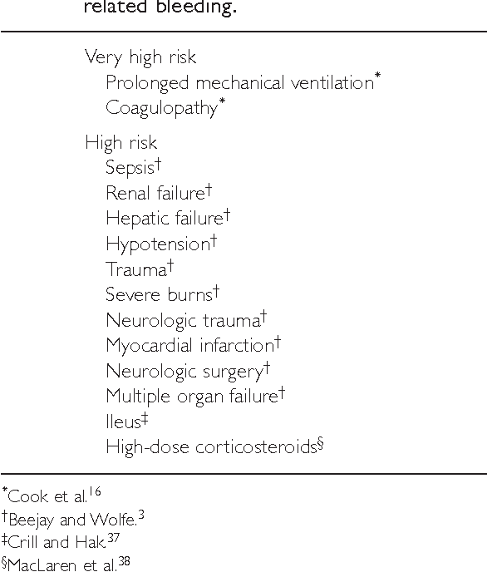
Stress factors for developing Stress Ulcer.

Slide 4
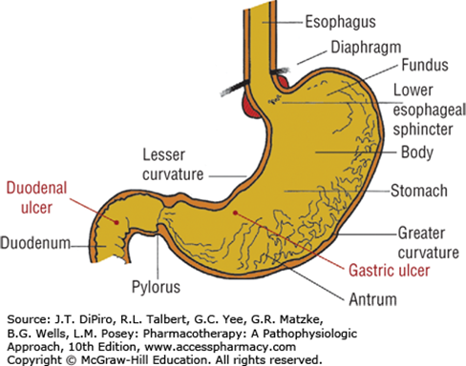
Occasionally, ulcers develop in the esophagus, jejunum, ileum, or colon.

Slide 5
Comparison of Common Forms of Peptic Ulcer.
Characteristic | H. Pylori -Induced | NSAID-Induced | SRMD
Condition | Chronic | Chronic | Acute
Site of damage | Duodenum > stomach | Stomach > duodenum | Stomach > duodenum
Intragastric pH | More dependent | Less dependent | Less dependent
Symptoms | Usually epigastric pain | Often asymptomatic | Asymptomatic
Ulcer depth | Superficial | Deep | Most superficial
GI bleeding | Less severe | More severe | More severe

Slide 6
Potential Causes of PUD
Critical illness (stress-related mucosal damage)
H. pylori infection and NSAID use
cigarette smoking, alcohol use
Virus
Vascular insufficiency
Medication non-adherence
gastric acid hypersecretion (Zollinger‐Ellison Syndrome)
Radiation
Chemotherapy

Slide 7
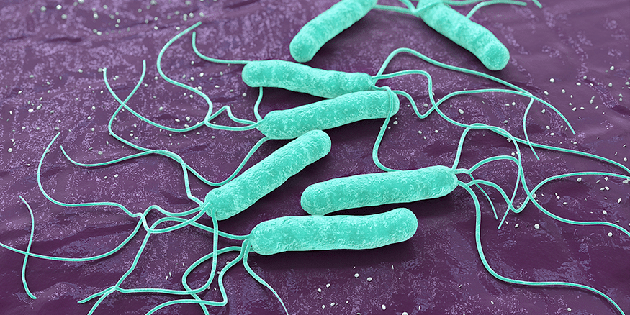
Etiology
H. pylori : H. pylori are spiral, microaerophilic, gram-negative bacteria with flagella that has urease, catalase, and oxidase activity. H. pylori is primarily transmitted via person to person routes by either gastro–oral (vomitus) or fecal–oral (diarrhea) contact. Risk factors for acquiring H. pylori include close contact within households, low socioeconomic status, and country of origin. PUD, mucosa-associated lymphoid tissue (MALT) lymphoma, and gastric cancer have all been linked to H. pylori infection.
2. Nonsteroidal Anti-Inflammatory Drugs: NSAID ulcers and related complications are dependent upon the dose, duration of use, and type of NSAID. Although dose is important, low doses of nonprescription NSAIDs and low cardioprotective dosages of aspirin (81-325 mg/day) can also be attributed to increased risk of ulcer formation. Factors such as NSAID potency, longer duration of effect, and a greater propensity to inhibit cyclooxygenase-1 (COX-1) versus cyclooxygenase-2 (COX-2) isoenzymes are associated with increased risk .

Slide 8
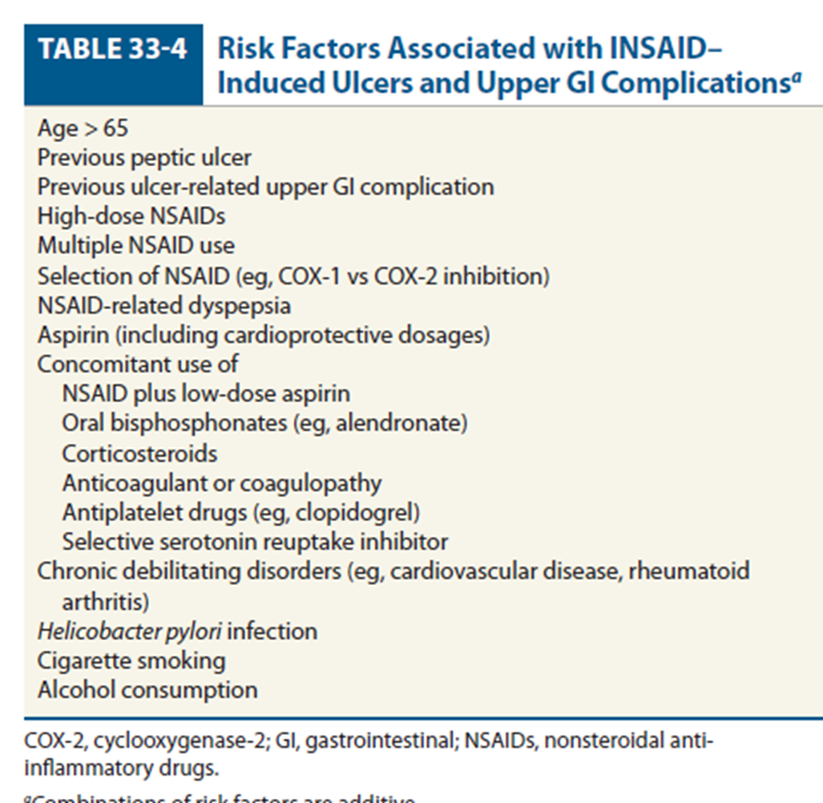

Slide 9
Etiology
Cigarette Smoking: Cigarette smoking impairs ulcer healing, promotes ulcer recurrence, and increases ulcer risk. However, the underlying mechanisms by which cigarette smoking exerts these adverse effects remains unclear. Possible mechanisms include mucosal ischemia, inhibition of pancreatic bicarbonate secretion, and increases in gastric acid and mucous secretion.
Psychological Stress: Emotional stress may induce behavioral risks such as smoking and the use of NSAIDs or alter the inflammatory response or resistance to H. pylori infection. The role of stress and how it affects PUD is complex and probably multifactorial.

Slide 10
PATHOPHYSIOLOGY
The pathophysiology of gastric and duodenal ulcers is determined by the balance between aggressive (gastric acid and pepsin) and protective (mucosal defense and repair) factors.
Helicobacter pylori:
1. Bacterial enzymes (urease, lipases, and proteases), bacterial adherence, and H. pylori virulence factors produce gastric mucosal injury.
2. H. pylori induces gastric inflammation by altering the host inflammatory response and damaging epithelial cells.
Nonsteroidal Anti-Inflammatory Drugs:
1. Direct toxicity to gastric epithethilal cells
3. inhibition of prostaglandin synthesis

Slide 11
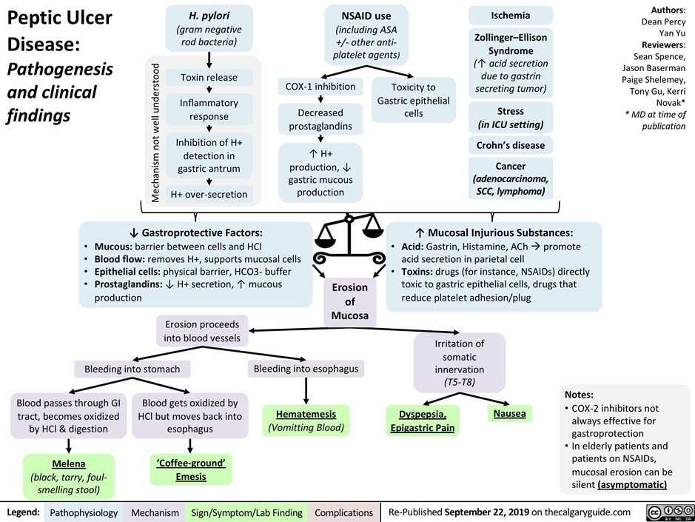

Slide 12
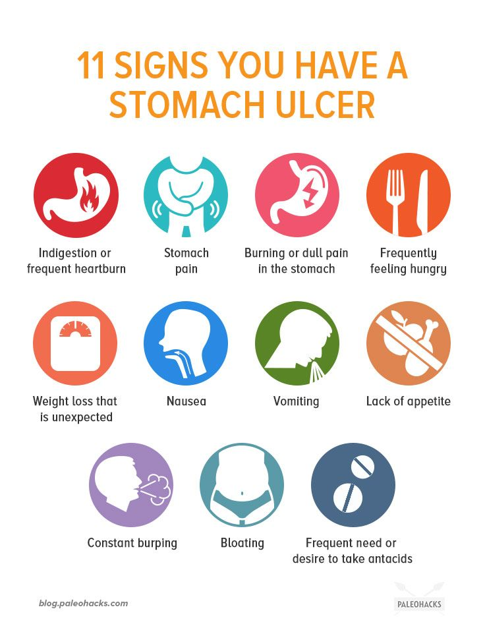
Signs and Symptoms
Symptoms
Abdominal pain that is often epigastric and described as burning but may present as vague discomfort, abdominal fullness, or cramping.
A typical nocturnal pain that awakens the patient from sleep (especially between 12 and 3 AM) .
Nausea, vomiting, and anorexia are more common for patients with gastric ulcer than with duodenal ulcer .
Heartburn, belching, and bloating often accompany the pain.
Signs
Weight loss associated with nausea, vomiting, and anorexia.
Complications including ulcer bleeding, perforation, penetration, or obstruction.

Slide 13
Alarm Symptoms
BLEEDING/ANEMIA
EARLY SATIETY
WEIGHT LOSS
DYSPHAGIA
ODYNOPHAGIA
RECURRENT VOMITING
FAMILY OR PERSONAL HX OF GI CANCER

Slide 14
Complications
Obstruction
Upper GI bleeding
Perforation
It may be occult (hidden) and insidious or may present as melena (black-colored stools) or hematemesis (vomiting of blood). NSAID use (especially in older adults) is the most important risk factor for upper GI bleeding. Deaths occur primarily in patients who continue to bleed or in those patients who re-bleed after the initial bleeding has stopped .
a hole forms all the way through the stomach, large bowel, or small intestine, and the gastric contents freely enter the general peritoneal cavity. The pain of perforation is usually sudden, sharp, and severe, beginning first in the epigastrium, but quickly spreading over the entire abdomen.
Gastric outlet obstruction is mechanical obstruction caused by scarring, muscular spasm, or edema of the duodenal bulb usually resulting from chronic ulceration. Symptoms occur over several months and include early satiety, bloating, anorexia, nausea, vomiting, and weight loss.

Slide 15
Diagnosis
The diagnosis of PUD depends on visualizing the ulcer crater by either upper GI radiography or upper endoscopy Upper endoscopy has replaced radiography as the diagnostic procedure of choice because it provides a more accurate diagnosis and permits direct visualization of the ulcer and implementation of therapeutic maneuvers.
Diagnosis of Helicobacter pylori.
• Invasive testing – requires endoscopy
• Noninvasive testing – no endoscopy

Slide 16
Diagnosis of H. pylori
Invasive testing – requires endoscopy
Testing that requires upper endoscopy is invasive, more expensive, and usually requires:
Mucosal biopsy for histology.
Detection of urease activity.
Culture (used in cases of treatment failure).
Because antibiotics and bismuth salts may decrease the sensitivity of rapid urease test, they should be withheld for 4 weeks and proton pump inhibitors (PPIs) for 2 weeks prior to endoscopic testing.

Slide 17
Diagnosis of H. pylori
Noninvasive testing – no endoscopy
Nonendoscopic tests are less invasive, more convenient, and less expensive than the endoscopic tests.
Antibody testing (IgG): 1. Fingerstick or blood test 2. Does not distinguish active vs. previous 3. Not affected by PPI, bismuth subsalicylate.
Urea breath test (UBT; 1.Ingest urea with carbon isotope (13C or 14C) 2. If urease present, urea is cleaved and labeled carbon excreted in CO2 3. Most accurate; ↓by antibiotics, bismuth, PPIs.
Fecal antigen test (FAT): 1. Antigen detected in stool 2.↓ by antibiotics, bismuth, PPIs

Slide 18
General Approach to Treatment
The treatment of chronic PUD varies depending on the etiology of the ulcer (H. pylori or NSAID), whether the ulcer is initial or recurrent, and whether complications have occurred .
Desired Outcomes are to : eradicate H. pylori, relieving ulcer pain, healing the ulcer, preventing ulcer recurrence, and reducing ulcer-related complications.
Antimicrobials such as clarithromycin, metronidazole, amoxicillin, bismuth salts, and antisecretory drugs (PPIs or H2RAs) eradicate H. pylori infection healing the ulcer and relieving ulcer symptoms.
PPIs are preferred to H2RAs or sucralfate for healing H. pylori-negative NSAID-induced ulcers because they accelerate ulcer healing and provide more effective relief of symptoms.

Slide 19
Non-pharmacologic Therapy
Patients with PUD should eliminate or reduce psychological stress, cigarette smoking, and the use of NSAIDs (including aspirin).
Although there is no “antiulcer diet,” the patient should avoid foods and beverages (eg, spicy foods, caffeine, and alcohol) that cause dyspepsia or that exacerbate ulcer symptoms.
If possible, alternative agents such as acetaminophen or non acetylated salicylate (eg, salsalate) should be used for relief of pain.
Elective surgery for PUD is rarely performed today because of highly effective medical management. A subset of patients, however, may require emergency surgery for bleeding, perforation, or obstruction.

Slide 20
Pharmacologic Therapy
Treatment of Helicobacter pylori–Positive Ulcers
Drug used: 1. Antibiotics – treat the infection : Amoxicillin • Clarithromycin • Metronidazole • Tetracycline
2. Bismuth subsalicylate (BSS)
3. Antisecretory agents – heal the ulcer: PPI or H2RA.
Bismuth subsalicylate (BSS): antibacterial effect, a local gastroprotective effect, and stimulation of endogenous PGs. S/E: black stools & tonque , constipation. Renal insufficiency may decrease bismuth elimination.

Slide 21
Regimens for H. pylori
PPI-based triple therapy
PPI once or twice daily +Clarithromycin 500 mg twice daily+ Amoxicillin 1 g twice daily.
- First‐line (cure rate 70‐85%).
- Duration 14 days.
- FDA approved.
Penicillin allergic?
PPI once or twice daily +Clarithromycin 500 mg twice daily+ metronidazole 500 mg twice daily.
- Duration 14 days.
- not FDA approved.
Or Bismuth-Based Quadruple Therapy.

Slide 22
Regimens for H. pylori
Bismuth-Based Quadruple Therapy.
PPI or H2RA once or twice daily +Bismuth subsalicylated 525 mg four times daily+ Metronidazole 250-500 mg four times daily+ Tetracycline 500 mg four times daily.
Good if previous macrolide exposure or allergic to penicillin.
alternative first-line eradication therapy, although this regimen may be used initially, it is often reserved as a second-line therapy after treatment failure with the PPI-based clarithromycin–amoxicillin regimen.
10- to 14-day duration.
High cure rate (80‐90%), but high pill burden.

Slide 23
Regimens for H. pylori
Sequential therapy
PPI once or twice daily on days 1 through 10 + Amoxicillin 1 g twice daily on days 1 through 5 +Metronidazole 250-500 mg twice daily on days 6 through 10 + Clarithromycin 250-500 mg twice daily on days 6 through 10.
The regimen requires a change in medication mid-treatment, which may contribute to nonadherence.
Beneficial in situations where antibiotic (particularly clarithromycin) resistance is high.
10 days duration.

Slide 24
Regimens for H. pylori
4. Non-Bismuth Quadruple “Concomitant” Therapy and Hybrid Therapy
- Non-Bismuth Quadruple or “Concomitant” Therapye
PPI once or twice daily on days 1 through 10 +Clarithromycin 250-500 mg twice daily on days
1-10 +Amoxicillin 1 g twice daily on days 1 through 10 +Metronidazole 250-500 mg twice daily on days 1 through 10.
- Hybrid Therapye
PPI once or twice daily on days 1 through 14 +Amoxicillin 1 g twice daily on days 1 through 14 +Metronidazole 250-500 mg twice daily on days 7 through 14+Clarithromycin 250-500 mg twice daily on days 7 through 14.

Slide 25
Regimens for H. pylori
Second-Line (Salvage) Therapy for Persistent Infections ( levofloxacin based)
Eradication of Helicobacter pylori After Initial Treatment Failure.
Second-line (salvage) treatment should :
use antibiotics that were not previously used during initial therapy;
use antibiotics that are not associated with resistance;
use a drug that has a topical effect such as bismuth;
extend the duration of treatment to 14 days.
Levofloxacin triple | 10-14 days | PPI twice daily | Levofloxacin 500 mg daily | Amoxacillin 1 g twice daily
Levofloxacin Sequential | 10 days | PPI twice daily on days 1-10 | Amoxicillin 1 g twice daily on days 1-10 | Levofloxacin 500 mg once daily on days 6-10 | Metronidazole 500 mg twice daily on days 6-10
LOAD | 7-10 days | Levofloxacin 250 mg once daily | Omeprazole (or other PPI) at high dose once daily | Nitazoxanide (Alinia) 500 mg twice daily | Doxycycline 100 mg once daily

Slide 26
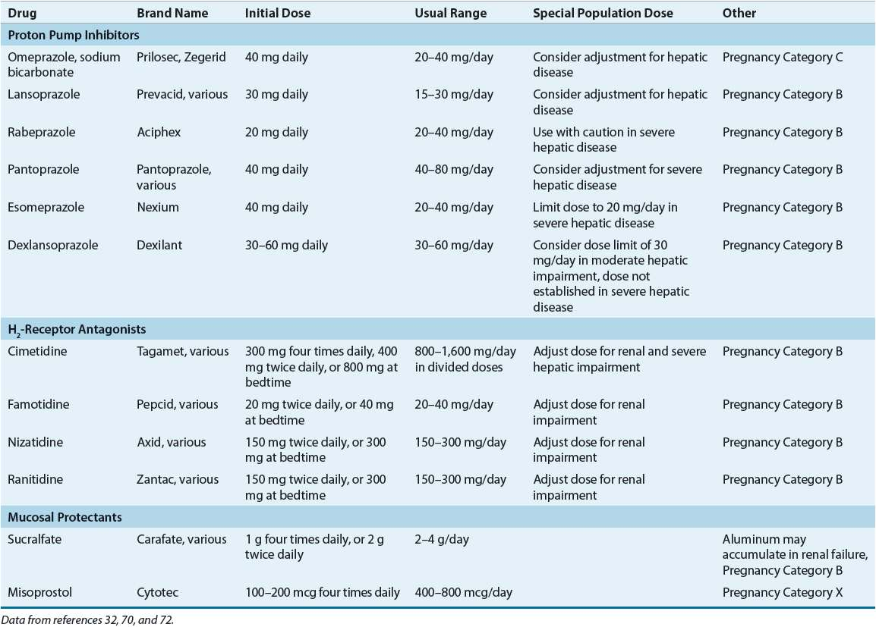

Slide 27
Regimen | Duration | Drug #1 | Drug #2 | Drug #3 | Drug #4
Proton Pump Inhibitor–Based Triple Therapyª | 14 days | PPI once or twice daily^{b} | Clarithromycin 500 mg twice daily | Amoxicillin 1 g twice daily or metronidazole 500 mg twice daily
Bismuth Quadruple Therapyª | 10-14 days | PPI or H2RA once or twice daily^{b,c} | Bismuth subsalicylate^{d} 525 mg four times daily | Metronidazole 250-500 mg four times daily | Tetracycline 500 mg four times daily
Non-Bismuth Quadruple or “Concomitant” Therapy^{e} | 10-14 days | PPI once or twice daily on days 1-10^{b} | Clarithromycin 250–500 mg twice daily on days 1-10 | Amoxicillin 1 g twice daily on days 1-10 | Metronidazole 250-500 mg twice daily on days 1-10
Sequential Therapy^{e} | 10 days | PPI once or twice daily on days 1-10^{b} | Amoxicillin 1 g twice daily on days 1-5 | Metronidazole 250–500 mg twice daily on days 6-10 | Clarithromycin 250-500 mg twice daily on days 6-10
Hybrid Therapy^{e} | 14 days | PPI once or twice daily on days 1-14^{b} | Amoxicillin 1 g twice daily on days 1-14 | Metronidazole 250–500 mg twice daily on days 7-14 | Clarithromycin 250-500 mg twice daily on days 7-14
Levofloxacin triple | 10-14 days | PPI twice daily | Levofloxacin 500 mg daily | Amoxacillin 1 g twice daily
Levofloxacin Sequential | 10 days | PPI twice daily on days 1-10 | Amoxicillin 1 g twice daily on days 1-10 | Levofloxacin 500 mg once daily on days 6-10 | Metronidazole 500 mg twice daily on days 6-10
LOAD | 7-10 days | Levofloxacin 250 mg once daily | Omeprazole (or other PPI) at high dose once daily | Nitazoxanide (Alinia) 500 mg twice daily | Doxycycline 100 mg once daily
Rifabutin-Based Triple Therapy | 14 days | Omeprazole 40 mg every 8 hours | Amoxicillin 1000 mg every 8 hours | Ribabutin 50 mg every 8 hours

Slide 28
Treatment of Nonsteroidal Anti-Inflammatory Drug-Induced Ulcers
NSAID therapy should be interrupted upon confirmation of an active ulcer. Once stopped, most uncomplicated NSAID ulcers heal with standard 8-week regimens of an H2RA, PPI, or sucralfate.
In patients where the NSAID is continued despite ulceration, treatment with a PPI or misoprostol should be initiated. PPIs are the drugs of choice when the NSAID is continued, as potent acid suppression is required to accelerate ulcer healing. PPI treatment duration should be extended 12 weeks if the NSAID must be continued.
In addition, consideration should be given to reducing the NSAID dose, switching to acetaminophen or a nonacetylated salicylate, or using a selective COX-2 inhibitor.

Slide 29
Cyclooxygenase-2 Inhibitors
COX-2 inhibitors are a group of drugs that preferentially act on the cyclooxygenase-2 enzyme, exhibiting equivalent anti-inflammatory activity of traditional NSAIDs without the increased risk of gastric or duodenal ulcers, avoidance of COX-1 isoenzyme inhibition preserves prostaglandin production and its beneficial gastroprotective effects.
S/E: Dyspepsia and abdominal pain, fluid retention, hypertension, and renal toxicity are associated with the COX-2 inhibitors including upper GI bleeding and cardiovascular risks.
Sucralfate
Sucralfate heals peptic ulcers but is not widely used today for this indication. Deterrents to its use include the requirement for multiple doses per day, large tablet size, and the need to separate the drug from meals and potentially interacting medications (eg, fluoroquinolones).
S/E; Constipation especially in older individuals, and seizures have been observed in dialysis patients taking aluminum-containing antacids. Hypophosphatemia may develop with long-term treatment.

Slide 30
Selected NSAIDs and COX-2 Inhibitors
Nonsalicylatesª Nonselective (traditional) NSAIDs: indomethacin, piroxicam, ibuprofen, naproxen, sulindac, ketoprofen, ketorolac, flurbiprofen Partially selective NSAIDs: etodolac, nabumetone, meloxicam, diclofenac, celecoxib Selective COX-2 inhibitors: rofecoxib,^{b} valdecoxib^{b}
Salicylates Acetylated: aspirin Nonacetylated: salsalate, trisalicylate

Slide 31
Treatment of Nonsteroidal Anti-Inflammatory Drug-Induced Ulcers
Prevention of NSAID‐Induced Ulcers
Use a COX‐2 inhibitor instead of an NSAID
co-therapy of an NSAID with:
proton pump inhibitor
misoprostol : it is a synthetic PGE1 analog, has dual gastroprotective effects by improving mucosal blood flow and by stimulating gastric mucous and bicarbonate secretion, dose: 400-600mg/day, S/E: high-rates of nausea, diarrhea, and abdominal cramping that increase with the dose limiting its clinical utility. Pregnancy category X
high‐dose H2RA : Double dose H2RA , Less effective than PPIs .
.

Slide 32
Related disorders
Zollinger-Ellison Syndrome
ZES, characterized by hypersecretion of gastric acid and severe gastroesophageal PUD, is caused by a neuroendocrine tumor (gastrinoma) that is present in the duodenum or pancreas. Patients with ZES presented with refractory PUD or complications of acid hypersecretion (perforation, penetration, bleeding, and esophageal stricture).
Treatment : Initial doses of 80 mg/day for pantoprazole (or an equivalent dose of other available PPIs) given every 8 to 12 hours.
2. Peptic Ulcer–Related Bleeding
Hematemesis (vomiting up blood), melena (dark, tarry stools), or both are most common presenting signs and symptoms of PUD-related bleeding.
Treatment : practice guidelines recommended that high-dose continuous-infusion PPI therapy (equivalent to omeprazole 80 mg given IV as a loading dose, followed by 8 mg/h continuous infusion for 72 hours) However, there is no benefit in high dose or continuous therapy respectively. Thus, intermittent IV dosing of PPIs (at cumulative daily doses of 80-160 mg) may be a therapeutic option that provides a greater ease of administration.

Slide 33
Related disorders
3. Stress-Related Mucosal Bleeding
Bleeding associated with SRMD develops in severely ill patients during hospitalization. The primary pathogenic factor of SRMD in critically ill patients is thought to be mucosal ischemia, which is a result of reduced gastric blood flow resulting from splanchnic hypoperfusion.
Prevention and Treatment:
For the prevention of SRMB , patients who can take oral medication or have a working NG tube in place may be placed on an oral H2RA or PPI suspension as a cost-effective measure.
For most patients who are not able to utilize one of these routes, an IV H2RA is appropriate. However, if the patient has any relative or absolute contraindications to an H2RA, then an IV PPI may be the most appropriate prophylaxis option.
If a patient develops clinically important bleeding, endoscopic evaluation of the GI tract is indicated along with aggressive antisecretory therapy.

Slide 34
References
Pharmacotherapy: A Pathophysiologic Approach, 11e
Pharmacotherapy: A Pathophysiologic Approach, 10e

