Slide 1
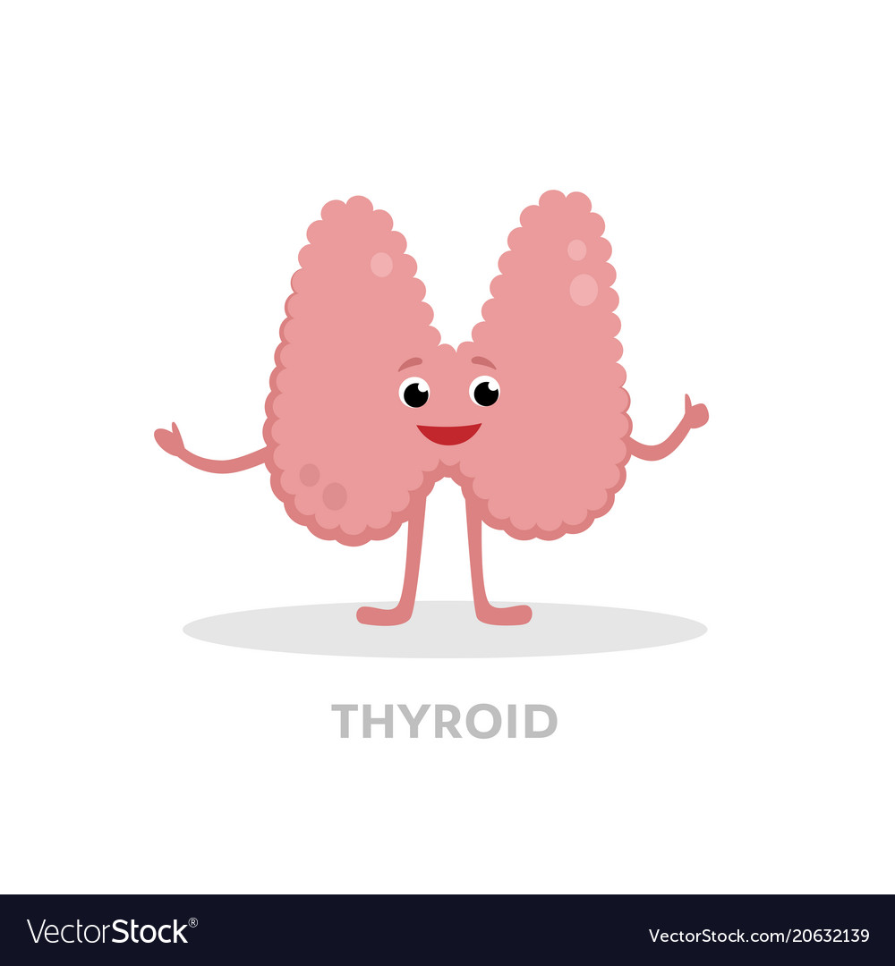
Thyroid Disorders
Done by: Hanan Nofal

Slide 2
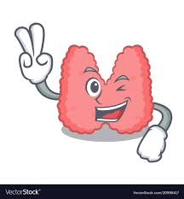
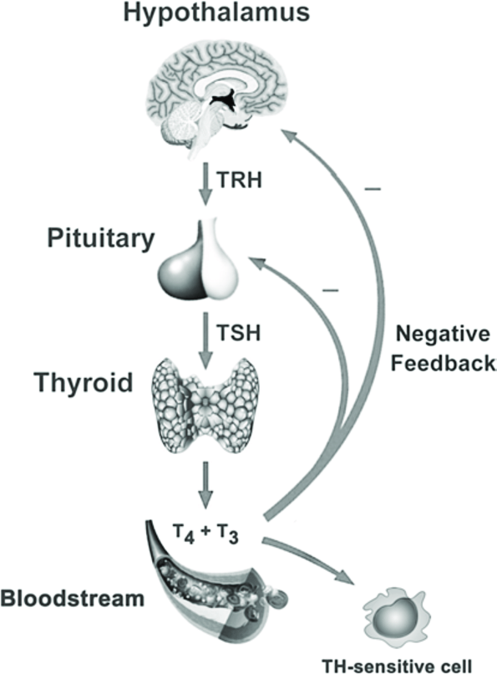
Introduction
Thyroid hormones affect the function of virtually every organ system.
thyroid hormone is critical for normal growth and development in children, while adults need the thyroid hormone to maintain metabolic stability.
the hypothalamic–pituitary–thyroid axis is extremely sensitive to small changes in circulating thyroid hormone concentrations, and alterations in thyroid hormone secretion maintain peripheral free thyroid hormone levels within a narrow range.

Slide 3
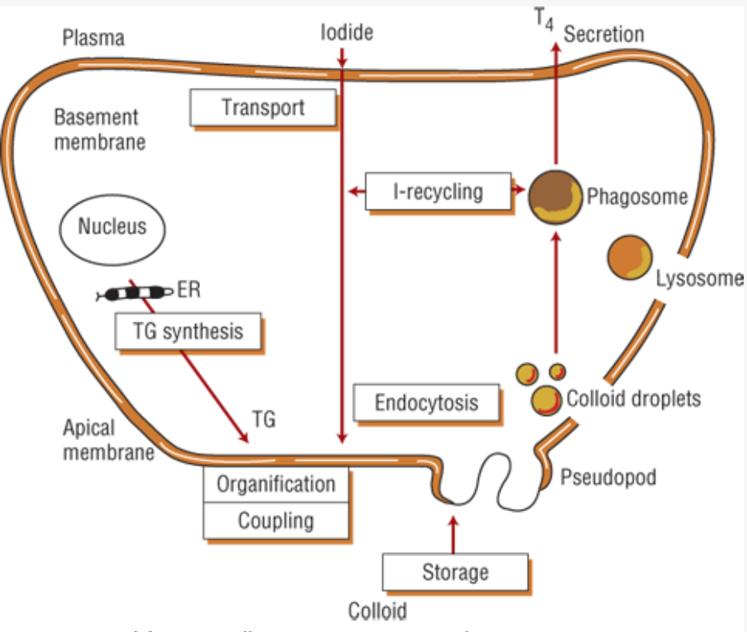
Thyroid hormone synthesis
Thyroxine (T₄) and triiodothyronine (T₃) are formed on thyroglobulin, a large glycoprotein synthesized within the thyroid cell.
Inorganic iodide enters the thyroid follicular cell and is oxidized by thyroid peroxidase and covalently bound (organified) to tyrosine residues of thyroglobulin.
Iodinated tyrosine residues monoiodotyrosine (MIT) and diiodotyrosine (DIT) combine (couple) to form iodothyronines in reactions catalyzed by thyroid peroxidase.

Slide 4
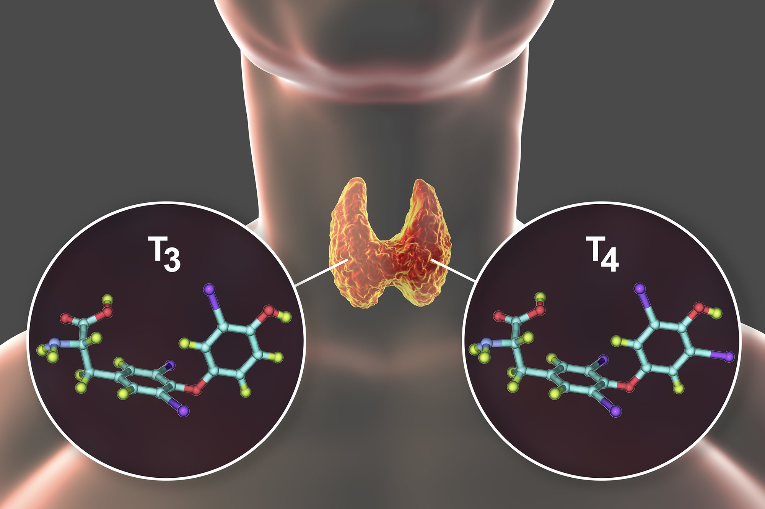
Thyroid hormone synthesis
two molecules of DIT combine to form T4, and MIT and DIT join to form T3.
Proteolysis within thyroid cells releases thyroid hormone into the bloodstream.
T₄ and T₃ are transported by thyroid-binding globulin (TBG), transthyretin, and albumin.
Only the unbound (free) thyroid hormone can diffuse into cells, elicit biologic effects, and regulate thyroid-stimulating hormone (TSH) secretion from the pituitary.

Slide 5
Thyroid hormone synthesis
T₄ is secreted solely from the thyroid, while less than 20% of T₃ is produced there; most T₃ is formed from breakdown of T₄ catalyzed by the enzyme 5′-monodeiodinase in extrathyroidal peripheral tissues.
T₃ is five times more active than T₄. T₄ may also be acted on by 5-monodeiodinase to form reverse T₃, which has no known biologic activity.

Slide 6
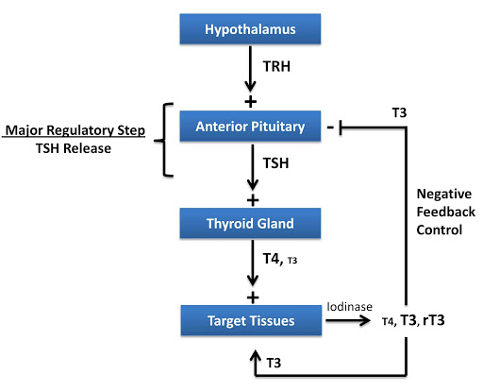
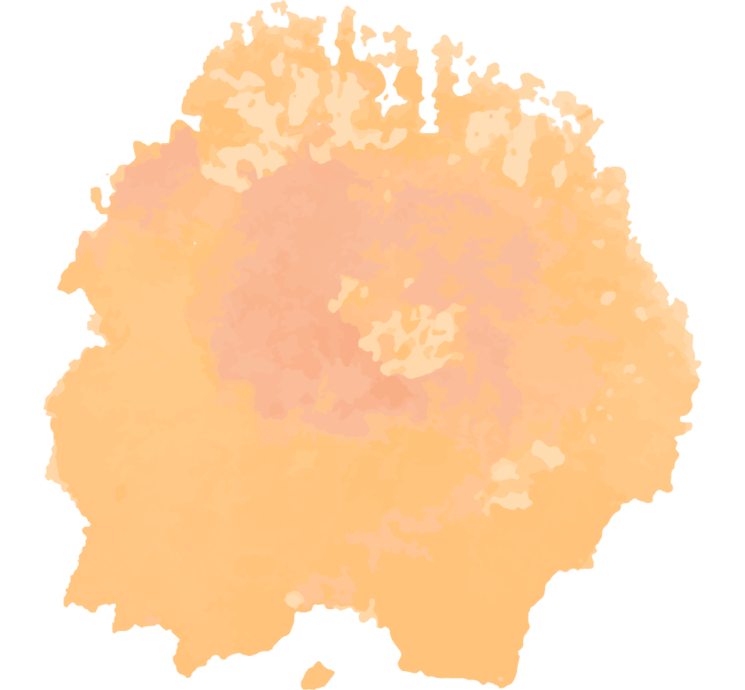
Thyroid Hormone Regulation
1
2
The production of thyroid hormone is regulated in two main ways
thyroid hormone is regulated by TSH secreted by the anterior pituitary. The secretion of TSH is itself under negative feedback control by the circulating level of free thyroid hormone and the positive influence of hypothalamic thyrotropin-releasing hormone (TRH)
It is also regulated by thr extrathyroidal deiodination of T4 to T3 is regulated by a variety of factors including nutrition, nonthyroidal hormones, ambient temperatures, drugs, and illness.

Slide 7
HYPERTHYROIDISM AND THYROTOXICOSIS
1
Thyrotoxicosis results when tissues are exposed to excessive levels of T4, T3, or both

Slide 8
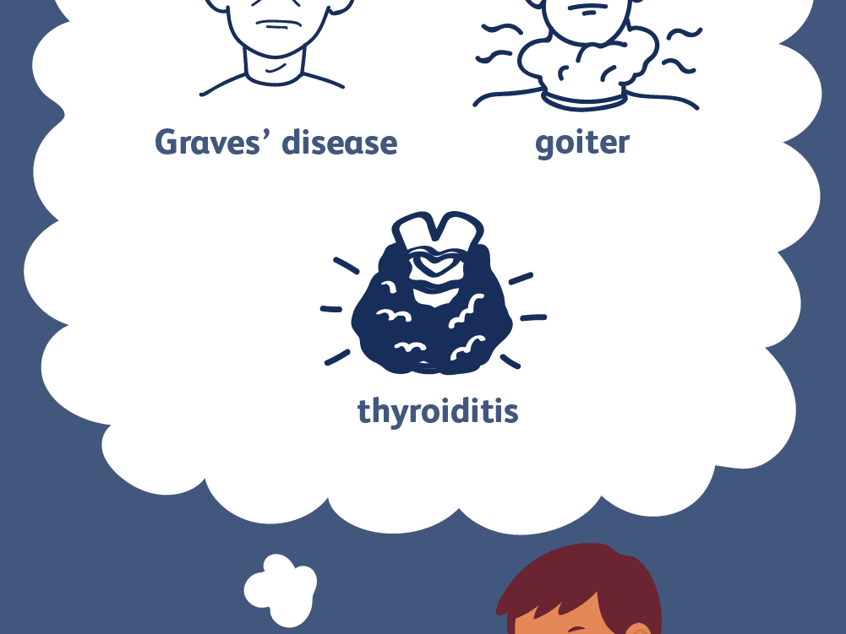
Thyrotoxicosis
Etiology and pathophysiology:
If the clinical history and examination do not provide pathognomonic clues to the etiology of the patient’s thyrotoxicosis, measurement of the radioactive iodine uptake (RAIU) is critical in the evaluation
the normal 24-hour RAIU ranges from 10% to 30% with some regional variation that is due to differences in iodine intake.
An elevated RAIU indicates endogenous hyperthyroidism, that is, the patient’s thyroid gland is actively overproducing T4, T3, or both.
a low RAIU in the absence of iodine excess indicates that high levels of thyroid hormone are likely due to thyroiditis or hormone ingestion.

Slide 9
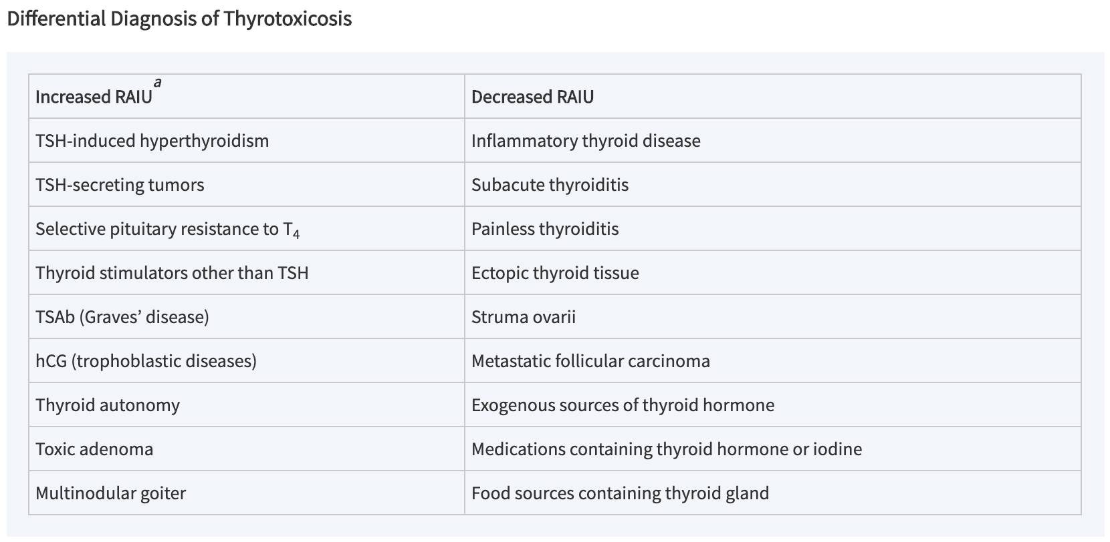

Slide 10
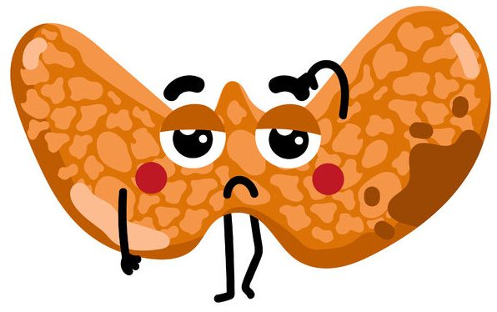
Hyperthyroidism, TSH-secreting pituitary tumors
Hyperthyroidism, which is one cause of thyrotoxicosis, refers to overproduction of thyroid hormone by the thyroid gland.
TSH-secreting pituitary tumors occur sporadically and release biologically active hormone that is unresponsive to normal feedback control.
The tumors may co-secrete prolactin or growth hormone; therefore, patients may present with amenorrhea, galactorrhea, or signs of acromegaly.

Slide 11
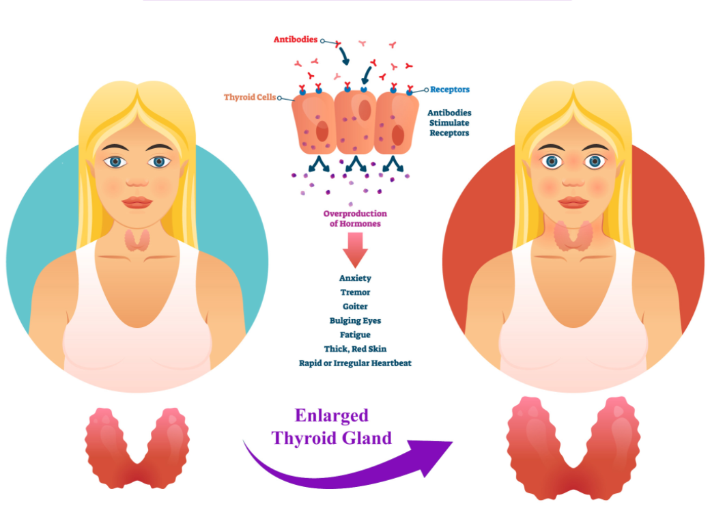
Graves’ disease
Graves’ disease is the most common cause of hyperthyroidism, which results from the action of thyroid-stimulating antibodies (TSAb) directed against the thyrotropin receptor on the surface of thyroid cell.
These immunoglobulins bind to the receptor and activate the enzyme adenylate cyclase in the same manner as TSH.
Features of Graves’ disease include: changes in facial appearance as lid retraction, periorbital edema, and proptosis, thyroid dermopathy over the lateral aspects of the shins, thyroid acropachy.

Slide 12
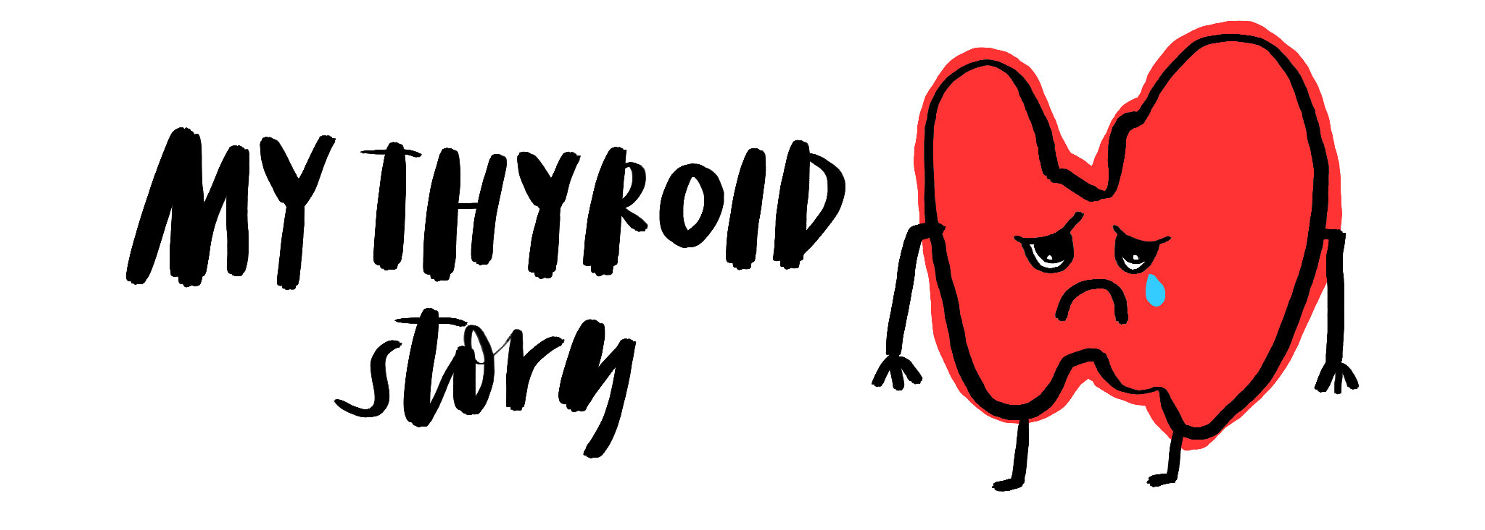
Pituitary resistance to thyroid hormone
Resistance to thyroid hormone occurs rarely and can be due to various molecular defects, including mutations in the TRβ gene.
Pituitary resistance to thyroid hormone (PRTH) refers to selective resistance of the pituitary thyrotrophs to thyroid hormone.
Patients with PRTH require treatment to reduce their elevated thyroid hormone levels.

Slide 13
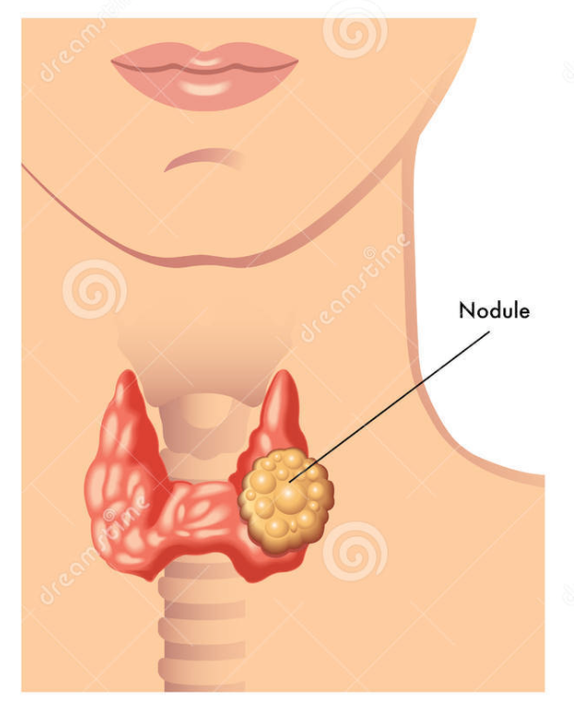
Autonomous thyroid nodule & multinodular goiter
An autonomous thyroid nodule (toxic adenoma) is a thyroid mass whose function is independent of pituitary control. Hyperthyroidism usually occurs with larger nodules (>3 cm in diameter).
In multinodular goiter, follicles with autonomous function coexist with normal or even nonfunctioning follicles. Thyrotoxicosis occurs when autonomous follicles generate more thyroid hormone than is required.

Slide 14
Thyrotoxicosis factitia
Thyrotoxicosis factitia is hyperthyroidism produced by ingestion of exogenous thyroid hormone.
This may occur when thyroid hormone is used for inappropriate indications, excessive doses are used for accepted medical indications, there is accidental ingestion, or it is used surreptitiously.

Slide 15
Thyroiditis
Painful subacute (granulomatous or de Quervain) thyroiditis often develops after a viral syndrome, but rarely has a specific virus been identified in thyroid parenchyma.
Painless (silent, lymphocytic, or postpartum) thyroiditis is a common cause of thyrotoxicosis; its etiology is not fully understood; autoimmunity may underlie most cases.

Slide 16
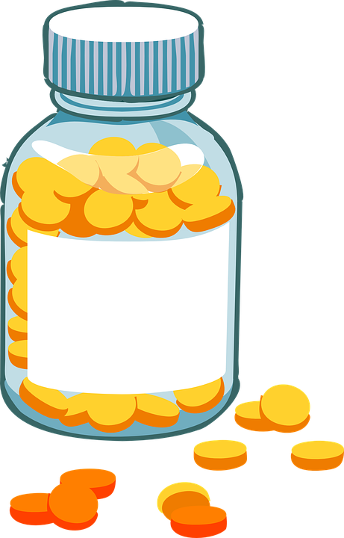
Medications Containing Iodine
Amiodarone may induce thyrotoxicosis (2%–3% of patients) or hypothyroidism.
amiodarone contains 37% iodine by weight
It interferes with type I 5′-deiodinase, leading to reduced conversion of T₄ to T₃, and iodide release from the drug may contribute to iodine excess.
Amiodarone also causes a destructive thyroiditis with loss of thyroglobulin and thyroid hormones.
Amiodarone

Slide 17
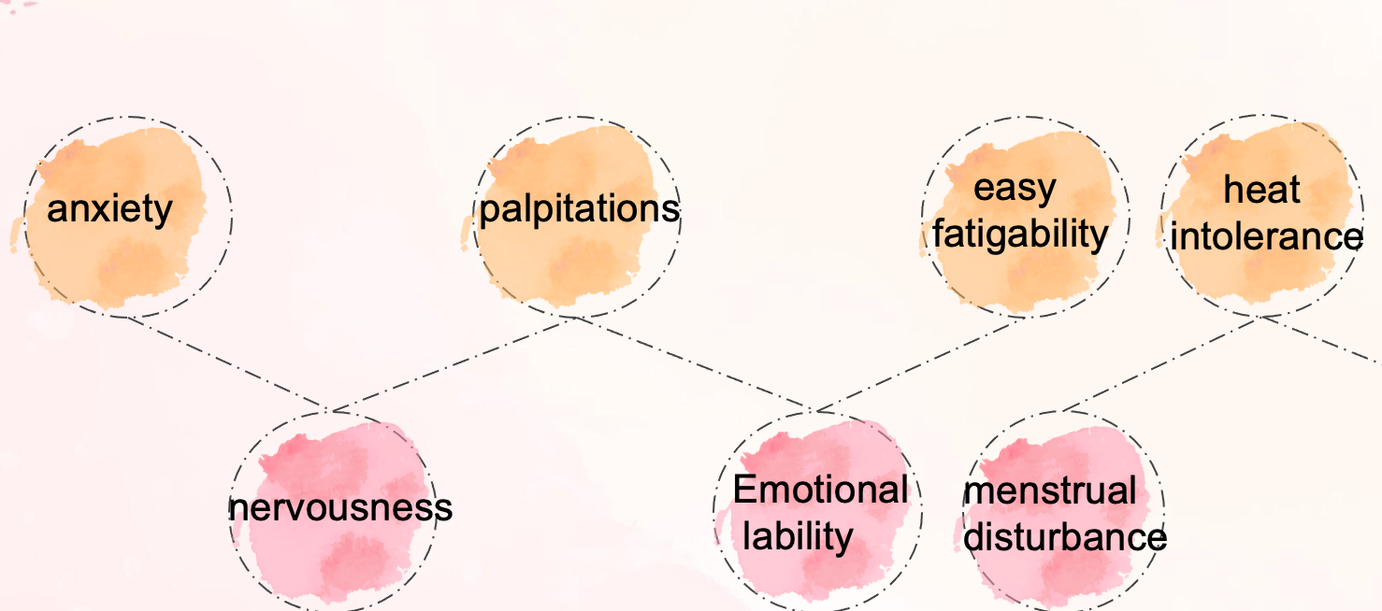
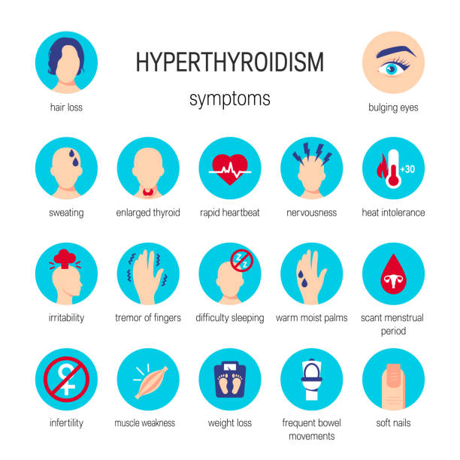
Clinical presentation
A cardinal sign is loss of weight concurrent with an increased appetite.

Slide 18
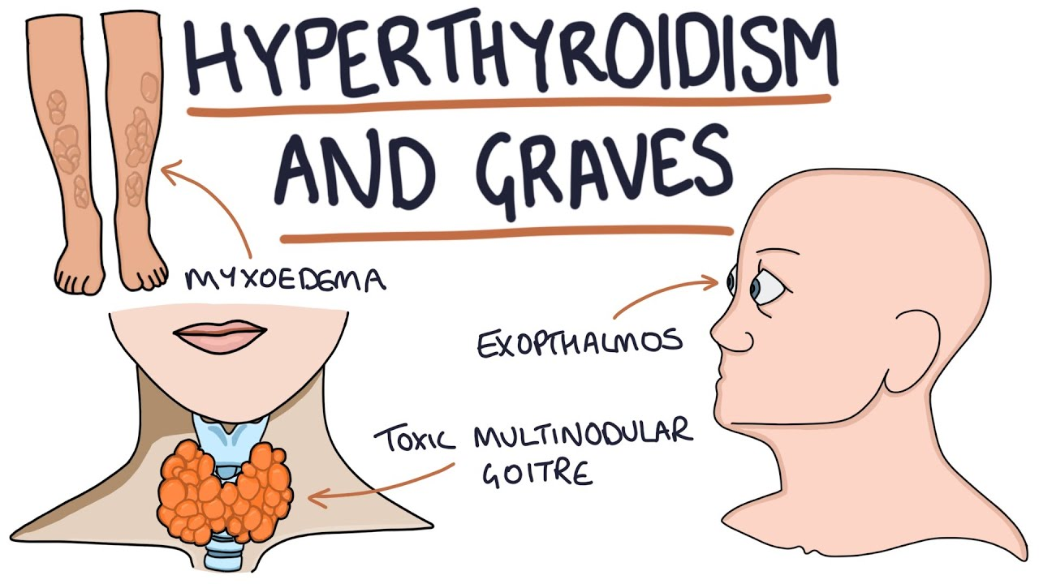
Clinical presentation
Signs:
A variety of physical signs may be observed including warm, smooth, moist skin, exophthalmos (in Graves’ disease only), pretibial myxedema (in Graves’ disease only), and unusually fine hair.
Thyromegaly is usually present

Slide 19
DIAGNOSIS
Low TSH serum concentration.
Elevated free and total T4 and T3 serum concentrations, particularly in more severe disease.
Elevated radioactive iodine uptake (RAIU) by the thyroid gland when hormone is being overproduced; suppressed RAIU in thyrotoxicosis due to thyroid inflammation (thyroiditis).

Slide 20
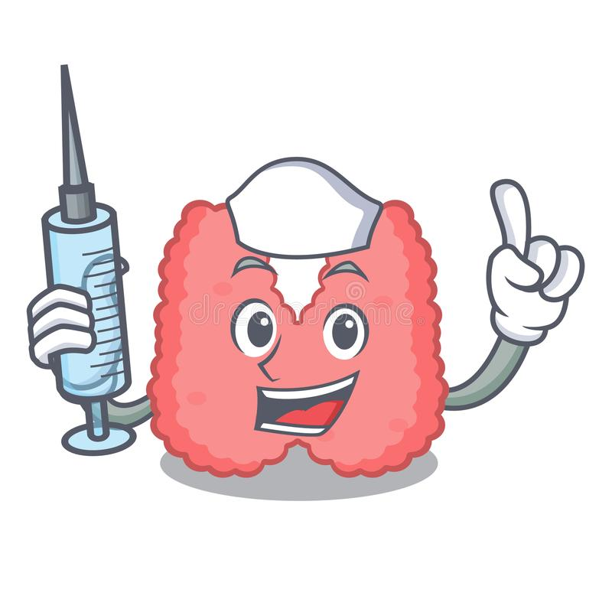
Treatment
Three common treatment modalities are used in the management of hyperthyroidism:
Antithyroid medications
Radioactive iodine
Surgery

Slide 21
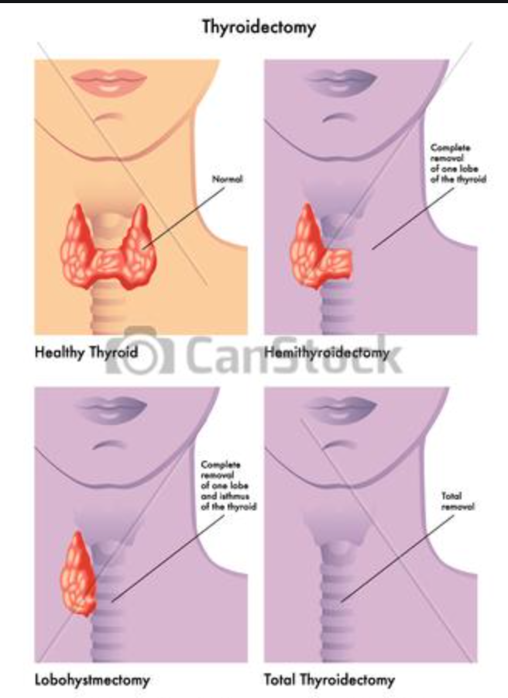
Nonpharmacologic Therapy (Surgery)
Surgical removal of the thyroid gland should be considered in patients with a large gland (>80 g), severe ophthalmopathy, or lack of remission on antithyroid drug treatment.
If thyroidectomy is planned, methimazole is usually given until the patient is biochemically euthyroid (usually 6–8 weeks), followed by addition of iodides (500 mg/day) for 10 to 14 days before surgery to decrease vascularity of the gland.
Levothyroxine may be added to maintain the euthyroid state while thionamides are continued.
Propranolol has been used for several weeks preoperatively and 7 to 10 days after surgery to maintain pulse rate less than 90 beats/min.
Combined pretreatment with propranolol and 10 to 14 days of potassium iodide also has been advocated.

Slide 22
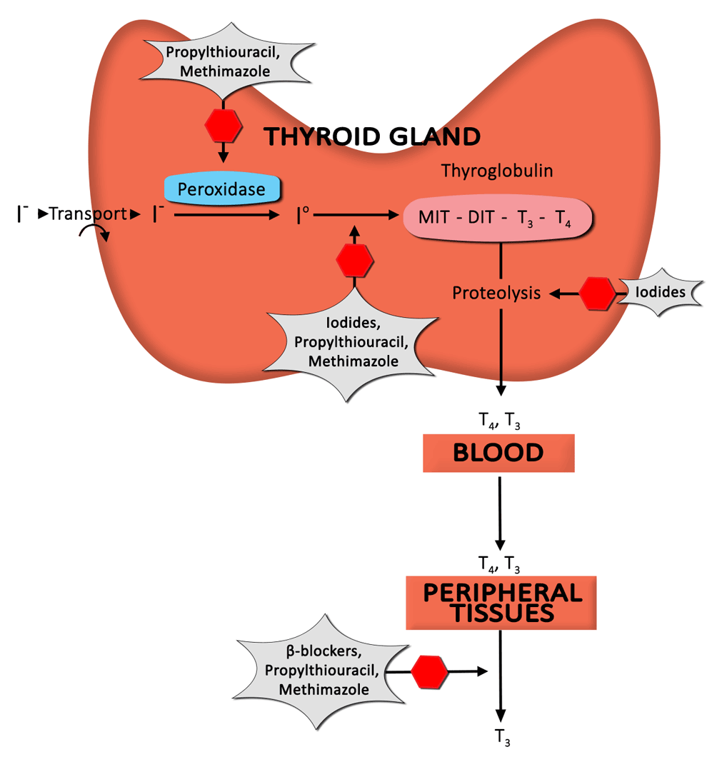
Pharmacological Therapy
THIOUREAS (THIONAMIDES)
IODIDES
ADRENERGIC BLOCKER
RADIOACTIVE IODINE

Slide 23
THIOUREAS (THIONAMIDES)
Agents: Methimazole and Propylthiouracil (PTU)
MOA: they block thyroid hormone synthesis by inhibiting the peroxidase enzyme system of the thyroid, preventing oxidation of trapped iodide and subsequent incorporation into iodotyrosines and ultimately iodothyronine (“organification”), also they inhibit coupling of MIT and DIT to form T4 and T3.
PTU also inhibits peripheral conversion of T₄ to T₃. MMI does not have this effect.
Experimentally, these drugs exhibit immunosuppressive effects, although the clinical relevance of this finding is unclear.
Improvement in symptoms and laboratory abnormalities should occur within 4 to 8 weeks, at which time a tapering regimen to maintenance doses can be started.

Slide 24
THIOUREAS (THIONAMIDES)
Dosing and administration
MMI is available as 5 and 10 mg tablets and PTU as 50 mg tablets.
MMI is approximately 10 to 20 times more potent than PTU.
Initial therapy with MMI is given in two or three divided doses totaling 30 to 60 mg/day. PTU is given in dose ranges from 300 to 600 mg daily, usually in three or four divided doses.
Monitoring
Monitor patients every 6 to 12 months after remission.
If a relapse occurs, alternate therapy with RAI is preferred to a second course of antithyroid drugs, because subsequent courses are less likely to induce remission.

Slide 25
THIOUREAS (THIONAMIDES)
Major side effects:
agranulocytosis (with fever, malaise, gingivitis, oropharyngeal infection, and granulocyte count <250/mm³ or 0.25 × 10⁹/L), aplastic anemia, lupus-like syndrome, polymyositis, GI intolerance, hepatotoxicity, and hypoprothrombinemia.
agranulocytosis occurs usually develops in the first 3 months of therapy; routine WBC count monitoring is not recommended because of its sudden onset.
Minor side effects:
pruritic maculopapular rashes, arthralgias, fever, and benign transient leukopenia (white blood cell count <4000/mm³ or 4 × 10⁹/L). The alternate thiourea may be tried in these situations, but cross-sensitivity occurs in about 50% of patients.

Slide 26
THIOUREAS (THIONAMIDES)
Because of the risk of serious hepatotoxicity, PTU should not be considered first-line therapy in either adults or children.
Exceptions to this recommendation include:
the first trimester of pregnancy, when the risk of methimazole-induced embryopathy may exceed that of PTU-induced hepatotoxicity.
intolerance to methimazole
thyroid storm

Slide 27
IODIDES
MOA: Iodide acutely blocks thyroid hormone release, inhibits thyroid hormone biosynthesis by interfering with intrathyroidal iodide use, and decreases size and vascularity of the gland.
Symptom improvement occurs within 2 to 7 days of initiating therapy, and serum T₄ and T₃concentrations may be reduced for a few weeks.
Iodides are often used:
as adjunctive therapy to prepare a patient with Graves’ disease for surgery,
to acutely inhibit thyroid hormone release and quickly attain the euthyroid state in severely thyrotoxic patients with cardiac decompensation,
or to inhibit thyroid hormone release after RAI therapy.

Slide 28
IODIDES
Potassium iodide is available as a saturated solution (SSKI) or as Lugol solution
As an adjunct to RAI, SSKI should not be used before but rather 3 to 7 days after RAI treatment so the RAI can concentrate in the thyroid.
Adverse effects:
hypersensitivity reactions (skin rashes, drug fever, and rhinitis, conjunctivitis)
salivary gland swelling
“iodism” (metallic taste, burning mouth and throat, sore teeth and gums, symptoms of a head cold, and sometimes stomach upset and diarrhea)
gynecomastia.

Slide 29
ADRENERGIC BLOCKERS
β-Blockers are used to ameliorate symptoms such as palpitations, anxiety, tremor, and heat intolerance.
They have no effect on peripheral thyrotoxicosis and protein metabolism and do not reduce TSAb or prevent thyroid storm.
Propranolol and nadolol partially block conversion of T₄ to T₃, but this contribution to overall effect is small.
β-Blockers are usually used as adjunctive therapy with antithyroid drugs, RAI, or iodides when treating Graves’ disease or toxic nodules; in preparation for surgery; or in thyroid storm.
The only conditions for which β-blockers are primary therapy for thyrotoxicosis are those associated with thyroiditis.

Slide 30
ADRENERGIC BLOCKERS
β-Blockers are contraindicated in decompensated heart failure unless it is caused solely by tachycardia (high output).
Other contraindications are sinus bradycardia, concomitant therapy with monoamine oxidase inhibitors or tricyclic antidepressants, and patients with spontaneous hypoglycemia.
Side effects include nausea, vomiting, anxiety, insomnia, lightheadedness, bradycardia, and hematologic disturbances.
Centrally acting sympatholytics (eg, clonidine) and calcium channel antagonists (eg, diltiazem) may be useful for symptom control when contraindications to β-blockade exist

Slide 31
RADIOACTIVE IODINE
RAI is administered as a colorless and tasteless liquid that is well absorbed and concentrates in the thyroid.
MOA: disrupts hormone synthesis by incorporating into thyroid hormones and thyroglobulin. Over a period of weeks, follicles that have taken up RAI and surrounding follicles develop evidence of cellular necrosis and fibrosis of interstitial tissue.
RAI is the agent of choice for Graves’ disease, toxic autonomous nodules, and toxic multinodular goiters.
Pregnancy is an absolute contraindication to use of RAI because radiation would be delivered to the fetal tissue.

Slide 32
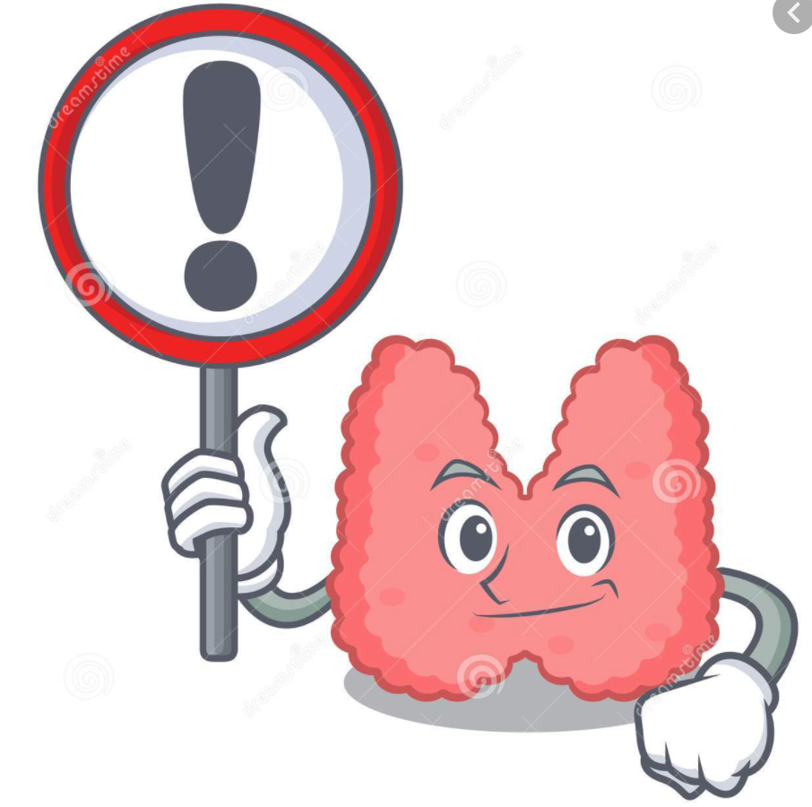
RADIOACTIVE IODINE
β-Blockers are the mainstay adjunctive therapy to RAI because they may be given anytime without compromising RAI therapy.
If iodides are administered, they should be given 3 to 7 days after RAI to prevent interference with uptake of RAI in the thyroid gland.
Patients with cardiac disease and elderly patients are often treated with thionamides prior to RAI ablation because thyroid hormone levels transiently increase after RAI treatment due to release of preformed thyroid hormone
Administering antithyroid drug therapy immediately after RAI may result in a higher rate of posttreatment recurrence or persistent hyperthyroidism.

Slide 33
RADIOACTIVE IODINE
Use of lithium as adjunctive therapy to RAI has benefits of increased cure rate, shortened time to cure, and prevention of posttherapy increases in thyroid hormone levels.
The goal of therapy is to destroy overactive thyroid cells, and a single dose of 4000 to 8000 rad (40–80 Gy) results in a euthyroid state in 60% of patients at 6 months or sooner.
A second dose of RAI should be given 6 months after the first RAI treatment if the patient remains hyperthyroid.
Side effects: Hypothyroidism commonly occurs months to years after RAI. The acute, short-term side effects include mild thyroidal tenderness and dysphagia.

Slide 34
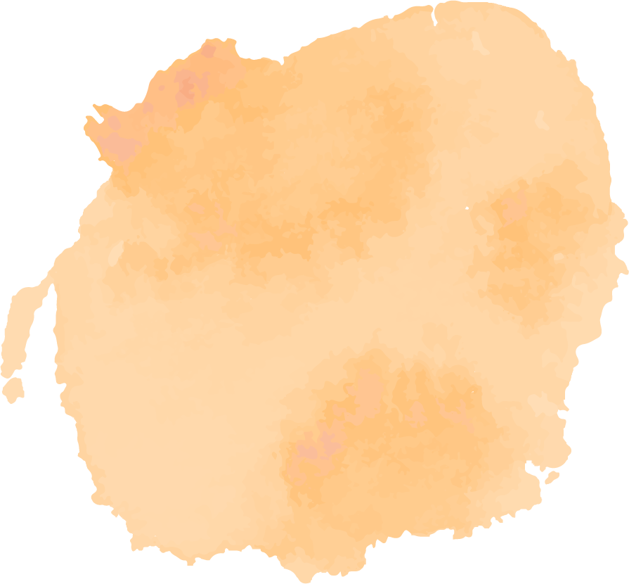
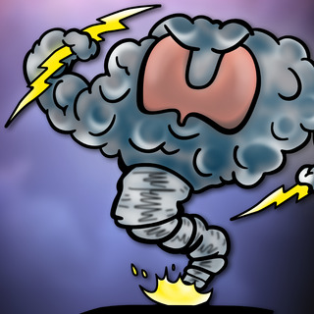
Thyroid storm
Thyroid storm is a life-threatening medical emergency characterized by decompensated thyrotoxicosis, high fever (often >39.4°C [103°F]), tachycardia, tachypnea, dehydration, delirium, coma, nausea, vomiting, and diarrhea.
Precipitating factors include infection, trauma, surgery, radioactive iodine (RAI) treatment, and withdrawal from antithyroid drugs.

Slide 35
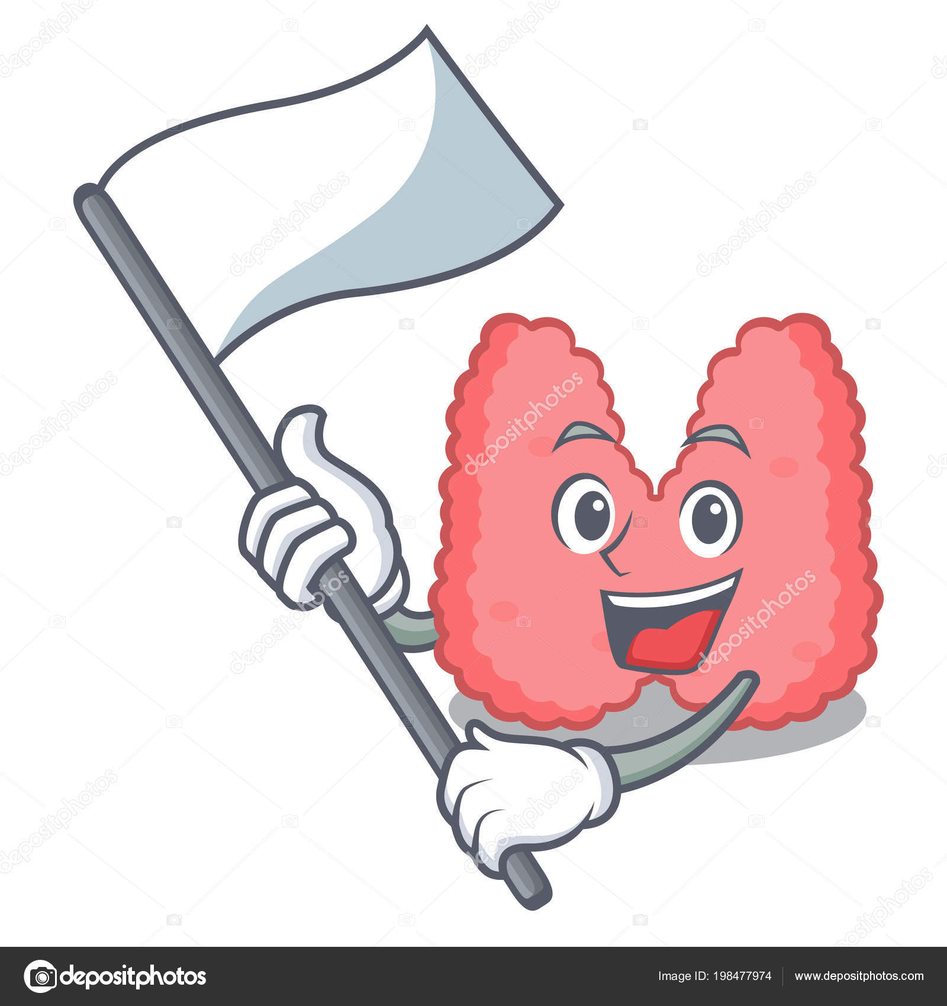
Treatment of Thyroid Storm
The following therapeutic measures should be instituted promptly:
suppression of thyroid hormone formation and secretion
Antiadrenergic therapy
Administration of corticosteroids
Treatment of associated complications or coexisting factors that may have precipitated the storm

Slide 36
Treatment of Thyroid Storm
PTU in large doses may be the preferred thionamide because it blocks peripheral conversion of T₄ to T₃in addition to interfering with thyroid hormone production.
However, β-blockers and corticosteroids serve the same purpose.
A theoretical advantage of Methimazole is that it has a longer duration of action.
Iodides, which rapidly block the release of preformed thyroid hormone, should be administered after a thionamide is initiated to inhibit iodide utilization by the overactive gland.
Antiadrenergic therapy with the short-acting agent esmolol is preferred because it can be used in patients with pulmonary disease or at risk for cardiac failure and because its effects can be rapidly reversed.

Slide 37
Treatment of Thyroid Storm
Corticosteroids are generally recommended, while there is no convincing evidence of adrenocortical insufficiency in thyroid storm, their benefits may be attributed to their antipyretic action and stabilization of blood pressure (BP).
General supportive measures, including :
acetaminophen as an antipyretic (avoid aspirin or other NSAIDs, as they may displace bound thyroid hormone)
fluid and electrolyte replacement
sedatives,
digoxin,
antiarrhythmics,
insulin,
antibiotics should be given as indicated.

Slide 38
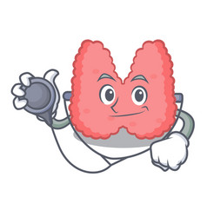
EVALUATION OF THERAPEUTIC OUTCOMES
After therapy (surgery, thionamides, or RAI) for hyperthyroidism has been initiated, evaluate patients monthly until they reach a euthyroid condition.
clinical signs of continuing thyrotoxicosis or development of hypothyroidism should be closely noted.
If T₄ replacement is initiated, the goal is to maintain both the free T₄ level and the TSH concentration in the normal range.
Once a stable dose of T₄ is identified, monitor the patient every 6 to 12 months.

Slide 39
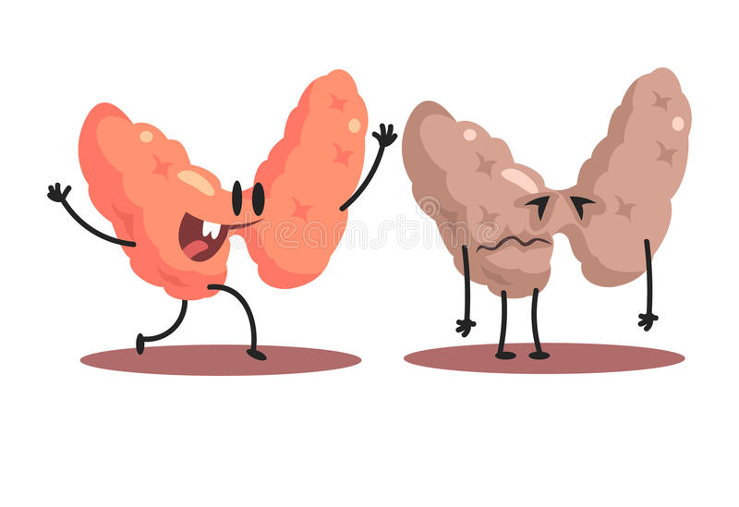
2
HYPOTHYROIDISM
Defined as the clinical and biochemical syndrome resulting from decreased thyroid hormone production.

Slide 40
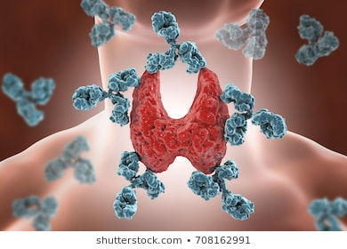
Primary Hypothyroidism
Primary hypothyroidism is defined as TSH concentrations above the reference range and free thyroxine and/or triiodothyronine levels below the reference range.
Primary hypothyroidism is due to thyroid gland failure:
Chronic autoimmune thyroiditis (Hashimoto disease).
Iatrogenic hypothyroidism: follows exposure to destructive amounts of radiation, after total thyroidectomy, or with excessive thionamide doses used to treat hyperthyroidism.
Other causes of primary hypothyroidism include iodine deficiency, enzymatic defects within the thyroid, thyroid hypoplasia, and ingestion of goitrogens.

Slide 41
Secondary Hypothyroidism
Secondary hypothyroidism due to pituitary failure is uncommon but should be suspected in a patient with decreased levels of T₄ and inappropriately normal or low TSH levels.
Pituitary insufficiency may be caused by destruction of thyrotrophs by pituitary tumors, surgical therapy
Most patients with secondary hypothyroidism due to inadequate TSH production will have clinical signs of more generalized pituitary insufficiency, such as abnormal menses and decreased libido, or evidence of a pituitary adenoma.

Slide 42
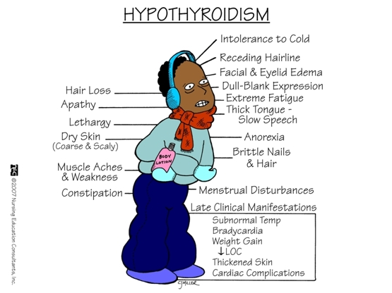
Clinical Presentation
Common symptoms of hypothyroidism include: dry skin, cold intolerance, weight gain, constipation, and weakness, muscle cramps, myalgia, and stiffness
Menorrhagia and infertility may present commonly in women.
The most common signs of decreased levels of thyroid hormone: coarse skin and hair, cold or dry skin, periorbital puffiness, bradycardia, Speech is often slow and the voice may be hoarse, Reversible neurologic syndromes such as carpal tunnel syndrome, polyneuropathy, and cerebellar dysfunction may also occur. Galactorrhea may be found in women.

Slide 43
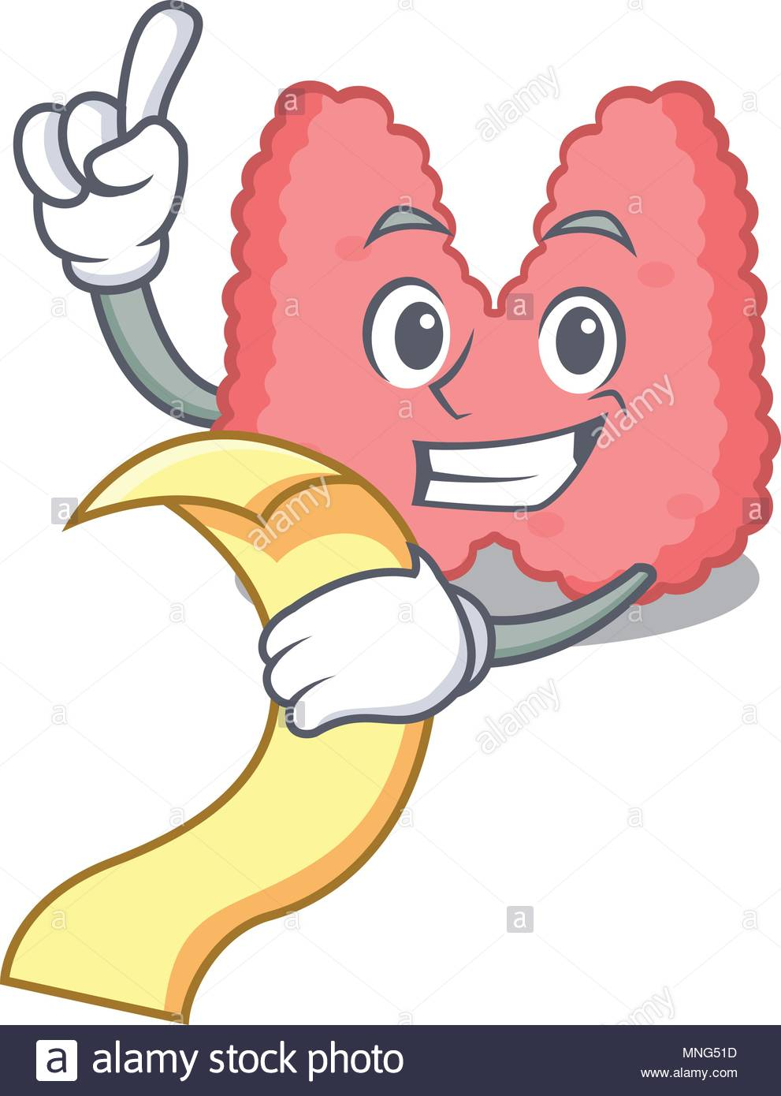
Diagnosis
A rise in the TSH is the first evidence of hypothyroidism in primary hypothyroidism.
In secondary hypothyroidism in patients with pituitary disease, serum TSH concentrations are generally low or normal. A serum TSH concentration in the normal range is clearly inappropriate if the patient’s T4 is low.
Many patients will have a free T4 level within the normal range (compensated or subclinical hypothyroidism), but with disease progression free T4 concentration will drop below the normal level. Eventually, Free and/or total T₄ and T₃ serum concentrations should be low.
The presence of anti-thyroid antibodies confirms Hashimoto’s disease

Slide 44
TREATMENT OF HYPOTHYROIDISM
Levothyroxine (T4) is the drug of choice for thyroid replacement and suppressive therapy because it is: chemically stable, relatively inexpensive, active when orally administered, free of antigenicity, and has uniform potency.
Levothyroxine administration results in a pool of thyroid hormone that is readily converted to T3 when needed; in this regard, levothyroxine may be thought of as a prohormone.
Recent studies suggest that the average maintenance dose of levothyroxine for most adults is about 125 mcg/day.
Liothyronine (synthetic T3) has uniform potency but has a higher incidence of cardiac adverse effects, higher cost, and difficulty in monitoring with conventional laboratory tests

Slide 45
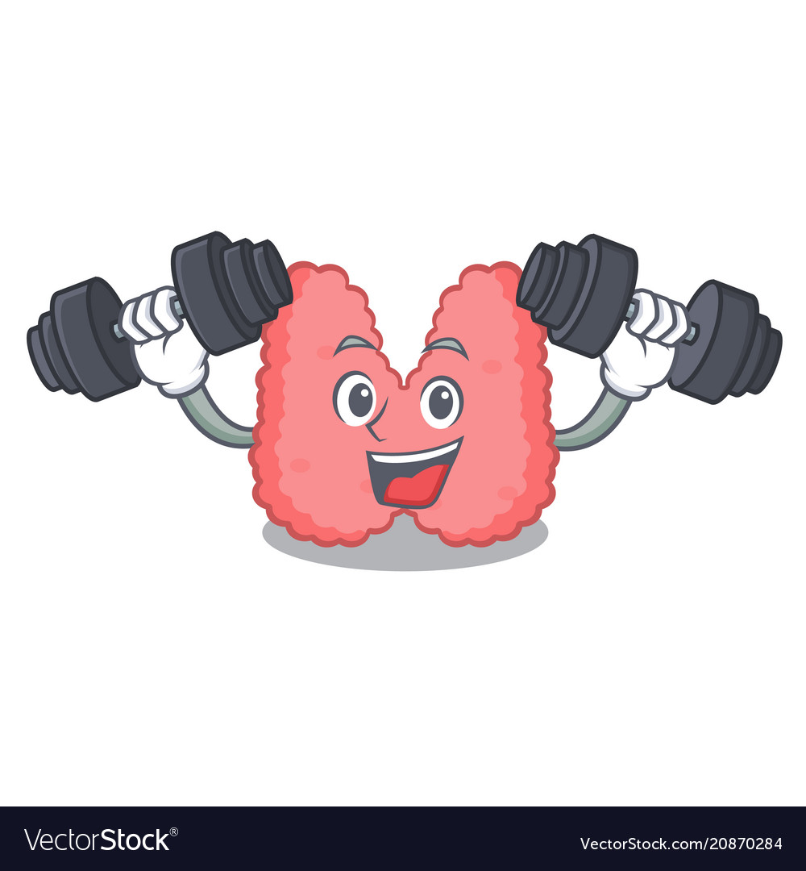
TREATMENT OF HYPOTHYROIDISM
Although treatment of subclinical hypothyroidism is controversial, patients presenting with marked elevations in TSH (>10 mIU/L) and high titers of thyroid peroxidase antibody or prior treatment with sodium iodide–131 may be most likely to benefit from treatment.
Levothyroxine is the drug of choice for pregnant women, and the goal is to decrease TSH to the normal reference range for pregnancy.

Slide 46
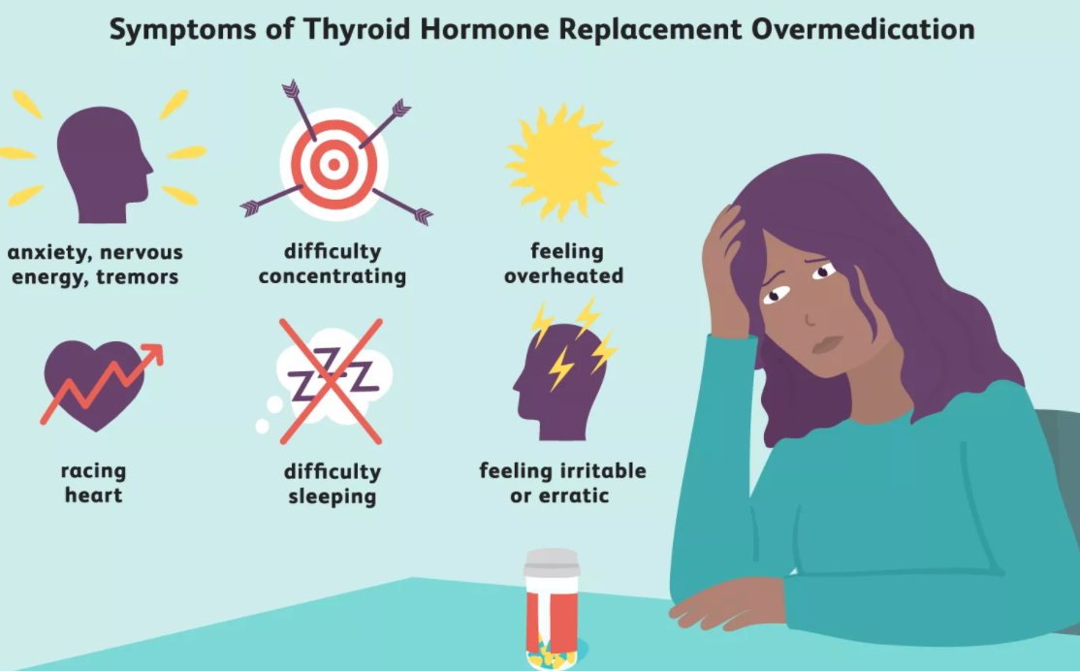
Side effects
Excessive doses of thyroid hormone may lead to heart failure, angina pectoris, and myocardial infarction (MI).
Hyperthyroidism leads to reduced bone density and increased risk of fracture.

Slide 47
Drug-Drug and Drug-Food Interactions
Drugs and food that result in impairing the GI absorption of levothyroxine include: Cholestyramine, calcium carbonate, sucralfate, aluminum hydroxide, ferrous sulfate, soybean formula, dietary fiber supplements, and espresso coffee
Drugs that increase nondeiodinative T4 clearance include rifampin, carbamazepine, and possibly phenytoin.
Selenium deficiency and amiodarone may block conversion of T4 to T3.

Slide 48
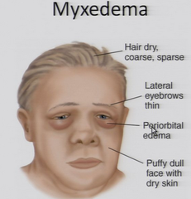
Myxedema coma
Myxedema coma is a rare consequence of decompensated hypothyroidism.
Clinical features include: hypothermia, advanced stages of hypothyroid symptoms, and altered sensorium ranging from delirium to coma.
Mortality rates of 60% to 70% necessitate immediate and aggressive therapy.

Slide 49
TREATMENT OF MYXEDEMA COMA
Immediate and aggressive therapy with IV bolus levothyroxine
Initial treatment with IV liothyronine or a combination of both hormones has also been advocated because of impaired conversion of T4 to T3
Give glucocorticoid therapy with IV hydrocortisone every 8 hours until coexisting adrenal suppression is ruled out.
Consciousness, lowered TSH concentrations, and improvement in vital signs are expected within 24 hours.
Provide supportive therapy to maintain adequate ventilation, euglycemia, BP, and body temperature. Diagnose and treat underlying disorders such as sepsis and MI.

Slide 50
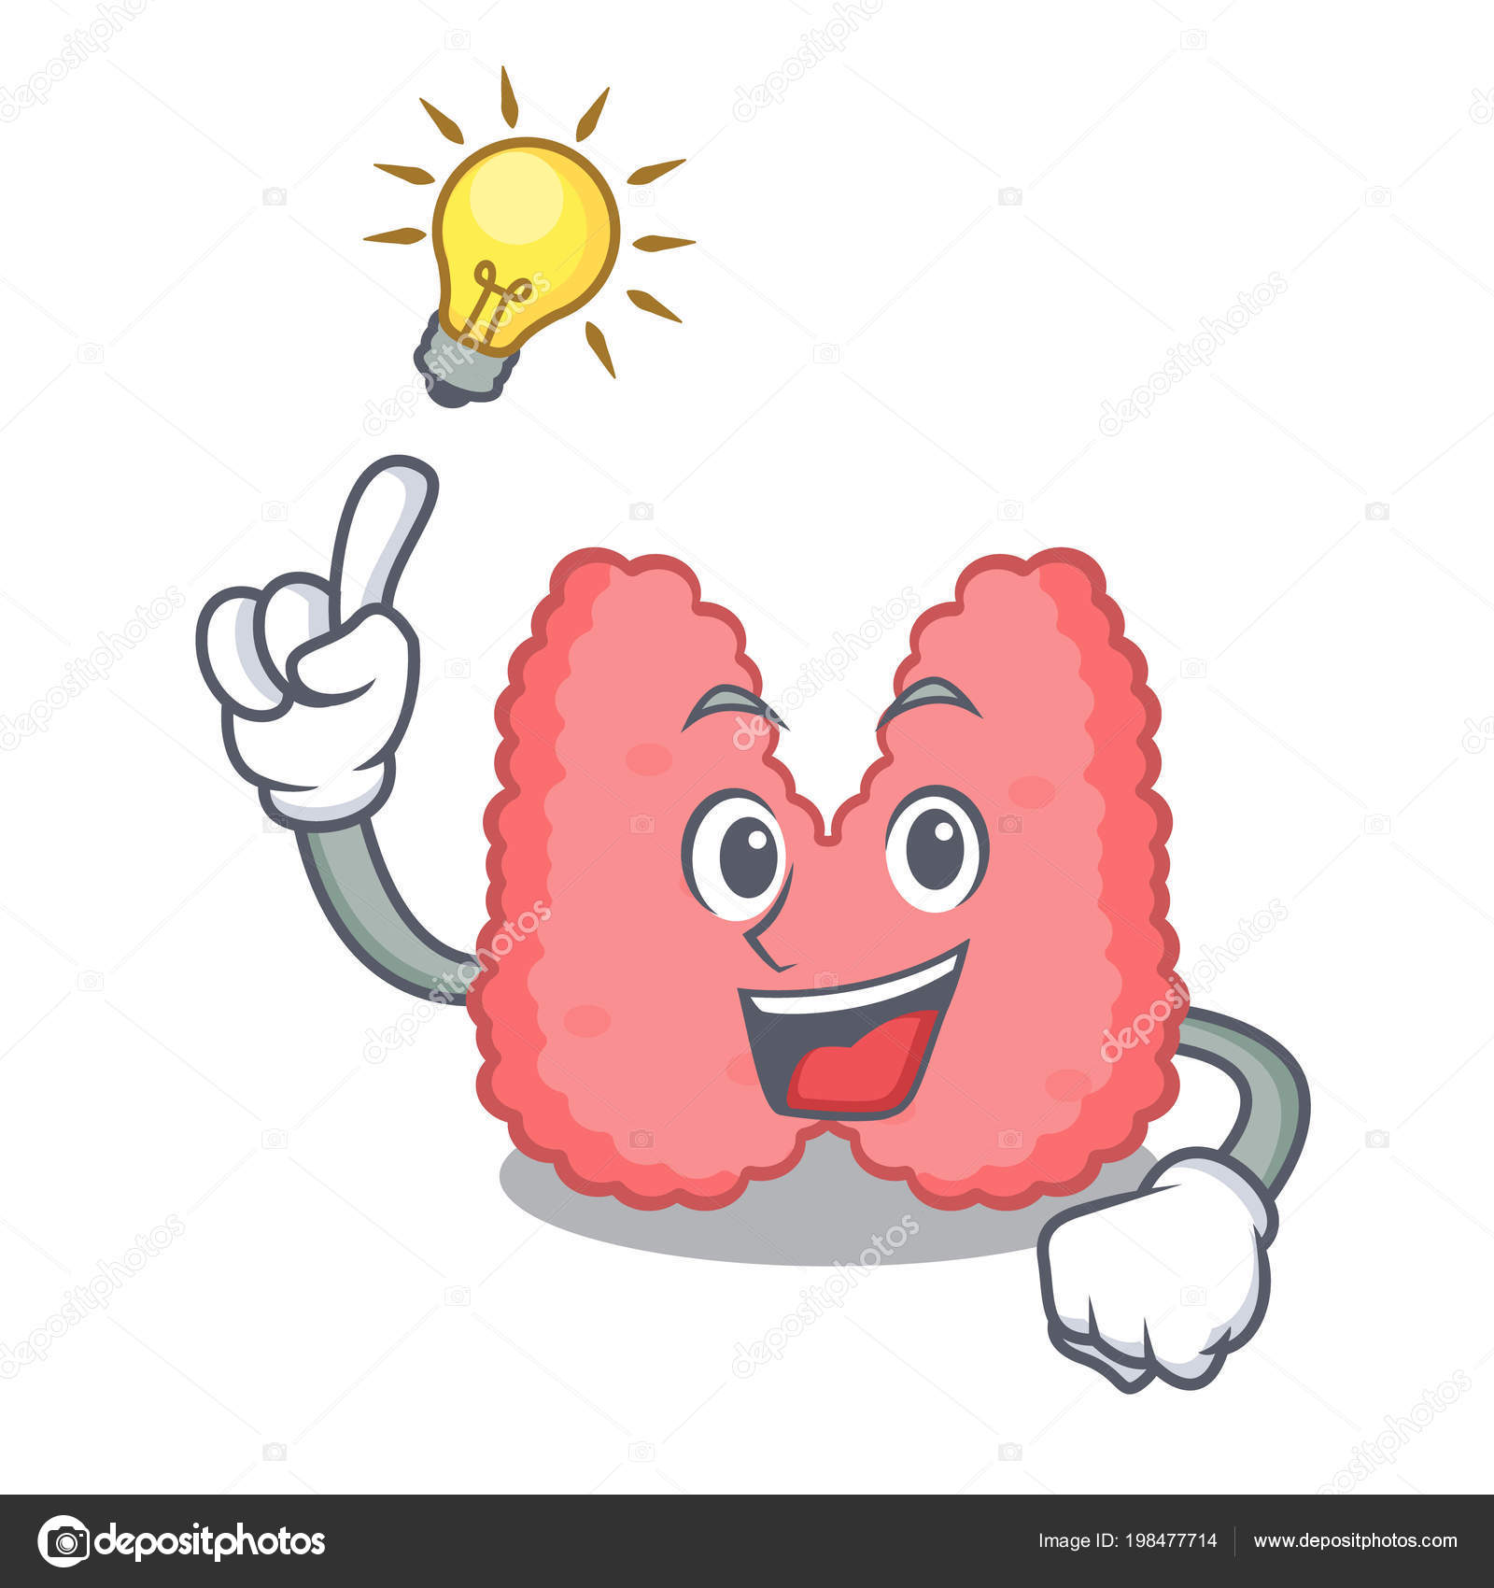
EVALUATION OF THERAPEUTIC OUTCOMES
Serum TSH concentration is the most sensitive and specific. Concentrations begin to fall within hours and are usually normalized within 2 to 6 weeks.
Check both TSH and T4 concentrations every 6 weeks until a euthyroid state is achieved.
In patients with hypothyroidism caused by hypothalamic or pituitary failure, alleviation of the clinical syndrome and restoration of serum T4 to the normal range are the only criteria available for estimating the appropriate replacement dose of levothyroxine.

Slide 51
REFERENCE
Pharmacotherapy: A Pathophysiologic Approach, 11th edition, Joseph T. DiPiro, Gary C. Yee, L. Michael Posey, Stuart T. Haines, Thomas D. Nolin, Vicki Ellingrod

