Slide 1
Chronic Kidney Disease (CKD)
-Definition, risk factors and staging -Pathophysiology of CKD -Anemia of CKD: causes, diagnosis and treatment
Instructor: Dr. Sona Ladadweh
Done by: Bara’ Sadaqa & Noor Ayman

Slide 2
Definition of CKD:
Chronic kidney disease (CKD) is defined as abnormalities in kidney structure or function, present for 3 months or longer.
Lower glomerular filtration rate (GFR) and a higher urinary albumin-to-creatinine ratio (uACR) are both independently associated with adverse events.
For decades, kidney disease was primarily considered to be present only when the patient’s estimated or measured creatinine clearance (CLcr) was reduced to less than 50 mL/min (0.83 mL/s). In 2012, a new classification system was proposed that incorporated GFR and uACR.

Slide 3
The KDIGO classification system is referred to as CGA staging (Cause, GFR, Albuminuria).
A patient is classified with end-stage renal disease (ESRD) when the GFR is below 15 mL/min/1.73 m2 (0.14 mL/s/m2 ) and either chronic dialysis or kidney transplantation is needed to sustain life. The term CKD 5D indicates a patient with ESRD requiring dialysis as either hemodialysis (CKD 5HD) or peritoneal dialysis (CKD 5PD).

Slide 4
KDIGO recommends that all patients with CKD be staged according to eGFR and uACR and that their prognosis be considered to help guide further testing and treatment decisions
Prognosis Scale – Green: low risk (if no other markers of kidney disease, no CKD); Yellow: moderately increased risk; Orange: high risk; Red: very high risk
The prognosis of CKD is dependent on the following factors: (a) cause of kidney disease. (b) GFR at time of diagnosis. (c) degree of albuminuria measured by uACR. (d) presence of other comorbid conditions.

Slide 5
When to refer to nephrologist?
Persistent and significant albuminuria (uACR >1000 mg/g or 110 mg/mmol).
Progression of CKD (eg, a marked but nonacute decline in GFR).
Presence of a nonsurgical cause of hematuria, hypertension refractory to treatment (eg, ≥4 antihypertensive agents).
Persistent abnormalities of serum potassium.
Recurrent or extensive nephrolithiasis.
GFR less than 30 mL/min/1.73 m2 (0.29 mL/s/m2).
Hereditary kidney disease such as polycystic kidney disease even in the presence of normal GFR and uACR.

Slide 6
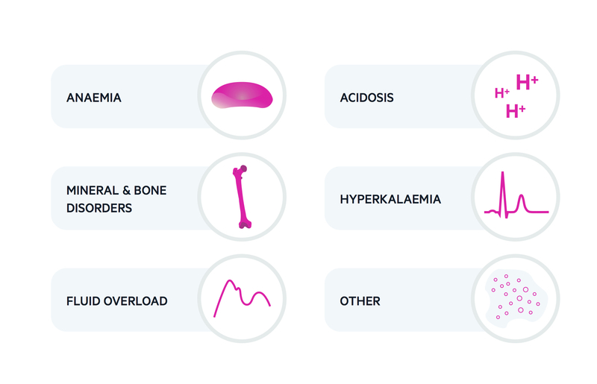
Complications of CKD:
Frequent complications of advanced CKD include hypervolemia, hypertension, hyperkalemia, metabolic acidosis, anemia, CKD-related mineral and bone disorder (CKD-MBD), and a disproportionate risk of cardiovascular disease (CVD).

Slide 7
Etiology:
Susceptibility and Initiation Risk Factors:
- Directly proven to cause CKD. - Modifiable by drug therapy
- Increase risk for CKD but don’t directly cause it.
- Typically non‐modifiable by drug therapy.
- Useful for identifying high‐risk population.

Slide 8
Predicting Risk of Progression:
Kidney failure risk equation (KFRE) provides an accurate 2- and 5-year risk of progression to kidney failure for individuals with stage 3 to 5 CKD.
KFRE provides the best current evidence-based approach to assess risk of progression and should be used in combination with expert clinical judgment.

Slide 9
Progression Risk Factors:
Diabetes Mellitus:
Achieving a hemoglobin A1C (HbA1c) target of 7% (0.07; 53 mmol/mol Hb) has been shown to prevent the surrogate endpoints of microalbuminuria and macroalbuminuria associated with diabetic chronic kidney disease (DCKD).
Highest survival rates in individuals with DCKD were associated with HbA1c levels in the range of 7% to 8% (0.07-0.08; 53-64 mmol/mol Hb), however the recommendation by the American Diabetes Association is to generally target these levels while being cautious of the limitations of using this marker in patients with CKD and the risk of hypoglycemia.
Hypertension:
It is both a cause and result of progressive kidney disease. KDIGO guidelines for the management of blood pressure in CKD recommend the goal is to control blood pressure at all categories of CKD regardless of the underlying cause since early treatment of hypertension and achievement of target blood pressure have been demonstrated to slow the rate of progression of CKD.

Slide 10
Obesity:
A body mass index (BMI) ≥ 25 kg/m2 at age 20 has been associated with a threefold increase in risk of CKD compared with a BMI ˂ 25 kg/m2.
Intentional weight loss in individuals with CKD was associated with decreases in proteinuria, systolic blood pressure, and stabilization in GFR during a mean follow-up of 7.4 months.
Proteinuria:
It is a strong independent predictor of accelerated progression of CKD and also a risk factor for CV mortality and morbidity. Albuminuria remains the primary modifiable risk factor associated with CKD progression in most patients.
Smoking:
GFR and urinary albumin excretion heart rate blood pressure, likely secondary to nicotine exposure. Smoking is also associated with an increase in CV events in people with CKD.

Slide 11
Pathophysiology of CKD
Progression of CKD from category 1 to 5 occurs over decades in the majority of people, with the precise mechanism of kidney damage dependent on the etiology of the disease.
Diabetic CKD is characterized by glomerular mesangial expansion while with hypertensive nephrosclerosis, the kidney’s arterioles have arteriolar hyalinosis.
Polycystic kidney disease is characterized by the development and expansion of renal cysts.
While the initial structural damage depends on the primary disease affecting the kidney, the key elements of the pathway to ESRD are (a) loss of nephron mass, (b) glomerular capillary hypertension, and (c) proteinuria

Slide 12
Autoregulation
In response to the decrease in nephron function, the remaining nephrons compensate through the process of autoregulation.
With nephron loss and the resulting reduction in perfusion pressure and GFR, renin release from the juxtaglomular apparatus increases and converts angiotensinogen to angiotensin I, which is then converted to angiotensin II (ATII).

Slide 13
Autoregulation
ATII is a potent vasoconstrictor of both afferent and efferent arterioles, but it preferentially affects the efferent arterioles, leading to increased pressure within the glomerular capillaries and consequent increased filtration fraction.
Initially, this compensatory action may be adaptive and beneficial. however, over time it can lead to the development of intraglomerular hypertension and hypertrophy and a further decline in the number of functioning nephrons.

Slide 14
Autoregulation
High intraglomerular capillary pressure impairs the size-selective function of the glomerular permeability barrier, resulting in increased urinary excretion of albumin and proteinuria.
The development of intraglomerular hypertension usually parallels the development of systemic hypertension.
ATII as well as aldosterone, may also mediate CKD progression through nonhemodynamic effects by increasing growth factors (eg, transforming growth factor beta [TGF-β]) and causing cellular proliferation and hypertrophy of the glomerular endothelial cells, epithelial cells, and fibroblasts ultimately resulting in further inflammation and fibrosis.

Slide 15
CLINICAL PRESENTATION of CKD
Stage 5 Chronic Kidney Disease (eGFR <15 mL/min/1.73 m2)
Symptoms
Fatigue, weakness, shortness of breath, confusion, nausea and vomiting, bleeding, loss of appetite, itching, cold intolerance, and peripheral neuropathies are common.
Signs
Edema, weight gain (from accumulation of fluid), changes in urine output (volume and consistency), “foaming” of urine (indicative of proteinuria).
Laboratory Tests
Decreased : eGFR, bicarbonate (metabolic acidosis), Hb/hematocrit (Hct) (anemia), transferrin saturation (TSat) and/or ferritin (iron deficiency; note: ferritin may be increased due to inflammatory conditions), vitamin D levels, albumin (malnutrition), glucose (may result from decreased degradation of insulin with impaired kidney function or poor oral intake), and calcium (in early stages of CKD).
Increased : Serum creatinine, blood urea nitrogen, potassium, phosphorus, PTH, FGF-23, uACR, PCR, blood pressure (hypertension is a common cause and result of CKD), glucose (uncontrolled diabetes is a cause of CKD), low-density lipoprotein (LDL) and triglycerides, and calcium (more likely in CKD 5 and CKD 5D).

Slide 16
Clinical presentation
Others
May be hemoccult-positive if GI bleeding occurs secondary to uremia.
Other Diagnostic Tests
-Urine sediment abnormalities (hematuria, red blood cell and white blood cell casts, renal tubular epithelial cells)
-Pathologic abnormalities indicating glomerular, vascular, tubulointerstitial disease, or cystic and congenital diseases
-Structural abnormalities such as polycystic kidneys, renal masses, renal artery stenosis, cortical scarring due to infarcts and pyelonephritis, or small kidneys (common in more severe CKD) detected by imaging studies (eg, ultrasound, computed tomography, magnetic resonance imaging, angiography)

Slide 17
Anemia of CKD:
The primary cause of anemia of CKD is a decrease in production of erythropoietin by interstitial fibroblasts in the renal cortex of the kidney where approximately 90% of production occurs. In individuals with normal kidney function, plasma concentrations of erythropoietin increase exponentially in response to hypoxia; however, this response is lost as kidney disease progresses to CKD 3 and higher.
Iron deficiency anemia is common in individuals with advanced kidney disease (ie, CKD 4 and 5) due to decreased gastrointestinal (GI) absorption of iron, inflammation, frequent blood testing, blood loss from hemodialysis (HD), and increased iron demands from erythropoiesis stimulating agent (ESA) therapy. It is the leading cause of resistance to ESAs and the reason frequent iron supplementation is necessary.

Slide 18
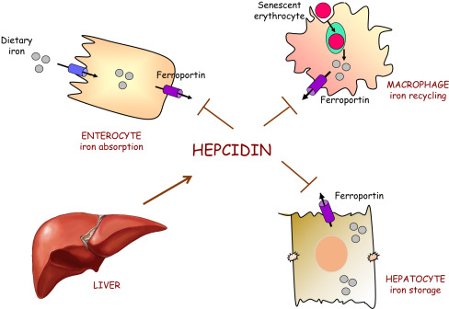
Hepcidin, a hormone produced by the liver, directly inhibits the protein ferroportin that transports iron out of storage cells.
When iron stores are high
Hepcidin production is also induced by inflammation or infection. As a result, the increase in hepcidin in inflammatory conditions may lead to a sequestering of iron and ineffective red blood cell production.
The fact that hepcidin plays such a role in iron regulation has prompted the development of agents to target hepcidin and potentially alter iron transport. At this time there are no commercially available agents.

Slide 19
Additional factors contributing to the development of anemia of CKD are the decreased red cell life span (from the normal of 120 days to approximately 60 days in individuals with CKD 5D), the effects of accumulation of uremic toxins and inflammatory cytokines, and vitamin B12 and folate deficiencies.
Anemia leads to
- Impaired quality of life
- Early death
- Cardiovascular disease >> LVH

Slide 20
Diagnostic Considerations for Anemia of Chronic Kidney Disease
Since individuals with anemia of CKD may be asymptomatic, laboratory evaluation is commonly the initial approach to diagnosing anemia of CKD.
According to the KDIGO guidelines Hb concentrations should be measured annually in CKD 3, biannually in CKD 4-5, and at least every 3 months in CKD 5D patients.
The diagnosis of anemia is made and further workup of anemia is required when the Hb is less than 13 g/dL for adult males and less than 12 g/dL (for adult females)
Assessment of the iron status is necessary.
Absulote iron deficiency : whole-body iron stores are low (low TSat and ferritin)
Functional iron deficiency when the TSat is low, but the serum ferritin is at or above goal.

Slide 21
Continue
Other causes of anemia are needed to be evaluated such as blood loss, deficiencies in vitamin B12 or folate, or other disease states that contribute to anemia, including human immunodeficiency virus infection and malignancies.
Red blood cell indices (mean corpuscular volume, mean corpuscular Hb concentration), white blood cell count, differential and platelet count, and absolute reticulocyte count should also be assessed.
A stool guaiac test should be performed to rule out GI bleeding.

Slide 22
Pharmacologic and Nonpharmacologic Therapy of Anemia
Maintaining adequate dietary intake of iron as well as folate and B₁₂.
Replenish iron stores before starting ESAs and at any point during ESA therapy if IDA suspected
Pharmacologic therapy for anemia of CKD includes iron supplementation to prevent and correct iron deficiency and ESA therapy to correct erythropoietin deficiency. Iron supplementation is first-line therapy for anemia of CKD if iron deficiency is present, and for some patients the target Hb may be achieved without concomitant ESA therapy. For most individuals with advanced CKD, however, combined therapy with iron and an ESA will be necessary to achieve the target Hb.

Slide 23
Goals of Treatment
oxygen-carrying capacity.
signs and symptoms of anemia.
need for blood transfusions.
Hb is the preferred monitoring parameter for red blood cell production because, unlike Hct, its concentration is not affected by blood storage conditions and instrumentation used for analysis.
Initiation of iron or ESA therapy is guided by the patient’s Hb, TSat, and ferritin. The risk of mortality and CV events is higher in CKD patients treated to higher Hb target values with an ESA.

Slide 24
The current labeling for all ESAs warns that dosing ESAs to target Hb levels greater than 11 g/dL (110 g/L; 6.83 mmol/L) for CKD patients increases the risk for death, serious CV reactions, and stroke.
Practitioners are advised to consider ESAs in patients with CKD only when the Hb is below 10 g/dL (100 g/L; 6.21 mmol/L) and to individualize therapy to use the lowest ESA dose necessary to decrease the need for red blood cell transfusions.

Slide 25
Iron supplementation therapy
Iron supplementation is required for absolute iron deficiency , but may also be warranted in individuals with a TSat less than 30% (<0.30) and a ferritin less than 500 ng/mL (μg/L; <1120 pmol/L) in whom an increase in Hb or a decrease in ESA dose is desired .
Approximately 10% of orally administered iron is absorbed in the duodenum and upper jejunum.
Absorption of iron is decreased by food and achlorhydria. Some oral iron formulations also include ascorbic acid to enhance iron absorption.

Slide 26
Iron supplementation therapy
Oral iron supplementation is more convenient in non-HD patients (eg, CKD category 3 or higher and PD patients) since these patients do not have regular IV access.
The route of administration should be based on the severity of iron deficiency, availability of IV access, response to prior oral iron therapy, side effects, patient adherence to therapy, and cost.
If oral therapy is initiated, a 1- to 3 month trial is recommended to assess response.

Slide 27
Iron supplementation therapy
In patients with CKD 5HD GI absorption of iron is often inadequate to meet the increase in iron demand from ESA therapy and chronic blood loss and thus , the IV route is preferred for almost all HD patients.
IV administration is also recommended in the PD population.
Parenteral iron improves the responsiveness to ESA therapy and, thus, lower doses can be used to maintain the target Hb in HD.

Slide 28
Oral Therapeutic options
Name of oral iron product | Amount of elemental iron
Ferrous sulfate | 20%
Ferrous fumarate | 12%
Ferrous gluconate | 33%
Polysaccharide iron complex | 100%
Carbonyl iron | 100%
Heme iron polypeptide | 12 mg
Ferric pyrophosphate citrate | _

Slide 29
IV iron preparations
IV iron preparations are colloids that consist of an iron-containing core that is surrounded by a carbohydrate shell to stabilize the iron complex.
Available agents differ in the size of the core and the composition of the surrounding carbohydrate.
Such differences affect the rate of dissociation of iron from the complex, the rate of distribution, and the maximum tolerated dose and rate of infusion.

Slide 30
Iron sucrose
The most commonly used one in clinical practice.
Used in adult and pediatric CKD 5HD patients ages 2 years and older.
- Adult dose : 100 mg over 2-5 minutes or 100 mg in maximum of 100 ml of 0.9% NaCl over 15 minutes per consecutive HD session.
- Pediatric dose : 0.5 mg/kg not to exceed 100 mg per dose over 5 minutes or diluted in 25 mL of 0.9% NaCl administered over 5-60 minutes (give dose every 2 weeks for 12 weeks)

Slide 31
Iron sucrose
Adult and pediatric NDCKD patients aged 2 years and older
Adult: 200 mg over 2–5 minutes on five different occasions within 14-day period.
There is limited experience with administration of 500 mg diluted in a maximum of 250 mL of 0.9% NaCl over 3.5 to 4 hours on day 1 and day 14
Pediatric: Give dose every 4 weeks for 12 weeks.

Slide 32
Iron sucrose
Adult and pediatric CKD 5PD patients aged 2 years and older.
- Adult: Give 3 divided doses within 28 days as 2 infusions of 300 mg over 1.5 hours 14 days apart followed by one 400 mg infusion over 2.5 hours 14 days later.
Dilute in a maximum of 250 mL of 0.9% NaCl
Pediatric: give dose every 4 weeks for 12 weeks

Slide 33
Adverse effects
Adverse effects of oral iron are primarily GI in nature and include constipation, nausea, and abdominal cramping .
These adverse effects are more likely as the dose is escalated and may be present in more than 50% of patients receiving 200 mg of elemental iron per day.

Slide 34
Adverse effects
Adverse effects of IV iron include allergic reactions, hypotension, dizziness, dyspnea, headaches, lower back pain, arthralgia, syncope, and arthritis.
The most concerning potential consequence of IV iron administration is anaphylaxis.
Serious reactions to iron dextran including respiratory complications and CV collapse.
Iron dextrans products (Dexferrum and INFeD) are not interchangeable.
Iron dextran products carry a black box warning of the risk of anaphylactic-type reactions, including fatalities, and a 25-mg test dose is required.
The highest anaphylaxis risk for iron dextran with the lowest risk with iron sucrose.

Slide 35
Adverse effects
The non-dextran IV iron formulations have a better safety record than either of the iron dextran products. The labeling for these formulations also includes a warning of the risk of hypersensitivity reactions.
Ferumoxytol should not be used in patients allergic to other iron products given by injection or infusion, or in patents with multiple drug allergies and only be diluted and administered as an IV infusion over a minimum of 15 minutes
As a superparamagnetic oxide, ferumoxytol may alter the diagnostic ability of magnetic resonance imaging studies for up to 3 months after administration,therefore, they should be done prior to administration of ferumoxytol whenever possible.

Slide 36
Iron overload
Long-term administration of IV iron also introduces a risk of iron overload.
Deposition of excess iron may affect several organ systems, leading to hepatic, pancreatic, and cardiac dysfunction.
Maintaining target serum ferritin and TSat values is the most reasonable approach to minimize the risk of iron toxicity.
If symptomatic overload does occur, iron chelating agents such as deferoxamine (Desferal), deferiprone (Ferriprox), deferasirox (Exjade), or phlebotomy may be necessary.

Slide 37
Iron therapy and the risk of infection
Some studies found that IV iron contributed to infection, whereas others refuted this assertion although they did indicate a link to increased oxidative stress.

Slide 38
Drug Interactions
Iron absorption is decreased by other elements
- calcium in calcium-containing phosphate binders
Medications that increase the pH of the GI tract such as proton pump inhibitors and H2-antagonists.
Antibiotics including doxycycline and tetracycline.
Iron also decreases absorption of other drugs such as antibiotics (fluoroquinolones, doxycycline)

Slide 39
Dosing and Administration
If oral therapy is initiated, the recommended dose is 200 mg of elemental iron per day.
KDIGO guidelines suggest a 1- to 3-month trial of oral therapy in the non-HD CKD population prior to initiating IV therapy.
For the HD population, IV therapy is preferred with administration of a 1-g course of IV iron (in divided doses) recommended to initially replete patients with an absolute iron deficiency.
Typical repletion dosing regimens for IV iron are 100 mg as iron sucrose over 10 dialysis sessions or 125 mg of sodium ferric gluconate over 8 dialysis sessions.

Slide 40
Maintenance dose
To prevent iron deficiency, maintenance doses of IV iron can be administered in HD patients (eg, iron sucrose 25-100 mg/wk; sodium ferric gluconate 62.5-125 mg/wk).
As a general practice, if IV iron doses higher than those currently approved are needed, they should be infused over a longer period of time (eg, at least 2-4 hours) due to the risk of hypersensitivity reactions, hypotension, dizziness, and nausea.

Slide 41
Test dose for dextran
Administration of a 25-mg test dose is required for all iron dextran products.
This test dose should be administered over at least 30 seconds for InFeD and 5 minutes for Dexferrum.
It is recommended that patients be observed for at least 1 hour before administering the remainder of the dose.
Regardless of which IV iron agent is used all patients should be monitored for signs and symptoms of hypersensitivity for at least 30 minutes following completion of a dose.
KDIGO clinical practice guidelines suggest monitoring patients for at least 60 minutes following administration of IV iron.

Slide 42
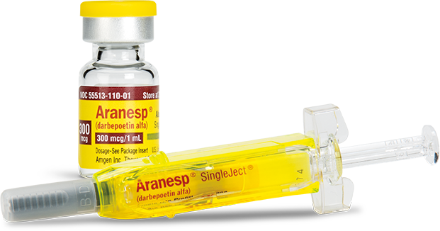
Erythropoiesis-Stimulating Agent Therapy

Slide 43
Mechanism of action:
These agents bind to the erythropoietin receptor (EPO-R) on the surface of erythroid progenitor cells and activates intracellular signal transduction pathways which leads finally to proliferation and differentiation of erythrocytes.
Benefits:
Improve survival
Improved quality of life
Reduced need for transfusions

Slide 44
Takes at least 10 days for new RBC release
Goal Hg is not to exceed 11-12 g/dL
Higher or lower target levels associated with increased mortality and CV events
Target initial rate of Hb rise is 1‐2 g/month

Slide 45
Agents:
Epoetin alfa is a glycoprotein manufactured by recombinant DNA technology that has the same amino acid sequence as endogenous erythropoietin.
Darbepoetin alfa has two additional N-linked carbohydrate chains that decrease the affinity for the erythropoietin receptor, but yield a longer duration of activity compared with erythropoietin.
Methoxy PEG-epoetin beta is referred to as a continuous erythropoietin receptor activator (CERA), has a much longer half-life than the other ESAs.
All ESAs have the same biologic activity as endogenous erythropoietin in that they bind to and activate the erythropoietin receptor to stimulate erythropoiesis.

Slide 47
Pharmacokinetics and Pharmacodynamics
All available ESAs: IV or the subcutaneous (SubQ) route. The prolonged half-lives of darbepoetin alfa and methoxy PEG-epoetin beta offer the advantage of less-frequent dosing.
It is important to evaluate the Hb response over several weeks and not make dosing changes too soon.

Slide 48
Efficacy
The most common causes of resistance are:
- Iron deficiency.
- Acute illness, inflammation, infection.
- Chronic bleeding.
- Aluminum toxicity.
- Malnutrition.
- Hyperparathyroidism.
- Cancer and chemotherapy.
- Deficiencies in folate and vitamin B₁₂ should also be considered.
- Use of ACEIs and ARBs has also been associated with hyporesponsiveness to ESA therapy.

Slide 49
Adverse Effects
Hypertension: most common side effect C/I for patients with uncontrolled blood pressure.
Seizures: particularly within the first 90 days of starting therapy.
Thrombosis of the HD vascular access site and other thromboembolic events were reported when ESAs were used to target Hb greater than 13 g/dL.
So:
close monitoring of the rate of rise in Hb, changes in blood pressure, and neurologic symptoms following initiation of therapy or a change in ESA dose.

Slide 50
ESAs have also been associated with a reduction in overall survival and increased risk of progression of certain tumor types among CKD patients (eg, head and neck).
ESAs are not indicated in patients receiving myelosuppressive chemotherapy when the anticipated outcome is cure. These are important effects to consider when managing a CKD patients with an oncologic disorder.

Slide 51
Antibody-associated pure red cell aplasia (PRCA), caused by induction of antibodies directed against the ESA molecule, was reported in the late 1990s and early in 2000 and was primarily associated with subcutaneous administration of Eprex, an epoetin alfa formulation. This reaction was potentially a result of organic compounds being formed when the stabilizing agent polysorbate was used in combination with uncoated rubber stoppers in the prefilled syringes. There have been very few cases since changes in the packaging of this product were made.
An evaluation for PRCA should be considered for patients receiving ESA therapy for more than 8 weeks who develop either a rapid decrease in Hb level (rate of 0.5-1 g/dL/wk [5-10 g/L/wk; 0.31-0.62 mmol/L/wk]) or require one to two blood transfusions per week, and have an absolute reticulocyte count of less than 10,000/μL (10 × 109/L) with a normal platelet and white blood cell count. Discontinuation of ESA therapy is recommended if antibody-mediated PRCA develops because antibodies are cross-reactive and continued exposure may lead to anaphylactic reactions.

Slide 52
Dosing and administration
Conversion from epoetin alpha to darbepoetin alpha (from units to micrograms):

Slide 53
Conversion from epoetin alpha or darbepoetin alpha to methoxy PEG-epoetin beta

Slide 54
When starting an ESA, Hb levels should be monitored at least monthly (weekly may be preferred) until stable and then monthly thereafter.
An acceptable rate of increase in Hb is 1 to 2 g/dL (10-20 g/L; 0.62-1.24 mmol/L) per month.
As a general rule, ESA doses should not be increased more frequently than every 4 weeks, although decreases in dose may occur more frequently in response to a rapid rate of rise in Hb.
Dose by at least 25% if the Hb increases by more than 1 g/dL (10 g/L; 0.62 mmol/L) in a 2-week period.
The dose should be reduced or temporarily discontinued if the Hb level approaches or exceeds 11 g/dL (110 g/L; 6.83 mmol/L) in dialysis patients or 10 g/dL (100 g/L; 6.21 mmol/L) in patients with CKD not requiring dialysis.
A 25% increase in dose may be considered if the Hb has not increased by 1 g/dL (10 g/L; 0.62 mmol/L) after 4 weeks of ESA treatment and if no causes of hyporesponsiveness to the ESA have been identified.

Slide 55
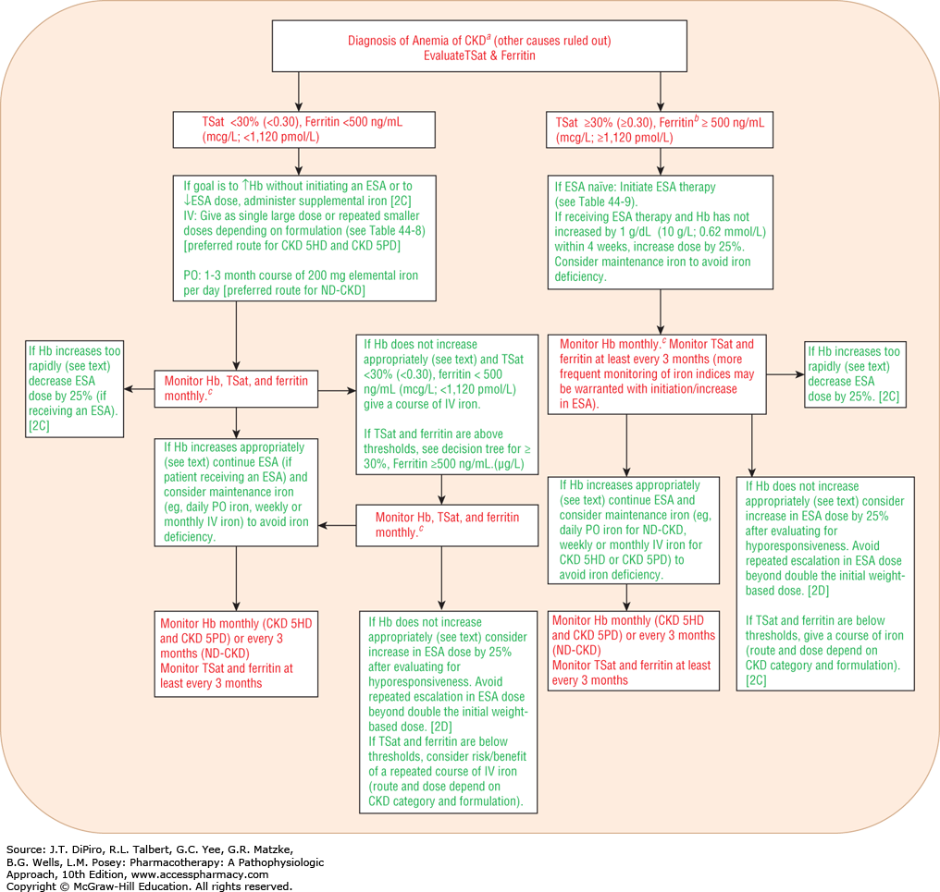

Slide 56
Transfusions and Adjunct Therapies
Red blood cell transfusions carry many risks and therefore should only be used in select situations, such as acute management of symptomatic anemia, following significant acute blood loss, and prior to surgical procedures that carry a high risk of blood loss, with the goal of preventing inadequate tissue oxygenation or cardiac failure.

Slide 57
Hypoxia-Inducible Factor Inhibitors
Hypoxia-inducible factor (HIF) is a transcription factor composed of alpha and beta subunits and is a key factor for production of erythropoietin that occurs in response to hypoxia.
When hypoxic conditions exist, the alpha and beta subunits join to form a heterodimer that translocates to the nucleus and binds to the hypoxia response element of erythropoietin to induce erythropoietin production.
When hypoxic conditions do not exist, HIF-2α is hydroxylated by prolyl-hydroxylase 2 and subsequently degraded resulting in reduced erythropoietin production.
There are four oral HIF-PH inhibitors in development in phase 3 trials including roxadustat, daprodustat, vadadustat, and molidustat.

Slide 58
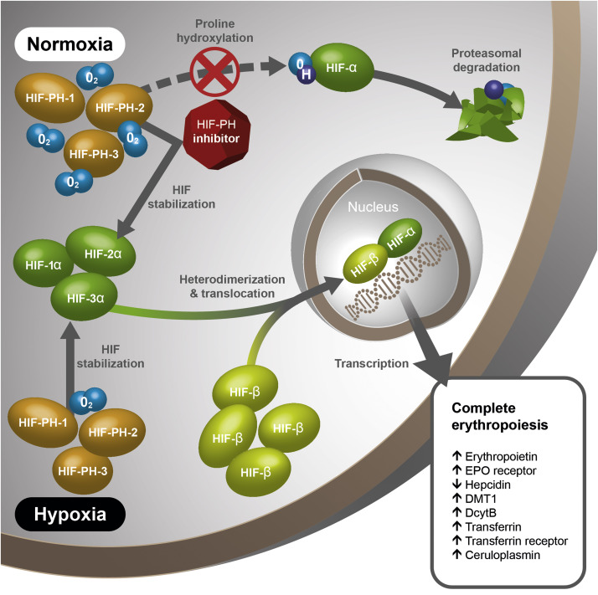

Slide 59
Evaluation of Therapeutic Outcomes
Important therapeutic outcomes to monitor in patients with anemia of CKD include Hb, iron status, as well as the need for blood transfusions.
Iron status should be assessed at least every 3 months in patients receiving a stable ESA regimen and more frequently (eg, every month) when initiating or increasing the ESA dose, following a course of IV iron, or when other factors put the patient at risk for iron loss (eg, bleeding).

Slide 60
Evaluation of Therapeutic Outcomes
Hb levels should be monitored at least every 3 months in patients with CKD not on dialysis or CKD 5PD and at least monthly in CKD 5HD patients.
Hb levels should be monitored at least monthly in patients started on ESA therapy until the Hb level is stable.
FDA labeling for ESAs recommends every 2 week monitoring of Hb with initiation of therapy or a change in dose until the Hb is stable.

Slide 61
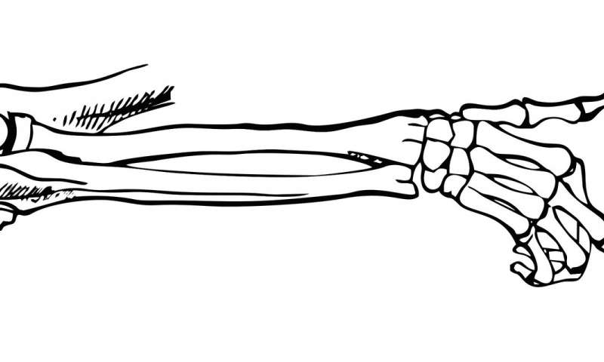
Chronic Kidney Disease–Related Mineral and Bone Disorder
- Disorders of mineral and bone metabolism are common in the CKD population and include abnormalities in PTH, calcium, phosphorus, vitamin D, fibroblast growth factor-23 (FGF-23), bone turnover, as well as soft-tissue calcifications.
- Historically these abnormalities have been described as characteristics of secondary hyperparathyroidism (sHPT) and renal osteodystrophy (ROD).
- The term CKD-MBD encompasses these abnormalities in mineral and bone metabolism as well as associated calcifications.

Slide 62
The pathophysiology of CKD-MBD
Calcium and phosphorus homeostasis is mediated through the effects of PTH, 1,25dihydroxyvitamin D3 (calcitriol), and FGF-23 on bone, the GI tract, kidney, and the parathyroid gland.
As kidney function declines, there is a decrease in phosphate elimination, which results in hyperphosphatemia and a decrease in serum calcium concentration.
Hypocalcemia is the primary stimulus for secretion of PTH by the parathyroid glands.
Hyperphosphatemia also increases PTH synthesis and release through its direct effects on the parathyroid gland and production of prepro-PTH messenger RNA.

Slide 63
The pathophysiology of CKD-MBD
In an attempt to normalize ionized calcium, PTH increases calcium reabsorption by the distal tubules and decreases phosphate reabsorption in the proximal tubules of the kidney (at least until the GFR falls to approximately 30 mL/min/1.73 m2 [0.29 mL/s/m2]) and also increases calcium mobilization from bone.
FGF-23 production in bone also increases in response to high phosphate levels and increased PTH and promotes phosphate excretion by the kidney.
The result is a relative normalization of calcium and phosphorus, at least in the early stages of CKD.
However, this occurs at the expense of an elevated PTH and FGF-23 (“the trade-off hypothesis”).

Slide 64
The pathophysiology of CKD-MBD
The increase in PTH is most notable when GFR is less than 60 mL/min/1.73 m2 (0.58 mL/s/m2) (CKD 3a and higher) and worsens as kidney function further declines.
With advanced kidney disease, the kidney fails to respond to PTH or to FGF-23 and abnormalities in calcium and phosphorus worsen.
Over time, the negative effects of sustained hyperparathyroidism on bone are realized as calcium resorption from bone persists.

Slide 65
Calcitriol
1,25-dihydroxyvitamin D3 or calcitriol promotes increased intestinal absorption of calcium and phosphorus, which helps normalize ionized calcium.
Calcitriol also works directly on the parathyroid gland to suppress PTH production
The enzyme 1-α-hydroxylase is responsible for the final hydroxylation and conversion of the vitamin D precursor, 25-hydroxyvitamin D or 25(OH)D, to calcitriol in the kidney .
As kidney disease progresses, the concentrations of calcitriol decline due to loss of 1-α-hydroxylase activity.
The resultant vitamin D deficiency leads to reduced intestinal calcium and phosphorus absorption and worsening hyperparathyroidism.
Increases in FGF-23 also promote calcitriol deficiency.
calcitriol deficiency : is more prevalent in individuals with CKD 4-5. Deficiency in 25(OH)D (levels of <30 ng/mL [75 nmol/L]) is also common in individuals with CKD due to decreased dermal synthesis of vitamin D, decreased exposure to sunlight, and reduced dietary intake of vitamin D.

Slide 66
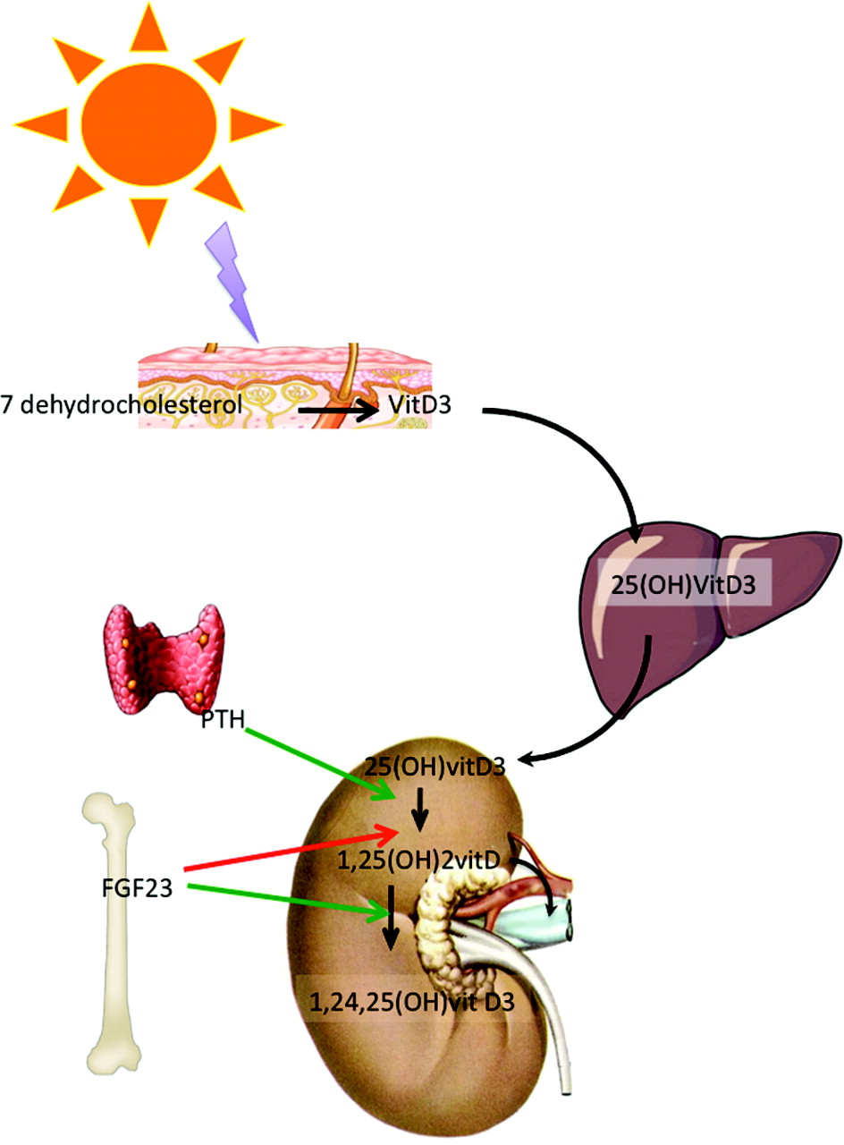

Slide 67
Bone Abnormalities
The abnormalities of CKD-MBD lead to alterations in structural integrity of bone and other associated consequences.
The continuous high rate of production of PTH by the parathyroid glands promotes parathyroid hyperplasia.
Nodular tissue demonstrates more rapid growth potential and appears to be associated with fewer vitamin D and calcium-sensing receptors, resulting in resistance to exogenous calcitriol therapy.
Bone abnormalities are almost universal in dialysis patients and observed in the majority of those with CKD 3-5.

Slide 68
The bone abnormalities include:
Osteitis fibrosa cystica (high bone turnover disease): is most common and is characterized by areas of peritrabecular fibrosis. Bone marrow fibrosis and decreased erythropoiesis are also consequences of severe osteitis.
Osteomalacia (low bone turnover disease): was historically noted in HD patients with aluminum toxicity, a finding less common today due to the decreased use of aluminum-containing phosphate binders and changes in the processing of dialysate solutions to decrease aluminum content.
Adynamic bone disease : Characterized by low amounts of fibrosis or osteoid tissue and low bone formation rates. Multiple risk factors for the development of this bone disease include high concentrations of dialysate calcium along with high doses of calcium-containing phosphate binders, aggressive management with vitamin D therapy, diabetes, and aluminum toxicity.

Slide 69
The comorbidity and mortality
The morbidity and mortality of CKD patients is increased in individuals with both severe hypo- and hyperparathyroidism.
Elevations of serum phosphorus, even within the upper limits of the normal range, have been associated with increased risk of CV events and/or mortality (all-cause or CV mortality) in patients with CKD 3-5.
FGF-23 has also been associated with increased mortality and cardiovascular events in individuals with CKD.
The incidence of calciphylaxis, or rapid calcification of subcutaneous tissue, in patients with advanced kidney disease has increased over the past decade and has been associated with CKD-MBD, an elevated calcium times phosphorus product, and warfarin use.
Warfarin inhibits the matrix Gla protein, which is a vitamin K–dependent protein that prevents calcium deposition in arteries, and may therefore promote vascular calcification in individuals at risk.
Intake of calcium from calcium-based binders may also contribute to coronary artery calcification.
These data underscore the need to consider all the consequences of elevated PTH, calcium, and phosphorus, not just their effects on bone.

Slide 70
Diagnostic Considerations for Chronic Kidney Disease–Related Mineral and Bone Disorder
Symptoms of CKD-MBD are often not evident until significant skeletal damage has developed, consequently, prevention is the key to minimize the risk of long-term complications.
When signs and symptoms such as bone pain and skeletal fractures are evident, the disease is not easily amenable to treatment.
Thus, the identification of biochemical or imaging abnormalities which typically precede clinical manifestations is an essential component of patient evaluation.
The biochemical abnormalities of CKD-MBD that are commonly present in patients with CKD include alterations in serum phosphorus, calcium, PTH, 25(OH)D, 1,25(OH)2D3 or calcitriol, and FGF-23.
Because deficiency in the vitamin D precursor, 25(OH)D is common and has been associated with negative outcomes in the CKD population, measurement of 25(OH)D levels in patients with CKD 3-5D is suggested.
It should be noted, however, that the assay methods for 25(OH)D are not standardized, which creates a challenge regarding the clinical implications of abnormal values and limits its value as an indicator of therapeutic

Slide 71
Bone biopsy
In addition to evaluating biochemical indices that define CKD-MBD, evaluation of bone architecture may be desirable.
The gold standard test for diagnosing bone manifestations of CKD-MBD is a bone biopsy for histologic analysis, however, this is a very invasive test that is not easily performed.
KDIGO guidelines recommend bone biopsy only in patients in whom the etiology of clinical symptoms and biochemical abnormalities is not clear and the results may lead to changes in therapy.
This includes patients experiencing unexplained fractures, persistent hypercalcemia, osteomalacia, an atypical response to standard therapies for elevated PTH, or progressive decreases in bone mineral density despite therapy.

Slide 72
Bone biopsy
Bone biopsy findings are described on the basis of turnover rate, mineralization, and volume.
Bone mineral density testing is recommended in patients with CKD 3-5D with evidence of CKD-MBD and/or risk factors for osteoporosis.
CKD-MBD is also highly associated with vascular and soft-tissue calcifications, known risk factors for mortality, therefore, diagnostic testing for calcifications should be considered in the evaluation for CKD-MBD.

Slide 73
Treatment of CKD-MBD
Goal of treatment:
Management of PTH, phosphorus, and calcium.
Preventing bone manifistations and CV and extravascular calcifications.
So:
Patients with CKD-MBD usually require a combination of dietary intervention, phosphate-binding medications, vitamin D, and calcimimetic therapy (for ESRD patients) to achieve these goals.

Slide 75
Clinicians involved in the care of patients with CKD should know which PTH assays are available in their facilities. PTH is secreted from the parathyroid gland as intact PTH, an 84-amino-acid peptide chain (1-84 PTH) that is biologically active, and as smaller carboxy-terminal PTH fragments.
The available immunoradiometric assays measure not only the intact PTH molecule but also fragments, which may lead to overestimation of biologically active PTH.
An increase in PTH is expected in response to declining kidney function and to promote the desired phosphaturic effects; therefore, the guidelines specify that PTH levels persistently above the upper limit of normal and progressively rising should warrant a treatment decision. KDIGO recommends that PTH values for ESRD patients be within two to nine times the upper limit of the normal range, which corresponds to a PTH of approximately 130 to 600 pg/Ml. PTH values above 600 pg/mL (ng/L; 64 pmol/L) have been associated with higher CV mortality and hospitalizations

Slide 76
Note:
Monitoring of alkaline phosphatase activity is also recommended as this test may serve as a gauge of a patient’s response to therapy and/or bone turnover status. Avoiding the development of vascular calcification and calciphylaxis is also important as treatment options for this complication once it develops are extremely limited.

Slide 77
Nonpharmacologic Therapy
Dietary Phosphorus Restriction: first-line intervention for management of hyperphosphatemia and should be initiated for most patients with CKD 3-5.
The challenge with dietary restriction of phosphorus is providing enough protein to prevent malnutrition, a common problem in the ESRD population because dialysis patients require a higher protein intake (1.2-1.3 g/kg/day) and foods high in phosphorus are generally high in protein.
Inorganic sources such as from frozen meals and processed foods include preservatives or additives used during food processing, whereas organic sources such as from meat and plant sources typically do not and may be a better option.
Dietary supplements and certain brands of medications also contain phosphate (eg, amlodipine, codeine) and may contribute to phosphate intake.

Slide 78
Nonpharmacologic Therapy
Dialysis: HD and PD lower serum phosphorus and calcium, the extent of which is dependent on the concentration of each in the dialysate and the duration of dialysis
It is recommended that the dialysate calcium concentration be between 2.5 and 3 mEq/L
Removal of phosphorus does occur with dialysis (approximately 2.5-3.5 g/week, dependent on the dialysis prescription); however, conventional dialysis alone does not usually control hyperphosphatemia.
Patients on daily HD or nocturnal HD who typically have longer and/or more frequent dialysis sessions have better phosphorus control and require fewer phosphate-binding agents and in some cases may even require phosphate supplementation.

Slide 79
Nonpharmacologic Therapy
Parathyroidectomy: Parathyroidectomy is a therapeutic option for those patients with persistently elevated PTH associated with hypercalcemia and/or hyperphosphatemia who are refractory to medical therapy.
Parathyroidectomy or total parathyroidectomy.
Postoperative: Ca, P and Mg may occur because of a marked increase in bone production in relation to bone absorption (“hungry bone syndrome”) frequent monitoring of calcium and phosphorus is necessary. Treatment with supplemental calcium and vitamin D may be required for weeks or months.

Slide 80
Pharmacologic Therapy
Phosphate-binding agents
In addition to dietary phosphorus restriction to limit GI absorption.
For CKD patients with progressive or persistent hyperphosphatemia.
MOA:
Bind dietary phosphorous in the GI tract insoluble phosphate compounds excreted in feces phosphorus absorption
Patients must be instructed to take these agents with meals to maximize the binding of phosphorus from dietary sources.
Non adherence due to: high pill burden and high cost.
Doses should be titrated to achieve the recommended serum phosphorus concentrations in conjunction with dietary intervention and dialysis (for ESRD patients).

Slide 81
Pharmacologic Therapy
Calcium-based binders
First-line agents for control of serum phosphorus.
Common agents: calcium carbonate and calcium acetate.
Calcium citrate increases aluminum abs. > more GI S/E > not used.
Gastric pH may affect disintegration or dissolution, and thus phosphate-binding efficacy.
Calcium carbonate is more soluble in acidic medium, so:
- Administered before meals. - Avoid concomitatnt use of H2 blockers and PPIs.
For patients with hypocalcemia, calcium carbonate or calcium acetate may also be given as a calcium supplement taken between meals to promote calcium absorption. This is a common scenario for patients following a parathyroidectomy.
Sevelamer
Nonabsorbable, nonelemental hydrogel phosphate-binding agent.
Approved for ESRD patients.
Lowers phosphorus and has also been shown to lower LDL and increase HDL cholesterol.
Sevelamer hydrochloride carries the risk of metabolic acidosis, a problem that has been overcome with development of the carbonate formulation. Sevelamer carbonate also comes in a powder formulation, which is a good option for many patients unable to swallow tablets.

Slide 82
Pharmacologic Therapy
Lanthanum carbonate binder
Approved for patients with ESRD
Efficacy in controlling phosphorus and maintaining PTH in the target range with less risk of hypercalcemia than calcium-containing binders.
The initial daily dose= 1,500 mg (administered in divided doses with meals).
Advantages:
- Poor GI absorption, which limits systemic effects.
- High-binding capacity with phosphorus.
- Available as a chewable tablet.
Attractive option when calcium containing binders are not recommended due to hypercalcemia.
Iron-based binders
Ferric citrate and sucroferric oxyhydroxide are the newest iron-based phosphate-binding agents approved for ESRD patients.
Sucroferric oxyhydroxide effectively lowers phosphorus over a long-term (1-year) period and may have a lower pill burden compared to other agents. It is also available as a chewable tablet.
Ferric citrate effectively lowers phosphorus and also offers the potential advantage of increasing iron indices (TSat and ferritin) while lowering IV iron and ESA use.

Slide 83
Pharmacologic Therapy
Aluminum salts
Due to the potential for accumulation and toxicities in patients with CKD, they should no longer be used as first-line agents. KDIGO recommends avoiding the long-term use of aluminum-containing binders in all patients with CKD stage 3a-5D.
Magnesium-containing antacids
Effective phosphate binders and may decrease the amount of calcium-containing binders necessary for control of phosphorus; however, their use is limited by the frequent occurrence of GI side effects (ie, diarrhea) and the potential for magnesium accumulation.

Slide 84
use (4 weeks) in patients with hyperphosphatemia not responding to other binders Evaluate for drug interactions

Slide 85
Pharmacologic Therapy
Side effects of phosphate binding agents:
- Constipation, diarrhea. - Nausea, vomiting. - Abdominal pain.
Calcium-containing binders: hypercalcemia which may necessitate restriction of binder use and/or a reduction in dietary intake.
Aluminum binders: CNS toxicity and worsening of anemia.
Magnesium binders: may lead to hypermagnesemia and hyperkalemia. Therefore, aluminum and magnesium are not recommended for regular use in patients with kidney disease.
Ferric citrate: iron overload, and may contribute to increased aluminum absorption due to the citrate component.
Lanthanum tablets and sucroferric oxyhydroxide: may accumulate in the GI tract and causing severe complications in a patient who swallowed these tablets whole; therefore, it is important to counsel patients to chew these tablets.

Slide 86
Pharmacologic Therapy
Drug-drug and drug-food interaction:
In general, separate the administration time of oral medications for which a reduction in bioavailability has a clinically significant effect (eg, quinolones, tetracyclines) from phosphate binders by at least 1-2 hours before or 3 hours after administration of the phosphate binder.
Calcium-containing phosphate-binding agents interfere with the absorption of iron, zinc, and quinolone antibiotics.
Coadministration of sevelamer with ciprofloxacin and mycophenolate did result in a reduction in bioavailability of these agents and they should be taken at least 2 hours before sevelamer.
Coadministration of lanthanum with tetracyclines, fluoroquinolones, levothyroxine, or drugs known to bind with cationic antacids may result in decreased bioavailability of these agents.

Slide 87
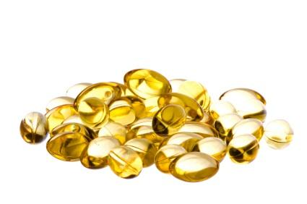
Vitamin D Therapy
Vitamin D compounds available in the United States include nutritional vitamin D [ergocalciferol (D2) and cholecalciferol (D3)], the prohormone calcifediol [25(OH)D3], active vitamin D [calcitriol (D3)], and vitamin D analogs [paricalcitol and doxercalciferol (both D2)].
Nutritional vitamin D (NVD) is derived from dietary plant (D2) and animal (D3) sources, or from supplements.

Slide 88
Pharmacology and Mechanism of Action
Vitamin D is a cholesterol derivative and is transported in the circulation by vitamin D–binding protein.
Both endogenously synthesized D3 and NVD compounds (as D2 or D3) are converted in the liver to 25(OH)D, by the 25-hydroxylase enzyme and then converted to the biologically active form 1,25-dihydroxyvitamin D (either D2 or D3 depending on the parent compound) by the 1-α-hydroxylase enzyme.
It is the concentration of 25(OH)D that is most commonly measured clinically to diagnose vitamin D deficiency.

Slide 89
Calcifediol
The 25(OH)D form is now available as calcifediol, an extended release oral formulation of the prohormone, indicated for patients with CKD stages 3 or 4 with low 25(OH)D levels.
Calcifediol has been shown to lower PTH with relatively minimal effects on serum calcium and phosphorus in stage 3-4 CKD, which is the reason it has gained approval in nondialysis CKD patients to treat 25(OH)D deficiency.

Slide 90
Pharmacology and Mechanism of Action
Calcitriol and the vitamin D analogs bind to the vitamin D receptors (VDRs), which are located in many organ systems including the parathyroid glands, intestine, bone, kidney, heart, nervous, and immune systems.
Vitamin D inhibits or suppresses PTH synthesis and also stimulates absorption of serum calcium (and phosphorus) by intestinal cells.

Slide 93
The Effects of Vitamin D
The serum calcium concentration is raised, which decreases PTH secretion by the parathyroid glands.
The set point for calcium (ie, the calcium concentration at which PTH secretion is decreased by 50%), which is generally raised in those with CKD-MBD, is lowered when active vitamin D therapy is initiated. This results in a lower ionized calcium concentration becoming effective at suppressing secretion of PTH.
Unfortunately, the enhanced GI absorption of calcium and phosphorus associated with calcitriol therapy may lead to hypercalcemia and hyperphosphatemia, which are associated with soft-tissue and vascular calcifications.

Slide 94
Pharmacology and Mechanism of Action
The unique interactions of vitamin D with the VDRs have led to the development of vitamin D analogs that vary in their affinity for the VDRs.
Paricalcitol and doxercalciferol retain activity with vitamin D receptors on the parathyroid gland to effectively lower PTH, but have less risk of hypercalcemia and hyperphosphatemia due to their lower intestinal activity.
Paricalcitol differs from calcitriol by the absence of the exocyclic carbon 19 and the fact that it is a vitamin D2 derivative (19-nor-1,25-dihydroxyvitamin D2)and it is active as given.
Doxercalciferol, however, is a prohormone that requires activation by CYP27 in the liver to form the major active D2 metabolite 1,25-dihydroxyvitamin D2.

Slide 95
Efficacy
Calcitriol, paricalcitol, and doxercalciferol are all effective in lowering PTH in patients with CKD.
The trade-off is the undesired effect of raising calcium and phosphorus concentrations due to increased intestinal absorption.
Although these effects are less likely with paricalcitol and doxercalciferol, elevated calcium concentrations have been observed.
An all-cause and CV survival benefit has also been reported with these agents in both CKD and ESRD patients in observational studies.
KDIGO does not advocate for routine use of calcitriol and vitamin D analogs in the nondialysis CKD population and suggests that they be reserved for patients with CKD stages 4-5.
These agents may be used in conjunction with calcimimetics when warranted in the dialysis population.

Slide 96
Efficacy
A review and meta-analysis in CKD patients (including ESRD patients) reported that NVD supplementation was associated with an improvement in 25(OH)D levels and decreased PTH without significant hypercalcemia or hyperphosphatemia in nondialysis CKD patients .
The survival benefit of correcting vitamin D deficiency with NVD in the CKD population is unknown.
The recommendation by KDIGO is that confirmed 25(OH)D deficiency in patients with CKD 3a-5D be corrected using treatment strategies in the general population, which includes NVD therapies.

Slide 97
Adverse Effects
Although all agents are effective in suppressing PTH, they may cause:
hypercalcemia and hyperphosphatemia, an effect that is most likely with calcitriol.
Oversuppression of PTH and inducement of adynamic bone disease are also distinct possibilities.

Slide 98
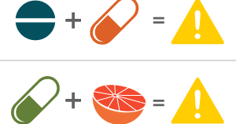
Drug–Drug and Drug–Food Interactions
- Cholestyramine may reduce the absorption of orally administered calcitriol and doxercalciferol.
- In vitro data suggest that paricalcitol is metabolized by the hepatic enzyme CYP3A4 and thus it has the potential to interact with other agents that are metabolized by this enzyme.
- Caution is also advised when CYP3A4 inhibitors are given to those receiving doxercalciferol since hydroxylation of this precursor agent may be inhibited.

Slide 99
Dosing and Administration
Despite limited evidence, KDIGO guidelines support administering NVD to patients with CKD 3a-5 and ESRD with vitamin D deficiency or insufficiency .
ESRD patients typically require calcitriol, doxercalciferol, or paricalcitol.
Calcitriol, doxercalciferol, or paricalcitol should be administered when PTH remains elevated despite the achievement of adequate 25(OH)D levels.

Slide 100
Dosing and Administration
Calcitriol by either the oral or the IV route may be administered daily (usually 0.25-1 mcg/day) or using a pulse dosing approach (0.5-2 mcg two to three times per week).
Prior to starting therapy, the serum calcium and phosphorus should be within the normal range.
Dose adjustments of vitamin D should be made every 2 to 4 weeks based on PTH concentrations and trends in calcium and phosphorus.

Slide 101
Pharmacologic Therapy
Calcimimetics
 | Cinacalcet (senipar) | Etelcalcetide (parsabiv)
Administeration | Oral | IV
Uses | Both agents are approved for use only in dialysis patients with secondary hyperparathyroidism.
Binding site | Transmembrane domain | Extracellular domain
Half-life | 30 to 40 hours | 3 to 4 days
Steady state | 7 days | Several weeks
Removal by dialysis | Large volume of distribution and is 93%- 97% bound to plasma proteins; thus, removal by dialysis is negligible | Cleared by hemodialysis
Excretion | Liver enzymes (CYP3A4, CYP2D6, and CYP1A2) | Renally

Slide 102
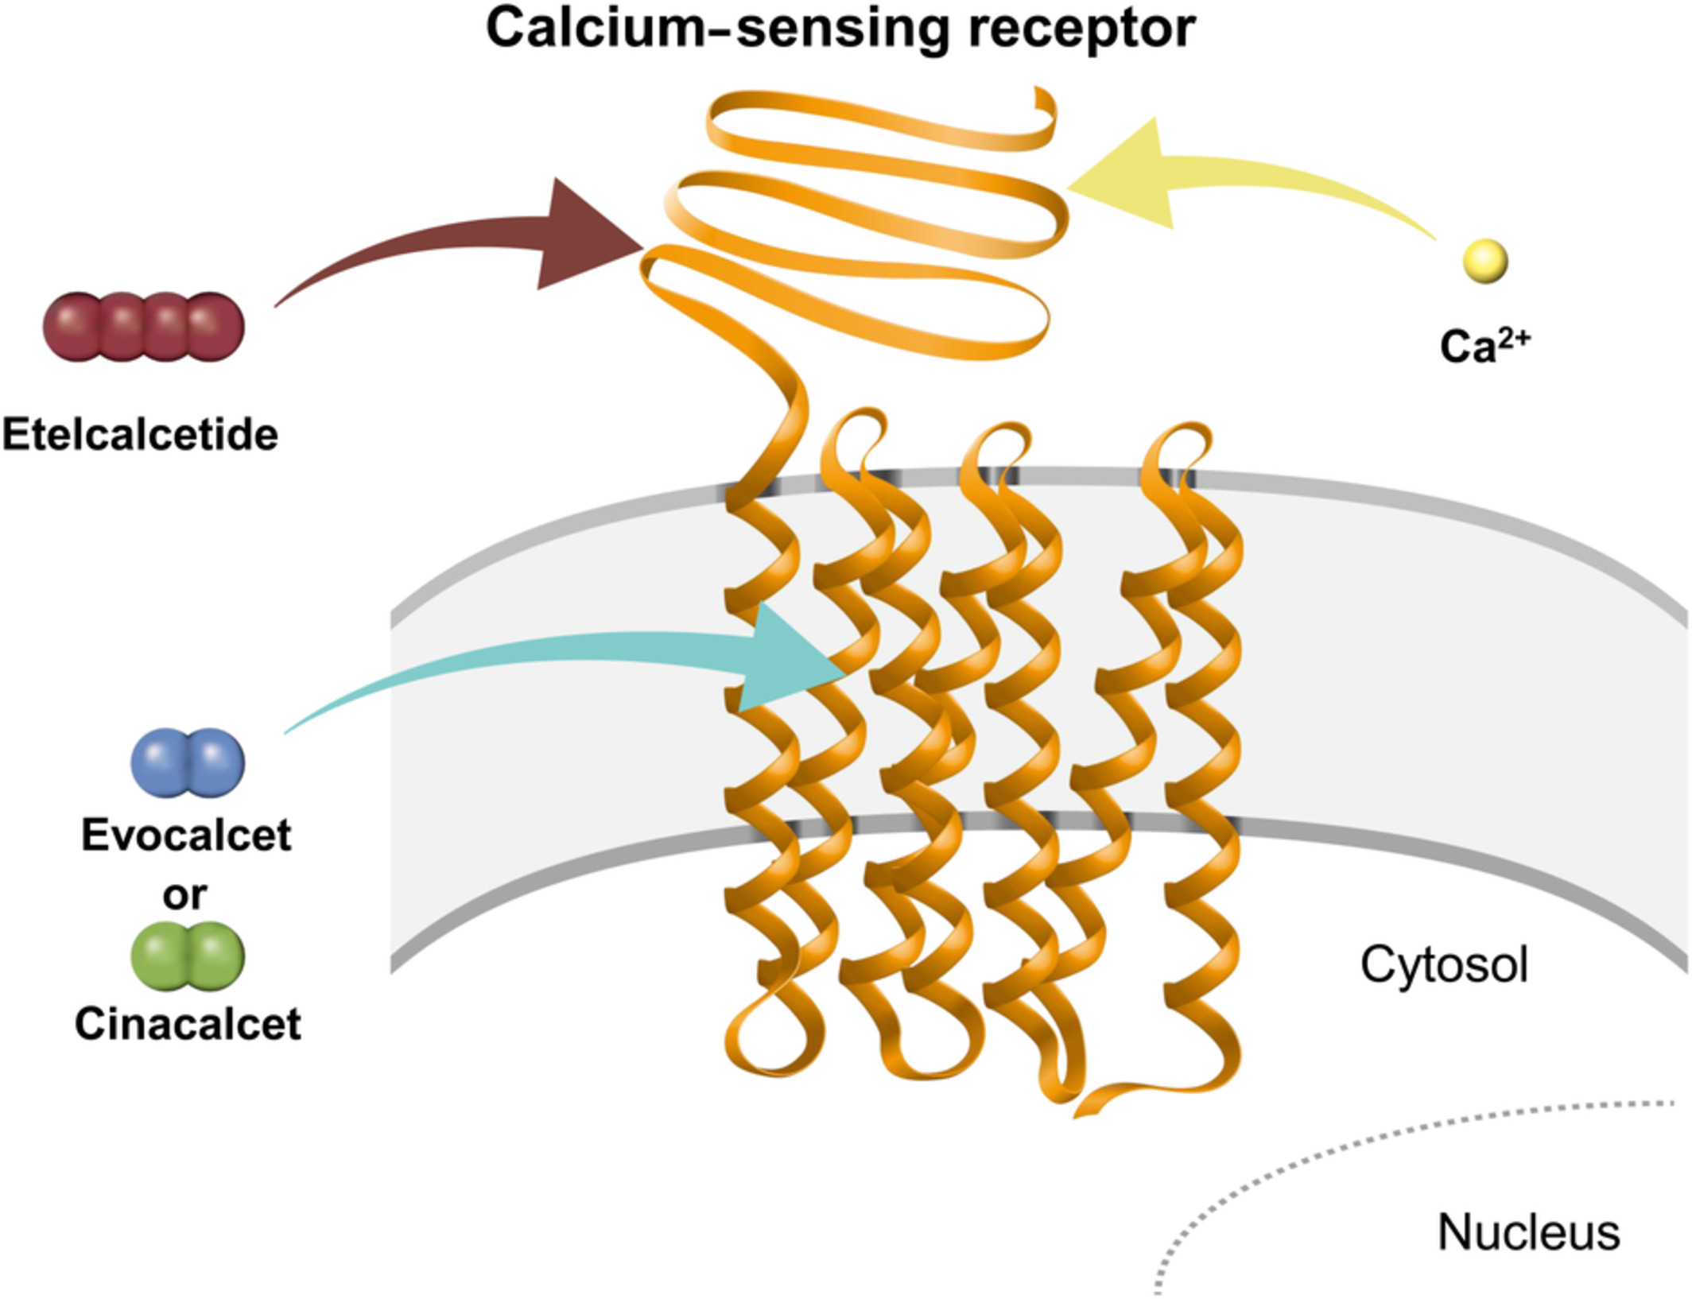
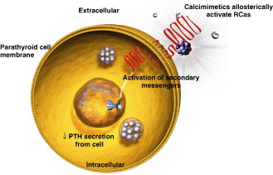
Pharmacologic Therapy
Mechanism of action
work through interactions on the calcium-sensing receptor (CSR) on the surface of the chief cells of the parathyroid gland. Cinacalcet works as an allosteric modulator of the CSR through binding to the transmembrane domain of the receptor while etelcalcetide binds directly to the extracellular domain >>> increased sensitivity of the receptor to extracellular calcium (ie, lowering the threshold for receptor activation by calcium) and subsequently reducing PTH secretion.

Slide 103
Pharmacologic Therapy
Efficacy:
In clinical trials conducted predominantly in dialysis patients, cinacalcet significantly decreased PTH, calcium, and phosphorus, regardless of the severity of secondary hyperparathyroidism. In nondialysis CKD patients, it reduced PTH, but was associated with a high incidence of hypocalcemia; thus, this agent is not approved for use in nondialysis CKD patients.
Cinacalcet may be used as a single agent to control hyperparathyroidism in ESRD patients; however, combined therapy with vitamin D is often necessary to achieve target PTH, calcium, and phosphorus values.
Etelcalcetide lowers calcium and phosphorus and has also been shown to lower FGF23.
There was a greater reduction in serum calcium and phosphorus with etelcalcetide compared with cinacalcet.

Slide 104
Pharmacologic Therapy
Side effects:
Nausea and vomiting.
Side effects related to hypocalcemia: Q-T interval prolongation, ventricular arrhythmias, convulsions, paresthesia, myalgia, cramping and tetany.
Don’t start if the corrected serum calcium is less than the lower limit of normal [≈ 8.4 mg/dL (2.10 mmol/L)].
Serum calcium should be measured within 1 week after initiation or following a dose adjustment. Once the maintenance dose is established, serum calcium should be measured monthly.

Slide 105
Pharmacologic Therapy
Drug–Drug and Drug–Food Interactions
Cinacalcet with CYP3A4 inhibitor (e.g ketoconazole): twofold increase in AUC and maximum concentration.
Cinacalcet is also a potent inhibitor of CYP2D6: dose adjustments of concomitant medications that affected by that enzyme and have a narrow therapeutic index, such as flecainide, thioridazine, vinblastine, and most tricyclic antidepressants (eg, amitriptyline), may be necessary. It increases amitriptyline and nortriptyline (active metabolite) exposure by approximately 20% in CYP2D6-extensive metabolizers.
Food has been shown to increase absorption of cinacalcet by up to 82% compared with fasting; therefore, this medication should be taken with meals to achieve the maximal effect.
There are no drug interactions reported with etelcalcetide.

Slide 106
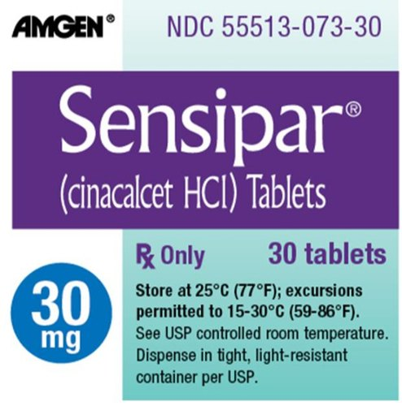
Pharmacologic Therapy
Dosing and Administration
Starting dose of cinacalcet= 30 mg orally once daily.
Monitoring: Calcium and phosphorus should be measured at 1 week and PTH should be measured within 1 to 4 weeks after starting cinacalcet or adjusting the dose.
Titration: every 2-4 weeks.
Maximum dose= 180mg once daily.
Patients with hepatic disease may require lower doses, since the cinacalcet half-life is approximately doubled in those with severe liver disease.

Slide 107
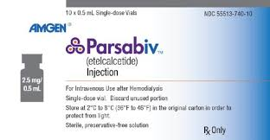
Pharmacologic Therapy
Dosing and Administration
Starting dose of cinacalcet= 5 mg IV three times per week at the end of the hemodialysis treatment (during or after rinse back)
Monitoring: calcium and phosphorus should be measured 1 week after initiation and then every 4 weeks for maintenance therapy. PTH levels should be measured 4 weeks after initiation and then per protocol based on the practices of the dialysis center.

Slide 108
Pharmacologic Therapy
Dosing and Administration of etelcalcetide
PTH
> Target range & corrected Ca normal
2.5- or 5-mg increments, max. dose= 15mg
< Target range
Reduce dose or temporarily D/C.
≥ 7.5 mg/dL w/o sx. of hypocalcemia
Reduce dose or temporarily D/C.
Corrected calcium
< 7.5 mg/dL
D/C. and correct hypocalcemia
Reinitiated at a dose 5 mg lower than the last administered dose.
2.5mg for 2.5 or 5 mg pts.

Slide 109
Missing doses and switching
Since etelcalcetide is removed by hemodialysis, it should be administered at the end of the hemodialysis treatment and injected into the venous line of the dialysis circuit during or after rinse back.
If a dose is missed (eg, due to a missed hemodialysis treatment), then that missed dose should not be administered, but the patient should resume the regular treatment schedule at the next hemodialysis session. If doses are missed for more than 2 weeks, then etelcalcetide should be restarted at the 5 mg dose.
If switching a patient from cinacalcet to etelcalcetide, then cinacalcet should be discontinued for at least 7 days prior to starting etelcalcetide.
There are currently no recommendations for switching patients from etelcalcetide to cinacalcet. The fact that etelcalcetide has a longer half-life should be considered if making a transition to cinacalcet.

Slide 110
Treatment of proteinuria
ACEI & ARBs
First-line therapy if the urine albumin excretion is in category A2 or greater (uACR >30 mg/g; 3.4 mg/mmol).
The antiproteinuric effect is a class effect.
For patients with hypertension, the primary goal is to achieve the target blood pressure while a secondary goal is to control proteinuria.
The dose is usually increased until albuminuria is reduced by 30% to 50% or side effects such as a greater than 30% decrease in eGFR or elevation in serum potassium occur.
If patients exhibit a cough with an ACEI, a switch to an ARB is appropriate.

Slide 113
The lack of response of some patients to ACEI or ARB therapy may be due to aldosterone escape from renin–angiotensin–aldosterone system (RAAS) blockade. Combination therapy with an ACEI plus an ARB or direct renin inhibitor (aliskiren) produces a more complete blockade of the RAAS and results in a greater reduction in macroalbuminuria. However, several trials have failed to show that dual blockade of the RAAS either slowed progression of CKD or decreased CV events.
Combination therapy in these trials was also associated with increased risks of hyperkalemia and acute kidney injury. Thus, the combination of an ACEI plus an ARB or aliskiren for the treatment of proteinuria is no longer recommended.

Slide 114
Treatment of proteinuria
Sodium Glucose Transport-2 Inhibitors
Show considerable promise in slowing progression of DCKD with benefits that seem to be independent of the glucose lowering effect
MOA: reducing glucose and sodium reabsorption in the proximal tubule of the kidney, these agents decrease glomerular hyperfiltration and reduce glomerular hypertension.
FDA approved canagliflozin for treatment of DCKD to reduce the risk of renal events, cardiovascular mortality, and hospitalization for heart failure.
Empagliflozin showed beneficial kidney effects including reduced albuminuria, slowed eGFR decline, and a 50% reduced risk for progressing to ESRD; these benefits were consistent across patients with eGFR ≥30 mL/min/1.73 m2.

Slide 115
Treatment of proteinuria
Other agents
Addition of aldosterone antagonist to ACEI or ARBs significantly reduced proteinuria and blood pressure, but doubled the risk of hyperkalemia and significantly increased the risk of gynecomastia.
Dihydropyridine calcium channel blockers (CCBs) do not appear to have any beneficial effects beyond those attributable to reducing blood pressure.
Nondihydropyridine agents (diltiazem and verapamil) have yielded beneficial effects on proteinuria, although not as profoundly as ACEIs. The postulated mechanisms for this decrease in kidney injury include suppression of glomerular hypertrophy, inhibition of platelet aggregation, and a decrease in salt accumulation. These agents have been used to reduce proteinuria in combination with an ACEI or ARB despite the fact that there are limited data to support this strategy. In general, nondihydropyridine CCBs should be considered second- or third-line antiproteinuric drugs when an ACEI or ARB is contraindicated or not tolerated.

Slide 116
Hypertension
The Systolic Blood Pressure Intervention Trial (SPRINT) assessed whether a lower systolic blood pressure goal of less than 120 mm Hg versus a target of less than 140 mm Hg was desirable.
Patients aged 50 years or older with a systolic blood pressure of 130 to 180 mm Hg and an increased risk of CV events were included.
CKD 3a to 4 patients (eGFR of 20-59 mL/min/1.73 m2) were enrolled into this trial as they were considered to be at high CV risk .
It is important to note that patients with a history of diabetes, category A3 proteinuria defined as greater than or equal to 1 g/24 hours of protein or albuminuria greater than or equal to 600 mg/24 hours, polycystic kidney disease, or a history of stroke were excluded.
In the 2,646 participants with CKD, the composite renal outcome of a decrease in eGFR of 50% or more or the need for chronic dialysis or kidney transplantation was not significant over the 3.3 years duration of this trial.
There were also potential harms to all participants (with and without CKD) in the intensive systolic blood pressure group that included significantly increased risks of syncope, hypotension, electrolyte abnormalities, AKI and CKD progression.
A target SBP of <120 mm Hg may be appropriate in patients with a Framingham risk score of >15% who do not have comorbidities such as diabetes, stroke, or advanced CKD.
It may also be appropriate in patients who achieve SBP in the 120s without requiring a high number of antihypertensives and who are not experiencing adverse effects of therapy.
Lastly, patients prescribed ACEI/ARBs or diuretics who are targeting an SBP <120 mm Hg need to be reliable and able to maintain adequate fluid intake (eg, vomiting/diarrhea) due to the risk of AKI.

Slide 117
Diabetes
Patients with diabetes should be screened annually for CKD starting at the time of diagnosis of type 2 diabetes and 5 years after the diagnosis of type 1 diabetes by ordering a serum creatinine, eGFR, and a uACR.
The management of diabetes in patients with CKD includes reduction of proteinuria and achievement of desired blood pressure and HbA1c .
The HbA1c target in this patient population should be 7%)
However, clinicians may consider a target greater than 7% , if there is a risk of hypoglycemia or limited life .
It should be noted that HbA1C measurements are based on an assumed red blood cell life span of 120 days.
In CKD, the red blood cell life span is decreased, so HbA1c values may be falsely low.
Hence, in patients with CKD, the HbA1c should be interpreted along with the patient’s home blood glucose readings when assessing diabetic control.

Slide 118
Diabetes
It is also important to note that patients with CKD 3 and 4 are at higher risk of developing hypoglycemia because of the reduction in metabolism of insulin by the kidney as GFR declines.
As a result, these patients may require reduced doses of oral or injectable hypoglycemic agents.
Metformin is still considered a first-line agent in individuals with type 2 diabetes and CKD.
As previously discussed, SGLT-2 inhibitors are emerging as a potential new treatment of DCKD and may be used in patients with an eGFR above 25 to 30 mL/min/1.73 m2 .
Metformin can be initiated and/or continued in individuals with an eGFR greater than or equal to 45 mL/min/1.73 m2.
It is not recommended to initiate metformin in patients with an eGFR between 30 and 44 mL/min/1.73 m2, and the decision whether to continue therapy in patients who reach this level of kidney function should be made only after weighing the risks and benefits.
Metformin is contraindicated in individuals with an eGFR less than 30 mL/min/1.73 m2 and should be temporarily discontinued before administering iodinated contrast agents for imaging studies.
Dose adjustments or avoidance of other renally eliminated hypoglycemic agents may also be necessary.

Slide 119
Cardiovascular Complications of Chronic Kidney Disease
Patients with CKD are at increased risk of CVD, independent of the etiology of their kidney disease.
The prevalence of any form of CVD is double in elderly CKD patients compared to patients without CKD (65% vs 33%).
Twenty six percent of elderly CKD patients had heart failure and 25% had a history of atrial fibrillation.
In contrast, the rates in non-CKD patients were 6% and 10%, respectively.
This burden of CVD is associated with much higher mortality rates.
In general, CKD patients have a lower probability of survival for all of the CVD conditions reported, with late stages of CKD being associated with the worst outcomes.
For example, the adjusted two-year survival of myocardial infarction patients without a diagnosis of CKD was 81.7% versus 74.5% for CKD stage 1-2 patients and 58.6% for CKD stage 4-5 patients.
The adjusted two-year survival of patients undergoing percutaneous coronary intervention without a diagnosis of CKD was 83.2% versus 76.3% for CKD stage 1-2 patients and 64.3% for CKD stage 4-5 patients.

Slide 120
Cardiovascular Complications of Chronic Kidney Disease
Traditional CVD risk factors present in patients with CKD include : diabetes mellitus, dyslipidemia, hypertension, LVH, smoking, and obesity.
Nontraditional risk factors include proteinuria, hyperhomocysteinemia, anemia, inflammation, and abnormal calcium and phosphate metabolism resulting in vascular calcification oxidative stress.
Unfortunately, the lack of randomized trials treating CVD in patients with CKD often leads to treatment decisions that are based on extrapolation from trials in non-CKD populations and from observational data in CKD.
However, the level of care for ischemic heart disease offered to people with CKD should not differ from people without CKD as there is evidence indicating that treatment of traditional risk factors in CKD patients is of benefit.
These patients should also receive the standard assessments and treatments such as statins for CKD 1-5 (nondialysis), beta-blockers, ACEIs/ARBs, and antiplatelet agents.
Clinicians should note that in the diagnosis of acute coronary syndrome, elevated serum troponins should be interpreted with caution in individuals with a GFR less than 60 mL/min/1.73 m2 , because these markers are often elevated as a result of reduced renal excretion .

Slide 121
Cardiovascular Complications of Chronic Kidney Disease
Patients with CKD should receive standard heart failure therapies .
However, clinicians should be aware that RAAS blockade (eg, ACEI, ARB, spironolactone, eplerenone) and diuretic therapy (eg, furosemide, metolazone) may lead to significant changes in GFR and serum potassium concentrations.
Such therapy should not be avoided, but closely monitored and put into the context of individual risks and benefits.
With regard to the cardiac biomarkers of B-type natriuretic peptide (BNP) and N-terminal pro-BNP (NT-pro-BNP) in individuals with a GFR less than 60 mL/min/1.73 m2 (0.58 mL/s/m2) (CKD 3a-5), it is recommended that serum concentrations be interpreted with caution with respect to diagnosis of heart failure and assessment of volume status .
Aspirin (ASA) is recommended for secondary prevention in all patients with CKD based on decreased mortality in observational studies.
ASA is generally not recommended for primary prevention as compared to placebo or no treatment as it reduces the risk of myocardial infarction but not all-cause mortality, cardiovascular mortality, or stroke and increases the risk of major and minor bleeding.

Slide 122
Hyperlipidemia
CKD with or without nephrotic syndrome is frequently accompanied by abnormalities in lipoprotein metabolism.
Although the concentrations of LDL are not uniformly increased in patients with kidney disease, these patients appear to produce small, dense LDL particles that are more susceptible to oxidation and more atherogenic than larger LDL subfractions.
Other lipid abnormalities include low HDL and increased triglycerides.
In patients with nephrotic syndrome, the major lipid abnormalities are elevation of plasma total and LDL cholesterol, with or without low HDL cholesterol, and elevated triglycerides.
The KDIGO lipid guidelines recommend that a complete fasting lipid profile be performed in all adults with newly identified .
Follow-up lipid levels are not recommended unless the information may alter management (eg, assessing adherence to therapy or assessing CV risk in a patient <50 years and not currently on a statin).
Reduction in the risk of CV events in patients with CKD has only been demonstrated with statins or a statin plus ezetimibe combination.

Slide 123
Statins in Chronic Kidney Disease
Statins have been shown to decrease mortality and CV events in CKD 1-5 patients, however, the data are not as compelling in the ESRD population.
The Study of Heart and Renal Protection (SHARP) trial was a primary prevention trial that evaluated the effects of combined simvastatin (20 mg) and ezetimibe (10 mg) compared with placebo on time to first major vascular event (nonfatal MI or cardiac death, any stroke, or revascularization) in patients with no history of MI or coronary revascularization and included patients with CKD (6,247) and ESRD (3,023).
In all patients receiving combined therapy during the 4.9-year follow-up period, there was a significant 17% reduction in the relative risk (RR) of major vascular events and a 32% reduction in LDL in the patients who were assessed as compliant with therapy (two-thirds were compliant).
While overall these results are positive, the study was not powered to evaluate whether the observed effect was significant in ESRD patients as a separate group.
A subgroup analysis comparing dialysis versus nondialysis and diabetic versus nondiabetic patients showed no differences in the RR of CV events even after adjustment for the reduction in LDL.
A meta-analysis of statins in dialysis patients indicated that they had no significant beneficial effect on major CV events, all-cause mortality, CV death, or myocardial infarction, and a trend toward increased strokes despite clinically relevant reductions in LDL cholesterol.
In contrast, a meta-analysis of statins in nondialysis CKD showed significant reductions in major CV events, CV death, all-cause mortality; myocardial infarction but uncertain effects on stroke.

Slide 124
The KDIGO lipid guidelines make the following recommendations:
1. In adults age 18 to 49 years with CKD but not treated with chronic dialysis or kidney transplantation, we suggest statin treatment in people with one or more of the following:known coronary disease (myocardial infarction or coronary revascularization); diabetes mellitus; prior ischemic stroke; estimated 10-year incidence of coronary death or nonfatal myocardial infarction greater than 10%.
2. In adults age greater than 50 years with eGFR less than 60 mL/min/1.73 m2 but not treated with chronic dialysis or kidney transplantation, we recommend treatment with a statin or statin/ezetimibe combination.

Slide 125
3. In adults with dialysis-dependent CKD, we suggest that statins or statin/ezetimibe combination not be initiated. However, in patients already receiving statins or statin/ezetimibe combination at the time of dialysis initiation, we suggest that these agents be continued.

Slide 126
Thank you

