Slide 1
Nephrotic syndrome

Slide 2
Nephrotic syndrome: is the combination of nephrotic-range proteinuria with a low serum albumin level and edema. Nephrotic-range proteinuria is the loss of 3 grams or more per day of protein into the urine or, on a single spot urine collection, the presence of 2 g of protein per gram of urine creatinine.
Nephritic syndrome: are caused by diseases that produce proliferative inflammatory responses that decrease the permeability of the glomerular capillary membrane.

Slide 3
Nephrotic syndrome causes
Primary causes
secondary causes
1-minimal–change nephropathy.
2- focal segmental
Glomerulosclerosis
3- membranous nephropathy.
4- Hereditary nephropathies
1- DM.
2-HTN.
3- SLE.
4- amyloidosis.
5- preeclampsia.
6- viral infections such as hepatitis B

Slide 4
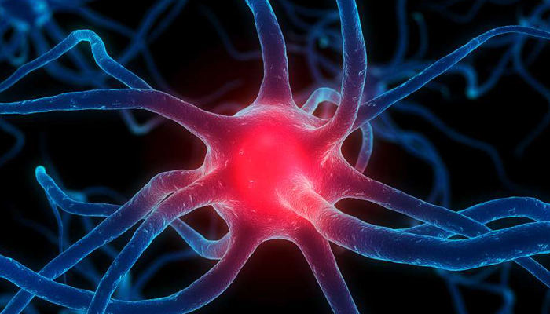
etiology
Primary causes.
Secondary causes.
The proposed mechanisms of membranous nephropathy are as follows:
1) Immune complex deposition from the circulation. (SLE)
2) In-situ formation of immune complexes through the reaction of circulating autoantibodies to a native antigen. (idiopathic membranous nephropathy, (PLA2R) antibodies).
3) In-situ formation of immune complexes with a non-native (extrinsic) antigen that is bound to the podocytes or glomerular basement membrane. (enzyme replacement therapy for genetic enzyme deficiency diseases such as Pompe or Fabry disease, allo-antibodies)

Slide 5
Medication can cause nephrotic syndrome:
1- NSAIDs cause very infrequent occurrence of minimal-change nephropathy.
2- gold and penicillamine for rheumatoid disease cause membranous nephropathy.
3- intravenous bisphosphonates cause focal glomerulosclerosis.
4- Lithium and interferon therapy have been associated with focal glomerulosclerosis of the collapsing type.
5- anti cancer drugs such as bevacizumab.
6- drug abuse to heroin.
Cancer can cause membranous nephropathy due to immune
Complex injury to the glomeruli by the cancer antigens.
In a study, Individuals with membranous nephropathy have
a rate 10-fold Higher to cancer than normal people.

Slide 6
Nephrotic syndrome classification based on therapeutic perspective.
Steroid resistance nephrotic syndrome: absence of remission despite therapy with daily prednisolone at a dose 2mg/kg/d for 4 weeks.

Slide 7
Pathophysiology
In healthy individual the normal albumin in urine is less than 50mg/day.
With individual with tubular transport defect the concertation in albumin is 3.5mg/L, this mean amount of albumin in urine per day above 500mg/day suggest glomerular disease.
A damage with one or more of the layers of the glomerulus ( endothelial, podocyte, glomerular basement membrane), have been seen in nephrotic syndrome.
In congenital nephrotic syndrome of the Finnish type, the gene for nephrin, a protein of the filtration slit, is mutated, leading to nephrotic syndrome in infancy.
In steroid-resistant focal glomerulosclerosis, a podocin, a protein of the podocytes, may be abnormal in a number of children.
Nephrotic syndrome can be selective proteinuria (85% albumin) which will be only loss of glomerular membrane negative charge , or nonselective proteinuria which will be a generalized permeability defect.

Slide 8
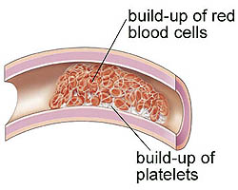
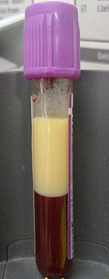
Metabolic consequences of the nephrotic syndrome include the following:
1- edema
2- Infection
3- Hyperlipidemia and atherosclerosis
4- Hypocalcemia and bone abnormalities
5- Hypercoagulability
6- Hypovolemia
The primary cause of the metabolic consequences is proteinuria.

Slide 9
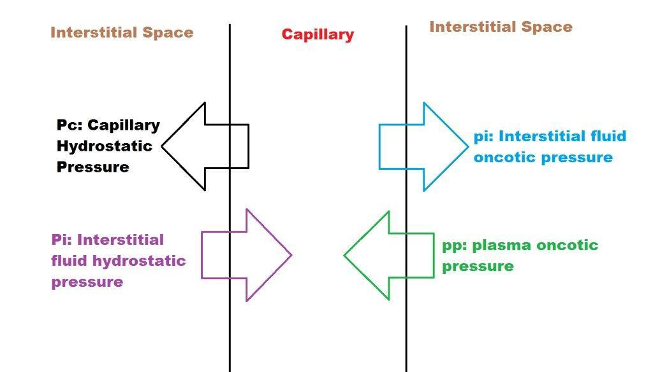
Pathogenesis of edema
1- The underfill hypothesis holds that the loss of albumin leading to lower plasma colloid pressure is the cause.
Qw = K ([Pc -­ pp] ­- [Pi ­- pi]
1- Qw is net flux of water.
2- K is the capillary filtration coefficient.
3- The overfill hypothesis states that the edema is due to primary renal sodium retention.
Intrinsic defect that prevent sodium excretion, two facts support that:
1- sodium retention is observed even before the serum albumin level starts falling.
2- intravascular volume is normal or even increased in most patients with nephrotic syndrome.

Slide 10
Metabolic consequences of proteinuria
infection due to:
Urinary immunoglobulin losses.
Edema fluid acting as a culture medium.
Protein deficiency.
Decreased bactericidal activity of the leukocytes.
Immunosuppressive therapy.
Decreased perfusion of the spleen caused by hypovolemia.
Urinary loss of a complement factor (properdin factor B) that opsonizes certain bacteria.
2) Hyperlipidemia and atherosclerosis due to:
It is related to the hypoproteinemia and low serum oncotic pressure of nephrotic syndrome, which then leads to reactive hepatic protein synthesis, including of lipoproteins.
reduced plasma levels of lipoprotein lipase results in diminution of lipid catabolism. Some of the elevated serum lipoproteins are filtered at the glomeruli, leading to lipiduria and the classic findings of oval fat bodies and fatty casts in the urine sediment.

Slide 11
3) Hypocalcemia and bone abnormalities
The long duration of the nephrotic syndrome and its treatment with steroids are the main cause.
This could be caused by urinary losses of vitamin D–binding proteins, with consequent hypovitaminosis D and, as a result, reduced intestinal calcium absorption.
4) Hypercoagulability
due to urinary loss of anticoagulant proteins, such as antithrombin III and plasminogen, along with the simultaneous increase in clotting factors, especially factors I, VII, VIII, and X.
In a study, of almost 300 patients with nephrotic syndrome confirmed that the annual incidence of venous thromboembolism (VTE) was almost 10 times higher in these persons than in the normal population ( preventive anticoagulant treatment should be used in the first 6 months of persistent nephrotic syndrome due to high risk of DVT in the first 6 months).
The study also showed an increased risk of arterial thrombotic events in subjects with nephrotic syndrome, including coronary and cerebrovascular ones. Unlike the risk of VTE, which was related to proteinuria, this arterial risk was related to usual risk factors for arterial disease, such as hypertension, diabetes, smoking, and reduced GFR.
5) Hypovolemia
Is due to loss of serum albumin which result in a decrease of plasma oncotic pressure resulting in a loss of plasma water into the interstitium and causing a decrease in circulating blood volume, it is observed when albumin level is less than 1.5g/dl.
Symptoms include vomiting, abdominal pain, and diarrhea. The signs include cold hands and feet, delayed capillary filling, oliguria, and tachycardia. Hypotension is a late feature.

Slide 12
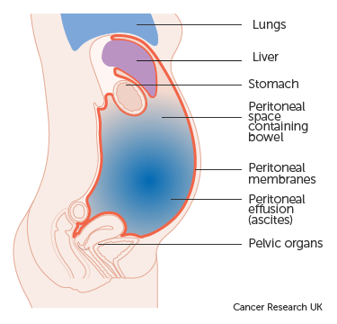
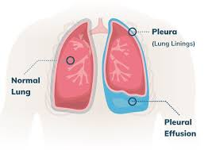
Additional consequences include the following:
1) Hypertension related to fluid retention and reduced kidney function may occur.
2) Edema of the gut may cause defective absorption, leading to malnutrition.
3) Ascites and pleural effusions may develop.

Slide 13
prognosis
treatments for nephrotic syndrome and its complications have reduced the morbidity and mortality once associated with the syndrome.
the prognosis for the patients with primary nephrotic syndrome depends on its cause.
Examples:
1- Infants with congenital nephrotic syndrome have a dismal prognosis: survival beyond several months is possible only with dialysis and kidney transplantation.
2- Only approximately 20% of patients with focal glomerulosclerosis undergo remission of proteinuria; an additional 10% improve but remain proteinuric.
3- End-stage renal disease (ESRD) develops in 25-30% of patients with focal segmental glomerulosclerosis by 5 years and in 30-40% of these patients by 10 years.
4- The prognosis for patients with minimal-change nephropathy is very good. ( same as adult).
5- Poor patient response to steroid therapy may predict a poor outcome. Children who present with hematuria and hypertension are more likely to be steroid-resistant and have a poorer prognosis than those without hematuria or hypertension

Slide 14
The prognosis may worsen due to:
an increased incidence of renal failure and the complications secondary to nephrotic syndrome, including thrombotic episodes and infection.
Or treatment-related conditions, such as infectious complications of immunosuppressive drug therapy.
In secondary nephrotic syndromes, morbidity and mortality are related to the primary disease process such as diabetes and lupus.
In diabetic nephropathy with nephrotic syndrome, patients usually have a good response to angiotensin blockade, with reduction of proteinuria and some slowing of the loss of renal function. But there is no complete remission.
In primary amyloidosis, prognosis is not good, even with intensive chemotherapy. In secondary amyloidosis, remission of the underlying cause, such as rheumatoid arthritis, is followed by remission of the amyloidosis and its associated nephrotic syndrome

Slide 15
presentation
1) history:
The signs of nephrotic syndrome in children is swelling of the face followed by swelling of the entire body.
Adult will have dependent edema.
Foamy urine may be a presenting feature.
fatigue and loss of appetite are common.
A thrombotic complication, such as DVT of the calf veins or even a PE, may be the first clue to nephrotic syndrome.
the recent start of NSAID suggests such drugs as the cause.
more than 10-year history of diabetes with symptomatic neuropathy indicates diabetic nephropathy.

Slide 16
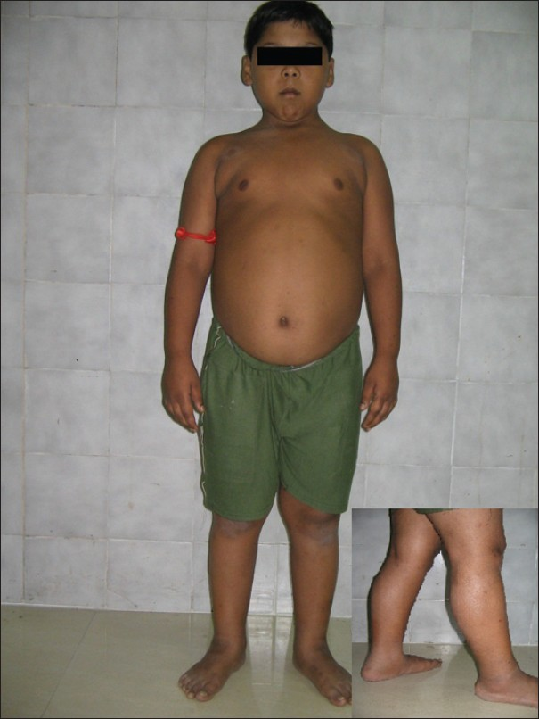
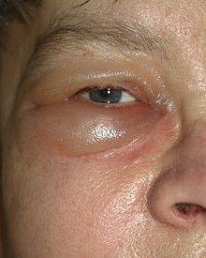
2) Physical examination:
Hematuria and hypertension manifest in a minority of patients.
Additional features on exam will vary according to cause and as a result of whether or not renal function impairment exists.

Slide 17
Work up
Diagnostic studies for nephrotic syndrome may include the following:
1- Urinalysis.
2- Urine sediment examination.
3- Urinary protein measurement.
4- Serum albumin.
5- Serologic studies for infection and immune abnormalities.
6- Renal ultrasonography.
7- Renal biopsy.
8- genetic testing for NPHS1 and NPHS2 for nephrin and podocin mutation respectively, In children with steroid-resistant nephrotic syndrome, testing for the NPHS2 mutation may be indicated.

Slide 18
Urine studies
Urinalysis:
Nephrotic-range proteinuria will be apparent by 3+ or 4+ readings on the dipstick.
2) Urine sediment examination:
The urine sediment exam may show cells and/or casts.
By use of a polarizing microscope, one can see oval fat bodies and also fatty casts. These point to the nephrotic syndrome. (due to lipoprotein filtration).
The presence of more than 2 red blood cells (RBCs) per high power field is indicative of microhematuria. Microhematuria may occur in membranous nephropathy but not in minimal-change nephropathy.
3) Urinary protein measurement:
A single spot urine collection is much easier to obtain. When the ratio of urine protein to urine creatinine is greater than 2 g/g, this corresponds to 3 g of urinary protein per day or more.

Slide 19
Renal Biopsy
For childhood nephrotic syndrome, a renal biopsy is indicated for the following:
1-Congenital nephrotic syndrome.
2-Children older than 8 years at onset.
3-Steroid resistance.
4-Frequent relapses or steroid dependency.
5-Significant nephritic manifestations.
For adult, renal biopsy is needed to determine the unknown cause of nephrotic syndrome
Note: Renal biopsy is very helpful to differentiate minimal-change disease and its variants such as IgM nephropathy and C1q nephropathy.

Slide 20
Laboratory studies
Kidney function:
SrCr will be in normal range with uncomplicated nephrotic syndrome.
Children below 0.5mg/dl SrCr, indicate reduced kidney function.
Serum albumin:
The serum albumin level is classically low in nephrotic syndrome.
Serologic studies:
In adults with nephrotic syndrome, tests for hepatitis B and C, HIV, and even syphilis may be useful.
Tests for lupus, including antinuclear antibody (ANA), anti–double stranded DNA (anti-dsDNA) antibodies, and complement, may be useful.

Slide 21
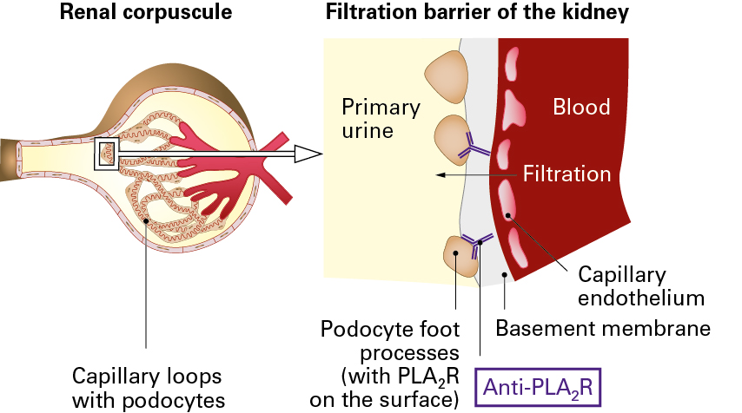
Phospholipase A2 receptor:
PLA2 R is a cell surface transmembrane receptor expressed on the surface of podocytes.
Seventy percent of patients with idiopathic membranous nephropathy have autoantibodies directed against PLA2 R.
Levels of this antibody have a strong correlation with clinical disease activity and thus help in monitoring disease activity and treatment efficacy.
Absence of these antibodies may suggest secondary membranous nephropathy such as that associated with cancers.
Use of the PLA2R antibody test has changed the diagnosis and treatment of idiopathic membranous nephropathy.

Slide 22
Treatment
Non-pharmacology:
The diet in patients with nephrotic syndrome should provide adequate caloric intake and adequate protein (1 g/kg/d).
A low-salt diet will limit the fluid retention and edema that occurs in nephrotic syndrome. A 24-hour urine collection is useful to quantify dietary intake of sodium. More than 88 mEq/day in the 24-hour urine suggests high salt intake. The help of a dietician will be useful to bring the daily sodium intake down to 2 g (88 mEq)/day or less.
exercise, rather than bedrest, will reduce the risk of blood clots.

Slide 23
Pharmacologic treatment:
The treatment depend on the cause and it is varies between adults and childrens.
Specific treatment for children:
For children with idiopathic nephrotic syndrome, corticosteroids are the mainstay of treatment.
Alternative immunosuppressive agents (eg, cyclophosphamide, mycophenolate mofetil [MMF], calcineurin inhibitors) are often used in children with steroid-dependent or frequently relapsing nephrotic syndrome.
For steroid-resistant nephrotic syndrome, calcineurin inhibitors are the principal choice, children who fail to respond may be tried on agents such as MMF or prolonged and/or high-dose intravenous pulse corticosteroids.
Rituximab, has proved an effective steroid-sparing agent in children with steroid-dependent idiopathic nephrotic syndrome. However, children dependent on both steroids and calcineurin inhibitors are less likely to achieve drug-free remission with rituximab.
Rituximab may also be used in children with steroid-resistant disease.
rituximab halted disease-associated growth deficit in the children.
ofatumumab was used on four children with persistent proteinuria, two of them got remission of proteinuria and the other two have renal impairment didn’t have remission.

Slide 24
Cyclosporin A or cyclosporin A with mycophenolate mofetil were used in steroid-dependent nephrotic syndrome and steroid-resistant nephrotic syndrome patients. mycophenolate mofetil was effective in all patients with steroid-dependent nephrotic syndrome in whom cyclosporine A treatment was not successful.
In a study, found low-dose daily dosing of prednisolone (0.2-0.3 mg/kg) was more effective than alternate-day dosing (0.5-0.7 mg/kg).
Congenital nephrotic syndrome is often treated with bilateral nephrectomy followed by dialysis and transplantation.

Slide 25
2) Specific treatment in adults:
Treatment depend on the cause:
Minimal change nephropathy in adults should respond to prednisone.
In lupus nephritis, prednisone with cyclophosphamide or mycophenolate mofetil should induce remission.
Secondary amyloidosis with nephrotic syndrome should improve with anti-inflammatory treatment of the primary disease.
Membranous nephropathy in adults:
Angiotensin blockers can be used for the first 6 months in patients at low risk for progression who are with SrCr level < 1.5 mg/dL and less than 4 g of proteinuria per day.
Patients with renal insufficiency (SrCr level >1.5 mg/dL) or those with higher amounts of urine protein are at risk for loss of kidney function and should receive immunosuppressive therapy such as regimens that combine prednisone with cyclophosphamide or chlorambucil.
Mycophenolate mofetil is not helpful in membranous nephropathy.
Rituximab is effective in membranous nephropathy in adults

Slide 26
Acute Nephrotic Syndrome in Childhood
Not always the hospital is necessary especially with educated parent.
Hospitalization should be considered if any of the following are present:
1- Generalized edema severe enough to cause respiratory distress.
2- Tense scrotal or labial edema.
3- Complications such as bacterial sepsis, peritonitis, pneumonia, or thromboembolism.
4- Failure to thrive.
5- Uncertainty regarding patient or family compliance with treatment.

Slide 27
Diuretic are needed such as Furosemide (1 mg/kg/d) and spironolactone (2 mg/kg/d) will help when fluid retention is severe.
Achieving a satisfactory diuresis is difficult when the patient's serum albumin level is less than 1.5 g/dL. Albumin in a dose of 1 g/kg may be given intravenously (IV), followed by IV furosemide.
Complication such as pulmonary edema may occur due to use of IV albumin. In addition, some evidence suggests that administration of albumin may delay the response to steroids and may even induce more frequent relapses, probably by causing severe glomerular epithelial damage.
Fluid removal and weight loss remain transient unless proteinuria remits.
To prevent infection, oral penicillin can be prescribed for children with gross edema.
Abdominal paracentesis should be performed if the patient develops signs of peritonitis, and any bacterial infection should be treated promptly.
A non-immune patient with varicella should get immunoglobulin therapy if exposed to chickenpox, and acyclovir should be given if the patient develops chickenpox.
Depending on the cause of nephrotic syndrome, a patient may need specialty consultation.

Slide 28
Acute Nephrotic Syndrome in Adults
Same as childhood.
Diuretics will be needed; furosemide, spironolactone, and even metolazone may be used.
Volume depletion may occur with diuretic use, which should be monitored by assessment of symptoms, weight, pulse, and blood pressure.
Anticoagulation has been advocated for use in preventing thromboembolic complications, but its use in primary prevention is unproven.
Hypolipidemic agents may be used such as statins except from rosuvastatin, which can worsen proteinuria. lipoprotein apheresis, which is a second-line therapy for pediatric patients with focal segmental glomerulosclerosis, may yield clinical benefits in nephrotic syndrome.
ACEi and ARBs are widely used for secondary nephrotic syndrome caused by diabetes, they work by three mechanisms that reduce proteinuria are by reducing the systemic blood pressure, by reducing intraglomerular pressure, and also by direct action on podocytes.

Slide 29
Long-Term Monitoring
the use and adjustment of diuretics and angiotensin antagonists are done according to the amount of edema and proteinuria that a patient has.
Routine immunizations should be delayed until the patient is free of relapses and has been off immunosuppression for 3 months.
Monitor for steroid toxicity every 3 months in the outpatient clinic will detect adverse effects such as slowing of growth.
Give Supplemental calcium and vitamin D may attenuate bone loss.
A yearly checkup will detect cataracts.

Slide 30
Medication treatment summary:
corticosteroids (prednisone), cyclophosphamide, and cyclosporine are used to induce remission in nephrotic syndrome.
Corticosteroids is the first-line agent, with cyclophosphamide or cyclosporine as backup for steroid-resistant cases.
cyclophosphamide is a safer alkylating agent than chlorambucil.
Cyclosporine is indicated when relapses occur after cyclophosphamide treatment. Cyclosporine may be preferable in a pubertal male who is at risk of developing cyclophosphamide-induced azoospermia.
Diuretics are used to reduce edema.
ACEi and ARBs can reduce proteinuria.
Minimal-change disease has an excellent response to corticosteroids, while in focal glomerulosclerosis, only 20% of patients respond well to corticosteroids.
Prednisone in short courses from 12-20 weeks duration remains the mainstay treatment for patients with minimal-change disease.
Immunosuppressive medications other than steroids are usually reserved for steroid-resistant patients with persistent edema, or for steroid-dependent patients with significant steroid-related adverse effects.

Slide 31
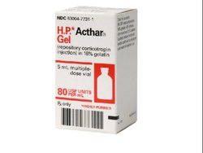
For idiopathic membranous nephropathy, prednisone along with chlorambucil or cyclophosphamide remains important for treatment.
Rituximab has been effective in some cases of nephrotic syndrome that relapse after prednisone treatment or in cases resistant to prednisone treatment.
Natural, highly purified corticotropin gel formulation (repository corticotropin injection) is also a potential treatment option for steroid-resistant nephrotic syndrome and has shown some results in reducing proteinuria, but need more study, same adverse effect as steroids, but it have high cost.

Slide 32
Prednisone:
MOA: Decrease inflammation by suppression of migration of polymorphonuclear leukocytes and reversal of increases capillary permeability, suppresses the immune system by reducing activity and volume of lymphatic system.
Adverse reaction: HTN, fluid retention, hypothyroidism, increase in serum liver enzymes, glaucoma, cataract, infection.
Cyclophosphamide:
MOA: is an alkylating agent that prevents cell division by cross-linking DNA strands and decreasing DNA synthesis.
Adverse effect: alopecia, bone marrow suppression, azoospermia, infection, and secondary malignancy.
Cyclosporin:
MOA: inhibition production and release of interleukin II and inhibit interleukin II- induced activation of resting T-lymphocytes.
Adverse effect: HTN, edema, headache, hirsutism, hypertrichosis, tremor, and increase SrCr.

Slide 33
Rituximab:
MOA: Binding of antibodies to CD20 results in inhibition of CD20-mediated signaling that leads to inhibition of cell activation and cell cycle progression.
Adverse effect: Infusion-related symptoms, Tumor lysis syndrome, Skin reactions, and Arrhythmias and chest pain.
Mycophenolate:
MOA: inhibits inosine monophosphate dehydrogenase and suppresses de novo purine synthesis by lymphocytes, thereby inhibiting their proliferation. It inhibits antibody production.
Adverse effect: HTN, edema, hypotension, tachycardia, pain, skin rash, hyperglycemia, hypercholesteremia, and abdominal pain.
Chlorambucil:
MOA: Forms cross-links with DNA resulting in inhibition of DNA synthesis and function.
Adverse effect: Myelosuppression is dose-limiting, N&V, Hyperuricemia, Seizures, Skin rash, Amenorrhea, and Increased risk of secondary malignancies.

Slide 34
Tacrolimus:
MOA: suppresses cellular immunity by binding to an intracellular protein, FKBP-12 complexes with calcineurin dependent proteins to inhibit calcineurin phosphatase activity.
Adverse effect: acute cardiorespiratory failure, acne vulgaris, alopecia, cellulitis, acidosis, abdominal distention, anemia, and graft complications.
Corticotropin:
MOA: stimulate adrenal cortex to secrete adrenal steroids, weakly androgenic substances, and aldosterone.
Adverse effect: hypertension, convulsions, and infection.
Ofatumumab:
MOA: anti-CD20 monoclonal antibody.
Adverse effect: BBW( HBV activation and PML), skin rash, diarrhea, anemia, infections, infusion related reactions.

