Slide 1
Hormonal replacement therapy
By: Alaa Sandouka

Slide 2
Menopause is determined retrospectively after 12 consecutive months of amenorrhea. FSH on day 2 or 3 of the menstrual cycle greater than 10 to 12 IU/L indicates diminished ovarian reserve.
As women age, circulating FSH progressively rises, and ovarian inhibin-B and anti mullerian hormone declines. In menopause there is 10-15 fold increase in circulating FSH and a greater than 90% decrease in circulating estradiol concentrations.
The diagnosis should include a comprehensive medical history and physical examination. complete blood count, and measurement of serum FSH. When ovarian function has ceased, serum FSH concentrations exceed 40 IU/L. altered thyroid function and pregnancy must be excluded.

Slide 3
Symptoms of menopause and perimenopause
Signs of menopause and perimenopause
vasomotor symptoms (hot flushes and night sweats), sleep disturbances, depression, anxiety, poor concentration and memory, vaginal dryness and dyspareunia, headache, sexual dysfunction.
urogenital atrophy in menopause and dysfunctional uterine bleeding in perimenopause. Other potential causes of dysfunctional uterine bleeding should be ruled out.

Slide 4
treatment
The primary goals of therapy for menopause are to relieve symptoms and improve quality of life while minimizing adverse effects.
In women with mild vasomotor symptoms and/or vaginal symptoms can often be alleviated by lowering room temperature, decrease intake of caffeine , spicy food and hot beverages, smoking cessation, exercise and a healthy diet.
Mild vaginal dryness can sometimes be relieved by nonestrogenic vaginal creams but significant vaginal dryness often require local or systemic estrogen therapy.

Slide 5
Absolute contraindications | Undiagnosed abnormal genital bleeding Known, suspected, or history of cancer of the breast Known or suspected estrogen- or progesterone-dependent neoplasia Active deep vein thrombosis, pulmonary embolism, or a history of these conditions Active or recent (eg, within the past year) arterial thromboembolic disease (eg, stroke, myocardial infarction) Liver dysfunction or disease
Relative contraindications | Elevated blood pressure Hypertriglyceridemia Impaired liver function and past history of cholestasis jaundice Hypothyroidism Fluid retention Severe hypocalcemia Ovarian cancer Exacerbation of endometriosis Exacerbation of asthma , DM, migraine, systemic SLE , epilepsy .

Slide 6
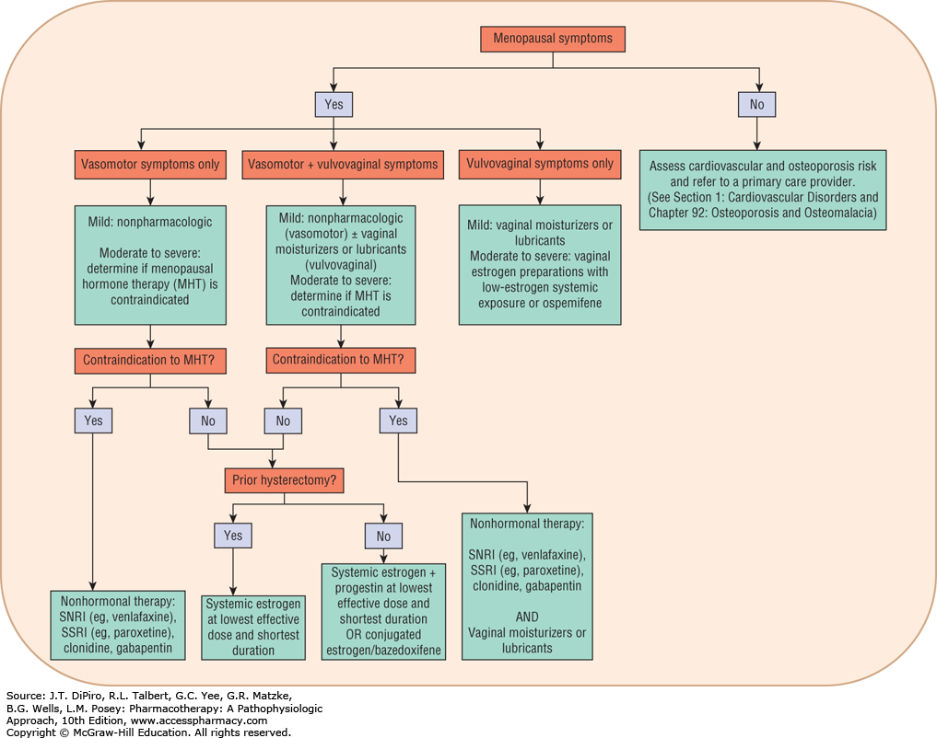
Algorithm for pharmacologic management of menopause symptoms

Slide 7
Therapy for Perimenopausal Women
Perimenopausal women can experience hot flushes despite having menstrual cycles
Combined hormonal contraceptives (containing low-dose estrogen and progestogen) provide contraception and vasomotor symptom relief.
approved indications for MHT are moderate o severe vasomotor symptoms, moderate to severe volvuvaginal atrophy and prevention of post menopausal osteoporosis.
Perimenopausal women should not use estrogen-containing contraceptives if they smoke ,have a history of estrogen-dependent cancer ,heart disease , high blood pressure ,diabetes ,thromboembolism

Slide 8
The continuous combined oral estrogen-progestogen arm of the women’s health initiative (WHI) study was terminated after a mean of 5.2 year follow up because of the occurrence of prespecified level of invasive breast cancer. This study also found to increase coronary disease events, stroke, and pulmonary embolism. Beneficial effects included decrease in hip, spine and wrist fracture and colorectal cancer.
The oral estrogen alone arm of the WHI was stopped after a mean of 6.8 year follow up. Estrogen only therapy cause no decrease in coronary heart disease risk or in breast cancer risk, but the risk of stroke and venous thromboembolism was increased.

Slide 9
MHT For Vasomotor Symptoms and urogenital symptoms
Women with mild vasomotor symptoms can experience relief by lifestyle modification
Moderate and severe symptoms can treated with ,vaginal estrogen cream, tablet, or ring; with low systemic estrogen exposure or with the selective estrogen receptor modulator (SERM) ospemifene 60 mg orally per day.
If urogenital symptoms are the only menopausal complaint, intravaginal estrogen cream, tablet, or ring should be considered before oral therapy.
Intra-vaginal estrogen minimizes systemic absorption ,improve atrophic symptoms and vaginal mucosal appearance, decrease vaginal pH, reduce the risk of UTI and by modifying the vaginal flora and is more effective for vaginal symptoms than oral therapy
Dose-related adverse effects of vaginal estrogen include vulvovaginal candidiasis, vaginal bleeding.
Therapeutic response is attained after 2 weeks of daily estrogen use.
For maintenance therapy, the frequency of use is decreased to 2 to 3 times weekly.

Slide 10
Estrogens
Estradiol is the predominant and most active form of endogenous estrogens. given orally and it is metabolized by intestinal mucosa and liver.
The primary indication for systemic estrogen-based MHT is the relief of moderate and severe vasomotor and vulvovaginal symptoms, and the initial dose should be the lowest effective dose for symptom control.
There are also conjugate equine estrogens (contain: estrone sulfate ,equilin , 17 a dihydroequilin.) , ethinyl estradiol that has similar activity following oral or parental administration.
Low-dose estrogen regimens include 0.3 to 0.45 mg conjugated estrogens, 0.5 mg micronized 17β-estradiol, and 0.014 mg/day once weekly transdermal 17β-estradiol patch. Topical gels, sprays, and creams are also available in low doses.
Non-oral estrogens including transdermal , intranasal , estradiol pellets placed sc (abdomen or buttock) and vaginal products(creams,tablets and rings) for urogenital symptoms. Transdermal estrogen has also been associated with a lower risk of DVT, stroke, and MI.

Slide 11
Taking oral estrogen ,a micronized form of estradiol , is readily absorbed from the small intestines.
In other routes of administration (non-oral) No significant increase in triglycerides, CRP, sex hormone binding globulin, and BP compared to oral.
Intravaginal tablets and rings are sustained-release delivery systems that can maintain adequate estradiol concentrations. Most tablets and rings provide local estrogen ,but femring (estradiol acetate) is designed to achieve systemic estrogen concentrations. And is indicated for moderate to severe vasomotor symptoms.

Slide 12
progestins
The most used oral progestogens are medroxyprogestrone acetate, micronized progesterone and Norethindrone (available as patch) .
For women with a history of hysterectomy, use of progestogens is not indicated.
However, in women with endometriosis who have had a hysterectomy, the use of a progestogen along with estrogen may minimize endometriosis exacerbations
S/E :Irritability, weight gain, bloating, and HA.
For women who haven’t undergone hysterectomy progestin should be added.

Slide 13
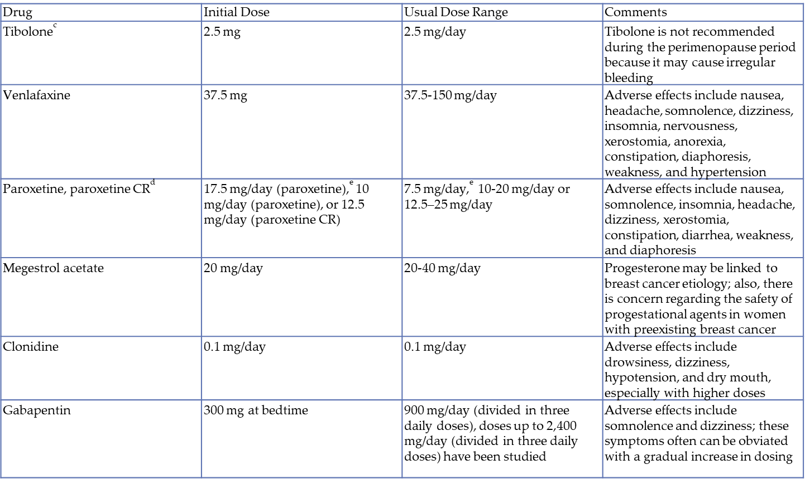
Other Treatments for Menopause-Related Symptoms
Selective serotonin reuptake inhibitors ex:Paroxitine and serotonin norepinephrine reuptake inhibitor ex: Venlafaxine are first line therapy for treatment of hot flushes in women for whom MHT is C/I .
Clonidine can be effective but side affects are problematic (eg: sedation, dry mouth, hypotension).

Slide 14
SELECTIVE ESTROGEN RECEPTOR MODULATORS (SERMS)
Nonsteroidal compounds that are chemically distinct from estradiol.
They act as estrogen agonists in some tissues, such as bone, and as estrogen antagonists in other tissues, such as breast .
Tamoxifen , the 1st generation SERM (a nonsteroidal triphenylethylene derivative), has estrogen antagonist activity on the breast and estrogen-like agonist activity on bone and endometrium.
Raloxifene 2nd generation SERM , it is used to reduce the risk of postmenopausal osteoporosis and invasive breast cancer in woman with osteoporosis, and also for treatment of postmenopausal osteoporosis. 60mg once daily.
However, Raloxifene has an increased incidence of hot flushes compared to placebo.
SERMs alone do not alleviate, and may even exacerbate vasomotor symptoms.

Slide 15
Ospemifene is an orally administered 3rd generation SERM approved by the FDA for the treatment of moderate-to-severe dyspareunia from menopausal vulvar and vaginal atrophy.
Box warning: increased risk of endometrial hyperplasia and endometrial cancer in a woman with a uterus ( estrogen agonist in the endometrium)who don’t take progetins with it
possible risk of stroke and venous thromboembolism. It also increases hot flashes.

Slide 16
Tibolone
Is a gonadomimetic synthetic steroid with combined estrogenic, progestogenic, and androgenic activity.
Beneficial effects on mood and improves menopausal symptoms and vaginal atrophy.
Protects against bone loss and significantly reduces the risk of vertebral fractures in postmenopausal women with osteoporosis.
Decrease the risk of breast cancer and colon cancer in healthy women aged 60 to 85 years. .

Slide 17
Most commonly S/E : weight gain and bloating.
Increased risk of stroke in elderly women .
Breast cancer recurrence in breast cancer patients with vasomotor symptoms.
Lowers concentrations of total cholesterol, triglycerides, and lipoprotein (a) but may decrease high-density lipoprotein (HDL).

Slide 18
Natural remedies Phytoestrogen
Mild estrogenic effects in postmenopausal women.
Decrease LDL and triglyceride with no significant change in HDL.
BMD may be improved by phytoestrogens.
Common S/E : constipation, bloating, and nausea.
A recent meta-analysis reported that phytoestrogen use is not associated with increased rates of endometrial cancer, vaginal bleeding, and breast cancer.
Black cohosh: Widely used herbal supplement, may not offer substantial benefits for relief of vasomotor symptoms , Does not appear to have strong intrinsic estrogenic properties but may act through the serotonergic system, it appears to be generally well tolerated, although hepatotoxicity has been reported.

Slide 19
Risks from the use of MHT coronary heart diseases
the women’s health initiative (WHI) study found an overall increase the risk of coronary disease events in healthy postmenopausal women ages 50 to 79 years taking estrogen-progestin therapy.
The oral estrogen alone arm of the WHI cause no effect in coronary heart disease risk.
A more recent analysis from WHI , which included only adherent participants, found that the risk of coronary heart disease increases with estrogen-progestin in the first 2 years of treatments. However, the women who initiated therapy within 10 years of menopause appears to decrease after 6 years of treatment.

Slide 20
venous thromboembolism
Includes thrombosis of the deep veins of the legs and embolism to the pulmonary arteries.
Risk of VTE and stroke increases with oral MHT containing estrogen. but the absolute risk is low in women bellow 60 . transdermal MHT and low-dose oral estrogen therapy have lower risks.
Avoid MHT in women with high risk for thromboembolic events :factor v mutation, previous thromboembolic events and obesity
Norpregnane progestogens appear to be thrombogenic

Slide 21
Breast cancer
MHT is contraindicated in women with personal history of breast cancer. This risk may be associated with the addition of progestin to estrogen and increased after use of 5 or more use of combined therapy.
However using estrogen alone may decrease rather than increase breast cancer risk.

Slide 22
Endometrial cancer
The WHI trial suggests that combined oral MHT does not increase endometrial cancer Vs. placebo.
However, estrogen alone given to women with an intact uterus significantly increases uterine cancer risk.
The excess risk increases with dose and duration of estrogen and persists for many years after estrogen replacement is discontinued.

Slide 23
Ovarian cancer
The WHI study suggested that oral combined MHT doesn't increase ovarian cancer risk
.
Postmenopausal women taking estrogen only for more than 10 years has a higher risk

Slide 24
The WHI study found that women 65 years or older taking estrogen plus progestogen therapy had twice the rate of dementia including alzehimer disease than those taking placebo. The estrogen alone arm show similar findings.

Slide 25
osteoporosis
Menopause is accompanied by accelerated bone loss.
MHT reduces the risk of fractures at the hip, spine, and wrist.
Estrogen therapy reduces bone turnover and increases bone density in postmenopausal women of all ages. The protective effect persists as long as the treatment is maintained.
However, lower doses of estrogen have been shown to increase bone mass to the same extent as standard-dose estrogen therapy.
General protective health measures, such as regular weight-bearing exercise and avoidance of detrimental lifestyle habits such as smoking and alcohol abuse, are appropriate for all women.
Some women require calcium supplementation to their usual dietary intake. Adequate vitamin D intake and/or supplementation are also needed.

Slide 26
Kalantaridou S.N., & Borgelt L.M., & Dang D.K., & Calis K (2017). Hormone therapy in women. DiPiro J.T., & Talbert R.L., & Yee G.C., & Matzke G.R., & Wells B.G., & Posey L(Eds.), Pharmacotherapy: A Pathophysiologic Approach, 10e. McGraw-Hill. https://accesspharmacy.mhmedical.com/content.aspx?bookid=1861&sectionid=146067309

Slide 27
Lung cancer
The WHI trial found that combined oral estrogen–progestogen therapy did not increase lung cancer incidence, but significantly increased deaths from lung cancer, mainly from nonsmall cell lung cancers
The estrogen-only arm of the WHI trial found no increased risk for lung cancer death.

Slide 28
Hormone therapy should be used only as long as vasomotor symptom control is necessary (usually 2-3 years).
A 6 w visit follow up to discuss patient concerns about hormone therapy and to evaluate the patient for symptom relief, adverse effects, and patterns of withdrawal bleeding.
Annual Follow-up Visit
Annual monitoring
Breast examinations
Osteoporosis prevention: BMD should be measured in women 65 years and older and in women younger than 65 years with risk factors for osteoporosis.

