Slide 1
Psoriasis by: Alaa Sandouka

Slide 2
Psoriasis is a progressive T-lymphocyte mediated systemic inflammatory disease that results from complex interplay between genetic factors and environmental influences. it is characterized by recurrent exacerbations and remissions of thickened, erythematous, and scaling plaques and multiple comorbidities.
The majority of patients (approximately 75%) have onset before the age of 40, but psoriasis has been observed at birth and as late as the ninth decade of life

Slide 3
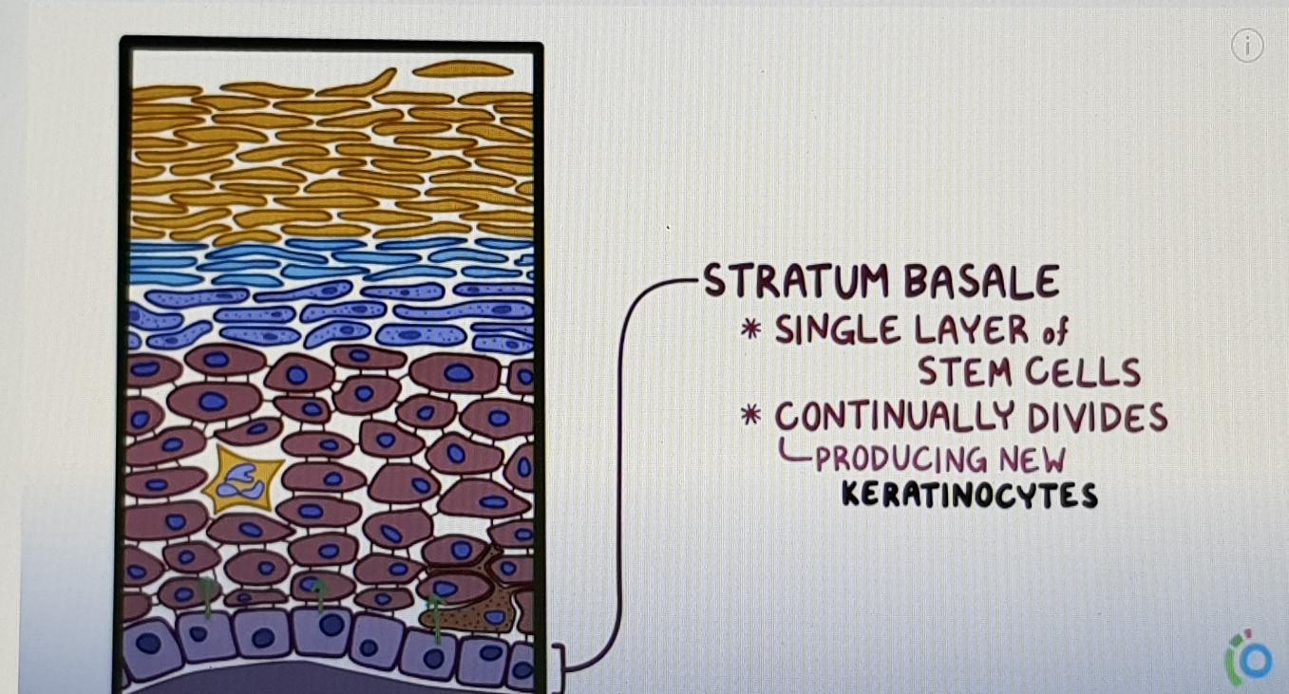
- How are psoriasis plaques formed?
2
1
4
3

Slide 4
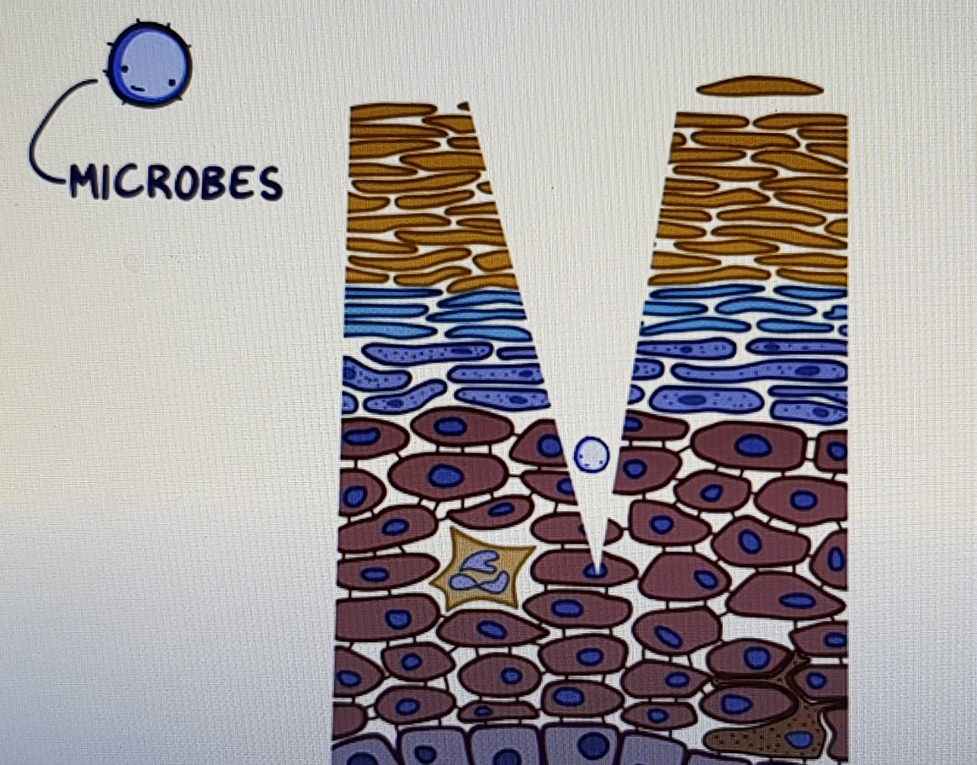
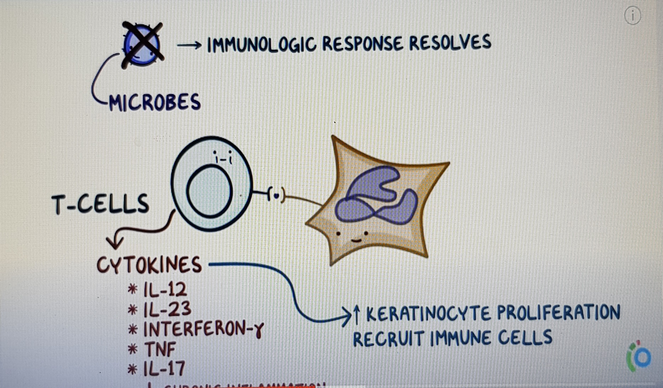
- How are psoriasis plaques formed?

Slide 5
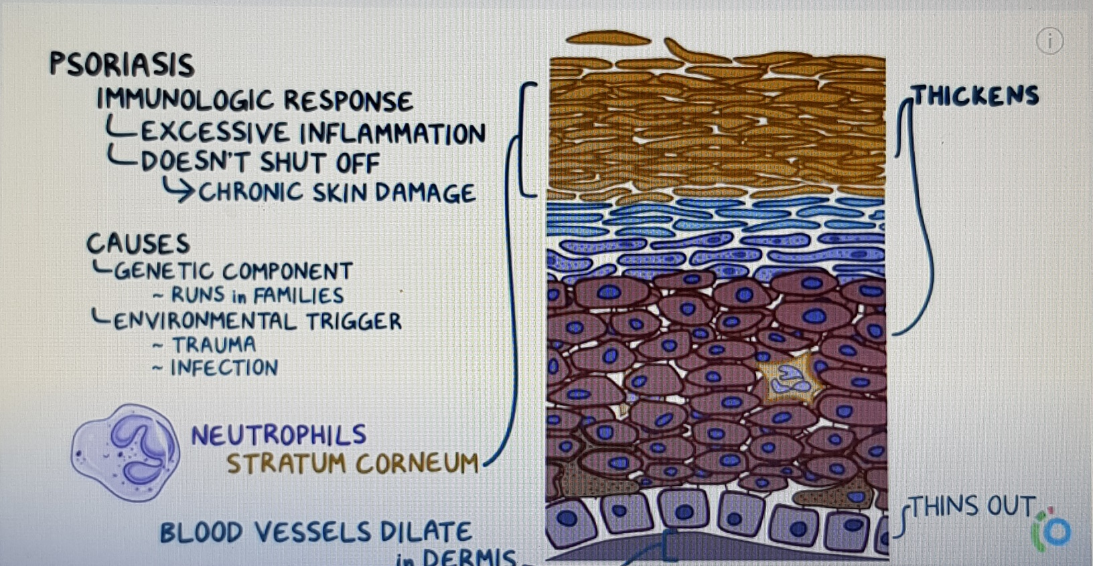
- How are psoriasis plaques formed?

Slide 6
Etiology
Psoriasis results from a complex interplay between multiple genetic factors and environmental influences
There are psoriasis susceptibility genes and variants that reside on various chromosomes. The psoriasis susceptibility locus 1 (PSORS1) on chromosome 6p is a key gene locus, accounting for up to 50% of disease heritability

Slide 7
Predisposing Factors and Precipitating Factors
Precipitating factors implicated in the development of psoriasis:
Skin injury ,infection , smoking , alcohol consumption , obesity ,psychogenic stress .
psoriatic patients commonly have exacerbations during times of stress
Can be exacerbated by drugs:
Lithium
NSAIDs
Antimalarials such as chloroquine
Beta adrenergic blockers
Fluxetine
Withdrawal of corticosteroids

Slide 8
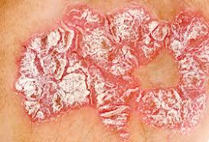
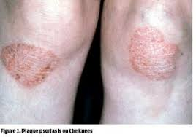
Clinical presentation
1. Lesion characteristics
Plaque psoriasis
Lesions are erythematous
Red-violet in color
At least 0.5 cm in diameter
Covered with silver flaking scales
2. The covered area (skin involvment)
* Over a wide body surface area (BSA)
* Single lesions at predisposed area ( knees and elbows)
OR

Slide 9
3. Also Suffering from pruritus which may be severe and should be treated to minimize excoriations that result from scratching. Therefore this psoriatic lesions may make the person prefer social isolation.
4. The systemic immune response may lead to potential comorbidities include :heart disease, diabetes, metabolic syndrome and other immune mediated disorders like multiple sclerosis

Slide 10
Diagnosis
Physical examination of the lesions and its characteristics is done to diagnose psoriasis.
We cant use Skin biopsies and laboratory tests for psoriasis diagnosis.
It can be mild , moderate or severe regarding to psoriasis area and severity index.
Mild psoriasis: ≤5% BSA involvement
Moderate psoriasis: BSA ≥8% (higher in trials of biologics)
Severe psoriasis: BSA ≥10% (in some phototherapy trials, BSA ≥20% used as lower limit)

Slide 11
Goals of treatment
Minimize/eliminate psoriatic skin lesions
Reduce frequency of flare-ups
Reduce pruritus
Eliminate triggering factors such as stress reduction, avoid smoking and alcohol consumption, weight reduction.
Prevent adverse drug reactions
Treat comorbidities
Improve quality of life

Slide 12
Non-pharmacological therapy
stress reduction
the liberal use of moisturizers may be very beneficial and should always be considered and initiated when appropriate.
Harsh soaps and detergents should be avoided.
Sunscreens of SPF 30 or higher should be used when outdoors.
For patients with comorbidities such as dyslipidemia, obesity, or cardiovascular disease, cessation of nicotine and alcohol consumption, diet control, and increasing physical activity are all important interventions.

Slide 13
Pharmacologic Therapy
Treatment algorithm for mild-to-moderate psoriasis

Slide 14
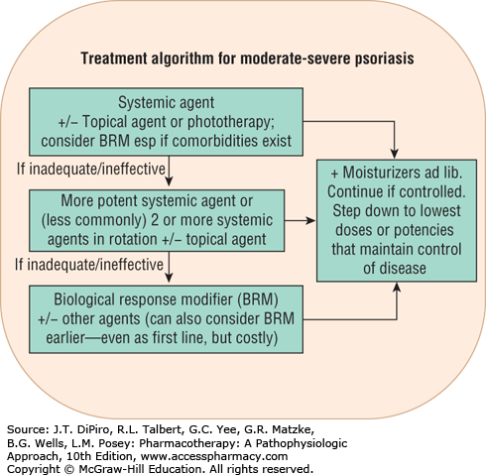
Treatment algorithm for moderate-to-severe psoriasis

Slide 15
Topical Therapies
Corticosteroids
- Corticosteroids have anti-inflammatory, anti-proliferative, immunosuppressive, and vasoconstrictive effects.
- There are many formulations of topical corticosteroid include :ointments, creams, gels, foams, lotions, sprays, shampoos and solutions
- The choice of vehicle affects corticosteroid potency: Ointments, being the most occlusive, enhance drug penetration and provide the most potent formulations. However, patients may prefer a less greasy formulation, such as a cream or lotion for daytime use, although they may be willing to apply the more effective ointment-based corticosteroid during the night
- Lower-potency products should be used for infants and for lesions on the face and areas with thin skin.
- For other areas of the body in adults, mid- to high-potency agents are generally recommended as initial therapy
- All topical corticosteroids are pregnancy category C

Slide 16
Cont…
* Cutaneous adverse effects include skin atrophy, acne, contact dermatitis, hypertrichosis, hypopigmentation, perioral dermatitis, striae.
* The use of most potent corticosteroids should be limited to a duration of 2 to 4 weeks

Slide 17
Calcipotriene (synthetic vitamin D3 analogue)
Mechanism of action: it binds to vitamin D receptors, which inhibits keratinocyte proliferation , it also .it is inhibits T-lymphocyte activity. It is Used For mild psoriasis
In head-to-head comparison studies with other topical agents, calcipotriol was found to be more effective than anthralin and comparable or slightly more effective than betamethasone valerate
Adverse effects of calcipotriene include mild irritant contact dermatitis, pruritus, edema, dryness, and erythema.
Calcipotriene is pregnancy category C.

Slide 18
Retinoids
Tazarotene is a topical retinoid that acts through the following mechanisms: normalizing abnormal keratinocyte differentiation, diminishing keratinocyte hyper-proliferation. It is effective in clearing psoriatic plaque lesions and achieving remission
Adverse effects of tazarotene include a high incidence of dose-dependent irritation at application sites, resulting in burning and stinging.
Irritation may be reduced by using the cream formulation, lower concentration or short-contact (30-60 minutes) treatment
Tazarotene is pregnancy category X and should not be used in women of childbearing age unless effective contraception is being used.

Slide 19
Anthralin
Anthralin is not as commonly used as other topical therapies currently available for psoriasis. It has a direct antiproliferative effect on epidermal keratinocytes, normalizing keratinocyte differentiation. Although the exact mechanism of action is unknown, it may have a direct effect on mitochondria and reduce the mitotic activity. It also prevents T-lymphocyte activation.
Currently, short-contact anthralin therapy (SCAT) is usually the preferred regimen, where the anthralin ointment 1% to 4% or as tolerated is applied only to the thick plaque lesions for 2 hours or less and then wiped off. zinc oxide ointment should be applied to the surrounding normal skin to protect it from irritation and burning. Anthralin should be used with caution, if at all, on the face because of the risk of severe skin irritation
Anthralin is pregnancy category C

Slide 20
Coal Tar
It is keratolytic and may have antiproliferative and anti-inflammatory effects
Coal tar concentrations as used in psoriasis treatments (0.5%-5%) are considered safe by the Food and Drug Administration (FDA)
Adverse effects include folliculitis, acne, local irritation, and phototoxicity.
Risk of teratogenicity when used in pregnancy is low

Slide 21
Salicylic acid
It has keratolytic properties
In combination with topical corticosteroids, it enhances steroid penetration thus increasing efficacy
when applied to greater than 20% BSA ,Systemic absorption and toxicity can occur also in patient with renal impairment.
it may be used for limited and localized plaque psoriasis in pregnancy
Avoid the use of salicylic acid in children.

Slide 22
Pimecrolimus
Pimecrolimus was found to be effective for plaque psoriasis when used under occlusion
and also effective for patients with moderate-to-severe inverse psoriasis
Because this cream is less irritating than calcipotriol and also avoids steroid adverse effects such as skin atrophy, it may be a useful alternative for patients with lesions on the face

Slide 23
Phototherapies and Photochemotherapy
Phototherapy consists of using nonionizing electromagnetic radiation, either UVA or UVB, as light therapy to treat psoriatic lesions.
UVB interferes with protein and nucleic acid synthesis, leading to decreased proliferation of epidermal keratinocytes. UVA has similar effects on epidermal keratinocytes. However, because of deeper penetration into the dermis, it also has effects on dermal dendritic cells, fibroblasts, endothelial cells, mast cells.
UVB is given alone as either broadband or narrowband UVB (NB-UVB) or with topical agents such as coal tar or Anthralin for enhanced efficacy and it is called photochemotherapy.

Slide 24
UVA is generally given with a photosensitizer, such as an oral psoralens, to enhance efficacy—this regimen is known as PUVA.
With respect to comparative efficacy, NB-UVB is more efficacious than broadband UVB, but may be slightly less effective than PUVA, but there are increasing concerns about PUVA toxicities (including skin cancers). Failure of NB-UVB may justify PUVA therapy
Thus, the use of phototherapy or photochemotherapy is contraindicated in patients with a history of melanoma or multiple non-melanoma skin cancers. Furthermore, although UVB has a theoretical risk of photocarcinogenesis, the risk is significantly higher with PUVA.

Slide 25
broad band UVB lamps emit a variety of wavelengths ranging from 280-330 nm however narrow band lamps emit wave lengths from 311-312nm
Clinical studies show the peak therapeutic effectiveness of UVB to be within the range of 295-313 nm, but wavelengths below 300 nm can cause erythema or severe burning and increase the risk of skin cancer. Also eliminating UV in wavelengths below 311 nm permits higher intensities and longer exposure times.
S/E : erythema, pruritus, hyperpigmentation, and blistering
eye protection should be provided during and for 24 hours after PUVA treatments

Slide 26
Systemic therapies
Acitretin ( retinoic acid derivative)
It works by inhibiting the excessive cell growth.
Initial dose 25 or 50 mg daily with meals
May be less effective than MTX or Cyclosporine when used as monotherapy so it is Often used in combination with topical calcipotriol or phototherapy
Pregnancy category X
Adverse effects: Hypertriglyceridemia, mucocutaneous and ophthalmologic change.

Slide 27
Cyclosporine
Systemic calcineurin inhibitor for moderate-severe plaque psoriasis.
It is similar or slightly better efficacy than MTX
We start with dose of 2.5–5 mg/kg/day given in two divided doses. Then the maintenance therapy using lower doses 1.25–3 mg/kg/day. It should be gradually tapered 1mg/kg/day each week to prevent relapse.
Adverse effects: nephrotoxicity , Hypertriglyceridemia , HTN , gingival hyperplasia

Slide 28
Methotrexate
Methotrexate works by suppressing the overactive immune system that causes psoriasis
Induction dose 7.5–15 mg once weekly, increased by 2.5 mg Q 2–4 weeks until response; maximum dose 25 mg weekly.
Adverse effects: N/V, Macrocytic anemia, Hepatic and pulmonary toxicity ,Stomatitis. Folic acid 1-5mg/day may reduce nausea and anemia.
Pregnancy cat. X

Slide 29
BIOLOGIC AGENTS
TNF-Alfa inhibitors
Adalimumab (Humira), Monoclonal TNF-alpha Antibody, It specifically binds to TNF and blocks its action in the body. It is used for moderate to severe plaque psoriasis and psoriatic arthritis.
Adverse reactions: Infections, Injection site reactions, Rash.
Contraindicated in patients with active tuberculosis and CHF

Slide 30
Etanercept
a biologic tumor necrosis factor (TNF) inhibitor
for adults with chronic moderate-severe plaque psoriasis and psoriatic arthritis.
It can be used in combination with methotrexate in patients who do not respond to methotrexate alone.
Adverse effects: Injection site reactions, Infections (GI, respiratory, TB), Abdominal pain, N/V, rash, malignancies are rare.

Slide 31
Infliximab
Monoclonal antibody indicated directly against tumor necrosis factor-alpha
It is indicated for psoriatic arthritis and chronic severe psoriatic lesions
for psoriatic arthritis it can be used with methotrexate or alone
Adverse effects include: headache , Fever, Fatigue, Diarrhea, Pharyngitis, Infections, Hypersensitivity reactions, lymphoproliferative disorders have been reported.

Slide 32
Alefacept
It Binds to CD2 on T cells to inhibit cutaneous T-cell activation and proliferation.
It is indicated for severe psoriasis and psoriatic arthritis.
Significant response is usually achieved after about 3 months
Adverse effects: Pharyngitis, Flu-like symptoms, Chills, Dizziness, N, HA, Injection site pain and inflammation, Infection

Slide 33
Ustekinumab
IL- 12/23 monoclonal antibody approved for the treatment of psoriasis in adults 18 years or older with moderate to severe psoriasis. And response can be seen in 2 weeks.
Adverse effects: headache , fatigue , infections

Slide 34
Combination Therapies
Aim to enhance efficacy and minimize toxicities.
Combinations can be: two topical agents, a topical agent plus phototherapy, a systemic agent plus topical therapy, a systemic agent plus phototherapy, two systemic agents used in rotation, or a systemic agent and a biologic agent.

Slide 35
The combination of a topical corticosteroids and a topical vitamin D3 analogue is effective and safe with less skin irritation than monothherapy like calcipotriene and betamethasone dipropionate ointment.
The combination of retinoids with phototherapy also increases efficacy such as UVB with tazarotene.
Phototherapy is also being used with other topical agents.such as UVB with coal tar
Cyclosporine with betamethasone dipropionate or calcipitriol is superior to cyclosporine alone. But cyclosporine shouldn’t be used with UVA due to reduced efficacy and an increased risk of cutaneous malignancies.
The combination of UVB and MTX appears to be synergistic. It also can be combined with TNF inhibitors.

Slide 36
Alternative drug treatments
Mycophenolate mofetil
inhibits DNA and RNA synthesis and may have a lymphocyte antiproliferative effect.
S/E: N/V/D, anemia, neutropenia, and thrombocytopenia, and viral and bacterial infections.
Hydroxyurea
inhibits cell synthesis in the S phase of the DNA cycle.
S/E: bone marrow suppression, lesional erythema, localized tenderness, and reversible hyperpigmentation

Slide 37
Reference
Law R.M., & Gulliver W.P. (2017). Psoriasis. DiPiro J.T., & Talbert R.L., & Yee G.C., & Matzke G.R., & Wells B.G., & Posey L(Eds.), Pharmacotherapy: A Pathophysiologic Approach, 10e. McGraw-Hill. https://accesspharmacy.mhmedical.com/content.aspx?bookid=1861&sectionid=146069987

