Slide 1
Density, Specific Gravity and Specific Volume
Chap 5

Slide 3
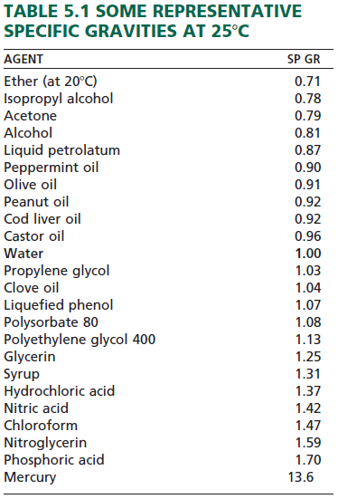
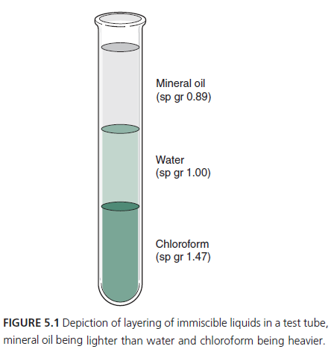

Slide 5
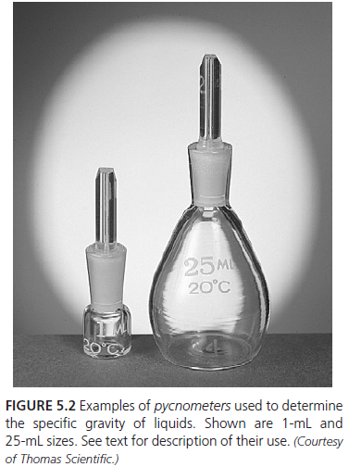

Slide 6
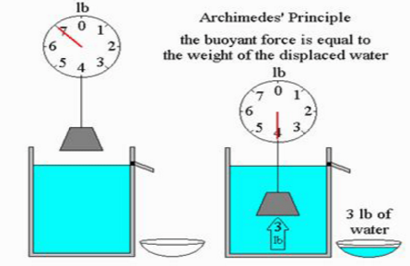
Videos

Slide 9
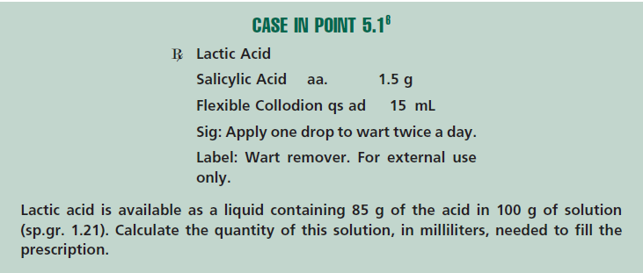

Slide 10
Specific volume tells us how much greater (or smaller) in volume a mass is than the same weight of water. It may be calculated by dividing the volume of a given mass by the volume of an equal weight of water.

