Slide 1
Lab1

Slide 2
Expiration Dates
For non-aqueous liquids and solid formulations,
where the manufactured drug product is the source of active ingredient, the beyond use date is not later than 25% of the time remaining until the product’s expiration date or 6 months, whichever is earlier;
where a USP substance is the source of active ingredient, the beyond-use date is not later than 6 months.

Slide 3
For water-containing formulations prepared from ingredients in solid form, the beyond-use date is not later than 14 days when stored at cold temperatures
For all other formulations, the beyond-use date is not later than the intended duration of therapy or 30 days, whichever is earlier
date limits can be exceeded if there is supporting, valid scientific stability information directly applicable to the product being compounded.

Slide 4
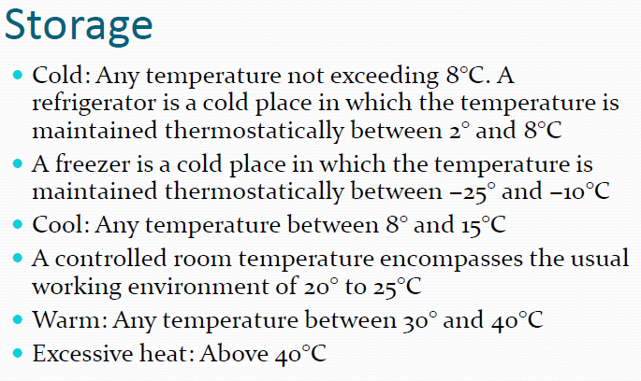

Slide 5
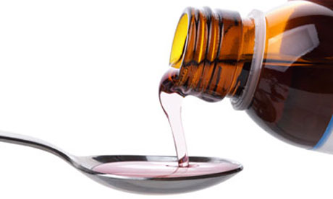
SYRUPS
Syrups are concentrated aqueous preparations of a sugar or sugar substitute with or without flavoring agents and medicinal substances
1- Non-medicated (flavored Vehicle) Pleasant tasting vehicles for medicinal substances(ready for Comp)
2- Medicated syrups are commercially prepared
from the starting materials, i.e., by combining each of the individual components of the syrup, sucrose, purified water, flavoring agents, coloring agents, the therapeutic agent, other ingredients if necessary

Slide 6
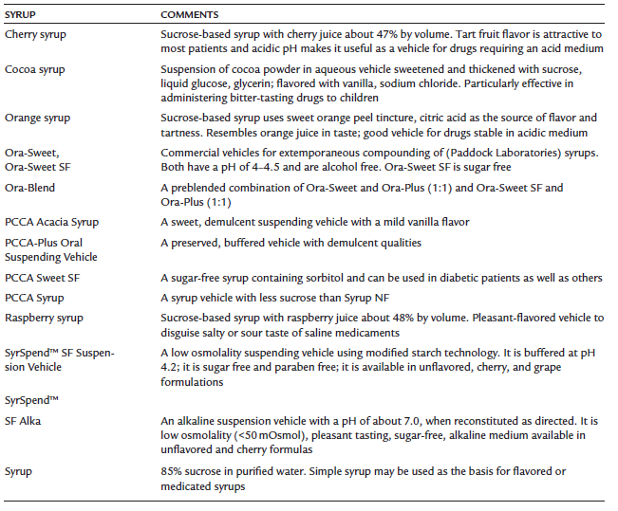
Notes:
Tartness : لاذع demulscent: relieving inflammation or irritation.
Ora-sweet : Purified water, sucrose, glycerin, sorbitol, and flavoring. Buffered with citric acid and sodium phosphate. Preservedwith methylparaben and potassium sorbate.
Orasweet SF (sugar free): Purified water, glycerin, sorbitol, sodium saccharin, xanthan gum, and flavoring. Buffered with citric acid and sodium citrate. Preserved with methylparaben (0.03%), potassium sorbate (0.1%), and propylparaben (0.008%).
OraPlus: (suspending vehicle)Purified water, microcrystalline cellulose, sodium, xanthan gum, carrageenan, calcium sulfate, trisodium phosphate, citric acid and sodium osphate as buffers, dimethicone antifoam emulsion. Preserved with methylparaben and potassium sorbate

Slide 7
COMPONENTS OF SYRUPS
the sugar, usually sucrose, or sugar substitute used to provide sweetness and viscosity;
antimicrobial preservatives
Flavorants
colorants.
Solubilizing agents
thickeners,
stabilizers.
Sucrose/Glycerine/Sorbitol/methylcellulose or hydroxyethylcellulose.(sweetened Syrup Like)

Slide 8
COMPONENTS OF SYRUPS
Most syrups contain a high proportion of sucrose, usually 60% to 80%, not only because of the desirable sweetness and viscosity of such solutions but also because of their inherent stability in contrast to the unstable character of dilute sucrose solutions
concentrated sugar solutions are quite resistant to microbial growth because of the unavailability of the water required for the growth of microorganisms.
simple syrup.
It is prepared by dissolving 85 g of sucrose in enough purified water to make 100 mL of (USP)

Slide 9
PREPARATION OF SYRUPS
(a) solution of the ingredients with the aid of heat,
(b) solution of the ingredients by agitation without the use of heat, or Simple admixture of liquid components,
(d) percolation of either the source of the medicating substance or the sucrose
Notes:
Percolation is the process of a liquid slowly passing through a filter. It's how coffee is usually made.

Slide 10
Syrup Prep Solution with the Aid of Heat
Very quick method
Heat stable ingredients
Method
Sugar is added to water
Heat is applied while mixing
other heat-stable components are added to the hot syrup, the mixture is allowed to cool
If heat labile or volatile materials are present they are added when after sugar is dissolved and syrup is rapidly cooled
Don’t use excessive heat (brown color)

Slide 11
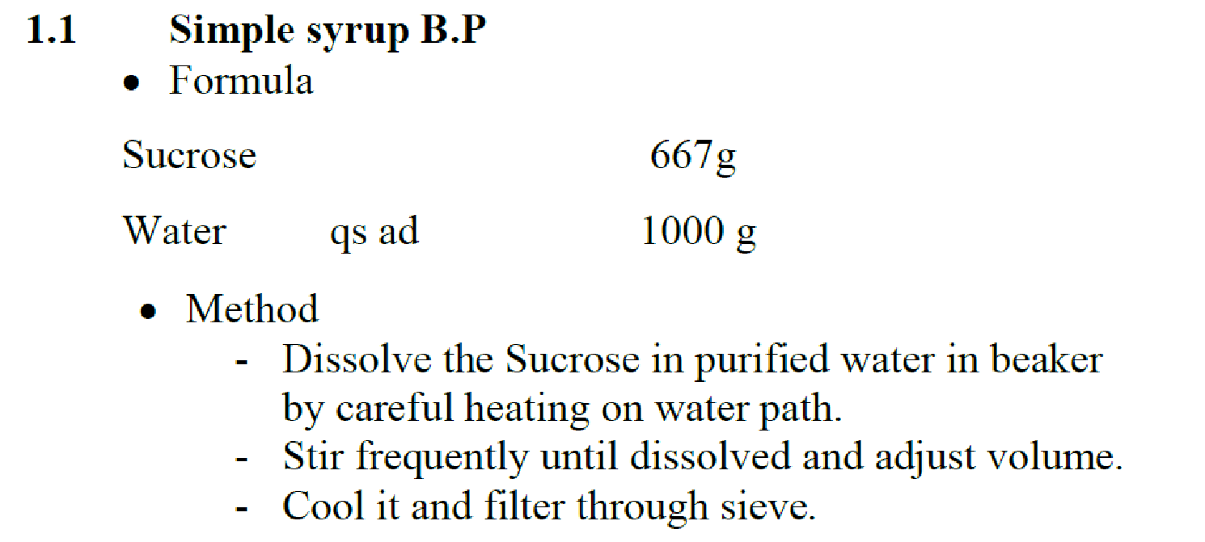
Syrup

Slide 12
Syrup
Simple syrup used as: sweetening agent, preservative, demulcent and nutrient material., vehicle
Under 4 C syrups crystalize
it is preferred to add 10% Glycerol to act as a preservative and to prevent crystallization
Stored at room temperature, in Tightly stopper and well filled bottles to avoid contamination
Refrigeration, inhibit both fermentation and hydrolysis but cooler than 4 Cº cause crystallization of sucrose

Slide 13
Chloroform water B.P
Chloroform is an anaesthetic when inhaled. When taken by mouth, it has a pleasant taste and causes a sensation of warmth
Orally it is used as a carminative, a flavouring agent and a preservative.
In products made extemporaneously, it is added either as Chloroform Water BP (also referred to as Single Strength Chloroform Water BP), Double Strength Chloroform Water BP or as Chloroform Spirit BP.

Slide 14
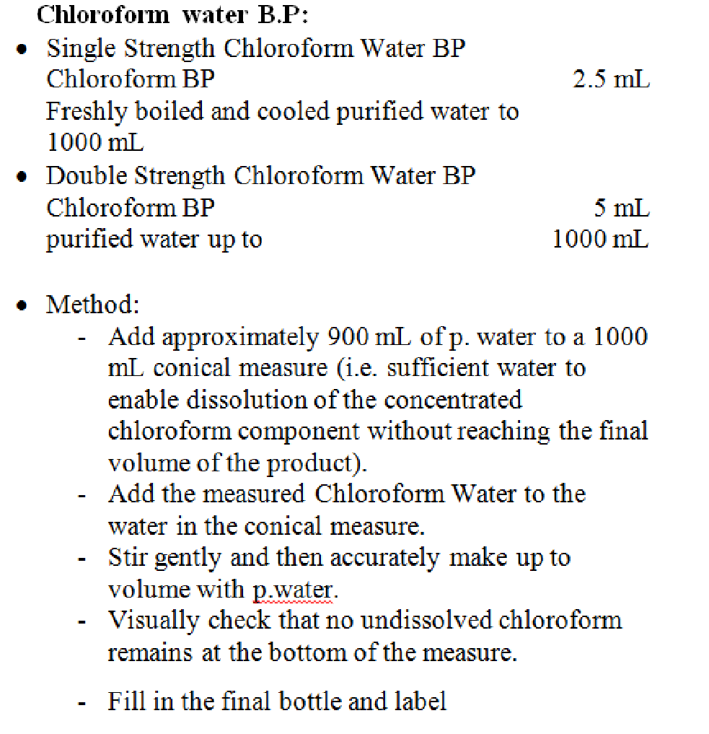
Chloroform water B.P
Notes:
Preservative 0.25%

Slide 15
Oral Solutions
A solution is a mixture of two or more components that form a single homogenous phase. They are liquid preparations that consist of solid or liquid substance dissolved in a liquid vehicle.

Slide 16
Types of solutions
Aqueous solutions containing a sugar are classified as syrups (even though some syrups may contain some alcohol).
Sweetened hydroalcoholic (combinations of water and ethanol) solutions are termed elixirs.
Solutions of aromatic materials are termed spirits if the solvent is alcoholic or aromatic waters if the solvent is aqueous.
Solutions prepared by extracting active constituents from crude drugs are termed tinctures or fluidextracts, depending on their method of preparation and concentration.
Certain solutions prepared to be sterile and pyrogen free and intended for parenteral administration are classified as injections.

Slide 17
Advantages Solutions
Drug available immediately for absorption
Flexible dosing
May be designed for any route of administration
No need to shake container
Facilitates swallowing in difficult cases
Disadvantages
Drug stability often reduced in solution
Difficult to mask unpleasant tastes
Bulky, difficult to transport and prone to container breakages
Technical accuracy needed to measure dose on administration
Some drugs poorly soluble
Measuring device needed for administration

Slide 18
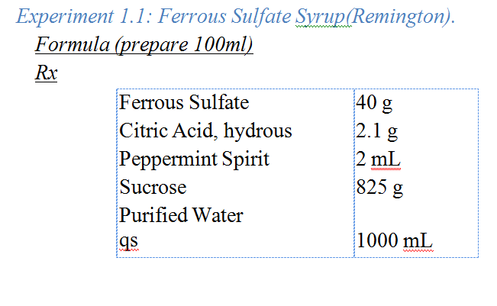
Dissolve the Ferrous Sulfate, Citric Acid, Peppermint Spirit, and 200 g of Sucrose in 450mL of Purified Water in 1000ml beaker, and filter the solution until clear.
Dissolve the remainder of the Sucrose in the clear filtrate, and add Purified Water to make 1000 ml.
Mix, and filter if necessary, through a pledget of cotton.

Slide 19
Ferrous sulfate
Store a cool and dark place..
Keep away from direct heat and light .
Keep Away from reach of children
Concurrent administration with tetracyclines may impair absorption of both agents. The absorption of ciprofloxacin, norfloxacin and ofloxacin is reduced by oral iron
Although iron preparations are best absorbed on an empty stomach, they may be taken after food to reduce gastrointestinal side-effects; they may discolour (blacken) stools.
Exp 1 month

Slide 20
Uses
Iron-deficiency anaemia
Citric acid increases the solubility by decreasing pH
Sucrose sweetener and preservative
Peppermint spirit (flavoring agent)
Dilute and Take by straw may cause teeth to be black
General dose up to 600 mg daily in divide doses

Slide 21
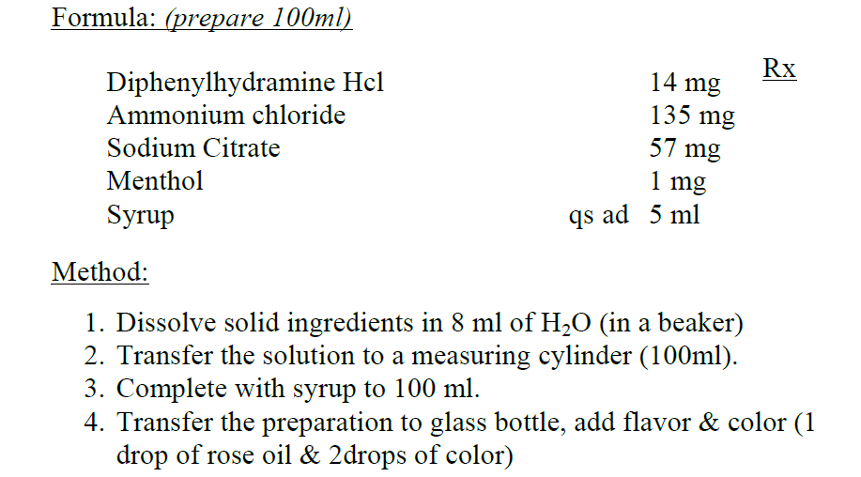
Cough Syrup

Slide 22
EXP 1 month

Slide 23
Mixtures
Mixtures:
Are liquid preparations intended for administration by mouth, consist of one or more medicaments dissolved or suspended usually in aqueous vehicle. They may be freshly or recently prepared.
USP

Slide 24
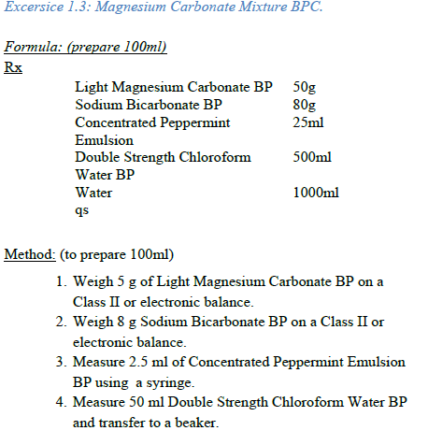
Magnesium Carbonate Mixture

Slide 25
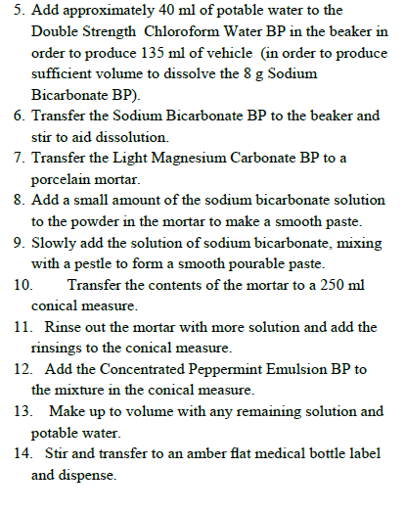

Slide 26
