Slide 1
Lab2
The compounding and Dispensing of Solutions used in the oral cavity

Slide 2
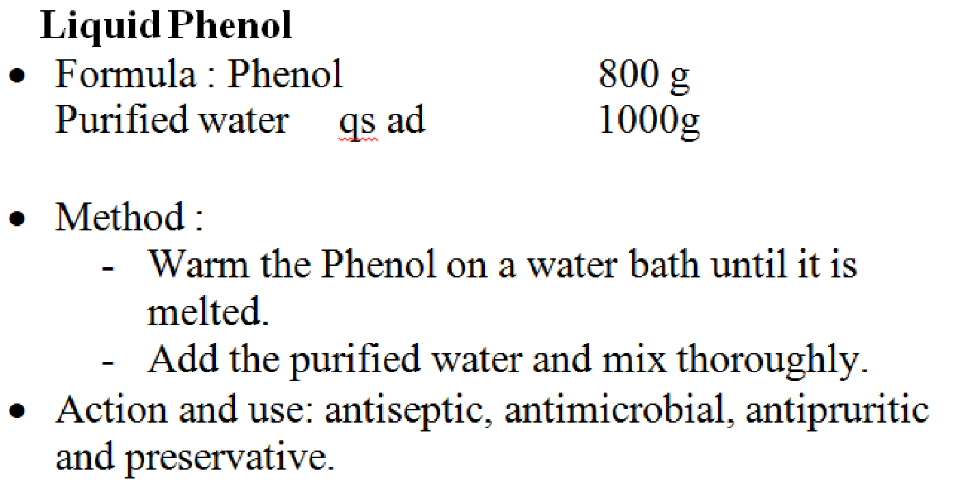
Liquid Phenol (BP)
Uses: antiseptic, antimicrobial, antipruritic and preservative.
Notes:
used to relieve itching

Slide 3
Liquid Phenol (BP)
Phenol CHARACTERISTICS: A colorless or faintly colored liquid; caustic.
Soluble in water; miscible with ethanol (96%), with ether and with glycerol
STORAGE: Liquefied Phenol should be protected from light. Liquefied Phenol may congeal or deposit crystals if stored at a temperature below 4C. It should be completely melted before use

Slide 4
Liquid Phenol (BP)
In full strength used : few drops of full strength may be used to cauterize small wounds( like dog bites)
Simple aqueous solution 0.5-1% bacteriostatic stronger bactericidal
Less than 1.5% in mouth washes
About 5% as disinfectant
If accidental spilled on skin remove by alcohol swabbing

Slide 5
Gargles
Gargles: Are aqueous solutions, usually in concentrated form, intended for use as a prophylactic or in the treatment of throat infections and for treating the pharynx and nasopharynx.
Gargles are usually diluted with water prior to their use and they should not be swallowed,
Gargarol, Listerine, Gingival, Septoral (Palestinian market)

Slide 6
Potassium Chlorate and Phenol Gargle BPC
Procedure (simple solution)
Accurately weigh potassium chlorate and dissolve in 3/4th of purified water by heating, on a water bath.
To this solution, add liquefied phenol, mix well by stirring.
Transfer this content to a measure and add patent blue 'V', mix well and add sufficient amount of purified water to adjust the final volume

Slide 7
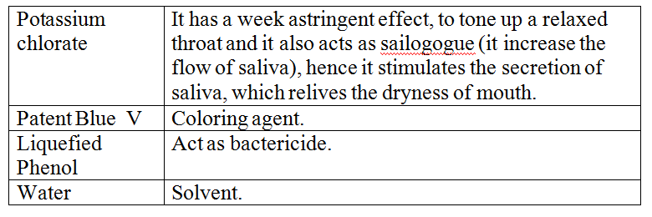
Role of each ingredient
General Use of this gargle
sialogogue, astringent and bactericide

Slide 8
Uses
The BPC. monograph recommends dilution with ten times its volume of warm water.
A suitable direction is “Three 5 ml spoonfuls to be added to a (or 150ml of warm water)
Storage: Store in a cool place.
Auxiliary label: - “For external use only”. - “Not to be swallowed in large quantities ”. - “ keep out of reach of children” since it smells and tastes well, they might ingest it.
protect from light”. Since potassium chlorate is very sensitive to the light
Exp: 2 weeks

Slide 9
Basic Preparation review Chloroform water B.P
Chloroform is an anesthetic when inhaled. When taken by mouth, it has a pleasant taste and causes a sensation of warmth
Orally it is used as a carminative, a flavoring agent and a preservative.
In products made extemporaneously, it is added either as Chloroform Water BP (also referred to as Single Strength Chloroform Water BP), Double Strength Chloroform Water BP or as Chloroform Spirit BP.

Slide 10
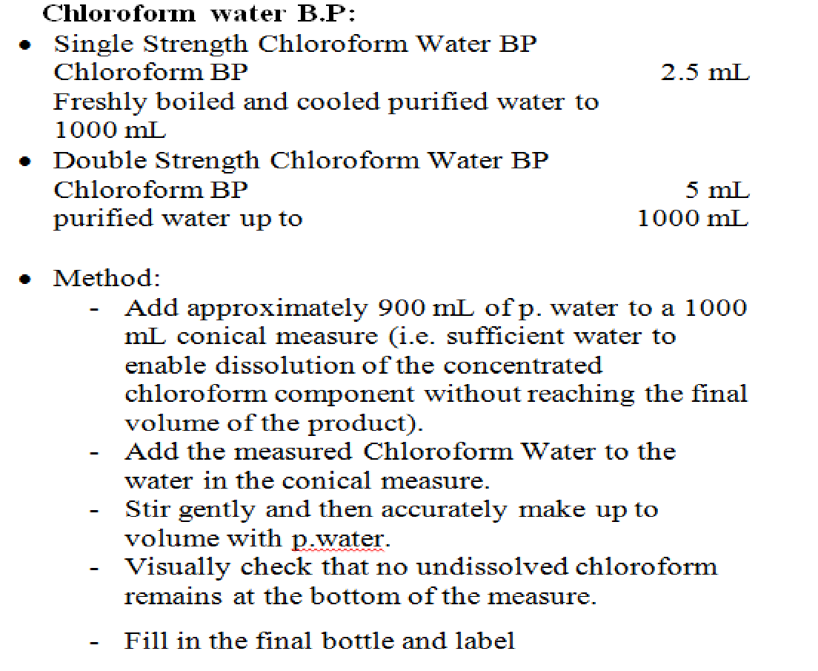
Chloroform water B.P
Notes:
Preservative 0.25%

Slide 11
Sodium Chloride Mouth-Wash BP
Calculations:
Sodium Bicarbonate is soluble 1 in 11 parts of water. Therefore to dissolve 1g of Sodium Bicarbonate a minimum of 1× 11 = 11 mL water would be required.
Sodium Chloride BP is soluble 1 in 3 parts of water. Therefore to dissolve 1.5 g of Sodium Chloride BP a minimum of 1.5 × 3 = 4.5 mL water would be required.

Slide 12
Procedure:
Weight 1.5 g Sodium Chloride.
Weight 1 g Sodium Bicarbonate.
Measure 50 mL of Double Strength Chloroform Water BP in a 100mL conical measure.
Transfer approximately 20 ml of Double Strength Chloroform Water BP to a beaker, add the sodium Bicarbonate BP and stir to aid dissolution.
When the Sodium Bicarbonate has dissolved, add the Sodium Chloride and stir to aid dissolution.
Add 3 drops of Concentrated Peppermint Emulsion.
Make up to volume with the remaining Double Strength Chloroform Water BP and potable water.
Transfer to a 100 ml amber fluted medicine bottle and label.

Slide 13
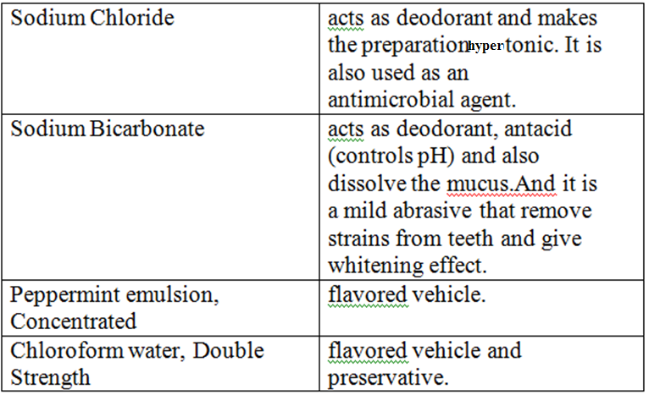
Notes:
Isotonic (same osmotic pressure)

Slide 14
Use:
Sodium chloride mouthwash is used to clean and deodorize the buccal cavity. It is widely used in refreshing of buccal cavity
This mouth wash is commonly advised by dentists when you have mouth sore, bleeding gum, inflamed sore gum. It kills bacteria by creating hypertonic environment (antiseptic effect). Used as a mouthwash to cleanse and freshen the mouth.

Slide 15
Advice to patient
The patient would be advised that 20 mL of mouthwash should preferably be diluted with an equal volume of warm water and used every 4 hours when required.
Storage: Store in a cool place.
Auxiliary label:
- “For external use only”. - “Not to be swallowed in large quantities”. - “keep out of reach of children”
Choice of container
As this is an extemporaneously prepared mouthwash, the container of choice would be an amber medical bottle with child-resistant closure.
Expiry : 1 month.

Slide 16
Glycerins:
Consist of solutions of medicinal substances in glycerol with or without the addition of water..
Glycerin is a cosolvent
producing an aqueous solution of a drug that was not otherwise readily soluble
Glycerin : Antimicrobial preservative; co-solvent; solvent; sweetening agent

Slide 17
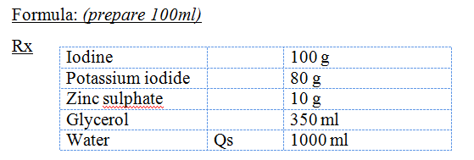
Dental-Iodine Glycerin 10% (J.P)
Procedure:
Dissolve potassium iodide in water
Add iodine and stir until completely dissolved
Dissolve zinc sulphate in glycerol.
Add iodine solution, add water to volume

Slide 18
Use:
Indicated for oral ulcers, gingivitis.
Storage: protect from light.
Auxiliary label:
- “keep out of reach of children”
Expiry: 1 month.
Notes:
Peri cornitis is inflammation of the soft tissues surrounding the crown of a partially erupted tooth

Slide 19
Thank You

