Slide 1
The compounding and Dispensing of Solutions instilled into body cavities.

Slide 2
Douches (vaginal):
Solutions (though they may be presented as an emulsion or suspension) intended for rinsing a body cavity (vagina)
Volumes of these preparations may vary from 5mL to much larger volumes.
When the larger volumes are used it is important that the liquid is warmed to body temperature before administration

Slide 3
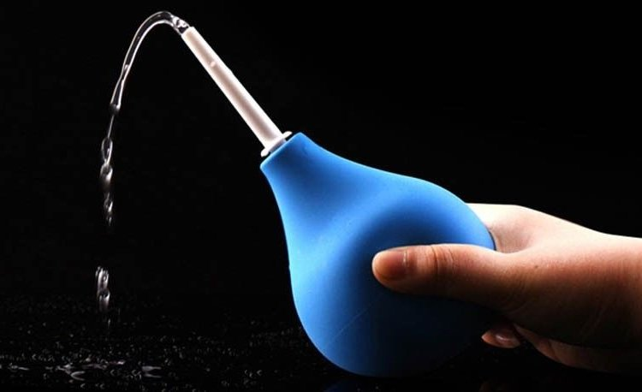
Douches are usually directed to the appropriate body parts by using Bulb syringe
It functions as a cleansing agent or antiseptic agent

Slide 4
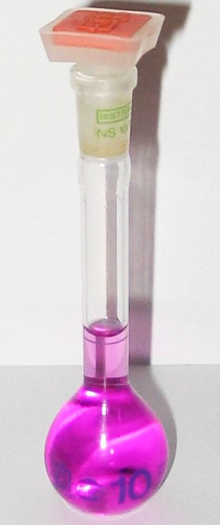
0.1% Potassium Permanganate solution

Slide 5
Role of each ingredient:
Potassium permanganate: Used as antiseptic, disinfectant, kill fungi, and parasites.
Water : Vehicle.
Use : Used for cleansing wounds and deodorizing suppurating eczematous (red patches with pus) reactions and wounds

Slide 6
Directions:
Our preparation is 0.1/100 ml => 1/1000 w/v
Label with directions for preparing 1 liter volume of a 1 in 4000 solution for use as a vaginal douche.
The strength of the prescribed solution is 1 in 1000. Therefore, to prepare a 1 in 4000 vaginal douche, this must be diluted with 3 times its volume of warm water, i.e. 250 ml to 1 liter.

Slide 7
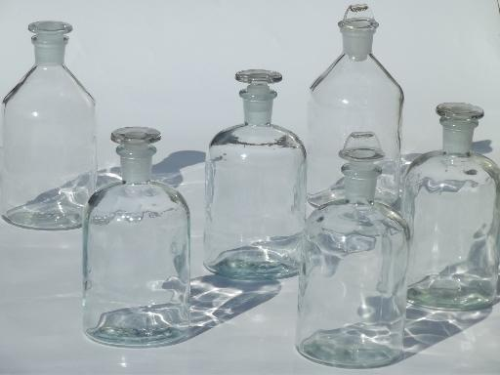
Notes
Potassium permanganate solution will stain plastic surfaces; take appropriate precautions.
The equipment and container must be spotlessly clean because this solution will react with oxidizable residues and turn brown with loss of strength.
The closure of the container must resist oxidation. Use a screw-cap containing a thick polythene cover. The old-fashioned glass stoppered bottle is also suitable

Slide 8
Notes
Use gloves (Important)
no sign of potassium permanganate crystals of solution on the bench or in any of the equipment used.
Potassium Permanganate is soluble cold water and freely soluble in boiling water
Storage: - Store in a cool place. (because of the reactivity of medicament. )

Slide 9
Container:
(amber bottle with a child-resistant closure would be most suitable as the preparation is a solution for external use.)
Label:
Use a label printed in red
As this preparation is for hospital use it is labeled with its proper name and strength and the dilution direction are given in milliliters.
AUXILLARY LABLE:
“For external use only” Or “Not to be taken by mouth”.
“For vaginal use only”.
Avoid contact with organic substances.
Should be freshly prepared, Expired in one week.

Slide 10
Ear Drops:
solutions or suspensions of medicaments in water, glycerol, diluted alcohol, propylene glycol, or other suitable solvent
Uses:
treating mild infections(chloramphenicol)
wax removing (sodium bicarbonate)
Antiseptic and anesthesia.
Anti inflammation.

Slide 11
Sodium bicarbonate ear-drops (BP)
softening and removal of ear wax.
Should be sterile

Slide 12
Procedure:
Accurately weigh sodium bicarbonate and dissolve in 3/4th quantity of freshly boiled and cooled water.
To the above solution, add glycerol, filter and adjust the final volume with water.
Role
Sodium bicarbonate | Soften the hardened ear wax
Glycerol | To maintain the viscosity.
Purified water. | Solvent.

Slide 13
Use:
Earwax is naturally produced by the body to protect the skin inside the ear. Sometimes it builds up and becomes hard, causing problems with hearing. Sodium bicarbonate ear drops can be used to soften the hardened earwax, enabling it to be removed and so relieving the problem
Direction:
Use sufficient drops to fill the ear canal (4 or 5 drops) and allow the solution to remain in the ear for 5-10 minutes
Storage: Store in cool, dry place, away from direct heat and light.

Slide 14
Auxiliary label:
Use a label printed in red
“For external use only” Or “For ear use only”.
“Not to be taken orally” Or Not for injection”.
Not to be diluted with water before use.
“Keep away from children”.
Expiry: one month.

Slide 15
Eye drops:
Eye drops are sterile solutions or suspensions especially designed to be applied to the eyes.
they may contain steroids, antihistamines, sympathomimetics, beta receptor blockers, non-steroidal anti-inflammatory drugs (NSAIDs), antibiotics, antifungal, or topical anesthetics.
Eye drops sometimes do not have medications in them and are only lubricating and tear-replacing solutions
Notes:
Glucoma eye pressure

Slide 16
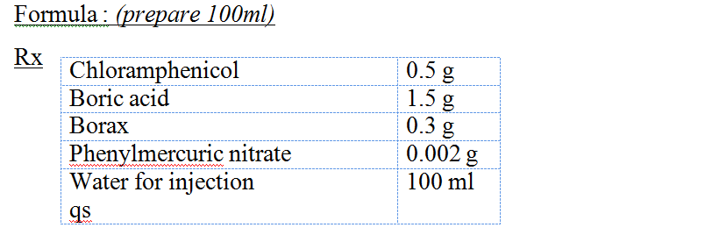
Exercise 3.3: Chloramphenicol eye drops (Martindale) 0.5% w/v
Procedure :
Dissolve Chloramphenicol, Boric acid, Borax, and Phenylmercuric nitrate in about 2/3 the amount of vehicle.
Transfer to a cylinder and complete to volume with WFI.
Transfer into a suitable container and fix a red label.

Slide 18
Use and indication:
Chloramphenicol eye drops and ointment are wide spectrum antibiotic used for the treatment of acute bacterial infection of the external eye. Eye infections are a common cause of conjunctivitis.
In conjunctivitis, your eye becomes inflamed, feels gritty, and may water more than usual.
The eye may look red, and your eyelids may become swollen and stuck together with a discharge when you wake up in the morning

Slide 19
Dosage
The recommended dosage for adults, children and infants of all age groups is two drops to be applied to the affected eye every three hours or more frequently if required.
Treatment should be continued for at least 48 hours after eye appears normal.
Chloramphenicol is absorbed systemically from the eye and toxicity has been reported following chronic exposure

Slide 20
Bone marrow depression, including aplastic anaemia and death, has been reported following topical use of chloramphenicol. Whilst the hazard is a rare one, it should be borne in mind when assessing the benefits expected from the use of the compound
Soft contact lenses should not be worn during treatment with chloramphenicol eye drops due to absorption of the preservative onto the lens which may cause damage to the lens. It is recommended that all types of contact lenses be avoided during ocular infections
Notes:
deficiency of all types of blood cells

Slide 21
This is a sterile solution. Contamination of the dropper or eye solution can lead to a serious eye infection.
If irritation persists or increases, discontinue use immediately.
Storage : must be kept in a fridge (2°C to 8°C), and protect from light.
Auxiliary label:
*Use a label printed in red.
“Keep away from children”.
“Throw away the bottle of chloramphenicol after you have finished the five-day course of treatment, even if there is some left”.
Expiry: 5 days.

Slide 22
Compounding Vs Manufacturing
Compounding is the act of preparing, mixing, assembling, packaging, and/or labeling a drug or device as the result of a practitioner’s prescription drug order or initiative based on the practitioner–patient–pharmacist relationship in the course of professional practice
Manufacturing is the mass production of drug products that have been approved by the Food and Drug Administration (related authotities)

Slide 23
Compounding Categories
Category (1) Non Sterile simple
Mixing of two commercially available drugs
Category 2 : Non Sterile Complex: Compounding of bulk drug substance or when calculations is required
Category 3: Sterile – Risk level 1 (Low risk contamination Level)
Compounding under aseptic processing, in a clean area, air quality ISO5 or better, using sterile ingredients, products or components
Example: Transfer of sterile dosage form from aseptically opened ampoule, using sterile syringe and containers in a clean area and filtering the contents using a sterile filter to remove glass particles
Mixing not more than three manufactured products to compound an admixture or a nutritional solution

Slide 24
Quality assurance practices (category 3)
Routine disinfection and air quality monitoring to the compounding environment
Visual confirmation that personnel are wearing appropriate items, gloves, goggles, protective clothes
Review of compounding order and ingredients to make sure that identity and amount of ingredients is correct
Visual inspection of particulate matter

Slide 25
Category 3: Sterile – Risk level 1 (Low risk contamination Level) “Storage”
In the absence of sterility test: store not more than 48 hours at controlled room temperature
Not more than 14 days in cold temperature
Not more than 45 days in freezer (-20C)
(generally contains preservative)

Slide 26
Category 4: Sterile – Risk level 2 (Medium risk contamination Level)
Compounding aseptically under low risk conditions but one of the following conditions occur
1- multiple individual small doses are combined together that will be administered to multiple patients or a patient on multiple occasion
2- complex aseptic manipulation other than volume transfer
3- compounding needing long manipulation (Mixing, dissolution complete)
5- no preservative is incorporated

Slide 27
Category 4: Sterile – Risk level 2 (Medium risk contamination Level) “Storage”
In the absence of sterility test:
store not more than 30 hours at controlled room temperature
Not more than 7 days in cold temperature
Not more than 45 days in freezer (-20C)
Quality assurance : same as low risk also a media fill test annually

Slide 28
Category 5: Sterile – Risk level 3 (High risk contamination Level)
Non sterile ingredients
Sterile ingredients Exposed to air not complying with ISO 5
Non sterile preparations are exposed for six hours before being sterilized
Final sterilization
In the absence of sterility test Storage :
store not more than 24 hours at controlled room temperature
Not more than 3 days in cold temperature
Not more than 45 days in freezer (-20C)
Quality assurance same as before

