Slide 1
The Compounding and Dispensing for External use

Slide 2
Lotions
Lotions are emulsions or suspensions generally in an aqueous vehicle
Lotions may be preferred over semisolid preparations because of their nongreasy character and their increased spreadability over large areas of skin
In some cases lotions are applied to the scalp, where the vehicle for the medication is alcohol based, allowing for rapid drying of the hair and thus making the product more acceptable to the patient

Slide 3
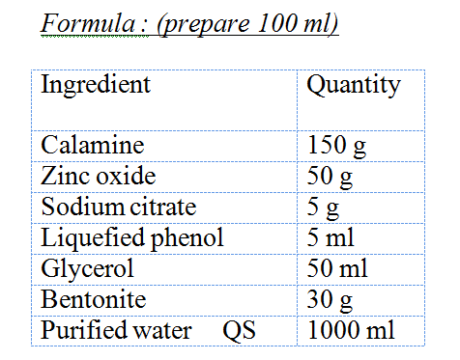
Experiment4.1: Phenolated Calamine Lotion B.P
Method :
Dissolve sodium citrate in about ½ amount of water.
Triturate calamine, zinc oxide and Bentonite with the solution of sodium citrate.
Add liquefied phenol and glycerol.
Transfer to a cylinder and adjust to 100 ml with water.
Transfer to a clean bottle

Slide 4
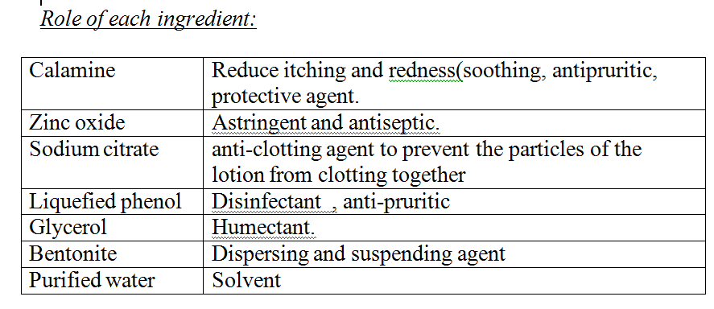
Bentonite: Colloidal hydrated aluminum silicate(natural)
Aqueous bentonite suspensions retain their viscosity above pH 6, but are precipitated by acids
Practically insoluble in ethanol, fixed oils, glycerin, propan-2-ol, and water. Bentonite swells to about 12 times its original volume in water, to form viscous homogeneous suspensions,

Slide 5
Uses:
Calamine is mainly used as mild astringent, protective and soothing for sun burns, burns, and as anti-pruritic for chicken box in children.
Phenolated Calamine Lotion is a topical suspension used to relieve itching and redness that come with a variety of skin conditions. This pink, thick fluid is applied directly to the skin to help soothe and protect it.
It contains calamine and zinc oxide which are used to cover and protect skin by reducing inflammation.
It also contains phenol which creates an anti-pruritic effect, meaning it helps prevent or relieve itching

Slide 6
Dose: It is applied topically to the skin, in various concentrations as a lotion or ointment.(as required)
Storage conditions:
Store at room temperature.
Auxiliary label :
Shake well before use.
For external use only.
Save at room temperature.
Expiry: 1-2 weeks after preparation

Slide 7
Calamine (BP) is a basic zinc carbonate with a small proportion of ferric oxide which gives the pink or reddish – brown color, while Calamine (USP) is zinc oxide with small proportions of ferric oxide.
Phenol is also known as carbolic acid, and is used as a disinfecting agent and topical anesthetic. It may be used to cauterize small wounds and is used in conjunction with calamine (zinc oxide and ferric oxide) as an antipruritic or anti-itch agent. The phenol most likely is present for its anesthetic and atiseptic effects to calm the itching sensation

Slide 8
Exercise 4.2: Alcoholic whitfield lotion
Procedure:
1. Mix salicylic acid and benzoic acid with alcohol
2. Add glycerol and mix well
3. Add alcohol up to the quantity

Slide 9
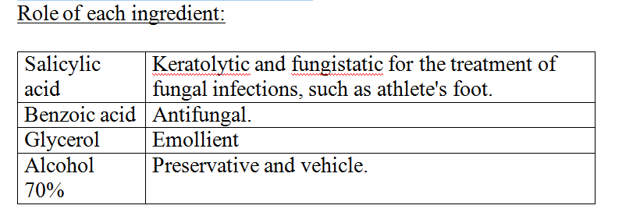
Dose: Topical to the affected area 2 times daily
Storage: Store in a cool and dark place.
Auxiliary label:
Store in cool place-
-Away from flame
-External use only, away from eyes and nose.
Keep out of reach of children.
Expiry: one month.

Slide 10
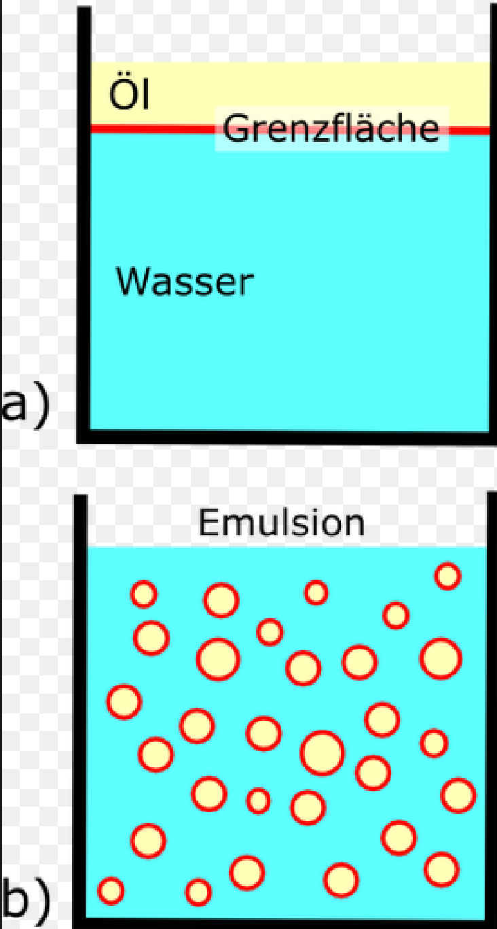
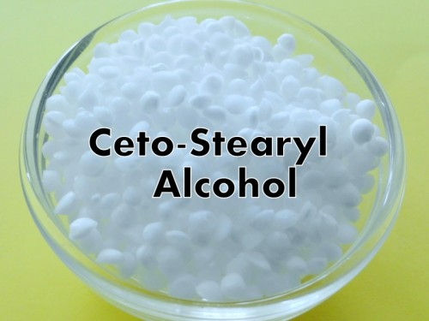
Emulsifying wax
Emulsifying wax is a type of cosmetic emulsifying ingredient used primarily in the manufacturing of creams, lotions, and other beauty products.
The emulsification occurs when two substances—in this case, oil and water — are successfully bound together, creating a sort of glue that combines the ingredients of a product.(interfacial tension is decreased)

Slide 11
Emulsifying wax (Basic Preperation)
Formula :
Cetostearyl Alcohol 90 g
Sodium Lauryl Sulphate 10 g
Method of preparation:
Melt the Cetostearyl alcohol and heat to about 95 º(water bath)
Add the Sodium Lauryl Sulphate and mix
heat to 100 º and maintain at this temperature, stirring vigorously, until the product is translucent
Cool quickly.
Notes:
Emollient; emulsifying agent; viscosity-increasing agent.

Slide 12
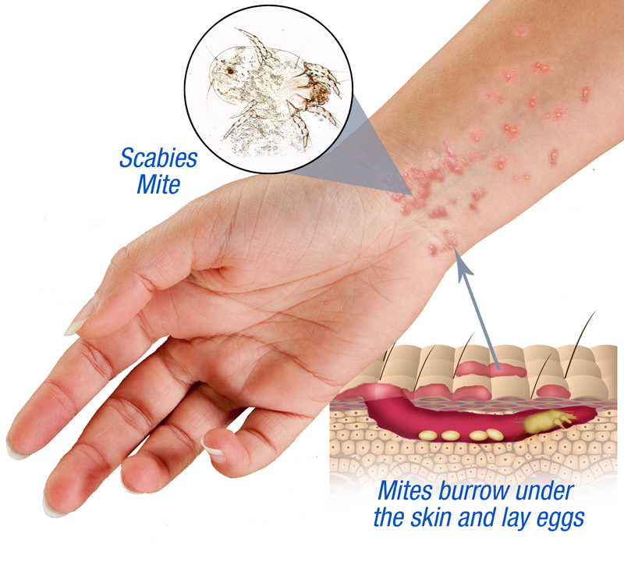
Exercise 4.3 Benzyl Benzoate Application BP
Scabies, is a contagious skin infestation by the mite Sarcoptes scabiei, The most common symptoms are severe itchiness and a pimple-like rash

Slide 13
Exercise 4.3 Benzyl Benzoate Application BP
Procedure:
Melt the Emulsifying Wax,
Heat the Benzyl Benzoate then add it to emulsifying wax and mix
Pour the mixture into sufficient warm Purified Water to produce 1000 g (add all the needed amount of water now)
Stir thoroughly until cold.

Slide 14
Exercise 4.3 Benzyl Benzoate Application BP
Therapeutic Class: Scabicide
Benzyl benzoate is used to treat lice and scabies infestations. This medicine is believed to be absorbed by the lice and mites and to destroy them by acting on their nervous system.
Directions: Apply over the whole body; repeat without bathing on the following day and wash off 24 hours later. A third application may be required in some cases.
Not recommended for use in children

Slide 15
Auxiliary label:
Store the medicine in a closed container at room temperature, away from heat, moisture, and direct light.
Keep out of the reach of children

Slide 16
Thank You

