Slide 1
The Compounding and Dispensing of Suspensions and Elixirs
Dr Moammal Qurt

Slide 2
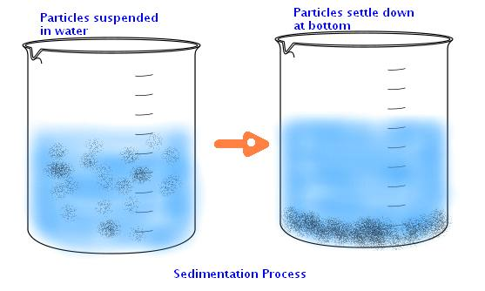
Suspensions
Suspensions may be defined as preparations containing finely divided drug particles distributed somewhat uniformly throughout a vehicle in which the drug exhibits a minimum degree of solubility.

Slide 3
Some suspensions are available in ready-to-use form, that is, already distributed through a liquid vehicle with or without stabilizers and other additives.
Other preparations are available as dry powders intended for suspension in liquid vehicles.
This type of product generally is a powder mixture containing the drug and suitable suspending and dispersing agents to be diluted and agitated with a specified quantity of vehicle, generally purified water
Notes:
Particles of drug substances can actually range from an aggregation of two or more molecules to millions
of molecules. The term “particle” should not be confused with “molecule.” The molecule is the smallest
unit of any chemical compound that possesses all the native properties of that compound

Slide 4
Reasons for Suspensions
There are several reasons for preparing suspensions.
Stability some APIs are stable in suspension not in solution
Liquid forms sometime are more accepted than solid dosage forms(kids, illness, old age) (ease of swallowing, range of doses can be administered)
relatively higher concentration of drugs can be incorporated into suspension products.

Slide 5
The disadvantage of a disagreeable taste of certain drugs in solution form is overcome when the drug is administered as undissolved particles of an oral suspension
erythromycin estolate is a less water-soluble ester form of erythromycin and is used to prepare a palatable liquid dosage form of erythromycin, the result being Erythromycin Estolate Oral Suspension, USP.
Controlled Release delivery
Solubility problems

Slide 6
Features Desired in a Pharmaceutical Suspension
There are many considerations in the development and preparation of a pharmaceutically elegant suspension.
A properly prepared pharmaceutical suspension should settle slowly and should be readily redispersed upon gentle shaking of the container.
The particle size of the suspensoid should remain fairly constant throughout long periods of undisturbed standing.

Slide 7
The suspension should pour readily and evenly from its container.
5. In an ideal suspension formulation, insoluble particles should be uniformly dispersed.
6. Regardless of the amount of sedimentation, a well-formulated suspension should redisperse uniformly in the continuous phase, upon moderate shaking, for a sufficient period of time.

Slide 8
Chloramphenicol suspension
Because of this drug's serious toxicities, chloramphenicol is indicated only for the treatment of serious infections in which less toxic antibacterials are ineffective or contraindicated.
Other medications, such as the third-generation cephalosporins, and clindamycin or metronidazole for the treatment of anaerobic infections, have generally replaced

Slide 9
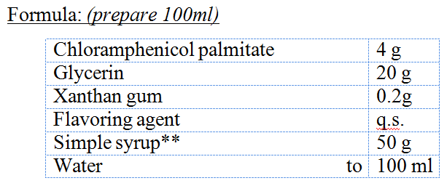
Method:
Triturate Chloramphenicol palmitate with Glycerin and xanthan gum in a mortar to give a smooth pourable paste.
Dilute the paste with simple syrup , mix.
Transfer to a cylinder , then add the rest amount of the syrup and add the flavor.
Complete to volume with water.
Transfer to a clean bottle and fix a white label
Notes:
Xanthan gum is an anionic material and is not usually compatible with cationic surfactants, polymers, or preservatives, as precipitation may occurs

Slide 10
Uses:
Chloramphenicol is a broad spectrum antibiotic which is effective against both gram + ve and gram –ve organisms
Dose :
for adults as: 50 – 100 mg/Kg / day in 4 divided doses (every six hours ), depending on the seriousness of the infection and sensitivity of bacteria

Slide 11
Most serious side Effects:
gray baby syndrome
anemia
bone marrow depression
Use extreme caution when giving this drug to children less than 2 years old
Gray baby syndrome: A syndrome due to toxicity of the antibiotic chloramphenicol in the newborn, especially the premature newborn, because of lack the necessary liver enzymes to metabolize this drug
Notes:
Loss of appetite Vomiting Ashen gray color of the skin (low blood pressure) (blue discolouration of lips and skin)
cardiovascular collapse Abdominal distension Irregular respiration

Slide 12
Grey baby syndrome(accumulation of chloramphinicol on blood)
Vomiting
gray color of the skin
Hypotension
blue color of lips and skin
Hypothermia, Cardiovascular collapse
Irregular respiration
Very serous side serious effect (life threatening)

Slide 13
Auxiliary label:
Shake well before use
Store in refrigerator.
For oral use only
Expiry: 2 weeks.

Slide 14
Elixers
An elixir is a hydro-alcoholic solution of at least one active ingredient. They are sweet in taste and have a nice flavor
Advantages:
Solubilize the active ingredient(s) and some excipients.
Retard the crystallization of sugar
Preserve the finished product
Provide a sharpness to the taste
Aid in masking the unpleasant taste of the active ingredient(s)

Slide 15
How much alcohol
The lowest alcoholic quantity that will dissolve completely the active ingredient(s) and give a clear solution is generally chosen.
High concentrations of alcohol give burning taste to the final product.

Slide 16
FDA alcohol in OTC preperation
Due to Toxic effect it is recommended by FDA to restrict use in OTC and supply a warning label
For OTC oral product (less than age 6) alcohol content limit 0.5%
OTC (6-12 age) limit 5%
OTC adult NMT 10%

Slide 17
Notes about alcohol
Alcohol precipitates substances like tragacanth, acacia from water..
Syrup is the best choice when taste is the main consideration.
Elixirs should be stored in a tightly closed and light resistant container away from direct heat and sunlight

Slide 18
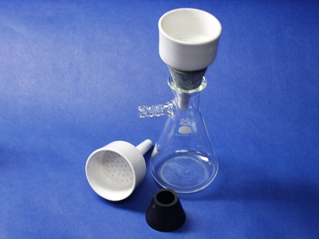
Aromatic Elixir USP
Method:
Add oil and peppermint oil to the alcohol and shake well.
Transfer to a measuring cylinder and add the syrup gradually while mixing vigorously after each addition and complete to 100 ml with purified water.
Add talc and mix vigorously then Filter using a Buchner funnel (if necessary).repeat until clear

Slide 19
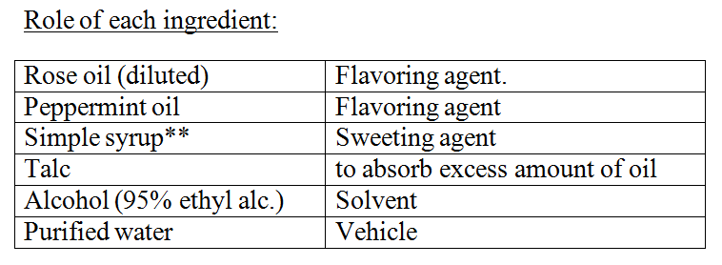
Uses:
A sweetened aromatic solution of alcohol and water, serving as a vehicle for medicine.
Auxiliary label:
Store at room temp.
Store away from heat and light.
Store at closed container
Expiry: 1 month

Slide 20
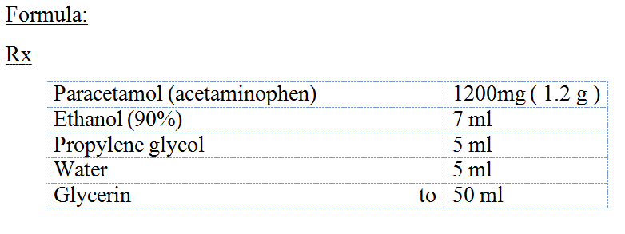
Paracetamol Elixir
Method:
In a small beaker , dissolve paracetamol in ethanol and propylene glycol.
Add half the amount of glycerin. Dissolve well using a glass rod.
Transfer to a cylinder
Add water , and mix.
Complete to volume (50 ml ) with glycerin.
Transfer to a clean bottle and fix a white label

Slide 21
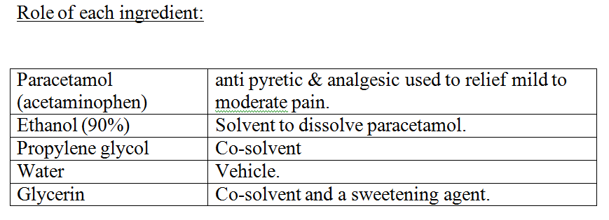
Dose:
One teaspoonful is to be taken every 6 hours for 4 days when necessary.
2.5-5 ml for child up to 1 years.
5-10 ml for child 1-4 years.
The maximum amount of paracetamol is 1 g per dose (adult) an 4g per day. And leaves at least 4 hours between doses.

Slide 22
Storage:
Store in a cool and dark place.
Auxiliary label:
Store at room temp.
Store away from heat and light.
Store at closed container
Expiry: 1 month

