Slide 1
The Compounding and Dispensing of Emulsions, and liniments.

Slide 2
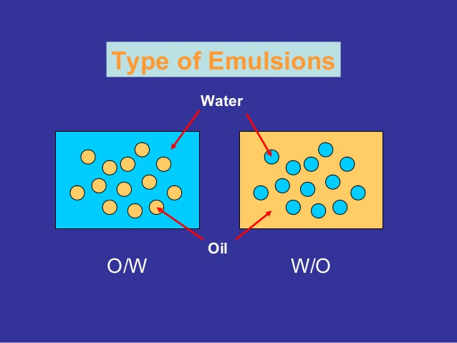
Emulsions
An emulsion is essentially a liquid preparation containing a mixture of oil and water that is rendered homogeneous by the addition of emulsifying agent (that ensures that the oil phase is finely dispersed throughout the water).
O/W, W/O

Slide 3
Generally, all oral dose emulsions tend to be o/w, as the oily phase is usually less pleasant to take and more difficult to flavor.
‘Water in oil’ emulsions can be formed, but these tend to be those with external use.
Lotions, creams, ointments (types of emulsions)

Slide 4
Purpose of Emulsions
The process of emulsification enables the pharmacist to prepare relatively stable and homogeneous mixtures of two immiscible liquids.
It permits the administration of a liquid drug in the form of minute globules rather than in bulk. The reduced particle size of the oil globules may render the oil more digestible and more readily absorbed.
Syrups of o/w emulsions may be used to mask taste
Medicinal agents that irritate the skin generally are less irritating in the internal phase of an emulsified topical preparation than in the external phase, from which direct contact with the skin is more prevalent
A w/o emulsion is also more softening to the skin, because it resists drying and removal by contact with water

Slide 5
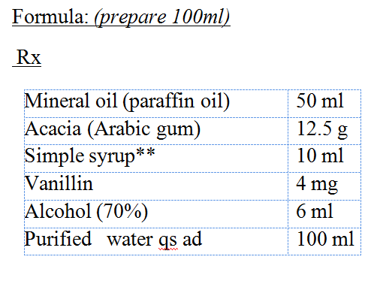
Mineral Oil Emulsion

Slide 6
Procedure:
Mix mineral oil with acacia in a dry mortar.
Add 25 ml of water all at once and emulsify the mixture (by strong rapid trituration using a pestle) until a smooth, creamy mass which produce a clicking sound is obtained (primary emulsion).
Dissolve vanillin in alcohol, and then add to a mixture of syrup and 2ml water.
Add the mixture in step #3 to the primary emulsion. The addition should be gradual, in divided portions and trituration is performed after each addition.
Transfer to a cylinder and adjust to volume with water, and mix.
Notes:
Primary emulsion 4:2:1(O/w/Axcia)
, alcohol has a precipitating action on gums such as acacia, thus no alcohol or solution containing alcohol should be added directly to the primary emulsion.

Slide 7
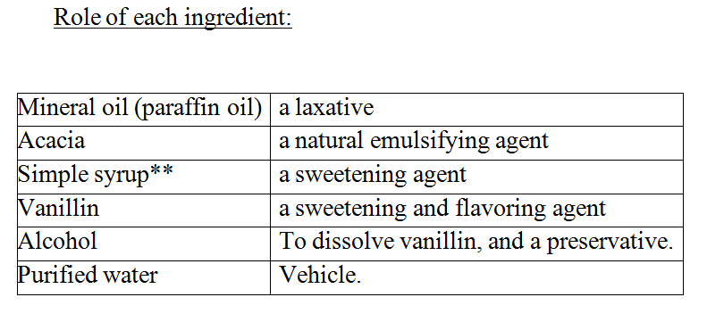

Slide 8
Uses:
This emulsion is used as a laxative. Liquid paraffin acts as a lubricant to keep the stool soft. It is employed in cases of chronic constipation, especially in presence of hemorrhoids.
The mixture should not be taken within 30 min of meal times and preferably on an empty stomach
Auxiliary label:
Keep out of reach of children.
Store at room temperature.
Don’t freeze.
Expiry: 1 month
Avoid prolonged use, There may be interference with the absorption of fat soluble vitamins.
Notes:
Adults over 18 years of age should take 10 to 30ml at night when needed to relieve constipation.

Slide 9
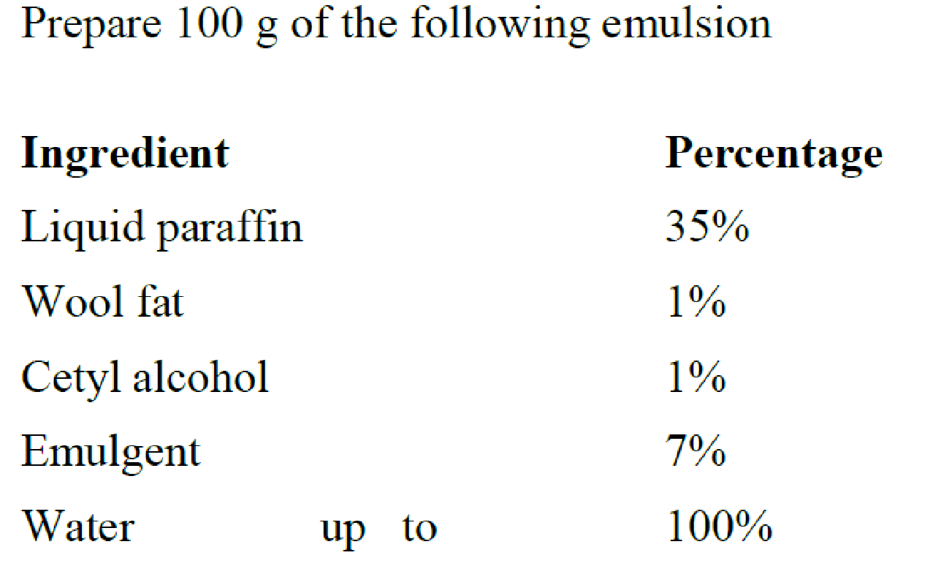
Experiment 6.1-B:Basic Emulsion
Knowing that the
1- Required HLB values of the first three ingredients are respectively 12, 10 and 15 for an o/w emulsion
2- (Span 20 has HLB value = 8.6 ) and polysorbate 80 (HLB value = 15 )is to be used as the emulgent blend

Slide 10
Procedure:
1- Add liquid paraffin, wool fat, span 20 and cetyl alcohol to a beaker and melt with gentle heating (60-65 0c).”Bulk A”
2- Using another beaker dissolves Tween 80 in 56 g of water while heating to (55-60c).”Bulk B”
3- Add bulk (B) to Bulk (A) with gentle stirring.
4- Continue mixing until the emulsion is cold. (less than 350c) (cold water can be used as water bath)
5- Fill in a suitable container and label

Slide 11
Liniments:
Liniments are liquid or semi-liquid preparations which are intended for external application, usually with considerable friction produced by massaging with the hand.
They should be applied to the intact skin and labeled with ‘For External Use Only’.
They may contain substances possessing analgesic, soothing or stimulating properties
Do not apply to open wounds or irritated skin, and avoid getting the medicine on contact lenses and other items that come into contact with sensitive areas of your body.

Slide 12
methyl salicylate liniment BP.

Slide 13
Use:
Methyl salicylate liniment is used for temporary relief of muscle or joint pain caused by strains, sprains, arthritis, bruising, or backaches.
Apply to the affected skin two times daily for two weeks

Slide 14
Notes:
Do not apply to open wounds or irritated skin, and avoid getting the medicine on contact lenses, dentures, and other items that come into contact with sensitive areas of your body.
Methyl salicylate topical can cause a cold or burning sensation, which is usually mild and should lessen over time. The liniment has a characteristic odor.

Slide 15
Storage:
Store in cool and dark place , in a closed container , below 25 °C
Auxiliary label:
For external use only.
Avoid contact with eyes and broken skin.
Shake well before use .
keep away from children.
Expiry: one month.

