Slide 1
Lab7 . The Compounding and Dispensing of Creams and ointments

Slide 2
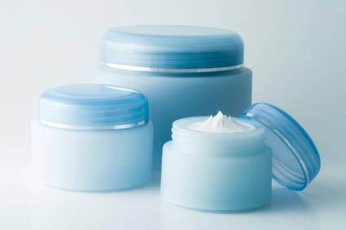
Creams
conditions such as rashes, skin irritation, stings, fungal infections preferred creams and ointments
Creams are external preparations of viscous semi-solid emulsions of either (o/w) or (w/o) type, depending on the emulsifying agent used
Oint vs creams difference

Slide 3
Types of cream:
Water in oil: the emulsifying agent is of natural origin, eg: beeswax. Creamy, white, stiff.
Oil in water: the emulsifying agent is a synthetic wax, eg: macrogol. Thin,white, smooth.
Techniques (adding solids)can be used :
1. Tritruation: mixing finely divided insoluble powders or liquids into the base.
2. Levigation: wet grinding. Rubbing the coarse powder down with the base (molten or semisolid).

Slide 4
General Method for preparation of creams
Dissolve water soluble components into water phase and bring up to about 60°C
Melt the fatty bases starting from the highest melting point base then and incorporate fat soluble components Depending on type:
Oil in water: add oily phase to water phase
Water in oil: add water phase to oily phase

Slide 5
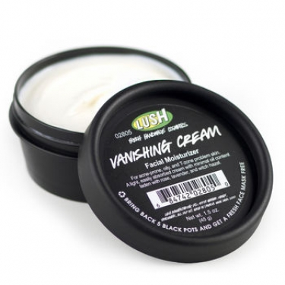
Experiment 7.1Emulsion Bases O/W
Vanishing Cream (aqueous cream).
Prepare the vanishing cream as follow:
Stearic acid 18.0 g
Potassium hydroxide 0.80 g
Glycerin 5.0 g
Methyl paraben 0.020 g
Propyl paraben 0.010 g
Purified water 76.0 g
to make: 100g

Slide 6
Method of preperation
Melt the stearic acid in a separate beaker.
The remaining ingredients are dissolved in the water at 75 °C.
Discontinue heating. The aqueous solution is added to the oil phase with agitation.
Allow to cool, and stir until congealed.

Slide 7
Notes on Emulsion Bases
The stearic acid is reacted with alkali, e.g. potassium hydroxide, to form a soap. The unreacted stearic aid forms the oily dispersed phase, which is left as a film on the skin after the water evaporates.
The glycerin serves as a humectant

Slide 8
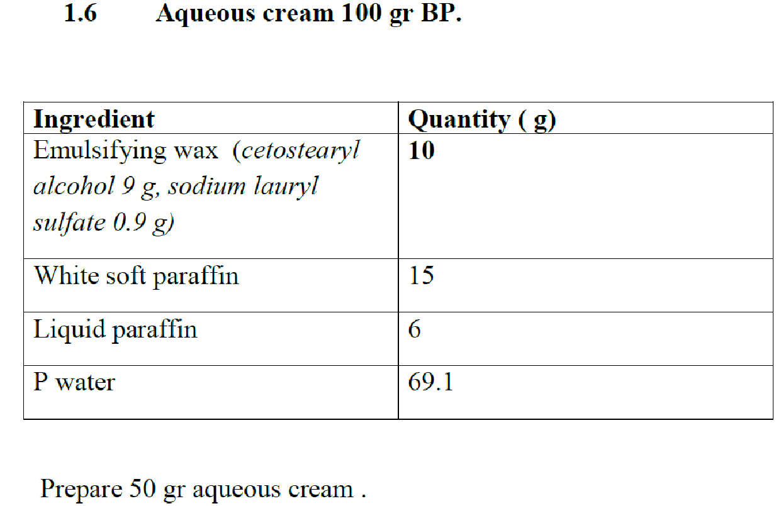
Aqueous cream 100 gr BP.

Slide 10
Experiment 7.1: Salicylic Acid and Sulphur Cream BP 20 g Formula (prepare 100g)
Ingredient | Quantity
Salicylic Acid | 20 g
Precipitated Sulfur | 20 g
Aqueous Cream BP ** | 960 g

Slide 11
Method :
Weigh the calculated quantity of salicylic Acid and of precipitated sulphur
Transfer salicylic acid to a glass mortar and grind with a pestle.
Add sulfur to the Salicylic Acid in the glass mortar and continue mixing with a pestle until a smooth, well mixed powder is formed.
Transfer the powder to a glass tile.
Weigh the calculated quantity of Aqueous Cream BP **on a Class II or electronic balance
Transfer the Aqueous Cream BP to the glass tile and triturate with the mixture to produce a smooth product.
Transfer the product to a suitable container and label it
https://www.youtube.com/watch?v=vFkcAJBGXek

Slide 12
Ingredient | Role
Salicylic Acid | Keratolytic agent
Precipitated Sulfur | Scabicide, Acne, fungus
Aqueous Cream BP | Base
Note:
Avoid inhaling the fumes from this product
Uses :
This cream is used for treatment of acne and some other skin disorders ,
Storage conditions :
Stored in a tightly closed container .
At controlled room temperature .
Auxiliary label :
For external use only.
Keep away from reach of children .
Store at room temperature

Slide 13
Experiment 7.2 : Zinc cream BP
Ingredient | Quantity
Zinc Oxide | 320 g
Calcium Hydroxide | 0.45 g
Oleic Acid | 5 ml
Arachis Oil | 320 ml
Wool Fat | 80 g
Purified Water Q | 1000 g
1- Mix the Zinc Oxide and the Calcium Hydroxide.
2- Triturate to a smooth paste with a mixture of the Oleic Acid and Arachis Oil.
3- Incorporate the Wool Fat .
4- Add gradually with continuous stirring
5- Add sufficient Purified Water to produce final volume.

Slide 14
Ingredient | Role of ingredients
Zinc Oxide | Astringent for mild irritation
Calcium Hydroxide | Emulsifying agent
Oleic Acid | Oily phase
Arachis Oil | Oily phase
Wool Fat | Natural emulsifying agent
Purified Water | Vehicle and watery phase
Uses :
This preparation is used for diaper rash for relive of itching and minor skin irritation. Also can be used for minor burns and sunburns.
Storage conditions:
Store at 15-30 C.
Keep out of reach of children
Auxiliary label :
Do not swallow .
Keep away from reach of children .
Store at 15-30 C.
Expiry date: 1 month
Note:
Do not use this drug on opened wounds, and apply the cream without reification on the affected area

Slide 15
Thank you

