Slide 1
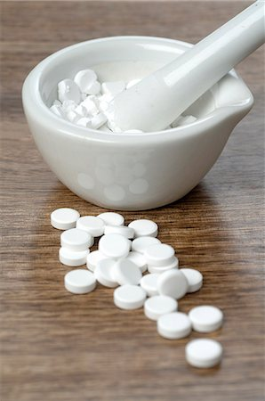
Cases in need extemporaneous preparation

Slide 2
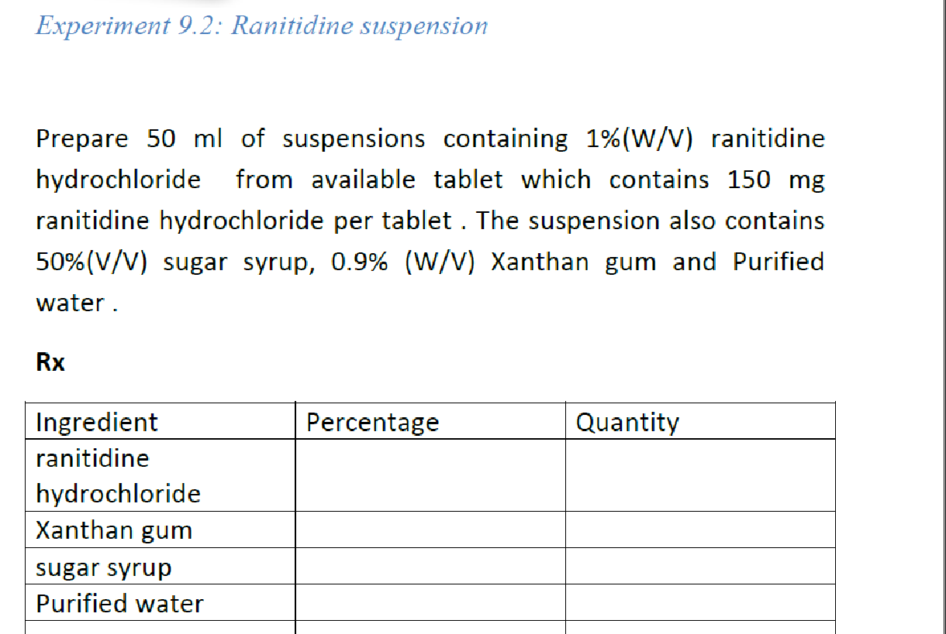
Calculations
Method of preparation
Counselling
Expiration

Slide 3
General Procedure

Slide 4
Xanthan Gum
Xanthan gum occurs as a cream- or white-colored, odorless, free flowing, fine powder.
high molecular weight polysaccharide gum
Functional Category
Gelling agent; stabilizing agent; suspending agent; sustained-release agent; viscosity-increasing agent
Xanthan gum is a stable material. Aqueous solutions are stable over a wide pH range (pH 3–12), although they demonstrate maximum stability at pH 4–10

Slide 5
Xanthan gum is an anionic material and is not usually compatible with cationic surfactants, polymers, or preservatives, as precipitation occurs.
Anionic surfactants at concentrations above 15% w/v cause precipitation of xanthan gum from a solution.
Stable at temperature up to of 60 C.

Slide 6
Xanthan gum is widely used in oral and topical pharmaceutical formulations, cosmetics, and food products, and is generally regarded as nontoxic and nonirritant at the levels employed as a pharmaceutical excipient.
It has been successfully used alone or in combination with agar for microbial culture media
https://www.youtube.com/watch?v=4uxLq_WD9Ho

Slide 8
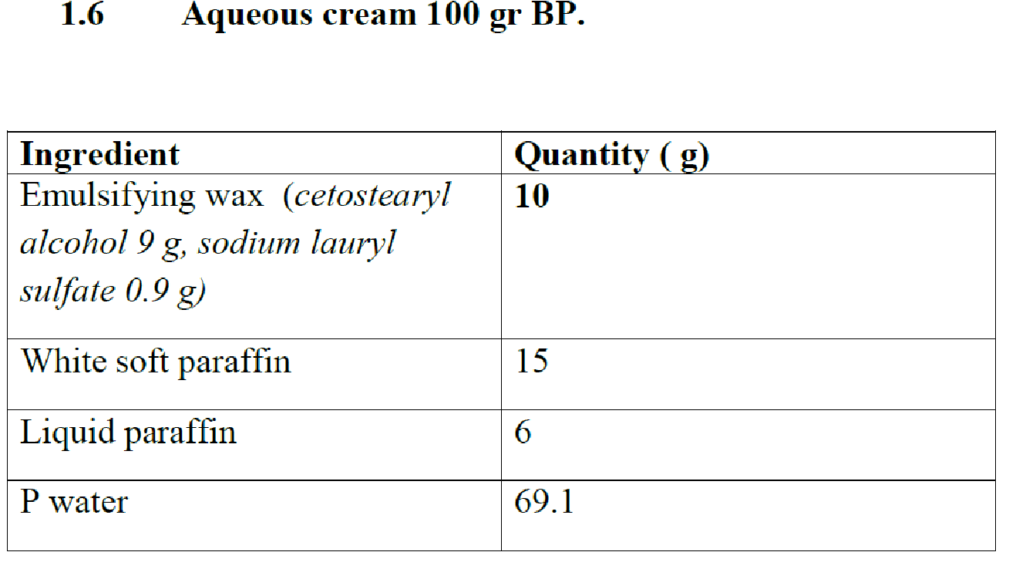
Aqueous cream BP
Notes:
Cetostearyl Alcohol 90 g
Sodium Lauryl Sulphate 10 g

Slide 9
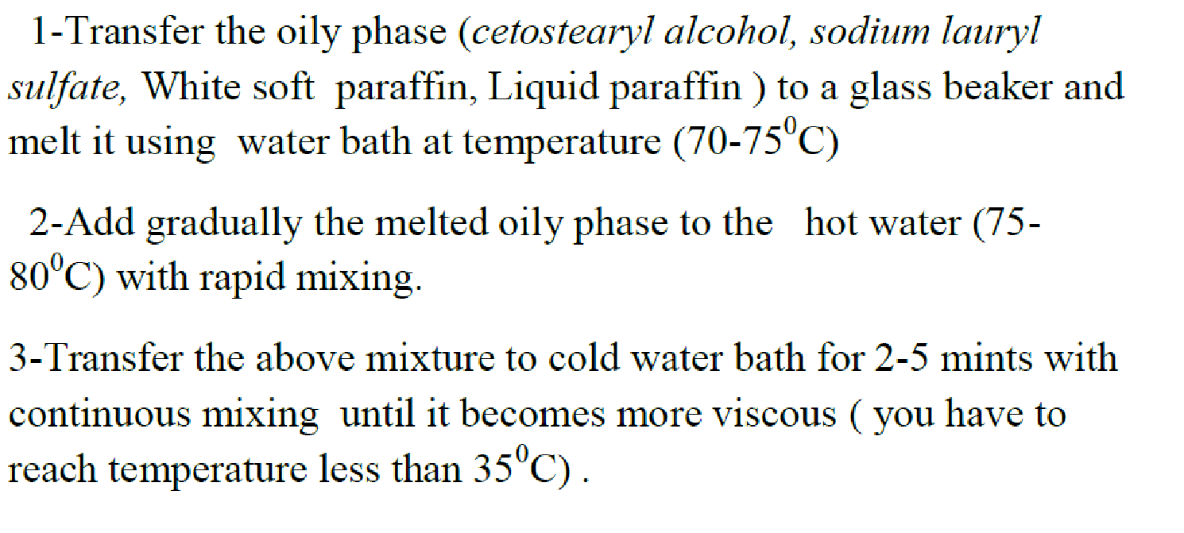
Procedure

Slide 10
https://www.youtube.com/watch?v=4uxLq_WD9Ho&t=19s

Slide 11
Rantidine
GERD
The usual dosage for adults is 150mg twice daily, taken in the morning and evening or a single bedtime dose of 300mg.
[1 mo-16 y]
Dose: 5-10 mg/kg/day PO divided q12h;
duodenal/gastric ulcer
[1 mo-16 y]
Dose: 2-4 mg/kg PO q12h

Slide 12
Quality assesment
a. Weight to Volume calculation
b. Color
c. Pourability
d. Settling
e. Resuspendability
Store in air tight amber plastic containers
Store refrigerated.

