Slide 1
Pharmacy skills
Lecture 1

Slide 2
Introduction
It is designed to give the student a clear idea about the different pharmaceutical dosage forms, materials and techniques used in preparing these
This lab will introduce the student to real prescriptions from day to day practice in the pharmacy.
The student will learn the different procedures, techniques, of preparing, labeling, filling, storage conditions, dispensing requirements for the different drug formulas represented by these dosage forms
Learn to counsel patients on them as dosage forms

Slide 3
General Laboratory instructions:-
Work on your own: if you require any help ask the course instructor or the teaching assistant
Wear a clean freshly laundered overall white lab. coat.
Read the prescription carefully, and make any necessary calculations
Compound the prescription according to procedure
Fill in container and label the drug product
Make sure that your place , balances and used equipment's are clean

Slide 4
Pharmacy Dispensing procedure on receipt of a compunding prescription
1- Check the prescription contains the following information:
a- Name and address of the patient.
b-Age of the patient
c- Signed by the prescriber.
d-Suitably dated by the prescriber.
2- Check your interpretation of the prescriber’s instructions.
a- Is the formula official or unofficial?
b- Are all ingredients within a safe dosage limit?
c- Are all ingredients compatible?

Slide 5
Dispensing procedure on receipt of a prescription
Prepare a label for the product
Copy out the formula onto the extemporaneous work record sheet
Recheck any calculations made.
Test the dispensing balance before use (particularly important if the scales have not been used for some time).
Select the equipment to be used for the preparation of the product

Slide 6
Dispensing procedure on receipt of a prescription
Select the container to be used for the completed product.
Select the first item to be measured or weighed and make a note of the batch number used.
Note when selecting an ingredient from stock, check the label, check it again when measuring/weighing the ingredient, and a third check should be made when returning it to the stock shelf.
Use a spatula when weighing (remember to clean the spatula between each different powder that is weighed).

Slide 7
Dispensing procedure on receipt of a prescription
Ensure the scale pan is cleaned between each weighing procedure
Do not put the material directly on weighing pan (Weighing boat)
Tare the balance after you finished weighing
Compound the ingredients
When the preparation is ready to be dispensed, transfer it to the final container and label

Slide 8
The label of a pharmaceutical product has many functions:
To indicate clearly the contents of the container
To indicate clearly to patients how and when the medicinal product should be taken or used
To indicate clearly to patients how the product should be stored and for how long
To indicate clearly to patients any warnings or cautions of which they need to be made aware.

Slide 9
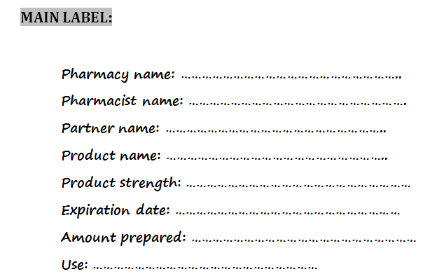

Slide 10
Drug warning label,Auxiliary label
drug warning label is a sticker placed on your prescription vial that contains important information about your medication. It is meant to serve as a quick reminder each time you take the medicine.
General colors for labels:
Red – most severe (ex. External use only ..)
Green, White and blue – recommendation that is less severe than red (ex. Shake well before use…)
(i.e. "May Cause Drowziness", "Refrigerate", "Do Not Crush", etc. see Appendix 1).

Slide 11
Auxiliary labels
Auxiliary labels are medication labels that contain warnings, dietary information, instructions for administrating medicine, or cautionary details including information relevant to the patient in taking the course of medication (i.e. "May Cause Drowziness", "Refrigerate", "Do Not Crush", etc. see Appendix 1).
Auxiliary labels are used to remind patients of important aspects to their medications such as route of administration or possible side effects to watch for

Slide 12
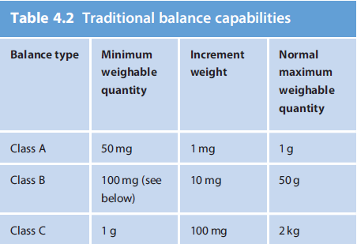
Measurement of Weight
For example, a balance designed to weigh 5 kg to an accuracy of 0.01 kg (10 g) is not going to be suitable to weigh 200mg (0.2 g).

Slide 13
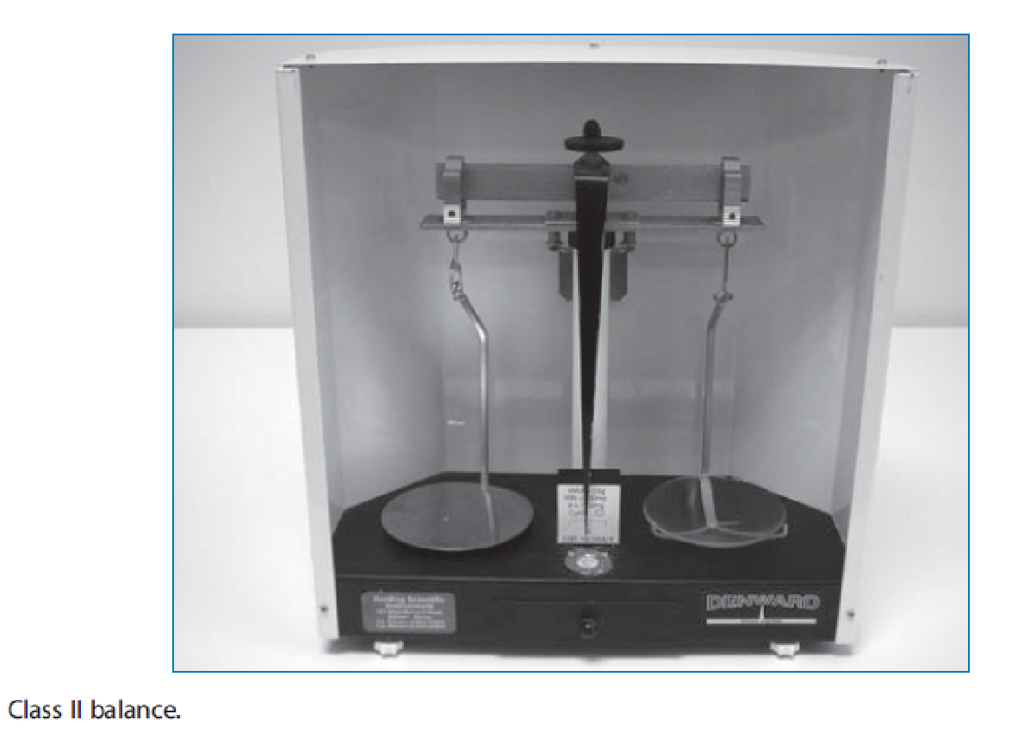
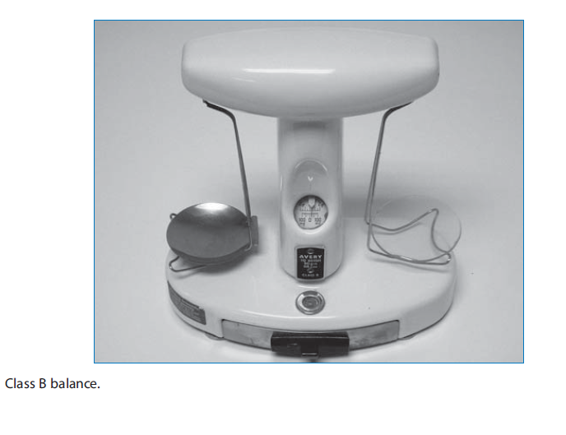

Slide 14
Weighing (Terms Definitions)
Accuracy – is a measure of the capability of a balance to approach a true or absolute value.
Precision – is the relative degree of repeatability, i.e. how closely the values within a series of replicate measurements agree
Tolerance – or ‘limits of allowed errors’ is the extreme value of an error permitted by specifications for a measuring instrument.
The term sensitivity requirement is defined as the load that will cause a change of one division on the index plate of the balance. It may be determined by the following procedure:
1. Level the balance.
2. Determine the rest point of the balance.
3. Determine the smallest weight that causes the rest point to shift one division on the index plate

Slide 15
It is generally agreed that pharmaceutical products should be prepared with a low percentage of error. The official compendia allow a tolerance of ± 5% for most formulas, although greater accuracy may be required for very potent drugs with greater toxicity potential.

Slide 16
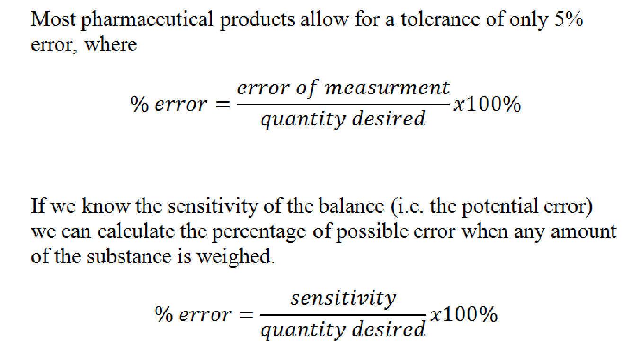

Slide 18
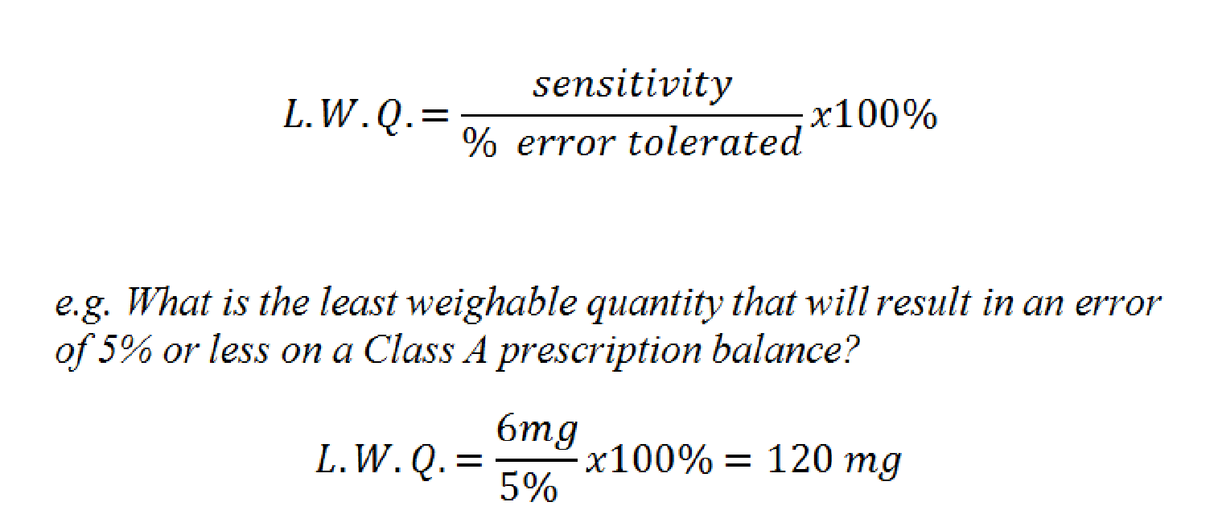
Similarly, we can calculate the smallest quantity that can be weighed, on a balance of known sensitivity, to maintain a desired level of accuracy. This weight is referred to as the least weighable quantity (L.W.Q.).

Slide 19
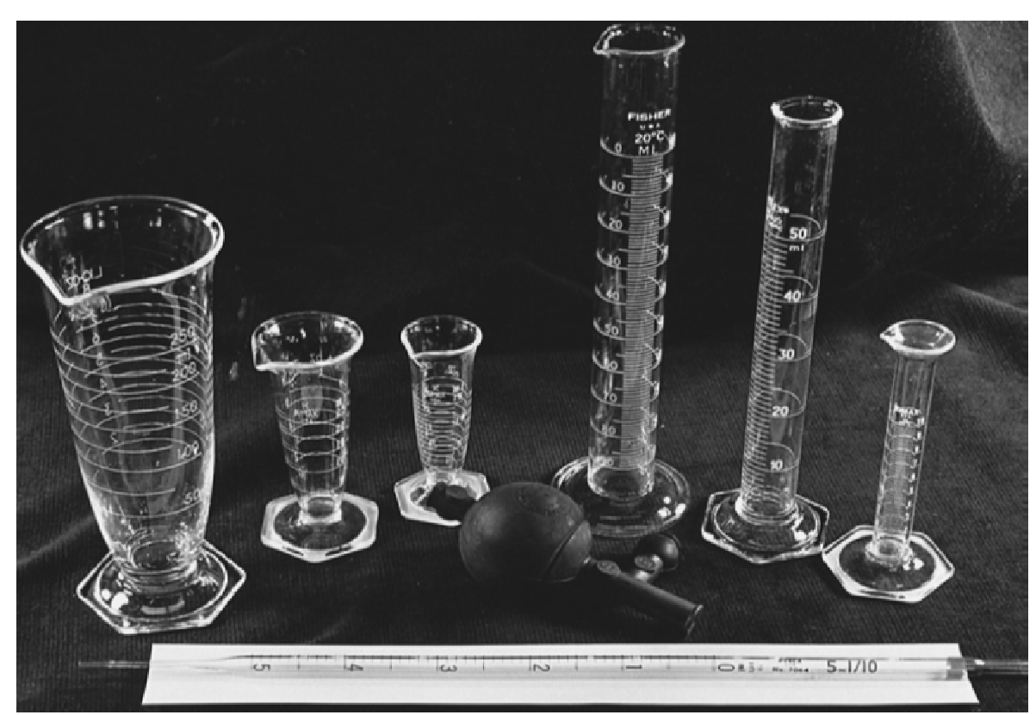
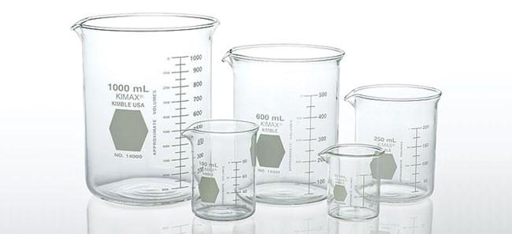
Measurement of Volume
the most common instruments for measuring volume are cylindric and conical (cone-shaped) graduates
For the measurement of small volumes, however, the pharmacist often uses a calibrated syringe or, when required, a pipette

Slide 20
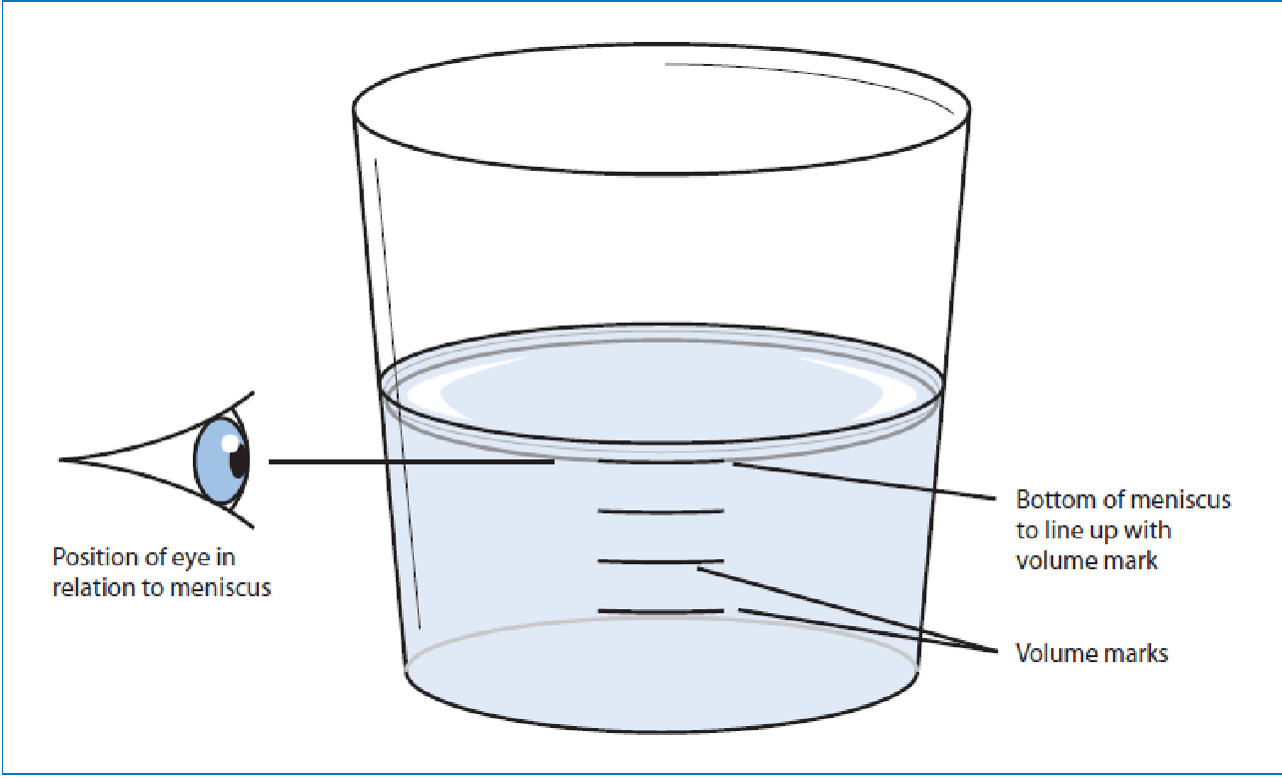
Important
As a general rule, it is best to select the graduate with a capacity equal to or just exceeding the volume to be measured. Measurement of small volumes in large graduates tends to increase the size of the error.

Slide 21
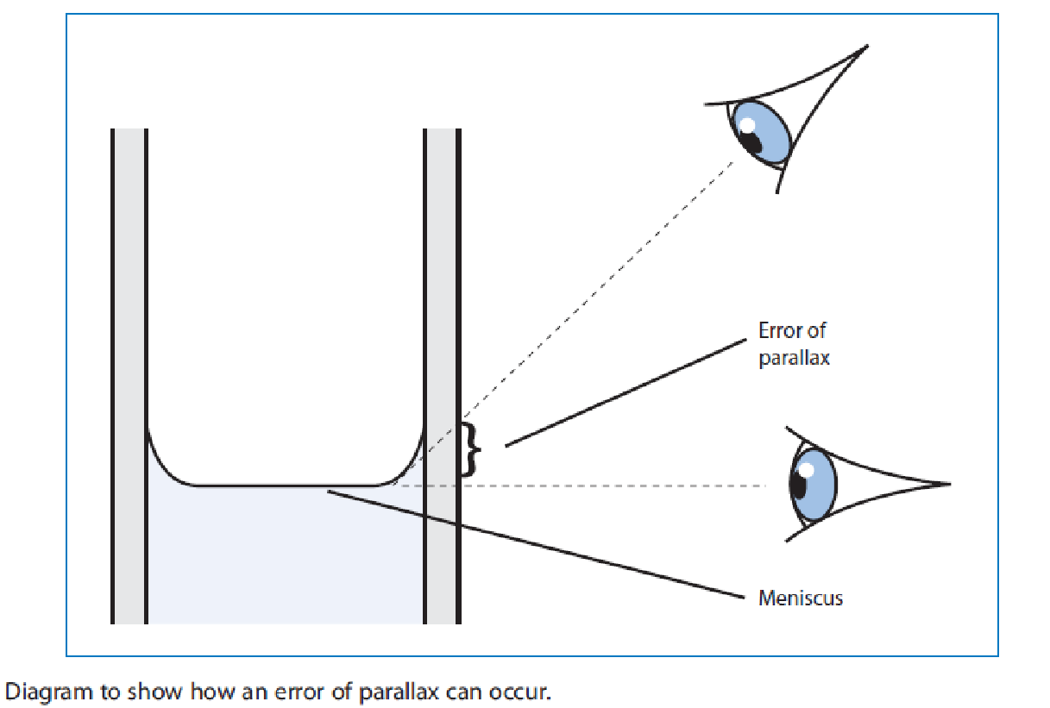

Slide 22
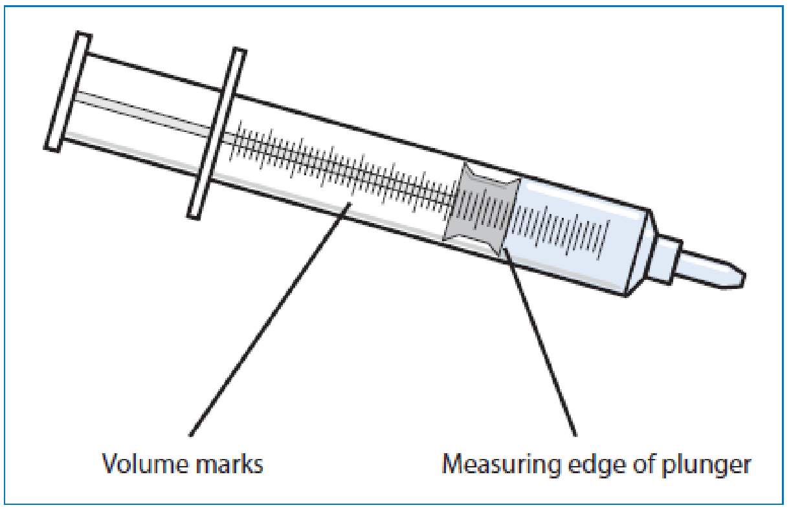
Syringes
Select an appropriate syringe.
Move the plunger up and down a couple of times
to check that it moves smoothly without sticking.
Draw up liquid in excess of the required volume.
Invert the syringe so the nozzle is pointing
upwards.
Draw the plunger back a little further to allow all the liquid in the nozzle to enter the main chamber.
Tap the syringe to allow all the trapped air to come together at the top of the syringe.
Expel the air.
Re-invert the syringe over the liquid and push the plunger until the desired volume is reached.
The desired volume is reached when the measuring edge of the plunger is in line with the desired volume mark in the syringe barrel

Slide 23
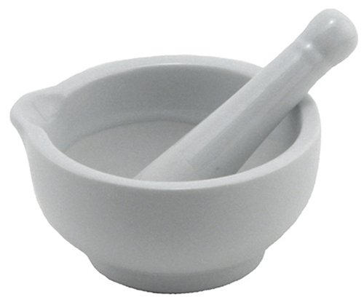
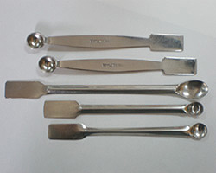
Mortar and Pestle

Slide 24
Thank You

