Slide 1
Upper GI disorder
PHAR322

Slide 2
Dysphagia
Swallowing stages
Or pharyngeal
esophageal
Types of dysphagia
Oropharyngeal
Esophageal
Stricture vs. achalasia

Slide 3
Dysphagia intervention
Level 1-dysphagia pureed
Mashed, cohesive, homogenous
Level 2-dyshagia mechanically altered
Moist, cohesive, soft texture
Level 3-dysphagia advanced
Moist and bite sized pieces
Liquid consistencies
Thin, nectar, honey, spoon-thick

Slide 4
Gastroesophageal Reflux
Heart burn or acid indigestion
Lower esophageal sphincter
Causes
Hatial hernia
Obesity
Pregnancy

Slide 5
GERD
Consequences
Barret’s esophagus
Reflux esophagitis
Anti-acids
Proton pump inhibitor
Histamine-2 receptor blocker
Nutrition management?

Slide 6
Stomach
Dyspepsia
Nausea & vomiting
Vomiting within an hour
Vomiting after one hour
Gastritis
Peptic Ulcer

Slide 7
Bariatric surgery جراحة لعلاج البدانة
Gastric bypass
Gastric Banding

Slide 8
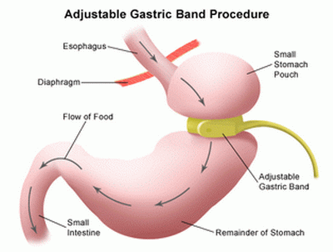
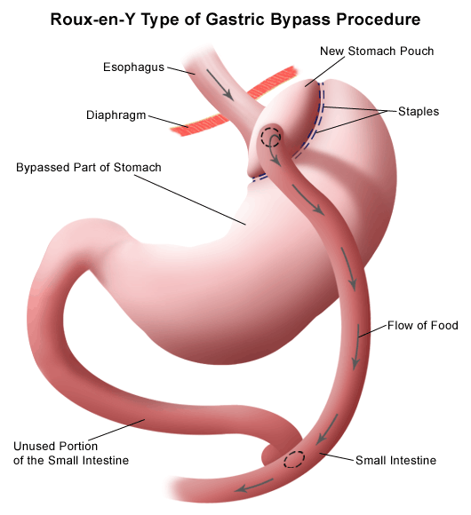

Slide 9
Gastric surgery
Gastrectomy
Gastroduodenostomy
Gastrojejunostomy
Total Gastrectomy
Post gastrectomy
Meats?
Milk and milk products
Bread and Cereal?
Vegetables
Fruits
Beverages?
Meal frequency
Eating settings

