Slide 1
Nutrition and Cardiovascular Diseases
PHAR322

Slide 2
Outline
Atherosclerosis
Coronary Heart Disease
Stroke
Hypertension
Heart Failure

Slide 3
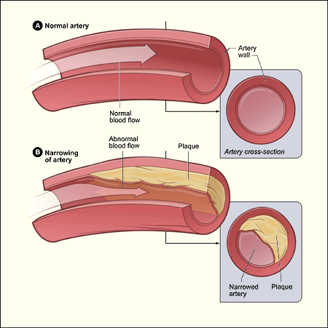
Atherosclerosis
Source: https://www.nhlbi.nih.gov/health/health-topics/topics/atherosclerosis/

Slide 4
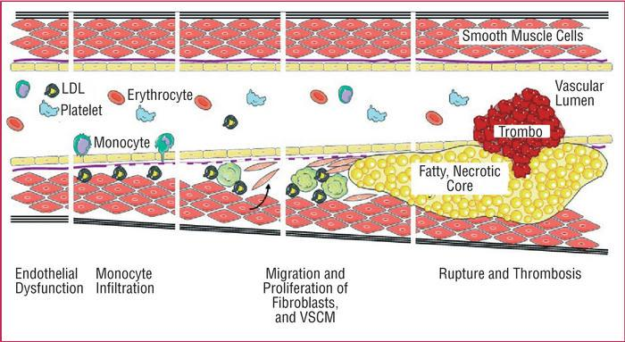
Pathology & development
Source: http://healthyprotocols.com/2_athero.htm

Slide 5
Concepts
Thrombus
Embolus
Embolism
Angina pectoris
Intermittent claudicating
Aneurysm

Slide 6
Causes
Can begin in Childhood and Adolescence
Risk
Shear Stress/hypertension
VLDL, LDL
Smoking
Diabetes Mellitus
Age & Gender

Slide 7
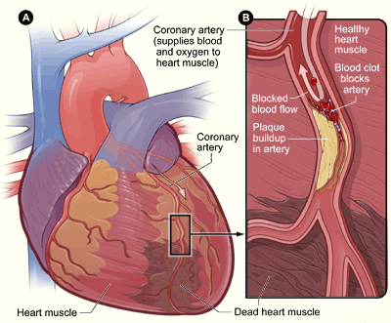
Coronary Heart Disease Pathology
Source: http://www.nhlbi.nih.gov/health//dci/Diseases/Cad/CAD_SignsAndSymptoms.html

Slide 8
Risk Factors for CHD
Non-modifiable
Modifiable
Age
Gender
Family history
Tot Cholesterol
Smoking
Excess Alcohol Consumption
Inactivity
Hypertension
Low HDL, High LDL
High triglycerides

Slide 9
symptoms
Angina Pectoris
Fatigue
Shortness of breath
Nausea and/or vomiting
Sweating

Slide 10
ASSESSING CHD 10 year Risk
Each one of you calculate your risk of CHD in the next 10 years
Refer to
https://www.nhlbi.nih.gov/health-pro/guidelines/current/cholesterol-guidelines/quick-desk-reference-html/10-year-risk-framingham-table

Slide 11
Stroke
Ischaemic
Hemmoraeghic
Transient Ischemic attack
Stroke and malnutrition
Stroke and dehydration
Stroke, nutritional status, and outcomes

Slide 12
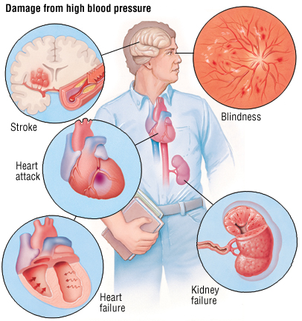
Hypertension
Blood pressure
Systolic
Diastolic
Hypertension
What is hypertension
Systolic= ?
Diastolic= ?
Source: http://patienteducationcenter.org/information/high-blood-pressure-hypertension/

Slide 13
Factors that increases BP
Salt sensitivity
Excess Alcohol consumption
Genetics/family history
Aging
Diet

Slide 14
Congestive Heart Failure
How does it happen?
Chronic
Acute
Why?
Heart muscle
kidney
Causes
CHD
Cardiomyopathy
Overworked muscle
Sodium and fluids

Slide 15
The Cardio-protective diet
The Classics
The findings or not!
Fat
Dietary Fiber
Carbohydrates
Plant Sterol and Stanols
Iron
Calcium & Pottassium
Garlic
Dark Chocolate

